Slide 1
Search Problems
CSD 15-780: Graduate Artificial Intelligence
Instructors: Zico Kolter and Zack Rubinstein
TA: Vittorio Perera

Slide 2
Search
Search lectures.
Readings:
Section II in Norvig and Russel (chapters 3,4, 5, and 6)

Slide 3
Today’s lecture
Why is search the key problem-solving technique in AI?
Formulating and solving search problems.
Understanding and comparing several “blind” or uniformed search techniques.

Slide 4
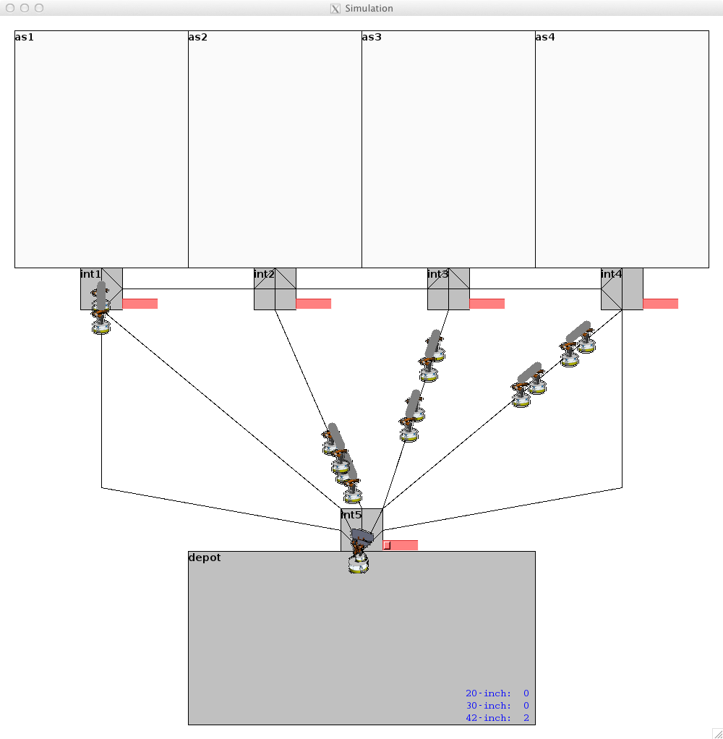
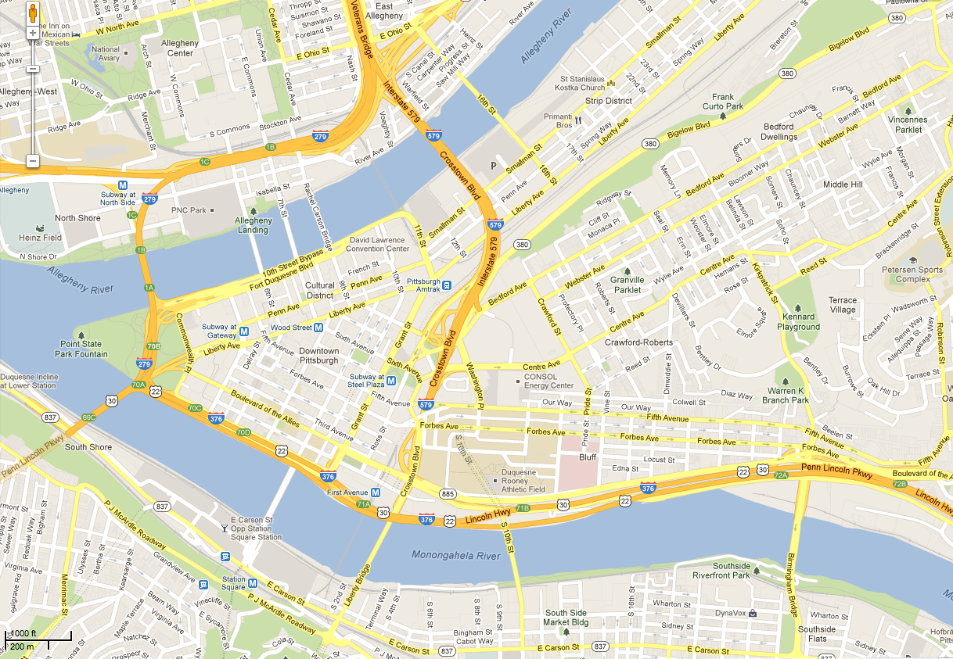
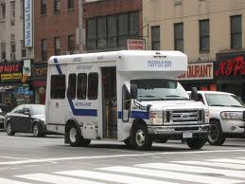
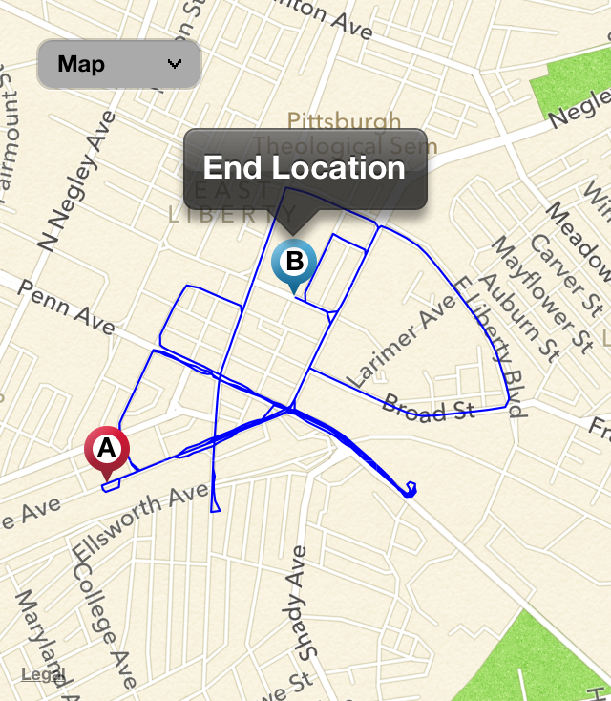
Projects
Multi-robot movement planner for robust, just-in-time delivery of components for wing ladder assembly (Boeing)
MARTI – Market-based dynamic allocation of tasks to RF devices to perform secondary mission requests (DARPA RadioMap)
Assessment Region
REVAMP - Same-day scheduler and real-time itinerary execution management support for paratransit operations. (ongoing ACCESS pilot)
SURTRAC - Adaptive traffic signalization control system
Focus on evaluation
(pilot and expansion)
SMOS - Cross-operations (air, cyber, space) coarse-level planner for missions (BAE and AFRL)

Slide 5
Examples of “toy” problems
Puzzles such as the 8-puzzle:
⇒
Cryptarithmetic problems:
SEND 9567
MORE ⇒ +1085
MONEY 10652

Slide 6
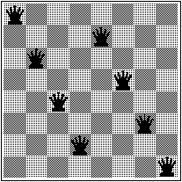
The n-queens problem
A popular benchmark for AI search
Solved for n up to 500,000

Slide 7
Explicit solution for n ≥ 4
[Hoffman, Loessi, and Moore, 1969]
If n is even but not of the form 6k+2:
For j = 1, 2, ..., n/2 place queens on elements
(j, 2j), (n/2+j, 2j-1)
If n is even but not of the form 6k:
For j = 1, 2, ..., n/2 place queens on elements
(j, 1+[(2(j-1) + n/2 - 1) mod n]), (n+1-j, n-[(2(j-1) + n/2 - 1) mod n])
If n is odd:
Use case A or B on n-1 and extend with a queen at (n,n)
Is this a good benchmark problem for testing search techniques?

Slide 8
Real-world problems
Signal interpretation (e.g. speech understanding)
Theorem proving (e.g. resolution techniques)
Combinatorial optimization (e.g. VLSI layout)
Robot navigation (e.g. path planning)
Factory scheduling (e.g. flexible manufacturing)
Symbolic computation (e.g. symbolic integration)
Can we find closed form solutions to these problems?

Slide 9
Formulating search problems
States and state spaces
Operators - representing possible actions
Successor function
Initial state and goal test
Path cost function
Examples: 8-puzzle, 8-queen, path planning, map coloring. What are the corresponding states, operators, initial state, goal test, and path cost.

Slide 10
States, Operators, Successor function.
State – choose data representation, e.g., 3x3 2D array with numbers and 0 representing the blank.
move-left, move-right, move-up, move-down.
Operators – transform state to next state, e.g., possible movements for the blank.
Successor Function – generate possible states by applying operators, e.g., apply operators and return states whose indices are between 1 and 3.

Slide 11
What is a solution?
A solution to a search problem is a sequence of operators that generate a path from the initial state to a goal state.
An optimal solution is a minimal cost solution.
Solution cost versus search cost.

Slide 12
Choosing states and actions
Efficiency versus expressiveness
The use of abstraction:
Ignore road condition travel planning.
Use job description and ignore names in task scheduling.
Ignore the color of the pieces when solving the 8-puzzle.
Compact action representation.
Notes:
Mention example of rush hour computation in ACCESS pick-up and delivery problems.

Slide 13
Quote for the day
“The problem of searching a graph has effectively been solved, and is no longer of interest to AI researchers.”
- Nils Nilsson, early 1970s

Slide 14
Searching for solutions
Search control strategies
Order in which the search space is explored
The extent to which partial solutions are kept and used to guide the search process
The degree to which the search process is guided by domain knowledge
The degree to which control decisions are made dynamically at run-time

Slide 15
Evaluation of search strategies
Completeness - does it guarantee to find a solution when there is one?
Time complexity - how long does it take to find a solution?
Space complexity - how much memory does it require?
Optimality - does it return the best solution when there are many?

Slide 16
Search trees
A graph representing the search process
Implicit graphs and explicit graphs
Branching factor and depth
Generating and expanding states
Open and closed lists of nodes
Representing a node of the explicit graph:
class Node:
State = None
ParentNode = None
Operator = None
Depth = None
PathCost = None

Slide 17
Example of a search tree

Slide 18
Blind search strategies
Depth-first search
Breadth-first search
Depth-limited search
Iterative-deepening search
Bidirectional search

Slide 19
Depth-First Search
function dfs (nodes, goalp, successors) returns solution or fail
if not nodes then return fail
else if goalp(first(nodes)) then return first(nodes)
else return dfs(append(successors(first(nodes)), rest(nodes)),
goalp, successors)

Slide 20
Example Road Network
A
Origin | Destinations
A | B(10), C(12)
B | A(10),D(8)
C | A(12), E(4), F(4)
D | B(8), G(6),H(8)
E | C(4), H(4)
F | C(4), I(20)
G | D(6), I(12)
H | D(8), E(4), I(6)
I | F(20), H(6), G(12)
10
12
B
8
C
4
4
D
E
F
8
4
6
H
G
20
6
12
I
DFS(A➔I): A, B, D, G, I = 36

Slide 21
Time and Space Complexity of DFS
Let b be the branching factor and m be the maximum depth of the state space.
Space complexity = bm
Time complexity = O(b^{m})
Complete?
Optimal?

Slide 22
Breadth-First Search
function bfs (nodes, goalp, successors) returns solution or fail
if not nodes then return fail
else if goalp(first(nodes)) then return first(nodes)
else return dfs(append(rest(nodes), successors(first(nodes))),
goalp, successors)

Slide 23
Example Road Network
A
Origin | Destinations
A | B(10), C(12)
B | A(10),D(8)
C | A(12), E(4), F(4)
D | B(8), G(6),H(8)
E | C(4), H(4)
F | C(4), I(20)
G | D(6), I(12)
H | D(8), E(4), I(6)
I | F(20), H(6), G(12)
10
12
B
8
C
4
4
D
E
F
8
4
6
H
G
20
6
12
I
BFS(A➔I): A, C, F, I = 36

Slide 24
Time and Space Complexity of BFS
Let b be the branching factor and d be the depth at which a solution is found.
Space complexity = O(b^{d})
Time complexity = O(b^{d})
Complete?
Optimal?

Slide 25
Uniform-Cost Search
function ucs (nodes, goalp, successors) returns solution or fail
nodes = sort(<, nodes, node.cost)
if not nodes then return fail
else if goalp(first(nodes)) then return first(nodes)
else return ucs(append(rest(nodes), successors(first(nodes))),
goalp, successors)
Time and space complexity?

Slide 26
Example Road Network
A
Origin | Destinations
A | B(10), C(12)
B | A(10),D(8)
C | A(12), E(4), F(4)
D | B(8), G(6),H(8)
E | C(4), H(4)
F | C(4), I(20)
G | D(6), I(12)
H | D(8), E(4), I(6)
I | F(20), H(6), G(12)
10
12
B
8
C
4
4
D
E
F
8
4
6
H
G
20
6
12
I
UCS(A➔I): A, C, E, H, I = 26

Slide 27
Uniform Cost Search Properties
Guaranteed to find lowest cost solution (optimal and complete) as long as cost never decreases.
Same complexity as Breadth-First search
Space complexity = O(b^{d})
Time complexity = O(b^{d})

Slide 28
Depth-Limited Search
Same as DFS, except depth threshold used to limit search.
Similar time and space complexity to DFS, except bounded by threshold.
Be careful to choose an appropriate threshold
Complete?
Optimal?

Slide 29
Example Road Network
A
Origin | Destinations
A | B(10), C(12)
B | A(10),D(8)
C | A(12), E(4), F(4)
D | B(8), G(6),H(8)
E | C(4), H(4)
F | C(4), I(20)
G | D(6), I(12)
H | D(8), E(4), I(6)
I | F(20), H(6), G(12)
10
12
B
8
C
4
4
D
E
F
8
4
6
H
G
20
6
12
I
DLS(A➔I,4): A, B, D, G, I = 36

Slide 30
Iterative Deepening Search
Do repeated Depth-Limited searches, while incrementally increasing the threshold.
Similar time and space complexity to DFS, except bounded by depth of the solution.
Does redundant expansions.
Is complete and optimal.

Slide 31
Example Road Network
A
Origin | Destinations
A | B(10), C(12)
B | A(10),D(8)
C | A(12), E(4), F(4)
D | B(8), G(6),H(8)
E | C(4), H(4)
F | C(4), I(20)
G | D(6), I(12)
H | D(8), E(4), I(6)
I | F(20), H(6), G(12)
10
12
B
8
C
4
4
D
E
F
8
4
6
H
G
20
6
12
I
IDS(A➔I): A, C, F, I = 36

Slide 32
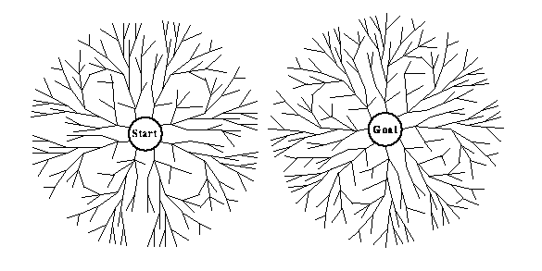
Bidirectional search
Time and space complexity: b^{d/2}
When is bidirectional search applicable?

Slide 33
Time and Space Complexity of Bidirectional Search
Time Complexity = O(b^{d/2})
Space Complexity = O(b^{d/2})
High space complexity because the nodes have to be kept in memory to test for intersection of the two frontiers.

Slide 34
Comparing search strategies

