Slide 1
Vulnerabilities in MLC NAND
Flash Memory Programming:
Experimental Analysis, Exploits, and Mitigation Techniques
Yu Cai, Saugata Ghose, Yixin Luo,
Ken Mai, Onur Mutlu, Erich F. Haratsch
February 6, 2017

Slide 2
Executive Summary
MLC (multi-level cell) NAND flash uses two-step programming
We find new reliability and security vulnerabilities
  In between two steps, cells are in a partially-programmed state
  Program interference, read disturb much worse for partially-programmed cells than for fully-programmed cells
We experimentally characterize vulnerabilities using real
state-of-the-art MLC NAND flash memory chips
We show that malicious programs can exploit vulnerabilities to corrupt data of other programs and reduce flash memory lifetime
We propose three solutions that target vulnerabilities
  One solution completely eliminates vulnerabilities, at the expense of
  4.9% program latency increase
  Two solutions mitigate vulnerabilities, increasing flash lifetime by 16%
Notes:
Fix image of partially-programmed cell

Slide 3
Presentation Outline
Executive Summary
NAND Flash Background
Characterizing New Vulnerabilities in Two-Step Programming
Example Sketches of Security Exploits
Protection and Mitigation Mechanisms
Conclusion

Slide 4
Storing Data in NAND Flash Memory
Flash cell uses the threshold voltage of a floating-gate transistor to represent the data stored in the cell
Per-bit cost of NAND flash memory has greatly decreased
  Aggressive process technology scaling
  Multi-level cell (MLC) technology
Flash Cell
NAND Flash
Chip
11
MSB: Most
Significant Bit
LSB: Least
Significant Bit
Notes:
Animate: interference arrows, increase as scaling, two steps of programming
Add MSB/LSB
Add partially-programmed, fully-programmed

Slide 5
Programming Data to a Multi-Level Cell
Cell programmed by pulsing a large voltage on the transistor gate
Cell-to-cell program interference
  Threshold voltage of a neighboring cell inadvertently increases
  Worsens as flash memory scales
Mitigation: two-step programming
10
00
00
??
Program
00
01
01
10
??
Step 1
?0
Step 2
00
Notes:
Animate: interference arrows, increase as scaling, two steps of programming
Add MSB/LSB
Add partially-programmed, fully-programmed

Slide 6
Reading Data from a Multi-Level Cell
Threshold voltages represented as a probability distribution
  Due to process variation
  Each two-bit value corresponds to a state (a range of threshold voltages)
Read reference voltages (V_{a}, V_{b}, V_{c})
  Identify the state a cell belongs to
  Applied to the transistor gate to see if a cell turns on
V_{a}
V_{b}
V_{c}
Probability
Density
ER
11
P1
01
P2
00
P3
10
MSB
LSB
Threshold Voltage (V_{th})

Slide 7
NAND Flash Memory Errors and Lifetime
During a read, raw bit errors occur when the cell threshold voltage incorrectly shifts to a different state
Controller employs sophisticated ECC to correct errors
If errors exceed ECC limit, flash memory has exhausted its lifetime
Raw Bit Error Rate
(RBER)
ECC Correction Capability
Lifetime
Program/Erase (P/E) Cycles
OUR GOAL
Understand how two-step programming
affects flash memory errors and lifetime
(and what potential vulnerabilities it causes)

Slide 8
Presentation Outline
Executive Summary
NAND Flash Background
Characterizing New Vulnerabilities in Two-Step Programming
  How Can Two-Step Programming Introduce Errors?
  Program Interference
  Read Disturb
Example Sketches of Security Exploits
Protection and Mitigation Mechanisms
Conclusion

Slide 9
How Can Two-Step Programming Introduce Errors?
Controller
Flash Memory
. . .
MSB
ECC
Engine
MSB data
LSB data
LSB
. . .
Read
With
Errors
Read
Without
Errors
Internal
Buffers
MSB
MSB 0
MSB 1
MSB n
. . .
LSB
LSB 0
LSB 1
LSB n
Cell starts in the erased state
Step 1 – LSB: Partially program the cell to a temporary state
Errors are introduced into the partially-programmed LSB data
Step 2 – MSB: Program the cell to its final state
  LSB data is read with errors into internal LSB buffer, not corrected by ECC
  MSB data comes from controller to internal MSB buffer
Errors in internal LSB buffer data cause the cell to be
programmed to an incorrect state
Notes:
Update image with new labels, animate, add X’s to LSB
Collapse distributions to a single graph

Slide 10
Cell-to-Cell Program Interference
Flash cells are grouped into
multiple wordlines (rows)
Two-step programming
interleaves LSB, MSB steps
of neighboring wordlines
Steps interleaved using shadow program sequencing
LSB
. . .
Wordline 2
Wordline
Wordline 1
MSB
. . .
LSB
Wordline 1
MSB
. . .
Wordline 0
A: LSB of Wordline 1 programmed: no interference
V_{ref}
B: After programming MSB of Wordline 0
Steps for neighboring wordlines cause interference
on partially-programmed cells
How bad is this interference?
Probability
Density
ER
TP
C: After programming LSB of Wordline 2
V_{th}
D: Error when programming MSB of Wordline 1

Slide 11
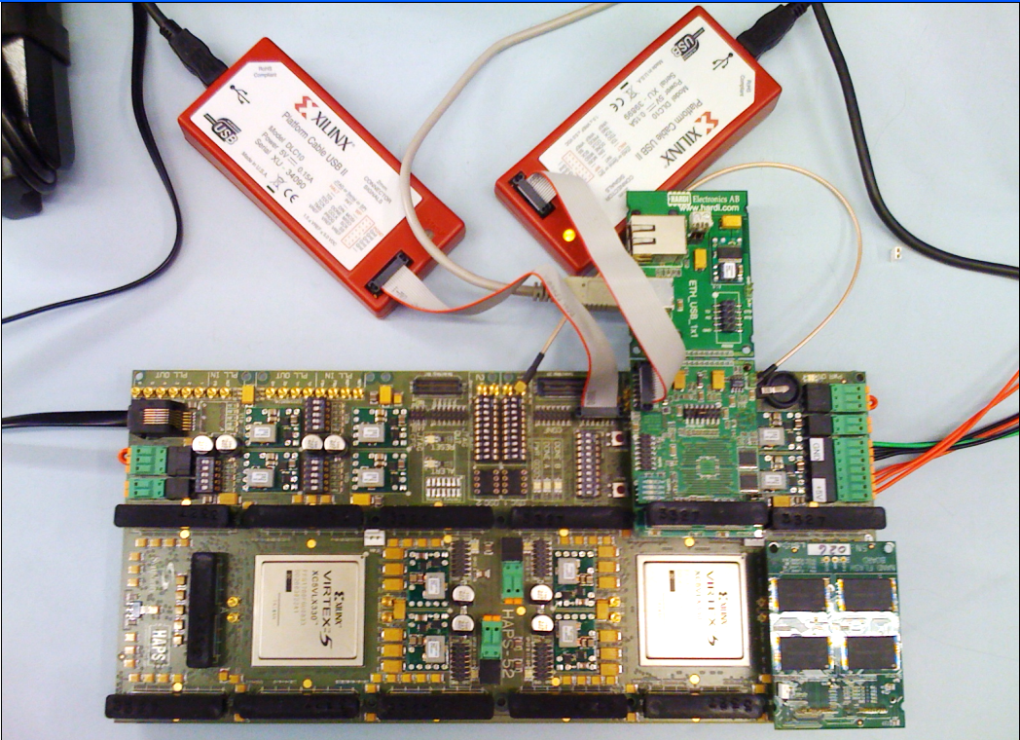
Characterizing Errors in Real NAND Flash Chips
We perform experiments on real state-of-the-art 1x-nm
(i.e., 15-19nm) MLC NAND flash memory chips
More info: Cai et al., FPGA-Based Solid-State Drive Prototyping Platform, FCCM 2011
NAND Flash
Daughterboard
FPGA
Flash
Controller

Slide 12
Measuring Errors Induced by Program Interference
Error rate increases with each programming step
  A: Before interference
  (LSBs in Wordline n
  just programmed)
  B: After programming
  pseudo-random data to
  MSBs in Wordline n-1
  C: After programming
  pseudo-random data to
  MSBs in Wordline n-1 and
  LSBs in Wordline n+1
Interference depends on the data value being programmed
  Higher voltage → more programming pulses → more interference
  W: After programming worst-case data pattern to Wordlines n-1 and n+1
4.9x
Raw Bit Error Rate
(Normalized to A)
Program interference with worst-case data pattern
increases the error rate of
partially-programmed cells by 4.9x

Slide 13
Read Disturb
Bitline
Flash block: cells from multiple
wordlines connected together
on bitlines (columns)
Reading a cell from a bitline
  Apply read reference voltage (V_{ref}) to cell
  Apply a pass-through voltage (V_{pass}) to turn on all unread cells
Pass-through voltage has a weak programming effect
V_{pass}
. . .
Wordline 2
V_{ref}
. . .
Wordline 1
V_{pass}
. . .
Wordline 0
ER
LARGER GAP →
GREATER EFFECT
Unprogrammed
Partially-programmed and unprogrammed cells
more susceptible to read disturb errors
V_{pass}
Partially
Programmed
ER
TP
Fully
Programmed
ER
P1
P2
P3
V_{th}

Slide 14
Measuring Errors Induced by Read Disturb
Read Disturb Count
Errors in Data Not Programmed When Read Disturb Occurs
10⁻¹
10⁻²
10⁻³
10⁻⁴
Order of Magnitude Increase
LSB Data
Raw Bit Error Rate
A
C
B
Induce read disturbs on:
  A: Fully-programmed cells
  B: Partially-programmed cells
  C: Unprogrammed cells
After read disturb, program remaining data and check error rate
LSB data in partially-programmed
and unprogrammed cells
most susceptible to read disturb
Notes:
Todo: make graphs bigger

Slide 15
Presentation Outline
Executive Summary
NAND Flash Background
Characterizing New Vulnerabilities in Two-Step Programming
Example Sketches of Security Exploits
  Program Interference Based Exploit
  Read Disturb Based Exploit
Protection and Mitigation Mechanisms
Conclusion

Slide 16
Sketch of Program Interference Based Exploit
Malicious program targets a piece of data that belongs to a victim program
Goal: Maximize program interference
induced on victim program’s data
Write worst-case data pattern
to neighboring wordlines (WL)
  Wordlines 0/1: all 1s to keep at
  lowest possible threshold voltage
  Wordline 2: victim program
  writes data
  Wordlines 1 and 3: all 0s
  to program to highest possible
  threshold voltage
In the paper
  More details on why this works
  Procedure to work around data scrambling
MSB
WL 3
3b
Malicious File B (all 0s)
LSB
MSB
WL 2
2
Data Under Attack
LSB
3a
Malicious File B (all 0s)
MSB
WL 1
Malicious File A (all 1s)
LSB
1
Malicious File A (all 1s)
MSB
WL 0
LSB

Slide 17
Presentation Outline
Executive Summary
NAND Flash Background
Characterizing New Vulnerabilities in Two-Step Programming
Example Sketches of Security Exploits
  Program Interference Based Exploit
  Read Disturb Based Exploit: in the paper
Protection and Mitigation Mechanisms
Conclusion

Slide 18
Presentation Outline
Executive Summary
NAND Flash Background
Characterizing New Vulnerabilities in Two-Step Programming
Example Sketches of Security Exploits
Protection and Mitigation Mechanisms
  Buffering LSB Data in the Controller
  Multiple Pass-Through Voltages
  Adaptive LSB Read Reference Voltage
Conclusion

Slide 19
1. Buffering LSB Data in the Controller
Key Observation: During MSB programming, LSB data is read from flash cells with uncorrected interference and read disturb errors
Key Idea: Keep a copy of the LSB data in the controller
Controller
Flash Memory
Read
Without
Errors
. . .
MSB
ECC
Engine
MSB data
LSB
. . .
Read
With
Errors
LSB data
Internal
Buffers
MSB 0
MSB 1
MSB n
. . .
LSB 0
LSB 1
LSB n
Completely eliminates vulnerabilities
to program interference and read disturb
Typical case: 4.9% increase in programming latency

Slide 20
2. Multiple Pass-Through Voltages
Key Observation: Large gap between threshold voltage and
pass-through voltage (V_{pass}) increases errors due to read disturb
Key Idea: Minimize gap by using three pass-through voltages
Reduces raw bit error rate by 72%
Increases flash lifetime by 16%
_{erase}
V_{pass}
V_{pass}
Unprogrammed
ER
LARGE GAP
_{partial}
Partially
Programmed
ER
TP
V_{pass}
Fully
Programmed
ER
P1
P2
P3
V_{th}
Mitigates vulnerabilities to read disturb
No increase in programming latency

Slide 21
Presentation Outline
Executive Summary
NAND Flash Background
Characterizing New Vulnerabilities in Two-Step Programming
Example Sketches of Security Exploits
Protection and Mitigation Mechanisms
  Buffering LSB Data in the Controller
  Multiple Pass-Through Voltages
  Adaptive LSB Read Reference Voltage: in the paper
Conclusion

Slide 22
Presentation Outline
Executive Summary
NAND Flash Background
Characterizing New Vulnerabilities in Two-Step Programming
Example Sketches of Security Exploits
Protection and Mitigation Mechanisms
Conclusion

Slide 23
Executive Summary
We find new reliability and security vulnerabilities in
MLC NAND flash memory
  In between two steps, cells are in a partially-programmed state
  Program interference, read disturb much worse for partially-programmed cells than for fully-programmed cells
We experimentally characterize vulnerabilities using real
state-of-the-art MLC NAND flash memory chips
We show that malicious programs can exploit vulnerabilities to corrupt data of other programs and reduce flash memory lifetime
We propose three solutions that target vulnerabilities
  One solution completely eliminates vulnerabilities, at the expense of
  4.9% program latency increase
  Two solutions mitigate vulnerabilities, increasing flash lifetime by 16%
Notes:
Fix image of partially-programmed cell

Slide 24
Vulnerabilities in MLC NAND
Flash Memory Programming:
Experimental Analysis, Exploits, and Mitigation Techniques
Yu Cai, Saugata Ghose, Yixin Luo,
Ken Mai, Onur Mutlu, Erich F. Haratsch
February 6, 2017

Slide 25
Backup Slides

Slide 26
NAND Flash Memory Scaling
SSDs use NAND flash memory chips, which contain billions of
flash cells
Per-bit cost of NAND flash memory has greatly decreased thanks to scaling
Aggressive process technology scaling
  Flash cell size decreases
  Cells placed closer to each other
Multi-level cell (MLC) technology
  Each flash cell represents data using a threshold voltage
  MLC stores two bits of data in a single cell
128GB
NAND Flash
256GB NAND Flash
01
11
11
00
11
10
00
10
MSB: Most
Significant Bit
LSB: Least
Significant Bit
Notes:
Animate: smaller cells, closer together, SLC → TLC
Color MSB/LSBs

Slide 27
Two-Step Programming
Per-bit cost of NAND flash memory has greatly decreased
  Aggressive process technology scaling
  Multi-level cell (MLC) technology
Flash cell programmed by pulsing
a large voltage to the cell transistor
Cell-to-cell program interference
  Threshold voltage of a neighboring
  cell inadvertently increases
  Worsens as flash memory scales
Mitigation: two-step programming
NAND Flash
Chip
01
11
11
00
11
10
00
10
MSB: Most
Significant Bit
LSB: Least
Significant Bit
11
11
10
??
Program
00
10
10
??
Step 1
?0
Step 2
00
Notes:
Animate: interference arrows, increase as scaling, two steps of programming
Add MSB/LSB
Add partially-programmed, fully-programmed

Slide 28
Representing Data in MLC NAND Flash Memory
Flash cell uses floating-gate transistor threshold voltage to represent the data stored in the cell
Threshold voltages represented as a probability distribution
  Each two-bit value corresponds to a state (a range of threshold voltages)
  Read reference voltages (V_{a}, V_{b}, V_{c}) identify the state a cell belongs to
V_{a}
V_{b}
V_{c}
Probability
Density
ER
11
P1
01
P2
00
P3
10
MSB
LSB
Threshold Voltage (V_{th})

Slide 29
Threshold Voltage Distributions During Programming
Unprogrammed
ER
XX
Probability
Density
Starting V_{th}
MSB
LSB
1. Program LSB
Probability
Density
ER
X1
TP
X0
Temporary V_{th}
Probability
Density
ER
11
P1
01
P2
00
P3
10
2. Program MSB
Final V_{th}

Slide 30
Characterizing NAND Flash Memory Reliability
Raw bit errors occur when the cell threshold voltage incorrectly shifts to a different state
Raw Bit
Error Rate
ECC Correction Capability
Lifetime
Program/Erase (P/E) Cycles
We experimentally characterize RBER, lifetime of
state-of-the-art 1x-nm (i.e., 15-19nm)
MLC NAND flash memory chips

Slide 31
Malicious Program Behavior
Raw Bit Error Rate
ECC Error Correction Capability
Malicious Usage
Reduced
Lifetime
Normal
Lifetime
Normal Usage
P/E Cycles

Slide 32
How Can Two-Step Programming Introduce Errors?
Controller
Flash Memory
. . .
MSB
ECC
Engine
MSB data
LSB
. . .
Read
With
Errors
MSB 0
MSB 1
MSB n
Read
Without
Errors
. . .
LSB 0
LSB 1
LSB n
Step 1: Program only the LSB data
Errors are introduced into the
partially-programmed LSB data
Step 2: Program the MSB data
  LSB data is read with errors directly into
  internal LSB buffer, not corrected by ECC
  MSB data comes from controller to internal MSB buffer
ER
??
Erased
V_{th}
MSB
LSB
ER
?1
TP
?0
Partially
Programmed
V_{th}
Probability Density
Errors in LSB data cause cell to be
programmed to an incorrect state
ER
11
P1
01
P2
00
P3
10
Final V_{th}
Notes:
Update image with new labels, animate, add X’s to LSB
Collapse distributions to a single graph

Slide 33
Data Scrambler Workaround
Some flash controllers employ XOR-based data scrambling
Workaround to write worst-case data pattern
  Recreate scrambler logic in software
  Scramble data in software with the same seed
  Hardware scrambler descrambles data using the same seed
  Descrambled data written to flash memory
Logical Block Address
Malicious Program
4
DESCRAMBLED DATA
Flash
Memory
Scrambler
Unscrambled Worst-Case Data
SEED Linear Feedback Shift Register
SSD Controller
2
ECC Engine
KEY
1
Software Scrambler
DESCRAMBLED
DATA
+
3
Hardware Scrambler
Input
Output
SCRAMBLED DATA

Slide 34
Sketch of Read Disturb Based Exploit
Malicious program wants to induce errors into unprogrammed and partially-programmed wordlines in an open block
Rapidly issues large number of reads to the open block
  Write data to the open block
  Issues ~10K reads per second directly to the SSD using syscalls
Induces errors in partially-programmed data
Induces errors in data not yet programmed
  Programming can only increase threshold voltage
  Exploit increases threshold voltage before programming, preventing cell from storing some data values
In the paper: working around SSD caches
Notes:
To do: diagram?

Slide 35
1. Buffering LSB Data in the Controller
Controller
Flash Memory
Read
Without
Errors
. . .
MSB
ECC
Engine
MSB data
LSB
. . .
Read
With
Errors
LSB data
MSB 0
MSB 1
MSB n
. . .
LSB 0
LSB 1
LSB n
When LSB data is initially programmed, keep a copy in the controller DRAM
During MSB programming, send both LSB and MSB data from controller to internal LSB/MSB buffers in flash memory
Procedure to retrieve, correct data from flash memory if DRAM loses data (e.g., after power loss)
Completely eliminates vulnerabilities
to interference, read disturb
Typical case: 4.9% increase in programming latency

Slide 36
Algorithm for Buffering LSB Data
A: Send LSB data to internal
LSB buffer
B: Keep copy
of LSB in
DRAM buffer
Program
LSB page
Step 1
Step 2
D: Retrieve LSB data from DRAM buffer
C: Is LSB
in DRAM buffer?
YES
E: Send LSB data to internal
LSB buffer
F: Send MSB data to internal
MSB buffer
Program
MSB page
NO
G: Retrieve LSB data from
flash chip
H: Correct LSB data using
ECC engine

Slide 37
Latency Impact of Buffering
Vary the speed of the interface between the controller and the flash memory
Assumes 8KB page size
Baseline Latency
LSB Page in DRAM
LSB Page Not in DRAM

Slide 38
Error Rate with Multiple Pass-Through Voltages
Single Pass-Through Voltage
Limit
LSB: unprogrammed,
partially programmed
MSB: fully programmed
MSB: unprogrammed,
partially programmed
Multiple Pass-Through Voltages
Limit
LSB: fully programmed

Slide 39
3. Adaptive LSB Read Reference Voltage
Adapt the read reference voltage used to read partially-programmed LSB data
  Compensates for threshold voltage shifts caused by program interference, read disturb
  Maintain one read reference voltage per die
  Relearn voltage once a day by checking error rate of test LSB data
Reduces error count, but does not completely eliminate errors
Baseline: Fixed V_{ref}
-30%
Adaptive V_{ref}
-21%

Slide 40
3. Adaptive LSB Read Reference Voltage
Adapt the read reference voltage for partially-programmed LSB data to compensate for voltage shifts
  Program reference data value to LSBs of test wordlines
  Relearn voltage once a day by checking error rate of test data
Reduces error count by 21-30%, but does not completely eliminate errors
V_{ref}
Before interference, read disturb
Probability
Density
ER
TP
After interference,
read disturb
V_{th}
Mitigates, but doesn’t fully eliminate, vulnerabilities
No increase in programming latency

Slide 41
Conclusion
Two-step programming used in MLC NAND flash memory
  Introduces new reliability and security vulnerabilities
  Partially-programmed cells susceptible to program interference and read disturb
We experimentally characterize vulnerabilities using real NAND flash chips
Malicious programs can exploit vulnerabilities to corrupt data belonging to other programs, and reduce flash memory lifetime
Solution | Protects Against | Latency Overhead | Error Rate Reduction
1. Buffering LSB in the Controller | program interference read disturb | 4.9% | 100%
2. Adaptive LSB Read Reference Voltage | program interference read disturb | 0.0% | 21-33%
3. Multiple Pass-Through Voltages | read disturb | 0.0% | 72% 16% lifetime increase
Notes:
Fix image of partially-programmed cell

