Slide 1




Data Retention in MLC NAND Flash Memory: Characterization, Optimization, and Recovery
Yixin Luo
yixinluo@cmu.edu
(joint work with Yu Cai, Erich F. Haratsch, Ken Mai, Onur Mutlu)
Presented in the best paper session at HPCA 2015
Notes:
Thank you for your introduction.
Welcome to our talk about Data retention in MLC NAND flash memory: characterization, optimization, and recovery.
The work in this talk is done with my collaborators from Carnegie Mellon University and Seagate Technology.
This talk was also presented in the best paper session at HPCA 2015.

Slide 2
Characterize
retention loss in real NAND chip
Optimize
read performance for old data
Recover
old data after failure
Notes:
Today, I will teach you something new about retention in flash memory through characterization of real NAND chip.
I will also show you an interesting way to optimize for read performance when reading old data.
Finally, I will also show you an effective technique to recover data from a failed flash page.

Slide 3
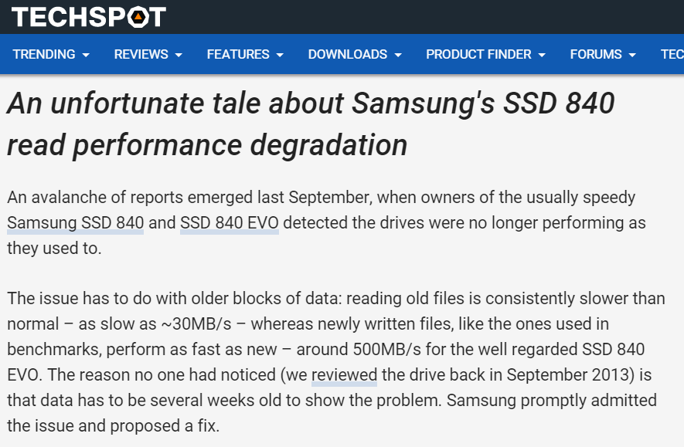
read performance degradation
old files
as slow as 30MB/s
newly-written files
500 MB/s
Reference: (May 5, 2015) Per Hansson, “When SSD Performance Goes Awry” http://www.techspot.com/article/997-samsung-ssd-read-performance-degradation/
Notes:
Now let’s start with a news report I downloaded from techspot.
What they observe is that

Slide 4

Why is old data slower?
Retention loss!
Image source: http://tinyurl.com/ng2gfg9

Slide 5


Retention loss
Charge leakage over time
Flash cell
Flash cell
Retention error
Flash cell
One dominant source of flash memory errors [DATE ‘12, ICCD ‘12]
Side effect: Longer read latency
Notes:
(fast) Retention loss is the phenomenon of charge leakage over time.
(natural)
Flash memory cell stores data as the amount of charge in its floating gate
Unfortunately, the more charge it holds, the faster it leaks charge.
As it leaks more and more charge, the data stored in the cell can be altered, resulting in a retention error.
(fast)
Prior works have shown that retention error is one dominant source of flash memory errors.
(natural)
In the mean time, retention loss also have a side effect, which is longer read latency.
Now let’s talk about the story of how we get this side effect.

Slide 6
Multi-Level Cell (MLC) threshold voltage distribution
PDF
V_{a}
V_{b}
V_{c}
Erased
(11)
P1
(10)
P2
(00)
P3
(01)
Normalized V_{th}
Notes:
The story starts from the threshold voltage distribution.
(point to)
This is figure of the threshold voltage distribution, which shows the probability density function of the threshold voltage for each multi-level cell.
Multi-level cells use 4 threshold voltage states to represent 2 bits.
Due to program variation, the threshold voltage of each state is distributed across a range, which looks like a hump.
And we use read reference voltages Va Vb Vc to read the bit values.
Note that in the rest of our talk, we will not show the erased state, because we are not able to measure the threshold voltage for the erased state.

Slide 7
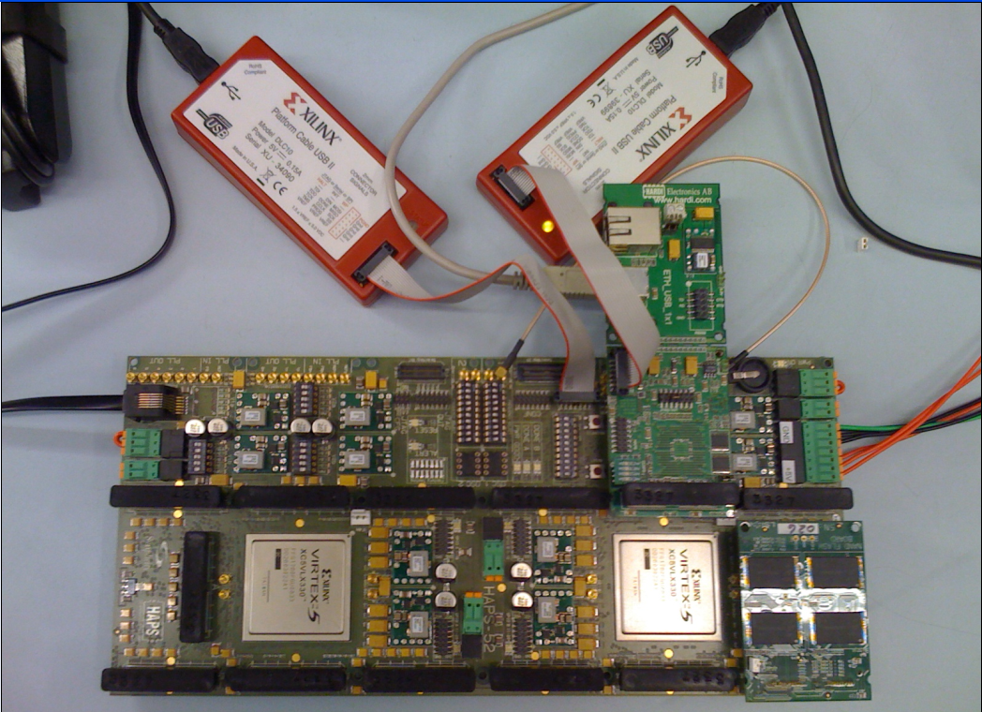
Experimental Testing Platform
USB Daughter Board
USB Jack
HAPS-52 Mother Board
Virtex-II Pro
(USB controller)
3x-nm
NAND Flash
Virtex-V FPGA
(NAND Controller)
[Cai+, FCCM 2011, DATE 2012, ICCD 2012, DATE 2013, ITJ 2013, ICCD 2013, SIGMETRICS 2014, DSN 2015, HPCA 2015]
NAND Daughter Board
Cai et al., FPGA-based Solid-State Drive prototyping platform, FCCM 2011.
Notes:
In order to characterize the distribution, we use an experimental testing platform which is shown on this figure.
This is an FPGA based platform to test 2x-nm MLC raw NAND chips.
We have used this in many prior works including this one.

Slide 8
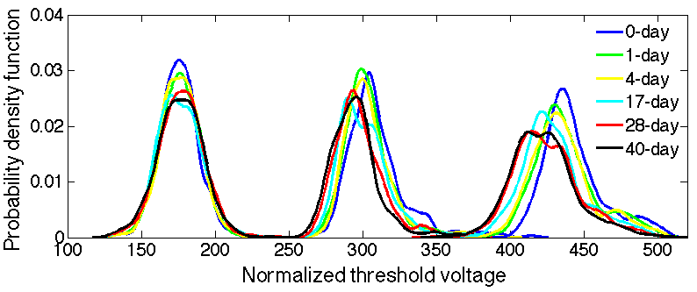
Characterized threshold voltage distribution
0-day
0-day
40-day
40-day
P1
P2
P3
Finding: Cell’s threshold voltage decreases over time
Notes:
This figure shows the real characterization of the threshold voltage distribution using the platform.
The blue line shows distribution 0 day after programming.
The black line shows distribution 40 day after programming.
The key takeaway from this figure is the finding that …
We can see this from …

Slide 9
Threshold voltage reduces over time
New data
Old data
PDF
Less charge
More charge
P1
(10)
P2
(00)
P3
(01)
Normalized V_{th}
Notes:
(fast)
Now let’s explain this effect a bit more.
(natural)
Higher threshold voltage represents more charge in the floating gate,
Lower threshold voltage represents less charge.
As data becomes older, electric charge is leaked over time so the threshold voltage decreases gradually, as we have seen in the real characterization.
(natural
But the flash controller is unaware of this change, so it will apply the default read reference voltage.

Slide 10
First read attempt fails
Old data
PDF
Less charge
More charge
V_{b}
V_{c}
P1
(10)
P2
(00)
P3
(01)
Normalized V_{th}
Normalized V_{th}
Raw bit errors >
ECC correctable errors
Notes:
So it will still use the default read reference voltages, which is not a good fit for the shifted distribution.
So we get lots of raw bit errors.
For old data, raw bit errors exceed the ECC correctable errors, and so we have to read again.

Slide 11
Read-retry
Old data
PDF
Increase read latency
V_{b}’
V_{b}
V_{c}’
V_{c}
P1
(10)
P2
(00)
P3
(01)
Normalized V_{th}
Fewer raw bit errors
Notes:
After the first read to old data fails, multiple read retries will be attempted (point) to reduce the raw bit errors (point) until a read succeeds.
Note that all these read attempts and ECC checks are processed sequentially,
So the overall read latency becomes much longer and read bandwidth is significantly reduced.

Slide 12
Why is old data slower?
Retention loss
→ Leak charge over time
→ Generate retention errors
→ Require read-retry
→ Longer read latency
Notes:
(fast)

Slide 13
Characterize
retention loss in real NAND chip
Optimize
read performance for old data
Recover
old data after failure

Slide 14
The ideal read voltage
Old data
OPT: Optimal read reference voltage
→ minimal read latency
PDF
OPT_{b}
OPT_{c}
P1
(10)
P2
(00)
P3
(01)
Normalized V_{th}
Minimal raw bit errors
Notes:
Ideally, to read the data with the shortest latency, we can apply the OPT, which is at the exact intersection of the two neighboring distribution.
OPT by definition achieves the minimal raw bit errors, and does not need read-retry, so it achieves minimal read latency.
So we say OPT is the ideal read voltage.

Slide 15
In reality
OPT changes over time due to retention loss
Luckily, OPT change is:
  Gradual
  Uni-directional (decrease over time)
Notes:
But in reality, OPT changes over time due to retention loss and many other factors, so it is not easy to predict the value of OPT accurately.
Luckily, OPT changes gradually, so it does not change much in a day.
Also, OPT change is uni-directional. In fact, it decreases monotonically over time.
As we will show next, these two property becomes useful when we design techniques to reduce latency.

Slide 16
Retention Optimized Reading (ROR)
Components:
1. Online pre-optimization algorithm
  Learns and records OPT
  Performs in the background once every day
2. Simpler read-retry technique
  If recorded OPT is out-of-date, read-retry with lower voltage
Notes:
The technique we developed to reduce read latency is called retention optimized reading, or ROR, which is composed of two major components that coordinates with each other.
The first component is an online pre-optimization algorithm. This algorithm periodically learns OPT.
The second component is an improved read retry technique. This technique utilizes the recorded OPT to minimize read retries.
We next explain each component in turn.
Note that this pre-optimization is performed in the background once every day to have minimal performance impact.
And the read-retry only needs to find read to succeed, and is now triggered much less frequently.

Slide 17
ROR result
Notes:
(fast)
Now let’s look at the result.
Blue bars are baseline, red bars are ROR, our proposal.
The first two bars show that ROR reduces read-retry count to 30%.
The second two bars show that ROR also reduces ECC decoding latency due to fewer retention errors.
The last two bars show the total latency is reduced to 29%, which is less than a third than baseline.

Slide 18
Retention optimized reading
Retention loss → longer read latency
Optimal read reference voltage (OPT)
→ Shortest read latency
→ Decreases gradually over time (retention)
→ Learn OPT periodically
→ Minimize read-retry & RBER
→ Shorter read latency
Notes:
(fast)

Slide 19
Characterize
retention loss in real NAND chip
Optimize
read performance for old data
Recover
old data after failure
Notes:
Next, let’s look at an even more challenging and of course more interesting problem.

Slide 20
Retention failure
Old data
Very old data
PDF
P1
(10)
P2
(00)
P3
(01)
OPT_{b}
OPT_{c}
Normalized V_{th}
Uncorrectable errors
Correctable errors
Notes:
(natural)
With ROR, we can quickly read old data with low RBER, which we optimistically assume is always correctable.
But when the data becomes very old, retention loss will shift the threshold voltage even further, and result in a lot more errors than before.
To some point they become uncorrectable errors even when we use optimal read reference voltage.
In this case, the read to this page fails, so we call this retention failure.
So what we want to do next is to recover the data after such retention failure happens.

Slide 21
Leakage speed variation
PDF
N-day retention
S
low-leaking cell
S
F
ast-leaking cell
F
N-day retention
Normalized V_{th}
Notes:
(natural)
At a very high level, what we do is to relate this property called leakage speed variation with the cell’s correct state, in order to correct a majority of retention errors before feeding it to ECC decoder.
Now let me elaborate how we did that.
Due to process variation, there are two types of cells.
Slow-leaking cells leak charge slowly over retention time.
Fast-leaking cells leak charge quickly over time.
Now how can we correlate this property with a cell’s correct state?

Slide 22
A simplified example
PDF
P2
P3
S
S
F
F
F
F
S
S
Normalized V_{th}
Notes:
Let’s look at a simplified example of P2 and P3 state distribution.
Initially, due to program variation, the fast and slow leaking cells are randomly programmed into different threshold voltage levels within each state.

Slide 23
Reading very old data
Very old data
Fast-leaking cells have lower V_{th}
PDF
Slow-leaking cells have higher V_{th}
P2
P3
S
S
F
F
F
F
F
F
F
F
S
S
Normalized V_{th}
Notes:
But as the data becomes old, fast-leaking cells naturally shift to lower threshold voltages within each state, and slow-leaking cells are left behind in higher voltages ranges within each state.
But at this point, we are still missing something to get the correct values. Because for example,

Slide 24
“Risky” cells
Key Formula
PDF
OPT–σ
OPT+σ
+ S =
P2
Risky cells
OPT
+ F =
P3
S
F
F
S
Normalized V_{th}
Uncorrectable errors
Notes:
So we look at “risky” cells, which are defined as cells with threshold voltages close to OPT.
Now we can see the correlation: (slow) risky and slow-leaking cells have P2 state, risky and fast-leaking cells have P3 state.
Now if we apply this key formula to the cells, we are able to correct these retention errors.
(Pause)

Slide 25
Retention Failure Recovery (RFR)
Key idea: Guess original state of the cell from its leakage speed property
Three steps
Identify risky cells
Identify fast-/slow-leaking cells
Guess original states
Key Formula
+ S =
P2
Risky cells
+ F =
P3
Notes:
(fast)
The technique we propose is retention failure recovery, RFR, whose key idea is to guess original state of the cell from its leakage speed property.
This technique is composed of three steps.

Slide 26
RFR Evaluation
Program with random data
Expect to eliminate 50% of raw bit errors
ECC can correct remaining errors
28 days
Detect failure, backup data
12 addt’l. days
Recover data
Notes:
(fast)
We evaluate our RFR technique based on our characterization.
We assume that the faulty page is originally programmed with random data.
After 28 days, we detect the failure and back up the data.
After 12 additional days, we perform RFR to recover the data.
On average, RFR reduces RBER by 50%, which means that it is expected to eliminate 50% of the original raw bit errors.
At this point, ECC code has a much higher chance to correct the remaining errors to recover the data.

Slide 27
Characterize
retention loss in real NAND chip
Optimize
read performance for old data
Recover
old data after failure
Notes:
Now let me conclude

Slide 28
Conclusion
Retention loss→ Longer read latency
Retention optimized reading (ROR)
→ Learns OPT periodically
→ 71% shorter read latency
Retention failure recovery (RFR)
→ Use leakage property to guess correct state
→ 50% error reduction before ECC correction
→ Recover data after failure
Notes:
(very fast)
We have walked through how retention loss leads to longer read latency.
And we have talked about how we reduce read latency with retention optimized reading.
And we have also introduced retention failure recovery, which recovers data after failure.

Slide 29
Our FMS Talks and Posters
Onur Mutlu, Error Analysis and Management for MLC NAND Flash Memory, FMS 2014.
Onur Mutlu, Read Disturb Errors in MLC NAND Flash Memory, FMS 2015.
Yixin Luo, Data Retention in MLC NAND Flash Memory, FMS 2015.
FMS 2015 posters:
  WARM: Improving NAND Flash Memory Lifetime with Write-hotness Aware Retention Management
  Read Disturb Errors in MLC NAND Flash Memory
  Data Retention in MLC NAND Flash Memory

Slide 30
Our Flash Memory Works (I)
Retention noise study and management
  Yu Cai, Gulay Yalcin, Onur Mutlu, Erich F. Haratsch, Adrian Cristal, Osman Unsal, and Ken Mai, Flash Correct-and-Refresh: Retention-Aware Error Management for Increased Flash Memory Lifetime, ICCD 2012.
  Yu Cai, Yixin Luo, Erich F. Haratsch, Ken Mai, and Onur Mutlu, Data Retention in MLC NAND Flash Memory: Characterization, Optimization and Recovery, HPCA 2015.
  Yixin Luo, Yu Cai, Saugata Ghose, Jongmoo Choi, and Onur Mutlu, WARM: Improving NAND Flash Memory Lifetime with Write-hotness Aware Retention Management, MSST 2015.
Flash-based SSD prototyping and testing platform
  Yu Cai, Erich F. Haratsh, Mark McCartney, Ken Mai, FPGA-based solid-state drive prototyping platform, FCCM 2011.

Slide 31
Our Flash Memory Works (II)
Overall flash error analysis
  Yu Cai, Erich F. Haratsch, Onur Mutlu, and Ken Mai, Error Patterns in MLC NAND Flash Memory: Measurement, Characterization, and Analysis, DATE 2012.
  Yu Cai, Gulay Yalcin, Onur Mutlu, Erich F. Haratsch, Adrian Cristal, Osman Unsal, and Ken Mai, Error Analysis and Retention-Aware Error Management for NAND Flash Memory, ITJ 2013.
Program and erase noise study
  Yu Cai, Erich F. Haratsch, Onur Mutlu, and Ken Mai, Threshold Voltage Distribution in MLC NAND Flash Memory: Characterization, Analysis and Modeling, DATE 2013.

Slide 32
Our Flash Memory Works (III)
5. Cell-to-cell interference characterization and tolerance
  Yu Cai, Onur Mutlu, Erich F. Haratsch, and Ken Mai, Program Interference in MLC NAND Flash Memory: Characterization, Modeling, and Mitigation, ICCD 2013.
  Yu Cai, Gulay Yalcin, Onur Mutlu, Erich F. Haratsch, Osman Unsal, Adrian Cristal, and Ken Mai, Neighbor-Cell Assisted Error Correction for MLC NAND Flash Memories, SIGMETRICS 2014.
6. Read disturb noise study
  Yu Cai, Yixin Luo, Saugata Ghose, Erich F. Haratsch, Ken Mai, and Onur Mutlu,
  Read Disturb Errors in MLC NAND Flash Memory: Characterization and Mitigation, DSN 2015.
7. Flash errors in the field
  Justin Meza, Qiang Wu, Sanjeev Kumar, and Onur Mutlu, A Large-Scale Study of Flash Memory Errors in the Field, SIGMETRICS 2015.

Slide 33
Referenced Papers and Talks
All are available at
  http://users.ece.cmu.edu/~omutlu/projects.htm

Slide 34
Thank you!
Feel free to email me with any questions & feedback
yixinluo@cmu.edu
http://www.cs.cmu.edu/~yixinluo

Slide 35
Data Retention in MLC NAND Flash Memory: Characterization, Optimization, and Recovery
Yixin Luo
yixinluo@cmu.edu
(joint work with Yu Cai, Erich F. Haratsch, Ken Mai, Onur Mutlu)
Notes:
I am ready to take questions

Slide 36
Backup Slides

Slide 37
ROR overheads
Power-on latency: 3, 15, and 23 seconds for flash memory with 1-day, 7-day, and 30-day equivalent retention age
Per-day pre-optimization latency: 3 seconds
Total storage overhead: 768 KB

Slide 38
Read-Retry Latency Diagnosis
Read page A:
time
Attempt 1
Attempt 2
Attempt 3
Flash Read Latency
ECC Latency
= Constant
∝ Raw bit error
Notes:
We further break down the latency of a single read retry into flash read latency and ECC decoding latency.
We find that the ECC latency is proportional to the number of raw bit errors found in the page.
This motivates us to reduce the raw bit error rate to improve read performance.

Slide 39
ROR assumptions
We model a 512 GB flash-based SSD (composed of sixteen 256 Gbit flash memory chips) with an 8 KB page size, 256-page block size, and 100 μs read latency.
We model a flash controller with an iterative BCH decoder that can correct 40 bit errors for every 1 KB of data [11] (i.e., it can tolerate an RBER of 10-3 during the flash lifetime).

Slide 40
RFR Motivation
Data loss can happen in many ways
High P/E cycle
High temperature → accelerates retention loss
High retention age (lost power for a long time)

Slide 41
What if there are other errors?
Key: RFR does not have to correct all errors
Example:
ECC can correct 40 errors in a page
Corrupted page has 20 retention errors, 25 other errors (45 total errors)
After RFR: 10 retention errors, 30 other errors (40 total errors → ECC correctable)

Slide 42
Characterization methodology
FPGA-based flash memory testing platform
Real 20- to 24-nm MLC NAND flash chips
0- to 40-day worth of retention loss
Room temperature (20⁰C)
0 to 50k P/E Cycles
Notes:
We test real 20 to 24-nm MLC NAND flash memory chips
to cover a range of 0 to 40 day worth of retention loss under room temperature.
And a range of 0 to 50k P/E cycles

Slide 43
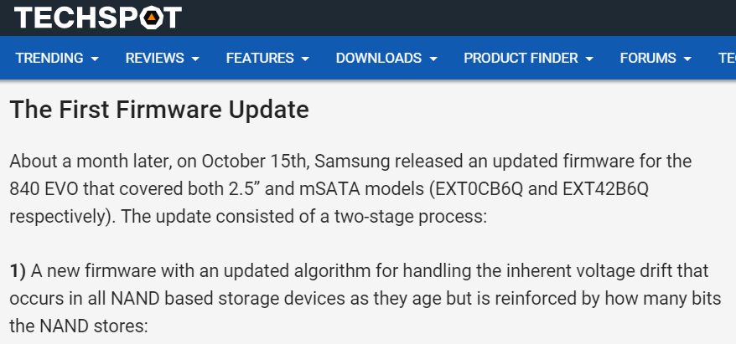
Firmware fix

Slide 44
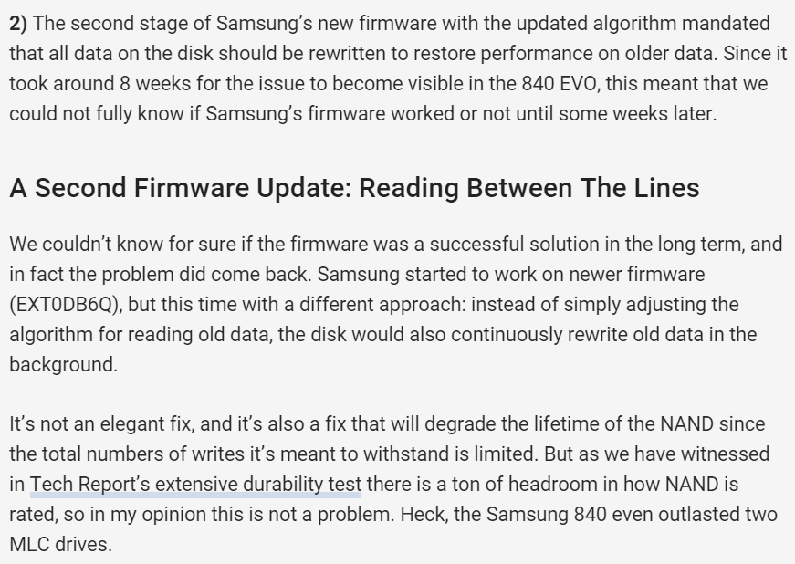
Firmware fix

Slide 45
Optimal Read Reference Voltage (OPT)
40-day OPT
0-day OPT
40-day OPT
0-day OPT
P1
P2
P3
Finding: OPT decreases over time
Notes:
Due to this shift, the optimal read reference voltage also decreases correspondingly.
0-day OPT is the read reference voltage optimized for reading data 0 days after programming
40-day OPT is the read reference voltage optimized for reading data 40 days after programming
In our experiments, we empirically find the optimal read reference voltage which is the one that minimizes raw bit error rate.

Slide 46
Retention Optimized Reading: Summary
Flash Read Techniques | Lifetime (P/E Cycle) | Performance (Read Latency)
Fixed V_{ref} | ✗ | ✓
Sweeping V_{ref} | ✓ 64% ↑ | ✗
ROR | ✓ 64% ↑ | ✓ _____
Nom. Life: 2.4% ↓
Ext. Life: 70.4% ↓
Notes:
We evaluate the benefit for the ROR technique using numbers from our characterization.
We find that ROR can achieve the same 64% lifetime improvement as naive read-retry.
While reducing read latency in stage-1 by as much as 70.4%.
Furthermore, we find that due to reduction in RBER, ROR also reduces read latency by 2.4%.

Slide 47
Observations
1. The optimal read reference voltage gradually decreases over time
Key idea: Record the old OPT as a prediction (V_{pred}) of the actual OPT
Benefit: Close to actual OPT → Fewer read retries
2. The amount of retention loss is similar across pages within a flash block
Key idea: Record only one V_{pred} for each block
Benefit: Small storage overhead (768KB out of 512GB)
Notes:
To reduce read latency, we make two observations.
The first observation utilizes our previous finding that optimal read reference voltage gradually decreases over time.
This motivates us to record the old OPT as a prediction.
With that Vpredict, which is now close to the actual OPT, we need less read-retries to read the data.
We characterize 14 real workload traces to make the second observation, which shows that the amounts of retention loss is similar within a flash block.
This allows us to record only one Vpred for each block and gives us the benefit of less storage overhead.
In fact, we only need 768 KB out of 512 GB to store Vpredict.

Slide 48
1. Online Pre-Optimization Algorithm
Triggered periodically (e.g., per day)
Find and record an OPT as per-block V_{pred}
Performed in background
Small storage overhead
New V_{pred}
Old V_{pred}
PDF
Normalized V_{th}
Notes:
We next explain each component in detail.
The online pre-optimization algorithm is triggered periodically.
And for each block, it finds and records an upper-bound for OPT within a time period.
The algorithm itself is very simple.
It starts with the old starting read reference voltage.
Then it progressively increases or decreases read reference voltage until it achieves a minimal raw bit error rate.
Note that this algorithm is performed in the background to have minimal performance impact.

Slide 49
2. Improved Read-Retry Technique
Performed as normal read
V_{pred} already close to actual OPT
Decrease V_{ref} if V_{pred} fails, and retry
PDF
OPT
V_{pred}
Very close
Normalized V_{th}
Notes:
The second component of ROR is an improved read-retry technique.
This technique is performed as a normal read operation.
Since we already have a starting read reference voltage that is close to OPT.
Even if the actual OPT shifts over retention age, we decrease read reference voltage for a few read-retries to successfully read the data.

Slide 50
1. Identify Risky Cells
Key Formula
OPT–σ
+ S =
P2
PDF
OPT
OPT+σ
Risky cells
+ F =
P3
S
F
F
S
Normalized V_{th}
Notes:
First, we identify risky cells who are cells that have threshold voltages close to OPT.
These cells are more prone to errors.
Notice that risky, and slow-leaking cells originally have P2 state, whereas risky, fast-leaking cells originally have P3 state.
We will exploit this key formula to recover the data.

Slide 51
2. Identifying Fast- vs. Slow-Leaking Cells
Key Formula
OPT–σ
+ S =
P2
PDF
OPT
OPT+σ
Risky cells
+ F =
P3
?
?
?
?
?
?
Normalized V_{th}
Notes:
However, without further measurements, we do not know the cells’ leaking properties.
The technique to do this is very straightforward.
We take the flash memory offline and introduce additional retention loss, simply by waiting for several days.
Then we compare the threshold voltage of the risky cells before and after the additional retention loss to find out how fast they leak.

Slide 52
2. Identifying Fast- vs. Slow-Leaking Cells
Key Formula
OPT–σ
+ S =
P2
PDF
OPT
OPT+σ
Risky cells
+ F =
P3
?
S
?
?
F
?
?
F
S
?
Normalized V_{th}
Notes:
However, without further measurements, we do not know the cells’ leaking properties.
The technique to do this is very straightforward.
We take the flash memory offline and introduce additional retention loss, simply by waiting for several days.
Then we compare the threshold voltage of the risky cells before and after the additional retention loss to find out how fast they leak.

Slide 53
3. Guess Original States
Key Formula
+ S =
P2
PDF
Risky cells
+ F =
P3
S
F
F
S
Normalized V_{th}
Notes:
Finally, using the formula we developed before to guess the original state, we set the risky and slow leaking cells into P2 state, risky and fast leaking cells into P3 state.

Slide 54
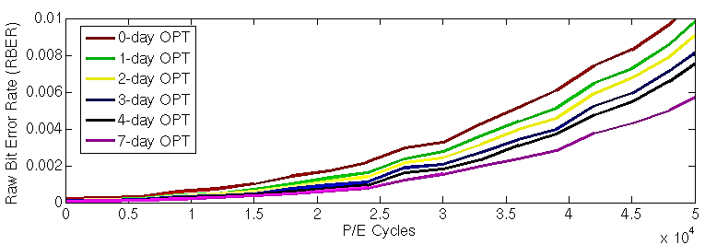
3. RBER and P/E Cycle Lifetime
V_{ref} closer to actual OPT
Reading data with 7-day worth of retention loss.
Nominal Lifetime
Extended Lifetime
Actual OPT
ECC-correctable RBER
Finding: Using actual OPT achieves the longest lifetime
Notes:
We read random data with 7-day worth of retention loss and plot their raw bit error rate under different P/E cycles.
The pink line is the actual OPT, in this case, 7-day OPT.
The other lines show reading with other read reference voltages.
The area shaded in blue is the ecc correctable range.
Up to a certain lifetime, any of these read reference voltage reads the data successfully. We call this nominal lifetime because any fixed read reference voltage can achieve this.
However, if we pick the actual OPT, the pink line, we can achieve the longest lifetime. We call this extended lifetime.
Explain OPT more

Slide 55
Characterization Summary
Due to retention loss
  Cell’s threshold voltage (V_{th}) decreases over time
  Optimal read reference voltage (OPT) decreases over time
Using the actual OPT for reading
  Achieves the longest lifetime
Notes:
To summarize our characterization, we find that, due to retention loss, threshold voltage and the optimal read reference voltage decrease.
We also find that, the actual OPT achieves the minimal raw bit error rate, and extend flash lifetime in Stage-1.
Next, we show how we find such actual OPT to extend the lifetime.

Slide 56
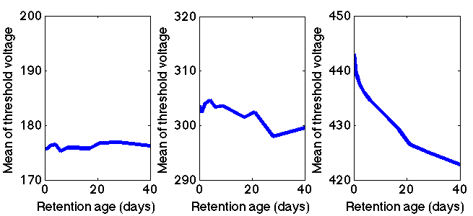
Threshold Voltage (V_{th}) Mean
P1
P2
P3
Relatively constant
Slowly decrease
Quickly decrease
Threshold voltage mean
Finding: V_{th} shifts faster in higher voltage states
Notes:
Next, we take a closer look at this shift by plotting the threshold voltage mean.
The x-axes of these three figures are retention age. The y-axes of the three figures are mean threshold voltages of the P1, P2, and P3 states respectively.
As we can see, the threshold voltage mean of P1 state is relatively constant. That of P2 slowly decreases, that of P3 quickly decreases.
So, we conclude the finding that threshold voltage shifts faster in higher voltage states.

Slide 57
Raw Bit Error Rate (RBER)
RBER gradually decreases as read reference voltage approaches the actual OPT
Actual OPT
Reading data with 7-day retention age.
Finding: The actual OPT achieves the lowest RBER
Notes:
However, today’s flash controllers are agnostic of the retention age.
In this figure, we show raw bit error rate under different P/E cycles when we read data with 7-day retention age, using different read reference voltages.
The x-asis is the Program/Erase cycle, the y-axis is the raw bit error rate. Different lines show different read reference voltages.
The pink line is RBER when reading with the actual OPT.
We find that the actual OPT achieves the lowest RBER. Note that RBER gradually reduces as read reference voltage approaches the actual OPT.

Slide 58
Online Pre-Optimization Algorithm
Periodically learn and record OPT for page 255 as per-block starting read reference voltage (V₀)
  Page 255 has the shortest retention age
  Other pages within the block have longer retention age and retention age will increase over time
Step 1: Read with V_{ref} = old V_{0,} record RBER
Step 2: Decrease V_{ref} =V_{ref} – ΔV* compare RBER
Step 3: Increase V_{ref} = V_{ref} + ΔV compare RBER
Step 4: Record new V₀ = V_{ref} | minimal RBER
*ΔV is the smallest step size for changing read reference voltage.
Notes:
We first describe the online pre-optimization algorithm, which is periodically triggered to learn and record OPT for page 255 in each block as starting read reference voltage.
We perform four steps to learn this voltage for each block.
In step 1, we read with the previously recorded starting read reference voltage and record the read reference voltage.
Next, in step 2 and 3, we progressively decrease and increase the read reference voltage until we find the read reference voltage with the lowest raw bit error rate.
Finally, in step 4, we record this voltage as the new starting read reference voltage for this block.
Note that this algorithm can be performed in background and has minimal performance impact.

Slide 59
Arrhenius Law
1 year
Room temperature (20°C)
32 hours
High temperature (70°C)
High temperature accelerates retention loss

Slide 60
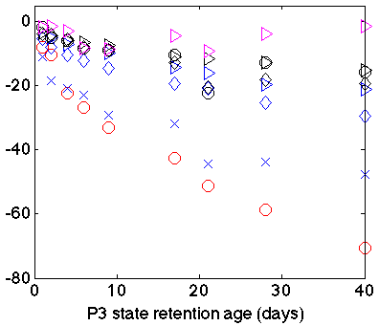
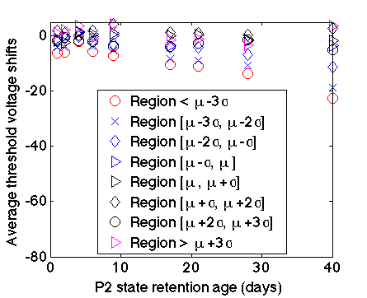
Fast- and Slow-Leaking Cells
Ends up in higher V_{th}
Slow-leaking cells
(-∞,-3σ)
(-3σ,-2σ)
(-2σ,-1σ)
Average V_{th} shift
(-1σ,μ)
Ends up in higher V_{th}
(μ,1σ)
(1σ,2σ)
Fast-leaking cells
(2σ,3σ)
(3σ,+∞)
Retention age (days)
*Similar trends are found in P2 state, as shown in the paper.

Slide 61
Fast- and Slow-Leaking Cells
PDF
Threshold voltage marks after 28 days:
-3σ
-2σ
-1σ
μ
1σ
2σ
3σ
Normalized V_{th}

Slide 62
Fast- and Slow-Leaking Cells
Ends up in higher V_{th}
Slow-leaking cells
(-∞,-3σ)
(-3σ,-2σ)
(-2σ,-1σ)
Average V_{th} shift
(-1σ,μ)
Ends up in lower V_{th}
(μ,1σ)
(1σ,2σ)
Fast-leaking cells
(2σ,3σ)
(3σ,+∞)
Retention age (days)
*Similar trends are found in P2 state, as shown in the paper.

Slide 63

CG
Control gate (CG)
FG
Inter-poly oxide
S
D
Substrate
Floating gate (FG)
Tunnel oxide
Source
Drain
Substrate

