Slide 1
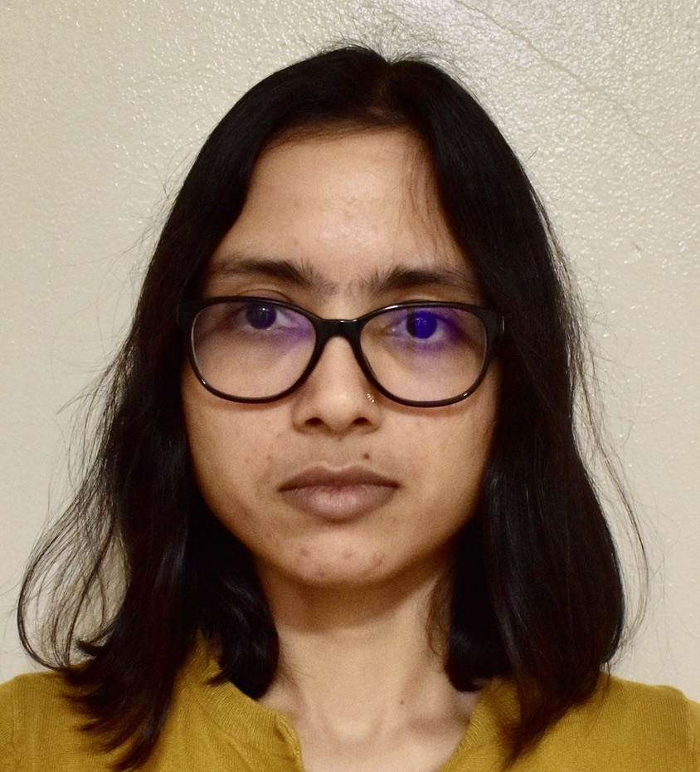




Ensembling Off-the-shelf Models
for GAN Training
Nupur Kumari¹, Richard Zhang², Eli Shechtman², Jun-Yan Zhu¹
¹CMU, ²Adobe Research

Slide 2
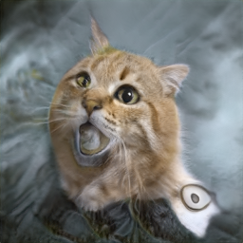
Standard GAN training
z
z
¨
Loss
Trained from scratch
VGG-16
(Classification)
Swin-T
(Detection)
Which pretrained models to use?
Swin-T (Segmentation)
ViT (CLIP)
Swin-T (MoBY)
ViT (DINO)
Available Off-the-shelf Models

Slide 3
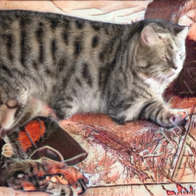
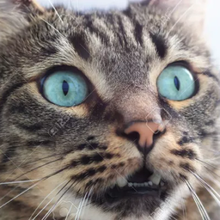
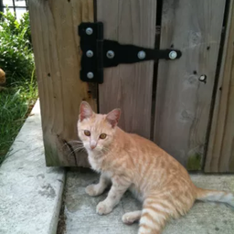
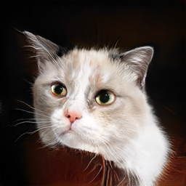
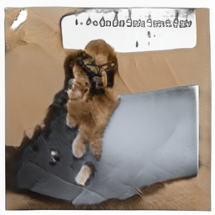
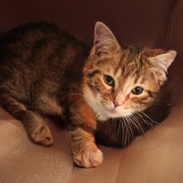
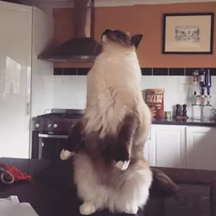
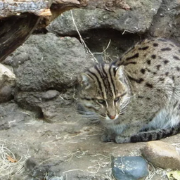

Model Selection
Fake samples
z
¨
82%
VGG-16
(Classification)
Swin-T
(Detection)
Real samples
Swin-T (Segmentation)
ViT (CLIP)
Linear Probe Accuracy
Swin-T (MoBY)
ViT (DINO)
VGG-16
(Classification)
Swin-T (MoBY)
Swin-T
(Segmentation)
ViT (CLIP)
Swin-T (Detection)
ViT (DINO)
Available Off-the-shelf Models

Slide 4
Model Selection
Fake samples
z
¨
Highest performing
99%
Real samples
98%
88%
89%
98%
82%
Linear Probe Accuracy
VGG-16
(Classification)
Swin-T (MoBY)
Swin-T
(Segmentation)
ViT (CLIP)
Swin-T (Detection)
ViT (CLIP)
ViT (DINO)
Available Off-the-shelf Models

Slide 5


Vision-aided GAN training
z
z
¨
Loss
VGG-16
(Classification)
Swin-T (MoBY)
Swin-T
(Segmentation)
ViT (CLIP)
Swin-T (Detection)
ViT (DINO)
Available Off-the-shelf Models

Slide 6
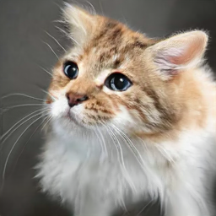
Linearly Probe Remaining Models
z
z
¨
Loss
Highest performing
82%
79%
86%
72%
77%
ViT (CLIP)
Linear Probe Accuracy
VGG-16
(Classification)
Swin-T (MoBY)
Swin-T
(Segmentation)
Swin-T (Detection)
ViT (DINO)
ViT (DINO)
Available Off-the-shelf Models

Slide 7
Add 2nd Vision-aided discriminator
z
z
¨
Loss
ViT (CLIP)
VGG-16
(Classification)
Swin-T (MoBY)
Swin-T
(Segmentation)
Swin-T (Detection)
ViT (DINO)
Available Off-the-shelf Models

Slide 8
Better pretrained features lead to lower FID
FFHQ 1k
FID

Slide 9
Better pretrained features lead to lower FID
FFHQ 1k
FID

Slide 10
Better pretrained features lead to lower FID
FFHQ 1k
FID

Slide 11
Benefit with varying training samples

Slide 12
Benefit with varying training samples

Slide 13
Benefit with varying training samples

Slide 14
Benefit with varying training samples

Slide 15
Benefit with varying training samples
similar FID with
~0.7% data

Slide 16
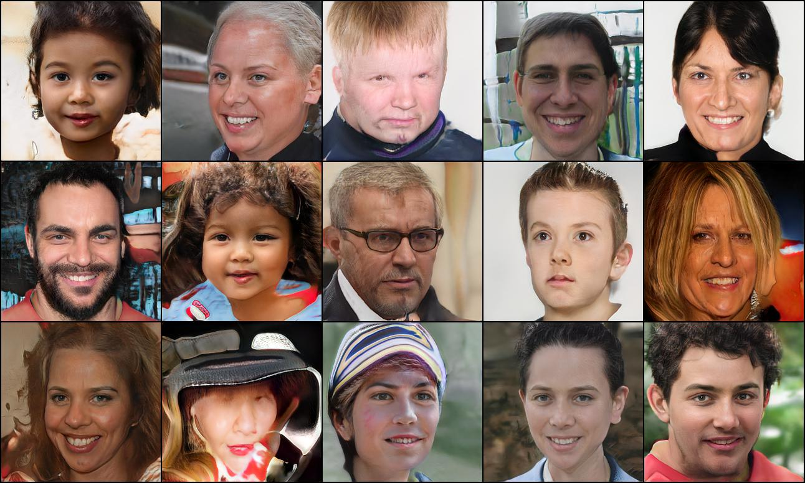
Improved Samples
StyleGAN2-ADA
FFHQ 1k

Slide 17
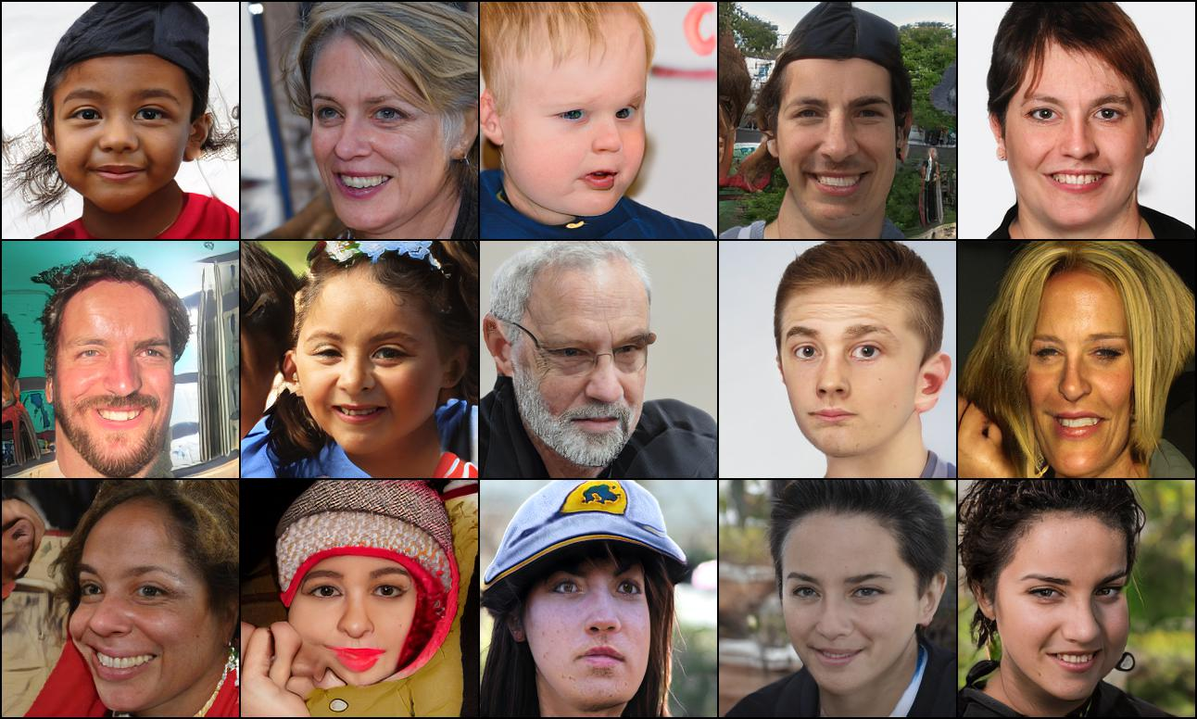
Improved Samples
Ours
FFHQ 1k

Slide 18
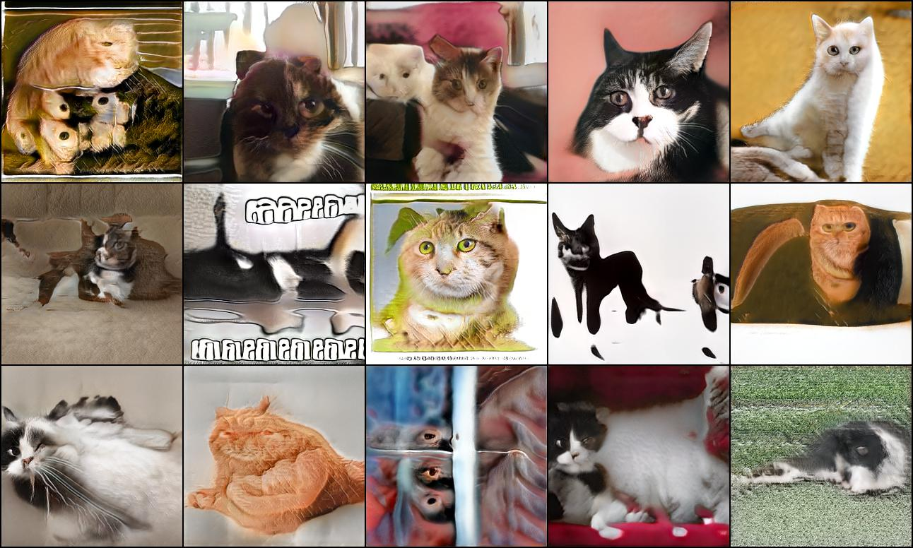
Improved Samples
StyleGAN2-ADA
LSUN CAT 1k

Slide 19
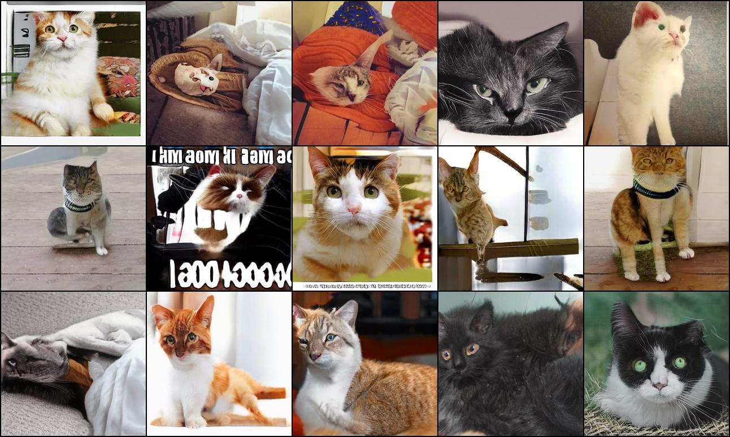
Improved Samples
Ours
LSUN CAT 1k

Slide 20
Lower Discriminator Overfitting
Our loss
is added

Slide 21
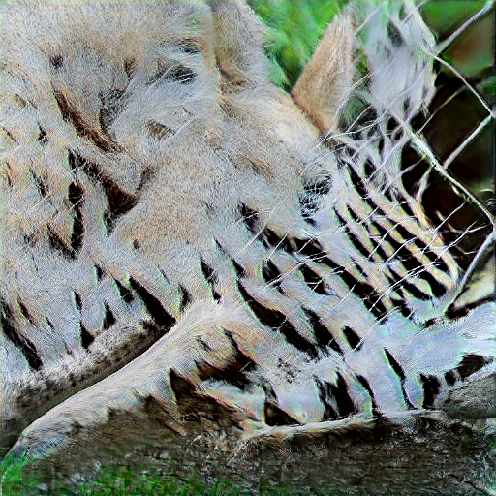
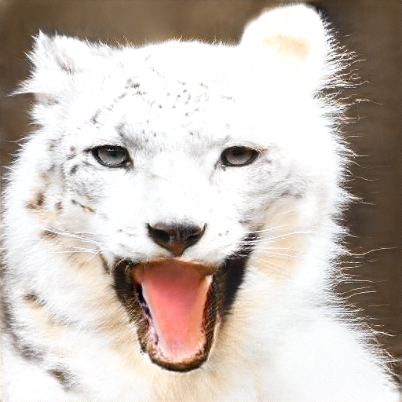
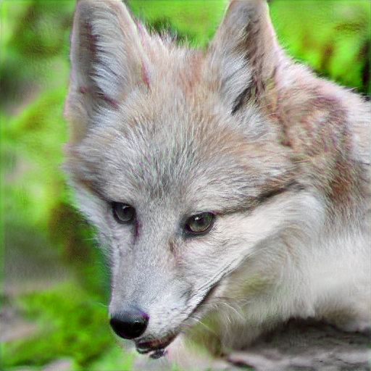
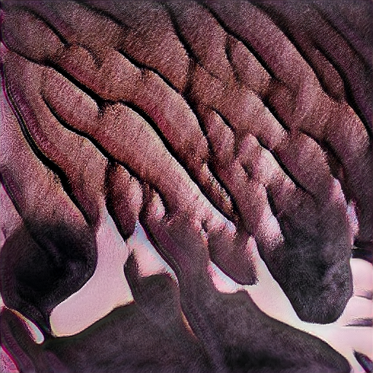
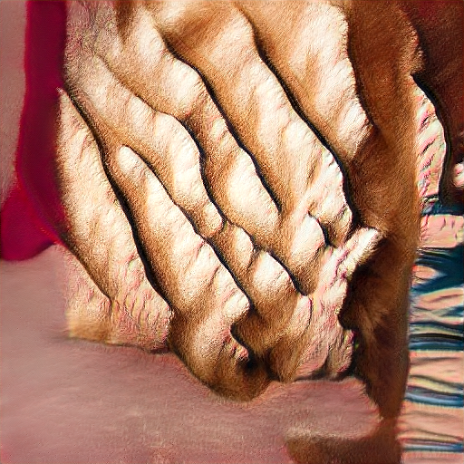
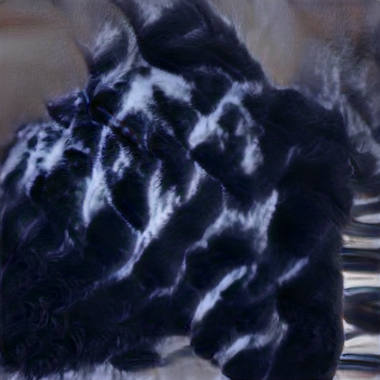
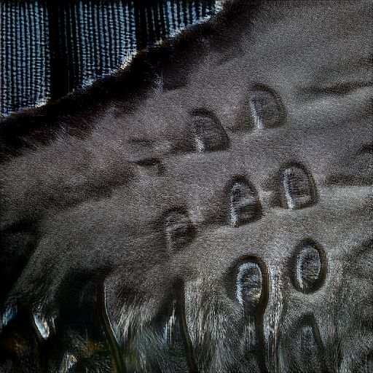
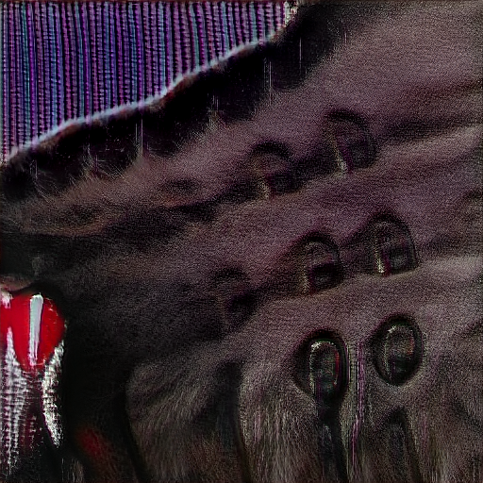
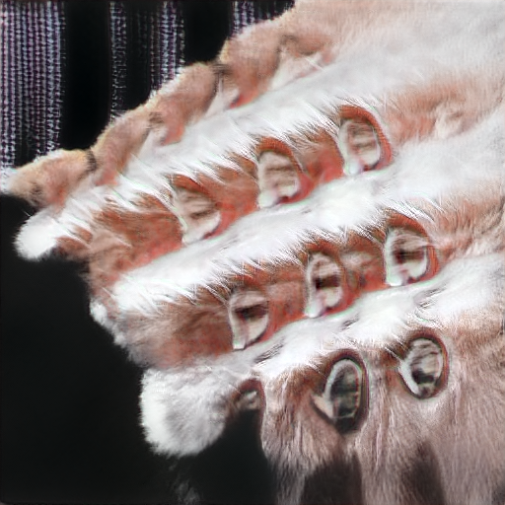
Improved Quality
StyleGAN2-ADA
Samples with high Mahalanobis distance out of randomly generated 5k images.
Distance is calculated using and of real sample distribution.
AFHQ WILD
AFHQ DOG
AFHQ CAT

Slide 22
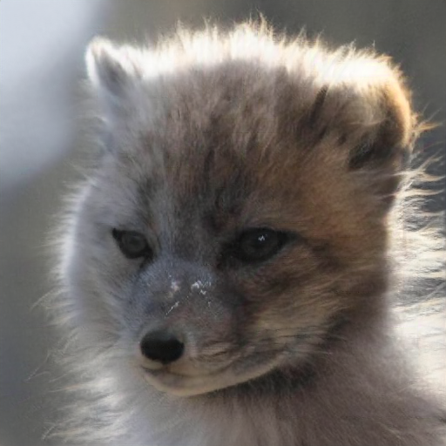
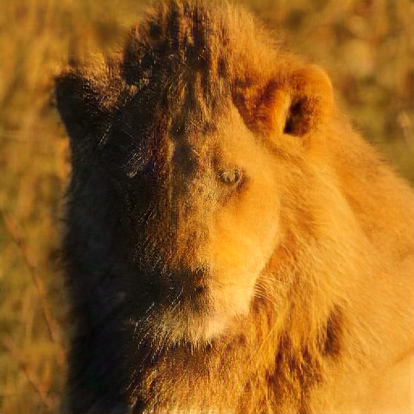
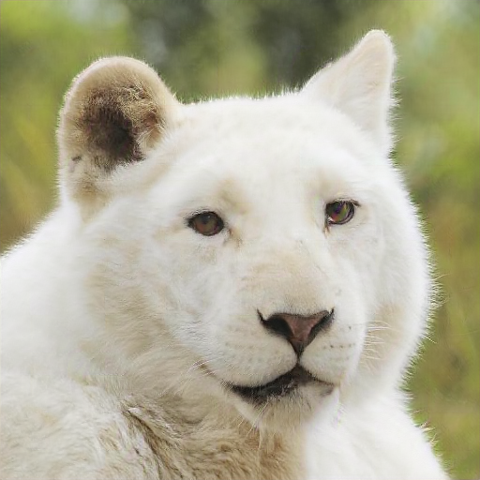
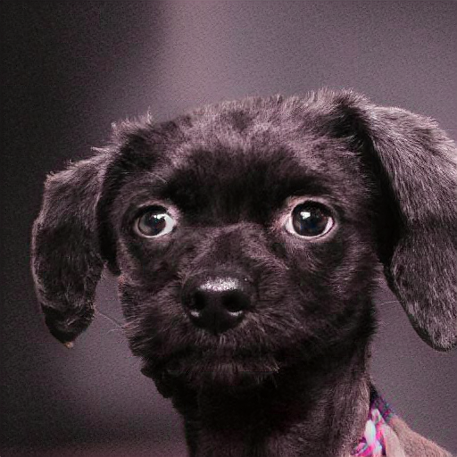
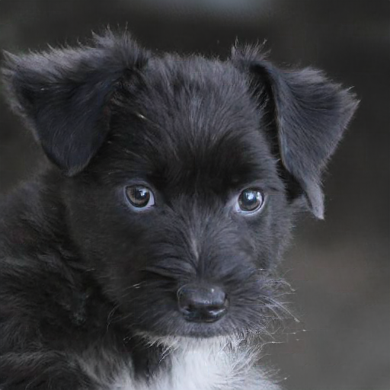
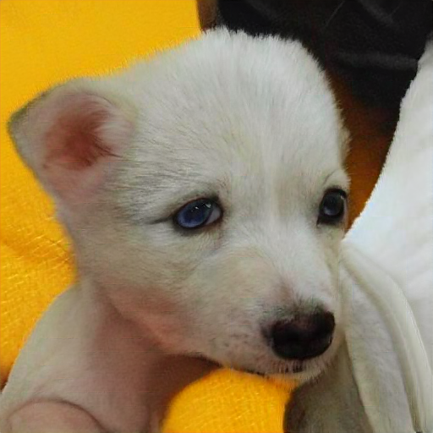
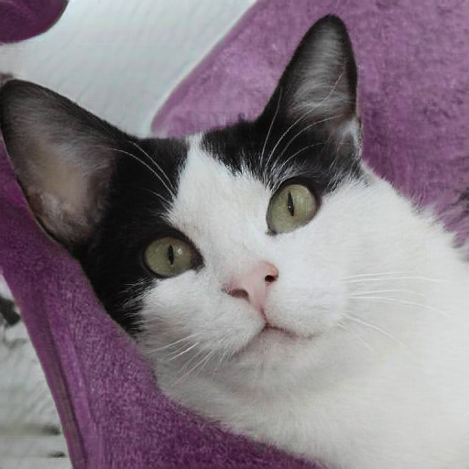
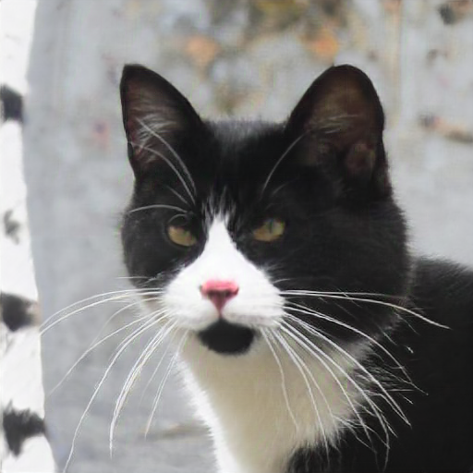
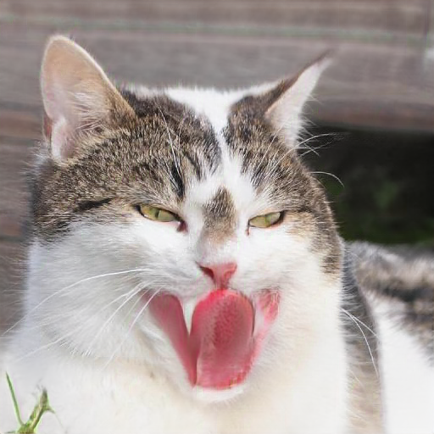
Improved Quality
Ours
Samples with high Mahalanobis distance out of randomly generated 5k images.
Distance is calculated using and of real sample distribution.
AFHQ WILD
AFHQ DOG
AFHQ CAT

Slide 23
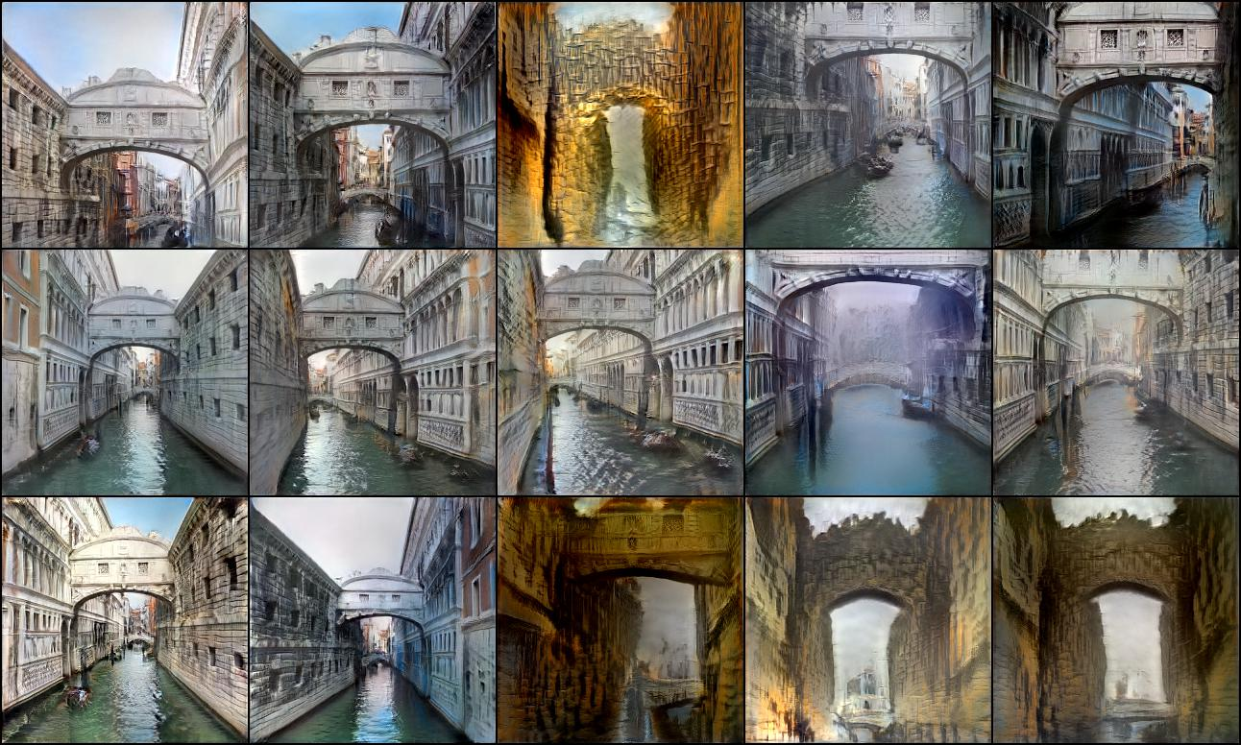
Low-shot Generation with 100 samples
Bridge of Sighs

Slide 24
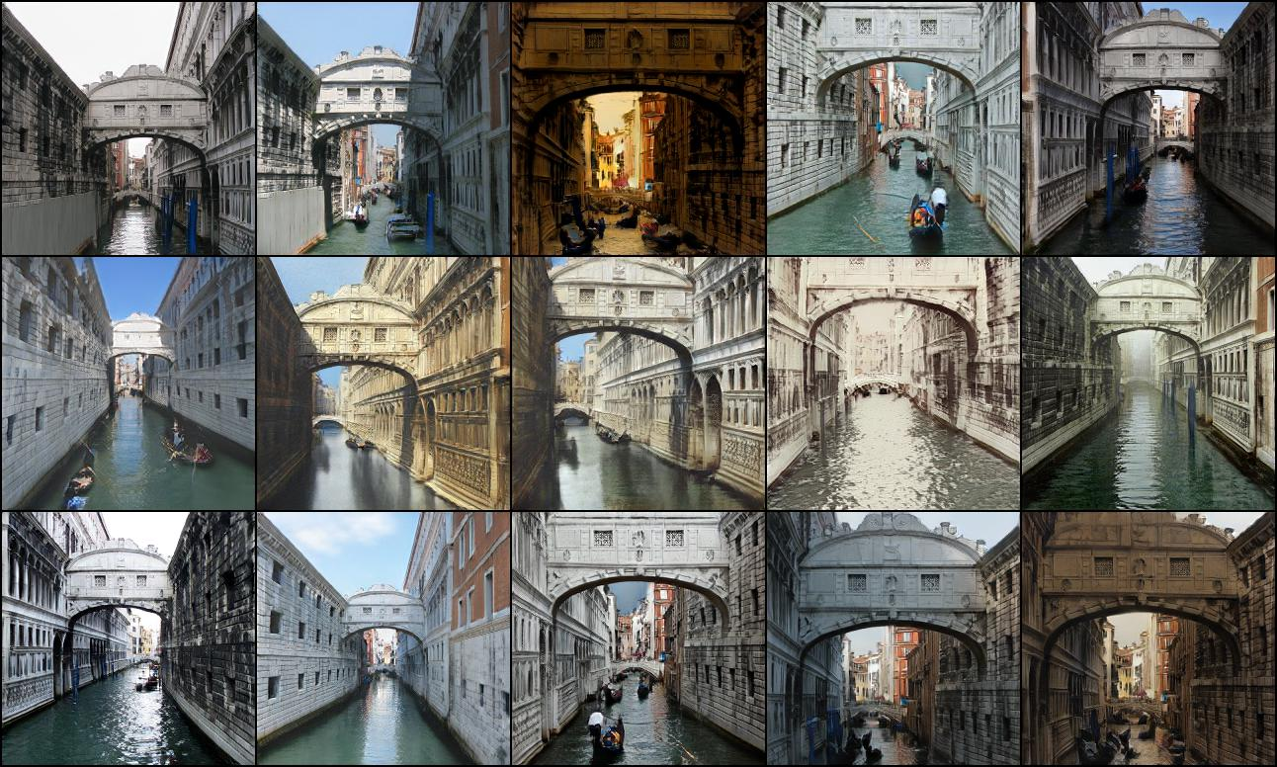
Low-shot Generation with 100 samples
Bridge of Sighs

Slide 25
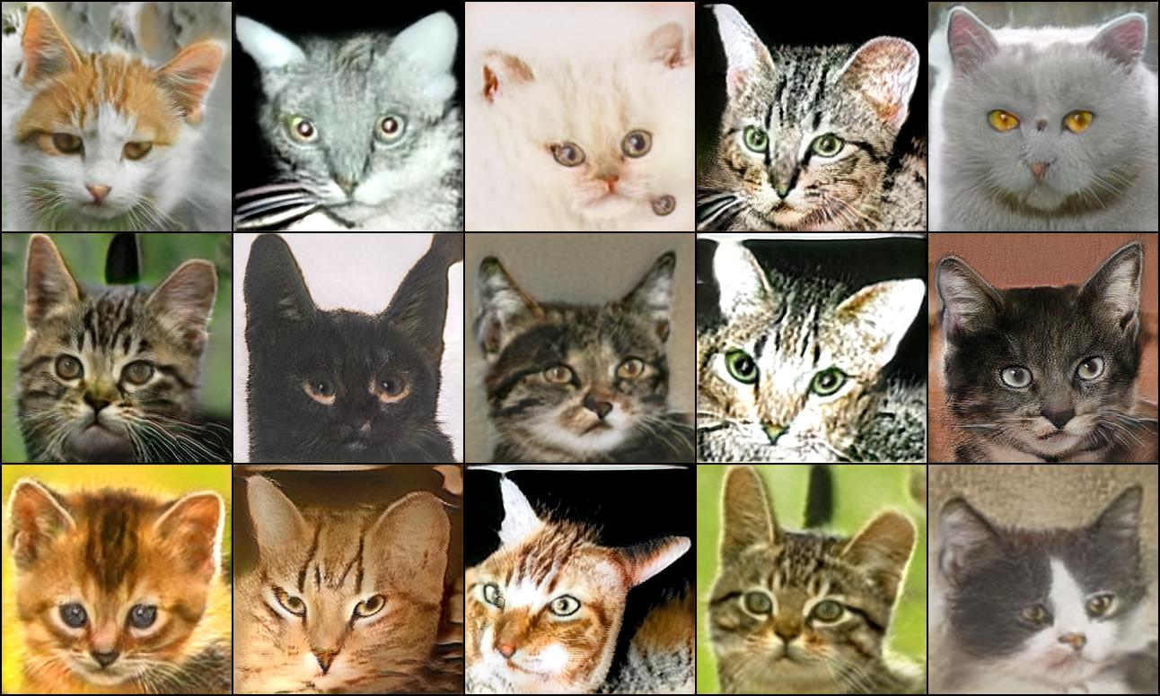
Low-shot Generation with 169 samples
StyleGAN2-ADA
AnimalFace Cat

Slide 26
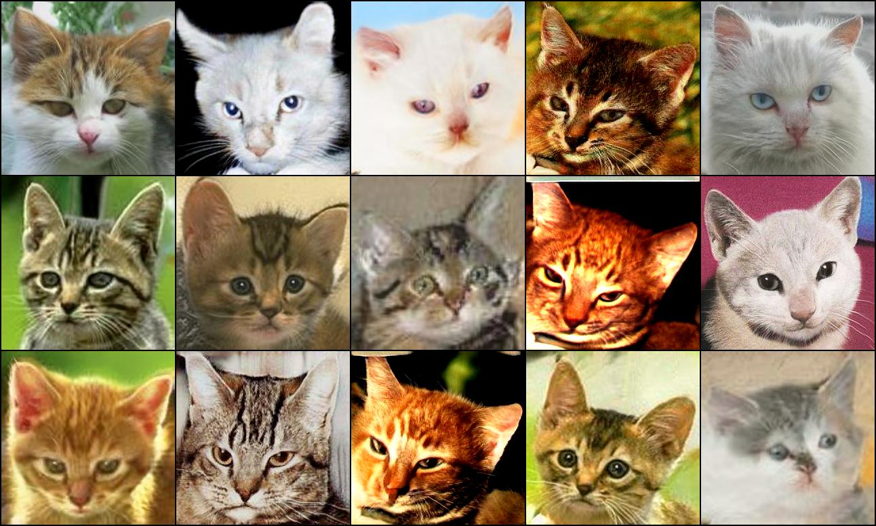
Low-shot Generation with 169 samples
Ours
AnimalFace Cat

Slide 27
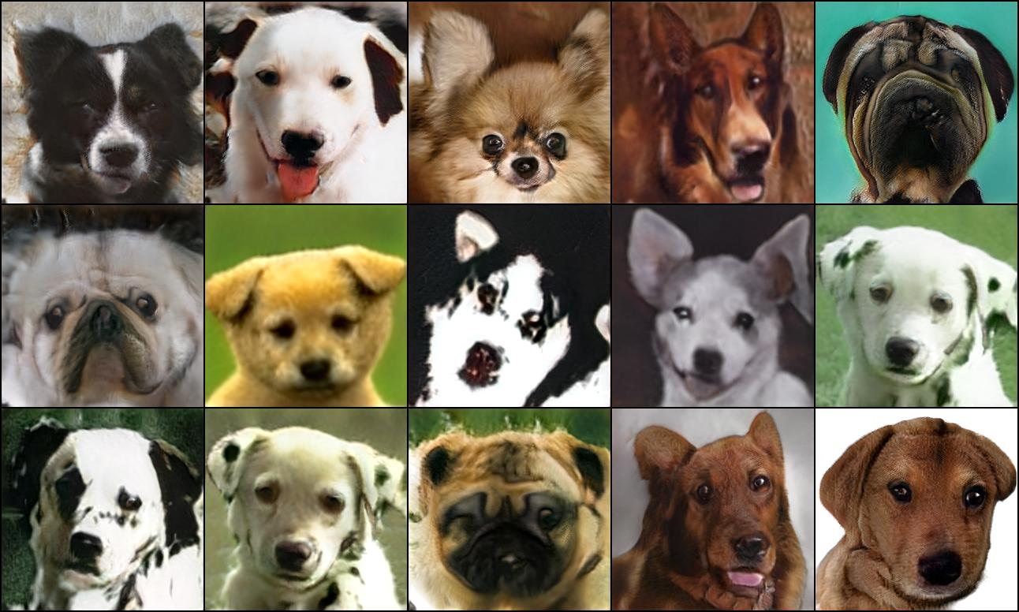
Low-shot Generation with 389 samples
AnimalFace Dog

Slide 28
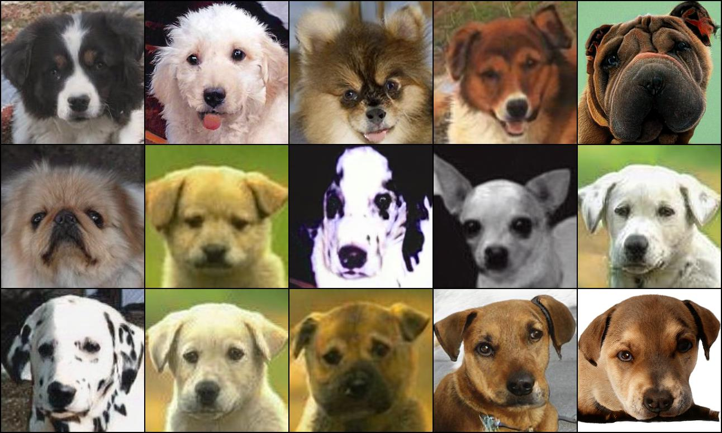
Low-shot Generation with 389 samples
AnimalFace Dog

Slide 29
Thank You
Nupur Kumari, Richard Zhang, Eli Shechtman, Jun-Yan Zhu
https://github.com/nupurkmr9/vision-aided-gan

