Slide 1
15-744: Computer Networking
L-24 DDoS Attacks

Slide 2
Overview
Denial of service
Reflector Attacks
Backscatter Analysis
Traceback

Slide 3
Denial of Service (DoS): General definition
DoS is not access or theft of information or services
Instead, goal is to stop the service from operating
Deny service to legitimate users
Usually a temporary effect that passes as soon as the attack stops

Slide 4
DoS: What is it?
Attacker
Victim
Crash victim (exploit software flaws)
Attempt to exhaust victim's resources
Network: Bandwidth
Host
Kernel: TCP connection state tables, etc.
Application: CPU, memory, etc.
Often high-rate attacks, but not always
Attack Types in 2016

Slide 5
TCP Reminder: 3-Way Handshake
C
S
SYN_{C}
Listening
Create TCB
SYN_{S}, ACK_{C}
Wait
ACK_{S}
Connected
slide credit: Feamster
Notes:
5

Slide 6
Example DoS: TCP SYN Floods
Each arriving SYN stores state at the server
TCP Control Block (TCB)
~ 280 bytes
FlowID, timer info, Sequence number, flow control status, out-of-band data, MSS, other options
Attack:
Send TCP SYN packets with bogus src addr
Half-open TCB entries exist until timeout
Kernel limits on # of TCBs
Resources exhausted  requests rejected
Notes:
6

Slide 7
Preventing SYN floods
Principle 1: Minimize state before auth
(3 way handshake == auth)?
Compressed TCP state
Very tiny state representation for half-open conns
Don't create the full TCB
A few bytes per connection == can store 100,000s of half-open connections

Slide 8
SYN Cookies
Idea: Keep no state until auth.
In response to SYN send back self-validating token to source that source must attach to ACK
SYN → SYN/ACK+token → ACK+token
Validates that the receiver's IP is valid
How to do in SYN? sequence #s!
top 5 bits: time counter
next 3: Encode the MSS
bottom 24: F(client IP, port, server IP, port, t)?
Downside to this encoding: Loses options.

Slide 9
Overview
Denial of service
Reflector Attacks
Backscatter Analysis
Traceback

Slide 10
Distributed Denial of Service (DDoS)
Motivation (from attacker’s perspective)
For simple DoS, attacker must be either more powerful than the target machine
Can one typical client machine generate enough work to overcome a powerful server?
Or request must be significantly more lightweight than response (e.g., TCP SYN flood)
Not always the case
Solution:
Use many attacking machines!

Slide 11

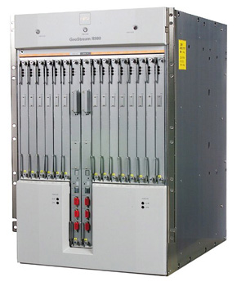
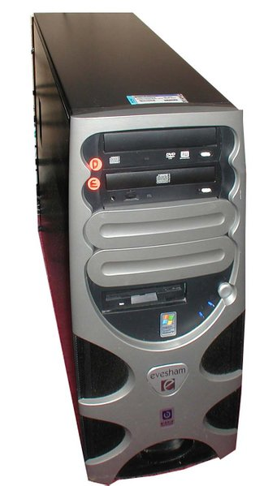
Distributed Denial of Service (DDoS)

Slide 12
Distributed Denial of Service (DDoS)

Slide 13

Distributed Denial of Service (DDoS)

Slide 14
Why DDoS is a hard problem?
Simple form of attack
Just send a lot of traffic!
Prey on the Internet’s strengths
Simplicity of processing in routers
Attack machines readily available
Easy to find 10,000’s vulnerable machines of the Internet
Attack can look like normal traffic
E.g., HTTP requests
Lack of Internet enforcement tools
No traceability
Lack of cooperation between targets
ISPs competition, cooperation only at human timescales
Effective solutions hard to deploy
We can’t change the core of the Internet easily

Slide 15
Evolution of (D)DoS (Types/Diversity)
Time
Point-to-point DoS attacks
TCP SYN floods, ping of death, etc.
Smurf (reflection) attacks
Coordinated DoS
Multi-stage DDoS
P2P botnets
Novel amplification attacks (return of the smurf)

Slide 16
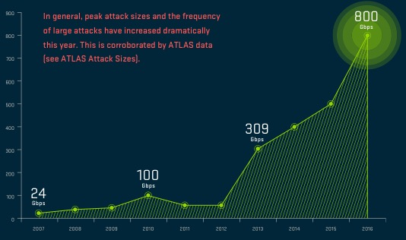
Evolution of (D)DoS (Volume)

Slide 17
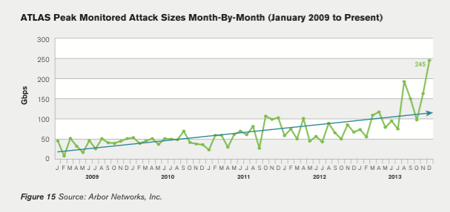
Current Trend of DDoS attacks
Volume
Becomes larger, at most 0.5 Tbps
Diversity
New type of attacks are emerging

Slide 18
Coordinated DoS
Simple extension of DoS
Coordination between multiple parties
Can be done off-band
IRC channels, email…
Attackers’
machines
Victims

Slide 19
Typical DDoS setup circa 2005
Attacker’s machine
Masters
(Handlers)
Slaves
(Agents)
Victim

Slide 20
Typical DDoS setup circa 2005
Attacker’s machine
Masters
(Handlers)
Slaves
(Agents)
Infection/recruitment
Command & control
Assault
Victim

Slide 21
Modern Botnet setup
Zombies
(P2P)
Attackers
Attackers
Attackers
Peer-to-peer communication
Command & control
Assault
Victim

Slide 22
Smurf attacks
Attacker’s machine
Attacker spoofs victim’s IP address
Attacker sends error-generating packets to reflectors
Reflectors all report errors to victim
Victim is killed by error messages
Reflectors
(Amplifiers)
Victim

Slide 23
Reflector Attacks
Spoof source address
Send query to service
Response goes to victim
If response >> query, “amplifies” attack
Hides real attack source from victim
Amplifiers:
DNS responses (50 byte query → 400 byte resp)?
ICMP to broadcast addr (1 pkt → 50 pkts) (“smurf”)

Slide 24
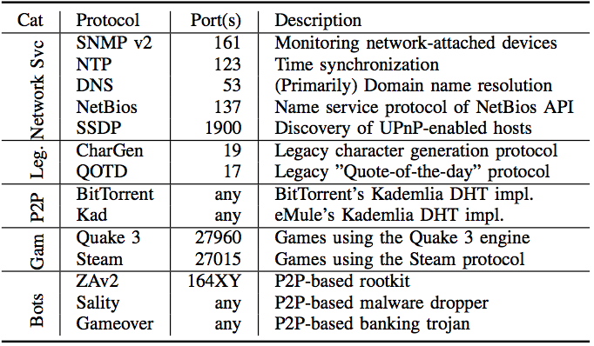
Survey of amplifiers (Rossow NDSS’14)

Slide 25
Is this used in practice?
Attacks per Week

Slide 26
Is this used in practice?

Slide 27
Amplification factors (DNS)
98 bytes
3902 bytes
39.81x amplification factor

Slide 28
Overview
Denial of service
Reflector Attacks
Backscatter Analysis
Traceback

Slide 29

Is this used in practice?
Intuition: attacker would scan for services they can use as reflectors
We can figure out if this happens by observing scans on network telescopes
see backscatter analysis
Network “telescope”, e.g., empty /8 network
Pick random IP address
Asks e.g. “Runs DNS?”

Slide 30
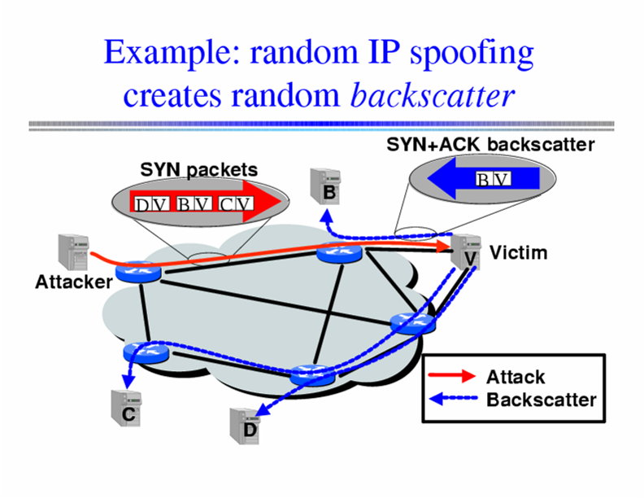
Inferring DoS Activity: Backscatter
IP address spoofing creates random backscatter.
Moore et al., 2001

Slide 31
Backscatter Analysis
Internet telescope/backscatter measurement
By monitoring unused portion of address space, possibility to see evidence of backscatter and infer type/number of DDoS attacks
(example: SYN flood)
Network “telescope”, e.g., empty /8 network
SYN, from IP = A
SYN-ACK, to IP = A

Slide 32
Backscatter Analysis
Use a big block of addresses (N of them)?
People often use a /16 or /8
Observe X backscatter packets/sec
How big is actual attack?
X * (2^32 / N)?
Assuming uniform distribution
Sometimes called “network telescope”

Slide 33
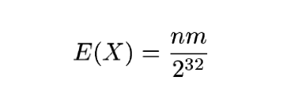
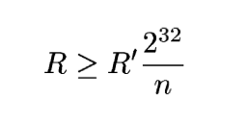
Calculating attack rate from backscatter
Attack of m packets
n monitored addresses
2³² = total IPv4

Slide 34
Overview
Denial of service
Reflector Attacks
Backscatter Analysis
Traceback

Slide 35
Possible defenses I: Filtering
Filtering at the victim’s firewall
Likely to be useless, firewall itself can be targeted
Filtering at the attacker’s firewall
Routers drop packets with an “invalid” source IP address field
Would need near universal deployment to be effective
Besides, does not prevent subnet-level spoofing
Economic incentives?

Slide 36
Ingress/Egress Filtering
Drop all packets with source address other than 204.69.207.0/24
Internet
204.69.207.0/24
RFC 2827: Routers install filters to drop packets from networks that are not downstream
Feasible at edges; harder at “core”

Slide 37
RPF Checks
Accept packet from interface only if forwarding table entry for source IP address matches ingress interface
Strict Mode
uRPF Enabled
10.0.18.3 from wrong interface
“A” Routing Table
Destination Next Hop
10.0.1.0/24 Int. 1
10.0.18.0/24 Int. 2
Unicast Reverse Path Forwarding
Cisco: “ip verify unicast reverse-path”
Requires symmetric routing
Slide Credit: Feamster

Slide 38
Possible defenses II: Pushback
Pushback: rate limit flows that compose large traffic aggregates to mitigate impact of DDoS
Distributed solution: the whole network benefits
Requires router modifications
Deployment may take very long

Slide 39
Filters & Pushback
Assumption: Can identify anomalous traffic?
Add “filters” that drop this traffic
Access control lists in routers
e.g. deny ip from dave.cmu.edu to victim.com tcp port 80
Pushback: Push filters further into network towards the source
Need to know where to push the filters (traceback)?
Need authentication of filters...
Tough problems. Filters usually deployed near victim.

Slide 40
Possible defenses III: Traceback
Traceback: Means of identifying source of attack even in presence of IP spoofing
Useful for forensics if available
Main problem: reaction time?
Secondary problem: requires router modification, which itself limits deployment
Savage et al. paper, among many others
Perrig et al., Snoeren et al.,…

Slide 41
Possible defenses IV: Network capabilities
DDoS attacks exploit fundamental problem: receiver has no control over who can send traffic to it
We need to enable receiver to stop misbehaving senders
One possibility is to have a “default disconnect” mode
You cannot talk to me unless I agree to talk to you first
Network capabilities
Capabilities need to be secured against forgery
Who issues the capabilities?
Capability server?
End-host?

Slide 42
Pitfalls and fallacies
Good host security protects against DDoS
Unfortunately, it’s the others’ lousy security that is a vehicle for DDoS
Overprovisioning protects against DDoS
You can’t be provisioned enough if 10,000+ machines attack you
Firewalls protect against DDoS
One can target the firewall, and you lose your network access anyway, or the attacker can tunnel through the firewall
Any machine connected to the Internet is potentially vulnerable.

Slide 43
The Need for Traceback
Internet Protocol permits anonymity
Attackers can “spoof” source address
IP forwarding maintains no audit trails
Need a traceback facility
For a given packet, find the path to source
Savage et al., 2000

Slide 44
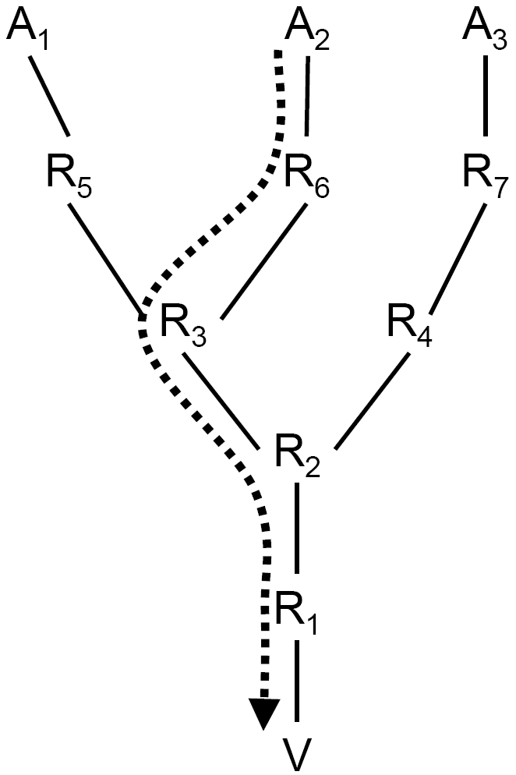
Traceback Schemes
Input Debugging
Logging
Record Route
ICMP Traceback
Probabilistic Packet Marking

Slide 45
Traceback: Input Debugging
Input Debugging
Many routers can filter egress port packets and determine ingress port.
Problems
Slow process to communicate packet signature for filter to upstream providers
Difficult to get ISP cooperation
Only works while attack is active

Slide 46
Traceback: Logging
Logging
Log packets at key routers.
Use data mining techniques to determine path.
Problems
Enormous resource requirements.
Large-scale inter-provider database integration.

Slide 47
Problem
Goal
Determine path from packets
Assumptions
an attacker may generate any packet
multiple attackers may conspire
attackers may be aware they are being traced
packets may be lost or reordered
attackers send numerous packets
the route between attacker and victim is fairly stable
routers are both CPU and memory limited
routers are not widely compromised

Slide 48
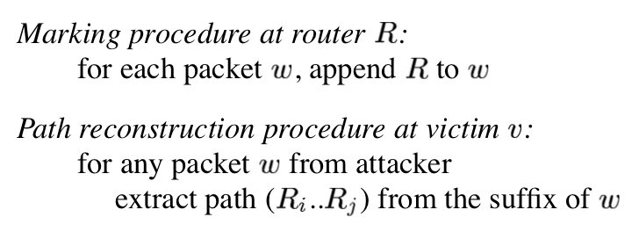
IP Traceback: Record Route
Record Path
Each router adds IP address to packet.
Victim reads path from packet.

Slide 49
IP Traceback: Record Route
Pro:
fast convergence!
Cons:
Requires space in packet.
Unknown path size.
Modifying all packets in transit is expensive

Slide 50
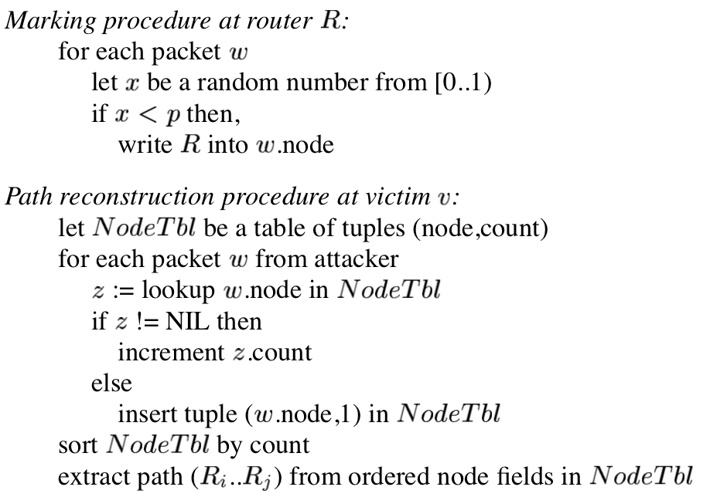
IP Traceback: Node sampling

Slide 51
IP Traceback: Node Sampling
Node Sampling
Probabilistically store router address in packet using an IP header field (IP identifier).
Fixed space regardless of path length.
Router distance inferred from frequency of marked packets.
Problems
Probability must > 0.5 to be robust against attacker.
Large probability decreases chance of seeing packets marked by far routers.
Ambiguity in case of multiple attackers at the same distance

Slide 52
IP Traceback: Edge sampling
Edge sampling
Solve node sampling problems by encoding edges & distance from victim in messages
Start router sets “start” field with probability p and sets distance to 0
If distance is 0, router sets “end” field
All routers increment distance
As before, P(receiving mark from router d hops away) = p(1 – p)^{d-1}
Multiple attackers can be identified since edge identifies splits in reverse path

Slide 53
IP Traceback: Edge sampling
Edge sampling
Easy for victim to reconstruct path to attacker.
Probably can be much less than for simple marking.
Optimal is p <= 1/d.
Effective for multiple attackers.
Number of required packets grows linearly.
Problems
Impossible to trust route further away than the closest attacker.
Require additional space in IP packet header.
2x 32 bit addresses, 8 bit distance.

Slide 54
Edge sampling: Final
Problem:
Slow convergence in practice
Path reconstruction does not scale well against distributed attacks
What if the routers are malicious?

Slide 55
Summary
DDoS is the networked version of DoS
DDoS attacks are a real threat
Easy to carry out
Toolkits readily available
Difficult to defend against
Patching and securing one’s host is not enough
Principally due to the nature (default connected) of the Internet
Prevention is difficult, due to the role other machines play
Involving multiple jurisdictions

Slide 56
Summary
Amplification attacks
Abuse existing protocols
Large amplification factors easy to achieve
E.g., BAF of 1,000 -> 1GB/s of aggregate traffic yields 1TB/s of DDoS traffic
Done in practice
Although people haven’t yet fully realized they could abuse NTP or P2P networks like Kad

Slide 57
Next lecture
NIDS and NIPS
Required reading:
Bro: A System for Detecting Network Intruders in Real-Time
Skim:
Network Intrusion Detection: Evasion, Traffic Normalization, and End-to-End Protocol Semantics
Optional:
Honeycomb – Creating Intrusion Detection Signatures Using Honeypots

Slide 58
Bandwidth DDoS Attacks - Solutions
Ingress filtering – examine packets to identify bogus source addresses
Link testing – have routers either explicitly identify which hops are involved in attack or use controlled flooding and a network map to perturb attack traffic
Logging – log packets at key routers and post-process to identify attacker’s path
ICMP traceback – sample occasional packets and copy path info into special ICMP messages
Capabilities
IP traceback + filtering

Slide 59
Secure Overlay Services
Source point
Beacon
Secret servlet
Overlay Access Point
Overlay Nodes
target
Filtered region
Authenticate client communication
Longer/slower route
Closed network
Keromytis, Misra, Rubenstein, 02

Slide 60
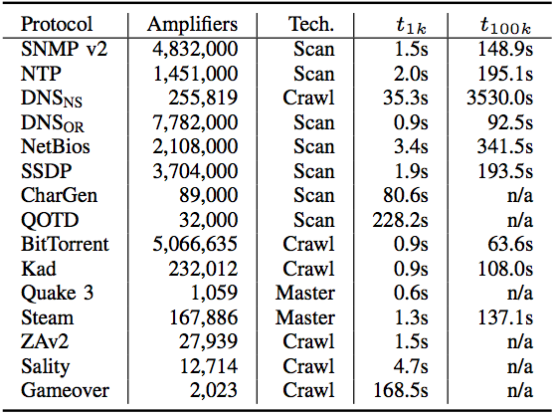
Survey of amplifiers (Rossow NDSS’14)

Slide 61
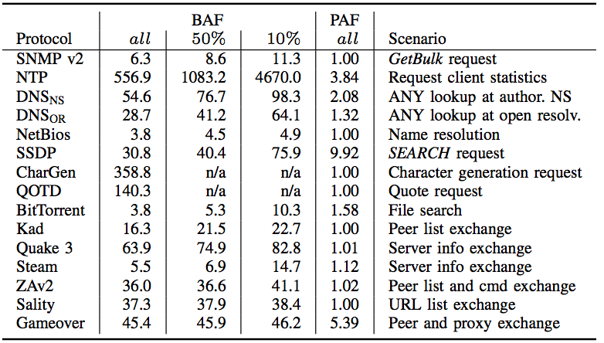
Survey of amplifiers (Rossow NDSS’14)

Slide 62
Log-Based Traceback
R
R
A
R
R
R
R₇
R
R₄
R₅
R₆
R
R₃
R₁
R₂
V

Slide 63
Challenges to Logging
Attack path reconstruction is difficult
Packet may be transformed as it moves through the network
Full packet storage is problematic
Memory requirements are prohibitive at high line speeds (OC-192 is ~10Mpkt/sec)
Extensive packet logs are a privacy risk
Traffic repositories may aid eavesdroppers
Notes:
Path construction

Slide 64
Solution: Packet Digesting
Record only invariant packet content
Mask dynamic fields (TTL, checksum, etc.)
Store information required to invert packet transformations at performing router
Compute packet digests instead
Use hash function to compute small digest
Store probabilistically in Bloom filters
Impossible to retrieve stored packets

Slide 65
Invariant Content
Ver
HLen
TOS
Total Length
Identification
D
F
M
F
Fragment Offset
TTL
Protocol
Checksum
28
bytes
Source Address
Destination Address
Options
First 8 bytes of Payload
Remainder of Payload

Slide 66
Bloom Filters
Fixed structure size
Uses 2n bit array
Initialized to zeros
Insertion is easy
Use n-bit digest as indices into bit array
Mitigate collisions by using multiple digests
Variable capacity
Easy to adjust
Page when full
n bits
1
H₁(P)
1
H(P)
H₂(P)
2^{n}
bits
H₃(P)
1
. . .
1
H_{k}(P)

Slide 67
Mistake Propagation is Limited
Bloom filters may be mistaken
Mistake frequency can be controlled
Depends on capacity of full filters
Neighboring routers won’t be fooled
Vary hash functions used in Bloom filters
Each router select hashes independently
Long chains of mistakes highly unlikely
Probability drops exponentially with length

Slide 68
Adjusting Graph Accuracy
False positives rate depends on:
Length of the attack path
Complexity of network topology
Capacity of Bloom filters
Bloom filter capacity is easy to adjust
Required filter capacity varies with router speed and number of neighbors
Appropriate capacity settings achieve linear error growth with path length

Slide 69
How long can digests last?
Filters require 0.5% of link capacity
Four OC-3s require 47MB per minute
A single drive can store a whole day
Access times are equally important
Current drives can write >3GB per minute
OC-192 needs SRAM access times
Still viable tomorrow
128 OC-192 links need <100GB per minute
Notes:
4 OC-3 Hd needs 67GB/day

Slide 70
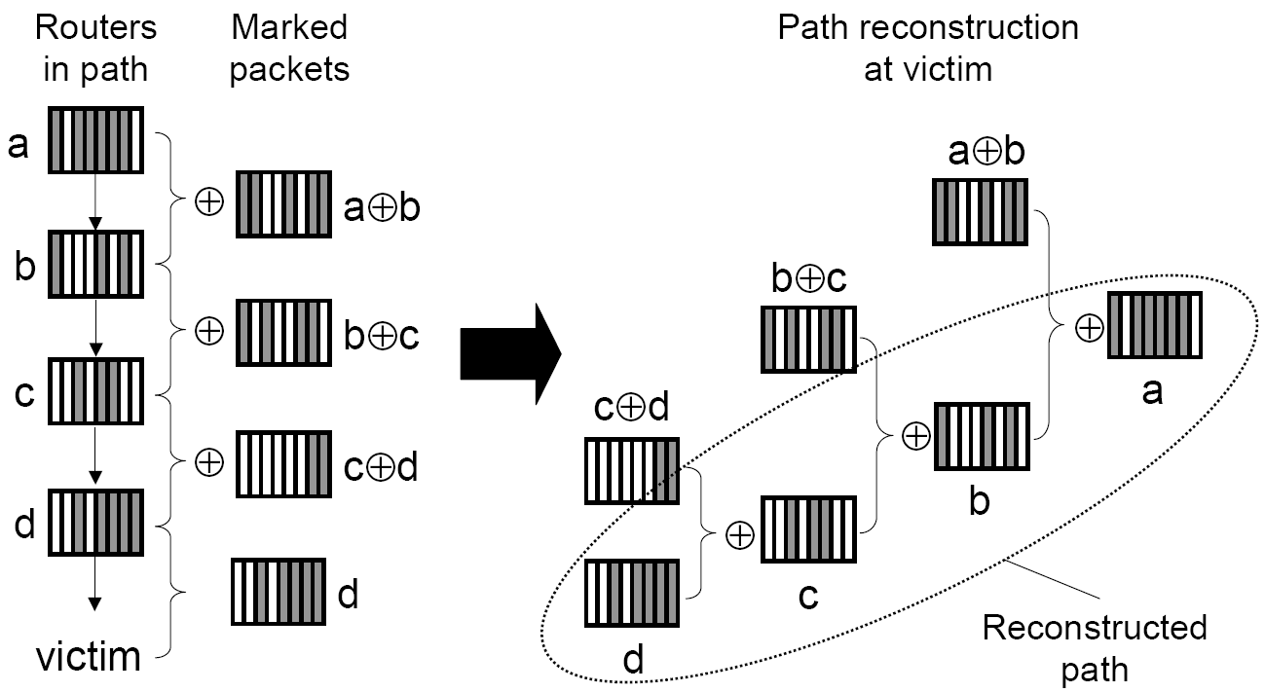
Edge sampling: Reduce Space Requirement - XOR
XOR two addresses for each edge together.

Slide 71
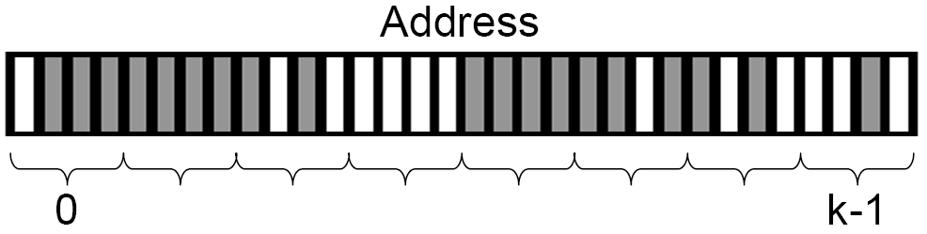
Edge sampling: Reduce Space Requirement - Subdivide
Break XORed addresses into k fragments.
Store only 1 fragment in packet with offset value.

Slide 72
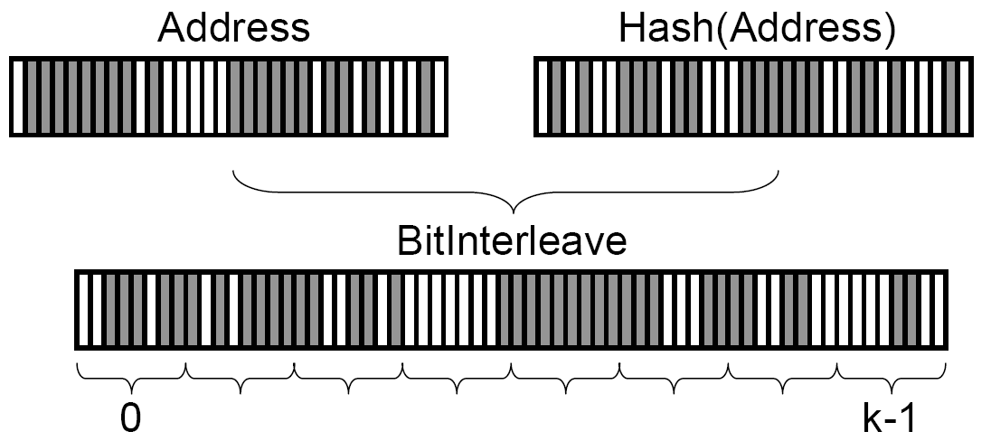
Edge sampling: Reduce Space Requirement - Hash
Multiple attackers may produce non-unique edges with same distance.
Add error detection:
Interleave IP with hash of itself.

Slide 73
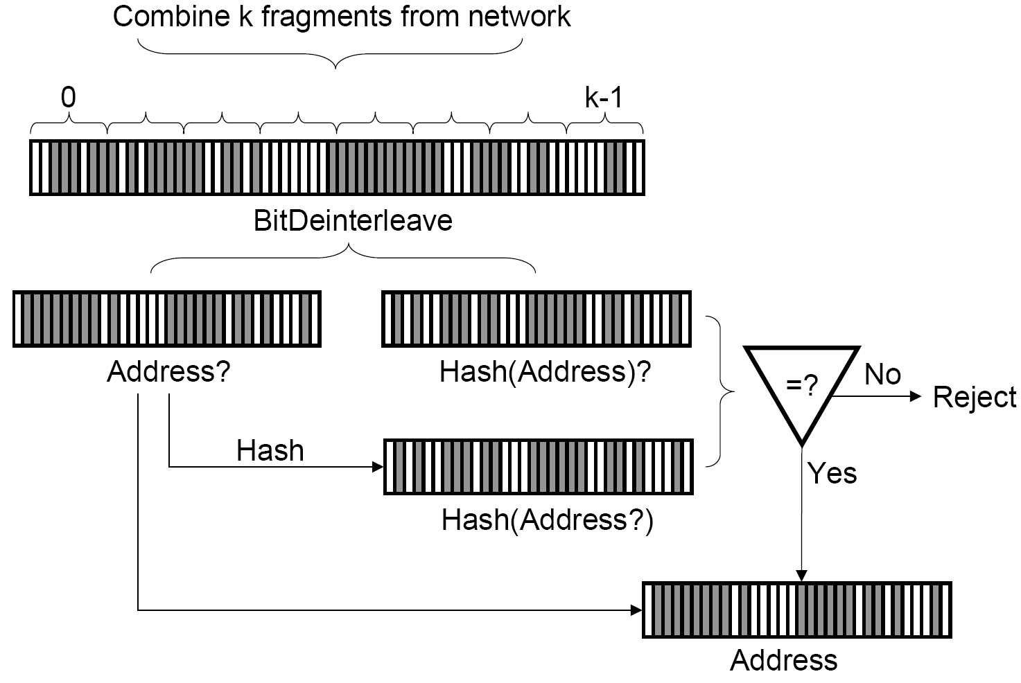
Edge sampling: Reduce Space Requirement - Hash

Slide 74
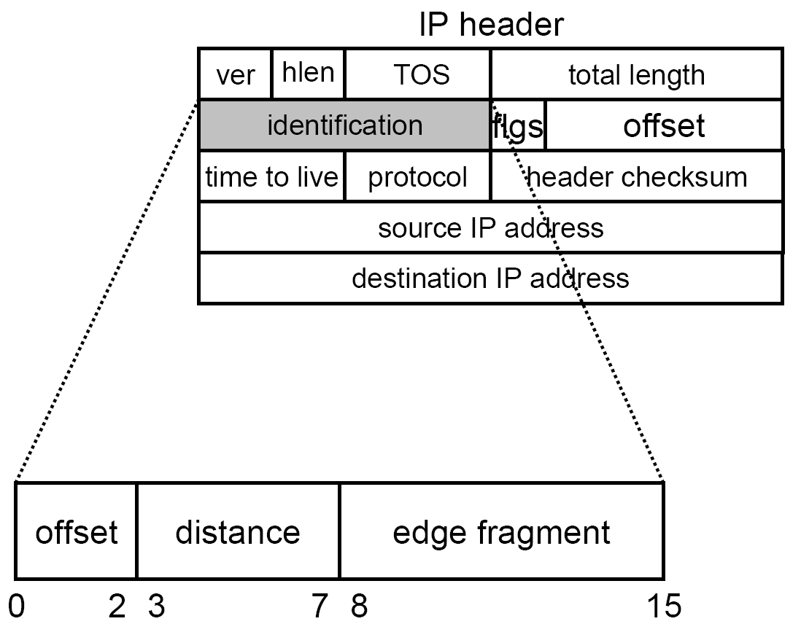
Edge sampling: Reduce Space Requirement - Storage
Final size: 16 bits

Slide 75
Host level impact
Host performance impacted
Need for good forensics
find_ddos
TCT
lsof

Slide 76
Network level impact
Determining whether you are under attack or attacking someone else
Anomaly detection
Performance
Gateways
Uplinks/ISPs
More signs
Network failure
Complaints

Slide 77
Host defenses
Protecting the host as a target
e.g., SYN cookies
Protecting the host as a source
Host hardening against compromise
What about all these unpatched systems?
Integrity checking

Slide 78
Network defenses
Network analysis tools overwhelmed or confused
Accuracy of data, dropped packets, better log raw packets
Differentiate flood and control traffic
Impact reduction
Traffic limiting, redundant pathways, deflection
More on traffic limiting next time
Source of IP packets
Need to trace spoofed packets to find agents
More on traceback soon
[Adapted from Dietrich, Long and Dittrich]

Slide 79
Impact of DDoS
Attacks on a wide variety of targets
Yahoo!, Microsoft, Port of Houston, ClickBank are all famous “victims”
Tend to be highly successful
Few good existing mechanisms to stop them
Successful attacks on major commercial sites

Slide 80
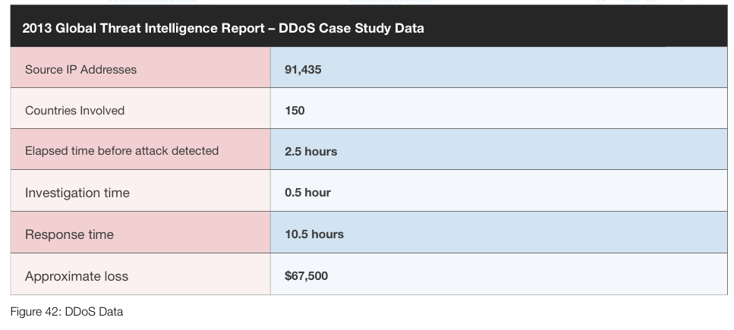
Current Trend of DDoS attacks
Major economic loss in the current industry
DDoS attack is increasing in volume and types DDoS is still a big problem for the Internet industry

Slide 81
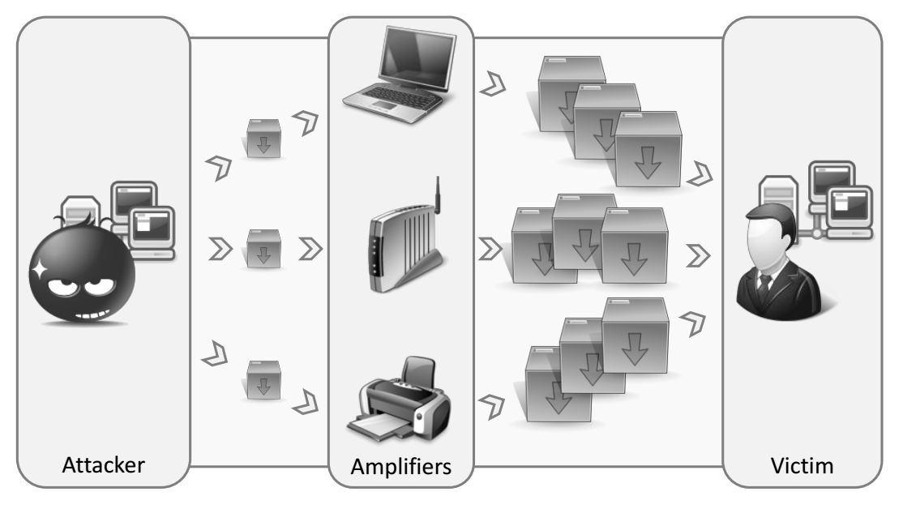
Reflector Attacks
Rossow., 2014

Slide 82
Amplification Attacks
Paper by Rossow (NDSS 2014)
Revisits 14 protocols that can be used for amplification attacks
Shows potentially horrible load factors
Investigates which amplification attacks are used “in the wild”
Rossow., 2014

Slide 83
Using amplification
3902 bytes
98 bytes

Slide 84
Is this used in practice?
Intuition: attacker would scan for services they can use as reflectors
We can figure out if this happens by…

Slide 85
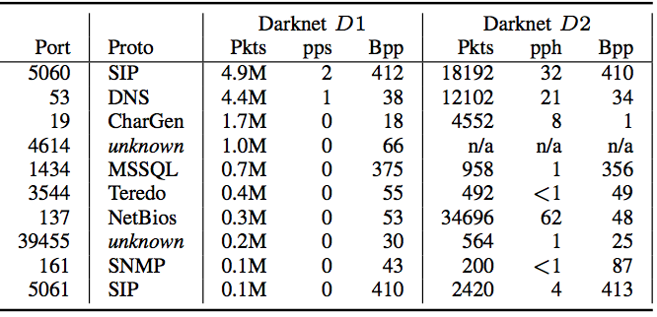
Results
All these protocols are scanned periodically!

Slide 86
Results
Analysis of netflow data showed:
55 DNS-based attacks (amplification ~34-67)
47 CharGen-based attacks (amp. 318~1395)
So, yes, it’s being done in practice…

Slide 87
Countermeasures
Preventing IP spoofing
About 24% of all ASes actually do not even check for it (or completely allow it), and another 13% have deficient checks
Protocol hardening
Secure service configuration
Packet filtering

