Slide 1
15-744: Computer Networking
L-23 Next Generation Wireless

Slide 2
Overview
802.11 Deployment patterns
White space networks
Ambient backscatter

Slide 3
Characterizing Current Deployments
Datasets
Place Lab: 28,000 APs
MAC, ESSID, GPS
Selected US cities
www.placelab.org
Wifimaps: 300,000 APs
MAC, ESSID, Channel, GPS (derived)
wifimaps.com
Pittsburgh Wardrive: 667 APs
MAC, ESSID, Channel, Supported Rates, GPS
Notes:
Caveats
Subset, old,
Relative strengths of each
Placelab: data collected as part of Intel’s placelab project, this is software that allows commodity hardware clients such as notebooks, PDAs to locate themselves by listening to radio beacons such as 802.11…
Wifimaps: provides a graphic visualization tool to map out access points in specific areas of the world. This under database is contributed by various war-drive efforts.
War-drive: small scale war drive of some dense areas of pittsburgh

Slide 4
AP Stats, Degrees: Placelab
(Placelab: 28000 APs, MAC, ESSID, GPS)
#APs
Max. degree
50 m
Portland | 8683 | 54
San Diego | 7934 | 76
San Francisco | 3037 | 85
Boston | 2551 | 39
1
2
1
Notes:
Data in placelab to understand how many APs in each city are in interference range of each other.
Figure on the right shows a distribution of the number on interfering neighboring APs in the various cities. More than 4…

Slide 5
Degree Distribution: Place Lab
Notes:
Color
Don’t say graph coloring, channel selection
Search for “placelab”
Data in placelab to understand how many APs in each city are in interference range of each other.
Figure on the right shows a distribution of the number on interfering neighboring APs in the various cities. More than 4…

Slide 6
Unmanaged Devices
WifiMaps.com (300,000 APs, MAC, ESSID, Channel)
Channel
%age
6 | 51
11 | 21
1 | 14
10 | 4
Most users don’t change default channel
Channel selection must be automated
Notes:
Change titles: as was done here…
Caveat
Mention autocell is used by new vendors, but solution is ?
Newer access points include
This is top 4 channels, number are unclassified
We computed several interesting statistics about deployment and usage. 6 – default on most APs, showing that users more often than not leave their def configs on. In the table on the right, I show the relatives levels of deployment a and g. We can determine this by looking at the supporting rates info for the APs… relatively recent standardization….

Slide 7
Overview
802.11 Deployment patterns
White space networks
Ambient backscatter

Slide 8
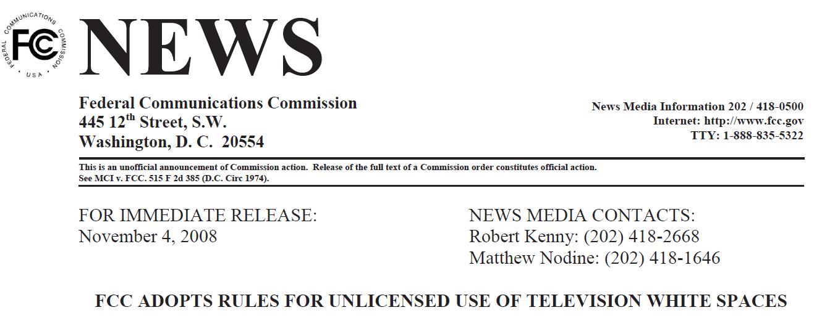
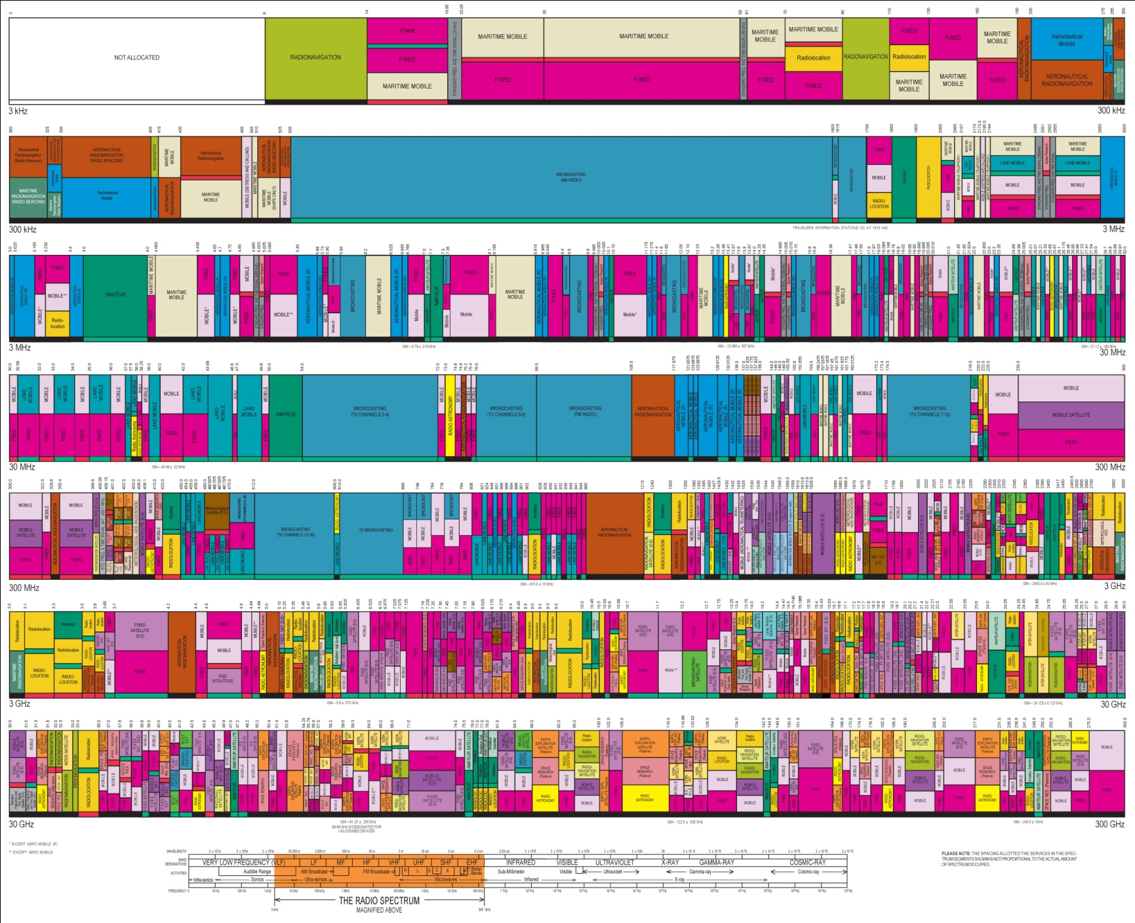



Higher Frequency
Broadcast TV
Wi-Fi (ISM)

Slide 9


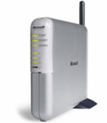
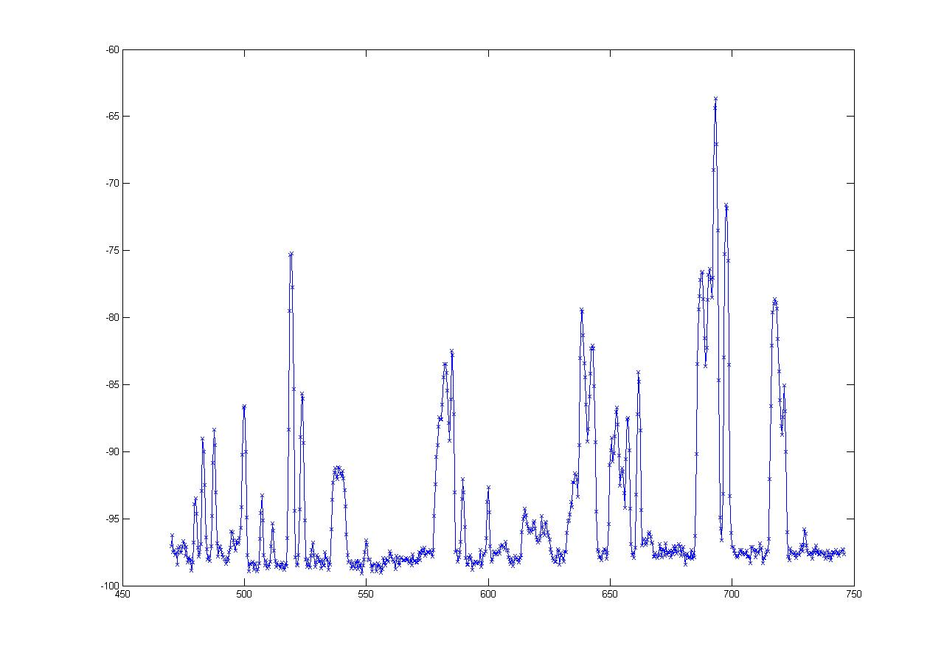
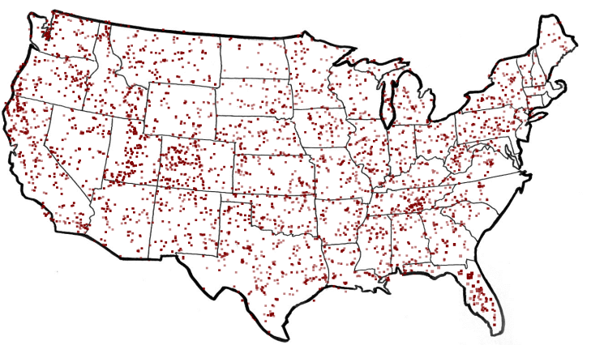
What are White Spaces?
TV
Wireless Mic
ISM (Wi-Fi)
0
MHz
54-90
170-216
470
700
2400
2500
5180
5300
7000
MHz
50 TV Channels
Each channel is 6 MHz wide
-60
“White spaces”
dbm
FCC Regulations*
Sense TV stations and Mics
Portable devices on channels 21 - 51
TV Stations in America
-100
470 MHz
Frequency
700 MHz
are Unoccupied TV Channels
White Spaces

Slide 10
The Promise of White Spaces
TV
Wireless Mic
ISM (Wi-Fi)
0
MHz
470
700
2400
2500
5180
5300
54-90
174-216
7000
MHz
More Spectrum
Up to 3x of 802.11g
Longer Range
at least 3 - 4x of Wi-Fi

Slide 11

White Spaces Spectrum Availability
Differences from ISM(Wi-Fi)
Fragmentation
Variable channel widths
1
2
3
4
5
1
2
3
4
5
Each TV Channel is 6 MHz wide
Spectrum is Fragmented
⇒ Use multiple channels for more bandwidth

Slide 12
White Spaces Spectrum Availability
Differences from ISM(Wi-Fi)
Fragmentation
Variable channel widths
Spatial Variation
Cannot assume same
channel free everywhere
1
2
3
4
5
1
2
3
4
5
TV
Tower
Location impacts spectrum availability
⇒ Spectrum exhibits spatial variation

Slide 13
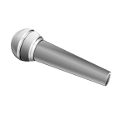

White Spaces Spectrum Availability
Differences from ISM(Wi-Fi)
Fragmentation
Variable channel widths
Spatial Variation
Cannot assume same
channel free everywhere
1
2
3
4
5
Temporal Variation
1
2
3
4
5
Same Channel will
not always be free
Any connection can be
disrupted any time
Incumbents appear/disappear over time
⇒ Must reconfigure after disconnection

Slide 14
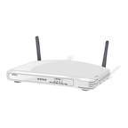
Channel Assignment in Wi-Fi
1
6
11
1
6
11
Fixed Width Channels
⇒ Optimize which channel to use

Slide 15
Spectrum Assignment in WhiteFi
Spectrum Assignment Problem
Goal
Maximize Throughput
Include
Spectrum at clients
1
2
3
4
5
1
2
3
4
5
Center Channel
Assign
&
Width
Fragmentation
⇒ Optimize for both, center channel and width
Spatial Variation
⇒ BS must use channel iff free at client

Slide 16
Accounting for Spatial Variation
1
2
3
4
5
1
2
3
4
5
1
2
3
4
5
∪
∪
=
1
2
3
4
5
1
2
3
4
5
1
2
3
4
5
1
2
3
4
5

Slide 17
Intuition
Intuition
Use widest possible channel
BS
But
Limited by most busy channel
1
2
3
4
5
Carrier Sense Across All Channels
All channels must be free
ρ_{BS}(2 and 3 are free) = ρ_{BS}(2 is free) x ρ_{BS}(3 is free)
Tradeoff between wider channel widths
and opportunity to transmit on each channel

Slide 18
Discovering a Base Station
1
2
3
4
5
1
2
3
4
5
Discovery Time = Ο(B x W)
How does the new client discover channels used by the BS?
Can we optimize this discovery time?
BS and Clients must use same channels
Fragmentation
⇒ Try different center channel and widths

Slide 19
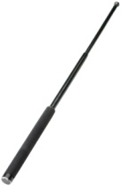
SIFT, by example
10 MHz
5 MHz
ADC
SIFT
SIFT
Data
ACK
Does not decode packets
Amplitude
SIFS
Pattern match in time domain
Time

Slide 20
Overview
802.11 Deployment patterns
White space networks
Ambient backscatter

Slide 21
Goal
Interactive devices that compute and communicate without batteries

Slide 22
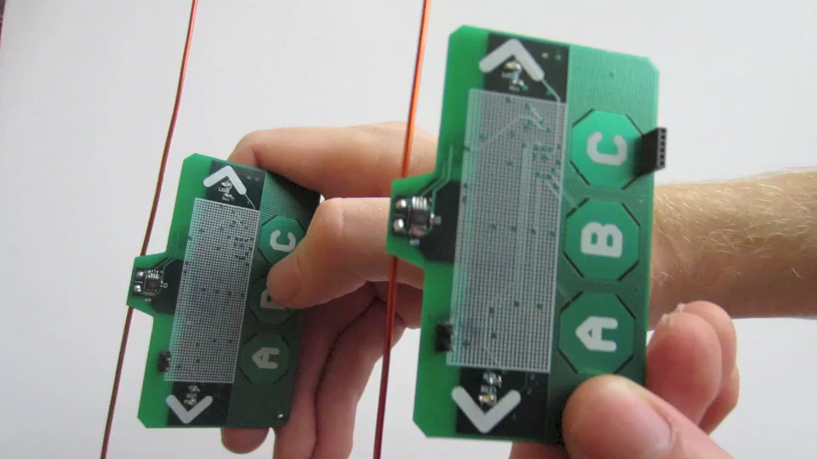
What We Are After
How to power computation, sensing,
and communication?

Slide 23
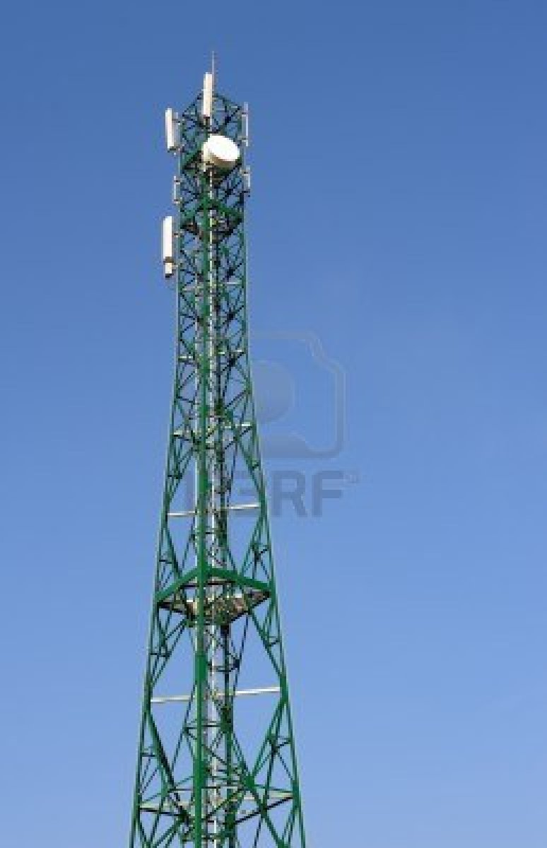
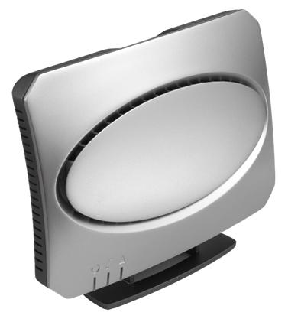
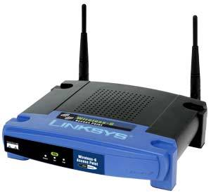
Leverage Existing Wireless Signals
TV
Cellular
Wi-Fi
Available at almost any time and place, rain or shine

Slide 24
Recent Work Harvests 10s of μW [‘09]
Enough for computation and sensing
Orders of magnitude less power than needed for radio communication [‘13]

Slide 25
Challenge: Communication Between Battery-Free Devices
Generating radio signals is expensive
Could duty cycle
Limits interactive applications
Can we communicate without
either device generating radio signals?

Slide 26


Ambient Backscatter
Use existing signals instead of generating our own
TV Tower
Works with only ~5% of the harvested power!
Reception
Unaffected
Additional
Multipath
Bob
Alice
‘0’ bit – Absorb TV Signals
‘1’ bit – Reflect TV signals

Slide 27
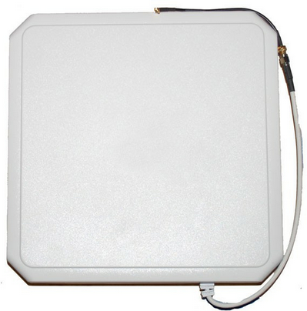
RFID
Ambient Backscatter
Reader
Tag
Reader sends constant wave
Receive chain: 100s of mW
Reader centrally coordinates

Slide 28
RFID
Ambient Backscatter
Reader
Tag
Tag
Tag
Reader sends constant wave
Receive chain: 100s of mW
Reader centrally coordinates
Uses uncontrollable signals
Receive chain: 0.5 μW
Need distributed MAC

Slide 29
Challenges
Extracting backscattered signals from ambient signals we don’t control
Decoding on a battery-free device
Designing distributed MAC for battery-free devices

Slide 30
How Do We Extract The Backscattered Signals?
TV Tower
Case 1: Alice absorbs
At Bob: TV signal
Case 2: Alice reflects
At Bob: TV signal
+ Weak Reflection
Alice
Bob
Alice’s reflections change the average amplitude

Slide 31
Solution: Detect Changes in Average Amplitude
Alice Sends 1010…
Alice Inactive
Moving Window Average

Slide 32
If we had digital samples, averaging would be easy
Need power-hungry analog-to-digital converters

Slide 33
Use RC Circuits to Average
R
C
Capacitor slowly charges/discharges when voltage is applied/removed
Provides a cheap, analog,
exponential moving average

Slide 34
Use RC Circuits to Average
R
C
Capacitor slowly charges/discharges when voltage is applied/removed
Provides a cheap, analog,
exponential moving average
By picking the right RC values,
we can selectively filter out the high TV frequencies

Slide 35
Now that we can decode bits…
Link Layer
Distributed MAC?
Physical Layer

Slide 36
We Use CSMA
CSMA uses carrier sense, i.e. energy detection
Battery-free devices do not have energy levels
Requires power-hungry ADCs
Challenge: Energy detection
without access to the energy levels

Slide 37
Solution: Leverage Hardware Properties for Energy Detection
RC circuit filters out the TV signals → Removes high-amplitude variations
Hardware elements have a threshold → Low-amplitudes don’t change output
In the absence of backscattering,
we see a constant output
Constant Output

Slide 38
Solution: Leverage Hardware Properties for Energy Detection
No backscatter → See all 0s or all 1s
Backscatter → See many transitions
Use bit transitions as proxy for
energy detection

Slide 39
Prototype Using Off-the-Shelf Components
Battery-free
Harvests and backscatters TV signals at 539 MHz
Microcontroller performs computation
LEDs
Touch Sensors

Slide 40
Tested Locations
Seattle area with a 1MW TV tower at 539 MHz
Indoor and outdoor environments
Distances up to 10.5 km from the TV tower
TV power ranged between -24dBm and -8dBm

Slide 41
What Bit Rates Can We Achieve?
Distance
Three bit rates: 10kbps, 1kbps, 100bps
BER versus distance between two devices

Slide 42
What Bit Rates Can We Achieve?
10 kbps
1 kbps
100 bps
These results show the feasibility
of Ambient Backscatter

Slide 43

Identifying Misplaced Items
In Grocery stores or Warehouses (e.g., Amazon)
With ambient backscatter, devices can figure out they are misplaced on their own

Slide 44
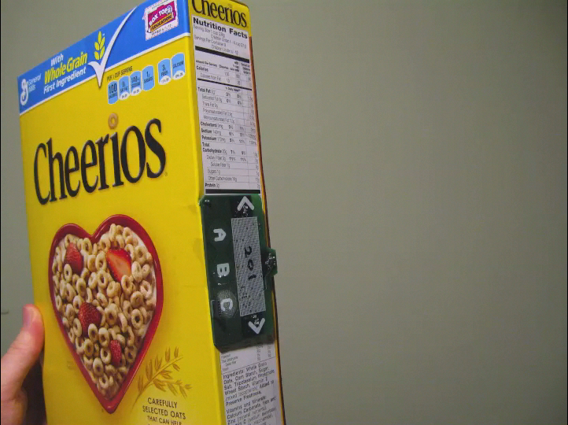
Identifying Misplaced Items
Works even if not all tags are in range of a reader

Slide 45
Overview
Carrier Sense vs. Rate Adaptation
Wireless TCP
802.11 Deployment patterns
Mesh networks
White space networks

Slide 46
Roofnet
Share a few wired Internet connections
Goals
Operate without extensive planning or central management
Provide wide coverage and acceptable performance
Design decisions
Unconstrained node placement
Omni-directional antennas
Multi-hop routing
Optimization of routing for throughput in a slowly changing network

Slide 47
Roofnet Design
Deployment
Over an area of about four square kilometers in Cambridge, Messachusetts
Most nodes are located in buildings
3~4 story apartment buildings
8 nodes are in taller buildings
Each Rooftnet node is hosted by a volunteer user
Hardware
PC, omni-directional antenna, hard drive …
802.11b card
RTS/CTS disabled
Share the same 802.11b channel
Non-standard “pseudo-IBSS” mode
Similar to standard 802.11b IBSS (ad hoc)
Omit beacon and BSSID (network ID)

Slide 48
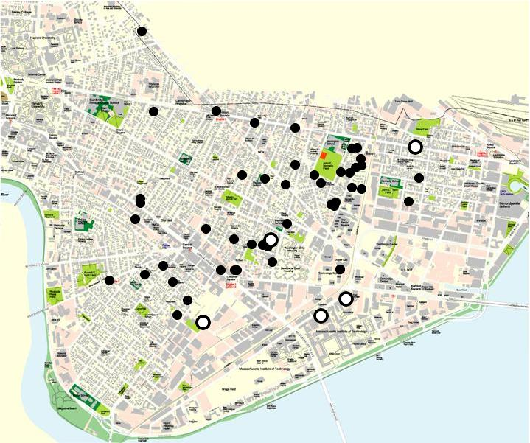
Roofnet Node Map
1 kilometer

Slide 49
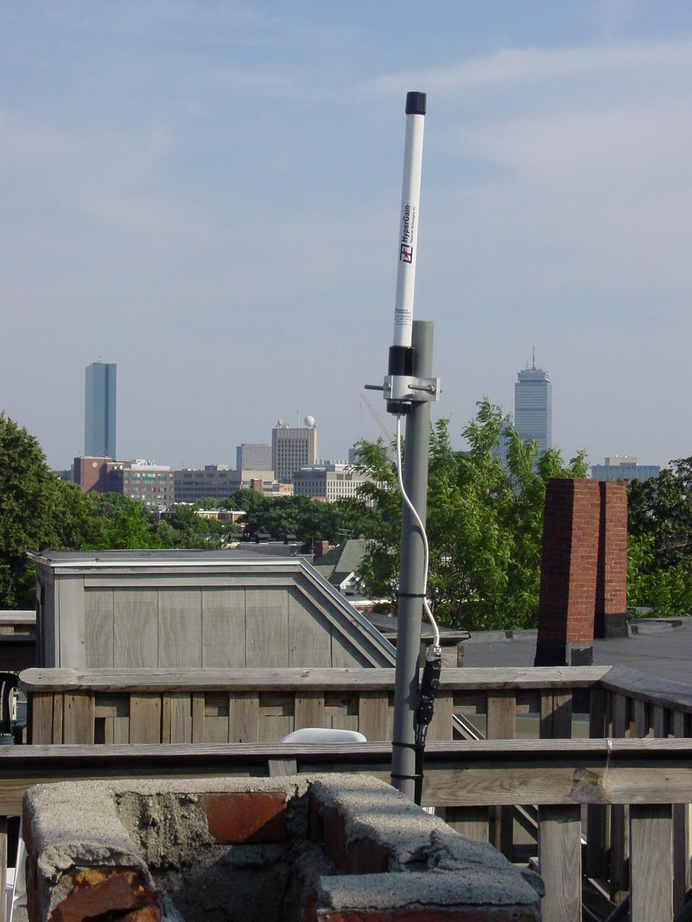
Typical Rooftop View

Slide 50
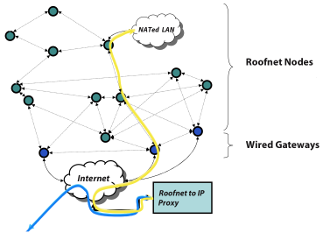
Roofnet

Slide 51
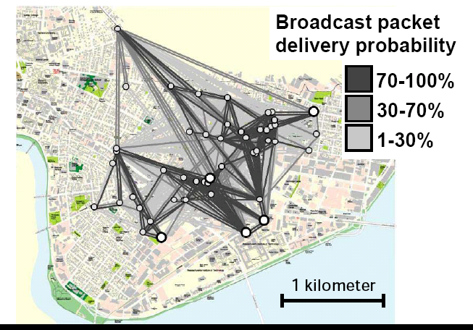
Lossy Links are Common

Slide 52
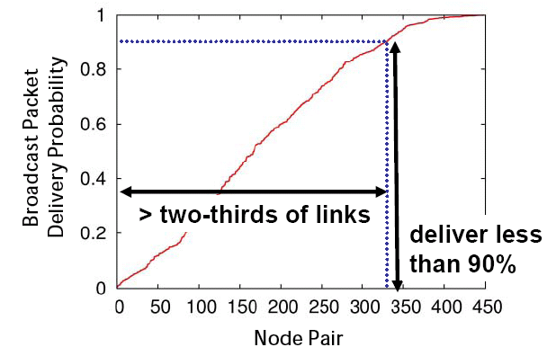
Delivery Probabilities are Uniformly Distributed

Slide 53
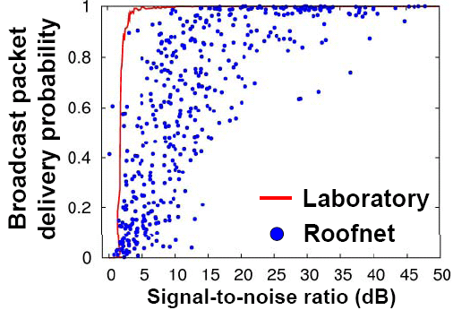
Delivery vs. SNR
SNR not a good predictor

Slide 54
Key Implications
Lack of a link abstraction!
Links aren’t on or off… sometimes in-between
Protocols must take advantage of these intermediate quality links to perform well
How unique is this to Roofnet?
Cards designed for indoor environments used outdoors

Slide 55
Evaluation
Method
Multi-hop TCP
15 second one-way bulk TCP transfer between each pair of Roofnet nodes
Single-hop TCP
The direct radio link between each pair of routes
Loss matrix
The loss rate between each pair of nodes using 1500-byte broadcasts
Multi-hop density
TCP throughput between a fixed set of four nodes
Varying the number of Roofnet nodes that are participating in routing

Slide 56
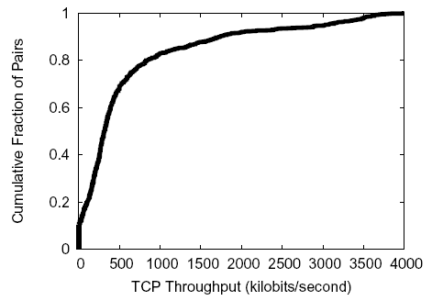
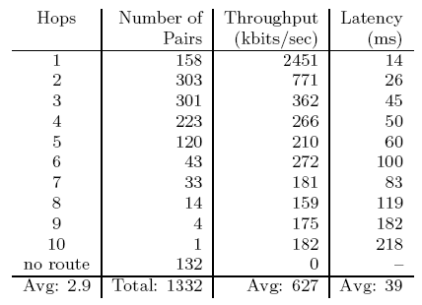
Evaluation
Basic Performance (Multi-hop TCP)
The routes with low hop-count have much higher throughput
Multi-hop routes suffer from inter-hop collisions

Slide 57
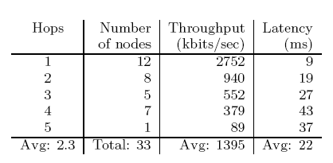
Evaluation
Basic Performance (Multi-hop TCP)
TCP throughput to each node from its chosen gateway
Round-trip latencies for 84-byte ping packets to estimate interactive delay

Slide 58
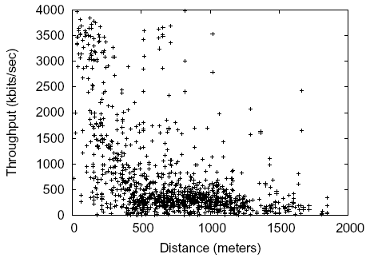
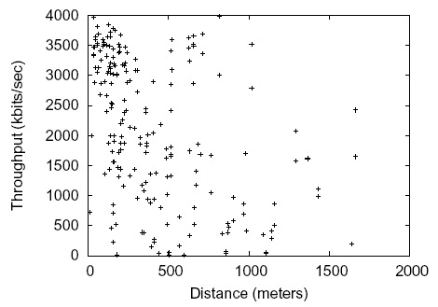
Evaluation
Link Quality and Distance (Single-hop TCP, Multi-hop TCP)
Most available links are between 500m and 1300m and give 500 kbits/s
Srcr
Use almost all of the links faster than 2 Mbits/s and ignore majority of the links which are slower than that
Fast short hops are the best policy

Slide 59
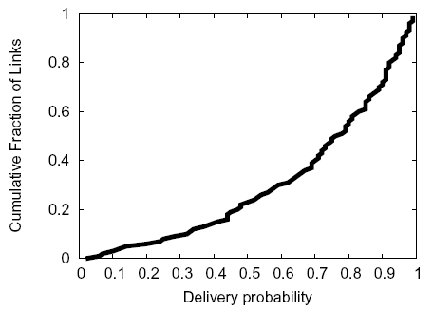
Evaluation
Link Quality and Distance (Multi-hop TCP, Loss matrix)
Median delivery probability is 0.8
1/4 links have loss rates of 50% or more
802.11 detects the losses with its ACK mechanism and resends the packets

Slide 60
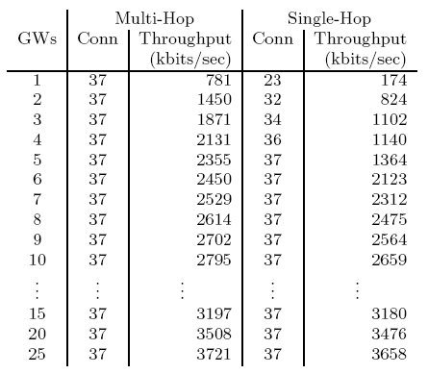
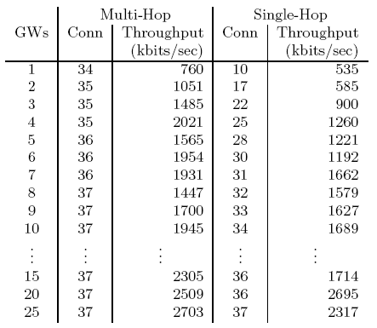
Evaluation
Architectural Alternatives
Maximize the number of additional nodes with non-zero throughput to some gateway
Ties are broken by average throughput

Slide 61
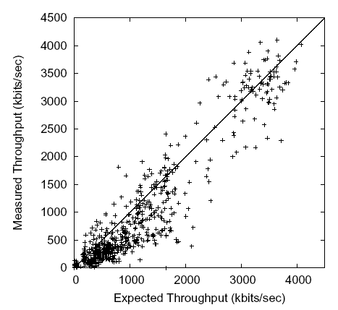
Evaluation
Inter-hop Interference (Multi-hop TCP, Single-hop TCP)
Concurrent transmissions on different hops of a route collide and cause packet loss

Slide 62
Roofnet Summary
The network’s architectures favors
Ease of deployment
Omni-directional antennas
Self-configuring software
Link-quality-aware multi-hop routing
Evaluation of network performance
Average throughput between nodes is 627kbits/s
Well served by just a few gateways whose position is determined by convenience
Multi-hop mesh increases both connectivity and throughput

Slide 63
Roofnet Link Level Measurements
Analyze cause of packet loss
Neighbor Abstraction
Ability to hear control packets or No Interference
Strong correlation between BER and S/N
RoofNet pairs communicate
At intermediate loss rates
Temporal Variation
Spatial Variation

Slide 64
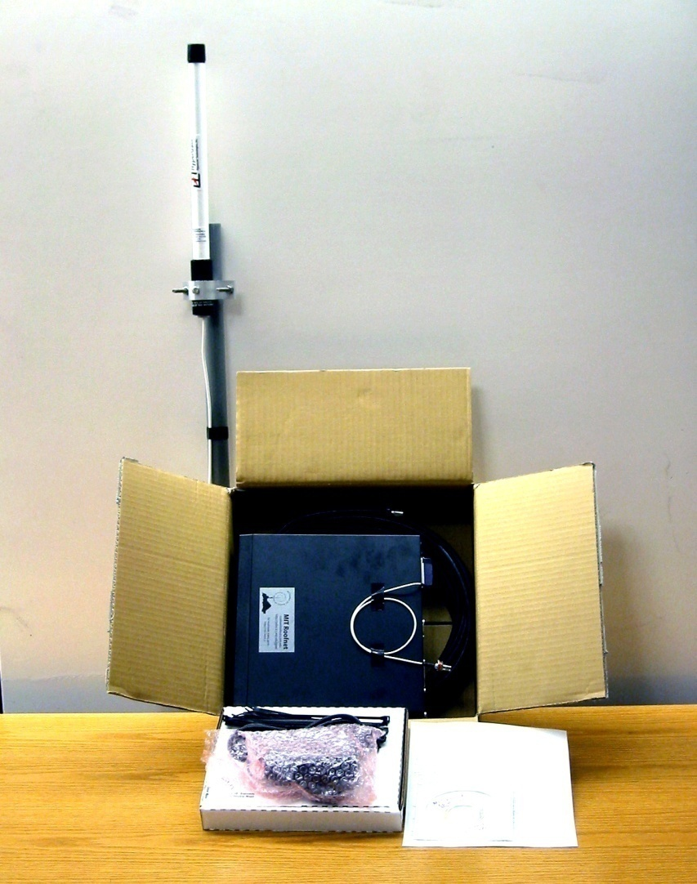
A Roofnet Self-Installation Kit
Antenna ($65)
8dBi, 20 degree vertical
50 ft. Cable ($40)
Low loss (3dB/100ft)
Computer ($340)
533 MHz PC, hard disk, CDROM
Miscellaneous ($75)
Chimney Mount,
Lightning Arrestor, etc.
802.11b card ($155)
Engenius Prism 2.5, 200mW
Software (“free”)
Our networking software based on Click
Total: $685
Takes a user about 45 minutes to install on a flat roof

Slide 65
Software and Auto-Configuration
Linux, routing software, DHCP server, web server …
Automatically solve a number of problems
Allocating addresses
Finding a gateway between Roofnet and the Internet
Choosing a good multi-hop route to that gateway
Addressing
Roofnet carries IP packets inside its own header format and routing protocol
Assign addresses automatically
Only meaningful inside Roofnet, not globally routable
The address of Roofnet nodes
Low 24 bits are the low 24 bits of the node’s Ethernet address
High 8 bits are an unused class-A IP address block
The address of hosts
Allocate 192.168.1.x via DHCP and use NAT between the Ethernet and Roofnet

Slide 66
Software and Auto-Configuration
Gateway and Internet Access
A small fraction of Roofnet users will share their wired Internet access links
Nodes which can reach the Internet
Advertise itself to Roofnet as an Internet gateway
Acts as a NAT for connection from Roofnet to the Internet
Other nodes
Select the gateway which has the best route metric
Roofnet currently has four Internet gateways

Slide 67
Roofnet Design - Routing Protocol
Srcr
Find the highest throughput route between any pair of Roofnet nodes
Source-routes data packets like DSR
Maintains a partial database of link metrics
Learning fresh link metrics
Forward a packet
Flood to find a route
Overhear queries and responses
Finding a route to a gateway
Each Roofnet gateway periodically floods a dummy query
When a node receives a new query, it adds the link metric information
The node computes the best route
The node re-broadcasts the query
Send a notification to a failed packet’s source if the link condition is changed

Slide 68

Roofnet Design
Routing Metric
ETT (Estimated Transmission Time) metric
Srcr chooses routes with ETT
Predict the total amount of time it would take to send a data packet
Take into account link’s highest-throughput transmit bit-rate and delivery probability
Each Roofnet node sends periodic 1500-byte broadcasts
Bit-rate Selection
802.11b transmit bit-rates
1, 2, 5.5, 11 Mbits/s
SampleRate
Judge which bit-rate will provide the highest throughput
Base decisions on actual data transmission
Periodically sends a packet at some other bit-rate

Slide 69
ETX measurement results
Delivery is probabilistic
A 1/r^2 model wouldn’t really predict this!
Sharp cutoff (by spec) of “good” vs “no” reception. Intermediate loss range band is just a few dB wide!
Why?
Biggest factor: Multi-path interference
802.11 receivers can suppress reflections < 250ns
Outdoor reflections delay often > 1 \mu sec
Delay offsets == symbol time look like valid symbols (large interferece)
Offsets != symbol time look like random noise
Small changes in delay == big changes in loss rate

Slide 70
Deciding Between Links
Most early protocols: Hop Count
Link-layer retransmission can mask some loss
But: a 50% loss rate means your link is only 50% as fast!
Threshold?
Can sacrifice connectivity. ☹
Isn’t a 90% path better than an 80% path?
Real life goal: Find highest throughput paths

Slide 71
Is there a better metric?
Cut-off threshold
Disconnected network
Product of link delivery ratio along path
Does not account for inter-hop interference
Bottleneck link (highest-loss-ratio link)
Same as above
End-to-end delay
Depends on interface queue lengths

Slide 72
ETX Metric Design Goals
Find high throughput paths
Account for lossy links
Account for asymmetric links
Account for inter-link interference
Independent of network load (don’t incorporate congestion)

Slide 73
Forwarding Packets is Expensive
Throughput of 802.11b =~ 11Mbits/s
In reality, you can get about 5.
What is throughput of a chain?
A → B → C ?
A → B → C → D ?
Assume minimum power for radios.
Routing metric should take this into account! Affects throughput

Slide 74
ETX
Measure each link’s delivery probability with broadcast probes (& measure reverse)
P(delivery) = ( d_{f} * d_{r} ) (ACK must be delivered too…)
Link ETX = 1 / P(delivery)
Route ETX = Σ link ETX
Assumes all hops interfere - not true, but seems to work okay so far

Slide 75
ETX: Sanity Checks
ETX of perfect 1-hop path: 1
ETX of 50% delivery 1-hop path: 2
ETX of perfect 3-hop path: 3
(So, e.g., a 50% loss path is better than a perfect 3-hop path! A threshold would probably fail here…)

Slide 76
Rate Adaptation
What if links @ different rates?
ETT – expected transmission time
ETX / Link rate = 1 / ( P(delivery) * Rate)
What is best rate for link?
The one that maximizes ETT for the link!
SampleRate is a technique to adaptively figure this out.

Slide 77
Discussion
Value of implementation & measurement
Simulators did not “do” multipath
Routing protocols dealt with the simulation environment just fine
Real world behaved differently and really broke a lot of the proposed protocols that worked so well in simulation!
Rehash: Wireless differs from wired…
Metrics: Optimize what matters; hop count often a very bad proxy in wireless
What we didn’t look at: routing protocol overhead
One cool area: Geographic routing

Slide 78
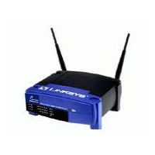
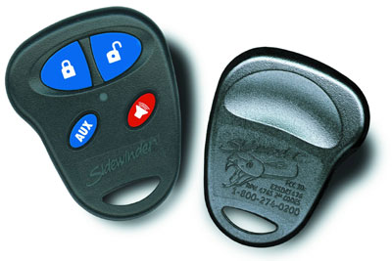

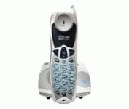
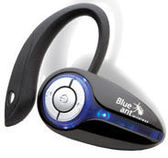
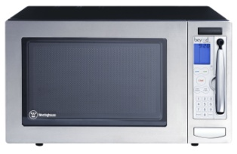
Growing Interference in Unlicensed Bands
Anecdotal evidence of problems, but how severe?
Characterize how 802.11 operates under interference in practice
Other 802.11
Notes:
The main problem we’re concerned with today is the impact of growing RF interference in unlicensed spectrum such as the 2.4GHz band used by 802.11. There has recently been a spate of anecdotal reports about the increasing severity of RF interference problems on the operation of wireless networks such as 802.11, but we don’t yet clearly know what the magnitude or the trend of the problem is. So, we would like to characterize how 802.11 performs under interference in reality.
Today, an 802.11 network has to contend with other 802.11 networks, as well as with other wireless devices that share the same spectrum, such as cordless phones, microwave ovens, car alarm systems, bluetooth, and a growing variety of other unlicensed band devices.

Slide 79
What do we expect?
Throughput to decrease linearly with interference
There to be lots of options for 802.11 devices to tolerate interference
Bit-rate adaptation
Power control
FEC
Packet size variation
Spread-spectrum processing
Transmission and reception diversity
Theory
Throughput (linear)
Interferer power
(log-scale)
Notes:
The standard SINR or (Signal to Interference and Noise Ratio) model predicts that throughput should decrease linearly with interferer power. The interferer power is on a log-scale. If this standard model holds in practice, then 802.11 devices have a variety of options at their disposal to tolerate interference gracefully. For example, they can change the bit rate at which they transmit, they can change the transmission power, they can use forward error correction, they can use smaller packets, and exploit various diversity techniques for transmission and reception, such as using multi-antenna systems.

Slide 80
Key Questions
How damaging can a low-power and/or narrow-band interferer be?
How can today’s hardware tolerate interference well?
What 802.11 options work well, and why?
Notes:
The key questions before us are whether 802.11 copes well with different types of low-power and/or narrow-band interferers, and which of the 802.11 options work well in practice, and why.

Slide 81
What we see
Effects of interference more severe in practice
Caused by hardware limitations of commodity cards, which theory doesn’t model
Theory
Throughput (linear)
Practice
Interferer power
(log-scale)
Notes:
The most interesting result we see is that the effects of interference are more severe in practice than theory would predict. There is a large gap between theory and practice at both low-end and high-end of the interference range. In fact, we find that the link throughput can drop to zero at medium to high end of the interference range. Such a rapid and severe degradation in performance is caused by several hardware limitations of commodity cards, which are not adequately modeled by theory.

Slide 82
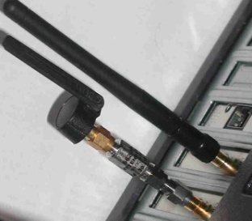
Experimental Setup
Access Point
UDP flow
802.11 Interferer
802.11 Client
Notes:
Our setup is a controlled testbed within an office building consisting of 802.11 transmitter and receiver that use different commodity cards. They exchange UDP flows. Interferers are various types of wireless devices such as an 802.11 interferer that can output arbitrary modulated 802.11 bit patterns, ZigBee sensor nodes, cordless phones, and camera jammers. They represent both worst-case natural and adversarial interferers arising in practice. The interferer varies in power as its physical distance to the 802.11 link changes. In order to simulate the effects of such an interferer in a controlled manner, we use hardware attenuators to vary the output power. The picture here shows such an attenuated 802.11 interferer.

Slide 83
802.11 Receiver Path
PHY
MAC
To RF Amplifiers
AGC
Analog
signal
ADC
Timing Recovery
Barker
Correlator
Data
(includes beacons)
Demodulator
Descrambler
6-bit
samples
Preamble Detector/ Header CRC-16 Checker
Receiver
SYNC
SFD
CRC
Payload
PHY header
Extend SINR model to capture these vulnerabilities
Interested in worst-case natural or adversarial interference
Have developed range of “attacks” that trigger these vulnerabilities
Notes:
For example, when three consecutive beacons from the AP are lost by the MAC layer, the link is commonly assumed to be dead.

Slide 84
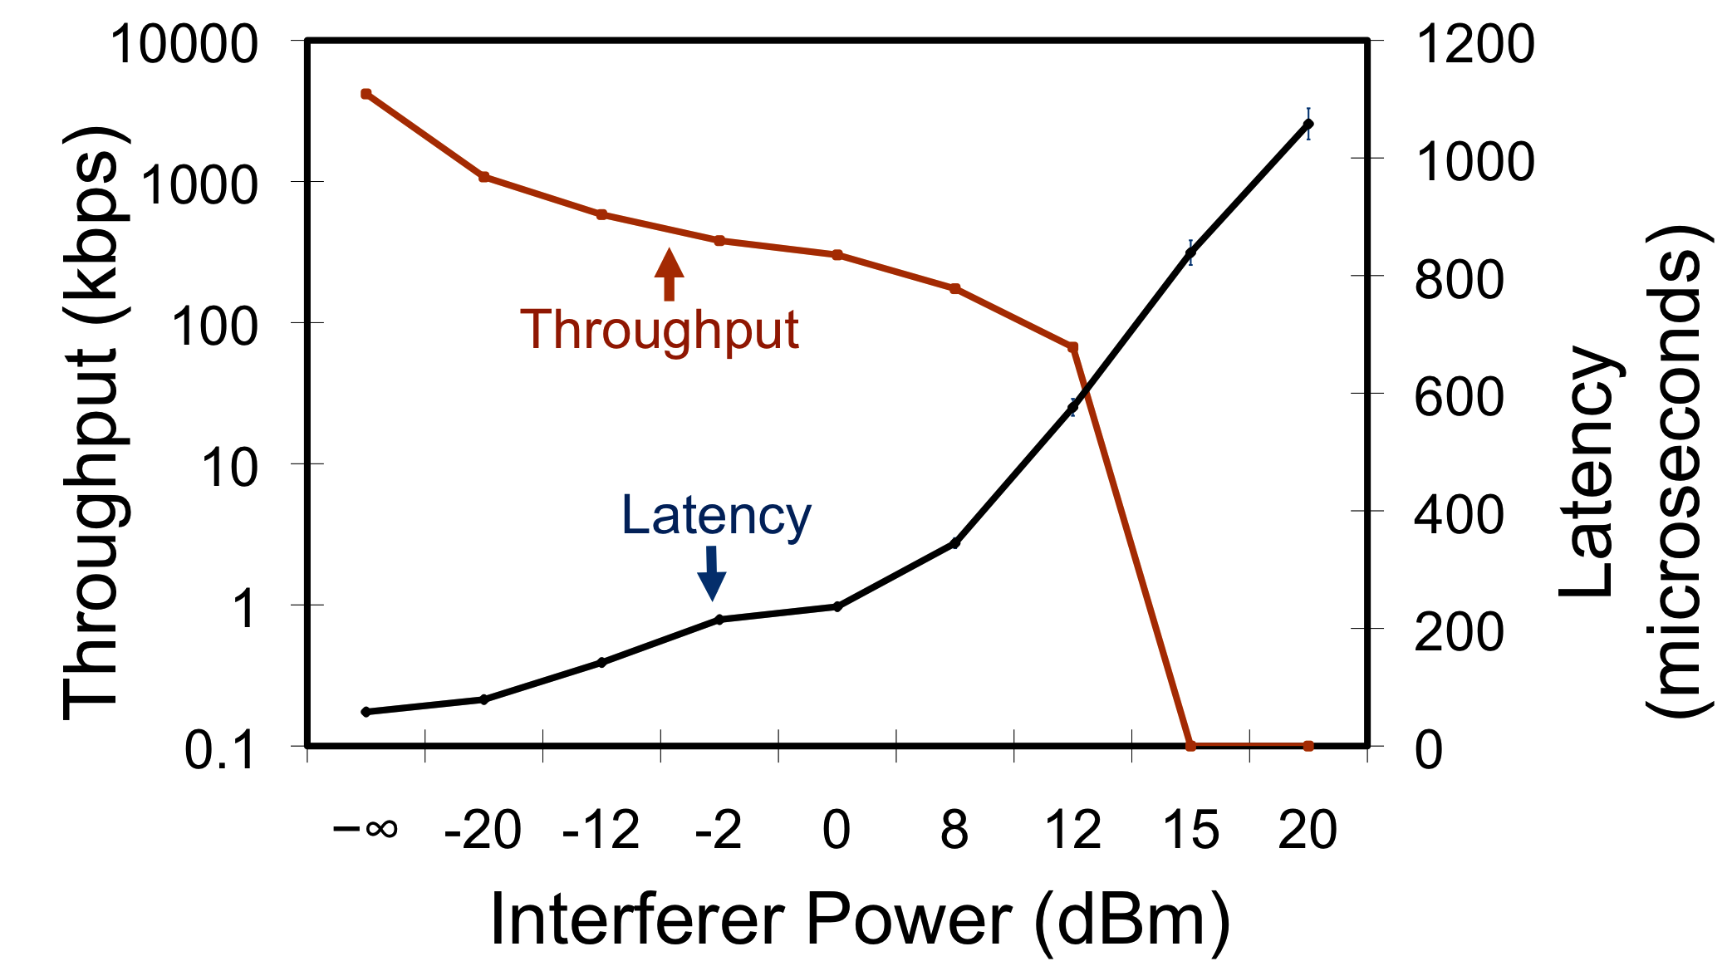
Timing Recovery Interference
Interferer sends continuous SYNC pattern
Interferes with packet acquisition (PHY reception errors)
Weak interferer
Moderate
interferer
Log-scale
Notes:
We found an interferer that sends a continuous sync pattern

Slide 85
Interference Management
Interference will get worse
Density/device diversity is increasing
Unlicensed spectrum is not keeping up
Spectrum management
“Channel hopping” 802.11 effective at mitigating some performance problems [Sigcomm07]
Coordinated spectrum use – based on RF sensor network
Transmission power control
Enable spatial reuse of spectrum by controlling transmit power
Must also adapt carrier sense behavior to take advantage

Slide 86
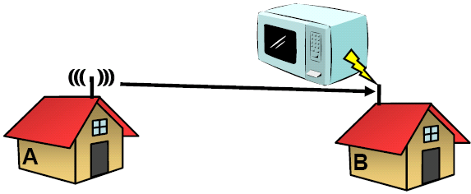
Is it Bursty Interference?
May interfere but not impact SNR measurement

Slide 87
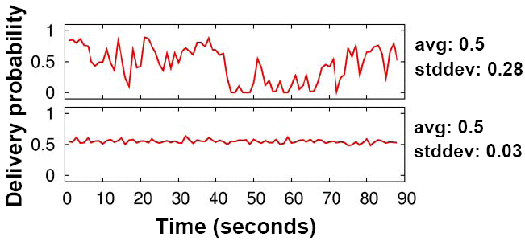
Two Different Roofnet Links
Top is typical of bursty interference, bottom is not
Most links are like the bottom

Slide 88
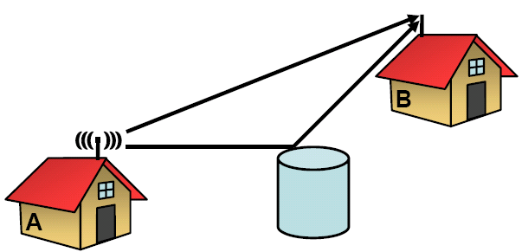
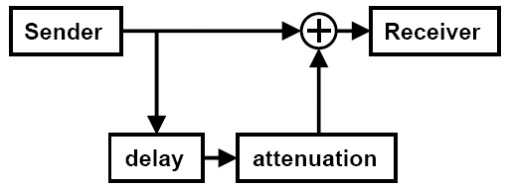
Is it Multipath Interference?
Simulate with channel emulator

Slide 89
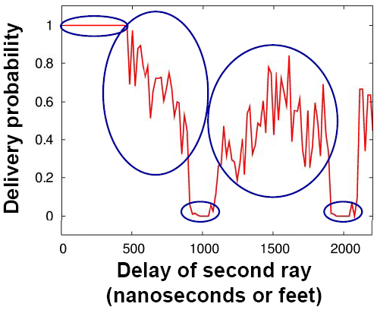
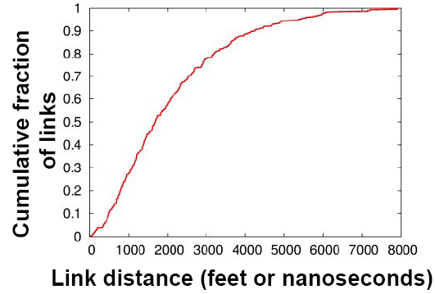
A Plausible Explanation
Multi-path can produce intermediate loss rates
Appropriate multi-path delay is possible due to long-links

