Slide 1
Achieving Single Channel, Full Duplex Wireless Communication
Jung Il Choi, Mayank Jain, Kannan Srinivasan, Philip Levis, Sachin Katti
Stanford University
Mobicom 10’

Slide 2
Wireless Channel – Half Duplex?
“It is generally not possible for radios to receive and transmit on the same frequency band because of the interference that results.”
- Andrea Goldsmith, “Wireless Communications,” Cambridge Press, 2005.
Reason: The signal from a local transmitting antenna is hundreds of thousands of times stronger than transmissions from other nodes.

Slide 3
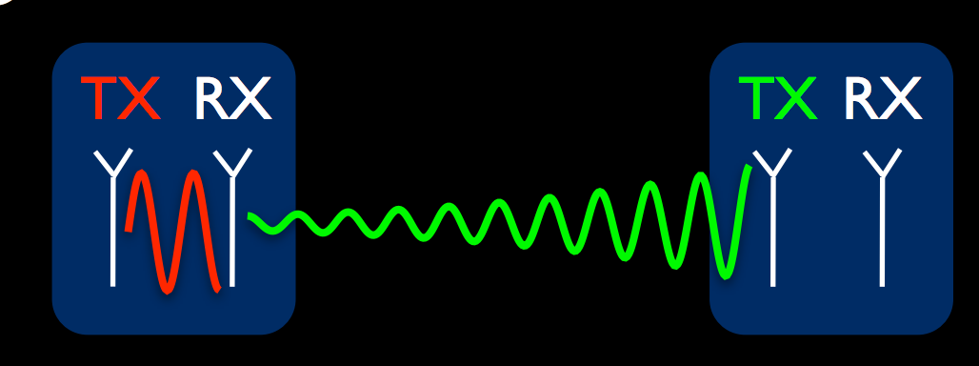
Challenge for Full Duplex
Decoding method
Subtract transmit signal from receive antenna signal
Problem: Very strong self-interference ~70dB

Slide 4
Existing Techniques
Digital cancellation
Subtracting known interference digital samples from received digital samples
Reduction in interference: ~15dB
Hardware cancellation
RF noise cancellation circuits with transmit signal as noise reference
Reduction in interference: ~25dB
Not Enough!

Slide 5
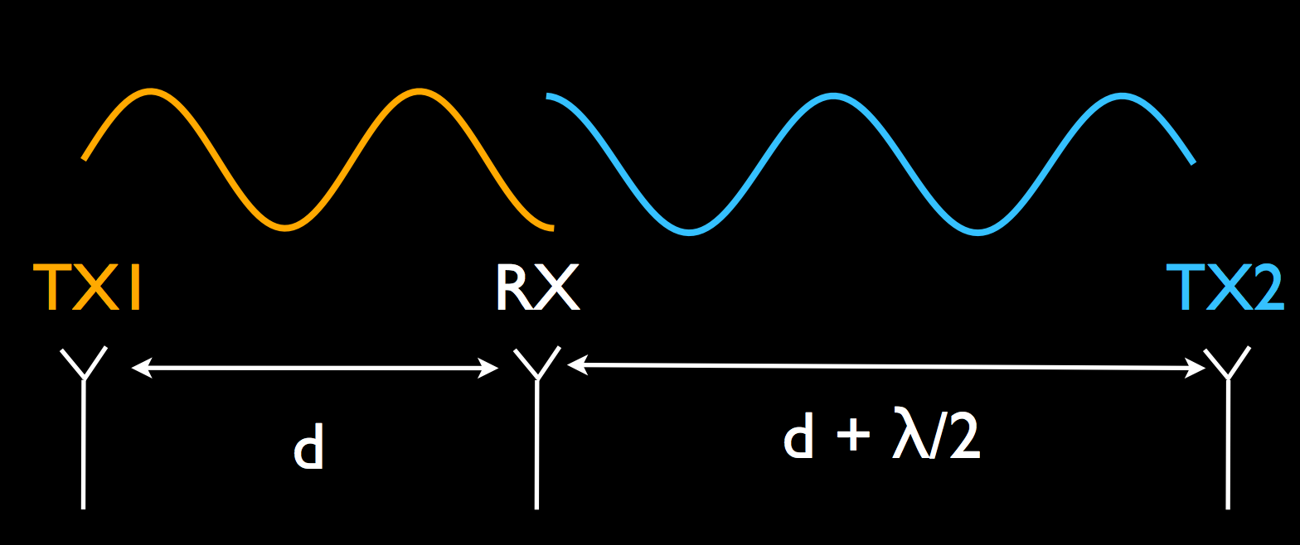
Antenna Cancellation
Two Transmit antennas, one Receive antenna ~30dB
Where to place the receive antenna?
Distance from the two transmit antennas differs by an odd multiple of half the wavelength of the center frequency of transmission --→ Signal add destructively

Slide 6
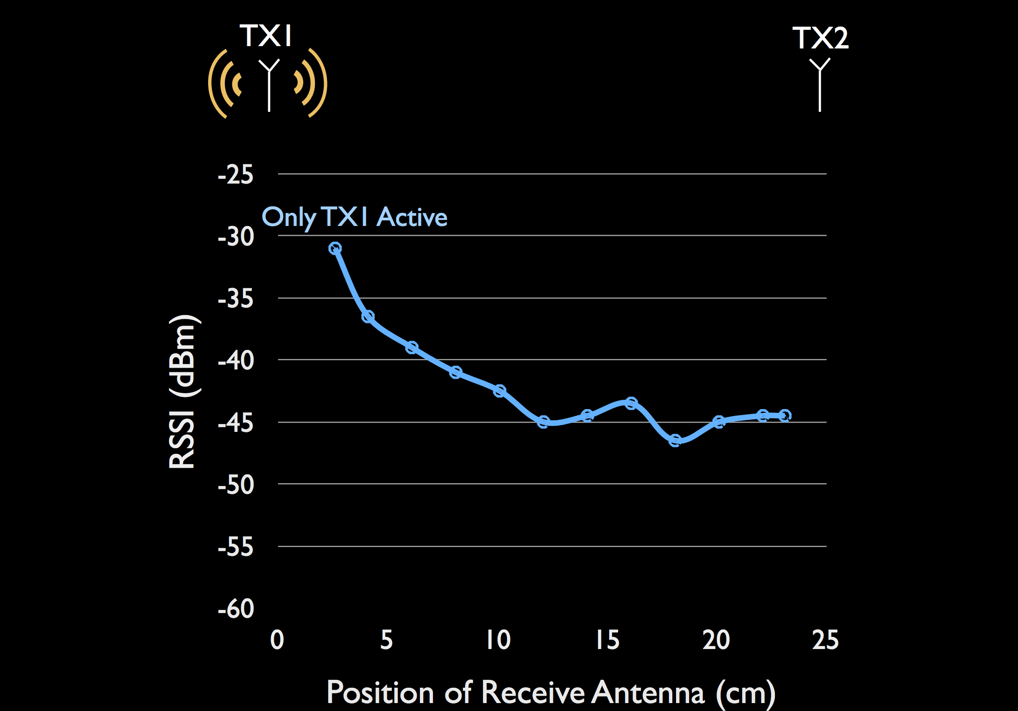
Antenna Cancellation - Performance

Slide 7
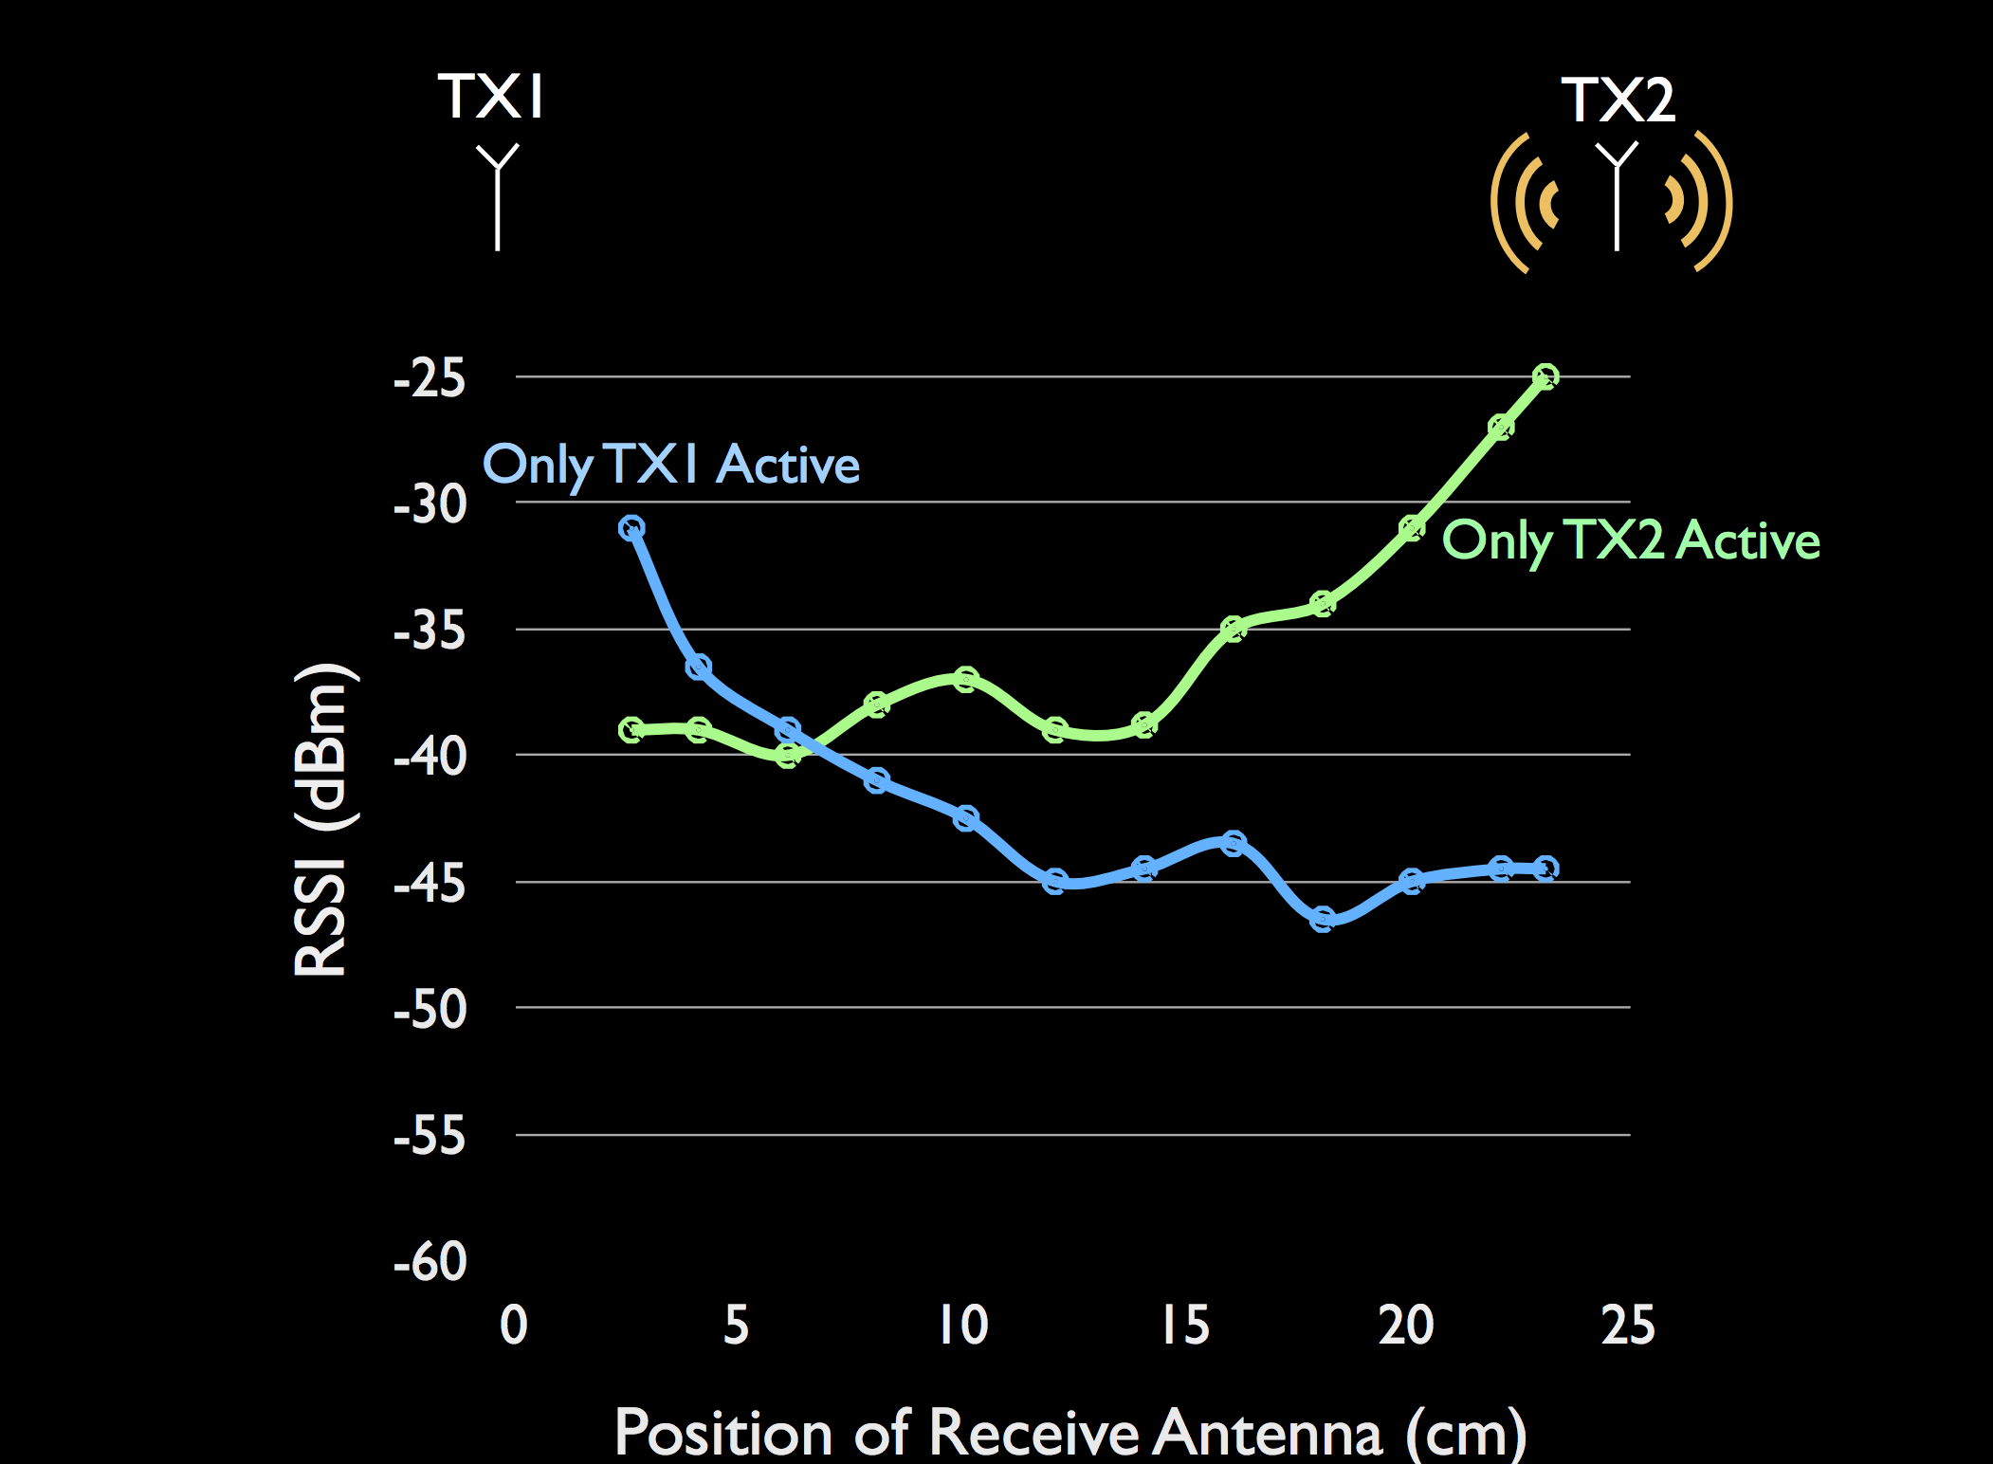
Antenna Cancellation - Performance

Slide 8
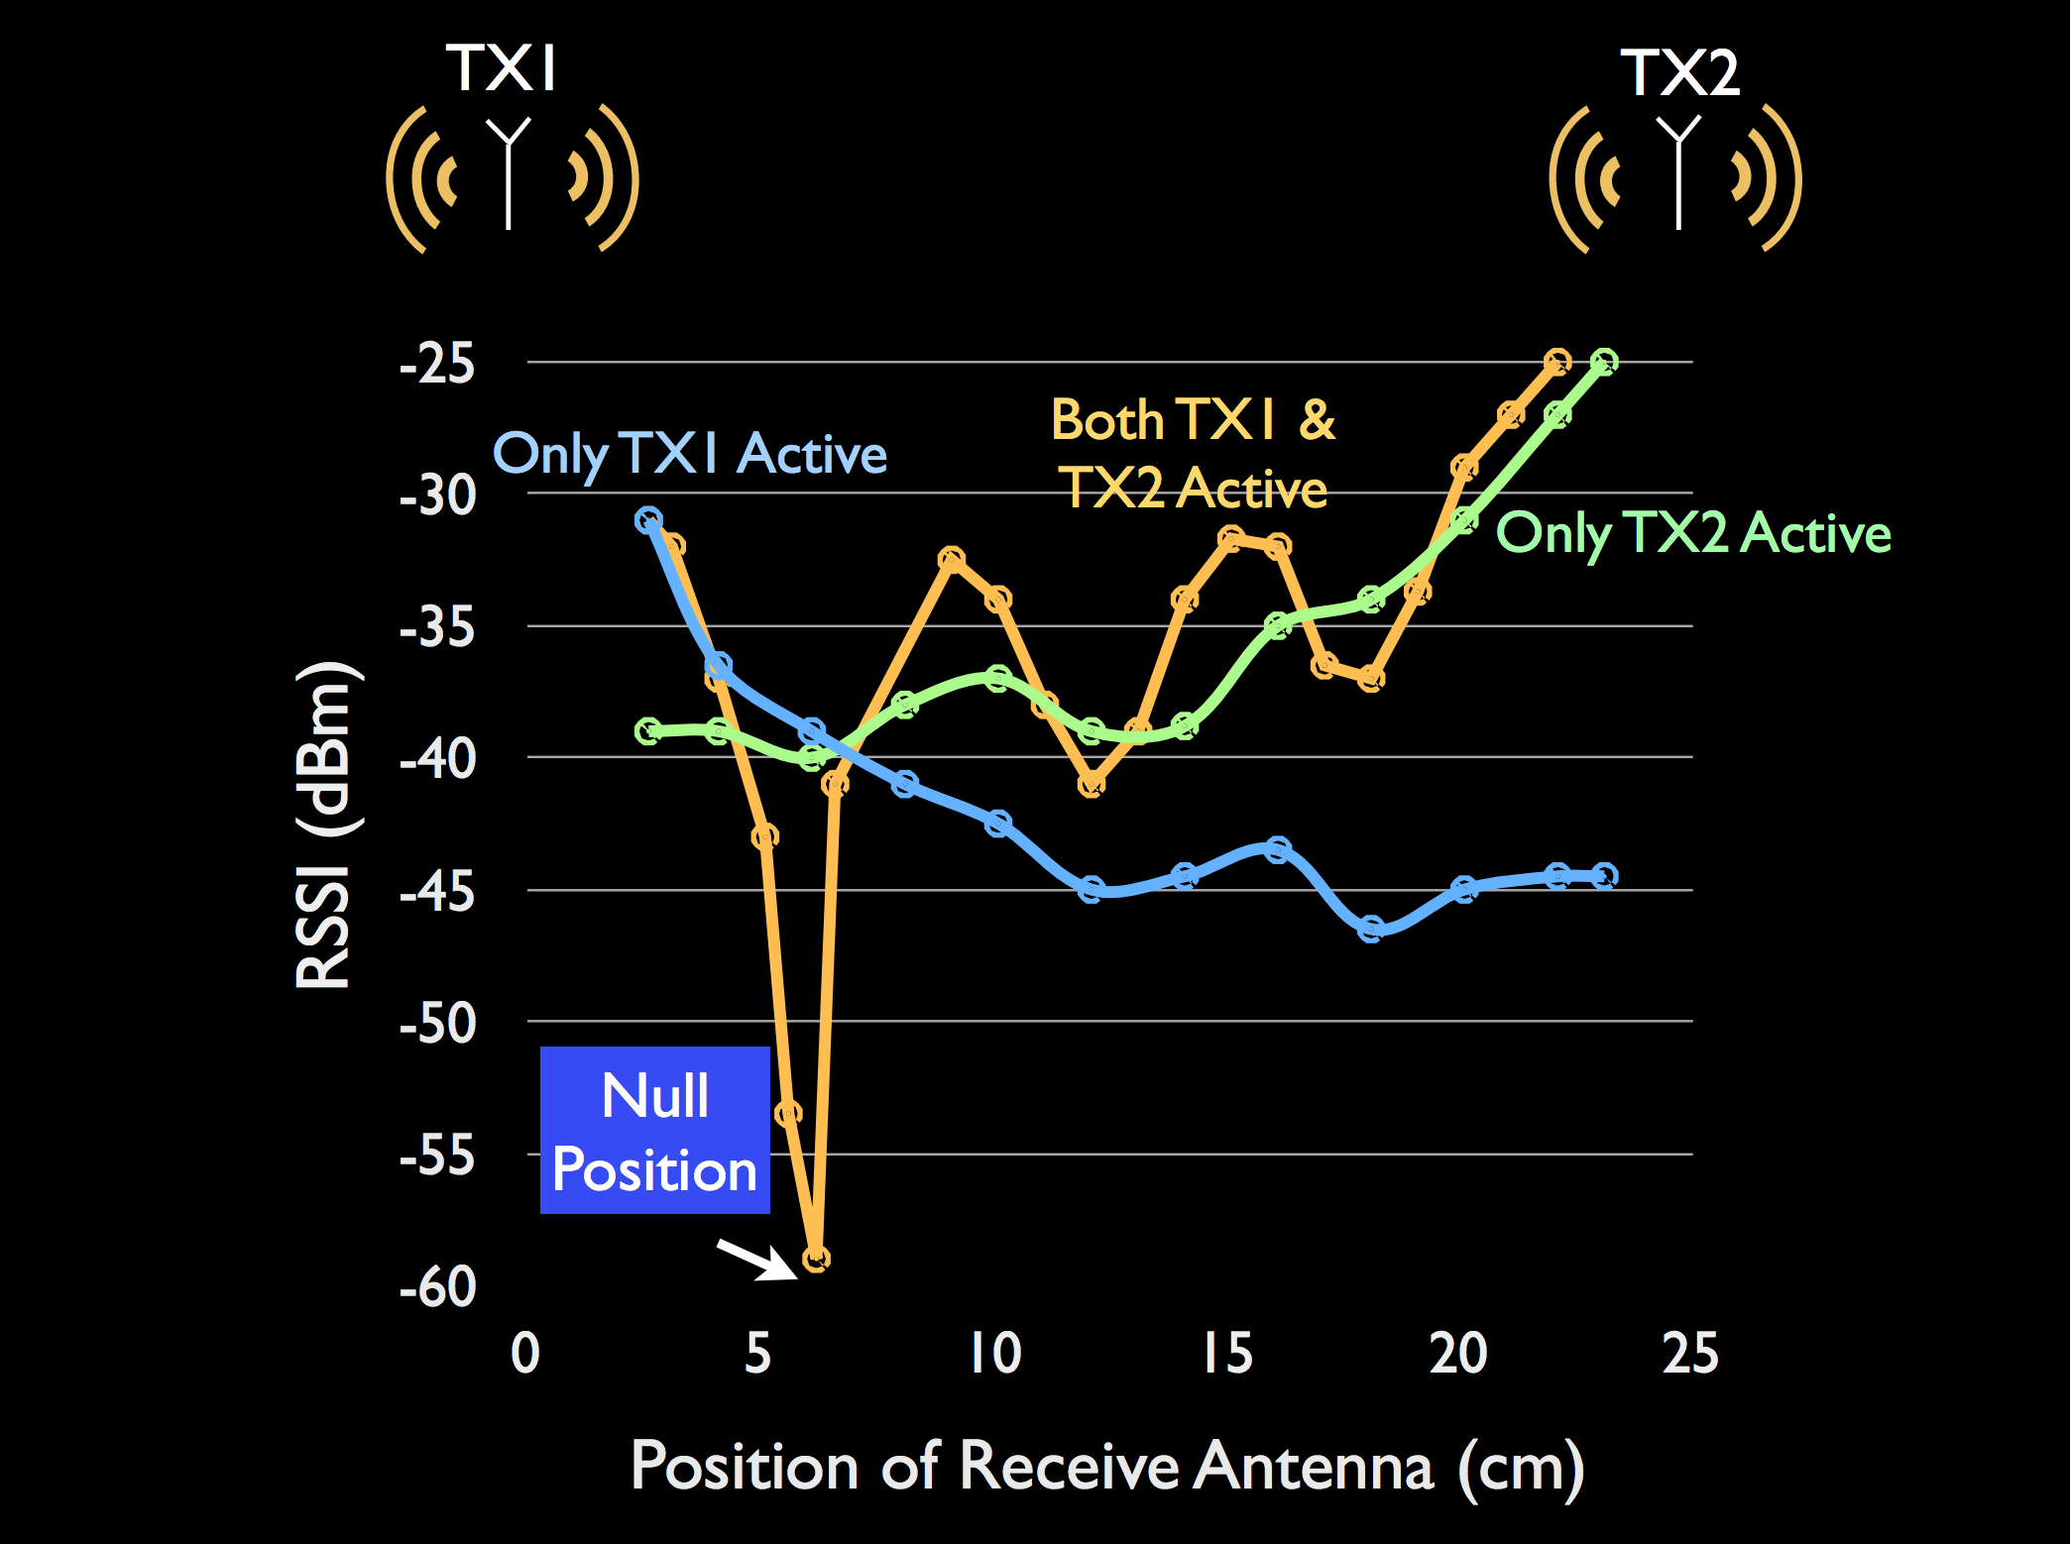
Antenna Cancellation - Performance

Slide 9
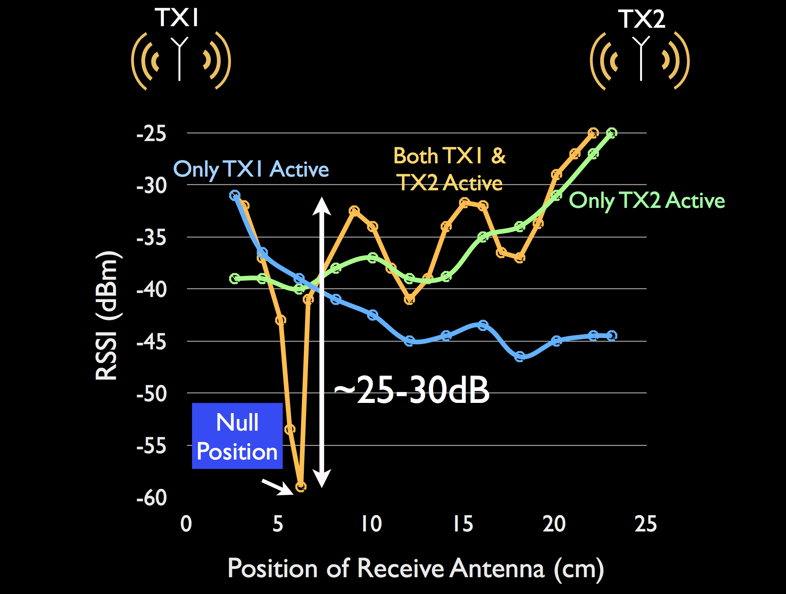
Antenna Cancellation - Performance

Slide 10
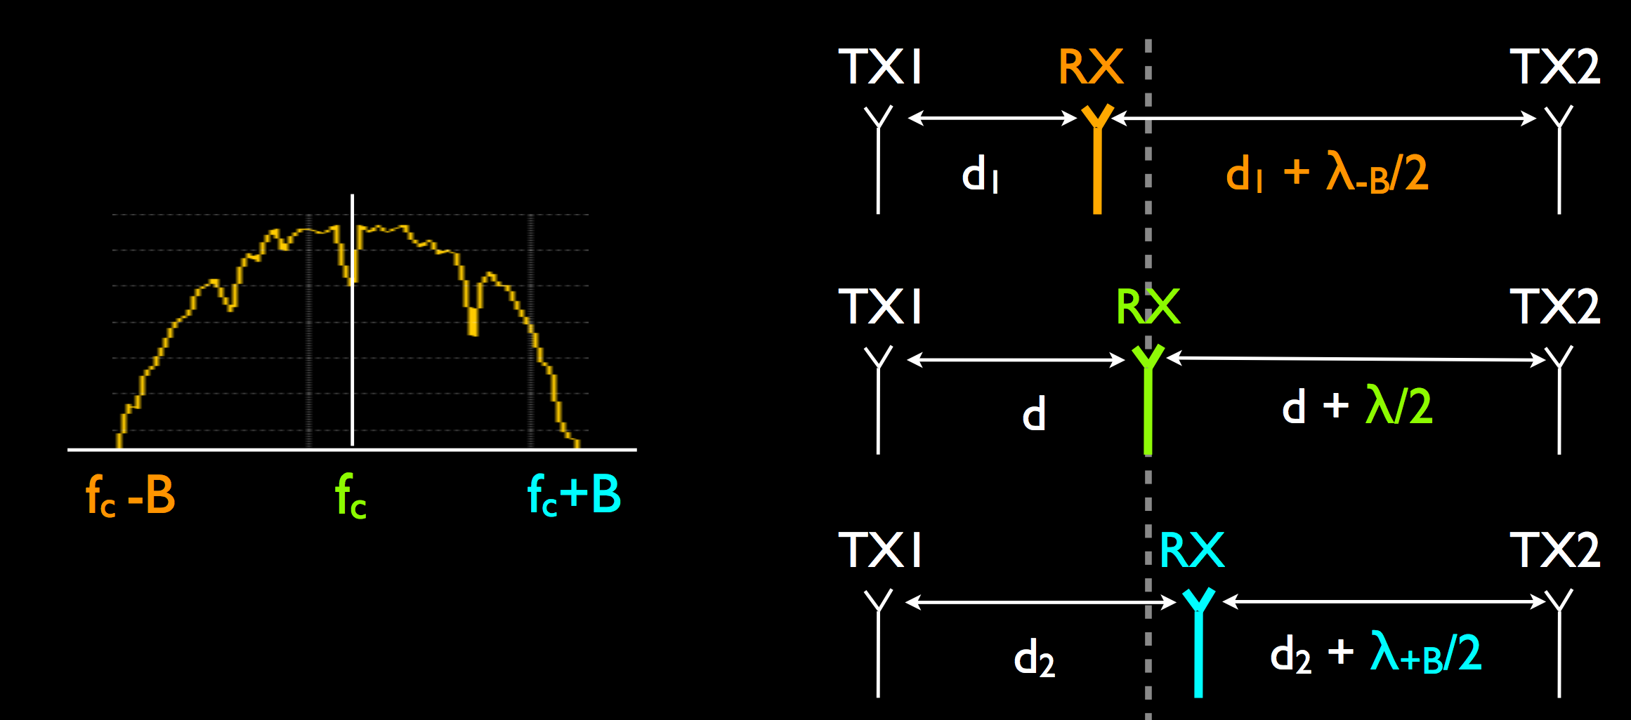
Antenna Cancellation - Bandwidth
Bandwidth constraint
λ/2 offset is precise for one frequency
BUT not for the whole bandwidth
WiFi (2.4G, 20MHz) => ~0.26mm precision error

Slide 11
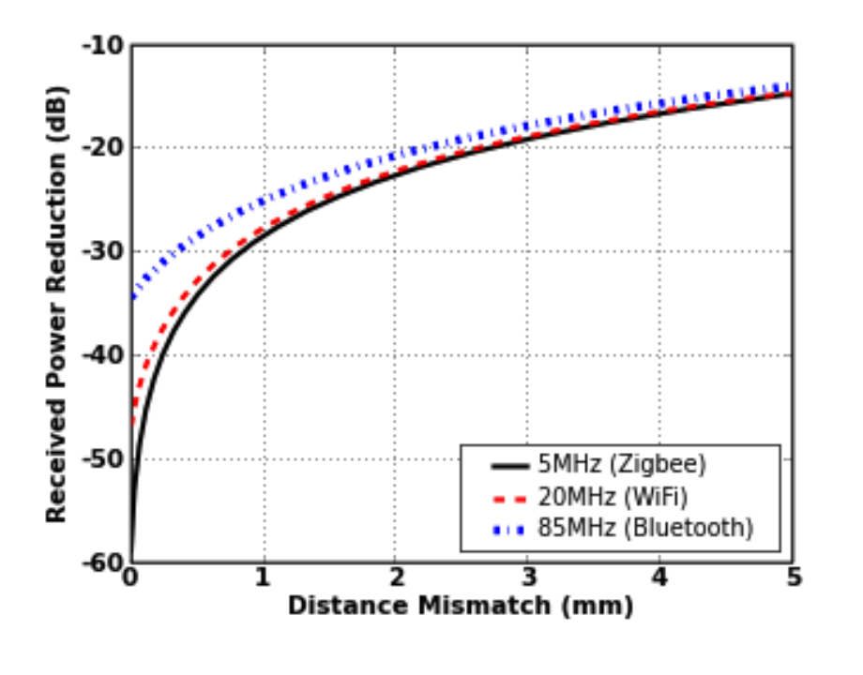
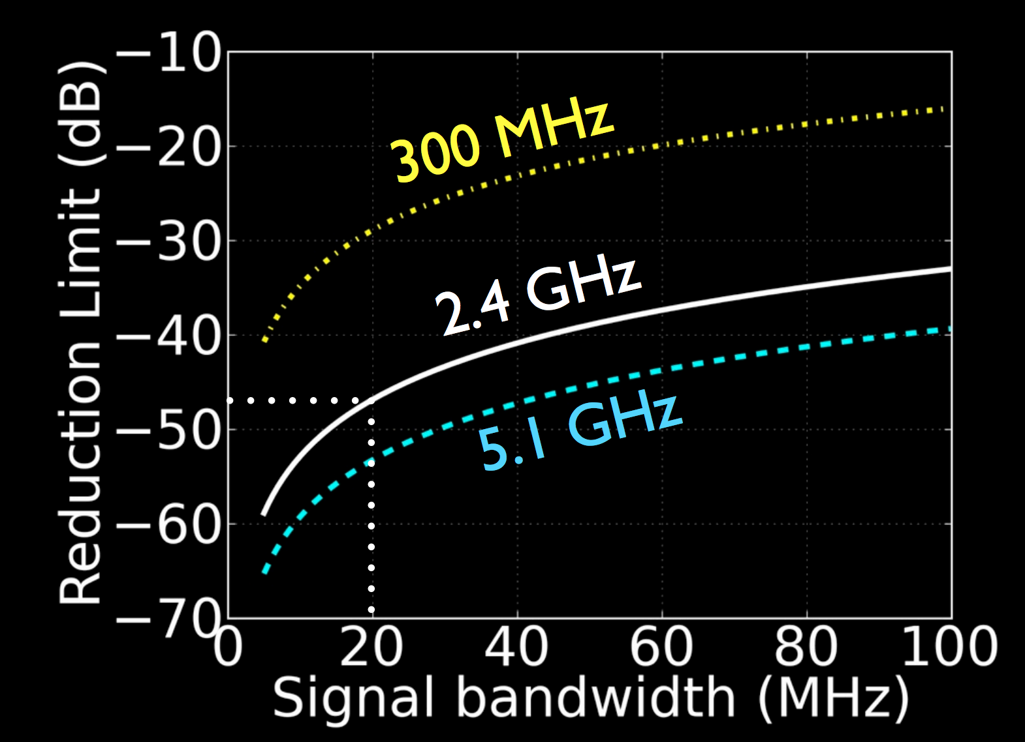
Antenna Cancellation - Bandwidth
Higher Bandwidth => Less Cancellation
Higher Carrier Frequency => More Cancellation⇧

Slide 12
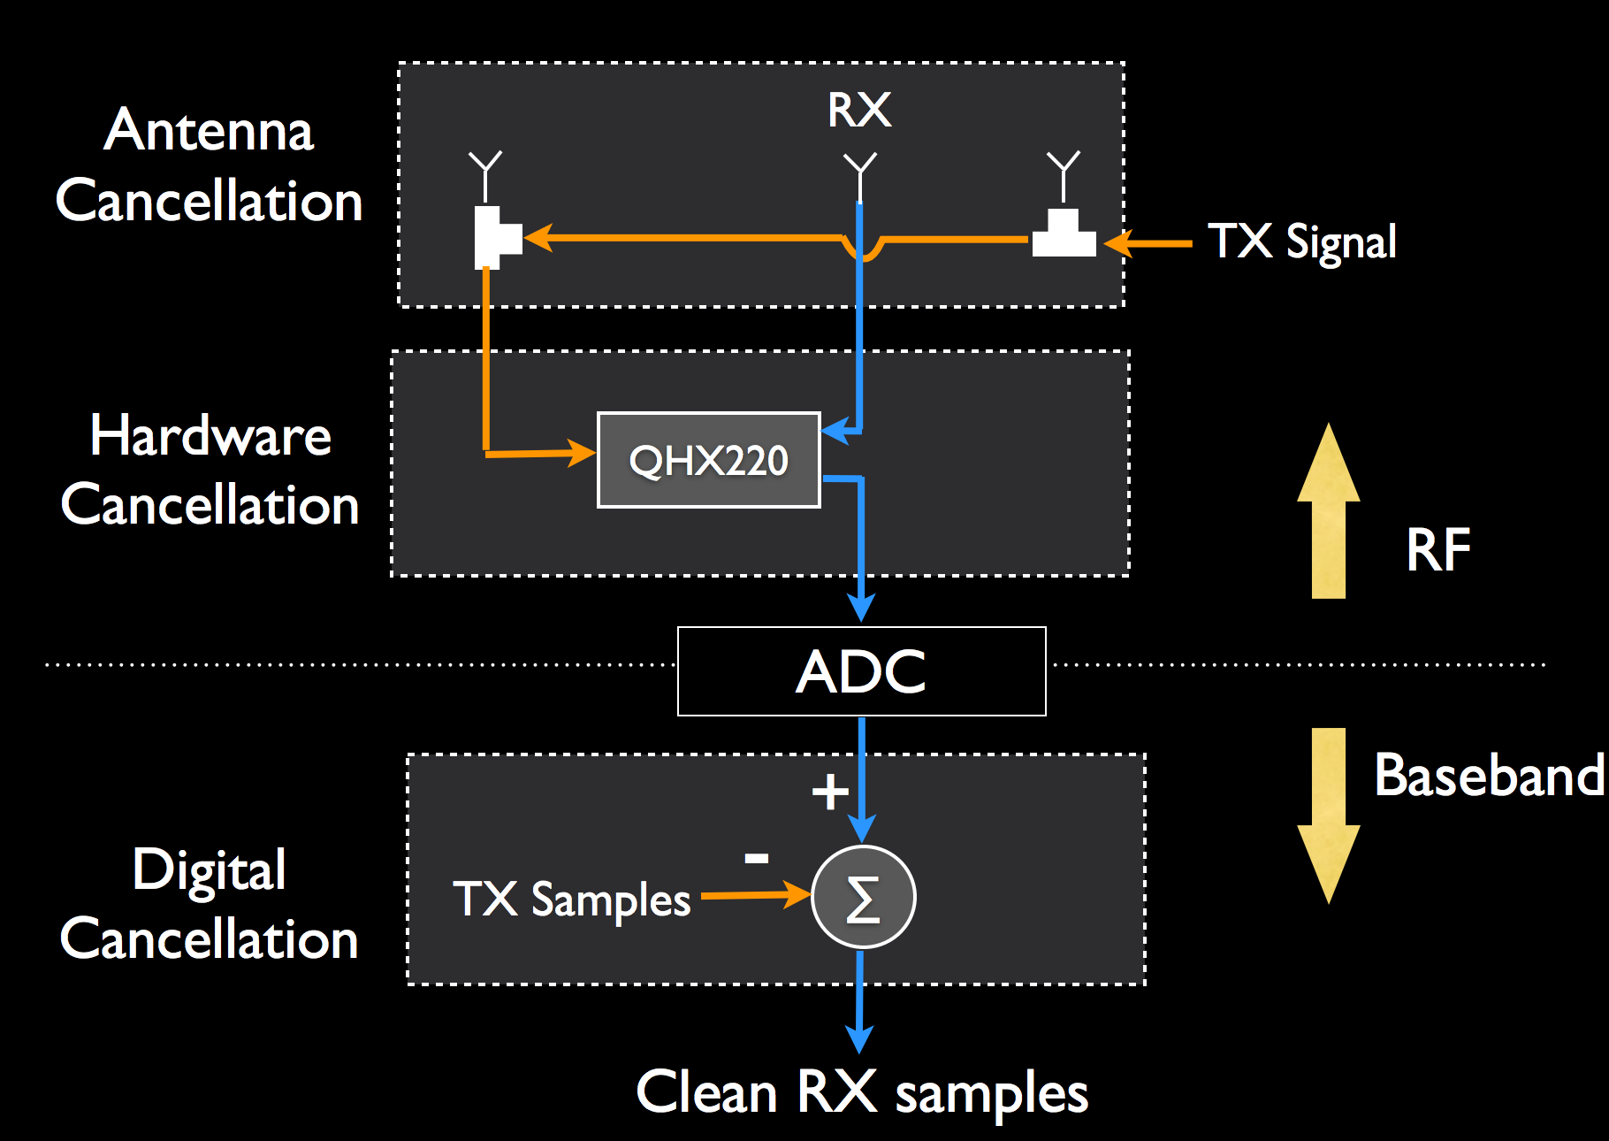
System Diagram
Three steps
Antenna Cancellation ~30dB
Hardware Cancellation ~25dB
Digital Cancellation ~15dB
Achieves ~70dB cancellation

Slide 13
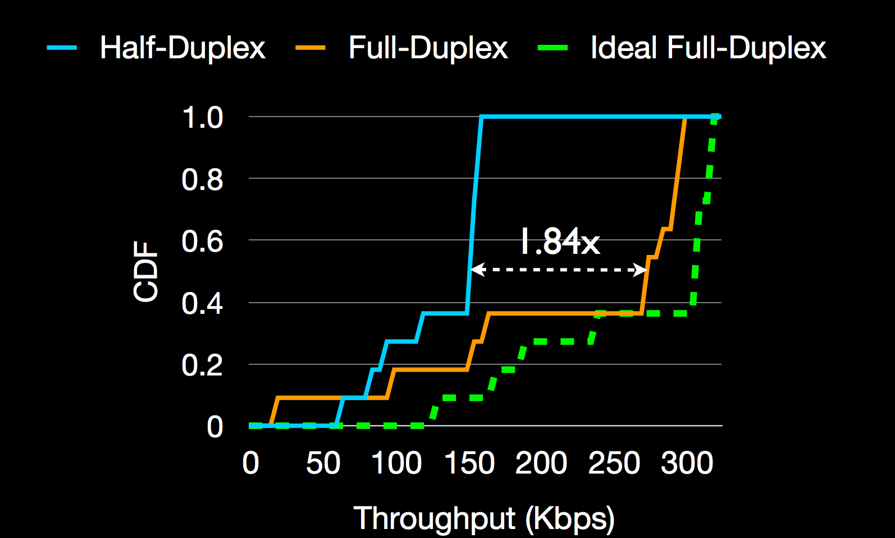
Evaluation – Aggregate Throughput
Median throughput 92% of ideal full-duplex

Slide 14
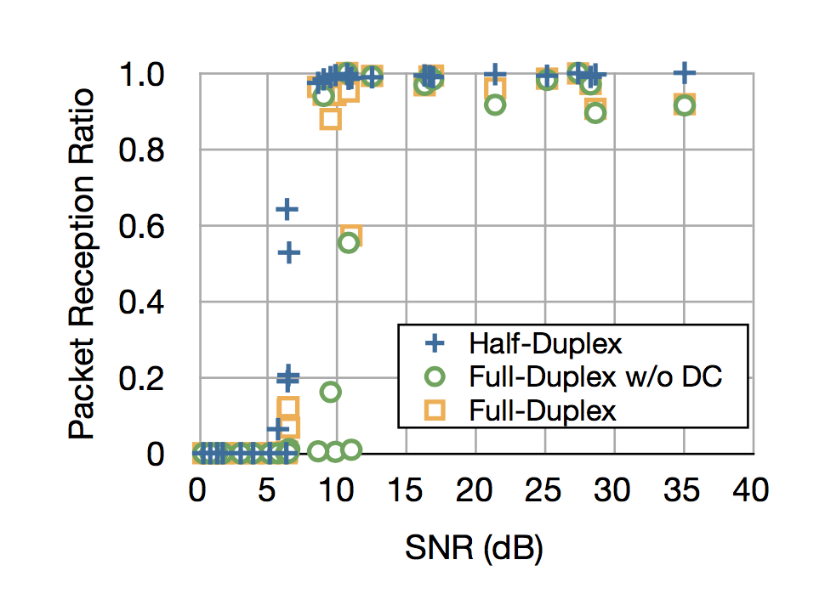
Evaluation – Link Reliability
Little loss in link reliability: 88% of half-duplex on average

Slide 15
Full Duplex - Applications
True benefit lies beyond the physical layer
Breaks a basic assumption in wireless
Can solve some fundamental problems with wireless networks
Hidden terminals
Reducing Congestion with MAC Scheduling
Wormhole Routing in Multihop Networks
Cognitive Radios

Slide 16
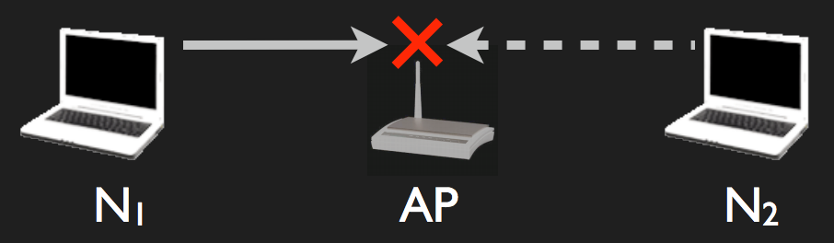
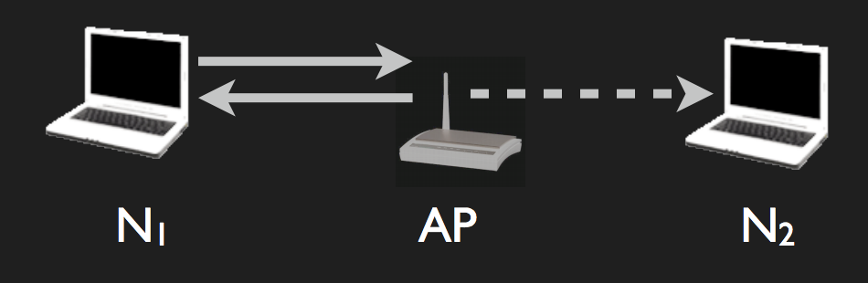
Mitigating Hidden Terminals
Full Duplex solves hidden terminals
N2 hears the transmission from the access point and delays its transmission, thereby avoiding a collision.

Slide 17
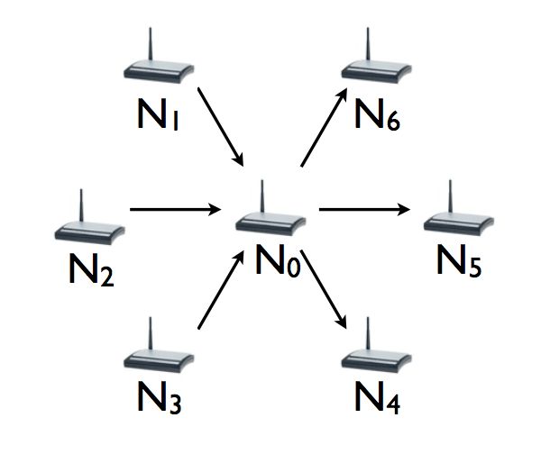
Reducing Congestion with MAC Scheduling
Aggregate Network throughput: 1/n -> 1*link_cap (2n+1 nodes, star topology)

Slide 18
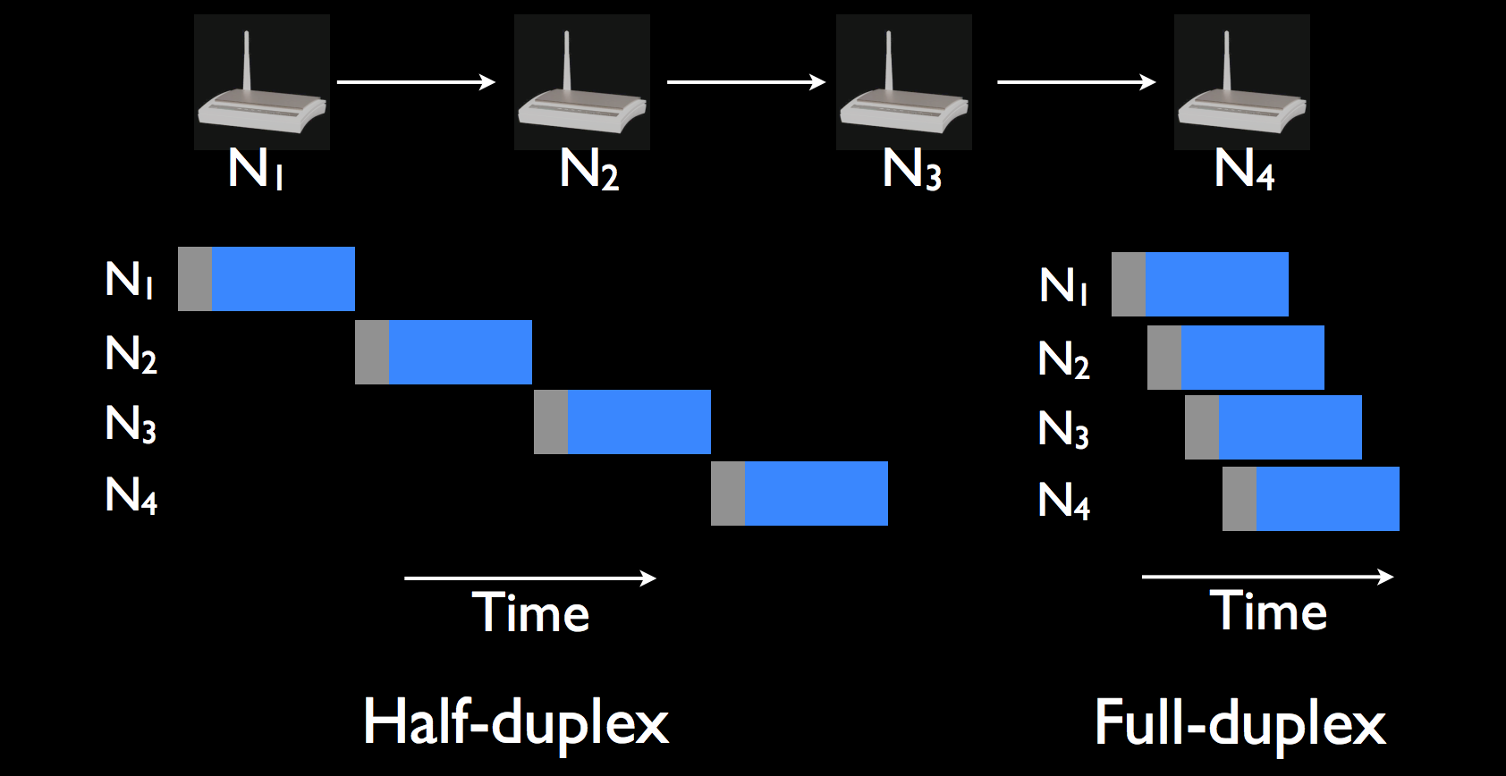
Wormhole Routing in Multihop Networks
Problem: Long delivery and round-trip times in multihop networks
Solution: Forward a packet while receiving it

Slide 19
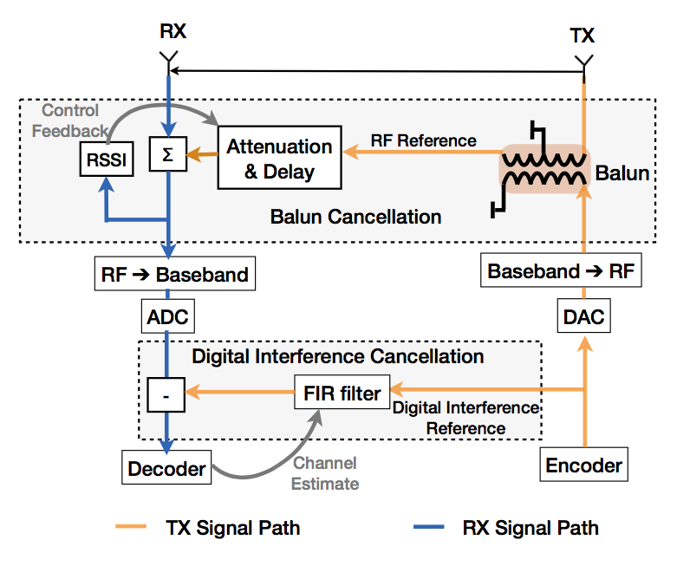
Limitations
High Transmit Power
Bandwidth Constraint
Time-varying wireless channel
Auto-tuning of the hardware cancellation circuit
Mayank Jain, Jung Il Choi, Taemin Kim, Dinesh Bharadia, Kannan Srinivasan, Siddharth Seth, Philip Levis, Sachin Katti and Prasun Sinha. “Practical, Real-time, Full Duplex Wireless.” In Proceedings of the 17th Annual International Conference on Mobile Computing and Networking (Mobicom 2011).

Slide 20
Questions

