Slide 1
Practical, Real-time Centralized Control for CDN-based Live Video Delivery (Mukerjee et al)
Presented by Devdeep Ray

Slide 2
Introduction

Slide 3
Challenges with (live) video
Live video traffic growing 4-5x every year
Providers and consumers have different needs: low deliver cost vs high quality, low joining latency
Fast failover
Fine-grained control
Low join times
Notes:
50 TBps in 2015, Facebook live, Large scale media events: WC 2014: 40% of all traffic.

Slide 4
Past solutions
Use traffic engineering
Done at coarse time scales
Usually distributed control for fast recovery
Main approach: Map users to POPs
Notes:
50 TBps in 2015, Facebook live, Large scale media events: WC 2014: 40% of all traffic.

Slide 5
VDN overview
CDN optimization
Hybrid approach: Centralized and distributed control
Fast join time, long-term global optimality
Can be tuned to optimize for delivery cost or video quality
Notes:
50 TBps in 2015, Facebook live, Large scale media events: WC 2014: 40% of all traffic.

Slide 6
Background

Slide 7
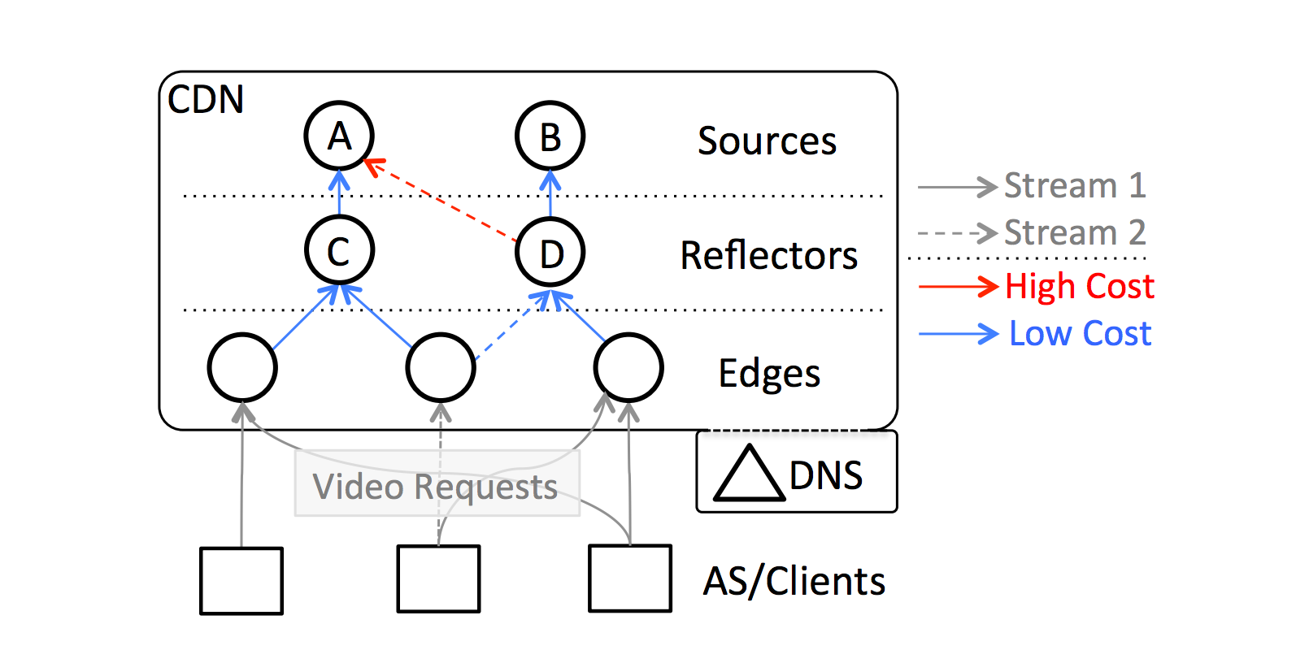
CDN background
Consists of sources, reflectors and edges
Links between sources and reflectors are costly (long haul)
Links between reflectors and edges are cheaper
Use DNS to send clients to the ‘best’ edge
Notes:
50 TBps in 2015, Facebook live, Large scale media events: WC 2014: 40% of all traffic.

Slide 8
DNS mapping
No way to push updates
DNS TTL may or may not be respected at local DNS servers
Mapping done using heuristics: Not optimal, difficult to tune
Notes:
50 TBps in 2015, Facebook live, Large scale media events: WC 2014: 40% of all traffic.

Slide 9
VDN

Slide 10
Design goals
Allow quality/cost tradeoff. Quality == Bitrate
Scalable to millions of users
Fine grained control
Fast join and recovery
Notes:
50 TBps in 2015, Facebook live, Large scale media events: WC 2014: 40% of all traffic.

Slide 11
Centralized or distributed control?
Centralized: Easy optimization, fine grained cost/quality control, but slow and does not scale easily
Distributed: High scalability, fast, not optimal and not easy to do cost/quality tradeoff
Solution? Hybrid.
Notes:
50 TBps in 2015, Facebook live, Large scale media events: WC 2014: 40% of all traffic.

Slide 12
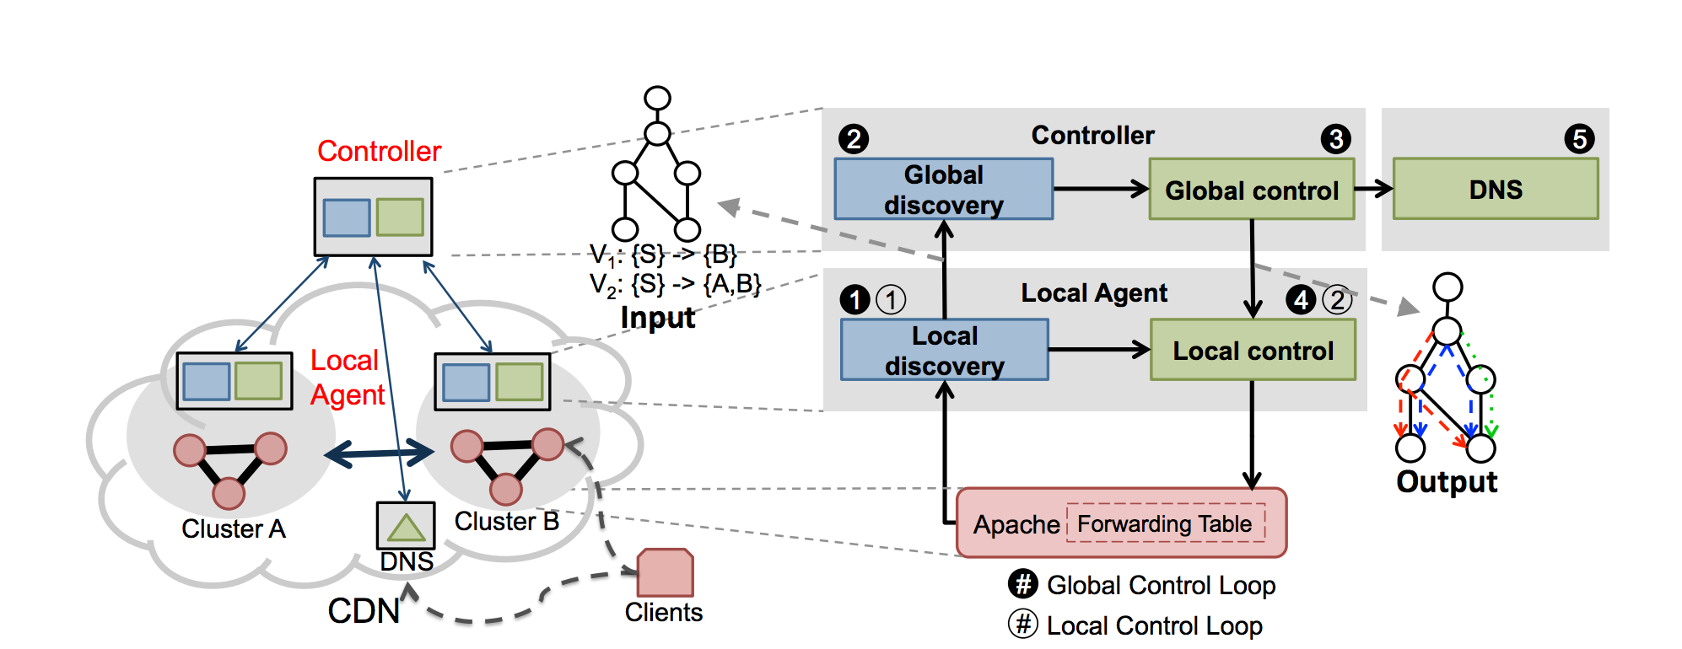
VDN components
Centralized controller
Distributed controllers
Notes:
50 TBps in 2015, Facebook live, Large scale media events: WC 2014: 40% of all traffic.

Slide 13
Centralized controller
Performs global optimization
Pushes optimal routing information to local controllers
Pushes optimal edge information to DNS
Granularity of few minutes
Notes:
50 TBps in 2015, Facebook live, Large scale media events: WC 2014: 40% of all traffic.

Slide 14
Local controller
Quickly picks parent for sourcing data (potentially sub-optimal)
Tracks viewership
Sends info to global controller
Receives optimized routes from central controller
Notes:
50 TBps in 2015, Facebook live, Large scale media events: WC 2014: 40% of all traffic.

Slide 15
Central optimization
Input: Wc, Ws, Costs, bitrates, topology, Capacity
Output: Routing tree/ table
Solved using MIP with early termination
Few minutes for 25K users to reach 1% within optimal
Notes:
50 TBps in 2015, Facebook live, Large scale media events: WC 2014: 40% of all traffic.

Slide 16
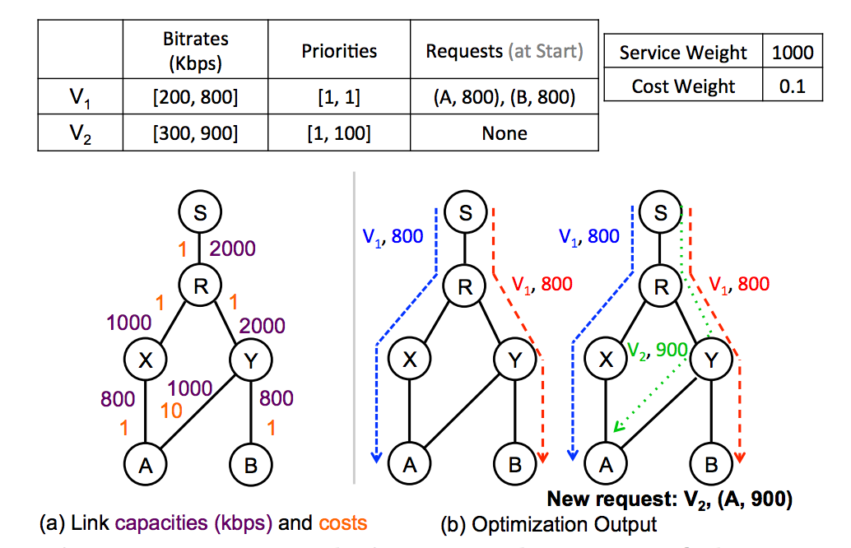
Central optimization
Notes:
50 TBps in 2015, Facebook live, Large scale media events: WC 2014: 40% of all traffic.

Slide 17
Evaluation
Trace driven evaluation
E2E evaluation on EC2
VDN achieves 1.7X improvement in average bitrate, 2X reduction in delivery cost
Responsive at a granularity of 200ms
Notes:
50 TBps in 2015, Facebook live, Large scale media events: WC 2014: 40% of all traffic.

Slide 18

Thanks!

