Slide 1
15-744: Computer Networking
L-19 DNS/CDN

Slide 2
This lecture
Domain Name System (DNS)
Content Delivery Networks (CDN)
Extension mechanisms for DNS (EDNS)
ICN vs. CDN

Slide 3
Host Names vs. IP Addresses
Name are human readable ➔ Easy to remember
www.cs.cmu.edu vs. 128.2.217.13
Flexibility ➔ Decoupling name and location
Same name to multiple IP addresses
To reduce latency, etc
Aliasing: multiple names for the same IP address
IP addresses can change underneath
Smooth server switch in failover
DNS: Translate host name ➔ IP address

Slide 4
Obvious Solutions (1)
Why not centralize DNS?
Single point of failure
Traffic volume
Distant centralized database
Single point of update
Doesn’t scale!

Slide 5
Obvious Solutions (2)
Why not use /etc/hosts?
Original Name to Address Mapping
Flat namespace
/etc/hosts
SRI kept main copy
Downloaded regularly
Count of hosts was increasing: machine per domain → machine per user
Many more downloads
Many more updates

Slide 6
Domain Name System Goals
Basically building a wide area distributed database
Scalability
Decentralized maintenance
Robustness
Global scope
Names mean the same thing everywhere
Don’t need
Atomicity
Strong consistency
CAP theorem – hard to get consistency, availability and partition tolerance

Slide 7
DNS Records
RR format: (class, name, value, type, ttl)
DB contains tuples called resource records (RRs)
Classes = Internet (IN), Chaosnet (CH), etc.
Each class defines value associated with type
FOR IN class:
Type=A
name is hostname
value is IP address
Type=NS
name is domain (e.g. foo.com)
value is name of authoritative name server for this domain
Type=CNAME
name is an alias name for some “canonical” (the real) name
value is canonical name
Type=MX
value is hostname of mailserver associated with name

Slide 8
DNS Design: Hierarchy Definitions
Each node in hierarchy stores a list of names that end with same suffix
Suffix = path up tree
E.g., given this tree, where would following be stored:
Fred.com
Fred.edu
Fred.cmu.edu
Fred.cmcl.cs.cmu.edu
Fred.cs.mit.edu
root
org
net
edu
com
uk
gwu
ucb
cmu
bu
mit
cs
ece
cmcl

Slide 9
DNS Design: Zone Definitions
Zone = contiguous section of name space
E.g., Complete tree, single node or subtree
A zone has an associated set of name servers
root
org
ca
net
edu
com
uk
gwu
ucb
cmu
bu
mit
Subtree
cs
ece
cmcl
Single node
Complete Tree

Slide 10
Root Zone
Generic Top Level Domains (gTLD) = .com, .net, .org, etc…
Country Code Top Level Domain (ccTLD) = .us, .ca, .fi, .uk, etc…
Root server ({a-m}.root-servers.net) also used to cover gTLD domains
Load on root servers was growing quickly!
Moving .com, .net, .org off root servers was clearly necessary to reduce load → done Aug 2000

Slide 11
New gTLDs
.info → general info
.biz → businesses
.aero → air-transport industry
.coop → business cooperatives
.name → individuals
.pro → accountants, lawyers, and physicians
.museum → museums
Only new one actives so far = .info, .biz, .name

Slide 12
DNS Design: Cont.
Zones are created by convincing owner node to create/delegate a subzone
Records within zone stored multiple redundant name servers
Primary/master name server updated manually
Secondary/redundant servers updated by zone transfer of name space
Zone transfer is a bulk transfer of the “configuration” of a DNS server – uses TCP to ensure reliability
Example:
CS.CMU.EDU created by CMU.EDU administrators

Slide 13
Servers/Resolvers
Each host has a resolver
Typically a library that applications can link to
Local name servers hand-configured (e.g. /etc/resolv.conf)
Name servers
Either responsible for some zone or…
Local servers
Do lookup of distant host names for local hosts
Typically answer queries about local zone

Slide 14
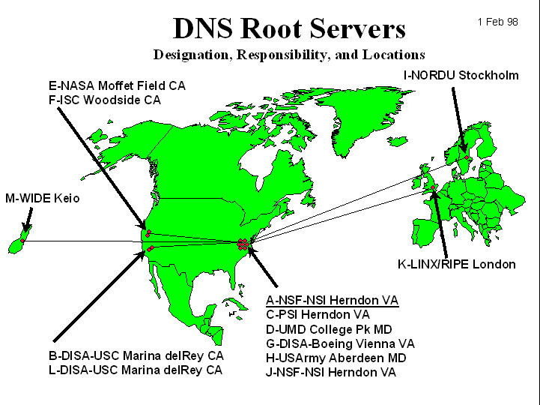
DNS: Root Name Servers
Responsible for “root” zone
Approx. dozen root name servers worldwide
Currently {a-m}.root-servers.net
Local name servers contact root servers when they cannot resolve a name
Configured with well-known root servers

Slide 15
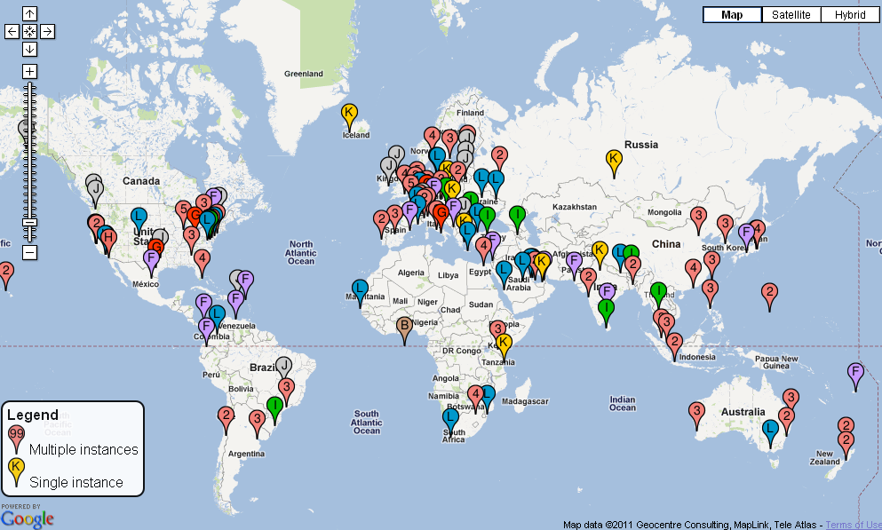
Physical Root Name Servers
Several root servers have multiple physical servers
Packets routed to “nearest” server by “Anycast” protocol
346 servers total

Slide 16
Typical Resolution
root & edu
DNS server
www.cs.cmu.edu
www.cs.cmu.edu
NS ns1.cmu.edu
ns1.cmu.edu
DNS server
Local
DNS server
NS ns1.cs.cmu.edu
Client
ns1.cs.cmu.edu
DNS
server
A www=IPaddr

Slide 17
Lookup Methods
Recursive query:
Server goes out and searches for more info (recursive)
Only returns final answer or “not found”
Iterative query:
Server responds with as much as it knows (iterative)
“I don’t know this name, but ask this server”
Workload impact on choice?
Local server typically does recursive
Root/distant server does iterative
root name server
2
iterated query
3
4
7
local name server
dns.eurecom.fr
intermediate name server
dns.umass.edu
5
6
1
8
authoritative name server
dns.cs.umass.edu
requesting host
surf.eurecom.fr
gaia.cs.umass.edu

Slide 18
DNS Caching
DNS responses are cached
Quick response for repeated translations
Other queries may reuse some parts of lookup
NS records for domains
DNS negative queries are cached
Don’t have to repeat past mistakes
E.g. misspellings, search strings in resolv.conf
Cached data periodically times out
Lifetime (TTL) of data controlled by owner of data
TTL passed with every record

Slide 19
Typical Resolution
root & edu
DNS server
www.cs.cmu.edu
www.cs.cmu.edu
NS ns1.cmu.edu
ns1.cmu.edu
DNS server
Local
DNS server
NS ns1.cs.cmu.edu
Client
ns1.cs.cmu.edu
DNS
server
A www=IPaddr

Slide 20
Subsequent Lookup Example
root & edu
DNS server
ftp.cs.cmu.edu
cmu.edu
DNS server
Local
DNS server
Client
ftp.cs.cmu.edu
cs.cmu.edu
DNS
server
ftp=IPaddr

Slide 21
Reliability
DNS servers are replicated
Name service available if ≥ one replica is up
Queries can be load balanced between replicas
UDP used for queries
Need reliability → must implement this on top of UDP!
Why not just use TCP?
Try alternate servers on timeout
Exponential backoff when retrying same server

Slide 22
Discussion: Cost of Using Hierarchy
Why hierarchical name is a bad idea?
http://www.cs.cmu.edu/index.html ➔ http://4e52/
Stable reference (when object changes)
Object replication
Avoid fighting over names (typo squatting)
Potential solution: semantics-free reference
Use DHT to map a reference to an IP
Adding another layer of “indirection”
End-system multicast, etc

Slide 23
What Happened on Oct 21st?
DDoS attack on Dyn
Dyn provides core Internet services for Twitter, SoundCloud, Spotify, Reddit and a host of other sites
Why didn’t DNS defense mechanisms work in this case?

Slide 24
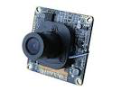
What was the source of attack?
Mirai botnet
Used in 620Gbps attack last month
Source: bad IoT devices, e.g.,
White-labeled DVR and IP camera electronics
username: root and password: xc3511
password is hardcoded into the device firmware

Slide 25
Attack Waves
DNS lookups are routed to the nearest data center
First wave
On three Dyn data centers – Chicago, Washington, D.C., and New York
Second wave,
Hit 20 Dyn data centers around the world.
Required extensive planning.
Since DNS request go to the closest DNS server, the attacker had to plan a successful attack for each of the 20 data centers with enough bots in each region to be able to take down the local Dyn services
Notes:
Drew says the attack consisted mainly of TCP SYN floods aimed directly at against port 53 of Dyn’s DNS servers, but also a prepend attack, which is also called a subdomain attack. That’s when attackers send DNS requests to a server for a domain for which they know the target is authoritative. But they tack onto the front of the domain name random prepends or subnet designations. The server won’t have these in its cache so will have to look them up, sapping computational resources and effectively preventing the server from handling legitimate traffic, he says.

Slide 26
Solutions?
Dyn customers
Going to backup DNS providers, as Amazon did
Signing up with an alternative today after the attacks, as PayPal did
Lowering their time-to-life settings on their DNS servers
Redirect traffic faster to another DNS service that is still available

Slide 27
This lecture
Domain Name System (DNS)
Content Delivery Networks (CDN)
Extension mechanisms for DNS (EDNS)
ICN vs. CDN

Slide 28
HTTP (Quick review)
Stateless request/response protocol
Completely TCP-based
Fetching URL: www.cs.cmu.edu/~junchenj/index.html
Resolve DNS of www.cs.cmu.edu
Setup TCP
Send HTTP request: GET /~junchenj/index.html
Wait for HTTP response, execute embedded code
Most content is cacheable (for some TTL)
Dynamic content, Live videos, etc are not cacheable

Slide 29
Background: Web
More popular contents, websites
Client-to-Client ➔ Server-to-Client
Content providers: Vested interest in performance, reliability, scalability
ISPs: Dramatic increase of peering traffic
Notes:
The motivation of CDN is very similar to that of CCN and other data-oriented systems.
Starting from the 90s, there is a huge change in traffic pattern: the web became very popular, and that changes fundam
The service model also changed from XXX to XXX
Vested interest…
For instance, a one-hour outage could cost one well-known, large online retailer $2.8 million in sales, based on 2009 revenue numbers.

Slide 30
Key Characteristics of Web Traffic
K-th item popularity = 1/k
# of appearance
Zipf or power law on both content popularity & access ISP population
Rank of content/ISP
Two implications:
Skewness: Popular content need to be optimized.
Long tail: Improving a few top ISPs is not enough.
Notes:
Now, let’s take a closer look at the implications of these trends.

Slide 31
Why Not Single Server?
Client
Internet
Server
Poor performance/reliability/scalability:
Single point of failure
Easy to be overloaded
Long latency
Suboptimal WAN (BGP) performance
Huge peering traffic!

Slide 32
Why Not ISP Proxy Caching?
Access ISP
Internet
Client
Server
Proxy
Cache HTTP responses
Pros:
Reduced RTT of cached content
Reduced peering traffic & server load
Cons:
Security/authentication
Content providers want fine-grained control on when/where to cache its content
Cold start

Slide 33
CDN Architecture
Internet
Origin server
EU Clients
CDN
Edge servers
CDNs
Content providers contract with CDNs
Better coordination across replicas (controlled content refresh/removal)
Proactive content replication on many edge servers
Win-win for ISPs and content providers
Asia
Notes:
CDN addresses all these issues, by building a coordinated global infrastructure of caches in almost all edge ISPs.
It addresses the security/authentication issues by contracting directly with content providers.
It addresses the fine-grained control over when/where the content is cached since it can dynamically XXX
It addresses the cold-start problem by proactively replicating content on many edge serves
Finally, it is a win-win solution for both ISPs and CP

Slide 34
CDN Challenges & Design Space
Internet
Origin server
EU Clients
CDN
How/where to replicate content?
Edge servers
How to direct client towards replica?
Asia

Slide 35
Case Study: Akamai
Distributed servers
60,000~ servers
1,000~ networks
70~ countries
Client requests
10^8~ requests per day
20% web, majority video
Major customers
BBC, FOX, Apple, NBC, Facebook, Vevo, NFL, etc

Slide 36
How Akamai Works
How is content replicated?
Akamai only replicates static content (*)
Modified name contains original file name
Akamai server is asked for content
First checks local cache
If not in cache, requests file from primary server and caches file
* (At least, the version we’re talking about today. Akamai actually lets sites write code that can run on Akamai’s servers, but that’s a pretty different beast)
36

Slide 37
How Akamai Works
Root server gives NS record for akamai.net
Akamai.net name server returns NS record for g.akamaitech.net
Name server chosen to be in region of client’s name server
TTL is large
G.akamaitech.net nameserver chooses server in region
Should try to chose server that has file in cache - How to choose?
Uses aXYZ name and hash
TTL is small → why?
37

Slide 38
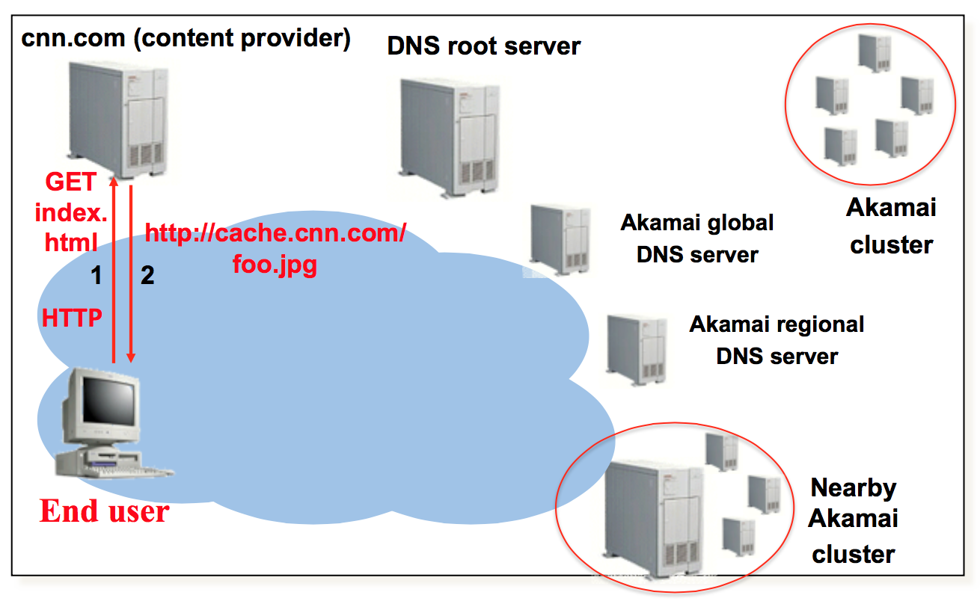
DNS-based Redirection

Slide 39
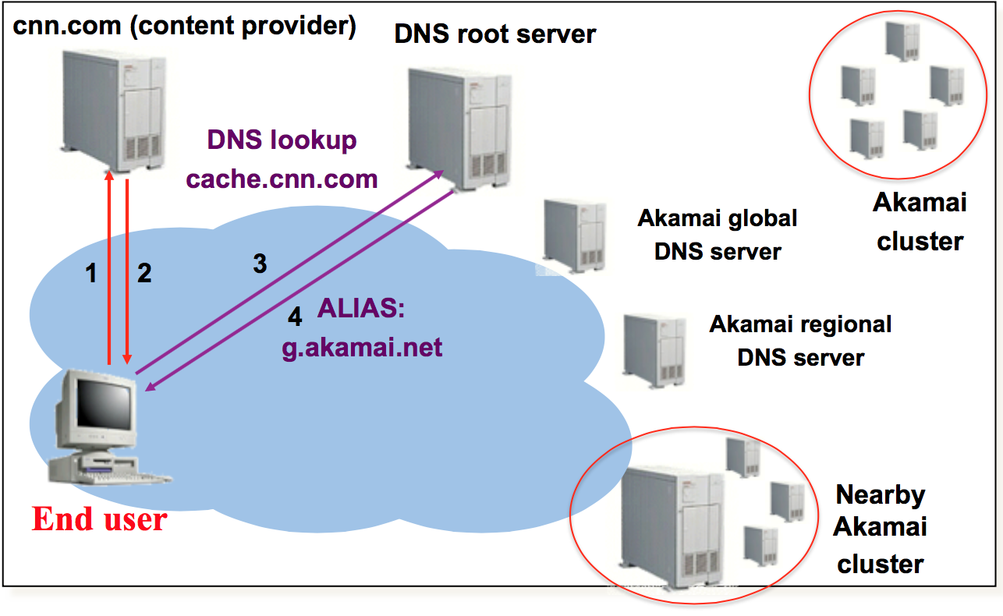
DNS-based Redirection

Slide 40
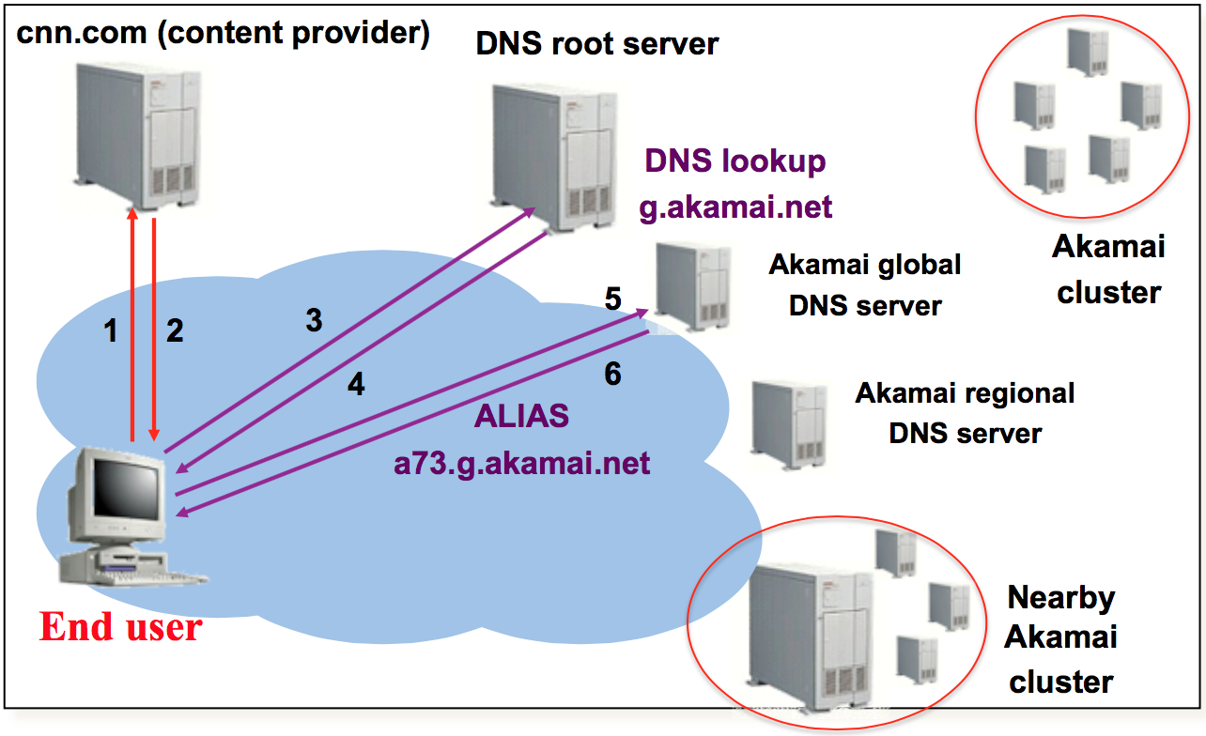
DNS-based Redirection
Source: Jannifer Rexford (http://www.cs.princeton.edu/courses/archive/spr12/cos461/)

Slide 41
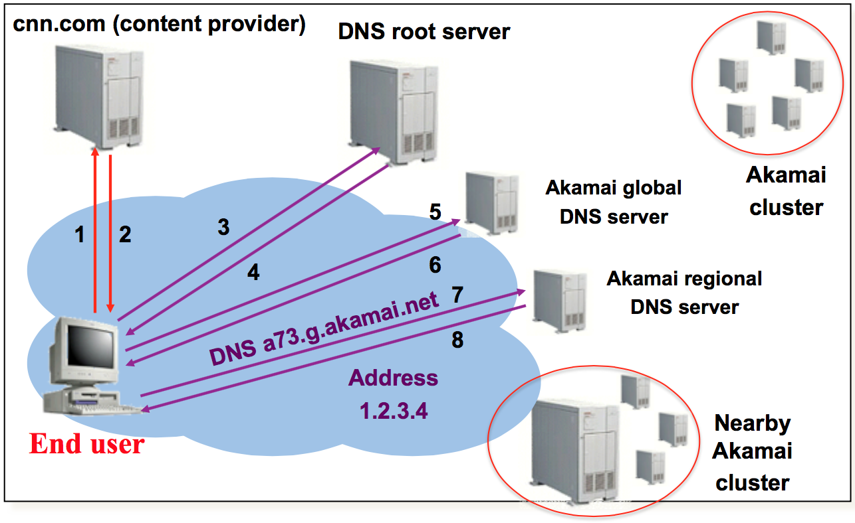
DNS-based Redirection
Source: Jannifer Rexford (http://www.cs.princeton.edu/courses/archive/spr12/cos461/)

Slide 42
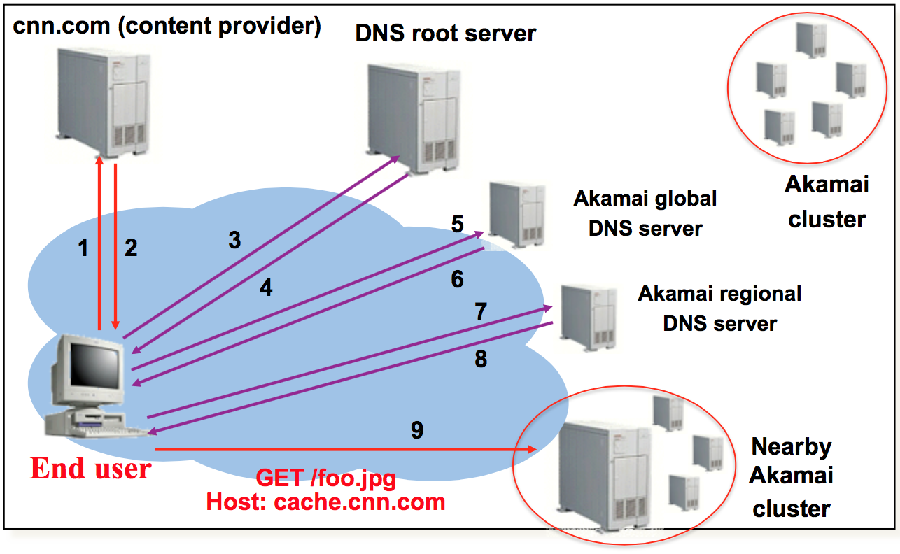
DNS-based Redirection

Slide 43
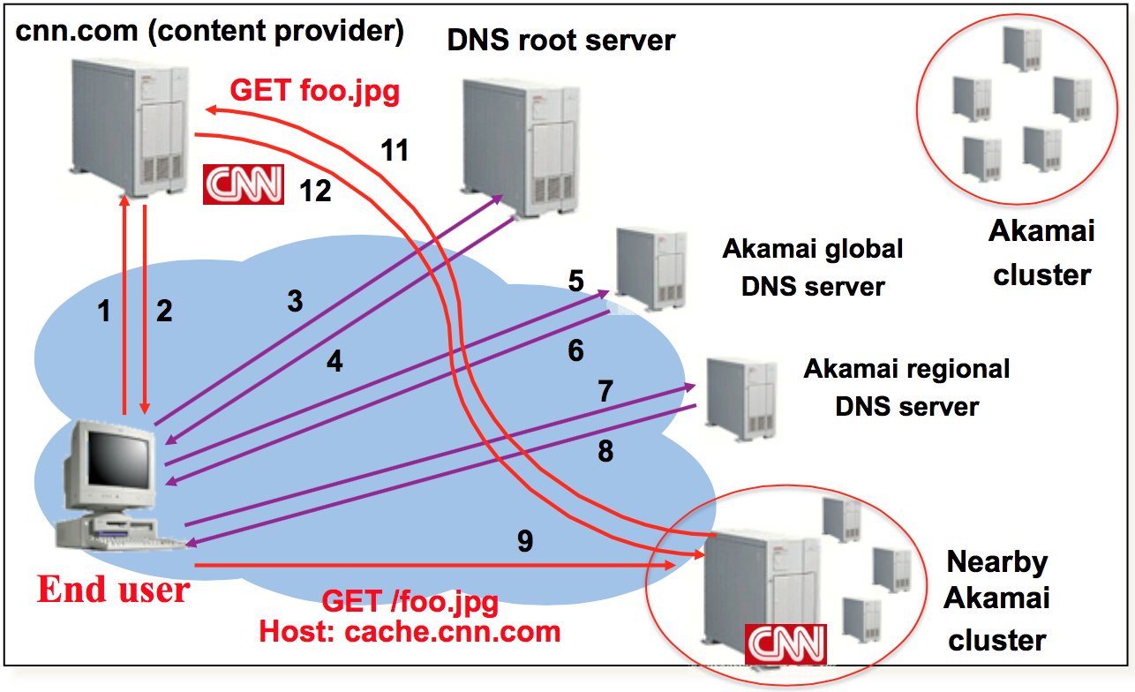
DNS-based Redirection

Slide 44
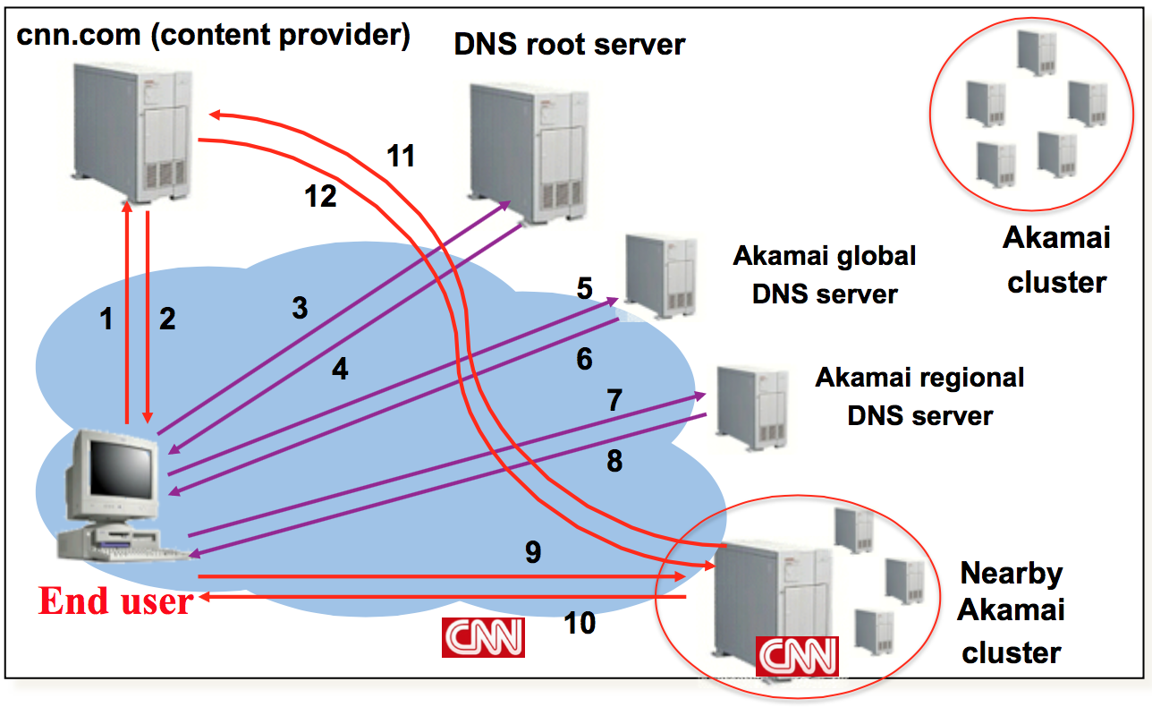
DNS-based Redirection

Slide 45
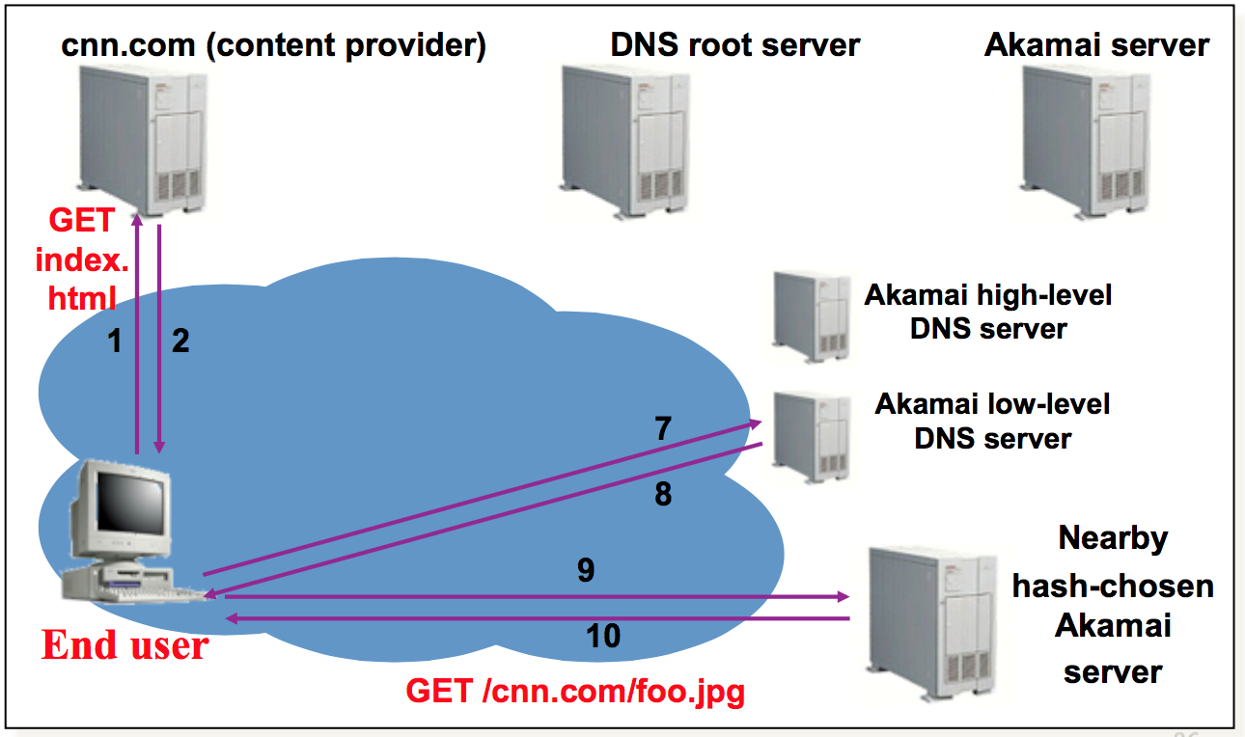
Subsequent Requests

Slide 46
Tradeoff: Anycast vs. DNS-based
Internet
Origin server
EU Clients
CDN
Edge servers
DNS-based redirection vs. Anycast
Anycast: Simplicity, reduce latency (less DNS lookup)
DNS-based redirection: Fine-grained server selection
Asia

Slide 47
Problem of DNS-based Redirection?
Third-party DNS resolvers become popular
OpenDNS, Google DNS
Better security (firewalls), less maintenance cost
Third-party DNS totally breaks the assumption of DNS-based redirection
Notes:
Finally, let’s introduce a recent trend in DNS techniques, called EDNS
The motivation is the recent emergence of third-party DNS resolvers totally breaks the DNS-based redirection.

Slide 48
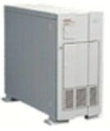
Problem of DNS-based Redirection
Picks servers near DNS resolver
Third-party DNS resolver
DNS server no longer in client’s domain.
CDN DNS server don’t see client’s IP.
Source: Jannifer Rexford (http://www.cs.princeton.edu/courses/archive/spr12/cos461/)

Slide 49
Problem of DNS-based Redirection
Picked servers = F(DNS resolver)
Google DNS, Open DNS
EDNS: include client IP prefix in DNS requests
DNS server no longer in client’s domain.
CDN DNS server don’t see client’s IP.
Source: Jannifer Rexford (http://www.cs.princeton.edu/courses/archive/spr12/cos461/)

Slide 50
Benefit of EDNS
Picked servers = F(Client IP)
DNS resolver
Why is Akamai lukewarm about switching to EDNS?

Slide 51
This lecture
Domain Name System (DNS)
Content Delivery Networks (CDN)
Extension mechanisms for DNS (EDNS)
ICN vs. CDN

Slide 52



Content Retrieval
S1
e.g., CCN, DONA, NDN, 4WARD ….
C
S2
C
C
ICN decouples “what” from “where”
Bind content names to intent
Today: 1) Ask search engine for name of server holding object
2) Resolve name to network address of server
3) Send request for object to server
Equip network with content caches
Route based on content names
e.g., find nearest replica

Slide 53

Benefits of deploying ICN
e.g., CCN, DONA, NDN, 4WARD ….
C
C
Lower latency
Reduced congestion
Support for mobility
Intrinsic security

Slide 54
Difficulties deploying ICN
e.g., CCN, DONA, NDN, 4WARD ….
C
C
Routers need to be replaced to support content-based routing and to incorporate caches
Notes:
.

Slide 55
Approach: Attribute gains to tenets
Quantitative
Qualitative
Lower latency
Reduced congestion
Support for mobility
Intrinsic security
Decouple “what” from “where”
Bind content names to intent
Equip network with content caches
Route based on content names

Slide 56
Key Takeaways
To achieve quantitative benefits:
Just cache at the “edge”
→With Zipf-like object popularities, pervasive caching and nearest-replica routing don’t add much
To achieve qualitative benefits:
Build on HTTP
Basis for incrementally deployable ICN

Slide 57
Representative points in design space
Cache Placement Request Routing
ICN-SP | Everywhere | Shortest path to origin
ICN-NR | Everywhere | Nearest replica
Edge | Only at edge nodes | Shortest path to origin
Edge-Coop | Only at edge nodes | Shortest path to origin Edge neighbors alone

Slide 58
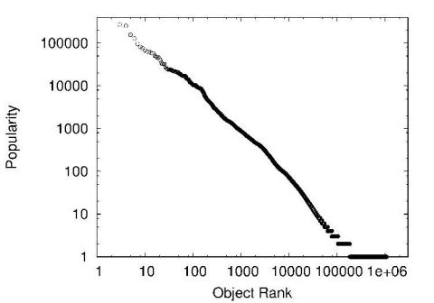
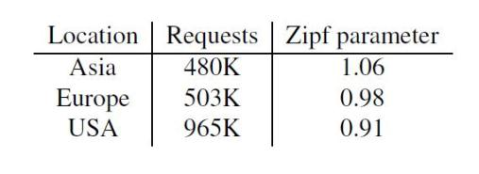
Object Popularities - Zipf Distribution
i^{th} most popular item occurs with frequency proportional to 1/i^{α}

Slide 59
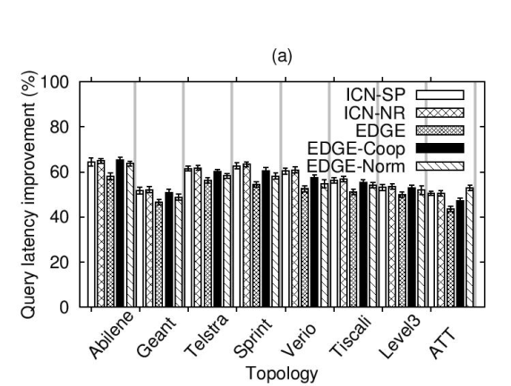
Request latency (hops) - Asia trace
Gap between all architectures is small (< 10%)
Nearest-replica routing provides almost no benefit

Slide 60
Revisiting Qualitative Aspects
Decouple names from locations
Build on HTTP
Can be viewed as providing “get-by-name” abstraction
Can reuse existing web protocols (e.g., proxy discovery)
2. Binding names to intents
Use self-certifying names
e.g., “Magnet” URI schemes
Extend HTTP for “crypto” and other metadata

Slide 61



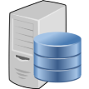

idICN: Content Registration
Name Resolution System
Register L.P.idicn.org
Reverse Proxy
P = Hash of public key
L = content label
Publish
content
e.g., http://en.5671….fda627b.idicn.org/wiki/
Origin Server

Slide 62

idICN: Client Configuration
Name Resolution System
Proxy
Edge
Cache
Reverse Proxy
Automatic Proxy Discovery
e.g., WPAD
Client
Origin Server

Slide 63
idICN: Content Delivery
Name Resolution System
2. Name resolution
3. Rqst by address
Proxy
Edge
Cache
Reverse Proxy
5. Response + Metadata
1. Rqst L.P.idicn.org
4. Fetch
6. Response
Client
Origin Server

Slide 64
Conclusions
Motivation: Gains of ICN with less pain
Latency, congestion, security
Without changes to routers or routing!
End-to-end argument applied to ICN design space
Can get most quantitative benefits with “edge” solutions
Pervasive caching, nearest-replica routing not needed
Can get qualitative benefits with existing techniques
With existing HTTP + HTTP-based extensions
Incrementally deployable + backwards compatible
idICN design: one possible feasible realization
Open issues: economics, other benefits, future workloads ..

Slide 65
Workload and Caching
What workload do you expect for different servers/names?
Why might this be a problem? How can we solve this problem?
DNS responses are cached
Quick response for repeated translations
Other queries may reuse some parts of lookup
NS records for domains
DNS negative queries are cached
Don’t have to repeat past mistakes
E.g. misspellings, search strings in resolv.conf
Cached data periodically times out
Lifetime (TTL) of data controlled by owner of data
TTL passed with every record

Slide 66
Reverse Name Lookup
128.2.206.138?
Lookup 138.206.2.128.in-addr.arpa
Why is the address reversed?
Happens to be www.intel-iris.net and mammoth.cmcl.cs.cmu.edu → what will reverse lookup return? Both?
Should only return name that reflects address allocation mechanism

Slide 67
Prefetching
Name servers can add additional data to any response
Typically used for prefetching
CNAME/MX/NS typically point to another host name
Responses include address of host referred to in “additional section”

Slide 68
New Registrars
Network Solutions (NSI) used to handle all registrations, root servers, etc…
Clearly not the democratic (Internet) way
Large number of registrars that can create new domains → However, NSI still handle root servers

Slide 69
Do you trust the TLD operators?
Wildcard DNS record for all .com and .net domain names not yet registered by others
September 15 – October 4, 2003
February 2004: Verisign sues ICANN
Redirection for these domain names to Verisign web portal (SiteFinder)
What services might this break?

Slide 70
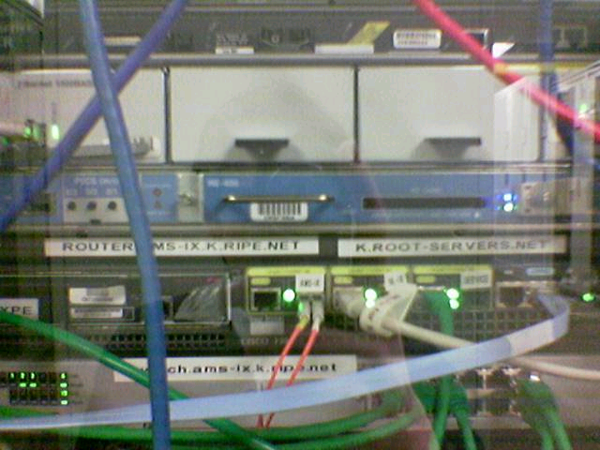
Protecting the Root Nameservers
Attack On Internet Called Largest Ever David McGuire and Brian Krebs, Washington Post 2002-10-23
The heart of the Internet sustained its largest and most sophisticated attack ever, starting late Monday, according to officials at key online backbone organizations.
Around 5:00 p.m. EDT on Monday, a "distributed denial of service" (DDOS) attack struck the 13 "root servers" that provide the primary roadmap for almost all Internet communications. Despite the scale of the attack, which lasted about an hour, Internet users worldwide were largely unaffected, experts said.
Sophisticated? Why did nobody notice?
seshan.org. 13759 NS www.seshan.org.
Defense Mechanisms
Redundancy: 13 root nameservers
IP Anycast for root DNS servers {c,f,i,j,k}.root-servers.net
RFC 3258
Most physical nameservers lie outside of the US

Slide 71
Design Choices of Akamai (1)
Internet
Origin server
EU Clients
CDN
How/where to replicate content?
High performance, fault tolerance
Edge servers
Multipath overlay routing to reduce loss
Recover packet losses by redundancy
Two-layer cache structure
Cache miss handled by an intermediate layer
Consistent hashing for replica placement
Replace < N/k items when one server is down.
Asia

Slide 72
Design Choices of Akamai (2)
Internet
Origin server
EU Clients
CDN
Edge servers
How to find replicated content?
Mapping system
Asia

Slide 73
Mapping System
Map a client IP to a server
Pick server of the best performance
Equivalence classes of IP addresses
IP addresses experiencing similar performance
Data-Driven: Collect and combine measurements
Traceroute, BGP feeds, server logs
Latency, loss rate, cluster health
Big data: 100 TB per day, update every minute
Notes:
The basic function of mapping system is to map XXX
There are two key ideas:
XXX
XXX

Slide 74
Mapping System
Client ➔ Cluster
Based on client-to-cluster performance
Updated every minute
Cluster ➔ Server
Load balancing
Maximizes cache hit rate (hashing)
Notes:
Mapping system uses two steps to map a client to a server

Slide 75
Design Choices of Akamai (2)
Internet
Origin server
EU Clients
CDN
Edge servers
How to direct client towards a replica?
HTTP redirection (rewriting URL)
No redirection transparency
Anycast
No direct control on replica selection
DNS-based redirection
Asia

