Slide 1
BitTyrant: Do incentives build robustness in BitTorrent?
Robert Maratos
15-744 Computer Networks

Slide 2
Tit for Tat
BitTorrent’s fairness strategy
Encourages users to upload chunks of the file to receive a faster download in return
Meant to prevent free loaders

Slide 3
BitTorrent Active Set Selection
Active set = set of peers to send torrent data to, called “unchoked”
Determined by rate-based TFT algorithm based on how much the peer sends to you and other peers
Send to peers which you got the most data from in a time period

Slide 4
How do new users start downloading?
During every active set calculation, a few peers are randomly chosen,
  ”optimistically unchoked”
Allows new peers with potential to be introduced to a swarm
Will be removed from the active set if they don’t impress, “choked”

Slide 5
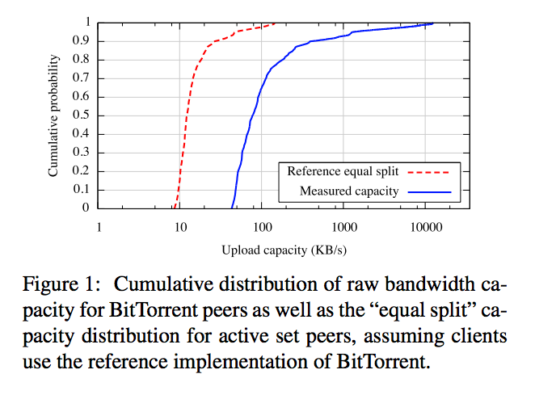
Researching Live BitTorrent Swarms
Most popular torrents can be joined by anyone
Connect to as many swarms and peers as you can and then measure their bandwidth capacity
Paper was able to observe 301,595 IP addresses over 48 hours in 2006

Slide 6
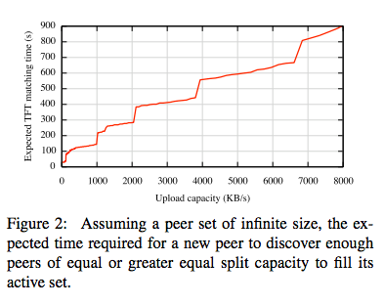
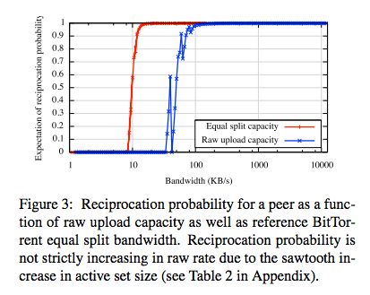
Observations
Difficult for high bandwidth peers to find other high bandwidth peers
Once upload bandwidth passes a certain point, chance of , you are guaranteed to get a download
Any extra upload bandwidth is “extra”, altruistic

Slide 7
Do TFT incentives create robustness?
Robustness = system performance cannot be strategically manipulated by users
“No” – majority of BitTorrent performance comes from altruism from high bandwidth peers, not from TFT
Strategies utilized by BitTyrant:
  Maximize reciprocation bandwidth per connection
    Find peers who give the most when you give the least
  Maximize number of reciprocating peers
    Add as many peers as possible until it is no longer beneficial
  Deviate from equal split
    Don’t evenly divvy up bandwidth, base it on how much you get from each peer

Slide 8
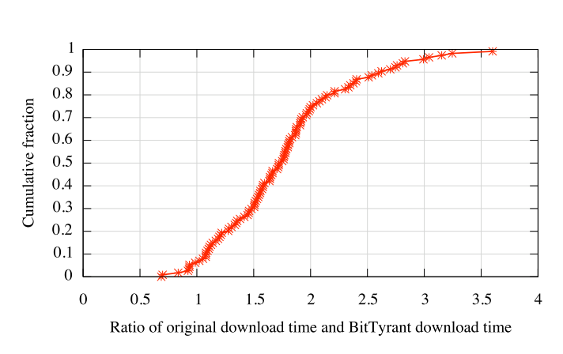
Results for a Single Strategic Peer
BitTyrant client joined popular streams for large files
Median download is 1.72 times faster than regular BitTorrent client
A small number of downloads were smaller because of the randomness involved in choosing initial peers

Slide 9
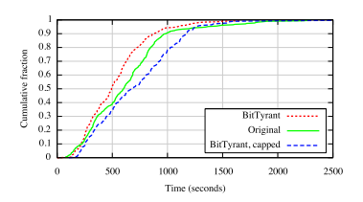
What if everyone uses BitTyrant?
Strategic vs Strategic and Selfish
If everyone is strategic, high capacity peers need many connections and increase overall swarm bandwidth making downloads faster
If everyone is selfish, low bandwidth peers can’t benefit from extra altruism and overall download performance decreases

Slide 10
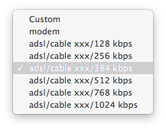
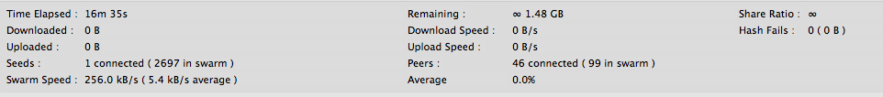
BitTyrant is 10 Years Old
It could run but downloading an Ubuntu ISO didn’t seem to work

Slide 11
Questions?

