Slide 1
15-744: Computer Networking
L-16 Network Measurement

Slide 2
Outline
Motivation
Three case studies:
Internet Topology
Bandwidth Map
Internet Latency

Slide 3
Why network measurement?
Help understand the network (Internet)
E.g. Topology (ISP don’t usually publish this)
Useful for modeling and simulation
Identify problems and bottlenecks
Where do we need more investment?
Which link is down (now)?
Improve application/user experience
End-to-end performance is key to UE…
…UE means money

Slide 4
What to measure?
Network topology
Connectivity, redundancy, coverage
Network performance
Bandwidth, latency, jitter, utility
Types of protocols/applications
TCP/UDP/ICMP, P2P/Client-server
Application specific data
Video player: buffering time, bitrate
Web service: page load time

Slide 5
How to measure?
A lot of general tools
Traceroute, ping, iperf, etc.
Components built in applications
E.g. video player could log buffering time
ISPs knows better about their own network
But usually not public
Passive and active
Pure listening vs. inject traffic
Overhead difference

Slide 6
Outline
Motivation
Three case studies:
Internet Topology
Faloutsos’99, Li’04
Bandwidth Map
Internet Latency

Slide 7
Why study topology?
Correctness of network protocols typically independent of topology
Performance of networks critically dependent on topology
e.g., convergence of route information
Identifying good topologies and mechanism design for them
Internet impossible to replicate
Modeling of topology needed to generate test topologies

Slide 8
Internet topologies
AT&T
AT&T
MCI
SPRINT
MCI
SPRINT
Router level
Autonomous System (AS) level

Slide 9
Router level vs. AS level
Router level topologies reflect physical connectivity between nodes
Inferred from tools like traceroute or well known public measurement projects like Mercator and Skitter
AS graph reflects a peering relationship between two providers/clients
Inferred from inter-domain routers that run BGP and public projects like Oregon Route Views

Slide 10
Hub-and-Spoke Topology
Single hub node
Common in enterprise networks
Main location and satellite sites
Simple design and trivial routing
Problems
Single point of failure
Bandwidth limitations
High delay between sites
Costs to backhaul to hub

Slide 11
Simple Alternatives to Hub-and-Spoke
Dual hub-and-spoke
Higher reliability
Higher cost
Good building block
Levels of hierarchy
Reduce backhaul cost
Aggregate the bandwidth
Shorter site-to-site delay
…

Slide 12
Waxman model (Waxman 1988)
Observation: Long-range links are expensive
Nodes placed at random in 2-d space with dimension L
Probability of edge (u,v):
ae^{-d/(bL)}, where d is Euclidean distance (u,v), a and b are constants
Models locality
u
d(u,v)
v

Slide 13
Transit-stub model (Zegura 1997)
Observation: Real networks exhibit
Hierarchical structure
Specialized nodes (transit, stub..)
Connectivity requirements
Redundancy
Characteristics incorporated into the Georgia Tech Internetwork Topology Models (GT-ITM) simulator (E. Zegura, K.Calvert and M.J. Donahoo, 1995)

Slide 14
Transit-stub model (Zegura 1997)
Transit domains
placed in 2-d space
populated with routers
connected to each other
Stub domains
placed in 2-d space
populated with routers
connected to transit domains
Models hierarchy

Slide 15
So…are we done?
No!
In 1999, Faloutsos, Faloutsos and Faloutsos published a paper, demonstrating power law relationships in Internet graphs
Specifically, the node degree distribution exhibited power laws
That Changed Everything…..

Slide 16
Power Law Measurement Methodology
AS level topology
Collect BGP routing information from many routers
Router level topology
Traceroute between a lot of pairs of nodes
Two IP addresses correspond two the same node if the their names (inverse DNS) are the same

Slide 17
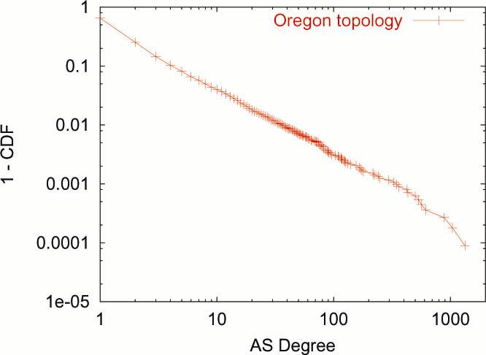
Power laws in AS level topology

Slide 18
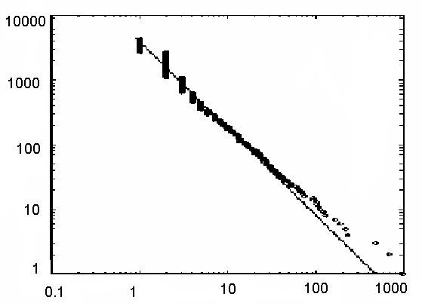
Power Laws and Internet Topology
Source: Faloutsos et al. (1999)
Most nodes have few connections
Rank R(d)
R(d) = P (D>d) x #nodes
Degree d
A few nodes have lots of connections
Router-level graph & Autonomous System (AS) graph
Led to active research in degree-based network models

Slide 19
GT-ITM abandoned..
GT-ITM did not give power law degree graphs
New topology generators and explanation for power law degrees were sought
Focus of generators to match degree distribution of observed graph

Slide 20
Features of Degree-Based Models
Preferential Attachment
Expected Degree Sequence
Degree sequence follows a power law (by construction)
High-degree nodes correspond to highly connected central “hubs”, which are crucial to the system
Achilles’ heel: robust to random failure, fragile to specific attack

Slide 21
Problem With Power Law
... but they're descriptive models!
Many graphs with similar distribution have different properties
No correct physical explanation, need an understanding of practical issues:
the driving force behind deployment
the driving force behind growth

Slide 22
Li et al. 2004(HOT)
Consider the explicit design of the Internet
Annotated network graphs (capacity, bandwidth)
Technological and economic limitations
Network performance
Seek a theory for Internet topology that is explanatory and not merely descriptive.
Explain high variability in network connectivity
Ability to match large scale statistics (e.g. power laws) is only secondary evidence
Notes:
Why do we have the power law distribution?

Slide 23
Router Technology Constraint
10
3
Cisco 12416 GSR, circa 2002
high BW low degree
Total Bandwidth
high degree low BW
10
2
1
Bandwidth per Degree
10
Bandwidth (Gbps)
15 x 10 GE
0
15 x 3 x 1 GE
10
15 x 4 x OC12
15 x 8 FE
Technology constraint
10
-1
10
0
10
1
Degree
10
2

Slide 24
Aggregate Router Feasibility
core technologies
approximate
aggregate
feasible region
older/cheaper
technologies
edge technologies
Source: Cisco Product Catalog, June 2002
Notes:
So what does this suggest?
Not possible to have high bw – high degree router as the hub nodes.

Slide 25
Variability in End-User Bandwidths
1e4
high
performance
computing
Ethernet
1-10Gbps
1e3
academic
and corporate
1e2
Ethernet
10-100Mbps
Connection Speed (Mbps)
a few users have very high speed connections
residential and
small business
1e1
Broadband
Cable/DSL
~500Kbps
1
1e-1
most users
have low speed connections
Dial-up
~56Kbps
1e-2
1
1e2
1e4
1e6
1e8
Rank (number of users)
Notes:
It look sat the end-user bandwidth demands, there is great variability in the availability and/or willingness-to-pay for bandwidth on the part of customers at the edge. Although a few users have very high speed connections, most users have low speed connections.
Given these facts, what will a ISP do? The goal of the ISP is to minimize cost.
The cost of links creates an economic incentive to aggregate traffic as close to the edge as possible.
The variability in edge connectivity speeds thus creates variability in the connectivity at edge routers.

Slide 26
Heuristically Optimal Topology
Mesh-like core of fast, low degree routers
Cores
High degree nodes are at the edges.
Edges
Hosts

Slide 27
Intermountain
GigaPoP
U. Memphis
Northern Lights
Indiana GigaPoP
Front Range
GigaPoP
Great Plains
U. Louisville
Merit
OARNET
WiscREN
Qwest Labs
OneNet
Arizona St.
NCSA
StarLight
U. Arizona
Iowa St.
MREN
Oregon
GigaPoP
NYSERNet
Pacific
Wave
UNM
Kansas
City
Indian-
apolis
WPI
Pacific
Northwest
GigaPoP
Denver
Northern
Crossroads
Seattle
Chicago
SINet
U. Hawaii
ESnet
New York
SURFNet
AMES NGIX
GEANT
WIDE
Sunnyvale
Wash
D.C.
Rutgers U.
CENIC
Los Angeles
MANLAN
UniNet
Houston
Atlanta
North Texas
GigaPoP
TransPAC/APAN
SOX
PSC
MAGPI
Texas Tech
SFGP/
AMPATH
DARPA
BossNet
Mid-Atlantic
Crossroads
Abilene Backbone
Physical Connectivity
(as of December 16, 2003)
Texas
GigaPoP
Miss State
GigaPoP
UMD NGIX
Drexel U.
0.1-0.5 Gbps
0.5-1.0 Gbps
1.0-5.0 Gbps
5.0-10.0 Gbps
UT Austin
LaNet
Florida A&M
U. Florida
UT-SW
Med Ctr.
U. Delaware
Tulane U.
U. So. Florida
NCNI/MCNC

Slide 28
Summary Topology Measurement
Faloutsos’99 on Internet topology
Observed “power laws” in Internet structure
Router level, AS-level, neighborhood sizes
Inspired degree-based topology generators
What is wrong with these topologies? Li’04
Many graphs with similar distribution have different properties
Should look at fundamental technology constraints and economic trade-offs
Thought
Network measurement is a function system response. It’s always better to know what the system is like first.

Slide 29
Outline
Motivation
Three case studies:
Internet Topology
Bandwidth Map
Sun’14
Internet Latency

Slide 30
Motivation
Measuring BW between nodes is easy
Iperf…
How about a real-time traffic map of Internet?
CDNs could have better server selection
P2P application choose the best peer
Network diagnoses and trouble-shooting
Think about Google Map for real-world traffic

Slide 31
Challenges
Coverage
Need millions of vantage points
Overhead
BW measurements usually inject non-trivial traffic to the network
(Near) real-time views
Even bigger overhead

Slide 32
Opportunity
Idea: infer traffic map from video player statistics
The growing volume of Internet video traffic (Coverage)
Accounts for 30%-50% of total traffic
30M NetFlix streaming subscribers
And the ability to instrument video players （Overhead, real-time)
Companies are already doing this

Slide 33
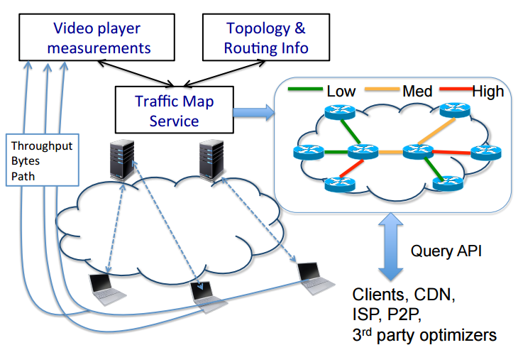
Overview of Service
Capacity & Utilization

Slide 34
…Yet Still Challenges
Video measurements provide estimates of end-to-end throughput
Not per link
Not capacity/utilization
No information about background traffic
Unobserved video & non-video traffic

Slide 35
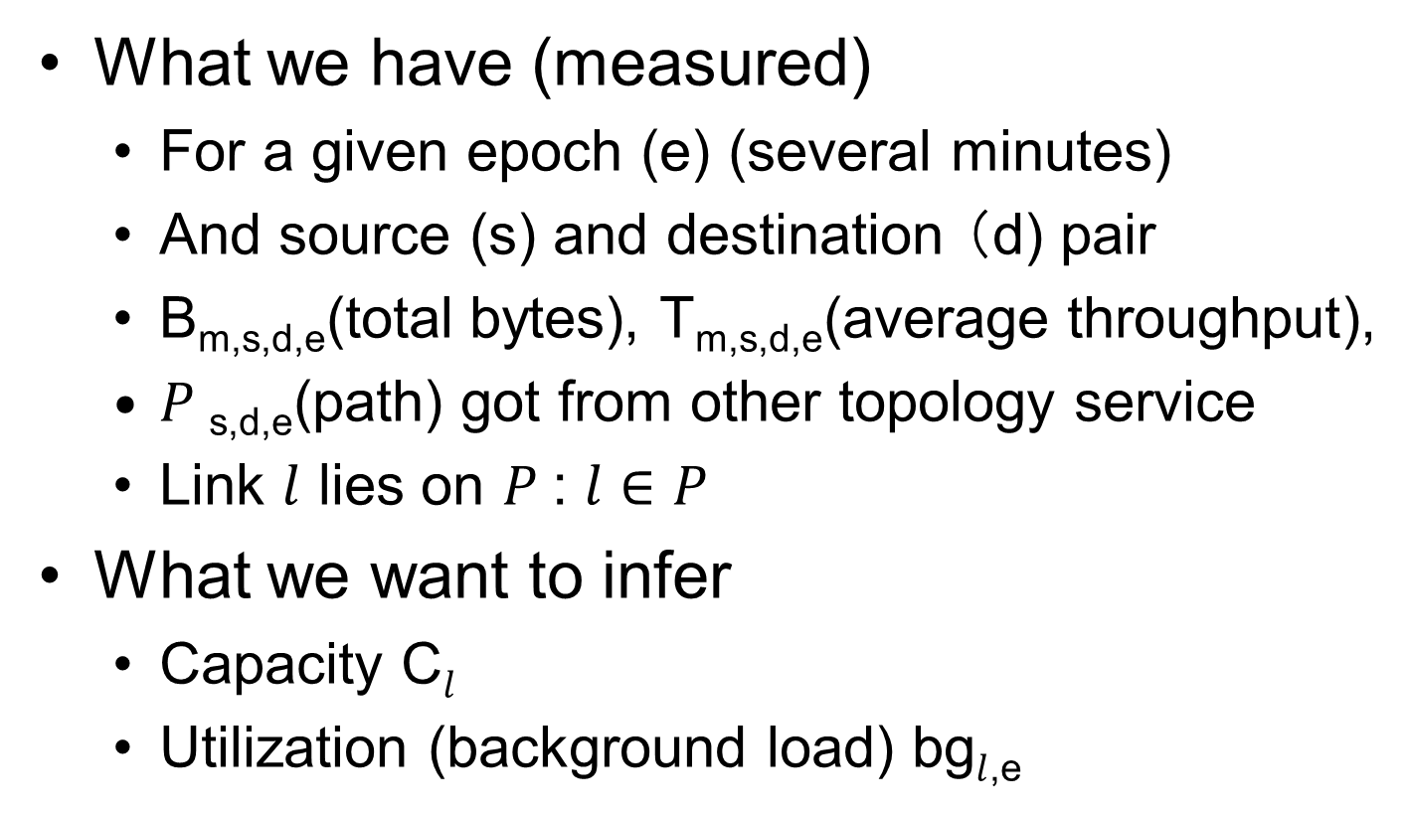
Problem definition

Slide 36

Inferring Capacity
Use max observed throughput?
Simple, but not accurate
Actually gives a lower bound
Problems
Tend to underestimate (background traffic)
Fails to consider confluence of flows
Practical aspects: capacity are likely drawn from discrete set of values (e.g. 1Gbps)
Practical aspects: ISPs tend to minimize cost

Slide 37
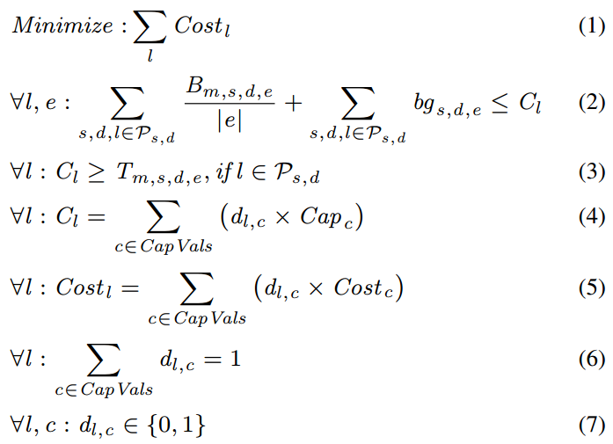
Inferring Capacity Continued…
Confluence of flows & background traffic
Minimize cost
Discrete capacities

Slide 38
Side Information to Help
Because original problem is hard to solve
Candidate side information:
Gravity models: The traffic volumes between a s, d pair is roughly proportional to the products of the total traffic volume originating in s and d.
Measurement vs. Background ratio: e.g., YouTube is ≈ 18% of peak traffic
Overprovisioning: network core links are typically overprovisioned to run at γ=30-40% link utilization on average.

Slide 39

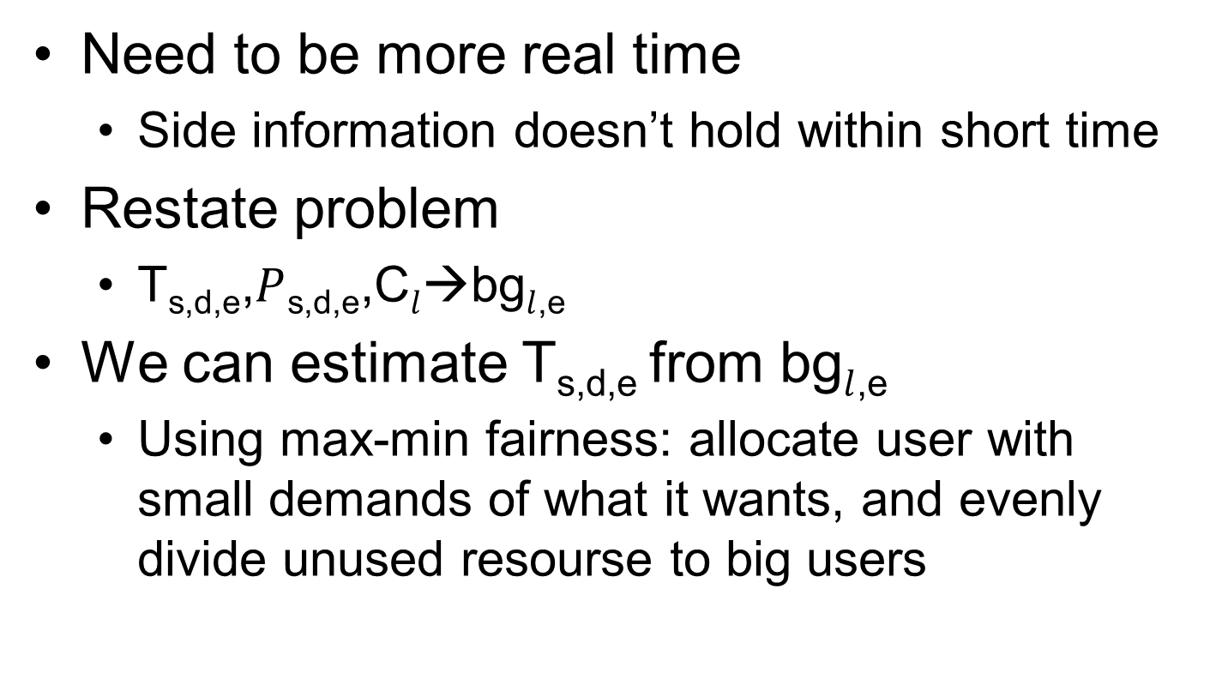
Inferring Utilization
Need to be more real time
Side information doesn’t hold within short time
Restate problem
T_{s,d,e},$P$_{s,d,e},C$l$→bg$l$_{,e}
We can estimate T_{s,d,e} from bg$l$_{,e}
Using max-min fairness: allocate user with small demands of what it wants, and evenly divide unused resourse to big users

Slide 40
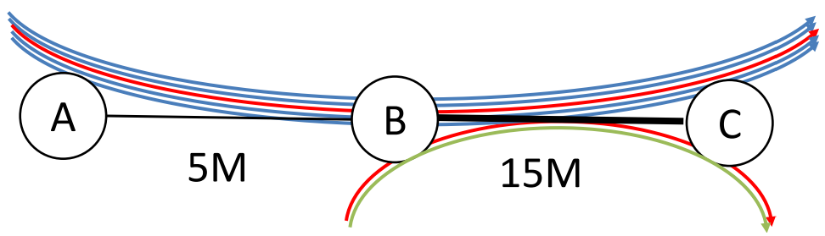
Inferring Utilization - Example
Each A-C flow gets 1M, B-C flow gets 5M
T_{A,C}=1M, T_{B,C}=5M
Suppose measured 1 AC and 1 BC link
If bg_{a,c}=4.5M, bg_{b,c}=13.5M, then T^{Est}_{A,C}=0.5M, T^{Est}_{B,C}=1M
If bg_{a,c}=4M, bg_{b,c}=9M, then T^{Est}_{A,C}=1M, T^{Est}_{B,C}=5M

Slide 41
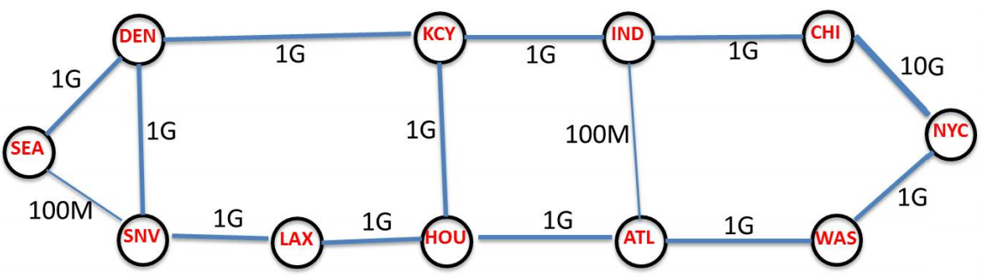
Evaluation – Simulation Setup
Synthesized traffic patterns
Sensitivity
Number of epochs
Background vs. measurement traffic ratio
Accuracy of capacity inference

Slide 42
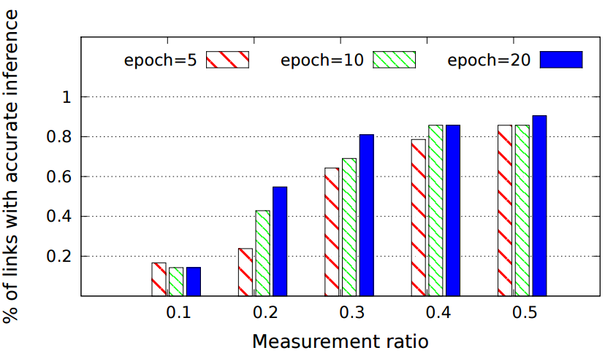
Evaluation – Capacity Accuracy

Slide 43
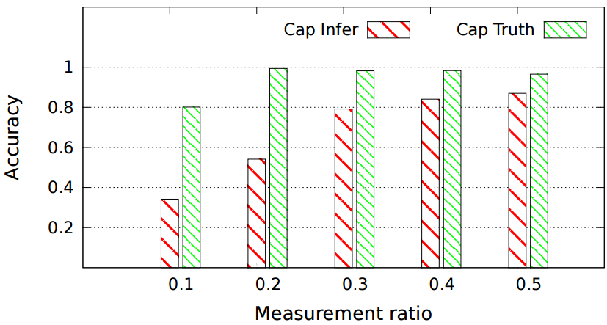
Evaluation – Utilization Accuracy

Slide 44
Summary Bandwidth Measurement
Early stage work (Sun’14) on traffic map
Leverage the popularity of video players
Low overhead and high coverage
The data is straight-forward to collect, but
Converting from end-to-end measurements to per-link number is hard
Converting from throughput to capacity is hard
Thought
The interesting fact may be hidden (deep) under the things we (can) measure

Slide 45
Outline
Motivation
Three case studies:
Internet Topology
Bandwidth Map
Internet Latency
Singla’14, Li’10

Slide 46
Value of (Very) Low Latency
User experience
Response within 30ms→illusion of zero wait-time
Money
A 100ms latency penalty for Amazon→1% loss
Cloud computing & thin clients
Desktop as a service
Computation offload from mobile devices
New applications
E.g. Telemedicine

Slide 47
Latency Lags Bandwidth
The improvement of b/w has been huge
It’s easier…
Easier to market
Average Internet connection is 11.5Mbps in US
Reducing latency is harder
Usually requires structural change of network
Can we build a “speed of light” Internet?
First let’s look at why it is slow? (Singla’14)

Slide 48
Wait, don’t CDNs solve the problem?
They do help to some extent, but…
It doesn’t help for all applications
E.g. telemedicine
CDNs are expensive
Available only to larger Internet companies
Lower Internet latency also helps to reduce CDN deployment cost

Slide 49
Latency Measurement Methodology
Fetch web pages using cURL
just the HTML for the landing pages
28,000 Web sites from 186 PlanetLab locations
Obtain time for
DNS resolution
TCP handshake: between SYN and SYN-ACK
TCP transfer: actual data transmission
Total

Slide 50
Latency Measurement Methodology Cont.
Also ping the Web servers for 30 times
Log min and median
traceroute from PlanetLab nodes to servers
Then geolocate each router/server using commercial geolocation services
Geolocation (based on IP) is not accurate
Use multiple services
Results are not sensitive to specific service

Slide 51
Important Concepts
C-latency:
Time for light to travel between client & server (shortest path)
Router path latency:
Time for light to travel through each router
Latency inflation:
measured time/c-latency

Slide 52
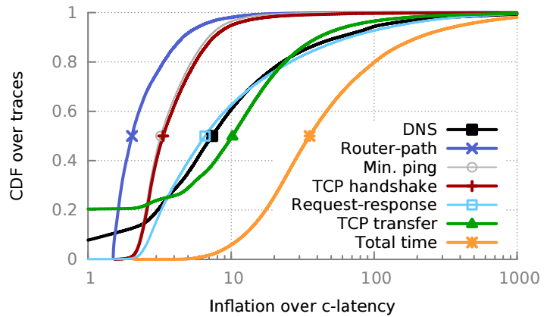
Result Overview
PlanetLab nodes are well-connected, so real world results are probably worse

Slide 53
Result Overview - Summary
Total latency inflation:
35.4 (median); 100 (80th percentile)
Protocol overhead
DNS (7.4) and TCP handshake （3.4）
But minimum ping is also 3.2 inflated
Suggests inefficiency in lower layers…
Very tail heavy distribution

Slide 54
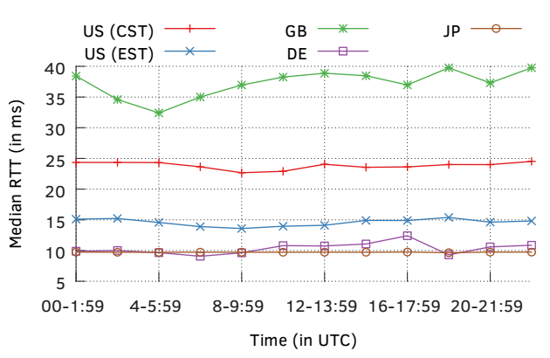
Is Congestion the Problem?
Log RTT (TCP SYN and SYN-ACK) over 24-hour time period
Variation is generally small

Slide 55
Infrastructure Inflation
Router path is 2x inflated (median)
Suggests inefficiency in route selection
Not too bad since speed of light in fiber is ~2/3rd the speed of light in vacuum
Then why is pinging still 3.2x inflated?
1) Traceroute may not yield response from all routers
2) Physical path of links may not follow shortest path for geological and economical reasons

Slide 56
Absolute Numbers (Li’10)
Consider client-server applications where server is running in the cloud
Methodology
Instantiate an instance in each data center of the cloud provider
Ping these instances from 200 PlanetLab nodes
Record the minimum RTT
The best latency you can get with today’s cloud

Slide 57
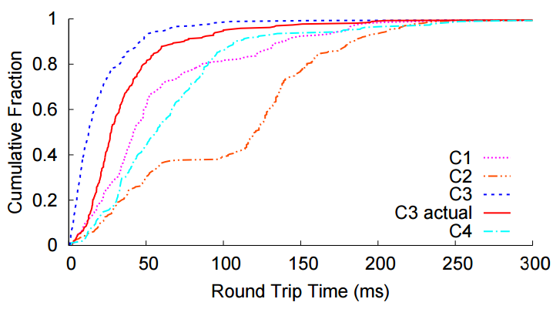
Latency to Closest Cloud
Using Amazon (C1), average RTT is 74ms

Slide 58
Summary Latency Measurement
Singla’14 proposes an ambitious goal
Cut Internet latency to the limit of speed of light
Will likely benefit many applications
Why is today’s Internet so slow?
Infrastructural inefficiency
Protocol overhead
Li’10 studied the latency to cloud
Many tens of milliseconds of latency
Long tail distribution
Thought
Detailed measurements are a good way to locate bottlenecks of the system

