Slide 1
15-744: Computer Networking
L-15 Data Center Networking III

Slide 2
Announcements
Midterm – next Wednesday 3/7
Project meeting slots – will be posted on Piazza by Wednesday
Slots mostly during lecture time on Friday

Slide 3
Overview
DCTCP
Pfabric
RDMA

Slide 4

Data Center Packet Transport
Large purpose-built DCs
Huge investment: R&D, business
Transport inside the DC
TCP rules (99.9% of traffic)
How’s TCP doing?

Slide 5
TCP in the Data Center
We’ll see TCP does not meet demands of apps.
Suffers from bursty packet drops, Incast [SIGCOMM ‘09], ...
Builds up large queues:
Adds significant latency.
Wastes precious buffers, esp. bad with shallow-buffered switches.
Operators work around TCP problems.
Ad-hoc, inefficient, often expensive solutions
No solid understanding of consequences, tradeoffs

Slide 6







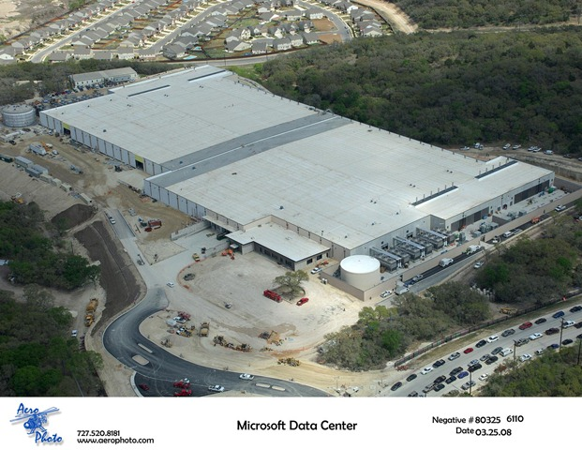










Partition/Aggregate Application Structure
1.
Picasso
Art is…
TLA
Deadline = 250ms
2. Art is a lie…
3.
…..
Picasso
Time is money
Strict deadlines (SLAs)
Missed deadline
Lower quality result
MLA
………
MLA
1. Art is a lie…
1.
Deadline = 50ms
2.
2. The chief…
…..
3.
…..
3.
“Bad artists copy.
Good artists steal.”
“The chief enemy of creativity is good sense.“
“I'd like to live as a poor man
with lots of money.“
“Computers are useless.
They can only give you answers.”
“Everything you can imagine is real.”
“It is your work in life that is the ultimate seduction.“
“Inspiration does exist,
but it must find you working.”
“Art is a lie that makes us
realize the truth.
Deadline = 10ms
Worker Nodes

Slide 7
Generality of Partition/Aggregate
The foundation for many large-scale web applications.
Web search, Social network composition, Ad selection, etc.
Example: Facebook
Partition/Aggregate ~ Multiget
Aggregators: Web Servers
Workers: Memcached Servers
Internet
Web
Servers
Memcached Protocol
Memcached Servers

Slide 8



Workloads
Partition/Aggregate
(Query)
Short messages [50KB-1MB]
(Coordination, Control state)
Large flows [1MB-50MB]
(Data update)
Delay-sensitive
Delay-sensitive
Throughput-sensitive
Notes:
Replace PDF

Slide 9


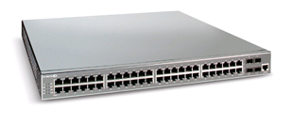
Incast: Cluster-based Storage Systems
Synchronized Read
1
R
R
R
R
2
Client
Switch
3
1
2
3
4
Server
Request Unit
(SRU)
Client now sends
next batch of requests
4
Storage
Servers
Data Block
Notes:
Data is striped across multiple servers for reliability (coding/replication) and performance. Also aids in incremental scalability.
To read this data a client performs a “Synchronized Read” operation.
The client reads data one data-block at a time. The portion of a data block stored by each server is called a SRU (in our terminology)
- mention that this setting is simplistic
- could have multiple clients, multiple outstanding blocks,
- describe sending of requests, responses
- the client sends out the next batch of requests only after it has received the entire data block (barrier synchronized)
To test how this read operation performs in the real world as we increase the number of servers on which we stripe data … (next slide)

Slide 10


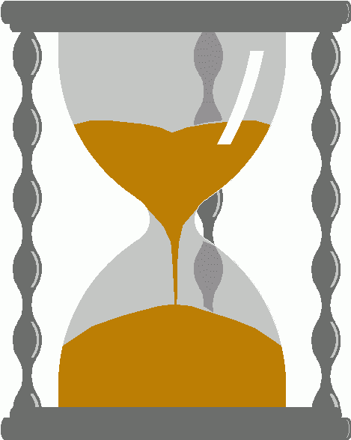
Incast
Worker 1
Synchronized mice collide.
Caused by Partition/Aggregate.
Aggregator
Worker 2
Worker 3
RTO_{min} = 300 ms
Worker 4
TCP timeout

Slide 11
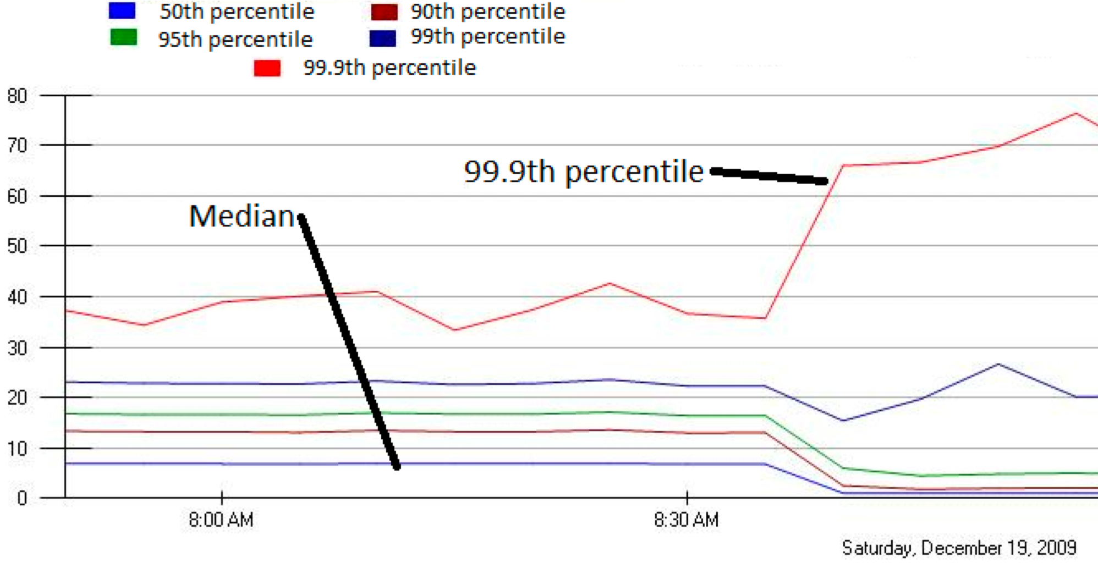
Incast in Bing
MLA Query Completion Time (ms)
Jittering trades of median for high percentiles
Requests are jittered over 10ms window.
Jittering switched off around 8:30 am.
Notes:
1. Incast really happens – see this actual screenshot from production tool
2. People care, they’ve solved it at application by jittering.
3. They care about the 99.9th percentile, 1-1000 customers

Slide 12
Queue Buildup
Sender 1
Big flows buildup queues.
Increased latency for short flows.
Receiver
Sender 2
Measurements in Bing cluster
For 90% packets: RTT < 1ms
For 10% packets: 1ms < RTT < 15ms

Slide 13
Data Center Transport Requirements
High Burst Tolerance
Incast due to Partition/Aggregate is common.
Low Latency
Short flows, queries
3. High Throughput
Continuous data updates, large file transfers
The challenge is to achieve these three together.

Slide 14
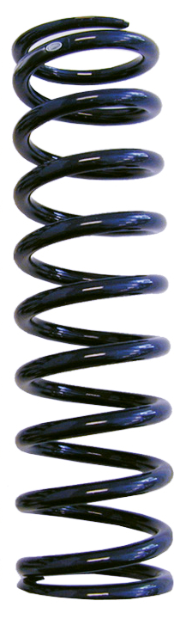
Tension Between Requirements
High Throughput
High Burst Tolerance
Low Latency
Deep Buffers:
Queuing Delays
Increase Latency
Shallow Buffers:
Bad for Bursts &
Throughput
Objective:
Low Queue Occupancy & High Throughput
Reduced RTO_{min} (SIGCOMM ‘09)
Doesn’t Help Latency
AQM – RED:
Avg Queue Not Fast
Enough for Incast
Notes:
Deep Buffers – bad for latency
Shallow Buffers – bad for bursts & throughput
Reduce RTO_{min} – no good for latency
AQM – Difficult to tune, not fast enough for incast-style micro-bursts, lose throughput in low stat-mux

Slide 15
Review: The TCP/ECN Control Loop
Sender 1
ECN = Explicit Congestion Notification
ECN Mark (1 bit)
Receiver
Sender 2
Notes:
DCTCP is based on the existing Explicit Congestion Notification framework in TCP.

Slide 16
Two Key Ideas
React in proportion to the extent of congestion, not its presence.
Reduces variance in sending rates, lowering queuing requirements.
Mark based on instantaneous queue length.
Fast feedback to better deal with bursts.
ECN Marks | TCP | DCTCP
1 0 1 1 1 1 0 1 1 1 | Cut window by 50% | Cut window by 40%
0 0 0 0 0 0 0 0 0 1 | Cut window by 50% | Cut window by 5%

Slide 17
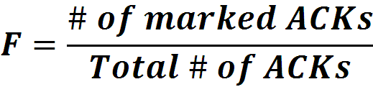

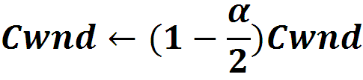
Data Center TCP Algorithm
B
K
Don’t
Mark
Switch side:
Mark packets when Queue Length > K.
Mark
Sender side:
Maintain running average of fraction of packets marked (α).
In each RTT:
Adaptive window decreases:
Note: decrease factor between 1 and 2.
Notes:
very simple marking mechanism
not all the tunings other aqms have
on the source side, the source is tryign to estimate the fraction of packets getting marked
using the obs that there is a stream of ecn marks coming back – more info in the stream than in any single bit
trying to maintain smooth rate variations to operate well even when using shallow buffers, and only a few flows (no stat mux)
F over the last RTT. In TCP there is always a way to get the next RTT from the window size. Comes from the self-clocking of TCP.
Only changing the decrease. Simplest version – makes a lot of sense. So generic could apply it to any algorithm – CTCP, CUBIC – how to cut its window leaving increase part to what it already does. Have to be careful here.

Slide 18
DCTCP in Action
(Kbytes)
Setup: Win 7, Broadcom 1Gbps Switch
Scenario: 2 long-lived flows, K = 30KB
Notes:
Not ns2.

Slide 19
Why it Works
High Burst Tolerance
Large buffer headroom → bursts fit.
Aggressive marking → sources react before packets are dropped.
Low Latency
Small buffer occupancies → low queuing delay.
3. High Throughput
ECN averaging → smooth rate adjustments, low variance.

Slide 20
Conclusions
DCTCP satisfies all our requirements for Data Center packet transport.
Handles bursts well
Keeps queuing delays low
Achieves high throughput
Features:
Very simple change to TCP and a single switch parameter.
Based on mechanisms already available in Silicon.

Slide 21
Overview
DCTCP
Pfabric
RDMA

Slide 22

DC Fabric: Just a Giant Switch
H1
H2
H3
H4
H5
H6
H7
H8
H9

Slide 23
DC Fabric: Just a Giant Switch
H1
H1
H1
H2
H2
H2
H3
H3
H3
H4
H4
H4
H5
H5
H5
H6
H6
H6
H7
H7
H7
H8
H8
H8
H9
TX
H9
H9
RX

Slide 24
DC Fabric: Just a Giant Switch
H1
H1
H2
H2
H3
H3
H4
H4
H5
H5
H6
H6
H7
H7
H8
H8
TX
H9
H9
RX

Slide 25
DC transport = Flow scheduling on giant switch
Objective?
Minimize avg FCT
H1
H1
H2
H2
H3
H3
H4
H4
H5
H5
H6
H6
H7
H7
H8
H8
TX
H9
H9
RX
ingress & egress
capacity constraints

Slide 26
“Ideal” Flow Scheduling
Problem is NP-hard ☹ [Bar-Noy et al.]
Simple greedy algorithm: 2-approximation
1
1
2
2
3
3
Notes:
State explicitly that you can’t actually build this in practice the way it is described
Central, etc

Slide 27

Key Insight
Decouple flow scheduling from rate control
Switches implement flow
scheduling via local mechanisms
Hosts implement simple rate control to avoid high packet loss
H1
H2
H3
H4
H5
H6
H7
H8
H9
Notes:
“you should not use rate control to implement flow scheduling… decouple”

Slide 28
pFabric Switch
H1
H2
H3
H4
H5
H6
H7
H8
H9
Priority Scheduling send highest priority packet first
Priority Dropping drop lowest priority packets first
5
9
3
4
Switch Port
2
3
6
7
1
small “bag” of packets per-port
prio = remaining flow size

Slide 29
pFabric Switch Complexity
Buffers are very small (~2×BDP per-port)
e.g., C=10Gbps, RTT=15µs → Buffer ~ 30KB
Today’s switch buffers are 10-30x larger
Priority Scheduling/Dropping
Worst-case: Minimum size packets (64B)
51.2ns to find min/max of ~600 numbers
Binary comparator tree: 10 clock cycles
Current ASICs: clock ~ 1ns
Notes:
Use small buffers as an advantage (not as a requirement)

Slide 30
pFabric Rate Control
With priority scheduling/dropping, queue buildup doesn’t matter
Greatly simplifies rate control
Only task for RC:
Prevent congestion collapse when elephants collide
50% Loss
H1
H2
H3
H4
H5
H6
H7
H8
H9

Slide 31
pFabric Rate Control
Minimal version of TCP algorithm
Start at line-rate
Initial window larger than BDP
No retransmission timeout estimation
Fixed RTO at small multiple of round-trip time
Reduce window size upon packet drops
Window increase same as TCP (slow start, congestion avoidance, …)
H1
H2
H3
H4
H5
H6
H7
H8
H9

Slide 32
Why does this work?
Key invariant for ideal scheduling:
At any instant, have the highest priority packet (according to ideal algorithm) available at the switch.
Priority scheduling
High priority packets traverse fabric as quickly as possible
What about dropped packets?
Lowest priority → not needed till all other packets depart
Buffer > BDP → enough time (> RTT) to retransmit
Notes:
If we step back, what are we trying to do? And tie to the conceptual ideal scheduelr
When might this invariant break?
This might happen if at an earlier point in time we dropped this packet because earlier high priority packets caused it to be dropped
Can this happen in pfabric’s design?
It cannot because…

Slide 33
Overview
DCTCP
Pfabric
RDMA

Slide 35
RDMA
RDMA performance typically better than TCP
Key assumption → lossless network
Need Priority Flow Control (PFC) in Ethernet

Slide 38

“Congestion Spreading” in Lossless Networks (Priority Flow Control of PFC)
PAUSE
PAUSE
PAUSE
PAUSE
PAUSE
PAUSE
PAUSE
PAUSE
PAUSE
PAUSE

Slide 39
DCQCN
Microsoft/Mellanox proposal to run congestion control for RoCEv2
Receiving NICS reflect back ECN info once per N microseconds
Sender adjusts rate in DCTCP-like fashion
Experience:
Although tree-like topology deadlocks can occur due to broadcast
Livelock issues if losses occur due to poor loss recovery
Hard to use > 2 priorities due to buffer limitations → need enough buffer to accommodate delays in pause
Simple fixes – but suggest fragile design

Slide 40
Analysis
How low can DCTCP maintain queues without loss of throughput?
How do we set the DCTCP parameters?
Need to quantify queue size oscillations (Stability).
Window Size
W*+1
W*
(W*+1)(1-α/2)
Time

Slide 41
Analysis
How low can DCTCP maintain queues without loss of throughput?
How do we set the DCTCP parameters?
Need to quantify queue size oscillations (Stability).
Packets sent in this
RTT are marked.
Window Size
W*+1
W*
(W*+1)(1-α/2)
Time

Slide 42
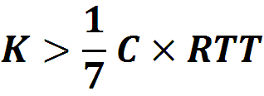
Analysis
How low can DCTCP maintain queues without loss of throughput?
How do we set the DCTCP parameters?
Need to quantify queue size oscillations (Stability).
85% Less Buffer than TCP

Slide 43
Evaluation
Implemented in Windows stack.
Real hardware, 1Gbps and 10Gbps experiments
90 server testbed
Broadcom Triumph 48 1G ports – 4MB shared memory
Cisco Cat4948 48 1G ports – 16MB shared memory
Broadcom Scorpion 24 10G ports – 4MB shared memory
Numerous micro-benchmarks
– Throughput and Queue Length
– Multi-hop
– Queue Buildup
– Buffer Pressure
Cluster traffic benchmark
– Fairness and Convergence
– Incast
– Static vs Dynamic Buffer Mgmt

Slide 44
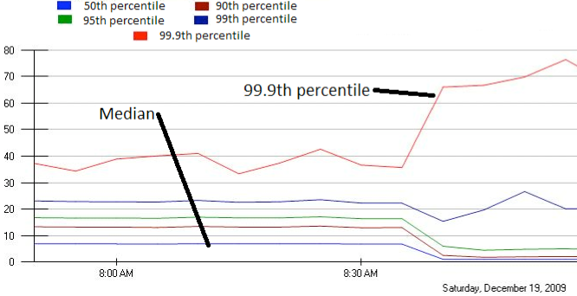
Incast Really Happens
MLA Query Completion Time (ms)
Requests are jittered over 10ms window.
Jittering switched off around 8:30 am.
99.9th percentile is being tracked.
Jittering trades off median against high percentiles.
Notes:
1. Incast really happens – see this actual screenshot from production tool
2. People care, they’ve solved it at application by jittering.
3. They care about the 99.9th percentile, 1-1000 customers

Slide 45
Overview
Data Center Overview
Routing in the DC
Transport in the DC

Slide 46
Cluster-based Storage Systems
Synchronized Read
1
R
R
R
R
2
Client
Switch
3
1
2
3
4
Server
Request Unit
(SRU)
Client now sends
next batch of requests
4
Storage
Servers
Data Block
Notes:
Data is striped across multiple servers for reliability (coding/replication) and performance. Also aids in incremental scalability.
To read this data a client performs a “Synchronized Read” operation.
The client reads data one data-block at a time. The portion of a data block stored by each server is called a SRU (in our terminology)
- mention that this setting is simplistic
- could have multiple clients, multiple outstanding blocks,
- describe sending of requests, responses
- the client sends out the next batch of requests only after it has received the entire data block (barrier synchronized)
To test how this read operation performs in the real world as we increase the number of servers on which we stripe data … (next slide)

Slide 47
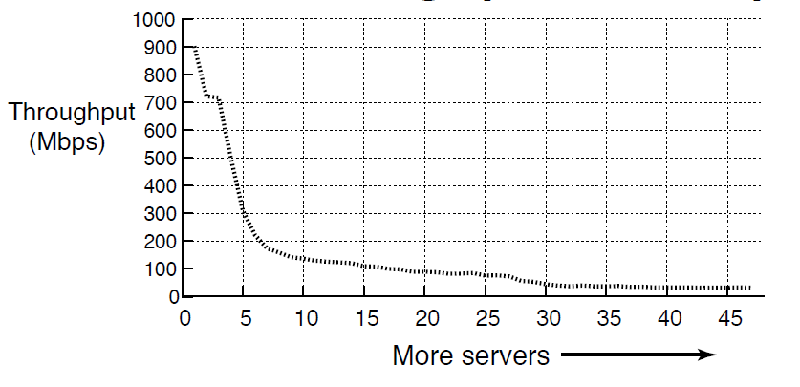
TCP Throughput Collapse
Cluster Setup
1Gbps Ethernet
Unmodified TCP
S50 Switch
1MB Block Size
Collapse!
TCP Incast
Cause of throughput collapse:
coarse-grained TCP timeouts
Notes:
And, here are the results of the experiment. On the Y axis we have Throughput (Goodput), and on the X axis we have the number of servers involved in the transfer. Initially the throughput is 900Mbps, close to the maximum achievable in the network. As we scale the number of servers, by around 7 servers we notice a drastic collapse in throughput down to 100Mbps (an order of magnitude lower than the max). This TCP throughput collapse is called TCP Incast, and the cause for this is coarse-grained TCP timeouts.

Slide 48
TCP: Loss recovery comparison
Timeout driven recovery is
slow (ms)
Data-driven recovery is
super fast (µs) in datacenters
Seq #
Seq #
1
1
Ack 1
2
2
3
Ack 1
4
3
5
Ack 1
Ack 1
4
5
Retransmit
2
Ack 5
Retransmission
Timeout
(RTO)
Sender
Receiver
Ack 1
1
Sender
Receiver
Notes:
So we have seen the 2 loss recovery mechanisms in TCP. The point to note is that timeouts are expensive, in ms, where as data-driven recovery is quick (us in datacenters)
But why are timeouts in milliseconds?

Slide 49
Link Idle Time Due To Timeouts
Synchronized Read
1
R
R
R
R
2
4
Client
Switch
3
1
2
3
4
Server
Request Unit
(SRU)
4
Req.
sent
Rsp.
sent
4 dropped
Response
resent
1 – 3 done
time
Link Idle!
Notes:
Let us revisit the synchronized reads scenario (in parallel filesystems) to understand why timeouts cause link idle time (and hence throughput collapse).
Setting: SRU contains only one packet worth of information for simplicity.
If 4 is dropped, when server 4 is timing out, the link is idle – no one is utilizing the available bandwidth.

Slide 50
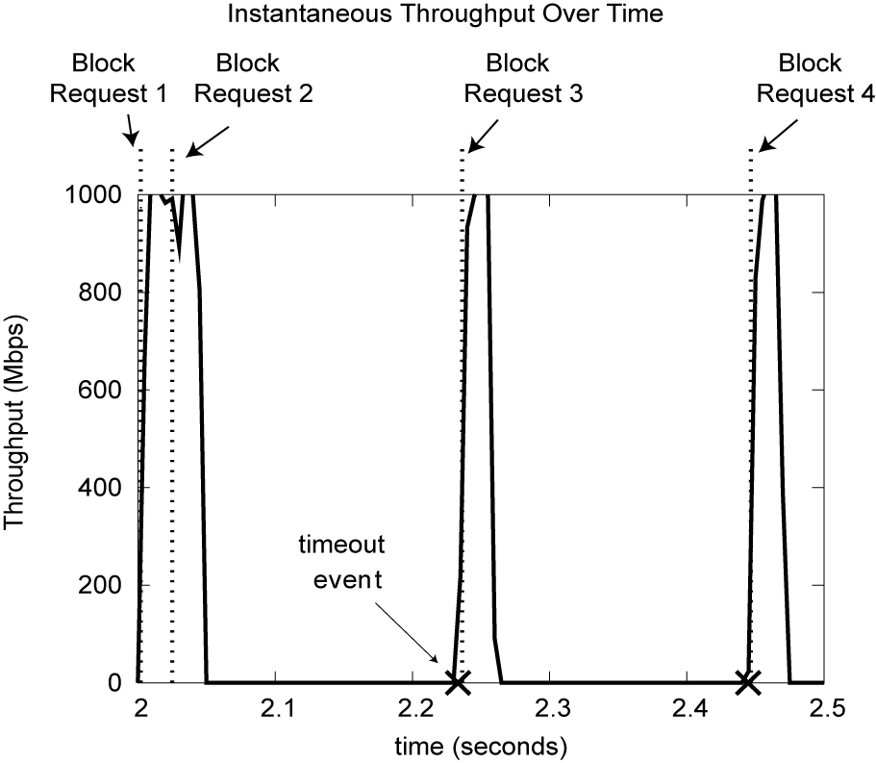
Client Link Utilization
Link Idle!
200ms
Notes:
Another way to visualize this is to look at the client link utilization when the transfer was taking place.
Y axis = Throughput
X axis = time
Let us consider only 1 block transfer (Block 2). When servers send their responses, the client link utilization reaches a peak (all links are 1Gbps). But one of the servers experiences losses and has to fallback on timeout driven loss recovery. When the remaining servers involved in the read finish their transfers, the link is idle (for 200ms in this example), just before the timeout event occurs and the final server completes the transfer. Once the entire data block is received, the request for the next data block can be sent out.
{ This is a visualization of a simulation run }

Slide 51
Default minRTO: Throughput Collapse
Unmodified TCP
(200ms minRTO)
Notes:
Same graph as before – synchronized reads, unmodified TCP on servers.

Slide 52
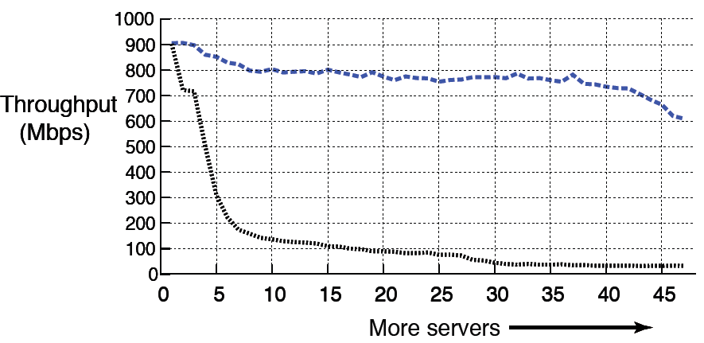
Lowering minRTO to 1ms helps
1ms minRTO
Unmodified TCP
(200ms minRTO)
Millisecond retransmissions are not enough
Notes:
The blue line represents the 1ms minRTO TCP implementation.
A single line change helps! Gets rid of collapse.
But not good enough at scale. There is a drop-off close to 40-47 servers.
Based on this one might be tempted to suggest, can we just eliminate minRTO. Only eliminating minRTO will not help. And the reason for this is that RTT is still measured in milliseconds, and hence the RTO values are still in miliseconds.
This is the case for microsecond retransmissions.

Slide 53
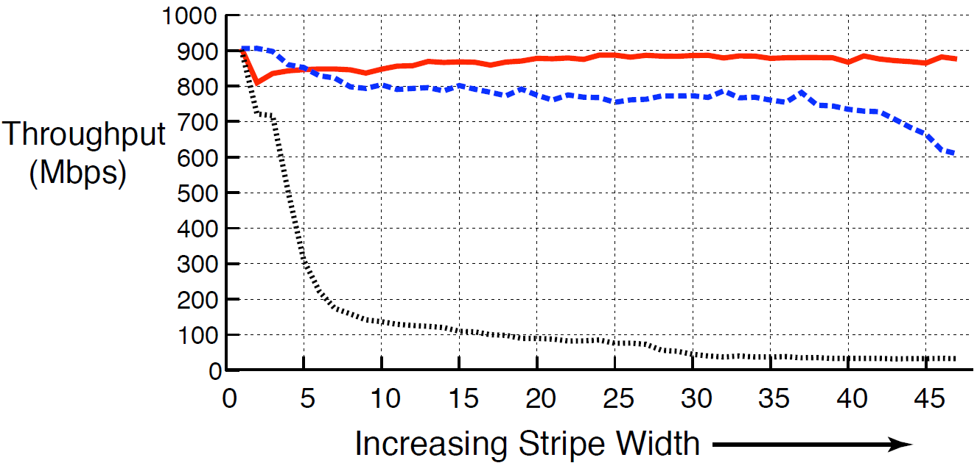
Solution: µsecond TCP + no minRTO
microsecond TCP
+ no minRTO
1ms minRTO
Unmodified TCP
(200ms minRTO)
more servers
High throughput for up to 47 servers

Slide 54
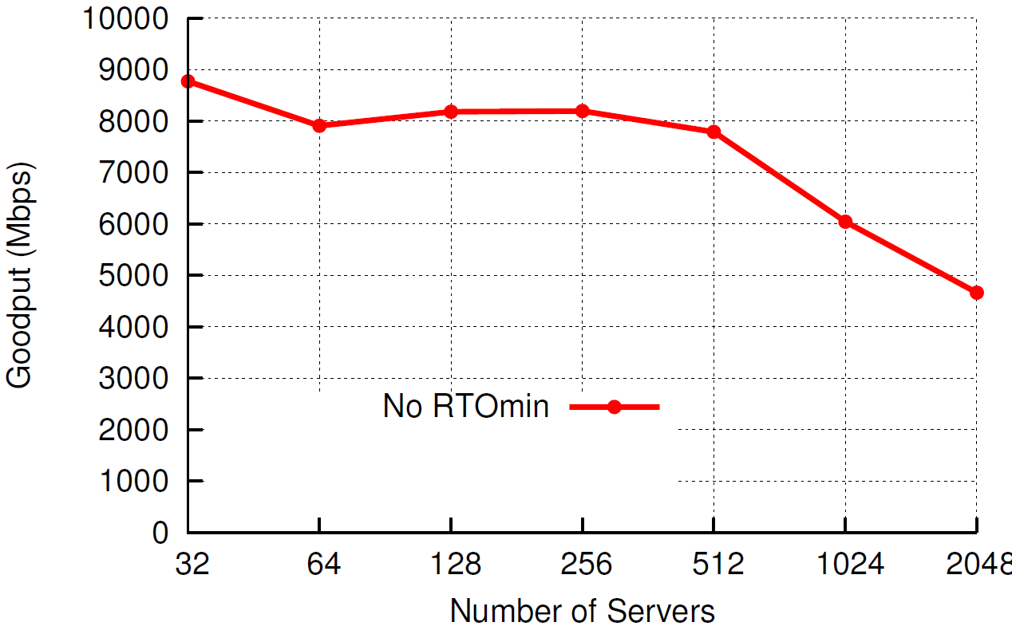
Simulation: Scaling to thousands
Block Size = 80MB, Buffer = 32KB, RTT = 20us
Notes:
Block size = 80MB, buffer = 32KB, RTT = 20us (next generation datacenters)

Slide 55
Delayed-ACK (for RTO > 40ms)
Seq #
Seq #
Seq #
1
1
1
2
2
Ack 2
Ack 0
40ms
Ack 1
Sender
Receiver
Sender
Receiver
Sender
Receiver
Delayed-Ack: Optimization to reduce #ACKs sent
Notes:
Explanation of Delayed ACK specification.

Slide 56
µsecond RTO and Delayed-ACK
RTO > 40ms
RTO < 40ms
Seq #
Seq #
1
1
Timeout
Retransmit packet
1
40ms
Ack 1
Ack 1
Sender
Receiver
Sender
Receiver
Premature Timeout
RTO on sender triggers before Delayed-ACK on receiver
Notes:
Premature timeouts slow the rate of transfer (timeouts still result in {slow start + congestion avoidance}).

Slide 57
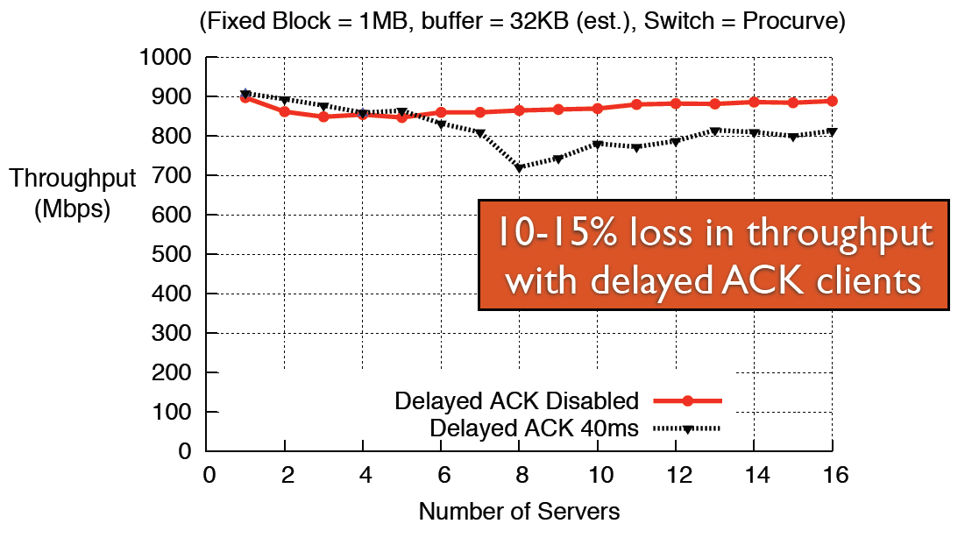
Impact of Delayed-ACK

Slide 58
Is it safe for the wide-area?
Stability: Could we cause congestion collapse?
No: Wide-area RTOs are in 10s, 100s of ms
No: Timeouts result in rediscovering link capacity (slow down the rate of transfer)
Performance: Do we timeout unnecessarily?
[Allman99] Reducing minRTO increases the chance of premature timeouts
Premature timeouts slow transfer rate
Today: detect and recover from premature timeouts
Wide-area experiments to determine performance impact
Notes:
Allman et. al said that reducing minRTO results in an increase in premature timeouts.
The reason why a premature timeout would occur in such a setting would be because of a sudden jump/increase in RTT, from it steady state value. Such a jump would most probably be caused by a significant path change in the wide area. We have reason to believe that such changes are not a common occurrence in the wide area today.
Also, premature timeouts just slow the rate of transfer (timeouts still result in {slow start + congestion avoidance}).
Premature timeouts are less harmful today
Can detect them using the tcp timestamp option - if we get an ack for a seq number that we retransmitted due to a timeout, but it has a timestamp of the first packet with this seq number that we transmitted, then we know we experienced a premature timeout.
Can recover from them (F-RTO) – If we detect a premature timeout, exit slow start and enter congestion avoidance (with cwnd = cwnd_before_timeout / 2)
Both implemented widely!

Slide 59

Wide-area Experiment
BitTorrent
Seeds
BitTorrent
Clients
Microsecond TCP
+
No minRTO
Standard TCP
Do microsecond timeouts harm wide-area throughput?

Slide 60
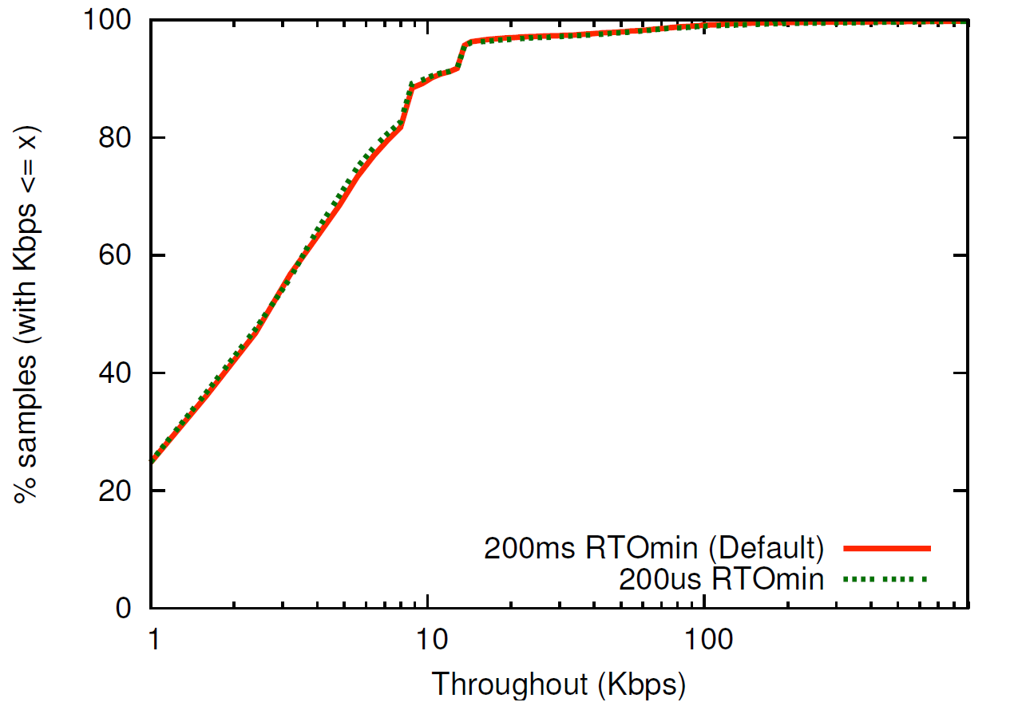
Wide-area Experiment: Results
No noticeable difference in throughput

Slide 61
Other Efforts
Topology
Using extra links to meet traffic matrix
60Ghz links → MSR paper in HotNets09
Reconfigurable optical interconnects → CMU and UCSD in Sigcomm2010
Transport
Data Center TCP → data-center only protocol that uses RED-like techniques in routers

Slide 62
Aside: Disk Power
IBM Microdrive (1inch)
writing 300mA (3.3V) 1W
standby 65mA (3.3V) .2W
IBM TravelStar (2.5inch)
read/write 2W
spinning 1.8W
low power idle .65W
standby .25W
sleep .1W
startup 4.7 W
seek 2.3W

Slide 63
Spin-down Disk Model
4.7W
2.3W
2W
Spinning
& Seek
Spinning up
Request
Spinning
& Access
Trigger: request or predict
Predictive
Not Spinning
Spinning
& Ready
.2W
Spinning down
.65-1.8W
Inactivity Timeout threshold*

Slide 64
Disk Spindown
Disk Power Management – Oracle (off-line)
Disk Power Management – Practical scheme (on-line)
IdleTime > BreakEvenTime
access1
access2
Idle for BreakEvenTime
Wait time
Source: from the presentation slides of the authors
Notes:
64
There are two disk power management schemes, one is called oracle scheme, the other is practical scheme. The oracle scheme is an offline scheme, which know ahead of time the length of upcoming idle period. If the idle time is larger than the breakeven time, the disk will spindown and spinup right in time before the next request. The practical scheme has no such future knowledge. If the disk is idle for a threshold of time, then the disk will spin down and spin up upon the arrival of next request. The previous work show if we set the threshold to be the breakeven time, the practical scheme is 2-compitative compared to the oracle scheme.

Slide 65
Spin-Down Policies
Fixed Thresholds
T_{out} = spin-down cost s.t. 2*E_{transition} = P_{spin}*T_{out}
Adaptive Thresholds: T_{out} = f (recent accesses)
Exploit burstiness in T_{idle}
Minimizing Bumps (user annoyance/latency)
Predictive spin-ups
Changing access patterns (making burstiness)
Caching
Prefetching

Slide 66
Google
Since 2005, its data centers have been composed of standard shipping containers--each with 1,160 servers and a power consumption that can reach 250 kilowatts
Google server was 3.5 inches thick--2U, or 2 rack units, in data center parlance. It had two processors, two hard drives, and eight memory slots mounted on a motherboard built by Gigabyte

Slide 67
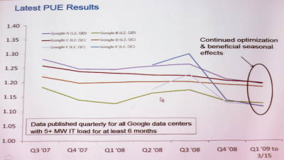
Google's PUE
In the third quarter of 2008, Google's PUE was 1.21, but it dropped to 1.20 for the fourth quarter and to 1.19 for the first quarter of 2009 through March 15
Newest facilities have 1.12

