Slide 1
Safe and Effective
Fine-grained TCP Retransmissions for Datacenter Communication
Presented by Daehyeok Kim
Vijay Vasudevan, Amar Phanishayee, Hiral Shah, Elie Krevat David Andersen, Greg Ganger, Garth Gibson, Brian Mueller*
Carnegie Mellon University, *Panasas Inc.

Slide 2





TCP request-response in Datacenter
Server 1
High-bandwidth / Low-latency links
Small switch buffer
Barrier-synchronized workloads
Client
Server 2
Server 3
RTO_{min} = 200 ms
Server 4
TCP timeout
*Animation from Mohammad Alizadeh’s lecture slide

Slide 3
Preconditions for TCP Incast
High-bandwidth, low-latency networks with small switch buffer.
Clients issuing barrier-synchronized requests in parallel.
Servers returning a relatively small amount of data per request.
Root cause of incast:
Imbalance between low link latency (us) and RTO (ms)

Slide 4
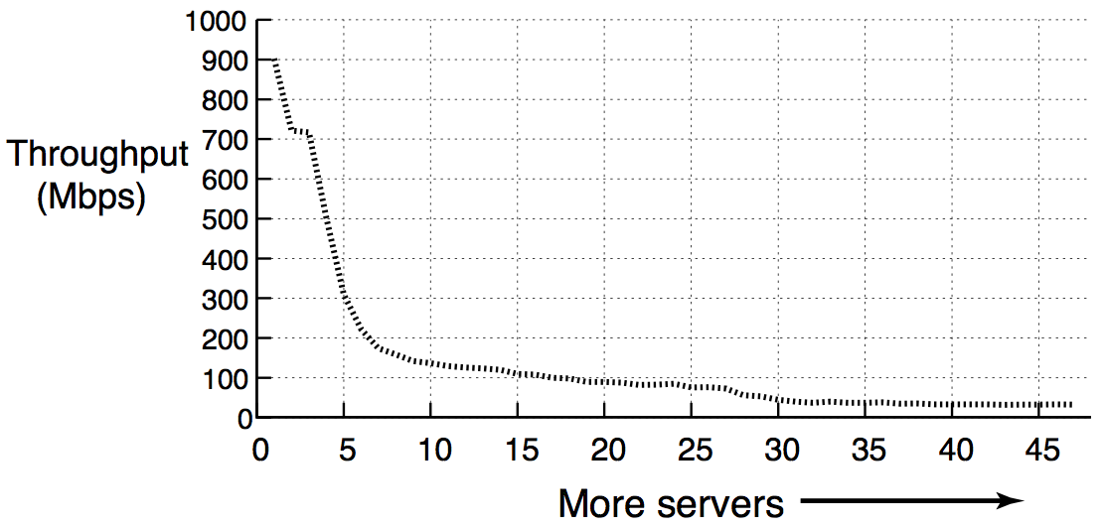
TCP Throughput Collapse
1Gbps Ethernet
100us delay
200ms RTO
1MB block size
Nagle et al*. called this problem “Incast”.
  Provided app-level solution.
* The Panasas ActiveScale Storage Cluster: Delivering Scalable High Bandwidth Storage, SC 2014.

Slide 5
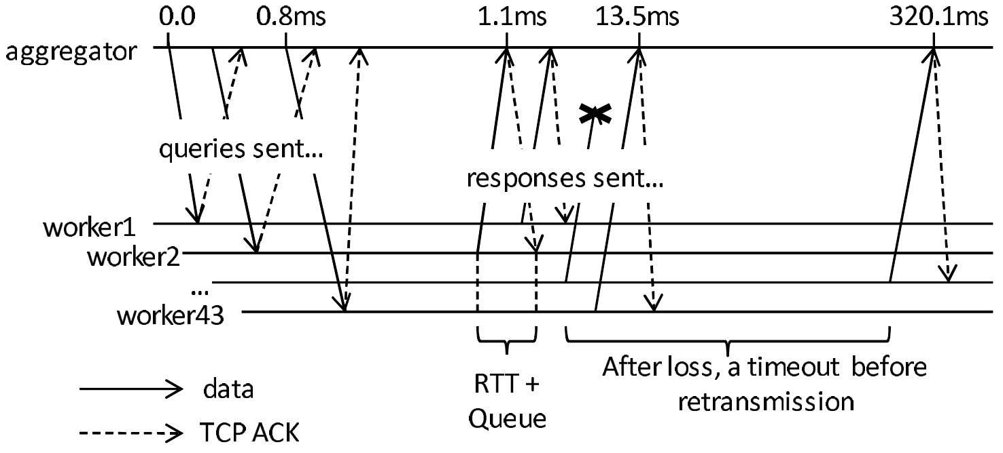
Incast Really Happens
Microsoft datacenter
Google datacenter*
~300ms
Idle!!
*Jupiter Rising: A Decade of Clos Topologies and Centralized Control in Google’s Datacenter Network, SIGCOMM 2015.

Slide 6
Recap: RTO estimation
Jacobson’s TCP RTO estimator
  RTO = RTT + 4*RTTVAR
Actual RTO Timer = max(RTO_{min}, RTO)
  Minimum RTO bound (RTO_{min}) = 200ms

Slide 7
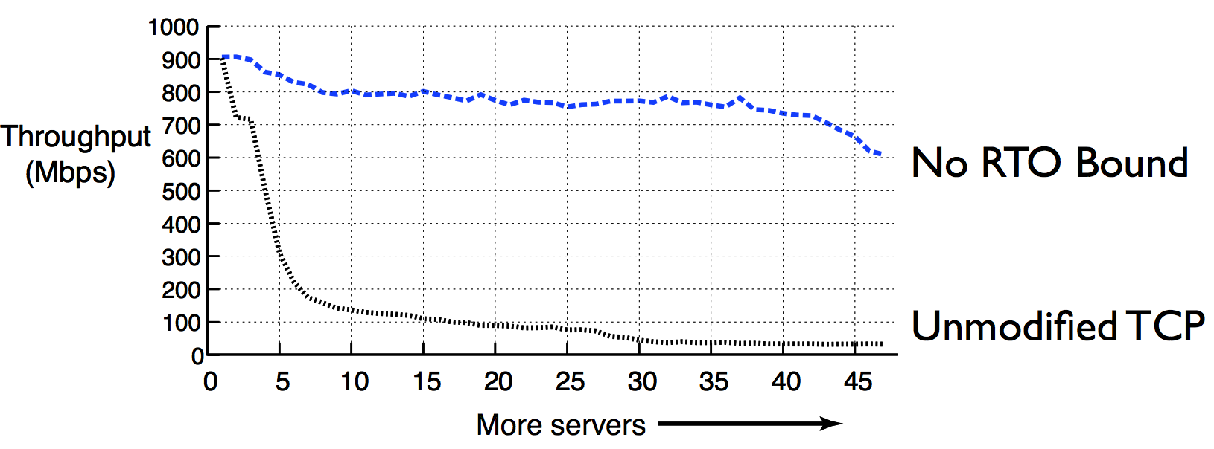
Solution: Eliminate RTO_{min}
Idea
  Enabling TCP retransmissions to fire up in microseconds.
RTT is still measured in milliseconds.
Millisecond retransmissions not enough!

Slide 8
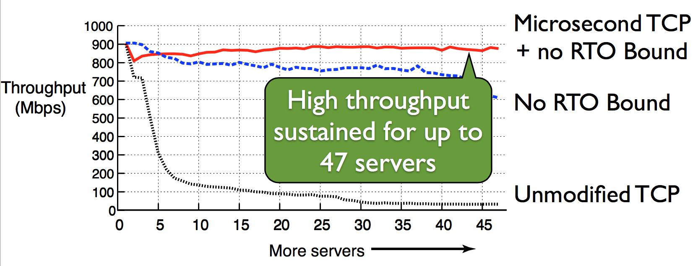
Solution++: Microsecond RTO
Idea
  Measure RTT in microseconds
  Use high-resolution kernel timers (HPET)

Slide 9
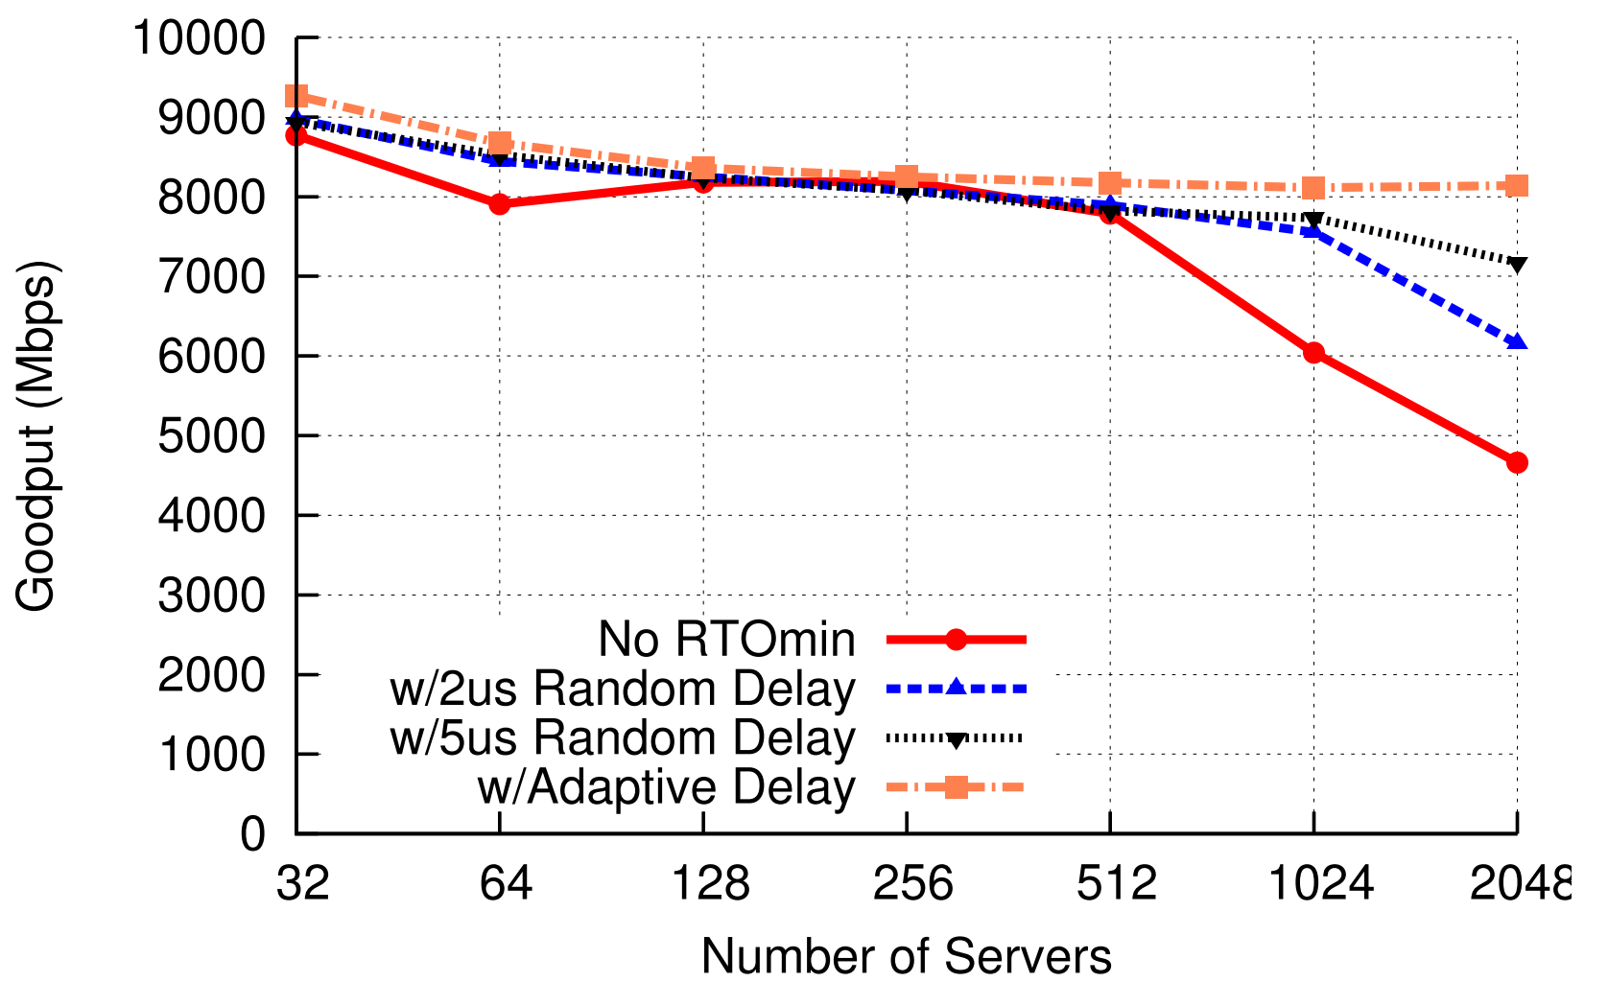
More Optimization:
RTO Desynchronization
Add some delay to avoid synchronized retransmissions

Slide 10
Discussion
Spurious retransmissions
  Do microsecond timeouts harm wide-area throughput?
  Showed that there is no noticeable different in performance via experiments
Interaction with delayed ACKs
  10-15% loss in throughput
  Delayed ACKs should be avoided when possible

Slide 11
Summary
Analyze the Incast problem using simulation and testbed experiment
Microsecond RTOs can help datacenter application response time and throughput
  Simple yet effective solution
Influence many works in datacenter networking
  DCTCP, ICTCP, …
  pFabric, Fastpass, …

