Slide 1
15-744: Computer Networking
L-13 Data Center Networking I

Slide 2
Overview
Data Center Overview
DC Topologies
Routing in the DC

Slide 3
Why study DCNs?
Scale
Google: 0 to 1B users in ~15 years
Facebook: 0 to 1B users in ~10 years
Must operate at the scale of O(1M+) users
Cost:
To build: Google ($3B/year), MSFT ($15B/total)
To operate: 1-2% of global energy consumption*
Must deliver apps using efficient HW/SW footprint
* LBNL, 2013.
Notes:
http://www.wired.com/wiredenterprise/2013/02/microsofts-data-center/
Koomey, Jonathan. 2008. "Worldwide electricity used in data centers." Environmental Research Letters. vol. 3, no. 034008. September 23. <http://stacks.iop.org/1748-9326/3/034008>
Masanet,! E.,! Shehabi,! A.,! Ramakrishnan,! L.,! Liang,! J.,! Ma,! X.,! Walker,! B.,! Hendrix,! V.,! and! P.! Mantha! (2013).!The)Energy)Efficiency)Potential)of)CloudABased)Software:)A)U.S.)Case)Study.!Lawrence!Berkeley!National!Laboratory,!Berkeley,!California.!!

Slide 4
Datacenter Arms Race
Amazon, Google, Microsoft, Yahoo!, … race to build next-gen mega-datacenters
Industrial-scale Information Technology
100,000+ servers
Located where land, water, fiber-optic connectivity, and cheap power are available

Slide 5
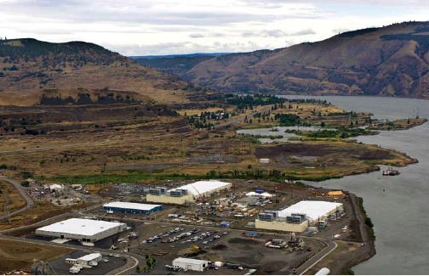
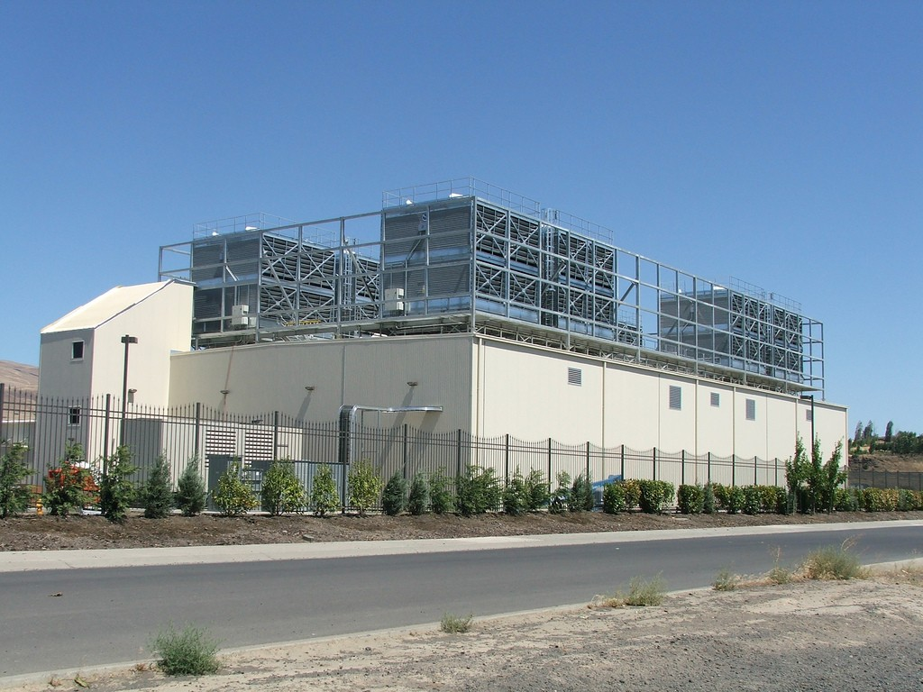
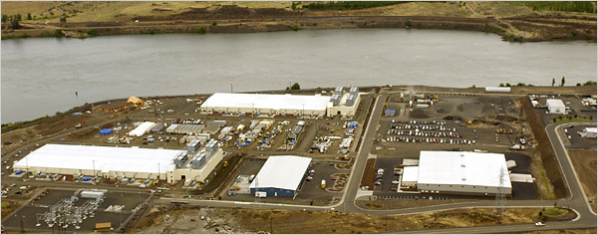
Google Oregon Datacenter

Slide 6
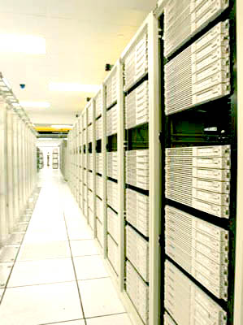
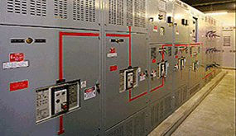
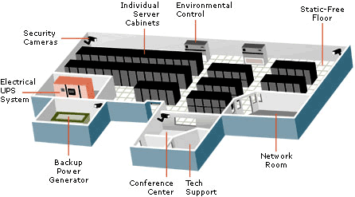
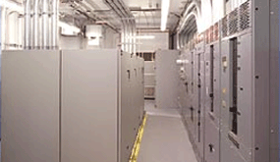
Computers + Net + Storage + Power + Cooling

Slide 7
What defines a data center network?
The Internet | Data Center Network (DCN)
Many autonomous systems (ASes) | One administrative domain
Distributed control/routing | Centralized control and route selection
Single shortest-path routing | Many paths from source to destination
Hard to measure | Easy to measure, but lots of data…
Standardized transport (TCP and UDP) | Many transports (DCTCP, pFabric, …)
Innovation requires consensus (IETF) | Single company can innovate
“Network of networks” | “Backplane of giant supercomputer”

Slide 8
DCN research “cheat sheet”
How would you design a network to support 1M endpoints?
If you could…
Control all the endpoints and the network?
Violate layering, end-to-end principle?
Build custom hardware?
Assume common OS, dataplane functions?
Top-to-bottom rethinking of the network

Slide 9
Overview
Data Center Overview
DC Topologies
Routing in the DC

Slide 10
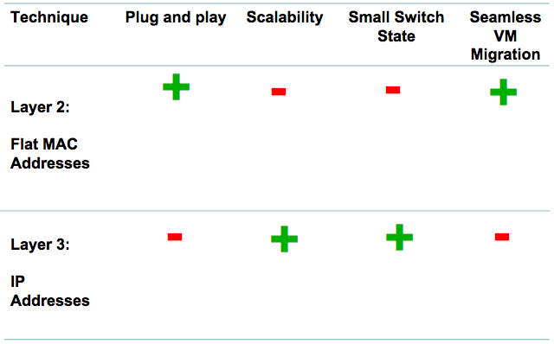
Layer 2 vs. Layer 3 for Data Centers

Slide 11
Data Center Costs
Amortized Cost* | Component | Sub-Components
~45% | Servers | CPU, memory, disk
~25% | Power infrastructure | UPS, cooling, power distribution
~15% | Power draw | Electrical utility costs
~15% | Network | Switches, links, transit
The Cost of a Cloud: Research Problems in Data Center Networks. Sigcomm CCR 2009. Greenberg, Hamilton, Maltz, Patel.
*3 yr amortization for servers, 15 yr for infrastructure; 5% cost of money

Slide 12
Server Costs
30% utilization considered “good” in most data centers!
Uneven application fit
Each server has CPU, memory, disk: most applications exhaust one resource, stranding the others
Uncertainty in demand
Demand for a new service can spike quickly
Risk management
Not having spare servers to meet demand brings failure just when success is at hand

Slide 13
Goal: Agility – Any service, Any Server
Turn the servers into a single large fungible pool
Dynamically expand and contract service footprint as needed
Benefits
Lower cost (higher utilization)
Increase developer productivity
Achieve high performance and reliability
Notes:
Increase productivity because services can be deployed much faster

Slide 14
Achieving Agility
Workload management
Means for rapidly installing a service’s code on a server
Virtual machines, disk images, containers
Storage Management
Means for a server to access persistent data
Distributed filesystems (e.g., HDFS, blob stores)
Network
Means for communicating with other servers, regardless of where they are in the data center

Slide 15

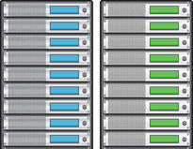
Datacenter Networks
Provide the illusion of
“One Big Switch”
10,000s of ports
Compute
Storage (Disk, Flash, …)

Slide 16
Datacenter Traffic Growth
Today: Petabits/s in one DC
More than core of the Internet!
Source: “Jupiter Rising: A Decade of Clos Topologies and Centralized Control in Google’s Datacenter Network”, SIGCOMM 2015.
Notes:
Today’s datacenter networks carry more traffic than the entire core of the Internet!

Slide 17
Tree-based network topologies
Can’t buy sufficiently fast core switches!
100,000 x 10 Gb/s = 1 Pb/s
Notes:
My first exposure to real networks was in 1994, when I worked for a large ISP called Neosoft, in Houston
At that time, our network was structured as a tree topology, which was quite common at the time and is still widely used
In a tree topology, groups of nodes are aggregated behind network switches, which connect to switches at higher branches of the tree
As you go up the tree, these switches get increasingly power and fast, to support the growth in aggregated bandwidth in subtrees
But they have the property that...
This means that as you add nodes to the leaves, you can overwhelm the root
Here are 100k nodes at 10G, however even today, the fastest switch is 100 Gb/s

Slide 18
Folded-Clos multi-rooted trees
Al Fares, et al., Sigcomm’08
Bandwidth needs met by massive multipathing
10 Gb/s
Switches
10 Gb/s
servers

Slide 19
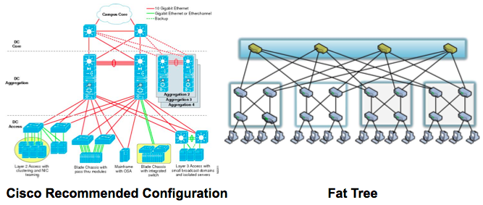
PortLand: Main Assumption
Hierarchical structure of data center networks:
They are multi-level, multi-rooted trees

Slide 20
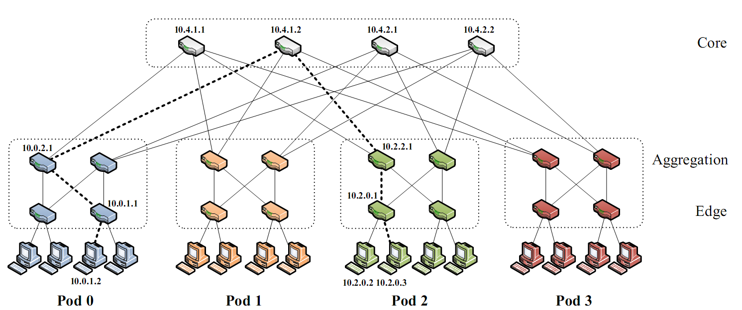
Background: Fat-Tree
Inter-connect racks (of servers) using a fat-tree topology
Fat-Tree: a special type of Clos Networks (after C. Clos) K-ary fat tree: three-layer topology (edge, aggregation and core)
each pod consists of (k/2)² servers & 2 layers of k/2 k-port switches
each edge switch connects to k/2 servers & k/2 aggr. switches
each aggr. switch connects to k/2 edge & k/2 core switches
(k/2)² core switches: each connects to k pods
Fat-tree
with K=4

Slide 21
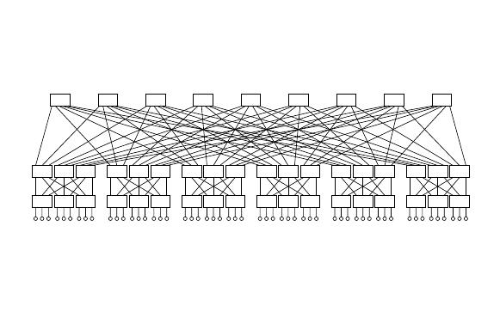
Why Fat-Tree?
Fat tree has identical bandwidth at any bisections
Each layer has the same aggregated bandwidth
Can be built using cheap devices with uniform capacity
Each port supports same speed as end host
All devices can transmit at line speed if packets are distributed uniform along available paths
Great scalability: k-port switch supports k³/4 servers
Fat tree network with K = 3 supporting 54 hosts

Slide 22
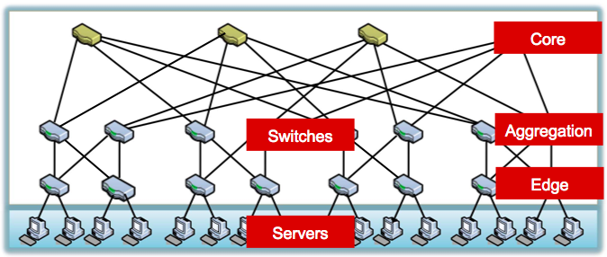
Data Center Network

Slide 23
Overview
Data Center Overview
DC Topologies
Routing in the DC

Slide 24
Flat vs. Location Based Addresses
Commodity switches today have ~640 KB of low latency, power hungry, expensive on chip memory
Stores 32 – 64 K flow entries
Assume 10 million virtual endpoints in 500,000 servers in datacenter
Flat addresses ➔ 10 million address mappings ➔ ~100 MB on chip memory ➔ ~150 times the memory size that can be put on chip today
Location based addresses ➔ 100 – 1000 address mappings ➔ ~10 KB of memory ➔ easily accommodated in switches today

Slide 25
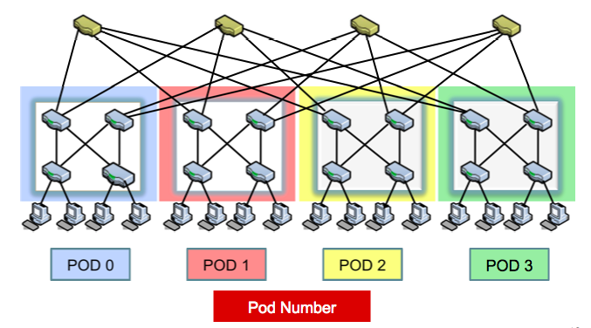
Hierarchical Addresses

Slide 26
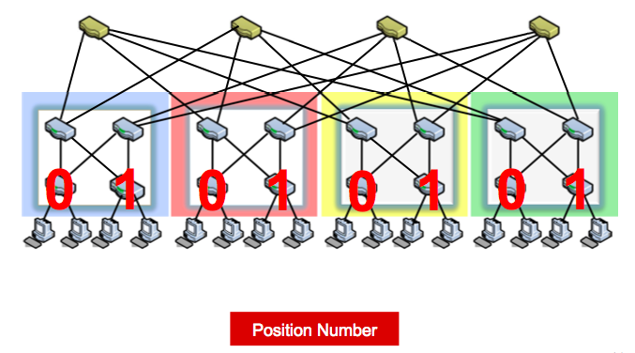
Hierarchical Addresses

Slide 27
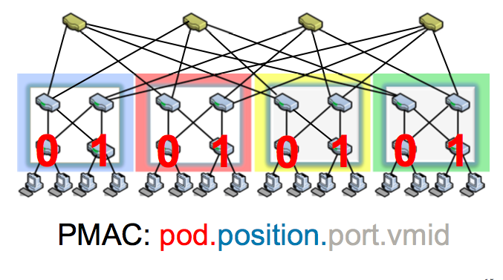
Hierarchical Addresses

Slide 28
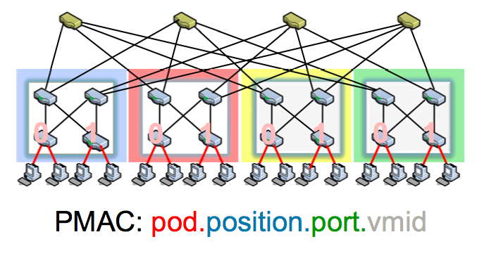
Hierarchical Addresses

Slide 29
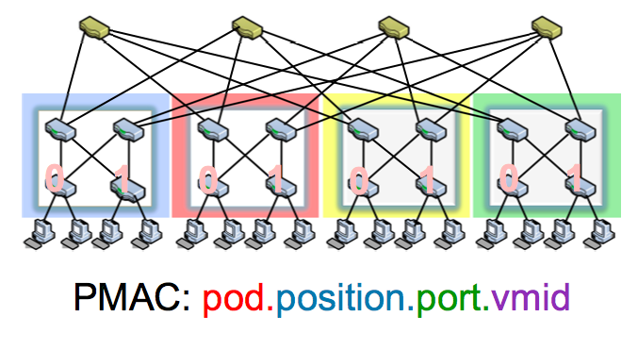
Hierarchical Addresses

Slide 30
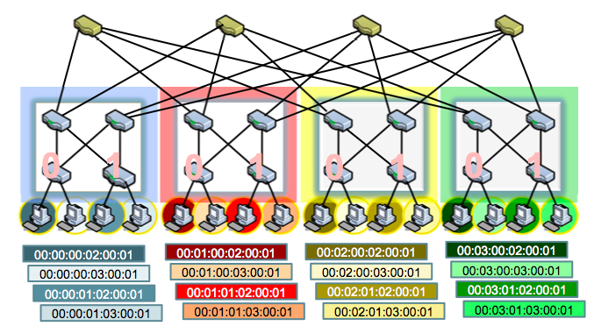
Hierarchical Addresses

Slide 31
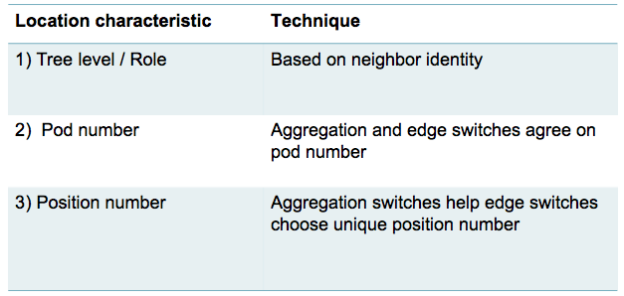
PortLand: Location Discovery Protocol
Location Discovery Messages (LDMs) exchanged between neighboring switches
Switches self-discover location on boot up

Slide 32
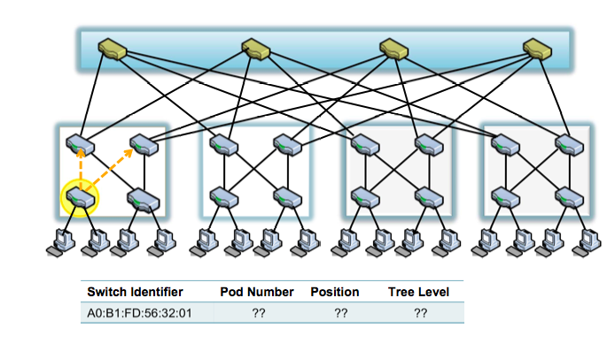
Location Discovery Protocol

Slide 33

Location Discovery Protocol

Slide 34
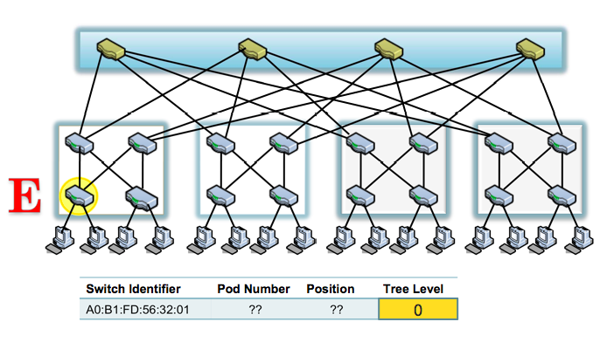
Location Discovery Protocol

Slide 35
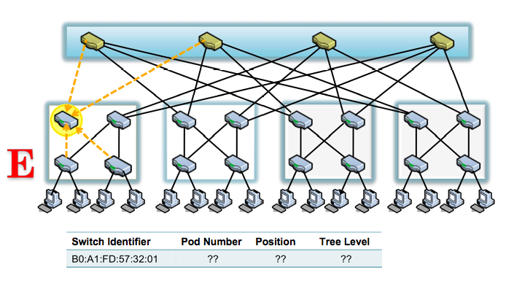
Location Discovery Protocol

Slide 36
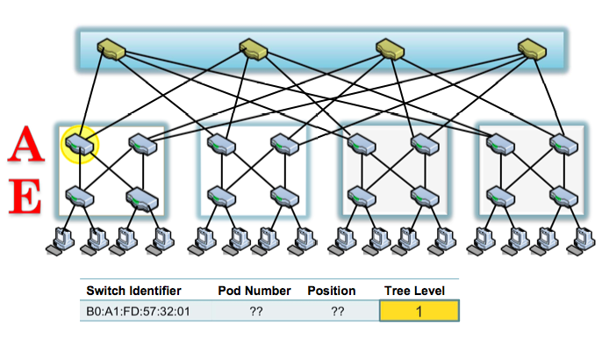
Location Discovery Protocol

Slide 37
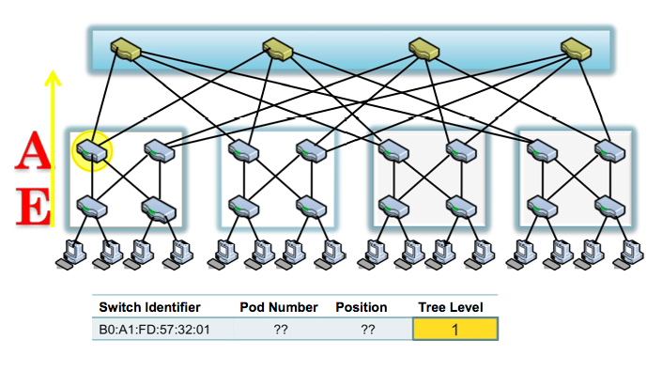
Location Discovery Protocol

Slide 38
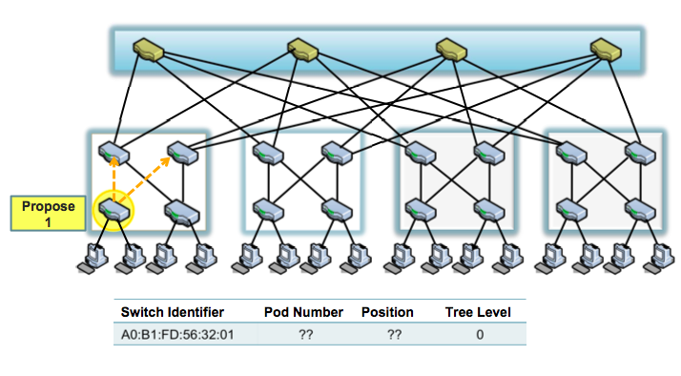
Location Discovery Protocol

Slide 39
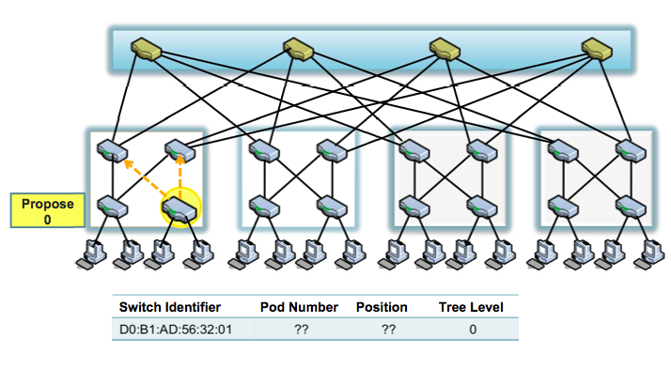
Location Discovery Protocol

Slide 40
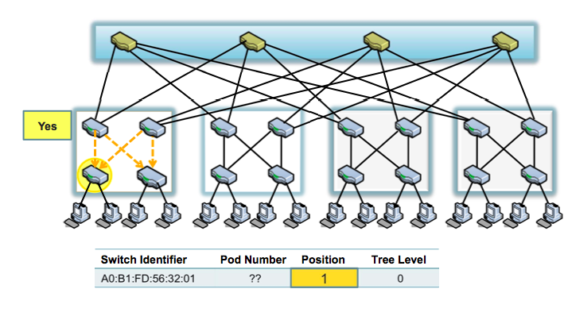
Location Discovery Protocol

Slide 41
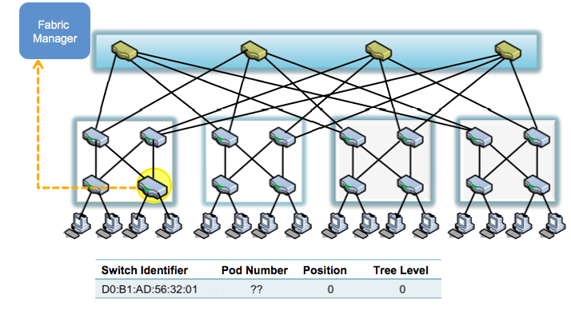
Location Discovery Protocol

Slide 42
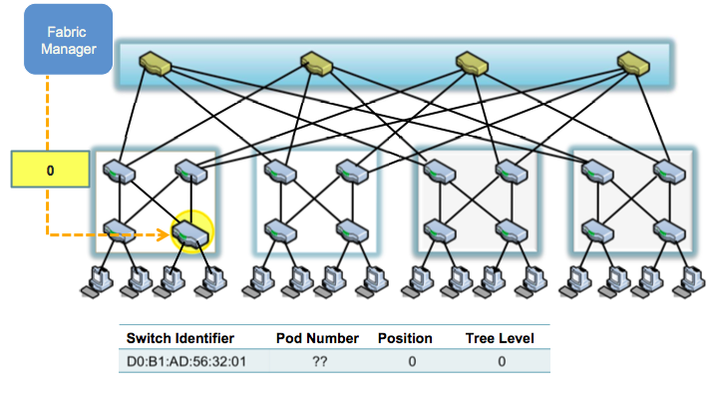
Location Discovery Protocol

Slide 43
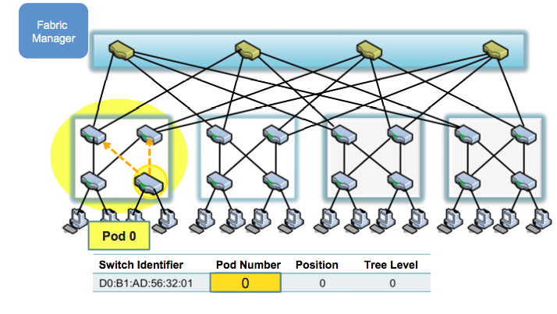
Location Discovery Protocol

Slide 44
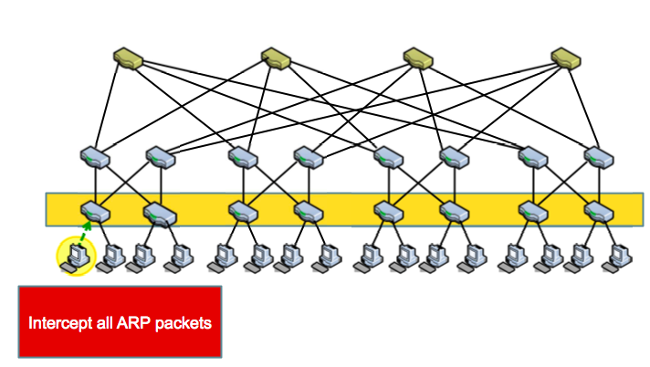
Name Resolution

Slide 45
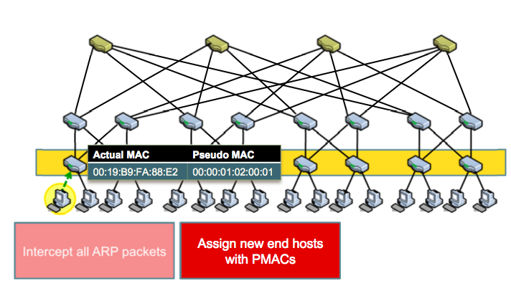
Name Resolution

Slide 46
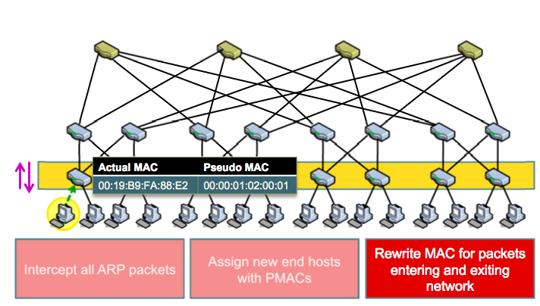
Name Resolution

Slide 47
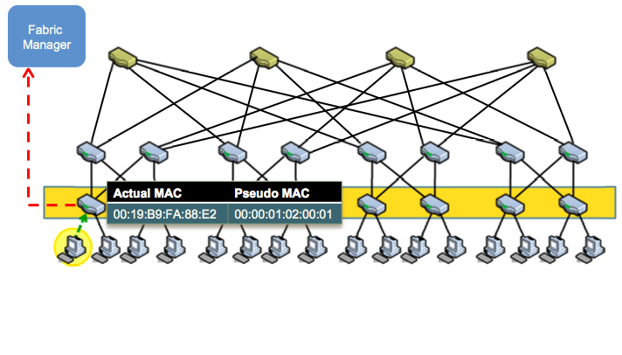
Name Resolution

Slide 48
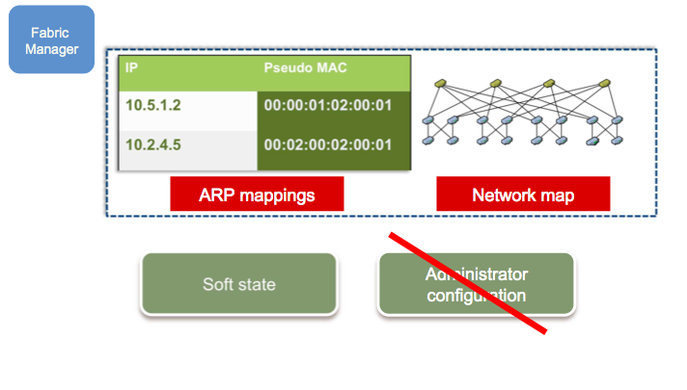
Fabric Manager

Slide 49
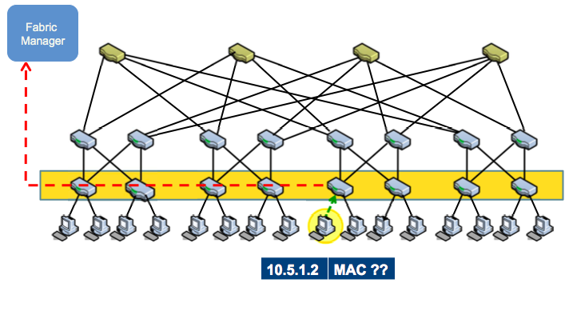
Name Resolution

Slide 50
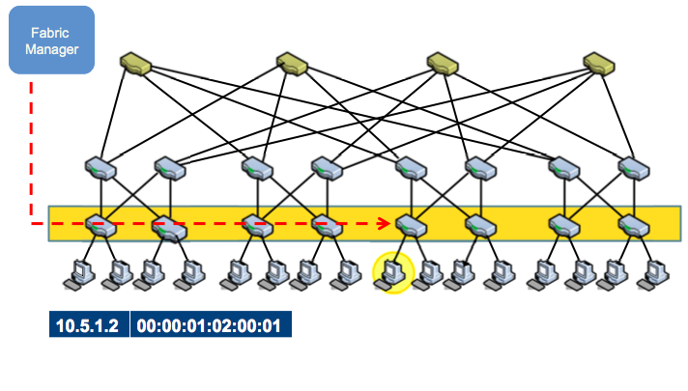
Name Resolution

Slide 51
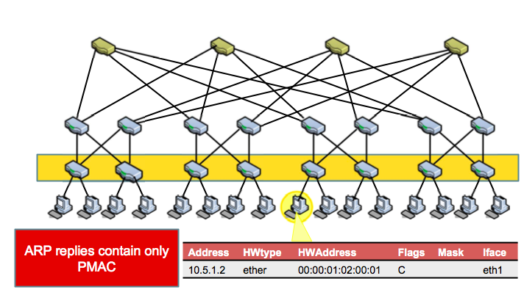
Name Resolution

Slide 52
Other Schemes
SEATTLE [SIGCOMM ‘08]:
Layer 2 network fabric that works at enterprise scale
Eliminates ARP broadcast, proposes one-hop DHT
Eliminates flooding, uses broadcast based LSR
Scalability limited by
Broadcast based routing protocol
Large switch state
VL2 [SIGCOMM ‘09]
Network architecture that scales to support huge data centers
Layer 3 routing fabric used to implement a virtual layer 2
Scale Layer 2 via end host modifications
Unmodified switch hardware and software
End hosts modified to perform enhanced resolution to assist routing and forwarding

Slide 53
VL2: Name-Location Separation
Cope with host churns with very little overhead
VL2
Switches run link-state routing and maintain only switch-level topology
Directory Service
Allows to use low-cost switches
Protects network and hosts from host-state churn
Obviates host and switch reconfiguration
…
x → ToR₂
y → ToR₃
z → ToR₄
…
…
x → ToR₂
y → ToR₃
z → ToR₃
…
ToR₁
. . .
ToR₂
. . .
ToR₃
. . .
ToR₄
ToR₃
y
payload
Lookup &
Response
y, z
ToR₄
x
y
z
ToR₃
z
z
payload
payload
Servers use flat names

Slide 54
VL2: Random Indirection
Cope with arbitrary TMs with very little overhead
I_{ANY}
I_{ANY}
I_{ANY}
Links used for up paths
Links used for down paths
[ ECMP + IP Anycast ]
Harness huge bisection bandwidth
Obviate esoteric traffic engineering or optimization
Ensure robustness to failures
Work with switch mechanisms available today
T₁
T₂
T₃
T₄
T₅
T₆
I_{ANY}
T₃
T₅
y
z
payload
payload
x
y
z

Slide 55
Next Lecture
Data center topology
Data center scheduling
Required reading
Efficient Coflow Scheduling with Varys
c-Through: Part-time Optics in Data Centers

Slide 56
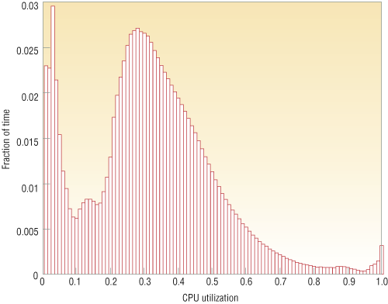
Energy Proportional Computing
It is surprisingly hard to achieve high levels of utilization of typical servers (and your home PC or laptop is even worse)
“The Case for
Energy-Proportional
Computing,”
Luiz André Barroso,
Urs Hölzle,
IEEE Computer
December 2007
Figure 1. Average CPU utilization of more than 5,000 servers during a six-month period. Servers
are rarely completely idle and seldom operate near their maximum utilization, instead operating
most of the time at between 10 and 50 percent of their maximum

Slide 57
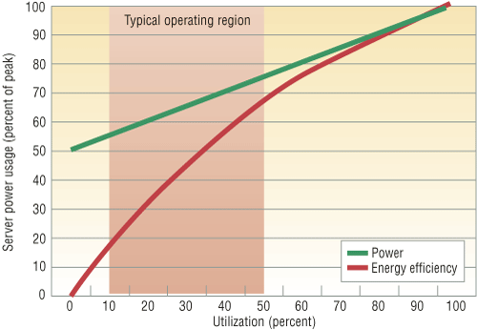
Energy Proportional Computing
“The Case for
Energy-Proportional
Computing,”
Luiz André Barroso,
Urs Hölzle,
IEEE Computer
December 2007
Doing nothing well … NOT!
Figure 2. Server power usage and energy efficiency at varying utilization levels, from idle to
peak performance. Even an energy-efficient server still consumes about half its full power
when doing virtually no work.

Slide 58
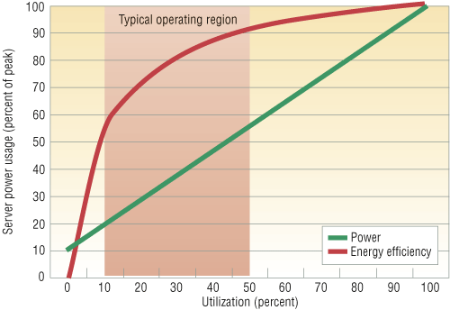
Energy Proportional Computing
“The Case for
Energy-Proportional
Computing,”
Luiz André Barroso,
Urs Hölzle,
IEEE Computer
December 2007
Doing nothing
VERY well
Design for
wide dynamic
power range and
active low power
modes
Figure 4. Power usage and energy efficiency in a more energy-proportional server. This
server has a power efficiency of more than 80 percent of its peak value for utilizations of
30 percent and above, with efficiency remaining above 50 percent for utilization levels as
low as 10 percent.

Slide 59
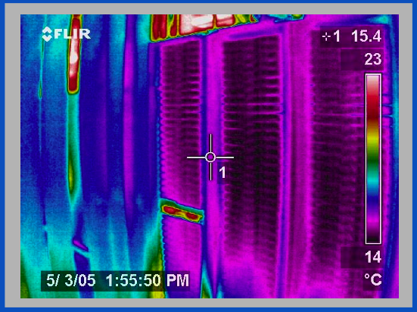
Thermal Image of Typical Cluster
Rack
Switch
M. K. Patterson, A. Pratt, P. Kumar, “From UPS to Silicon: an end-to-end evaluation of datacenter efficiency”, Intel Corporation

Slide 60
DC Networking and Power
Within DC racks, network equipment often the “hottest” components in the hot spot
Network opportunities for power reduction
Transition to higher speed interconnects (10 Gbs) at DC scales and densities
High function/high power assists embedded in network element (e.g., TCAMs)

Slide 61
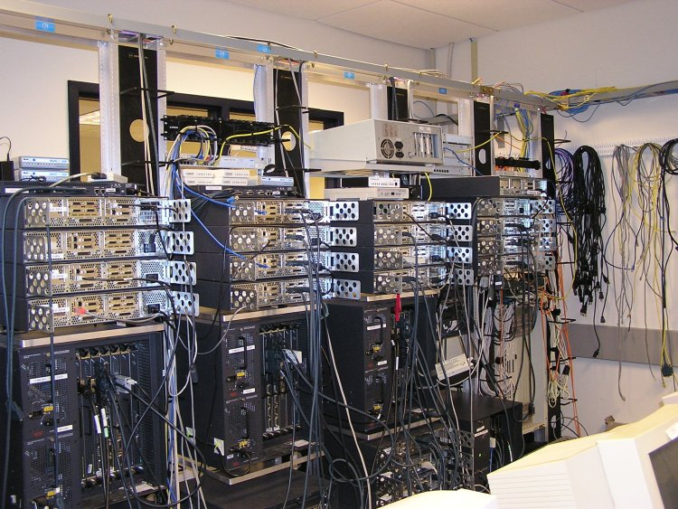
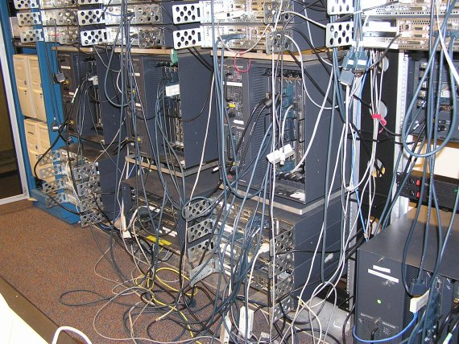
DC Networking and Power
96 x 1 Gbit port Cisco datacenter switch consumes around 15 kW -- approximately 100x a typical server @ 150 W
High port density drives network element design, but such high power density makes it difficult to tightly pack them with servers
Alternative distributed processing/communications topology under investigation by various research groups

Slide 62
Summary
Energy Consumption in IT Equipment
Energy Proportional Computing
Inherent inefficiencies in electrical energy distribution
Energy Consumption in Internet Datacenters
Backend to billions of network capable devices
Enormous processing, storage, and bandwidth supporting applications for huge user communities
Resource Management: Processor, Memory, I/O, Network to maximize performance subject to power constraints: “Do Nothing Well”
New packaging opportunities for better optimization of computing + communicating + power + mechanical

Slide 63
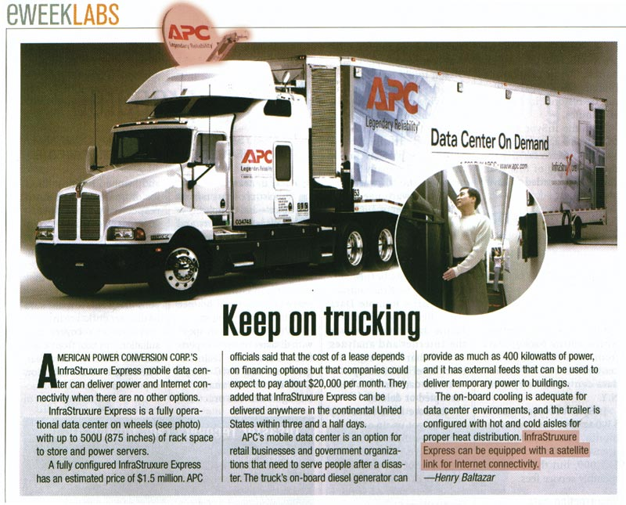

Slide 64
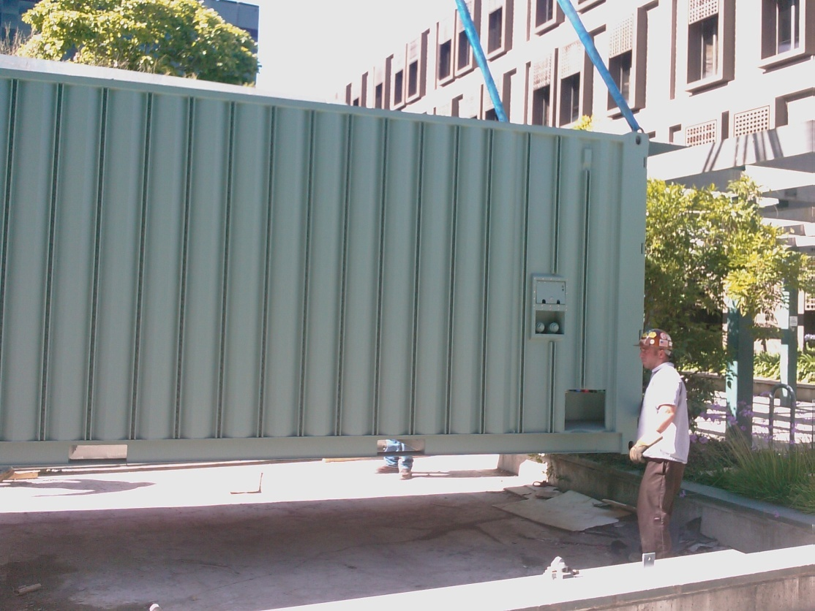
Containerized Datacenters
Sun Modular Data Center
Power/cooling for 200 KW of racked HW
External taps for electricity, network, water
7.5 racks: ~250 Servers, 7 TB DRAM, 1.5 PB disk
Notes:
64
2 slides imply many more devices to manage

Slide 65
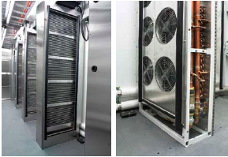
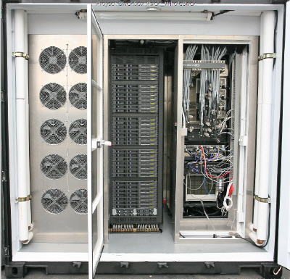
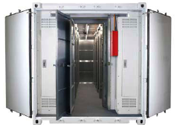
Containerized Datacenters

Slide 66
Aside: Disk Power
IBM Microdrive (1inch)
writing 300mA (3.3V) 1W
standby 65mA (3.3V) .2W
IBM TravelStar (2.5inch)
read/write 2W
spinning 1.8W
low power idle .65W
standby .25W
sleep .1W
startup 4.7 W
seek 2.3W

Slide 67
Spin-down Disk Model
4.7W
2.3W
2W
Spinning
& Seek
Spinning up
Request
Spinning
& Access
Trigger: request or predict
Predictive
Not Spinning
Spinning
& Ready
.2W
Spinning down
.65-1.8W
Inactivity Timeout threshold*

Slide 68
Disk Spindown
Disk Power Management – Oracle (off-line)
Disk Power Management – Practical scheme (on-line)
IdleTime > BreakEvenTime
access1
access2
Idle for BreakEvenTime
Wait time
Source: from the presentation slides of the authors
Notes:
68
There are two disk power management schemes, one is called oracle scheme, the other is practical scheme. The oracle scheme is an offline scheme, which know ahead of time the length of upcoming idle period. If the idle time is larger than the breakeven time, the disk will spindown and spinup right in time before the next request. The practical scheme has no such future knowledge. If the disk is idle for a threshold of time, then the disk will spin down and spin up upon the arrival of next request. The previous work show if we set the threshold to be the breakeven time, the practical scheme is 2-compitative compared to the oracle scheme.

Slide 69
Spin-Down Policies
Fixed Thresholds
T_{out} = spin-down cost s.t. 2*E_{transition} = P_{spin}*T_{out}
Adaptive Thresholds: T_{out} = f (recent accesses)
Exploit burstiness in T_{idle}
Minimizing Bumps (user annoyance/latency)
Predictive spin-ups
Changing access patterns (making burstiness)
Caching
Prefetching

Slide 70
Google
Since 2005, its data centers have been composed of standard shipping containers--each with 1,160 servers and a power consumption that can reach 250 kilowatts
Google server was 3.5 inches thick--2U, or 2 rack units, in data center parlance. It had two processors, two hard drives, and eight memory slots mounted on a motherboard built by Gigabyte

Slide 71

Google's PUE
In the third quarter of 2008, Google's PUE was 1.21, but it dropped to 1.20 for the fourth quarter and to 1.19 for the first quarter of 2009 through March 15
Newest facilities have 1.12

