Slide 1
BBR Congestion-Based Congestion Control
By: Neal Cardwell, Yuchung Cheng, C. Stephen Gunn, Soheil Hassas Yeganeh, and Van Jacobson
Presented by: Eric Hu

Slide 2
Overview
Background
Implementation
Comparison with Cubic
Issues / Active Research

Slide 3
Loss-Based Congestion Control
Currently in wide deployment: CUBIC
Problems to address
Full buffers for large bottleneck buffers
Low throughput for small bottleneck buffers

Slide 4
Congestion and Bottlenecks
Bottlenecks in TCP
Determines data-delivery rate
Where persistent queues form
End-host perspective
RTprop (round-trip propagation time)
BtlBw (bottleneck bandwidth)
Notes:
2 Bottlenecks for duplex TCP (1 in each direction)

Slide 5
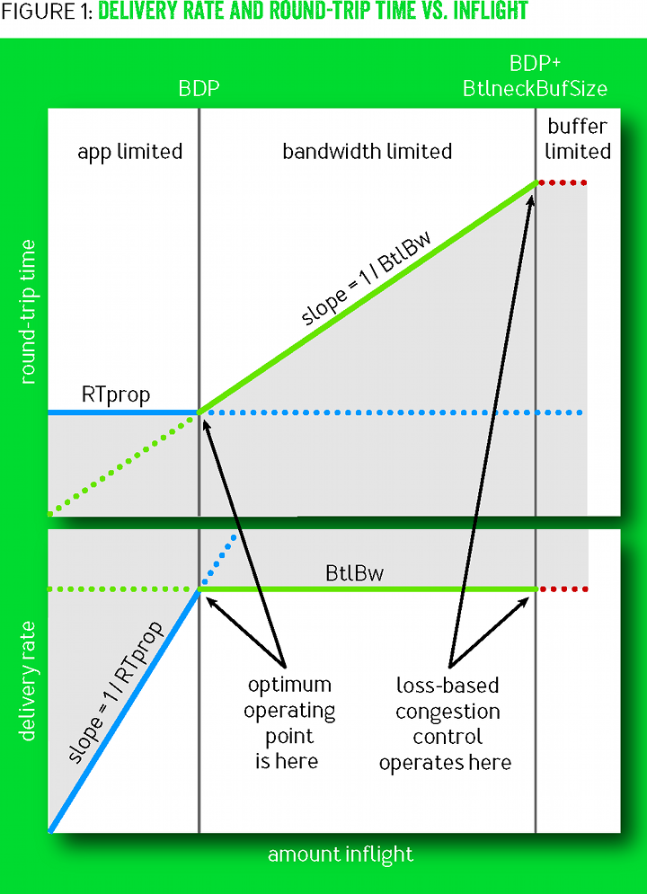
Observations on Routers
BDP (bandwidth-delay product)=BtlBw × RTprop
Excess = inflight - BDP
Uncertainty Principle
Notes:
Leonard Kleinrock¹⁶ showed this operating point was optimal, maximizing delivered bandwidth while minimizing delay and loss
Jeffrey M. Jaffe¹⁴ proved it was impossible to create a distributed algorithm that converged to this operating point
His result rests on fundamental measurement ambiguities (e.g., whether a measured RTT increase is caused by a path-length change, bottleneck bandwidth decrease, or queuing delay increase from another connection's traffic)
BtlBw and RTprop vary over the life of a connection, so they must be continuously estimated

Slide 6
Estimating RTprop and BtlBw
Notes:
Independent calculation

Slide 7
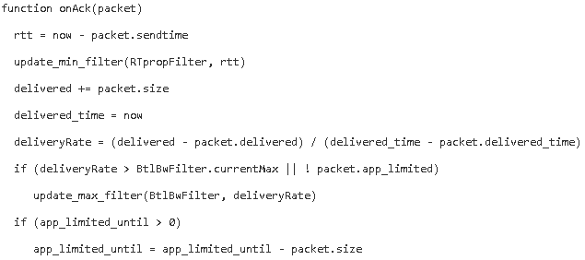
Receive

Slide 8
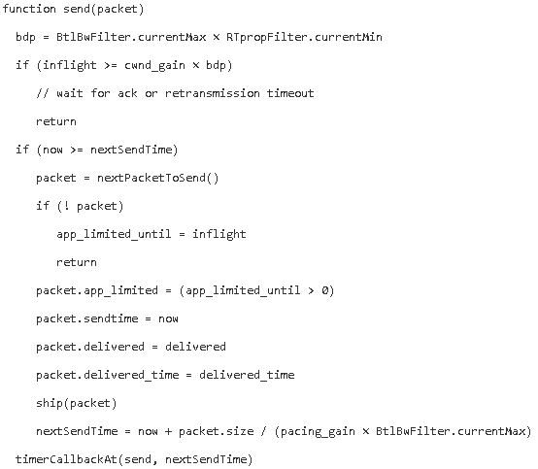
Send

Slide 9
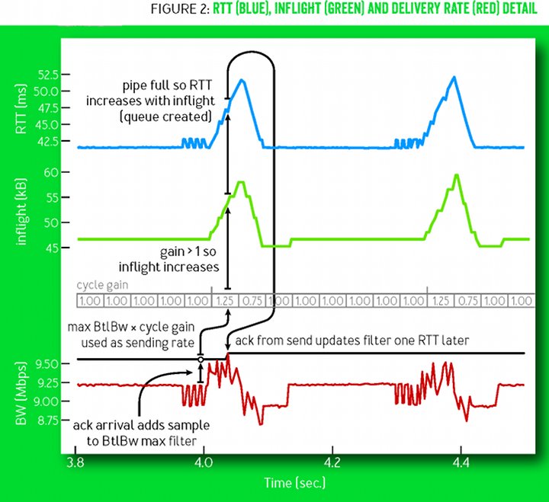
ProbeBW
Steady-State, majority of time is in this state
Cycle through rates:
5/4,3/4,1,1,1,1,1,1
Shows an example of bandwidth increase
Notes:
Exponential growth
Startup,Drain,ProbeBW,ProbeRTT

Slide 10
ProbeRTT
Entered when current max RTT expires
Drop to 4 packets inflight

Slide 11
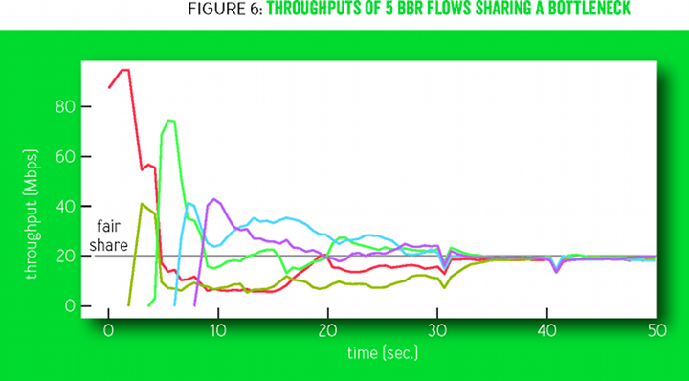
Fair-share during ProbeRRT of large flows

Slide 12
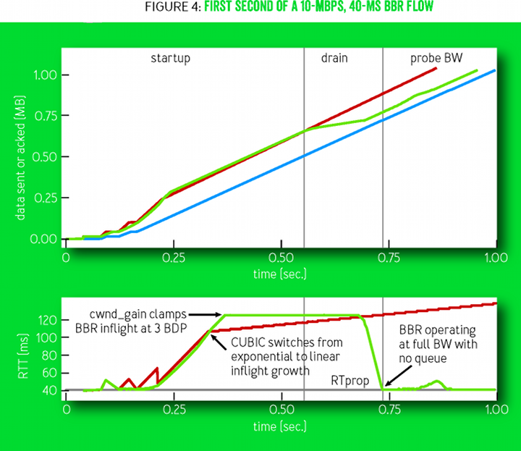
Startup/Drain
Red is Cubic
Green is BBR
Blue is receiver

Slide 13
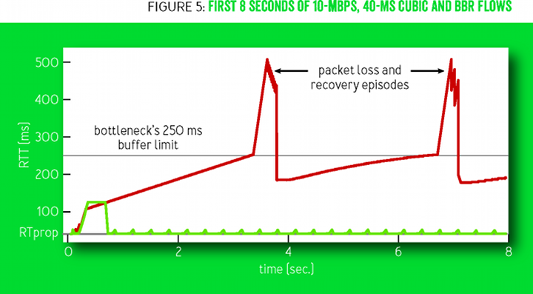
Lifetime of BBR vs Cubic

Slide 14
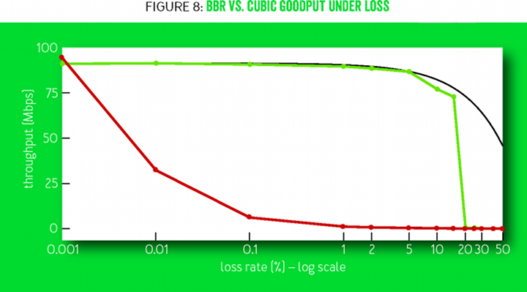
Handle lossy networks BBR vs Cubic
Notes:
Loss-based require fault-loss < BDP^-2 inverse square

Slide 15
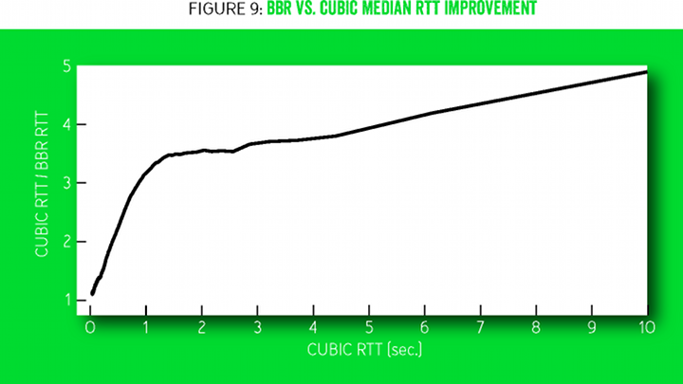
RTT Improvement BBR vs Cubic

Slide 16
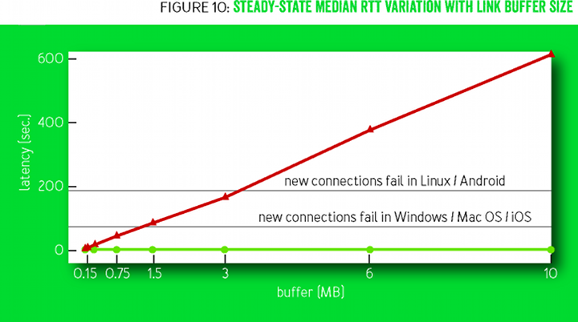
Cost of Buffer Size BBR vs Cubic

Slide 17
Issues with Current Networks
Mobile Cellular Adaptive Bandwidth
Delayed and Stretched ACKs
Token-Bucket Policers
Competition with Loss-Based Congestion Control
Notes:
Raising the peak ProbeBW pacing_gain to create bigger queues resulted in fewer stuck connections, indicating that it's possible to be too nice to some networks. With the current 1.25 × BtlBw peak gain, no degradation is apparent compared with CUBIC on any network.
Cellular, Wi-Fi, and cable broadband networks often delay and aggregate ACKs.¹When inflight is limited to one BDP, this results in throughput-reducing stalls. Raising ProbeBW's cwnd_gain to two
Bucket give high initial throughput leading to bad estimates.
Unmanaged router buffers exceeding several BDPs, however, cause long-lived loss-based competitors to bloat the queue and grab more than their fair share.

Slide 18
Conclusions
Loss is weakly correlated with congestion
BtlBw and RTprop can be estimated sequential (but not at the same time)
Maintain a small queue
Deployed by Google

