Slide 1
Making Middleboxes Someone Else’s Problem: Network Processing as a Cloud Service
    Authors: Justine Sherry*, Shaddi Hasan*, Colin Scott*, Arvind Krishnamurthy†, Sylvia Ratnasamy*, and Vyas Sekar‡
    Reviewer: Tiancheng Huang

Slide 2
What is middlebox?
A middlebox or network appliance is a computer networking device that transforms, inspects, filters, or otherwise manipulates traffic for purposes other than packet forwarding
Middleboxes offer valuable benefits, such as improved security (e.g., firewalls and intrusion detection systems), improved performance (e.g., proxies) and reduced bandwidth costs (e.g., WAN optimizers)

Slide 3
Middleboxes Today
A survey of 57 enterprise network administrators about middlebox deployments
The deployments are very large
  The average very large network 1946 total middleboxes; the average small network 10.2 total middleboxes.
The deployments are costly, requiring high up-front investment in hardware
The deployments are diverse: causing complexity in management & incuring substantial operational expenses
  Even small networks with only tens of middleboxes typically required a management team of 6-25 personnel
Administrators have to deal with Overload and Failures

Slide 4
Recap
High Capital and Operating Expenses
Time Consuming and Error-Prone
Physical and Overload Failures
How can we improve this?

Slide 5
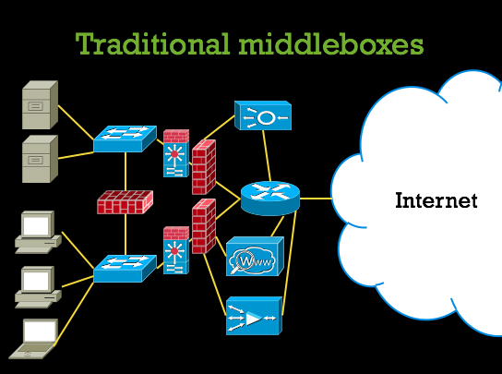
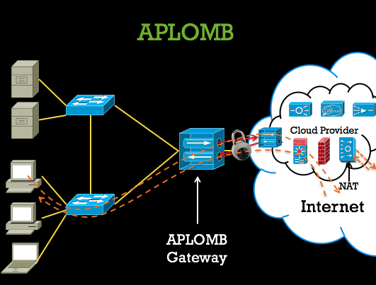
APLOMB: Appliance for Outsourcing Middleboxes
Outsourcing the processing of enterprises‘ traffic to third-party middlebox service providers running in the cloud.

Slide 6
A move to the cloud
Cloud outsourcing can cut costs by leveraging economies of scale, simplify management for enterprise administrators, and can provide elastic scaling to limit failures.
High Capital and Operating Expenses
  Provides Economies of scale and pay-per use
Time Consuming and Error-Prone
  Simplifies configuration and deployment
Physical and Overload Failures
  Redundant resources for failover (fault tolerance) & Autoscaling

Slide 7
Key challenges for outsourcing Middleboxes with APLOMB
Key challenges:
Functional equivalence.
  A cloud-based middlebox must offer functionality and semantics equivalent to that of an on-site middle- box
Low complexity at the enterprise
  Aim for a cloud-based middlebox architecture that minimizes the complexity of this enterprise-side functionality: failing to do so would detract from our motivation for outsourcing in the first place.
Low performance overhead.
  Minimize potential increase in packet latency and band- width consumption

Slide 8
Key challenges for outsourcing Middleboxes with APLOMB
Redirection of traffic
  What redirection architecture is required to retain the functional equivalence and low latency operation; e.g., ensuring that both directions of traffic between a and b via the cloud consistently traverse the same cloud point-of-presence (POP)
Minimizing Latency
Location Dependent Services

Slide 9
Redirection
We consider three natural approaches for redirecting the traffic to the cloud for middlebox processing
Bounce Redirection
IP Redirection
DNS Redirection

Slide 10
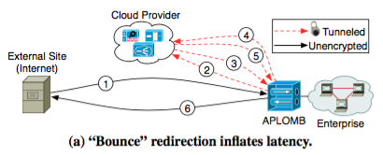
Bounce Redirection
Incoming traffic is bounced to the cloud PoP (1), processed by middleboxes, and then sent back to the enterprise (2,3). Outgoing traffic is similarly redirected (4-6).
Immediate drawback : increase in end-to-end latency
But very simple! Only the APLOMB gateway needs to be cloud-aware and no modification is required to existing enterprise applications

Slide 11
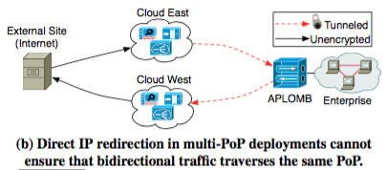
IP Redirection
To avoid the extra round-trips latency, we can route traffic directly to/from the cloud
Enterprises may want to redirect through several of the cloud provider’s datacenters for improved latency, load distribution, and fault tolerance
  The cloud provider might advertise P from multiple PoPs so that client traffic is effectively anycasted to the closest PoP.
IP-based redirection in a multi-PoP scenario cannot ensure that traffic from a client a to enterprise b will be routed to the same cloud PoP as that from b to a

Slide 12
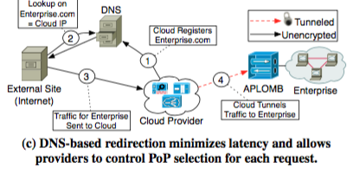
DNS redirection
To allow redirection using multiple cloud PoPs, we can rely on DNS-based redirection similar to its use in CDNs
The cloud provider runs DNS resolution on the enterprise’s behalf and registers DNS names for the client’s external services
Ensures that traffic between the enterprise and an external host will always traverse the same cloud PoPs

Slide 13
Minimizing Latency
Smart Redirection
Provider Footprint
  analyze how the middlebox provider’s choice of geo-graphic footprint impacts latency

Slide 14
Smart Redirection
Idea: redirect traffic not through the cloud PoP with the minimum RTT to and from the enterprise, but redirect traffic on a per-destination basis through the PoP that minmizes end-to-end latency

Slide 15
Provider Footprint
  Analyze how the middlebox provider’s choice of geo-graphic footprint impacts latency
  Amazon-like clouds: tens of global PoPs
Akamai-like middleboxes provider: thousands of vantage points
Conclusion: an Amazon-like footprint of a few tens of PoPs can service most customers with most types of middleboxes.

Slide 16
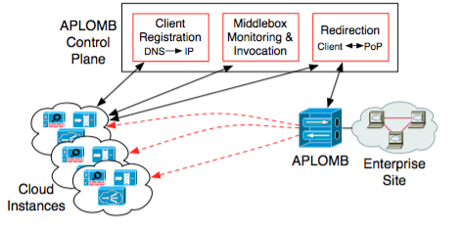
APLOMB architecture
Three key components
(1) A APLOMB gateway to redirect enterprise traffic
(2) Cloud provider
(3) A control plane which is responsible for managing and configuring these components

Slide 17
APLOMB gateway
logically co-located with the enterprise’s gateway router
Two key functions
  (1) maintaining persistent tunnels to multiple cloud PoPs
  (2) steering the outgoing traffic to the appropriate cloud PoP.
    The gateway registers itself with the cloud controller which supplies it with a list of cloud tunnel endpoints in each PoP and forwarding rules for redirection.

Slide 18
Cloud Functionality
^{Core components:}
^{Tunnel Endpoints}
  to encapsulate/decapsulate traffic from the enterprise
^{Middlebox Instances}
  to process the customers’ traffic
^{NAT Devices}
  to translate between publicly visible IP addresses and the clients’ internal addresses.
^{Policy switching logic}
  to steer packets between the above components.

Slide 19
Control Plane
Design principle: to keep the new components introduced by the architecture as stateless as possible
APLOMB Control Plane manages the relevant network state
  Determining optimal redirection strategies between communicating parties,
  Managing and pushing middlebox policy configurations, and
  Dynamically scaling cloud middlebox capacity to meet demands.

Slide 20
Control Plane(cont)
What control plane do?
  sends periodic ‘heartbeat’ health checks to each device
  gathers RTTs from each PoP to every prefix on the Internet (for PoP selection) and utilization statistics from each middlebox (for adaptive scaling).
Redirection Optimization
  pushes the current best tunnel selection strategies to the APLOMB gate by Using measurement data from the cloud PoPs
Middlebox Scaling
  detects changes in utilization using data from heartbeat health checks to automatically scale out or scale in

Slide 21
EVALUATION
Application Performance
  Measures three kinds of app: HTTP Page Loads, BitTorrent, Voice over IP
  Conclusion: suffer little or no penalty when their traffic is redirected through APLOMB
Scaling and Failover
  Once a new middle- box instance has been allocated and initialized, actual switchover time to begin routing traffic through it is less than 100ms
APLOMB is practical !

Slide 22
Conclusion
Outsourcing middlebox processing to the cloud relieves enterprises of major problems caused by today’s enterprise middlebox infrastructure: cost, management complexity, capacity rigidity, and failures
APLOMB succeeds in outsourcing the vast majority of middleboxes from a typical enterprise network without impacting performance, making scalable, affordable middlebox processing accessible to enterprise networks of every size

Slide 23
Thank you

