Slide 1
ETHANE: TAKING CONTROL OF THE ENTERPRISE
VAMSHI REDDY KONAGARI

Slide 2
Why Network Control and Management is Important for enterprise networks?
Enterprise networks are large, they run a variety of apps and protocols
Need high reliability and security constraints
62% of network downtime in multi-vendor networks comes from human errors and 80% spent on maintenance and operations.
Traditional ways to manage networks
  Middle boxes to intercept traffic and enforce policies
  Adding new layer of protocols on top of existing protocols to audit and manage hosts, networking devices using VLANS, ACLs, etc.

Slide 3
Problems with traditional ways to manage networks
Complexity of distributed protocols
Misconfigurations
No global view of network
Traffic can accidentally flow around middle boxes
Traditional management tools hide the complexity not reduce it.

Slide 4
Ethane’s Fundamental principles
Inspires from the 4D paper.
The network should be governed by policies declared over high-level names
  Users, hosts, access points instead of network addresses
Policy should determine the packet flow
  Which path to take – low-latency, high bandwidth, etc.
  Which services to hit – Firewall, NAT, proxy, etc. (Also called Service chaining)
Network should enforce a strong binding between a packet and its origin.
  Consistent binding between network addresses and hosts even if host changes its network address

Slide 5
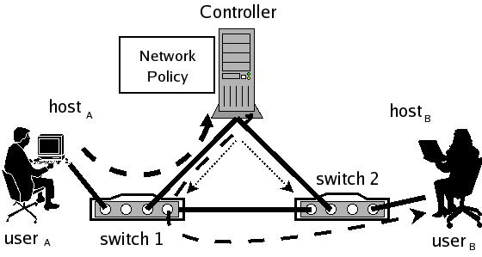
Ethane’s Design
Controller and Ethane switches

Slide 6
How Ethane works?
5 basic activities
Registration
  Hosts, users and switches register to the controller
Bootstrapping
  Tree with controller as root
  Switches connect to controller to setup secure channel
Authentication
  Controller intercepts DHCP setup packets - associates host to IP, IP to MAC, MAC to switch port mappings.
Flow Setup
  Controller decides whether to allow or deny flows
Forwarding
  If a flow is allowed, rules to allow traffic are installed on switches

Slide 7
How Ethane works?

Slide 8
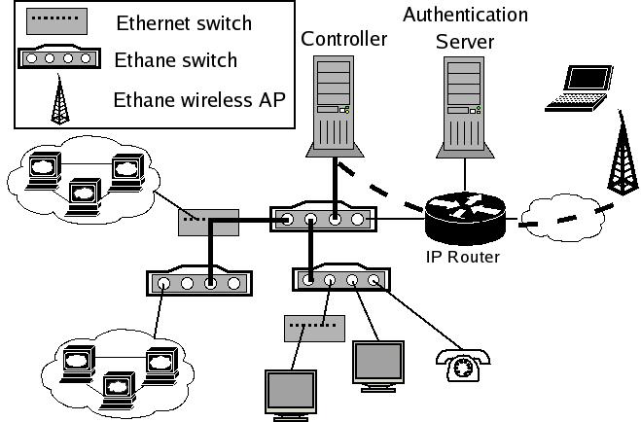
Example of Ethane deployment

Slide 9
Ethane Switch
L2 - Dumb switches - no STP, L2 Learning, VLAN support
L3 - Dumb routers - no OSPF, RIP, ACLs, NAT, etc.
Flow tables and entries
  Match and action pairs with per-flow stats
  Drop, flood, send it to a port or send it to controller
  Queue packets in a particular queue
  Address translations
Logical switch manager
  A process inside a switch to talk to controller to update link status, neighbours, etc.

Slide 10
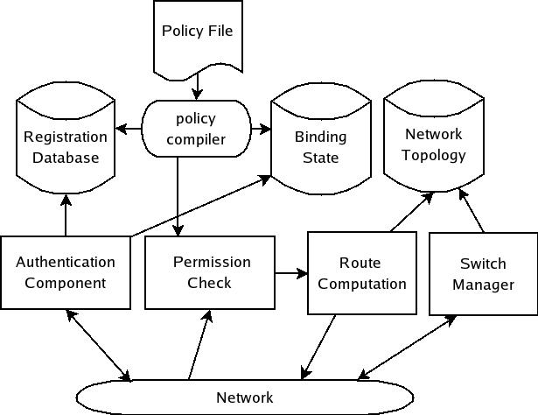
Ethane Controller

Slide 11
Replicating the controller: Fault-tolerance and scalability
Central controller - bottleneck
Possible approaches
  Warm standby - Controllers monitor each other and do failover - need to synchronize bindings, etc. - network state is eventually consistent - might lose some info on primary failure.
  Cold standby - backup controllers are waiting to take over the control. Switches do the failover.
  Fully-replicated controllers - requests from switches are spread over multiple controllers using some hashing - round robin.
    Weak semantics for consistency.

Slide 12
Policy Language
Policy language to enforce network wide policies
[(usrc="bob")∧(protocol="http")∧(hdst="websrv")]:allow;
  Conditions are conjunction of zero or more predicates followed by an action.
  Actions include allow, deny, outbound only (NAT), waypoints
  If two or more rules match with conflicting actions, then highest priority rule wins

Slide 13
Prototype and deployment
Single PC based controller
19 switches - Ethane switches (software and hardware), Ethane access points
300 hosts - Laptops, printers, VOIP phones, desktop workstations, servers

Slide 14
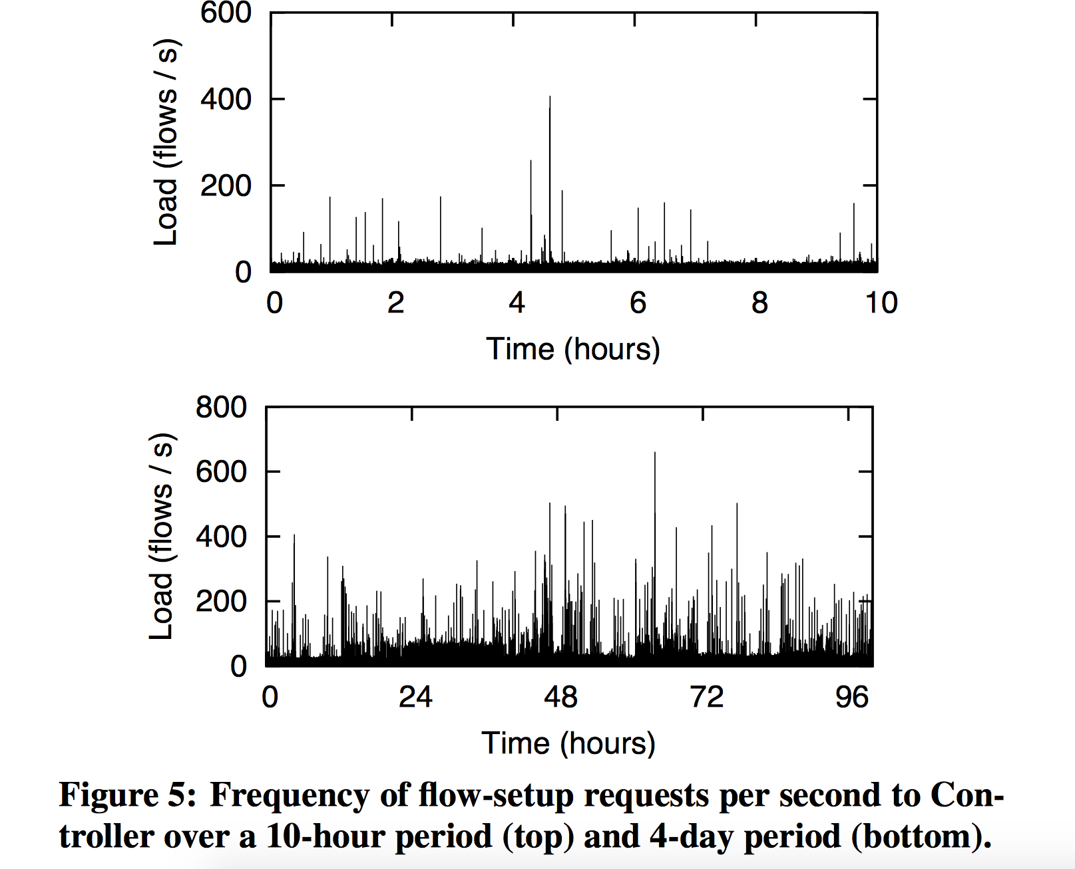
Frequency of flow setup requests
Peak of 750 flows per second

Slide 15
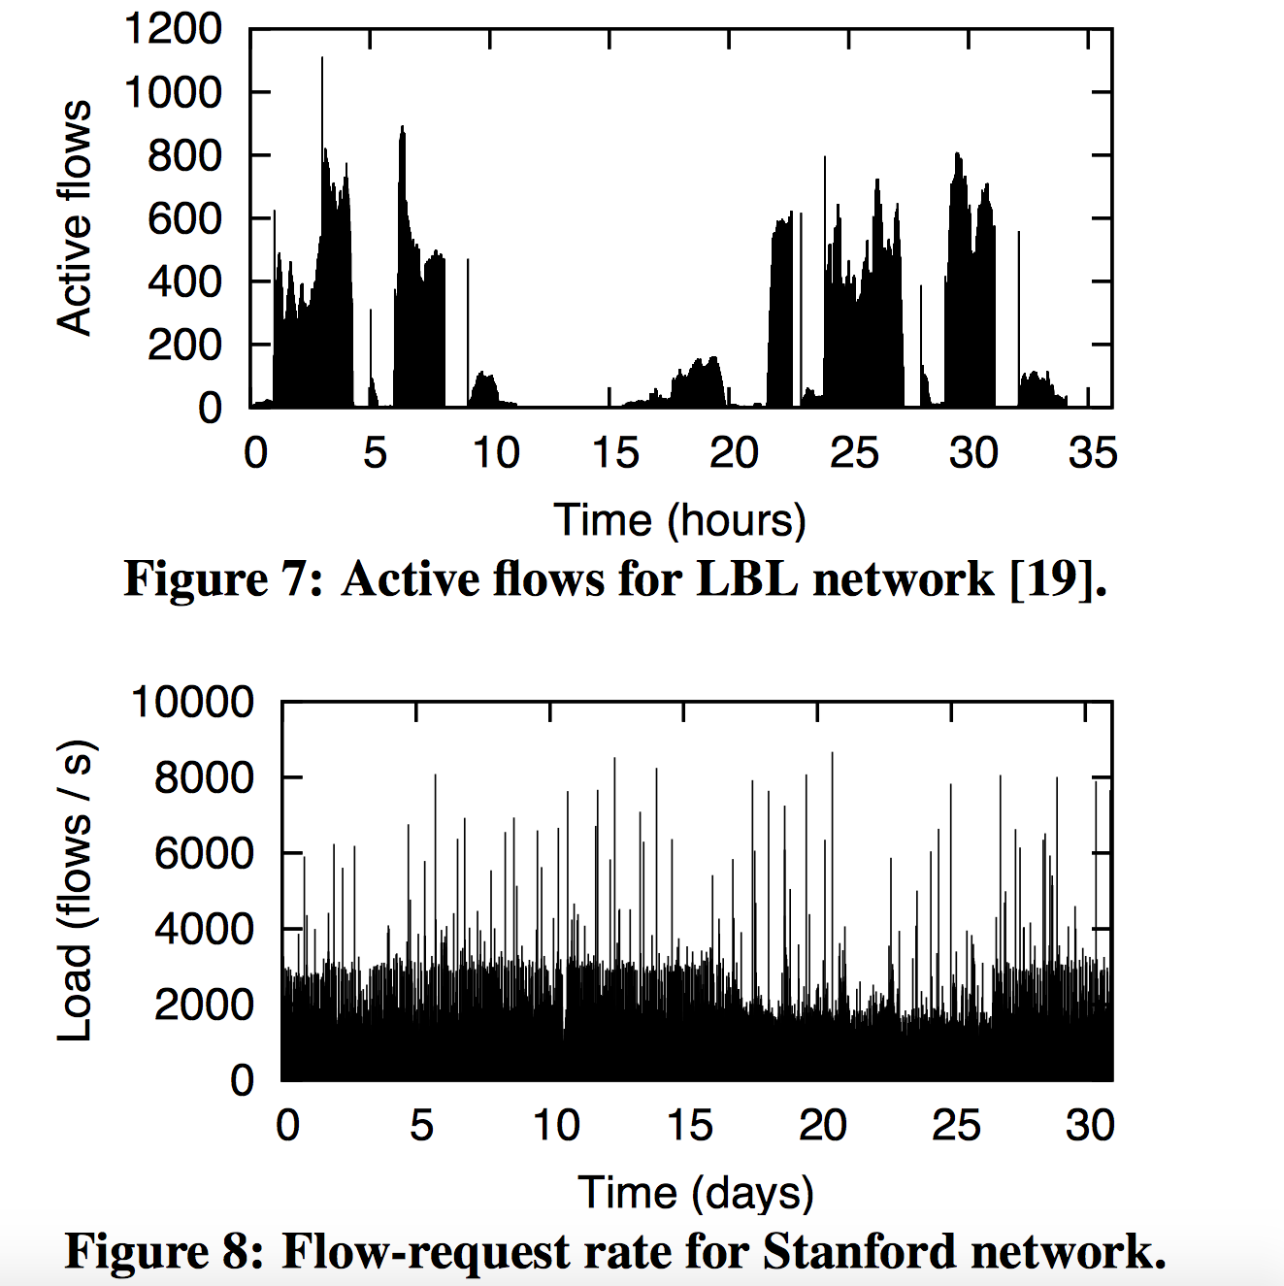
Flow request rate
Two data sets
  8000 hosts - LBL
  22,000 hosts – Stanford

Slide 16
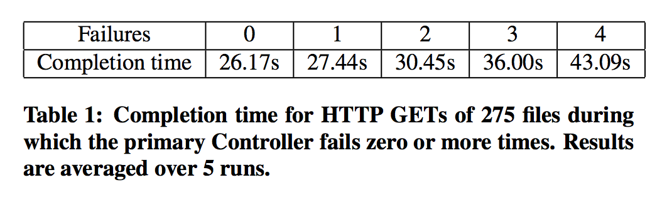
Performance during failures

Slide 17
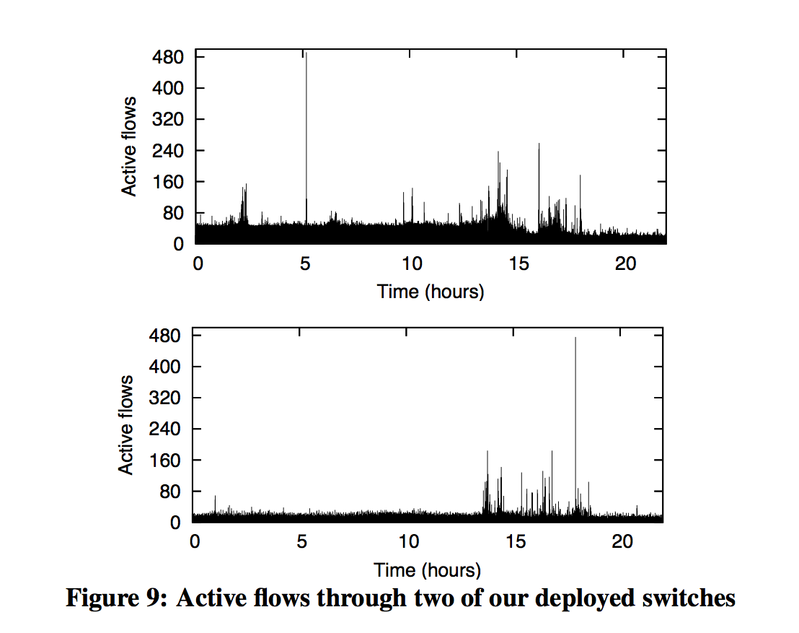
Active flows in switches

Slide 18
Shortcomings
Broadcast and service discovery
  ARP, OSPF discovery
  Leads to large number of flows
Application layer routing
  If A can talk to B, but not to C.
  B can talk to C.
  B can relay A's traffic to C --- Ethane can't detect this
Spoofing Ethernet addresses

Slide 19
Conclusion
Switches are best when they are dumb
Ethane makes networks much easier to manage
Single controller can manage 10,000 machines
Adding new users, switches, protocols, routing algorithms is very easy
Service chaining using ethane waypoints
Defining policies at a centralized location rather than distributed

