Slide 1
RouteBricks: Exploiting Parallelism To Scale Software Routers
Mihai Dobrescu et al.
SOSP 2009 Best Paper
Presentor : Hun Namkung

Slide 2
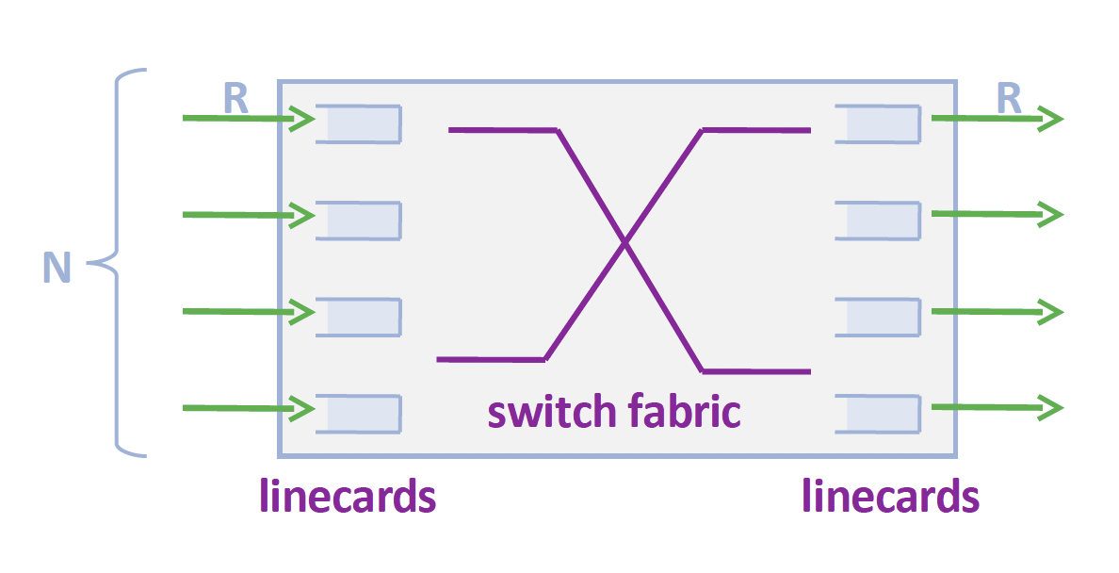
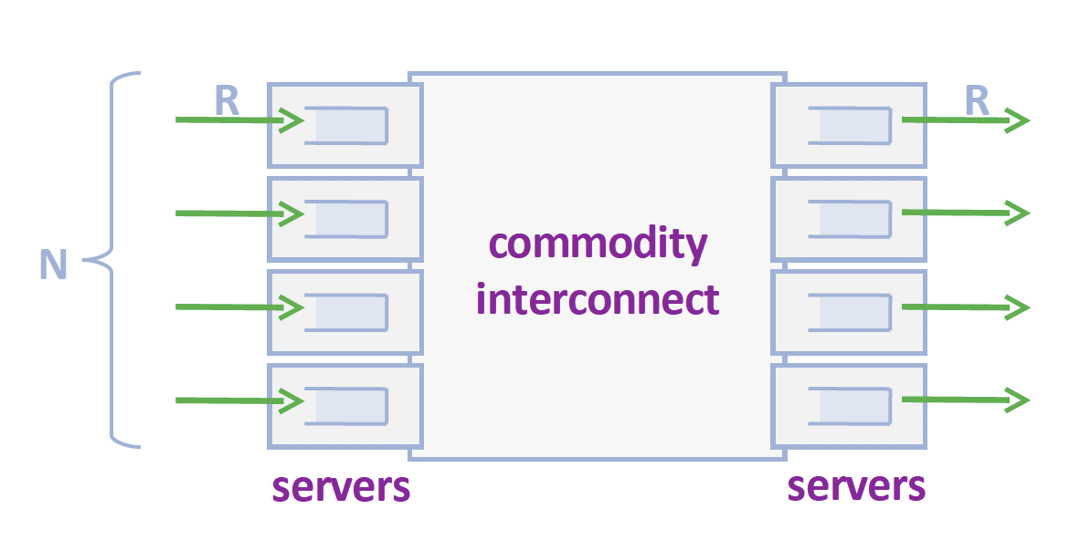
Contents
Introduction
Parallelizing Across Servers
Parallelizing Within Servers
Evaluation
Conclusion
HW Router
Many of the contents are from SOSP 2009 Slides
RouteBricks

Slide 3
Contents
Introduction
Parallelizing Across Servers
Parallelizing Within Servers
Evaluation
Conclusion
HW Router
Many of the contents are from SOSP 2009 Slides
RouteBricks

Slide 4
1. Introduction
1.1 HW router vs SW router
HW router
Fast
Throughput : Tbps
No programmability
SW router
Throughput < 10Gbps
General-purpose CPUs
Programmable
New network services / Research innovation / Management / etc

Slide 5
1. Introduction
1.2 RouteBricks
Off-the-shelf PCs
Uses Purely general purpose CPUs, purely software router
Advantage
Familiar programming environment
Large-volume manufacturers, thus low cost
Rapid advances in technology/features
Can this approach achieve Tbps?
Goal : achieve performance/scalability as much as possible
RouteBricks

Slide 6
2. Parallelizing Across Servers
2.1 Requirements
Internal link rates < R (low cost)
Per-server processing rate : c x R (where c > 1, independent from N, scalability)
Per-server fanout : constant (scalability)

Slide 7
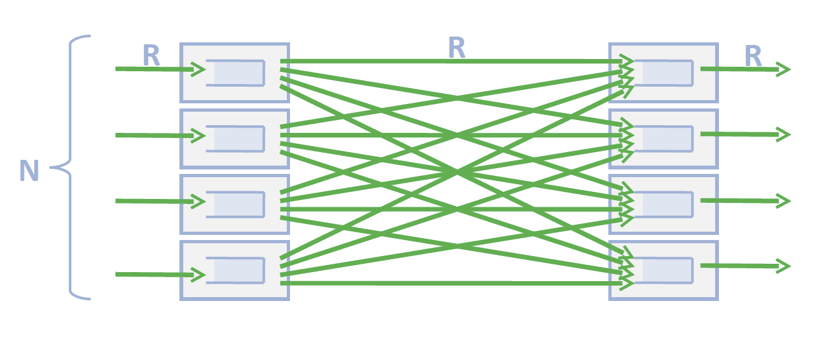
2. Parallelizing Across Servers
2.2 A Naïve Solution
$N^{2}$ internal links of capacity R, not cost efficient.

Slide 8
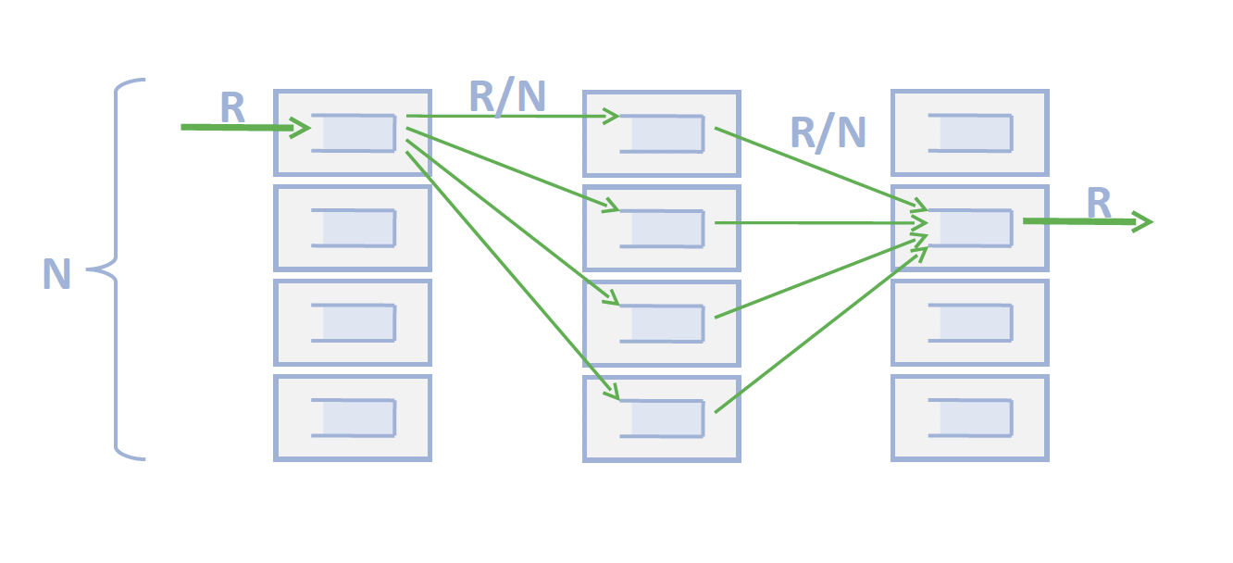
2. Parallelizing Across Servers
2.3 Better Solution – VLB(Valiant Load Balancing)
One more layer
Link capacity R -> R/N
L. Valiant et al. Universal Schemes for Parallel Communication. (STOC), 1981.

Slide 9
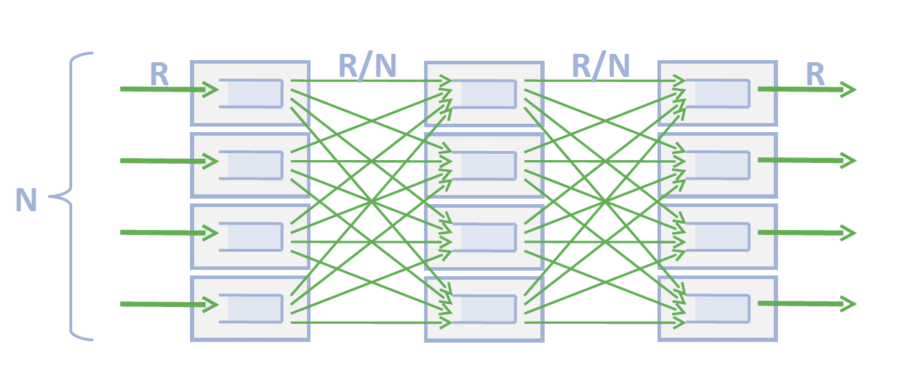
2. Parallelizing Across Servers
2.3 Better Solution – VLB(Valiant Load Balancing)
2 x $N^{2}$internal links of R/N, more cost efficient
Does not solve limited fanout problem

Slide 10
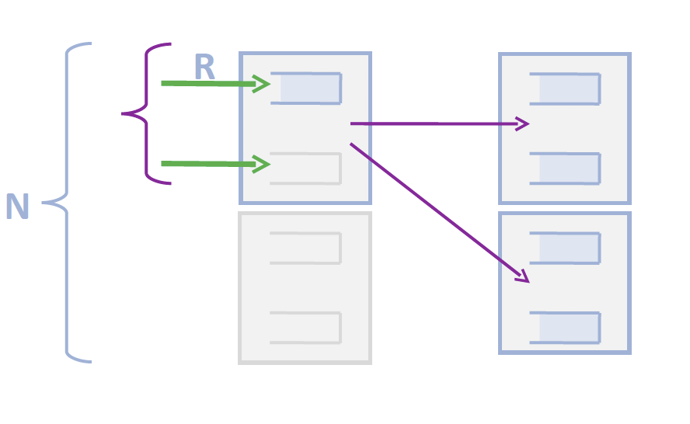
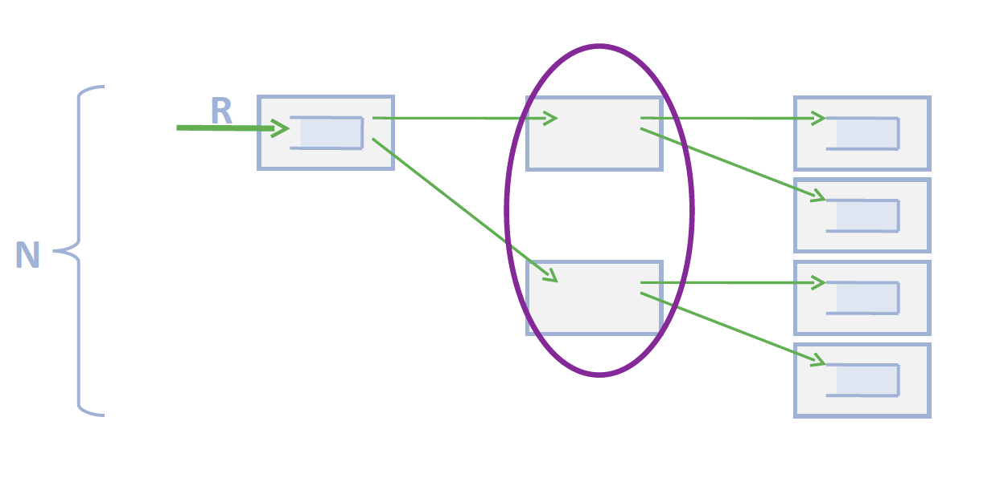
2. Parallelizing Across Servers
2.4 Extend VLB
Off-the-shelf PCs-> limited number of PCIe slots (i.e 5 NICs)
By combining both techniques, any number of ports(ie, N=32 or N=1024) can be supported
Tradeoff : throughput will be degraded (each server need increased capacity)
1. Single server handle multiple ports
2. Add more layer as you need

Slide 11
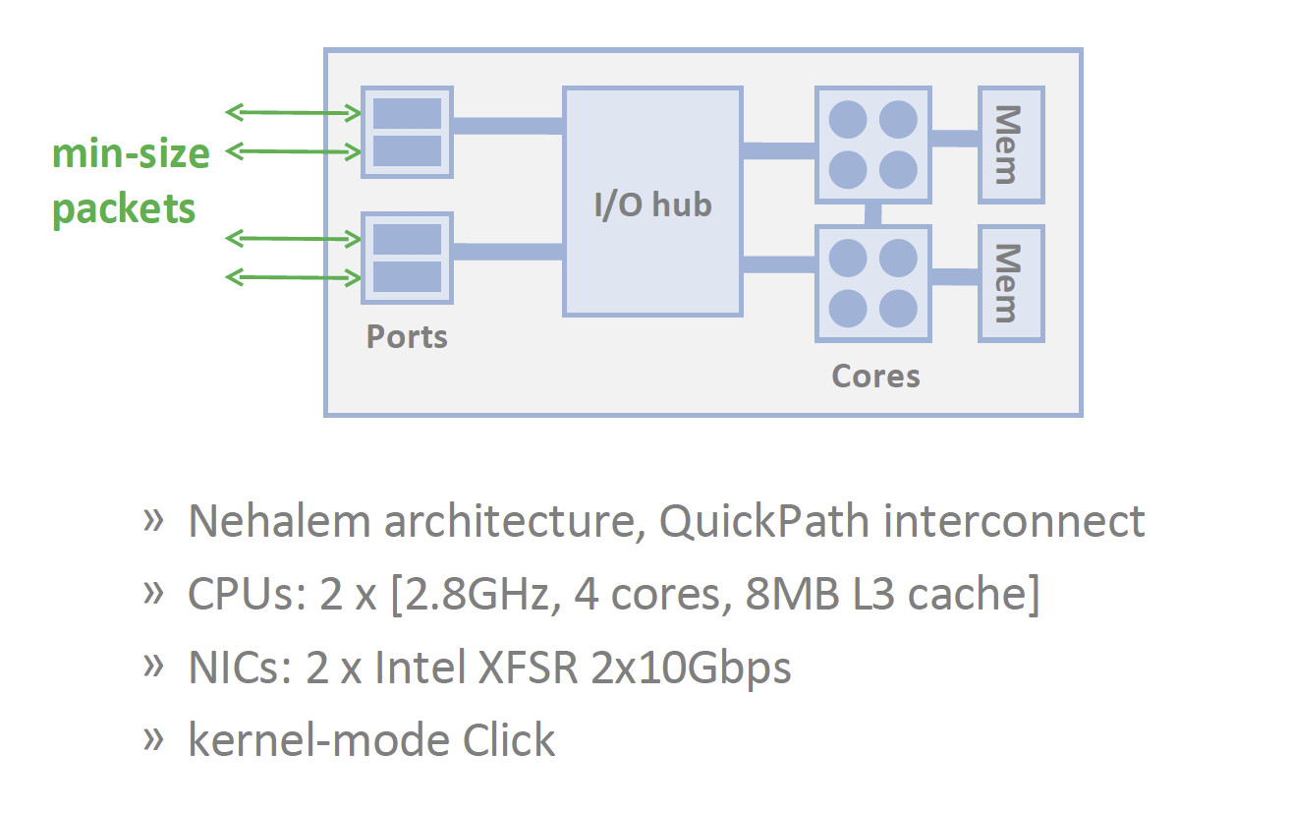
3. Parallelizing Within Servers
3.1 NUMA architecture
Sheer forwarding

Slide 12
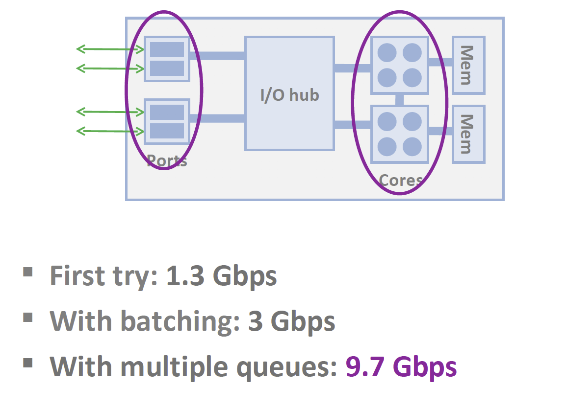
3. Parallelizing Within Servers
3.2 Result

Slide 13
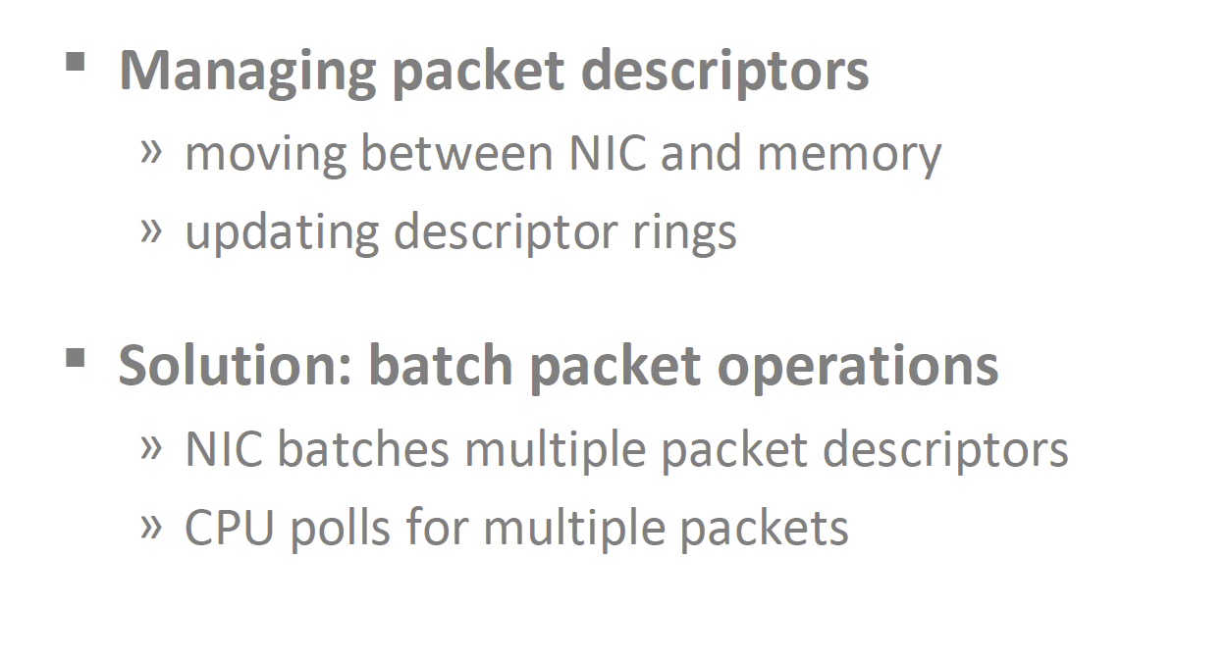
3. Parallelizing Within Servers
3.3 Batch Processing
Result : 1.3Gbps -> 3Gbps

Slide 14
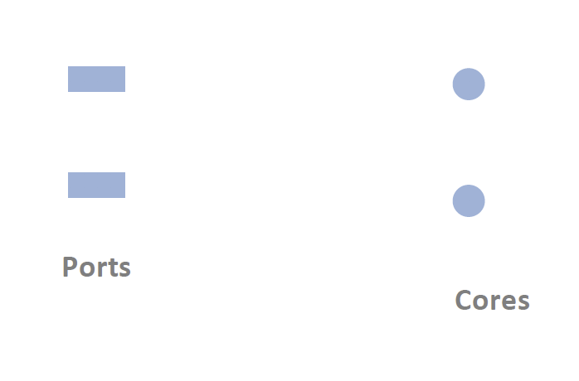
3. Parallelizing Within Servers
3.4 Multiple Queues

Slide 15
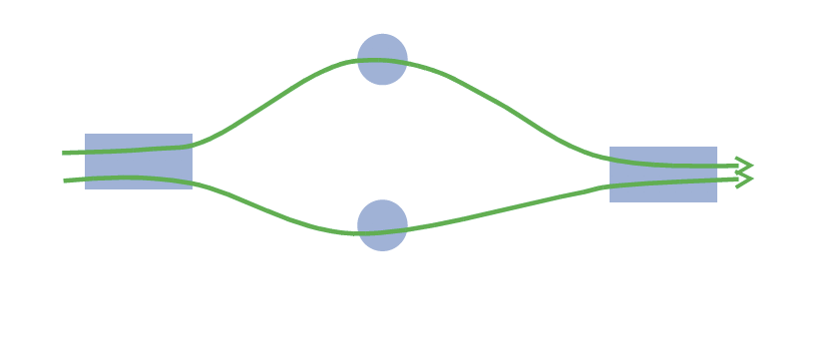
3. Parallelizing Within Servers
3.4 Multiple Queues
1 port, 2 cores
Synchronization overhead
1 packet , 2 cores
Cache misses

Slide 16
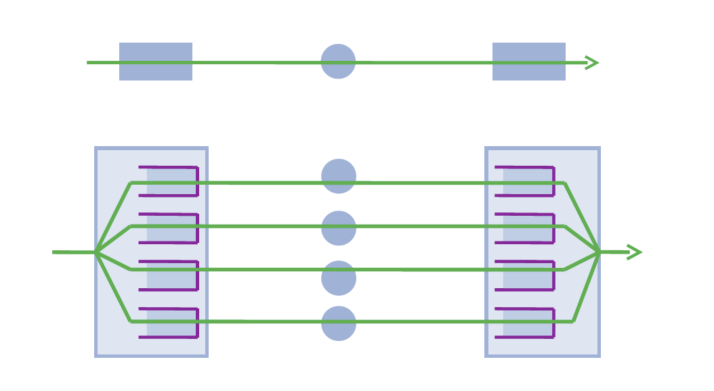
3. Parallelizing Within Servers
3.4 Multiple Queues
Rule1. 1 core per packet
Rule2. 1 core per queue
Result : 3Gbps -> 9.7Gbps

Slide 17
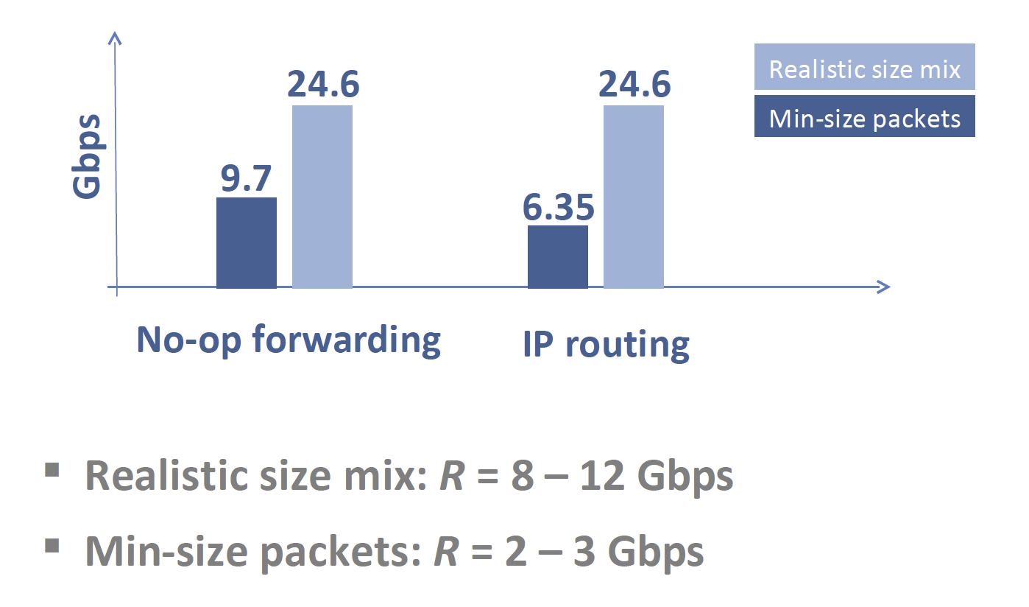
4. Evaluation
4.1 Single-server performance
Need to divide by three because there are 3 layers

Slide 18
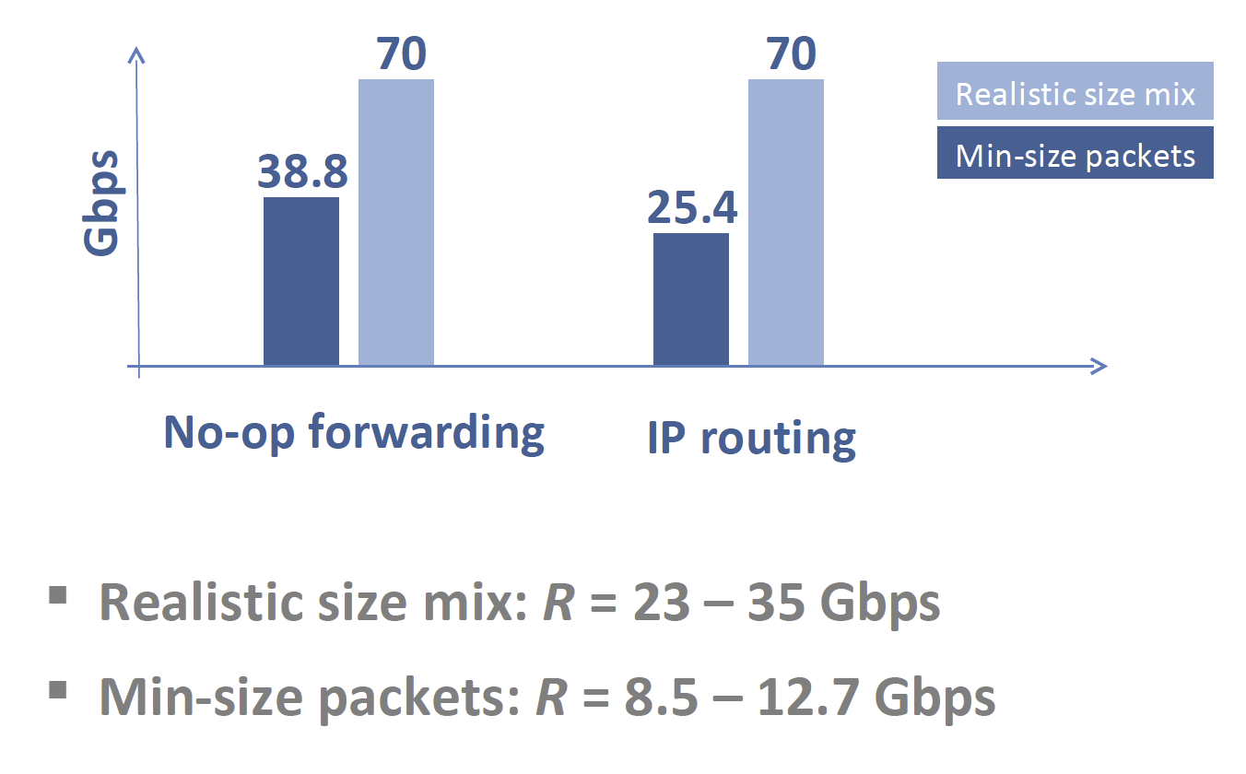
4. Evaluation
4.2 With upcoming servers

Slide 19
5. Conclusion
Scalable and fast software switch utilizing the state of the art HW(NUMA, multiple queue NIC cards)
Programmable with click
Performance is not close to HW router, but it shows SW router’s future potential.

