Slide 1
15-744: Computer Networking
L-23 DDoS Attacks

Slide 2
Overview
Denial of service
Traceback
Backscatter Analysis
Reflector Attacks

Slide 3
Denial of Service (DoS): General definition
DoS is not access or theft of information or services
Instead, goal is to stop the service from operating
Deny service to legitimate users
Usually a temporary effect that passes as soon as the attack stops

Slide 4
DoS: What is it?
Crash victim (exploit software flaws)
Attempt to exhaust victim's resources
  Network: Bandwidth
  Host
    Kernel: TCP connection state tables, etc.
    Application: CPU, memory, etc.
  Often high-rate attacks, but not always
Attacker
Victim

Slide 5
TCP Reminder: 3-Way Handshake
C
S
SYN_{C}
Listening
Create TCB
SYN_{S}, ACK_{C}
Wait
ACK_{S}
Connected
slide credit: Feamster
Notes:
5

Slide 6
Example DoS: TCP SYN Floods
Each arriving SYN stores state at the server
  TCP Control Block (TCB)
  ~ 280 bytes
    FlowID, timer info, Sequence number, flow control status, out-of-band data, MSS, other options
Attack:
  Send TCP SYN packets with bogus src addr
  Half-open TCB entries exist until timeout
  Kernel limits on # of TCBs
Resources exhausted  requests rejected
Notes:
6

Slide 7
Preventing SYN floods
Principle 1: Minimize state before auth
  (3 way handshake == auth)?
Compressed TCP state
  Very tiny state representation for half-open conns
  Don't create the full TCB
A few bytes per connection == can store 100,000s of half-open connections

Slide 8
SYN Cookies
Idea: Keep no state until auth.
  In response to SYN send back self-validating token to source that source must attach to ACK
SYN → SYN/ACK+token → ACK+token
  Validates that the receiver's IP is valid
How to do in SYN? sequence #s!
  top 5 bits: time counter
  next 3: Encode the MSS
  bottom 24: F(client IP, port, server IP, port, t)?
Downside to this encoding: Loses options.

Slide 9
Overview
Denial of service
Traceback
Backscatter Analysis
Reflector Attacks

Slide 10
Distributed Denial of Service (DDoS)
Motivation (from attacker’s perspective)
  For simple DoS, attacker must be either more powerful than the target machine
    Can one typical client machine generate enough work to overcome a powerful server?
  Or request must be significantly more lightweight than response (e.g., TCP SYN flood)
    Not always the case
Solution:
  Use many attacking machines!

Slide 11

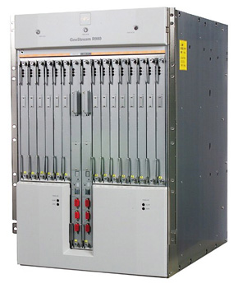
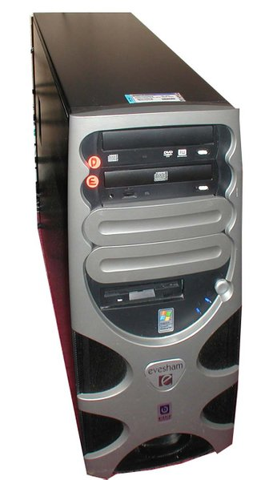
Distributed Denial of Service (DDoS)

Slide 12
Distributed Denial of Service (DDoS)

Slide 13

Distributed Denial of Service (DDoS)

Slide 14
Why DDoS is a hard problem?
Simple form of attack
  Just send a lot of traffic!
Prey on the Internet’s strengths
  Simplicity of processing in routers
Attack machines readily available
  Easy to find 10,000’s vulnerable machines of the Internet
Attack can look like normal traffic
  E.g., HTTP requests
Lack of Internet enforcement tools
  No traceability
Lack of cooperation between targets
  ISPs competition, cooperation only at human timescales
Effective solutions hard to deploy
  We can’t change the core of the Internet easily

Slide 15
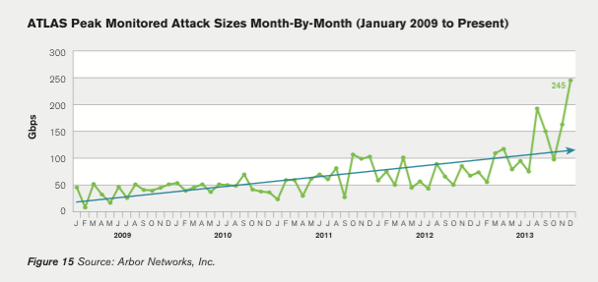
Current Trend of DDoS attacks
Volume
  Becomes larger, at most 0.5 Tbps
Diversity
  New type of attacks are emerging

Slide 16
Evolution of (D)DoS
Time
  Point-to-point DoS attacks
    TCP SYN floods, ping of death, etc.
  Smurf (reflection) attacks
  Coordinated DoS
  Multi-stage DDoS
  P2P botnets
  Novel amplification attacks (return of the smurf)

Slide 17
Coordinated DoS
Simple extension of DoS
Coordination between multiple parties
  Can be done off-band
  IRC channels, email…
Attackers’
machines
Victims

Slide 18
Typical DDoS setup circa 2005
Attacker’s machine
Masters
(Handlers)
Slaves
(Agents)
Victim

Slide 19
Typical DDoS setup circa 2005
Attacker’s machine
Masters
(Handlers)
Slaves
(Agents)
Infection/recruitment
Command & control
Assault
Victim

Slide 20
Modern Botnet setup
Zombies
(P2P)
Attackers
Attackers
Attackers
Peer-to-peer communication
Command & control
Assault
Victim

Slide 21
Smurf attacks
Attacker’s machine
Attacker spoofs victim’s IP address
Attacker sends error-generating packets to reflectors
Reflectors all report errors to victim
Victim is killed by error messages
Reflectors
(Amplifiers)
Victim

Slide 22
Reflector Attacks
Spoof source address
Send query to service
Response goes to victim
If response >> query, “amplifies” attack
Hides real attack source from victim
Amplifiers:
  DNS responses (50 byte query → 400 byte resp)?
  ICMP to broadcast addr (1 pkt → 50 pkts) (“smurf”)

Slide 23
Amplification factors (DNS)
98 bytes
3902 bytes
39.81x amplification factor

Slide 24
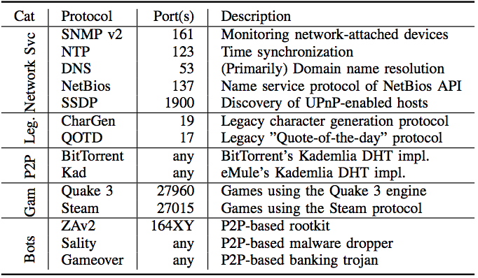
Survey of amplifiers
(Rossow NDSS’14)

Slide 25

Is this used in practice?
Intuition: attacker would scan for services they can use as reflectors
We can figure out if this happens by observing scans on network telescopes
  see backscatter analysis
Network “telescope”, e.g., empty /8 network
Pick random IP address
Asks e.g. “Runs DNS?”

Slide 26
Overview
Denial of service
Traceback
Backscatter Analysis
Reflector Attacks

Slide 27
Possible defenses I: Filtering
Filtering at the victim’s firewall
  Likely to be useless, firewall itself can be targeted
Filtering at the attacker’s firewall
  Routers drop packets with an “invalid” source IP address field
  Would need near universal deployment to be effective
    Besides, does not prevent subnet-level spoofing
  Economic incentives?

Slide 28
Ingress/Egress Filtering
Drop all packets with source address other than 204.69.207.0/24
Internet
204.69.207.0/24
RFC 2827: Routers install filters to drop packets from networks that are not downstream
Feasible at edges; harder at “core”

Slide 29
RPF Checks
Accept packet from interface only if forwarding table entry for source IP address matches ingress interface
Strict Mode
uRPF Enabled
10.0.18.3 from wrong interface
“A” Routing Table
Destination Next Hop
10.0.1.0/24 Int. 1
10.0.18.0/24 Int. 2
Unicast Reverse Path Forwarding
  Cisco: “ip verify unicast reverse-path”
Requires symmetric routing
Slide Credit: Feamster

Slide 30
Possible defenses II: Pushback
Pushback: rate limit flows that compose large traffic aggregates to mitigate impact of DDoS
Distributed solution: the whole network benefits
Requires router modifications
  Deployment may take very long

Slide 31
Filters & Pushback
Assumption: Can identify anomalous traffic?
  Add “filters” that drop this traffic
  Access control lists in routers
    e.g. deny ip from dave.cmu.edu to victim.com tcp port 80
Pushback: Push filters further into network towards the source
  Need to know where to push the filters (traceback)?
  Need authentication of filters...
  Tough problems. Filters usually deployed near victim.

Slide 32
Possible defenses III: Traceback
Traceback: Means of identifying source of attack even in presence of IP spoofing
Useful for forensics if available
Main problem: reaction time?
  Secondary problem: requires router modification, which itself limits deployment
Savage et al. paper, among many others
  Perrig et al., Snoeren et al.,…

Slide 33
Possible defenses IV: Network capabilities
DDoS attacks exploit fundamental problem: receiver has no control over who can send traffic to it
We need to enable receiver to stop misbehaving senders
One possibility is to have a “default disconnect” mode
  You cannot talk to me unless I agree to talk to you first
  Network capabilities
Capabilities need to be secured against forgery
Who issues the capabilities?
  Capability server?
  End-host?

Slide 34
Pitfalls and fallacies
Good host security protects against DDoS
  Unfortunately, it’s the others’ lousy security that is a vehicle for DDoS
Overprovisioning protects against DDoS
  You can’t be provisioned enough if 10,000+ machines attack you
Firewalls protect against DDoS
  One can target the firewall, and you lose your network access anyway, or the attacker can tunnel through the firewall
Any machine connected to the Internet is potentially vulnerable.

Slide 35
The Need for Traceback
Internet Protocol permits anonymity
  Attackers can “spoof” source address
  IP forwarding maintains no audit trails
Need a traceback facility
  For a given packet, find the path to source
Savage et al., 2000

Slide 36
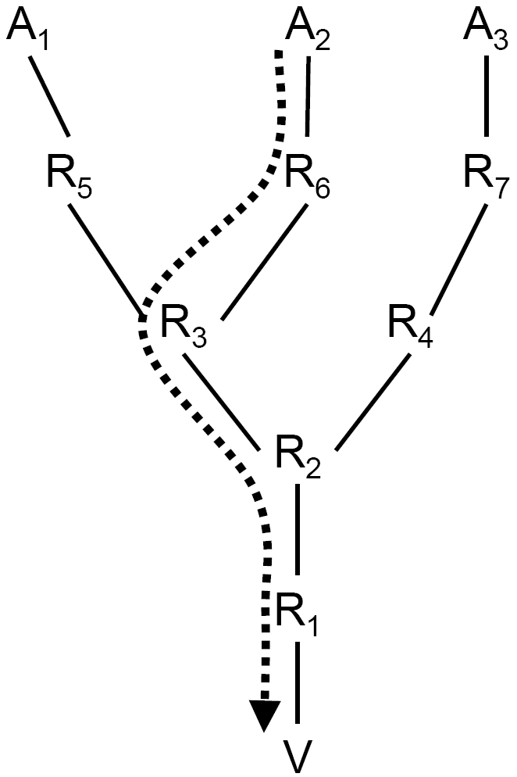
Traceback Schemes
Input Debugging
Logging
Record Route
ICMP Traceback
Probabilistic Packet Marking

Slide 37
Traceback: Input Debugging
Input Debugging
  Many routers can filter egress port packets and determine ingress port.
Problems
  Slow process to communicate packet signature for filter to upstream providers
  Difficult to get ISP cooperation
  Only works while attack is active

Slide 38
Traceback: Logging
Logging
  Log packets at key routers.
  Use data mining techniques to determine path.
Problems
  Enormous resource requirements.
  Large-scale inter-provider database integration.

Slide 39
Problem
Goal
  Determine path from packets
Assumptions
  an attacker may generate any packet
  multiple attackers may conspire
  attackers may be aware they are being traced
  packets may be lost or reordered
  attackers send numerous packets
  the route between attacker and victim is fairly stable
  routers are both CPU and memory limited
  routers are not widely compromised

Slide 40
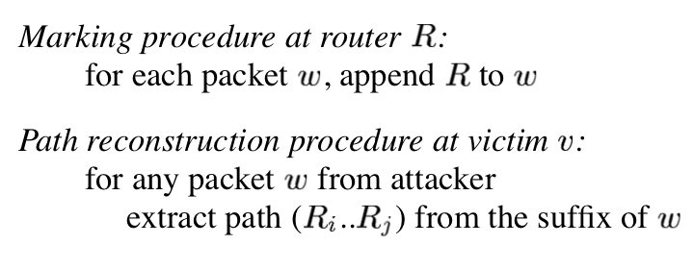
IP Traceback: Record Route
Record Path
  Each router adds IP address to packet.
  Victim reads path from packet.

Slide 41
IP Traceback: Record Route
Pro:
  fast convergence!
Cons:
  Requires space in packet.
    Unknown path size.
  Modifying all packets in transit is expensive

Slide 42
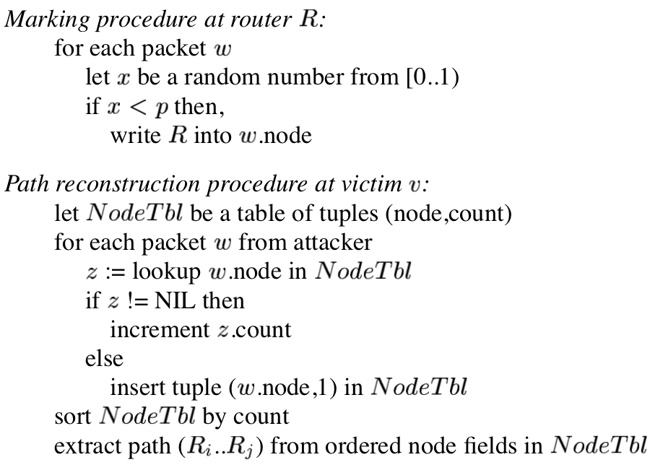
IP Traceback: Node sampling

Slide 43
IP Traceback: Node Sampling
Node Sampling
  Probabilistically store router address in packet using an IP header field (IP identifier).
    Fixed space regardless of path length.
  Router distance inferred from frequency of marked packets.
Problems
  Probability must > 0.5 to be robust against attacker.
  Large probability decreases chance of seeing packets marked by far routers.
  Ambiguity in case of multiple attackers at the same distance

Slide 44
IP Traceback: Edge sampling
Edge sampling
  Solve node sampling problems by encoding edges & distance from victim in messages
  Start router sets “start” field with probability p and sets distance to 0
  If distance is 0, router sets “end” field
  All routers increment distance
  As before, P(receiving mark from router d hops away) = p(1 – p)^{d-1}
Multiple attackers can be identified since edge identifies splits in reverse path

Slide 45
IP Traceback: Edge sampling
Edge sampling
  Easy for victim to reconstruct path to attacker.
  Probably can be much less than for simple marking.
    Optimal is p <= 1/d.
  Effective for multiple attackers.
    Number of required packets grows linearly.
Problems
  Impossible to trust route further away than the closest attacker.
  Require additional space in IP packet header.
    2x 32 bit addresses, 8 bit distance.

Slide 46
Edge sampling: Final
Problem:
  Slow convergence in practice
  Path reconstruction does not scale well against distributed attacks
  What if the routers are malicious?

Slide 47
Overview
Denial of Service
Traceback
Backscatter Analysis
Reflector Attacks

Slide 48
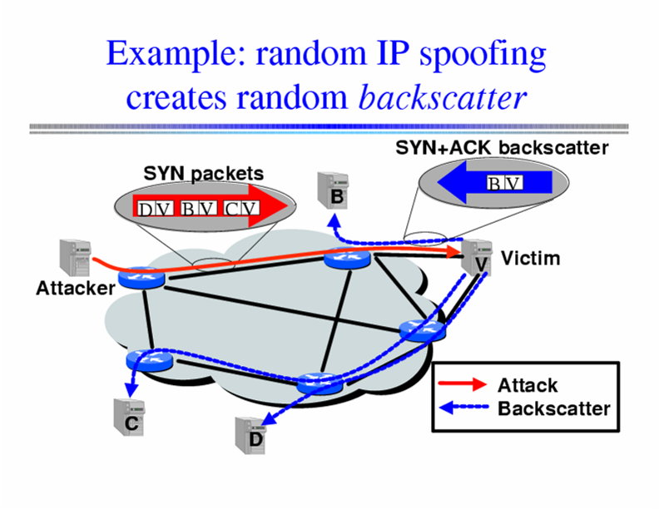
Inferring DoS Activity: Backscatter
IP address spoofing creates random backscatter.
Moore et al., 2001

Slide 49
Backscatter Analysis
Internet telescope/backscatter measurement
By monitoring unused portion of address space, possibility to see evidence of backscatter and infer type/number of DDoS attacks
(example: SYN flood)
Network “telescope”, e.g., empty /8 network
SYN, from IP = A
SYN-ACK, to IP = A

Slide 50
Backscatter Analysis
Use a big block of addresses (N of them)?
  People often use a /16 or /8
Observe X backscatter packets/sec
  How big is actual attack?
    X * (2^32 / N)?
    Assuming uniform distribution
Sometimes called “network telescope”

Slide 51
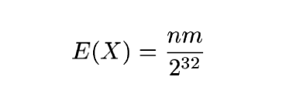
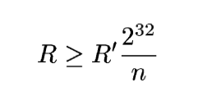
Calculating attack rate from backscatter
Attack of m packets
n monitored addresses
2³² = total IPv4

Slide 52
Summary
DDoS is the networked version of DoS
DDoS attacks are a real threat
Easy to carry out
  Toolkits readily available
Difficult to defend against
  Patching and securing one’s host is not enough
  Principally due to the nature (default connected) of the Internet
  Prevention is difficult, due to the role other machines play
  Involving multiple jurisdictions

Slide 53
Summary
Amplification attacks
  Abuse existing protocols
  Large amplification factors easy to achieve
    E.g., BAF of 1,000 -> 1GB/s of aggregate traffic yields 1TB/s of DDoS traffic
  Done in practice
    Although people haven’t yet fully realized they could abuse NTP or P2P networks like Kad

Slide 54
Next lecture
NIDS and NIPS
Required reading:
  Bro: A System for Detecting Network Intruders in Real-Time
Skim:
  Network Intrusion Detection: Evasion, Traffic Normalization, and End-to-End Protocol Semantics
Optional:
  Honeycomb – Creating Intrusion Detection Signatures Using Honeypots

Slide 55
Bandwidth DDoS Attacks - Solutions
Ingress filtering – examine packets to identify bogus source addresses
Link testing – have routers either explicitly identify which hops are involved in attack or use controlled flooding and a network map to perturb attack traffic
Logging – log packets at key routers and post-process to identify attacker’s path
ICMP traceback – sample occasional packets and copy path info into special ICMP messages
Capabilities
IP traceback + filtering

Slide 56
Secure Overlay Services
Source point
Beacon
Secret servlet
Overlay Access Point
Overlay Nodes
target
Filtered region
Authenticate client communication
Longer/slower route
Closed network
Keromytis, Misra, Rubenstein, 02

Slide 57
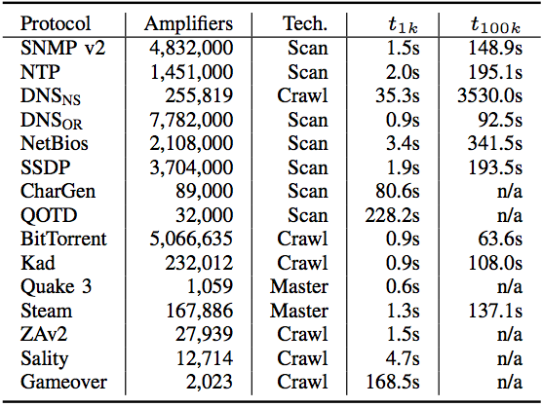
Survey of amplifiers
(Rossow NDSS’14)

Slide 58
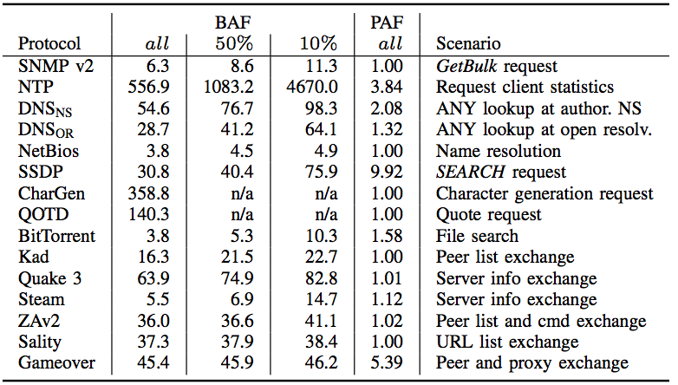
Survey of amplifiers
(Rossow NDSS’14)

Slide 59
Log-Based Traceback
R
R
A
R
R
R
R₇
R
R₄
R₅
R₆
R
R₃
R₁
R₂
V

Slide 60
Challenges to Logging
Attack path reconstruction is difficult
  Packet may be transformed as it moves through the network
Full packet storage is problematic
  Memory requirements are prohibitive at high line speeds (OC-192 is ~10Mpkt/sec)
Extensive packet logs are a privacy risk
  Traffic repositories may aid eavesdroppers
Notes:
Path construction

Slide 61
Solution: Packet Digesting
Record only invariant packet content
  Mask dynamic fields (TTL, checksum, etc.)
  Store information required to invert packet transformations at performing router
Compute packet digests instead
  Use hash function to compute small digest
  Store probabilistically in Bloom filters
Impossible to retrieve stored packets

Slide 62
Invariant Content
Ver
HLen
TOS
Total Length
Identification
D
F
M
F
Fragment Offset
TTL
Protocol
Checksum
28
bytes
Source Address
Destination Address
Options
First 8 bytes of Payload
Remainder of Payload

Slide 63
Bloom Filters
Fixed structure size
  Uses 2n bit array
  Initialized to zeros
Insertion is easy
  Use n-bit digest as indices into bit array
  Mitigate collisions by using multiple digests
Variable capacity
  Easy to adjust
  Page when full
n bits
1
H₁(P)
1
H(P)
H₂(P)
2^{n}
bits
H₃(P)
1
. . .
1
H_{k}(P)

Slide 64
Mistake Propagation is Limited
Bloom filters may be mistaken
  Mistake frequency can be controlled
  Depends on capacity of full filters
Neighboring routers won’t be fooled
  Vary hash functions used in Bloom filters
  Each router select hashes independently
Long chains of mistakes highly unlikely
  Probability drops exponentially with length

Slide 65
Adjusting Graph Accuracy
False positives rate depends on:
  Length of the attack path
  Complexity of network topology
  Capacity of Bloom filters
Bloom filter capacity is easy to adjust
  Required filter capacity varies with router speed and number of neighbors
  Appropriate capacity settings achieve linear error growth with path length

Slide 66
How long can digests last?
Filters require 0.5% of link capacity
  Four OC-3s require 47MB per minute
  A single drive can store a whole day
Access times are equally important
  Current drives can write >3GB per minute
  OC-192 needs SRAM access times
Still viable tomorrow
  128 OC-192 links need <100GB per minute
Notes:
4 OC-3 Hd needs 67GB/day

Slide 67
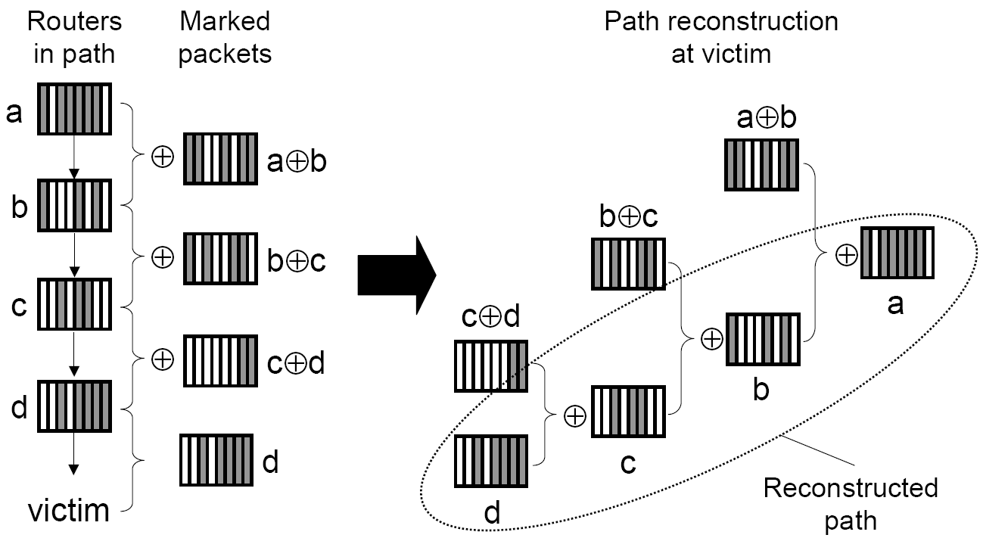
Edge sampling: Reduce Space Requirement - XOR
XOR two addresses for each edge together.

Slide 68
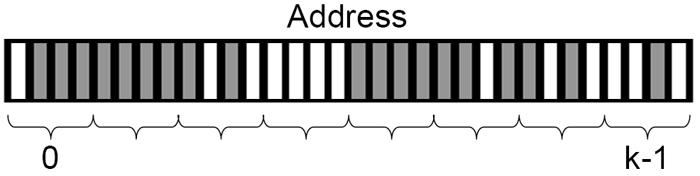
Edge sampling: Reduce Space Requirement - Subdivide
Break XORed addresses into k fragments.
Store only 1 fragment in packet with offset value.

Slide 69
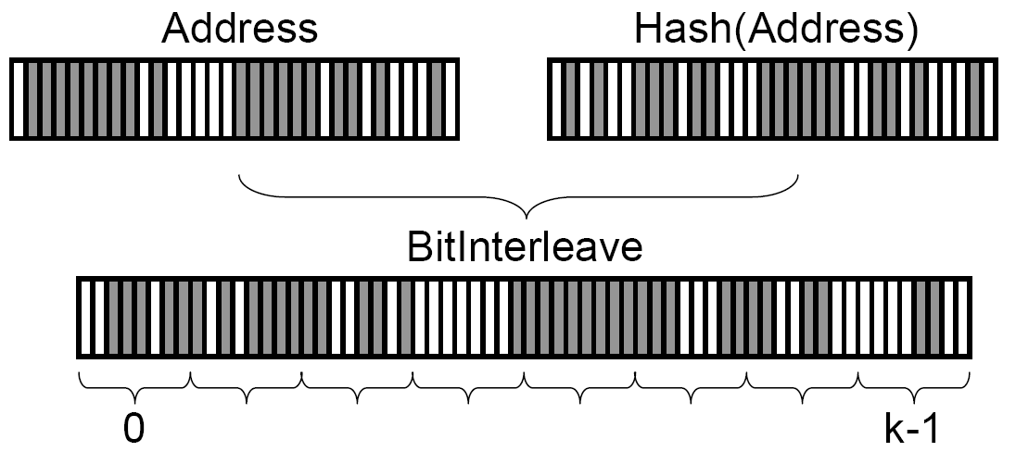
Edge sampling: Reduce Space Requirement - Hash
Multiple attackers may produce non-unique edges with same distance.
Add error detection:
  Interleave IP with hash of itself.

Slide 70
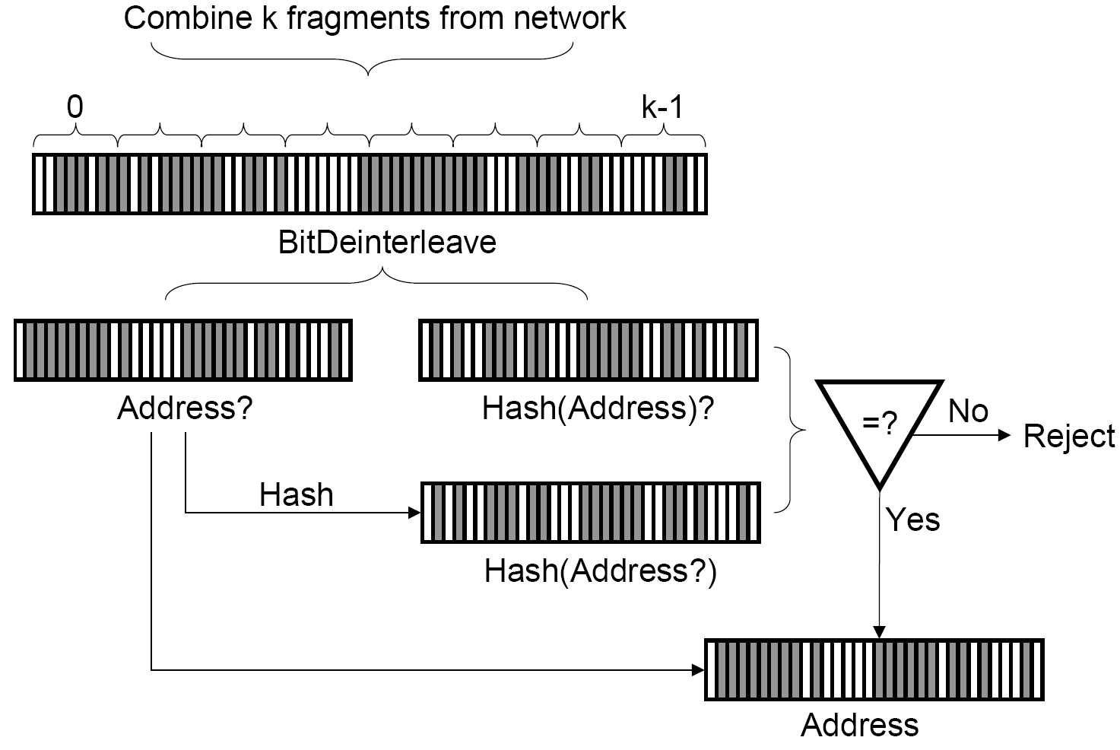
Edge sampling: Reduce Space Requirement - Hash

Slide 71
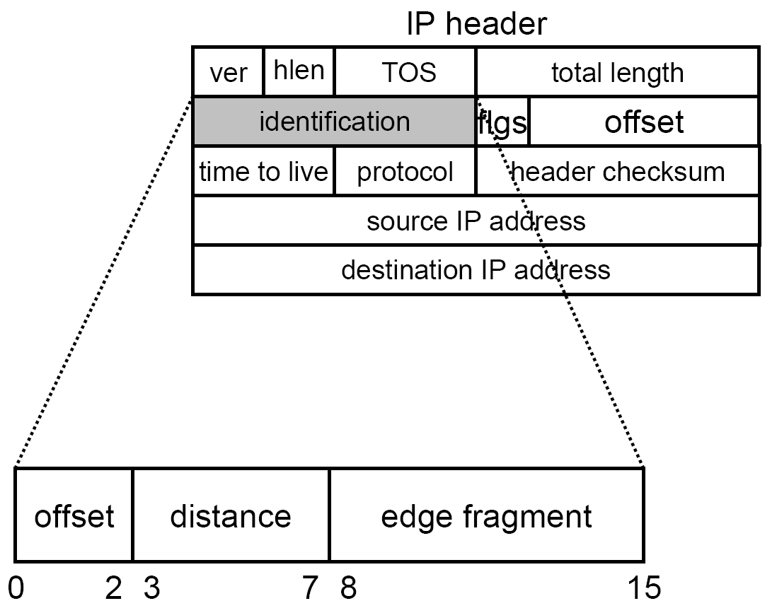
Edge sampling: Reduce Space Requirement - Storage
Final size: 16 bits

Slide 72
Host level impact
Host performance impacted
Need for good forensics
  find_ddos
  TCT
  lsof

Slide 73
Network level impact
Determining whether you are under attack or attacking someone else
  Anomaly detection
  Performance
  Gateways
  Uplinks/ISPs
More signs
  Network failure
  Complaints

Slide 74
Host defenses
Protecting the host as a target
  e.g., SYN cookies
Protecting the host as a source
  Host hardening against compromise
    What about all these unpatched systems?
  Integrity checking

Slide 75
Network defenses
Network analysis tools overwhelmed or confused
  Accuracy of data, dropped packets, better log raw packets
  Differentiate flood and control traffic
Impact reduction
  Traffic limiting, redundant pathways, deflection
  More on traffic limiting next time
Source of IP packets
  Need to trace spoofed packets to find agents
  More on traceback soon
[Adapted from Dietrich, Long and Dittrich]

Slide 76
Impact of DDoS
Attacks on a wide variety of targets
  Yahoo!, Microsoft, Port of Houston, ClickBank are all famous “victims”
Tend to be highly successful
Few good existing mechanisms to stop them
Successful attacks on major commercial sites

Slide 77
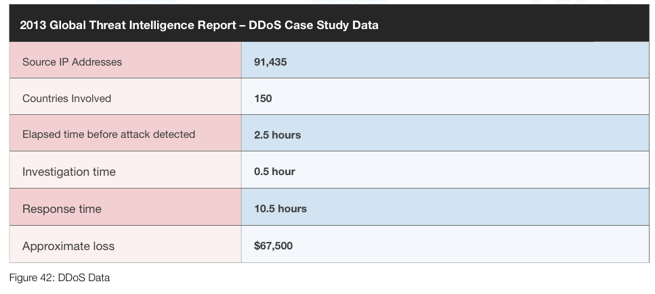
Current Trend of DDoS attacks
Major economic loss in the current industry
DDoS attack is increasing in volume and types
DDoS is still a big problem for the Internet industry

Slide 78
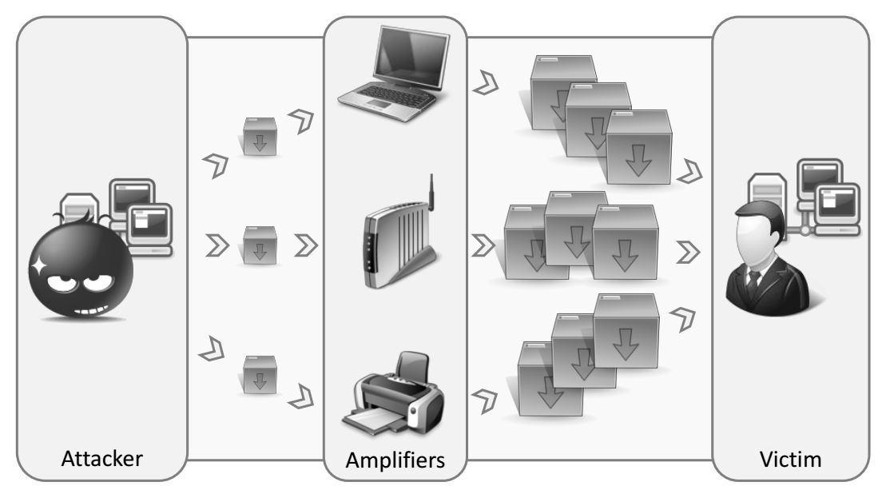
Reflector Attacks
Rossow., 2014

Slide 79
Amplification Attacks
Paper by Rossow (NDSS 2014)
Revisits 14 protocols that can be used for amplification attacks
  Shows potentially horrible load factors
Investigates which amplification attacks are used “in the wild”
Rossow., 2014

Slide 80
Using amplification
3902 bytes
98 bytes

Slide 81
Is this used in practice?
Intuition: attacker would scan for services they can use as reflectors
We can figure out if this happens by…

Slide 82
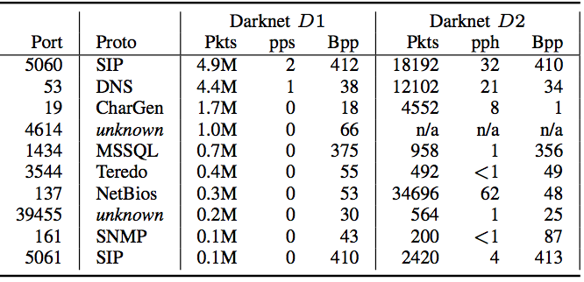
Results
All these protocols are scanned periodically!

Slide 83
Results
Analysis of netflow data showed:
  55 DNS-based attacks (amplification ~34-67)
  47 CharGen-based attacks (amp. 318~1395)
So, yes, it’s being done in practice…

Slide 84
Countermeasures
Preventing IP spoofing
  About 24% of all ASes actually do not even check for it (or completely allow it), and another 13% have deficient checks
Protocol hardening
Secure service configuration
Packet filtering

