Slide 1
15-744: Computer Networking
L-22 Wireless Broadcast

Slide 2
Overview
802.11
  Deployment patterns
  Reaction to interference
  Interference mitigation
Mesh networks
  Architecture
  Measurements
White space networks

Slide 3

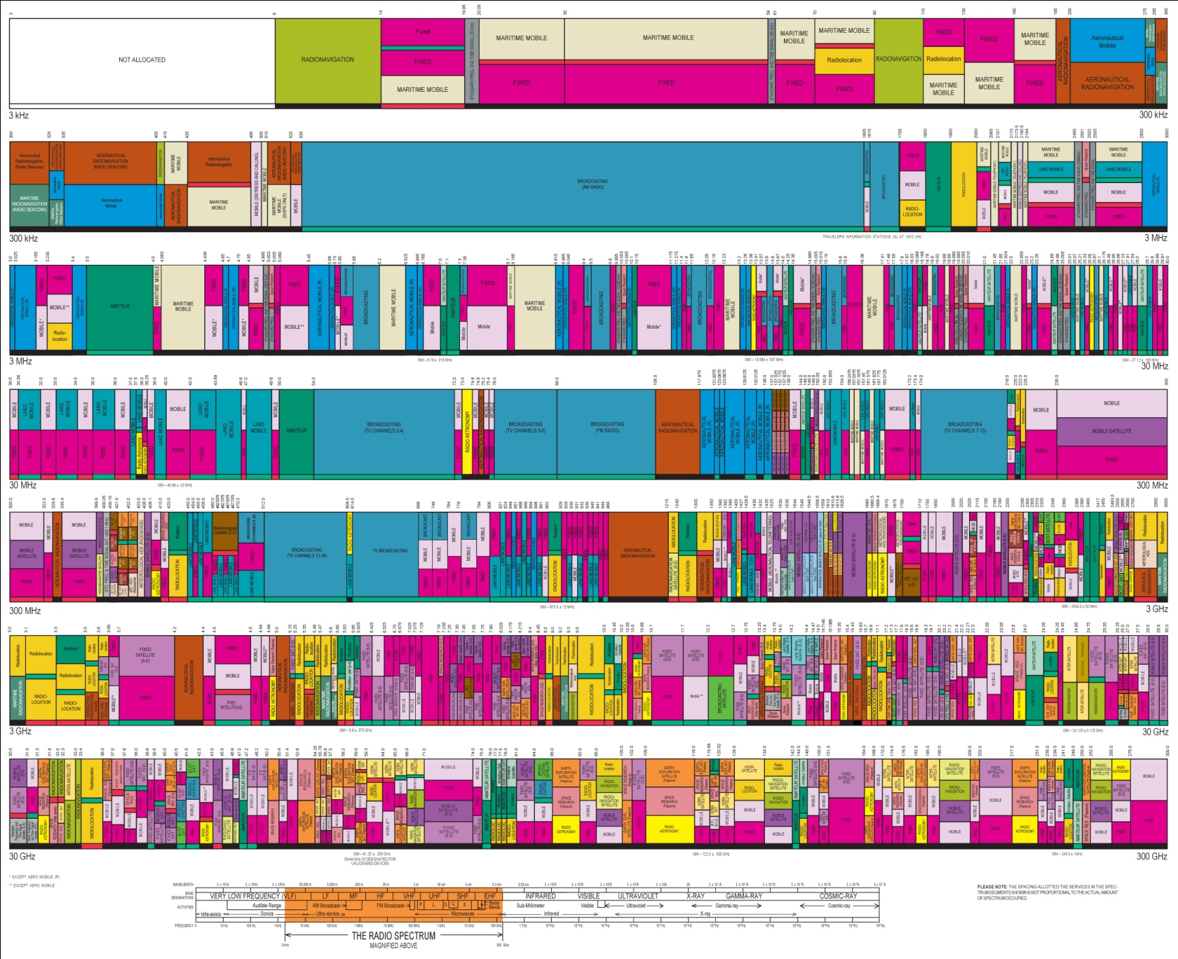



Higher Frequency
Broadcast TV
Wi-Fi (ISM)

Slide 4


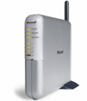
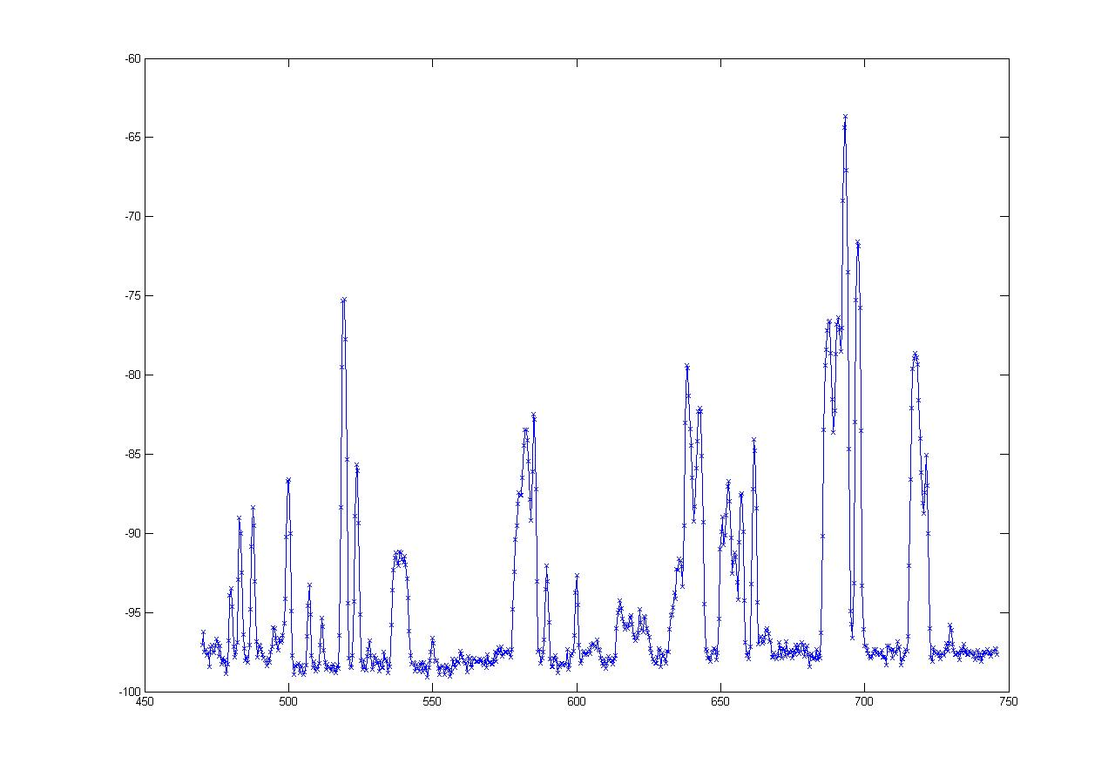
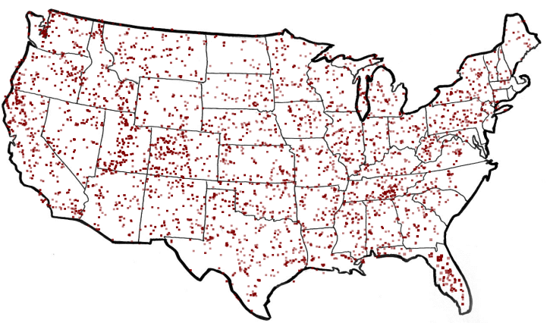
What are White Spaces?
TV
Wireless Mic
ISM (Wi-Fi)
0
MHz
54-90
170-216
470
700
2400
2500
5180
5300
7000
MHz
  50 TV Channels
  Each channel is 6 MHz wide
-60
“White spaces”
dbm
FCC Regulations*
    Sense TV stations and Mics
    Portable devices on channels 21 - 51
TV Stations in America
-100
470 MHz
Frequency
700 MHz
are Unoccupied TV Channels
White Spaces

Slide 5
The Promise of White Spaces
TV
Wireless Mic
ISM (Wi-Fi)
0
MHz
470
700
2400
2500
5180
5300
54-90
174-216
7000
MHz
More Spectrum
Up to 3x of 802.11g
Longer Range
at least 3 - 4x of Wi-Fi

Slide 6

White Spaces Spectrum Availability
Differences from ISM(Wi-Fi)
Fragmentation
Variable channel widths
1
2
3
4
5
1
2
3
4
5
Each TV Channel is 6 MHz wide
Spectrum is Fragmented
⇒ Use multiple channels for more bandwidth

Slide 7
White Spaces Spectrum Availability
Differences from ISM(Wi-Fi)
Fragmentation
Variable channel widths
Spatial Variation
Cannot assume same
channel free everywhere
1
2
3
4
5
1
2
3
4
5
TV
Tower
Location impacts spectrum availability
⇒ Spectrum exhibits spatial variation

Slide 8


White Spaces Spectrum Availability
Differences from ISM(Wi-Fi)
Fragmentation
Variable channel widths
Spatial Variation
Cannot assume same
channel free everywhere
1
2
3
4
5
Temporal Variation
1
2
3
4
5
Same Channel will
not always be free
Any connection can be
disrupted any time
Incumbents appear/disappear over time
⇒ Must reconfigure after disconnection

Slide 9

Channel Assignment in Wi-Fi
1
6
11
1
6
11
Fixed Width Channels
⇒ Optimize which channel to use

Slide 10
Spectrum Assignment in WhiteFi
Spectrum Assignment Problem
Goal
Maximize Throughput
Include
Spectrum at clients
1
2
3
4
5
1
2
3
4
5
Center Channel
Assign
&
Width
Fragmentation
⇒ Optimize for both, center channel and width
Spatial Variation
⇒ BS must use channel iff free at client

Slide 11
Accounting for Spatial Variation
1
2
3
4
5
1
2
3
4
5
1
2
3
4
5
∪
∪
=
1
2
3
4
5
1
2
3
4
5
1
2
3
4
5
1
2
3
4
5

Slide 12
Intuition
Intuition
Use widest possible channel
BS
But
Limited by most busy channel
1
2
3
4
5
Carrier Sense Across All Channels
All channels must be free
  ρ_{BS}(2 and 3 are free) = ρ_{BS}(2 is free) x ρ_{BS}(3 is free)
Tradeoff between wider channel widths
and opportunity to transmit on each channel

Slide 13
Discovering a Base Station
1
2
3
4
5
1
2
3
4
5
Discovery Time = Ο(B x W)
How does the new client discover channels used by the BS?
Can we optimize this discovery time?
BS and Clients must use same channels
Fragmentation
⇒ Try different center channel and widths

Slide 14
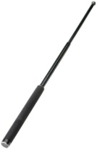
SIFT, by example
10 MHz
5 MHz
ADC
SIFT
SIFT
Data
ACK
Does not decode packets
Amplitude
SIFS
Pattern match in time domain
Time

Slide 15
Taking Advantage of Broadcast
Opportunistic forwarding
Network coding
Assigned reading
  802.11 with Multiple Antennas for Dummies
  XORs In The Air: Practical Wireless Network Coding
  ExOR: Opportunistic Multi-Hop Routing for Wireless Networks

Slide 16
Outline
MIMO
Opportunistic forwarding (ExOR)
Network coding (COPE)
Combining the two (MORE)

Slide 17
How Do We Increase
Throughput in Wireless?
Wired world: pull more wires!
Wireless world: use more antennas?

Slide 18
MIMO
Multiple In Multiple Out
N transmit
antennas
M receive
antennas
N x M subchannels
Fading on channels is largely independent
  Assuming antennas are separate ½ wavelength or more
Combines ideas from spatial and time diversity, e.g. 1 x N and N x 1
Very effective if there is no direct line of sight
  Subchannels become more independent

Slide 19
Why So Exciting?
Method
SISO
Diversity (1xN or Nx1)
Diversity (NxN)
Multiplexing
Capacity
B log₂(1 + ρ)
B log₂(1 + ρΝ)
B log₂(1 + ρΝ²)
NB log₂(1 + ρ)

Slide 20
Simple Channel Model
No diversity:
i x p_{T} x h x p_{R} = o
Adding multi-path:
i x p_{T} x h(t) x p_{R} = o
T
R
T
R

Slide 21
Transmit and Receive Diversity
Revisited
Receive diversity:
i x H x P_{R} = o
Transmit diversity:
i x P_{T} x H = o
T
R
T
R

Slide 22
MIMO How Does it Work?
Coordinate the processing at the transmitter and receiver to overcome channel impairments
  Maximize throughput or minimize interference
Generalization of earlier techniques
  Combines maximum ratio combining at transmitter and receiver with sending of multiple data streams
T
R
I x P_{T} x H x P_{R} = O
Precoding
from Nx1
Channel
Matrix
Combining
from 1xN

Slide 23
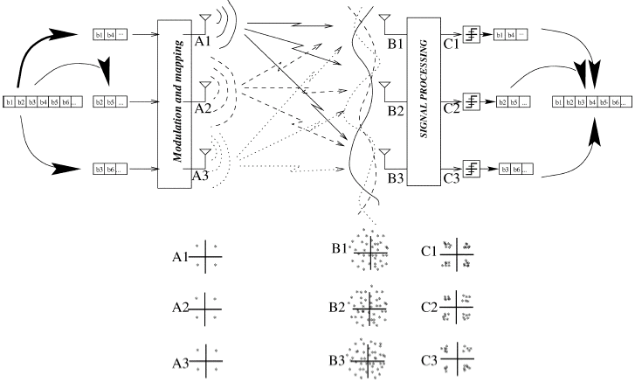
An Example of
Space Coding

Slide 24
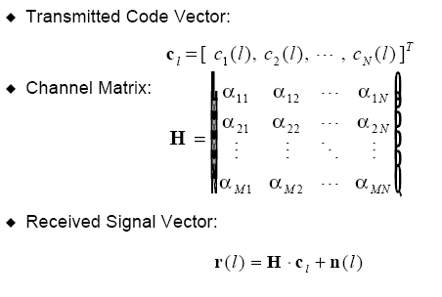
A Math View

Slide 25
Direct-Mapped NxM MIMO
M MxN N M
Effect of transmission R = H * C + N
Decoding O = P_{R} * R C = I
D DxM M N N
Results O = P_{R} * H * I + P_{R} * N
How do we pick P_{R} ? → Need “Inverse” of H: H⁻¹
  Equivalent of nulling the interfering possible (zero forcing)
  Only possible if the paths are completely independent
Noise amplification is a concern if H is non-invertible – its determinant will be small
  Minimum Mean Square Error detector balances two effects
Notes:
MRC maximum ratio combining

Slide 26
Precoded NxM MIMO
M MxN N M
Effect of transmission R = H * C + N
Coding/decoding O = P_{R} * R C = P_{T} * I
D DxM M N NxD D
Results O = P_{R} * H * P_{T} * I + P_{R} * N
How do we pick P_{R} and P_{T} ?

Slide 27
Precoded NxM MIMO
Results O = P_{R} * H * P_{T} * I + P_{R} * N
How do we pick P_{R} and P_{T} ?
Singular value decomposition of H = U * S * V
  U and V are unitary matrices – U^{H}*U = V^{H}*V = I
  S is diagonal matrix
Set P_{R} and P_{T} to U^{H} and V^{H}
  Similar to approach for transmit and receive MRC
Equations suggest that we can view MIMO as a set of independent paths with strength given by the singular values of S
  Suggests giving more power to the stronger paths
  Water filling algorithm allocates power while maximizing throughput
Notes:
MRC maximum ratio combining; superscript H means Hermition or complex conjugate transpose

Slide 28
MIMO Discussion
Need channel matrix H: use training with known signal
MIMO is used in 802.11n in the 2.4 GHz band
  Can use two of the non-overlapping “WiFi channels”
  Raises lots of compatibility issues
  Potential throughputs of 100 of Mbps
Focus is on maximizing throughput between two nodes
  Is this always the right goal?

Slide 29
Outline
MIMO
Opportunistic forwarding (ExOR)
Network coding (COPE)
Combining the two (MORE)

Slide 30
Initial Approach: Traditional Routing
packet
packet
A
B
packet
src
dst
C
Identify a route, forward over links
Abstract radio to look like a wired link
Notes:
just say picks a route, fwd over that route

Slide 31
Radios Aren’t Wires
A
B
1
2
src
dst
2
2
3
3
3
4
4
4
5
5
5
6
6
1
6
1
2
3
4
5
6
1
C
Every packet is broadcast
Reception is probabilistic
Notes:
what’s really going on is we’re abstracting → as youall know, radios don’t work like links

Slide 32
Exploiting Probabilistic Broadcast
packet
packet
packet
packet
A
B
src
dst
packet
packet
packet
packet
packet
C
Decide who forwards after reception
Goal: only closest receiver should forward
Challenge: agree efficiently and avoid duplicate transmissions
Notes:
say there’s an opportunity here, take advantage of bcast. spell it out: closest node should reduce the number of tx to get to dest. challenge:: key failure is that two people should not forward. make sure only one guy forwards

Slide 33
Why ExOR Might Increase Throughput
src
N1
N2
N3
N4
N5
dst
75%
50%
25%
Best traditional route over 50% hops: 3(¹/_{0.5}) = 6 tx
Throughput ≅ /_{# transmissions}
ExOR exploits lucky long receptions: 4 transmissions
Assumes probability falls off gradually with distance
Notes:
new slide earlier, assume figured out design. explore why exor might improve throughput/develop a feel title -> why exor might beat trad routing.
inverse prop to #trans, up to 4 hops

Slide 34
Why ExOR Might Increase Throughput
N1
25%
100%
N2
25%
100%
src
dst
25%
N3
100%
25%
100%
N4
Traditional routing: ¹/_{0.25} + 1 = 5 tx
ExOR: ¹/(1 – (1 – 0.25)⁴) + 1 = 2.5 transmissions
Assumes independent losses
Notes:
say this is a contrived example

Slide 35
ExOR Batching
rx: 0
rx: 40
rx: 57
rx: 85
tx: 0
N2
N4
tx: 100
tx: 57 -23
≅ 24
rx: 0
tx: ≅ 9
rx: 22
src
dst
rx: 88
rx: 99
rx: 23
N1
N3
rx: 53
tx: ≅ 8
tx: 23
Challenge: finding the closest node to have rx’d
Send batches of packets for efficiency
Node closest to the dst sends first
  Other nodes listen, send remaining packets in turn
Repeat schedule until dst has whole batch
Notes:
add circle for source, then some more circles showing next iteration (no rx/tx numbers). say at the end, packets go through multiple iteration. add source, add n4.

Slide 36
Reliable Summaries
tx: {2, 4, 10 ... 97, 98}
batch map: {1,2,6, ... 97, 98, 99}
N2
N4
src
dst
N1
N3
tx: {1, 6, 7 ... 91, 96, 99}
batch map: {1, 6, 7 ... 91, 96, 99}
Repeat summaries in every data packet
Cumulative: what all previous nodes rx’d
This is a gossip mechanism for summaries
Notes:
just say we incude a summary in every packet
repeated
cumulative
simplify: every node is listening, include list to make it more robust

Slide 37
Priority Ordering
N2
N4
src
dst
N1
N3
Goal: nodes “closest” to the destination send first
Sort by ETX metric to dst
  Nodes periodically flood ETX “link state” measurements
  Path ETX is weighted shortest path (Dijkstra’s algorithm)
Source sorts, includes list in ExOR header
Notes:
source calculates path etx for each node to dest, talk about dijkstra, sort by lowest etx

Slide 38
Using ExOR with TCP
Client PC
TCP
TCP
Web Server
Node
Gateway
Proxy
ExOR Batches (not TCP)
Web
Proxy
ExOR
Batching requires more packets than typical TCP window
Notes:
don’t say we will, say we do. Batching interacts badly with tcp. Internet cloud. NOT using TCP in the middle – spell it out

Slide 39
Discussion
Exploits radio properties, instead of hiding them
Scalability?
Parameters – 10%?
Overheads?

Slide 40
Outline
MIMO
Opportunistic forwarding (ExOR)
Network coding (COPE)
Combining the two (MORE)

Slide 41
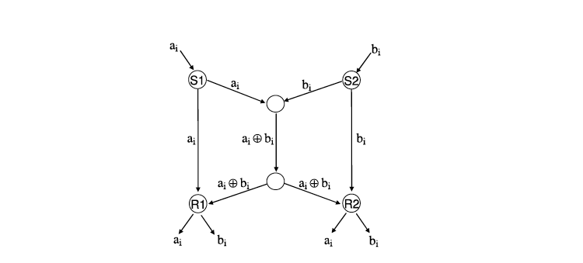
Background
Famous butterfly example:
All links can send one message per unit of time
  Coding increases overall throughput

Slide 42

Background
Bob and Alice
Relay
Require 4 transmissions

Slide 43
Background
Bob and Alice
Relay
XOR
XOR
XOR
Require 3 transmissions
Notes:
Bridge the gap between theory of network coding and practical network design

Slide 44
Coding Gain
Coding gain = 4/3
1
1+3
3

Slide 45
Throughput Improvement
UDP throughput improvement ~ a factor 2 > 4/3 coding gain
1
1+3
3

Slide 46
Coding Gain: more examples
2
5
1
3
4
1+2+3+4+5
Without opportunistic listening, coding [+MAC] gain=2N/(1+N) → 2.
With opportunistic listening, coding gain + MAC gain → ∞

Slide 47
COPE (Coding Opportunistically)
Overhear neighbors’ transmissions
Store these packets in a Packet Pool for a short time
Report the packet pool info. to neighbors
Determine what packets to code based on the info.
Send encoded packets

Slide 48
Opportunistic Coding
B’s queue | Next hop
P1 | A
P2 | C
P3 | C
P4 | D
P4 P1
C
P4 P3 P2 P1
B
Coding | Is it good?
P1+P2 | Bad (only C can decode)
P1+P3 | Better coding (Both A and C can decode)
P1+P3+P4 | Best coding (A, C, D can decode)
A
D
P4 P3
P3 P1

Slide 49
Packet Coding Algorithm
When to send?
  Option 1: delay packets till enough packets to code with
  Option 2: never delaying packets -- when there’s a transmission opportunity, send packet right away
Which packets to use for XOR?
  Prefer XOR-ing packets of similar lengths
  Never code together packets headed to the same next hop
  Limit packet re-ordering
  XORing a packet as long as all its nexthops can decode it with a high enough probability

Slide 50
Packet Decoding
Where to decode?
  Decode at each intermediate hop
How to decode?
  Upon receiving a packet encoded with n native packets
    find n-1 native packets from its queue
    XOR these n-1 native packets with the received packet to extract the new packet

Slide 51
Prevent Packet Reordering
Packet reordering due to async acks degrade TCP performance
Ordering agent
  Deliver in-sequence packets immediately
  Order the packets until the gap in seq. no is filled or timer expires

Slide 52
Summary of Results
Improve UDP throughput by a factor of 3-4
Improve TCP by
  wo/ hidden terminal: up to 38% improvement
  w/ hidden terminal and high loss: little improvement
Improvement is largest when uplink to downlink has similar traffic
Interesting follow-on work using analog coding

Slide 53
Reasons for Lower Improvement in TCP
COPE introduces packet re-ordering
Router queue is small ➔ smaller coding opportunity
  TCP congestion window does not sufficiently open up due to wireless losses
TCP doesn’t provide fair allocation across different flows

Slide 54
Discussion
Wired vs. wireless coding
Traffic patterns
Scale

Slide 55
Outline
MIMO
Opportunistic forwarding (ExOR)
Network coding (COPE)
Combining the two (MORE)

Slide 56
Use Opportunistic Routing
R1
50%
100%
50%
R2
100%
src
dst
50%
100%
R3
50%
100%
R4
Best single path → loss prob. 50%
In opp. routing [ExOR’05], any router that hears the packet can forward it → loss prob. 0.5⁴ = 6%
Opportunistic routing promises large increase in throughput
Notes:
BUT we realize that when the source transmits, the packet is actually broadcast over the radio..
Hence, even if it doesn’t reach a specific router, another one might get lucky and receive it.
So why discard these fortunate receptions, when we can exploit them?
2 years ago, there was this cool SIGCOMM paper on opportunistic routing that proposed a protocol called ExOR.
In opportunistic routing, any router that receives the transmission can participate in forwarding.
And because, we first broadcast, and then look at who receives the transmission,
The probability that the source must retransmit is greatly reduced to just 6%.
Thus, opp. routing promises significant improvement in throughput

Slide 57
But
Overlap in received packets → Routers forward duplicates
P₁
R1
P₂
P₁
src
dst
P₂
P₁₀
R2
P₁
P₂
Notes:
Let’s see this on an example.
The source wants to deliver 10 packets, P1 throgh P10,
So it broadcasts them,
And let’s say that among other things,
The two routers R1 and R2, both receive P! And P2.
If both forward these packets, the destination receives two copies of each,
..so we wasted valuable wireless bandwidth.

Slide 58
ExOR
State-of-the-art opp. routing, ExOR imposes a global scheduler:
Requires full coordination; every node must know who received what
Only one node transmits at a time, others listen

Slide 59
Global Scheduling
dst
src
Global coordination is too hard
One transmitter → You lost spatial reuse!
Notes:
(Furthermore, if the coordination requires that only one node transmits at a time...)
...then we cannot benefit from spatial reuse of the medium.
For example, in this network, up to 4 nodes could transmit at the same time without colliding,
So if we allow only one, then we give up a lot of wireless bandwidth.
So here’s what we thought…
Opportunistic routing is a really neat idea, so does it really have to be that complicated?
Do we really need global coordination, global scheduling, __and__ to give up spatial reuse?
Could we do it in a simpler way?
The answer is yes!

Slide 60
MORE (Sigcomm07)
Opportunistic routing with no global scheduler and no coordination
Uses random network coding
Experiments show that randomness outperforms both current routing and ExOR
Notes:
The rest of this talk is about how to do opportunistic routing without global scheduling and without global coordination.
The key idea is to use random network coding.
Our experiments show that this randomness actually outperforms both current single-path routing and ExOR

Slide 61
Go Random
Each router forwards random combinations of packets
P₁
R1
α P₁+ ß P₂
P₂
src
dst
P₁
R2
γ P₁+ δ P₂
P₂
Randomness prevents duplicates
No scheduler; No coordination
Simple and exploits spatial reuse
Notes:
Getting back to our example. -- Routers R1 and R2 had both received P1 and P2.
Now without any coordination,
...R1 picks two random numbers alpha and beta,
...multiplies the bytes in the packets by these numbers to create a coded packet
R2 does the same, picking some other random numbers…
When the destination receives two such combinations
...it actually gets 2 linear equations that it can solve to find the unknown packets P1 and P2.
This works, because we picked the numbers at random, so they are very unlikely duplicates.
So we don’t need the scheduler, because we don’t need the coordination!
This very simple idea allows us to do opportunistic routing _and_ exploit spatial reuse

Slide 62
Random Coding Benefits Multicast
P₁
P₂
src
P₃
P₄
dst1
dst2
dst3
P₁
P1
P1
P₂
P₂
P2
P3
P₃
P₃
P4
P4
P₄
Without coding → source retransmits all 4 packets
Notes:
But there is more to it --- With random coding we can extend opportunistic routing to multicast!
Suppose that the source wants to multicast 4 packets, P1 through P4
..to a group of 3 destinations.
The source bcast these 4 packets, --- And because wireless losses are independent,
it’s likely that each destination loses different packets.
In particular in this scenario, every packet is lost at some destination,
So even if source had global knowledge, it would have to retransmit each packet ( and so we would need 4 transmissions )

Slide 63
Random Coding Benefits Multicast
Random combinations
P₁
P₂
8 P₁+5 P₂+ P₃+3 P₄
src
P₃
7 P₁+3 P₂+6 P₃+ P₄
P₄
dst1
dst2
dst3
P₁
P1
P1
P₂
P₂
P2
P3
P₃
P₃
P4
P4
P₄
Without coding → source retransmits all 4 packets
With random coding → 2 packets are sufficient
Notes:
But WITH random coding, we can satisfy all destinations with just 2 packets. Let’s see how.
create two __completely random__ combinations of all 4 packets and broadcast them.
Destination 1 has already received P1 and P2,
…so it can substitute them in these two equations, and solve for (missing) P3 and P4.
Similarly destination 2 and 3 can retrieve their missing packets.
So this ex. shows that
Random coding is not just about removing the scheduler.
It’s actually more efficient than global coordination…

Slide 64
MORE
Source sends packets in batches
Forwarders keep all heard packets in a buffer
Nodes transmit linear combinations of buffered packets
a
P1
+ b
P2
+ c
P3
=
a,b,c
src
A
B
dst
P1
4,1,3
4,1,3
P2
0,2,1
P3
4
+ 1
+ 3
=
0
P1
+ 2
P2
+ 1
P3
=
4,1,3
P1
P2
P3
0,2,1
Notes:
Similarly to ExOR, in MORE, the source sends packets in batches…
Rather than the standard FIFO queue, the forwarders keep a buffer for incoming packets.
Whenever any node wants to transmit, it creates a random linear combinations of (all) the packets in its buffer.
Let me illustrate.
So here we have the source, destinatoin and two routers in between.
You can see their buffers for incoming packets. And you can also see that the source has a batch of 3 packets...
We put these numbers in the header of the packet, so that we know what equation it stands for.
In case you worry about this, as we show in the paper, we can compute such linear combinations and sustain high throughput.

Slide 65
MORE
Source sends packets in batches
Forwarders keep all heard packets in a buffer
Nodes transmit linear combinations of buffered packets
a
P1
+ b
P2
+ c
P3
=
a,b,c
src
A
B
dst
P1
4,1,3
4,1,3
8,4,7
P2
0,2,1
8,4,7
P3
2
4,1,3
+ 1
0,2,1
=
8,4,7

Slide 66
MORE
Source sends packets in batches
Forwarders keep all heard packets in a buffer
Nodes transmit linear combinations of buffered packets
Destination decodes once it receives enough combinations
  Say batch is 3 packets
1
P1
+ 3
P2
+ 2
P3
=
1,3,2
5
P1
+ 4
P2
+ 5
P3
=
5,4,5
4
P1
+ 5
P2
+ 5
P3
=
4,5,5
Destination acks batch, and source moves to next batch
Notes:
At some point the destination wil have enough combinations to decode the batch.
How much is enough? Let’s say that as in our example the batch is 3 packets.
Then once the destination gather 3 combinations, since each of them is actually a linear equation,
The destination can solve this set (of 3 lin.) equations to find the 3 unknown packets (with simple algebra)
But this is just a method, ...let’s not forget about our objective...

Slide 67
Summary
Wireless behavior is not all bad
Next lecture: Security: DDoS and Traceback
Readings:
  Practical Network Support for IP Traceback
  Amplification Hell: Revisiting Network Protocols for DDoS Abuse

Slide 68
But How Do We Get the Most Throughput?
Naïve approach transmits whenever 802.11 allows
A
dst
If A and B have same information, it is more efficient for B to send it
B
Need a Method to Our Madness
Notes:
`How can we get the most throughput?
A naive approach is to just stand there and keep creating linear combinations and spitting them out in the air…
… but that won’t work!
Let’s take a simple example..
Suppose that B is located very close to the destination, A is much farther off.
If A and B have the same information it is more efficient for B to send it, because it is more likely to reach the destination…
Clearly, we need a method to this maddness...

Slide 69
Probabilistic Forwarding
A
dst
B
Notes:
And that method is probabilistic forwarding
How does it work?

Slide 70
Probabilistic Forwarding
e1
A
e2
dst
Loss rate 0%
B
Src
Loss rate 50%
e1
P1
P2
Notes:
Getting back to our example.
Let’s add the source to the picture.
Suppose it has a batch of just 2 packets and it broadcasts 2 combinations ...
Because A is closer to the source, it has a very good link and receives both of them,
While B is farther and one of the packets is lost...

Slide 71
Probabilistic Forwarding
How many packets should I forward?
50% of buffer
e1
A
e2
dst
B
?
Src
e1
e1
e1
P1
P2
Notes:
A and B have shared information, and as we said, it’s more efficient for B to forward the common information, [ANIM]
Now, A is going to forward random combinations, but __how many__?
-- in this case, the batch has just 2 packets, so the destination can decode it from 2 combinations...
B is going to deliver one, so we only need one more...
In other terms, A should forward only 50% of its buffer, because the other 50% overlaps with B.

Slide 72
Probabilistic Forwarding
Pr = 0.5
e1
A
e2
dst
0%
Pr = 1
B
Src
50%
e1
e1
P1
Compute forwarding probabilities without coordination using loss rates
P2
Notes:
We could also say, that
FOR EVERY PACKET IT RECEIVES,
...A should forward one packet with probability 0.5.
...While B should forward one packet with probability 1.0
But, how do we compute these probabilities?
Easily!
We can predict these probabilities by looking at the loss rates on the links.
Here, for every packet that A receives from src, with probability 50%, B also received it, so we predict 50% overlap.
[BANNER]
Note that any routing protocol needs to know the loss rates…
…and in fact, the actual computation of the forwarding probabilities,
…is as easy as computing the shortest path in the network...
As we show in the paper.

Slide 73
Can ExOR Use Probabilistic Forwarding To Remove Coordination?
Pr = 0.5
Probability of duplicates is 50%
P1
A
P1
P2
dst
Pr = 1
B
Without random coding → need to know the exact packets to forward every time
With random coding → need to know only the average amount of overlap
P1
P1
Notes:
It’s then natural to ask can’t we just use these probabilities in ExOR and get rid of the coordination?
But we can’t. So A knows that it should forward 1 packet, but it has to pick one or the other.
Without coordinating with B, it could just as well choose wrongly and forward P1.
[BANNER]
So the basic issue is that
.. Without coding, we need to know __exactly__ the right packet to forward every time
.. This is much harder, than
…with random coding, when we only need to know the __average_ amount of overlap…

Slide 74
Adapting to Short-term Dynamics
Need to balance sent information with received information
MORE triggers transmission by receptions
A node has a credit counter
  Upon reception, increment the counter using forwarding probabilities
  Upon transmission, decrement the counter
Source stops → No triggers → Flow is done
Notes:
“Intuitiviely, there should be a balance between how much you send and how much you receive,
In the long-term this is achieved with probabilistic forwarding”
But in the short term, if you receive less than expected, because someone turned on microwave next to you,
Then you should send less, because you have less information.
This way, you will free up the medium for other nodes.
And if you received more, because the wireless medium in your area has improved, then you should send more.
The way to do that is to trigger transmissions by receptions..
So in MORE, every node has a credit counter…
A nice benefit of this credit mechanism, is that it brings a logical stop to a flow…
When the source stops …There are no more triggers in the network…

Slide 75
Opportunistic Coding
Three ways to get neighbor state
  Reception report
  Guess
    Based on ETX metric (delivery probability)
    Estimate the probability that packets are overheard
  The neighbor is the previous hop of the packet
Notes:
But how does a node know what packets its neighbors have?
Report to its neighbors the packets it stores.
However, at times of severe congestion, report may get lost in collisions. They also may arrive too late after the coding decision
The first way and the third way are reliable.

Slide 76
COPE Design
Pseudo Broadcast
  Cons of broadcast
    Unreliable due to no ACK
    Lack of backoff
  Piggy back on unicast
    Set one of intended node as Mac address
    List all others in COPE header (between MAC and IP header)
    Receiver: if it is on the list, decode the packet, else store the packet in its pool

