Slide 1
15-744: Computer Networking
L-21 Wireless in the Real World

Slide 2
Overview
Carrier Sense vs. Rate Adaptation
Wireless TCP
802.11 Deployment patterns
Mesh networks
White space networks

Slide 3
802.11 Rate Adaptation
802.11 spec specifies rates not algorithm for choices
  802.11b 4 rates, 802.11a 8 rates, 802.11g 12 rates
  Each rate has different modulation and coding
Transmission Rate
then Loss Ratio
Transmission Rate
then Capacity Utilization
throughput decreases either way – need to get it just right
Notes:
Current 802.11 specifications allow for multiple transmission rates at the physical layer
802(b) – 1, 2, 5.5, 11 (Megabytes per second)
802(a) – 6, 9, ,12, 18, 24, 26, 48, 54
802(g) – includes the set of a and b
Rate adaptation is critical to SYSTEM performance but is unspecified in the IEEE 802.11 standard

Slide 4
Auto Bit Rate (ABR) Algorithms
Probe Packets
  ARF
  AARF
  SampleRate
Consecutive successes/losses
  ARF
  AARF
  Hybrid Algorithm
Physical Layer metrics
  Hybrid Algorithm
  RBAR
  OAR
Long-term statistics
  ONOE
Commercially Deployed: ARF, SampleRate and ONOE
Notes:
ARF was introduced in WAVELAN II – autorate fallback --- and was the original rate adaptation algorithm
AARF – introduced in Rate Adaptation: A Practical Approach--- which is the adaptive autorate fallback
SampleRate – introduced in Bit-rate selection in Wireless networks–
Hybrid Algorithm -- introduced in Hybrid Rate Control for IEEE802.11 – uses Signal Strength (SNR) information to achieve fast responses
RBAR --- introduced in a Rate-Adaptive MAC protocol for Multihop Wireless networks – receiver based auto rate – the rate adaptation mechanism as in the receiver instead of the sender
OAR -- introduced in opportunistic Media Access for Multi-rate Ad Hoc Networks – opportunistic auto rate –goal: to send multiple back to back packets when there is an opportunity aka when there is good channel quality
ONOE introduce in Onoe Rate Control – which is an frame error based algorithm – goal : to select the highest bit rate with less then 50% frame loss

Slide 5
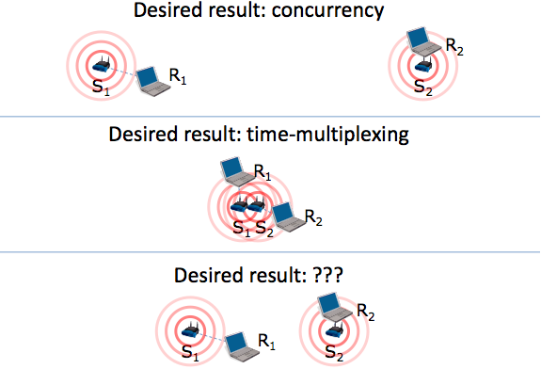
Carrier Sense

Slide 6
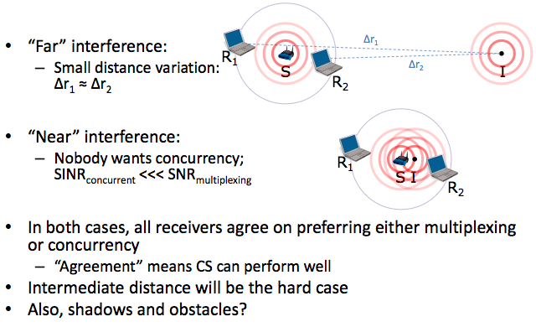
Maybe Carrier Sense is Fine?

Slide 7
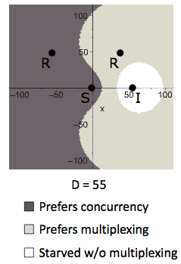
Single Receiver, Sender and Interferer

Slide 8
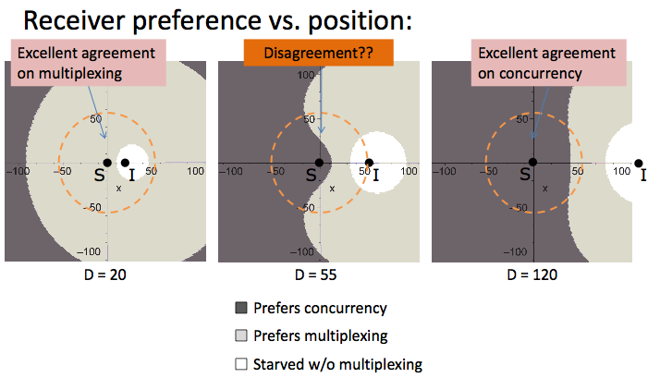
Interferer Position

Slide 9
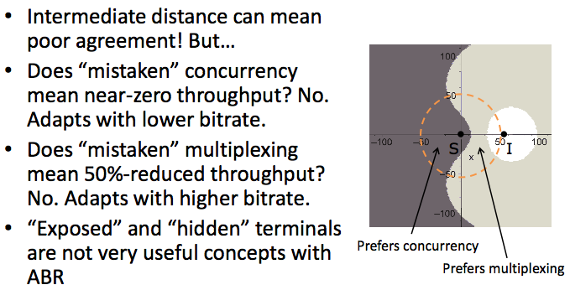
ABR Helps in Disagreements

Slide 10
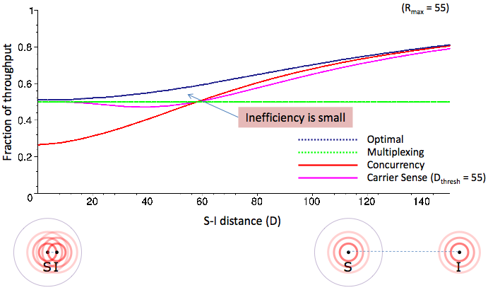
Carrier Sense + ABR Works Well

Slide 11
Key Assumptions
ABR == Shannon
  ABR is rarely this good
Interference and ABR are both stable
  Interference may be bursty/intermittent

Slide 12
Overview
Carrier Sense vs. Rate Adaptation
Wireless TCP
802.11 Deployment patterns
Mesh networks
White space networks

Slide 13
Wireless Challenges
Force us to rethink many assumptions
Need to share airwaves rather than wire
  Don’t know what hosts are involved
  Host may not be using same link technology
Mobility
Other characteristics of wireless
  Noisy → lots of losses
  Slow
  Interaction of multiple transmitters at receiver
    Collisions, capture, interference
  Multipath interference

Slide 14
TCP Problems Over Noisy Links
Wireless links are inherently error-prone
  Fades, interference, attenuation
  Errors often happen in bursts
TCP cannot distinguish between corruption and congestion
  TCP unnecessarily reduces window, resulting in low throughput and high latency
Burst losses often result in timeouts
Sender retransmission is the only option
  Inefficient use of bandwidth

Slide 15
Constraints & Requirements
Incremental deployment
  Solution should not require modifications to fixed hosts
  If possible, avoid modifying mobile hosts
Probably more data to mobile than from mobile
  Attempt to solve this first

Slide 16
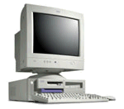
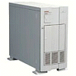
Challenge #1: Wireless Bit-Errors
Router
Computer 1
Computer 2
Loss → Congestion
3
2
2
2
1
2
0
Loss → Congestion
Wireless
Burst losses lead to coarse-grained timeouts
Result: Low throughput

Slide 17
Performance Degradation
Best possible
TCP with no errors
(1.30 Mbps)
TCP Reno
(280 Kbps)
Sequence number (bytes)
Time (s)
2 MB wide-area TCP transfer over 2 Mbps Lucent WaveLAN

Slide 18
Proposed Solutions
End-to-end protocols
  Selective ACKs, Explicit loss notification
Split-connection protocols
  Separate connections for wired path and wireless hop
Reliable link-layer protocols
  Error-correcting codes
  Local retransmission

Slide 19
Approach Styles (End-to-End)
Improve TCP implementations
  Not incrementally deployable
  Improve loss recovery (SACK, NewReno)
  Help it identify congestion (ELN, ECN)
    ACKs include flag indicating wireless loss
  Trick TCP into doing right thing → E.g. send extra dupacks
  What is SMART?
    DUPACK includes sequence of data packet that triggered it
Wired link
Wireless link

Slide 20
Approach Styles (Split Connection)
Split connections
  Wireless connection need not be TCP
  Hard state at base station
    Complicates mobility
    Vulnerable to failures
    Violates end-to-end semantics
Wired link
Wireless link

Slide 21
Split-Connection Congestion Window
60000
Wired connection
50000
Wireless connection
40000
Congestion Window (bytes)
30000
20000
10000
0
0
20
40
60
80
100
120
Time (sec)
Wired connection does not shrink congestion window
But wireless connection times out often, causing sender to stall

Slide 22
Approach Styles (Link Layer)
More aggressive local rexmit than TCP
  Bandwidth not wasted on wired links
Adverse interactions with transport layer
  Timer interactions
  Interactions with fast retransmissions
  Large end-to-end round-trip time variation
FEC does not work well with burst losses
Wired link
Wireless link
ARQ/FEC

Slide 23
Hybrid Approach: Snoop Protocol
Shield TCP sender from wireless vagaries
  Eliminate adverse interactions between protocol layers
  Congestion control only when congestion occurs
The End-to-End Argument [SRC84]
  Preserve TCP/IP service model: end-to-end semantics
  Is connection splitting fundamentally important?
Eliminate non-TCP protocol messages
  Is link-layer messaging fundamentally important?
Fixed to mobile: transport-aware link protocol
Mobile to fixed: link-aware transport protocol

Slide 24
Snoop Overview
Modify base station
  to cache un-acked TCP packets
  … and perform local retransmissions
Key ideas
  No transport level code in base station
  When node moves to different base station, state eventually recreated there

Slide 25
Snoop Protocol: CH to MH
4
3
2
1
Snoop Agent
6
5
1
Correspondent Host
Base Station
Mobile Host
Snoop agent: active interposition agent
  Snoops on TCP segments and ACKs
  Detects losses by duplicate ACKs and timers
  Suppresses duplicate ACKs from MH

Slide 26
Snoop Protocol: CH to MH
6
3
Snoop Agent
5
2
4
1
Correspondent Host
Base Station
Mobile Host
Transfer of file from CH to MH
Current window = 6 packets

Slide 27
Snoop Protocol: CH to MH
6
5
Snoop Agent
4
3
2
1
Correspondent Host
Base Station
Mobile Host
Transfer begins

Slide 28
Snoop Protocol: CH to MH
4
3
2
1
Snoop Agent
6
5
1
Correspondent Host
Base Station
Mobile Host
Snoop agent caches segments that pass by

Slide 29
Snoop Protocol: CH to MH
4
3
2
1
Snoop Agent
6
5
3
2
1
Correspondent Host
Base Station
Mobile Host
1
Lost Packets
Packet 1 is Lost

Slide 30
Snoop Protocol: CH to MH
5
4
3
2
1
Snoop Agent
6
4
3
2
ack 0
Correspondent Host
Base Station
Mobile Host
1
Lost Packets
Packet 1 is Lost
  Duplicate ACKs generated

Slide 31
Snoop Protocol: CH to MH
6
5
4
3
2
1
Snoop Agent
4
6
5
1
3
2
ack 0
Correspondent Host
Base Station
Mobile Host
ack 0
1
Lost Packets
Packet 1 is Lost
  Duplicate ACKs generated
Packet 1 retransmitted from cache at higher priority

Slide 32
Snoop Protocol: CH to MH
6
5
4
3
2
1
Snoop Agent
1
4
6
5
3
2
ack 4
Correspondent Host
Base Station
Mobile Host
X
ack 0
Duplicate ACKs suppressed

Slide 33
Snoop Protocol: CH to MH
5
1
6
5
Snoop Agent
4
6
3
2
ack 5
Correspondent Host
Base Station
Mobile Host
ack 4
Clean cache on new ACK

Slide 34
Snoop Protocol: CH to MH
6
5
1
6
Snoop Agent
4
3
2
ack 4
ack 6
Correspondent Host
Base Station
Mobile Host
ack 5
Clean cache on new ACK

Slide 35
Snoop Protocol: CH to MH
6
5
1
9
Snoop Agent
8
7
4
3
2
Correspondent Host
Base Station
Mobile Host
ack 5
ack 6
Active soft state agent at base station
Transport-aware reliable link protocol
Preserves end-to-end semantics

Slide 36
Performance: FH to MH
Snoop+SACK and Snoop perform best
Connection splitting not essential
TCP SACK performance disappointing
Snoop+SACK
Snoop
SPLIT-SACK
Typical error rates
Throughput (Mbps)
TCP SACK
SPLIT
TCP Reno
1/Bit-error Rate (1 error every x Kbits)
2 MB local-area TCP transfer over 2 Mbps Lucent WaveLAN

Slide 37
Discussion
Real link-layers aren’t windowed
  Out of order delivery not that significant a concern
TCP timers are very conservative

Slide 38
Wireless in the Real World
Real world deployment patterns
Mesh networks and deployments
Assigned reading
  Architecture and Evaluation of an Unplanned 802.11b Mesh Network
  White Space Networking with Wi-Fi like Connectivity

Slide 39
Wireless Challenges
Force us to rethink many assumptions
Need to share airwaves rather than wire
  Don’t know what hosts are involved
  Host may not be using same link technology
Mobility
Other characteristics of wireless
  Noisy → lots of losses
  Slow
  Interaction of multiple transmitters at receiver
    Collisions, capture, interference
  Multipath interference

Slide 40
Overview
Carrier Sense vs. Rate Adaptation
Wireless TCP
802.11 Deployment patterns
Mesh networks
White space networks

Slide 41
Characterizing Current Deployments
Datasets
Place Lab: 28,000 APs
  MAC, ESSID, GPS
  Selected US cities
  www.placelab.org
Wifimaps: 300,000 APs
  MAC, ESSID, Channel, GPS (derived)
  wifimaps.com
Pittsburgh Wardrive: 667 APs
  MAC, ESSID, Channel, Supported Rates, GPS
Notes:
Caveats
Subset, old,
Relative strengths of each
Placelab: data collected as part of Intel’s placelab project, this is software that allows commodity hardware clients such as notebooks, PDAs to locate themselves by listening to radio beacons such as 802.11…
Wifimaps: provides a graphic visualization tool to map out access points in specific areas of the world. This under database is contributed by various war-drive efforts.
War-drive: small scale war drive of some dense areas of pittsburgh

Slide 42
AP Stats, Degrees: Placelab
  (Placelab: 28000 APs, MAC, ESSID, GPS)
#APs
Max.
degree
50 m
Portland | 8683 | 54
San Diego | 7934 | 76
San Francisco | 3037 | 85
Boston | 2551 | 39
1
2
1
Notes:
Data in placelab to understand how many APs in each city are in interference range of each other.
Figure on the right shows a distribution of the number on interfering neighboring APs in the various cities. More than 4…

Slide 43
Degree Distribution: Place Lab
Notes:
Color
Don’t say graph coloring, channel selection
Search for “placelab”
Data in placelab to understand how many APs in each city are in interference range of each other.
Figure on the right shows a distribution of the number on interfering neighboring APs in the various cities. More than 4…

Slide 44
Unmanaged Devices
WifiMaps.com
(300,000 APs, MAC, ESSID, Channel)
Channel
%age
6 | 51
11 | 21
1 | 14
10 | 4
Most users don’t change default channel
Channel selection must be automated
Notes:
Change titles: as was done here…
Caveat
Mention autocell is used by new vendors, but solution is ?
Newer access points include
This is top 4 channels, number are unclassified
We computed several interesting statistics about deployment and usage. 6 – default on most APs, showing that users more often than not leave their def configs on. In the table on the right, I show the relatives levels of deployment a and g. We can determine this by looking at the supporting rates info for the APs… relatively recent standardization….

Slide 45
Overview
Carrier Sense vs. Rate Adaptation
Wireless TCP
802.11 Deployment patterns
Mesh networks
White space networks

Slide 46
Roofnet
Share a few wired Internet connections
Goals
  Operate without extensive planning or central management
  Provide wide coverage and acceptable performance
Design decisions
  Unconstrained node placement
  Omni-directional antennas
  Multi-hop routing
  Optimization of routing for throughput in a slowly changing network

Slide 47
Roofnet Design
Deployment
  Over an area of about four square kilometers in Cambridge, Messachusetts
  Most nodes are located in buildings
    3~4 story apartment buildings
    8 nodes are in taller buildings
  Each Rooftnet node is hosted by a volunteer user
Hardware
  PC, omni-directional antenna, hard drive …
  802.11b card
    RTS/CTS disabled
    Share the same 802.11b channel
    Non-standard “pseudo-IBSS” mode
      Similar to standard 802.11b IBSS (ad hoc)
      Omit beacon and BSSID (network ID)

Slide 48
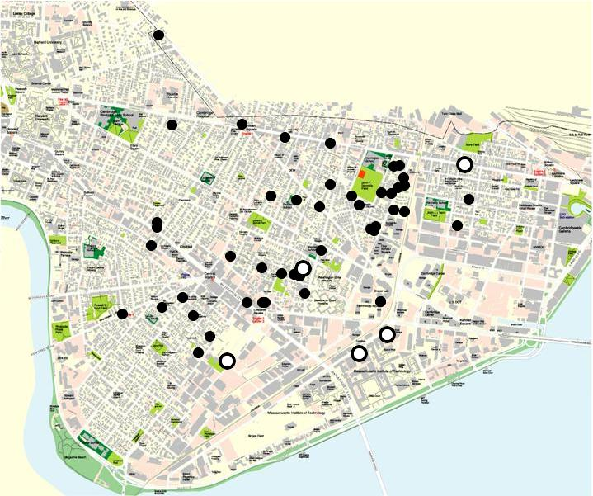
Roofnet Node Map
1 kilometer

Slide 49
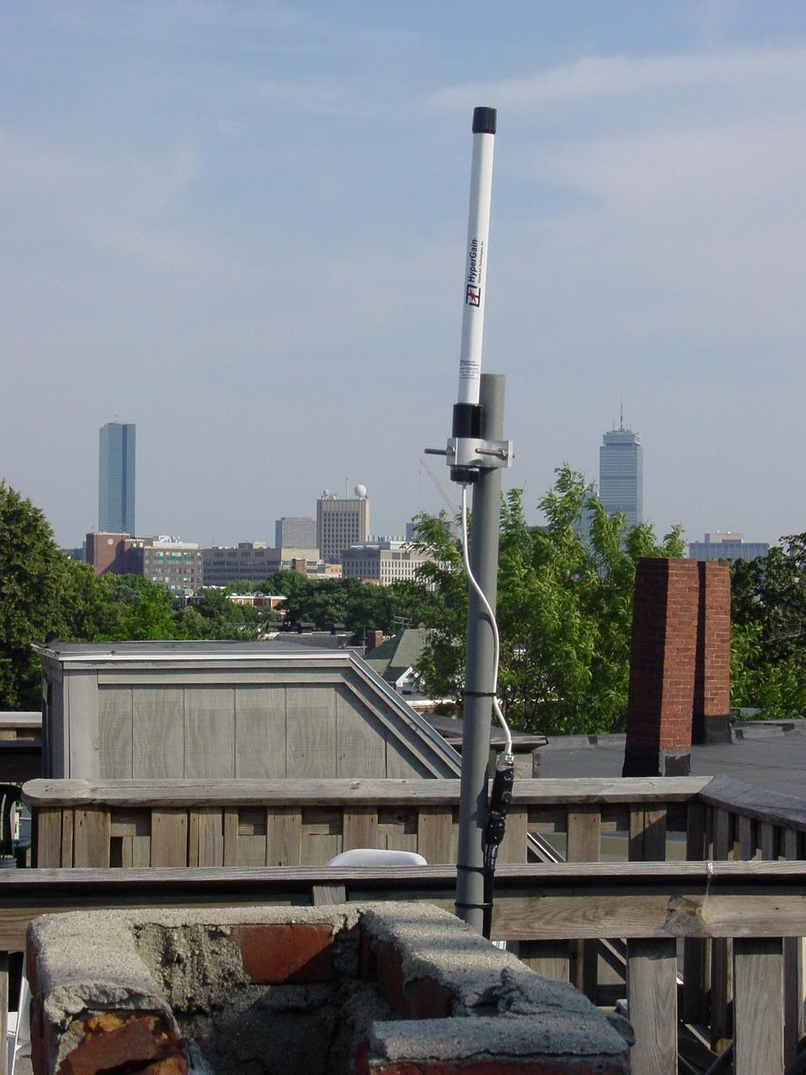
Typical Rooftop View

Slide 50
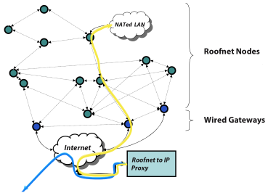
Roofnet

Slide 51
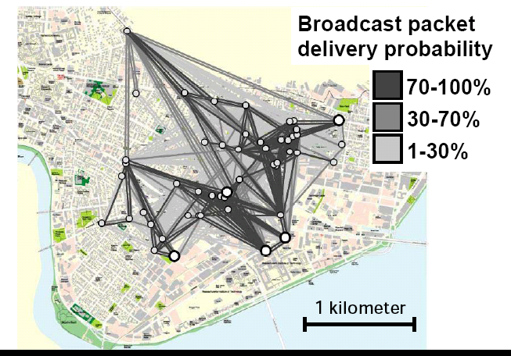
Lossy Links are Common

Slide 52
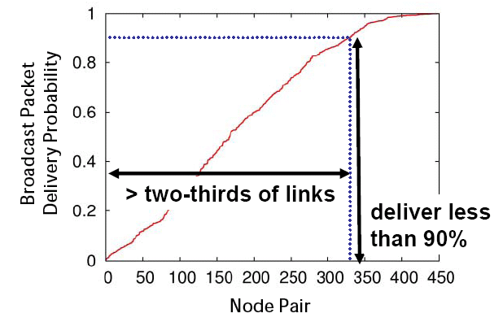
Delivery Probabilities are Uniformly Distributed

Slide 53
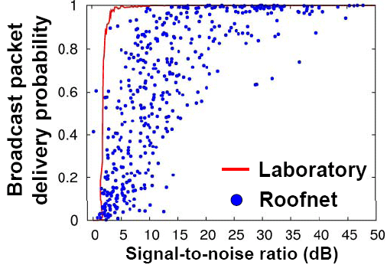
Delivery vs. SNR
SNR not a good predictor

Slide 54
Key Implications
Lack of a link abstraction!
  Links aren’t on or off… sometimes in-between
Protocols must take advantage of these intermediate quality links to perform well
How unique is this to Roofnet?
  Cards designed for indoor environments used outdoors

Slide 55
Overview
Carrier Sense vs. Rate Adaptation
Wireless TCP
802.11 Deployment patterns
Mesh networks
White space networks

Slide 56
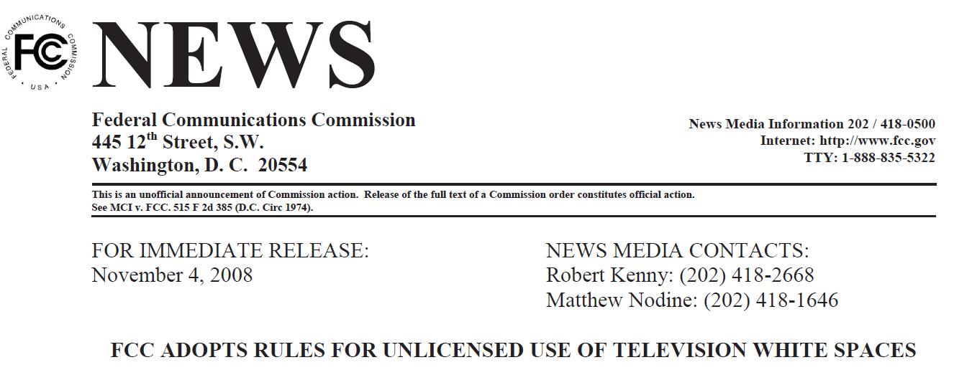
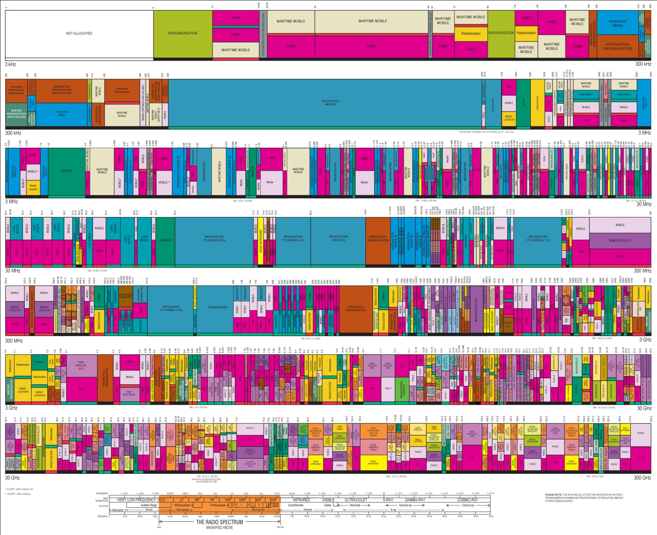



Higher Frequency
Broadcast TV
Wi-Fi (ISM)

Slide 57


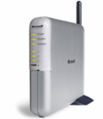
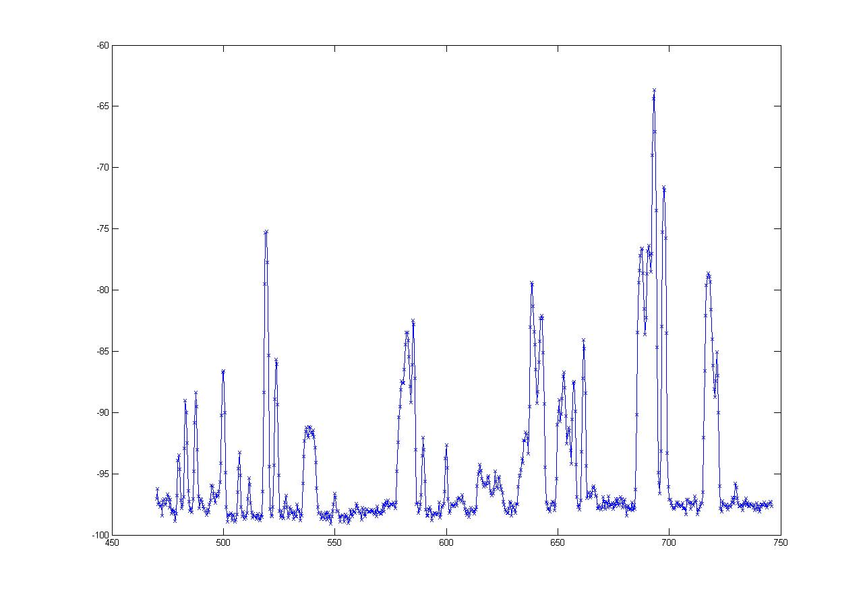
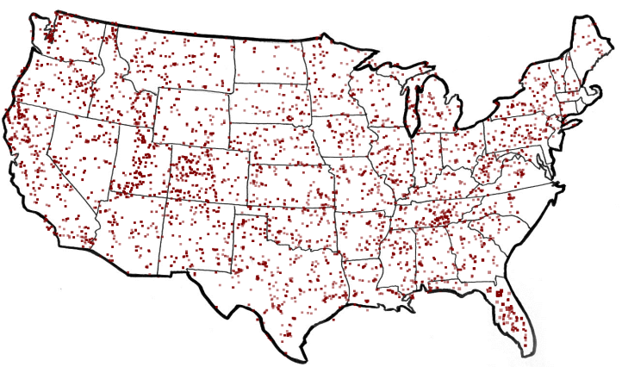
What are White Spaces?
TV
Wireless Mic
ISM (Wi-Fi)
0
MHz
54-90
170-216
470
700
2400
2500
5180
5300
7000
MHz
  50 TV Channels
  Each channel is 6 MHz wide
-60
“White spaces”
dbm
FCC Regulations*
    Sense TV stations and Mics
    Portable devices on channels 21 - 51
TV Stations in America
-100
470 MHz
Frequency
700 MHz
are Unoccupied TV Channels
White Spaces

Slide 58
The Promise of White Spaces
TV
Wireless Mic
ISM (Wi-Fi)
0
MHz
470
700
2400
2500
5180
5300
54-90
174-216
7000
MHz
More Spectrum
Up to 3x of 802.11g
Longer Range
at least 3 - 4x of Wi-Fi

Slide 59

White Spaces Spectrum Availability
Differences from ISM(Wi-Fi)
Fragmentation
Variable channel widths
1
2
3
4
5
1
2
3
4
5
Each TV Channel is 6 MHz wide
Spectrum is Fragmented
⇒ Use multiple channels for more bandwidth

Slide 60
White Spaces Spectrum Availability
Differences from ISM(Wi-Fi)
Fragmentation
Variable channel widths
Spatial Variation
Cannot assume same
channel free everywhere
1
2
3
4
5
1
2
3
4
5
TV
Tower
Location impacts spectrum availability
⇒ Spectrum exhibits spatial variation

Slide 61
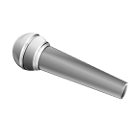

White Spaces Spectrum Availability
Differences from ISM(Wi-Fi)
Fragmentation
Variable channel widths
Spatial Variation
Cannot assume same
channel free everywhere
1
2
3
4
5
Temporal Variation
1
2
3
4
5
Same Channel will
not always be free
Any connection can be
disrupted any time
Incumbents appear/disappear over time
⇒ Must reconfigure after disconnection

Slide 62
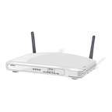
Channel Assignment in Wi-Fi
1
6
11
1
6
11
Fixed Width Channels
⇒ Optimize which channel to use

Slide 63
Spectrum Assignment in WhiteFi
Spectrum Assignment Problem
Goal
Maximize Throughput
Include
Spectrum at clients
1
2
3
4
5
1
2
3
4
5
Center Channel
Assign
&
Width
Fragmentation
⇒ Optimize for both, center channel and width
Spatial Variation
⇒ BS must use channel iff free at client

Slide 64
Accounting for Spatial Variation
1
2
3
4
5
1
2
3
4
5
1
2
3
4
5
∪
∪
=
1
2
3
4
5
1
2
3
4
5
1
2
3
4
5
1
2
3
4
5

Slide 65
Intuition
Intuition
Use widest possible channel
BS
But
Limited by most busy channel
1
2
3
4
5
Carrier Sense Across All Channels
All channels must be free
  ρ_{BS}(2 and 3 are free) = ρ_{BS}(2 is free) x ρ_{BS}(3 is free)
Tradeoff between wider channel widths
and opportunity to transmit on each channel

Slide 66
Discovering a Base Station
1
2
3
4
5
1
2
3
4
5
Discovery Time = Ο(B x W)
How does the new client discover channels used by the BS?
Can we optimize this discovery time?
BS and Clients must use same channels
Fragmentation
⇒ Try different center channel and widths

Slide 67
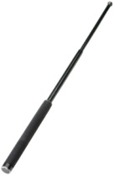
SIFT, by example
10 MHz
5 MHz
ADC
SIFT
SIFT
Data
ACK
Does not decode packets
Amplitude
SIFS
Pattern match in time domain
Time

Slide 68
Evaluation
Method
  Multi-hop TCP
    15 second one-way bulk TCP transfer between each pair of Roofnet nodes
  Single-hop TCP
    The direct radio link between each pair of routes
  Loss matrix
    The loss rate between each pair of nodes using 1500-byte broadcasts
  Multi-hop density
    TCP throughput between a fixed set of four nodes
    Varying the number of Roofnet nodes that are participating in routing

Slide 69
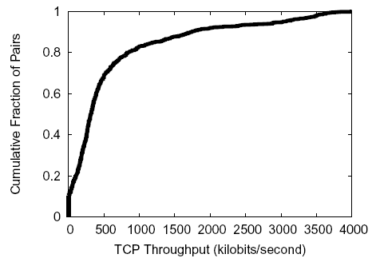
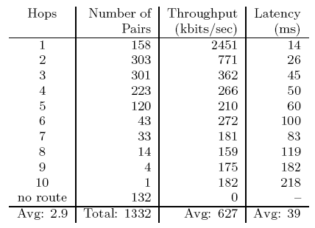
Evaluation
Basic Performance (Multi-hop TCP)
  The routes with low hop-count have much higher throughput
  Multi-hop routes suffer from inter-hop collisions

Slide 70
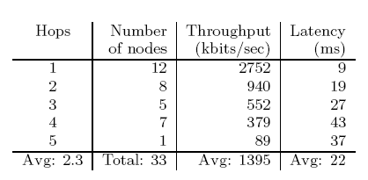
Evaluation
Basic Performance (Multi-hop TCP)
  TCP throughput to each node from its chosen gateway
  Round-trip latencies for 84-byte ping packets to estimate interactive delay

Slide 71
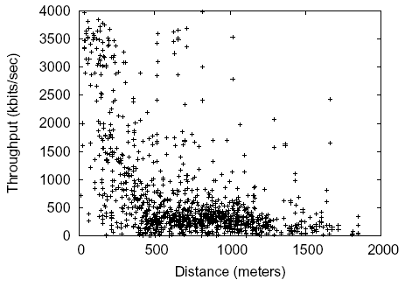
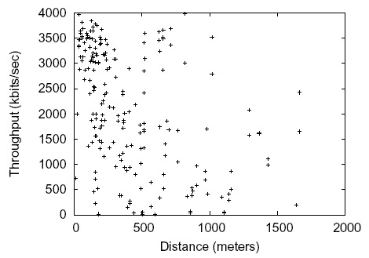
Evaluation
Link Quality and Distance (Single-hop TCP, Multi-hop TCP)
  Most available links are between 500m and 1300m and give 500 kbits/s
  Srcr
    Use almost all of the links faster than 2 Mbits/s and ignore majority of the links which are slower than that
    Fast short hops are the best policy

Slide 72
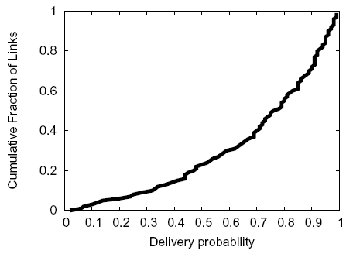
Evaluation
Link Quality and Distance (Multi-hop TCP, Loss matrix)
  Median delivery probability is 0.8
  1/4 links have loss rates of 50% or more
  802.11 detects the losses with its ACK mechanism and resends the packets

Slide 73
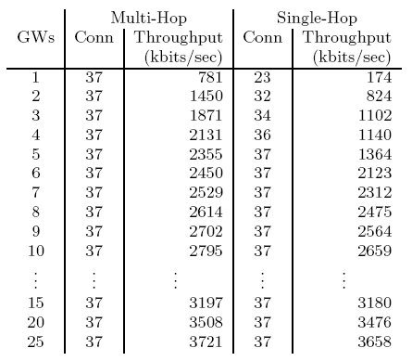
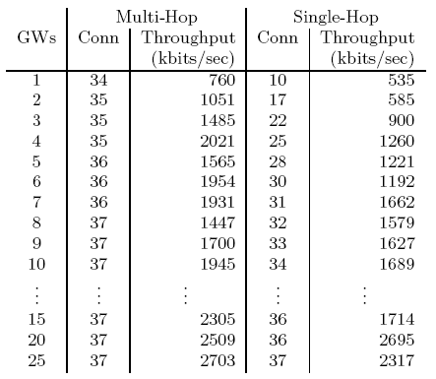
Evaluation
Architectural Alternatives
  Maximize the number of additional nodes with non-zero throughput to some gateway
  Ties are broken by average throughput

Slide 74
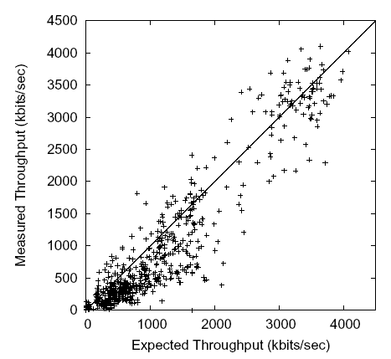
Evaluation
Inter-hop Interference (Multi-hop TCP, Single-hop TCP)
  Concurrent transmissions on different hops of a route collide and cause packet loss

Slide 75
Roofnet Summary
The network’s architectures favors
  Ease of deployment
  Omni-directional antennas
  Self-configuring software
  Link-quality-aware multi-hop routing
Evaluation of network performance
  Average throughput between nodes is 627kbits/s
  Well served by just a few gateways whose position is determined by convenience
  Multi-hop mesh increases both connectivity and throughput

Slide 76
Roofnet Link Level Measurements
Analyze cause of packet loss
Neighbor Abstraction
  Ability to hear control packets or No Interference
  Strong correlation between BER and S/N
RoofNet pairs communicate
  At intermediate loss rates
  Temporal Variation
  Spatial Variation

Slide 77
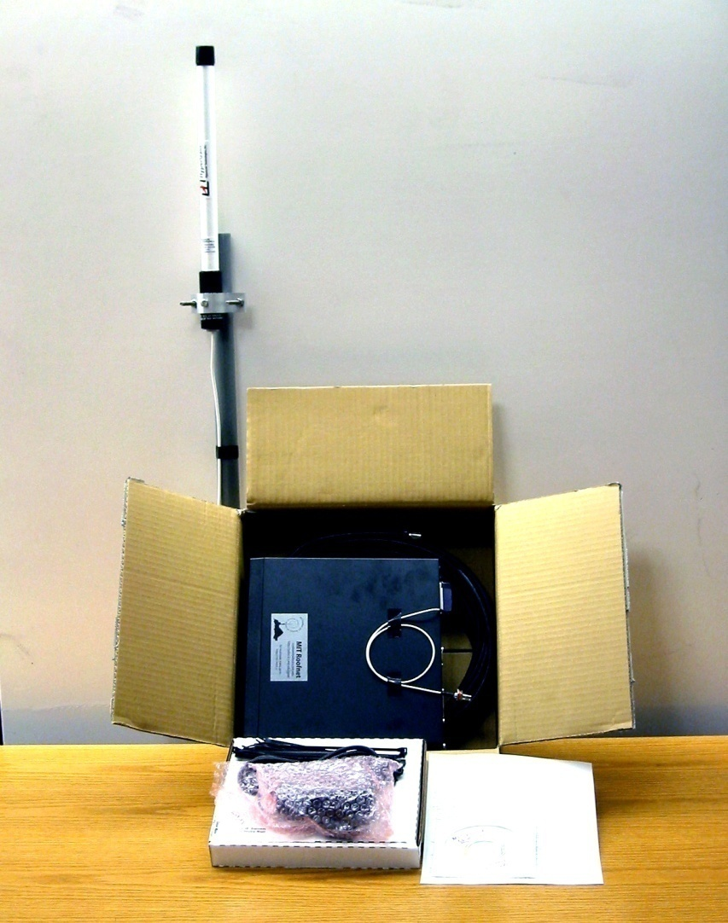
A Roofnet Self-Installation Kit
Antenna ($65)
8dBi, 20 degree vertical
50 ft. Cable ($40)
Low loss (3dB/100ft)
Computer ($340)
533 MHz PC, hard disk, CDROM
Miscellaneous ($75)
Chimney Mount,
Lightning Arrestor, etc.
802.11b card ($155)
Engenius Prism 2.5, 200mW
Software (“free”)
Our networking software based on Click
Total: $685
Takes a user about 45 minutes to install on a flat roof

Slide 78
Software and Auto-Configuration
Linux, routing software, DHCP server, web server …
Automatically solve a number of problems
  Allocating addresses
  Finding a gateway between Roofnet and the Internet
  Choosing a good multi-hop route to that gateway
Addressing
  Roofnet carries IP packets inside its own header format and routing protocol
  Assign addresses automatically
  Only meaningful inside Roofnet, not globally routable
  The address of Roofnet nodes
    Low 24 bits are the low 24 bits of the node’s Ethernet address
    High 8 bits are an unused class-A IP address block
  The address of hosts
    Allocate 192.168.1.x via DHCP and use NAT between the Ethernet and Roofnet

Slide 79
Software and Auto-Configuration
Gateway and Internet Access
  A small fraction of Roofnet users will share their wired Internet access links
  Nodes which can reach the Internet
    Advertise itself to Roofnet as an Internet gateway
    Acts as a NAT for connection from Roofnet to the Internet
  Other nodes
    Select the gateway which has the best route metric
  Roofnet currently has four Internet gateways

Slide 80
Roofnet Design - Routing Protocol
Srcr
  Find the highest throughput route between any pair of Roofnet nodes
  Source-routes data packets like DSR
  Maintains a partial database of link metrics
Learning fresh link metrics
  Forward a packet
  Flood to find a route
  Overhear queries and responses
Finding a route to a gateway
  Each Roofnet gateway periodically floods a dummy query
  When a node receives a new query, it adds the link metric information
  The node computes the best route
  The node re-broadcasts the query
  Send a notification to a failed packet’s source if the link condition is changed

Slide 81

Roofnet Design
Routing Metric
  ETT (Estimated Transmission Time) metric
    Srcr chooses routes with ETT
    Predict the total amount of time it would take to send a data packet
    Take into account link’s highest-throughput transmit bit-rate and delivery probability
    Each Roofnet node sends periodic 1500-byte broadcasts
Bit-rate Selection
  802.11b transmit bit-rates
    1, 2, 5.5, 11 Mbits/s
  SampleRate
    Judge which bit-rate will provide the highest throughput
    Base decisions on actual data transmission
    Periodically sends a packet at some other bit-rate

Slide 82
ETX measurement results
Delivery is probabilistic
  A 1/r^2 model wouldn’t really predict this!
  Sharp cutoff (by spec) of “good” vs “no” reception. Intermediate loss range band is just a few dB wide!
Why?
  Biggest factor: Multi-path interference
    802.11 receivers can suppress reflections < 250ns
    Outdoor reflections delay often > 1 \mu sec
    Delay offsets == symbol time look like valid symbols (large interferece)
    Offsets != symbol time look like random noise
    Small changes in delay == big changes in loss rate

Slide 83
Deciding Between Links
Most early protocols: Hop Count
  Link-layer retransmission can mask some loss
  But: a 50% loss rate means your link is only 50% as fast!
Threshold?
  Can sacrifice connectivity. ☹
  Isn’t a 90% path better than an 80% path?
Real life goal: Find highest throughput paths

Slide 84
Is there a better metric?
Cut-off threshold
  Disconnected network
Product of link delivery ratio along path
  Does not account for inter-hop interference
Bottleneck link (highest-loss-ratio link)
  Same as above
End-to-end delay
  Depends on interface queue lengths

Slide 85
ETX Metric Design Goals
Find high throughput paths
Account for lossy links
Account for asymmetric links
Account for inter-link interference
Independent of network load (don’t incorporate congestion)

Slide 86
Forwarding Packets is Expensive
Throughput of 802.11b =~ 11Mbits/s
  In reality, you can get about 5.
What is throughput of a chain?
  A → B → C ?
  A → B → C → D ?
  Assume minimum power for radios.
Routing metric should take this into account! Affects throughput

Slide 87
ETX
Measure each link’s delivery probability with broadcast probes (& measure reverse)
P(delivery) = ( d_{f} * d_{r} ) (ACK must be delivered too…)
Link ETX = 1 / P(delivery)
Route ETX = Σ link ETX
  Assumes all hops interfere - not true, but seems to work okay so far

Slide 88
ETX: Sanity Checks
ETX of perfect 1-hop path: 1
ETX of 50% delivery 1-hop path: 2
ETX of perfect 3-hop path: 3
(So, e.g., a 50% loss path is better than a perfect 3-hop path! A threshold would probably fail here…)

Slide 89
Rate Adaptation
What if links @ different rates?
ETT – expected transmission time
  ETX / Link rate = 1 / ( P(delivery) * Rate)
What is best rate for link?
  The one that maximizes ETT for the link!
  SampleRate is a technique to adaptively figure this out.

Slide 90
Discussion
Value of implementation & measurement
  Simulators did not “do” multipath
    Routing protocols dealt with the simulation environment just fine
    Real world behaved differently and really broke a lot of the proposed protocols that worked so well in simulation!
Rehash: Wireless differs from wired…
Metrics: Optimize what matters; hop count often a very bad proxy in wireless
What we didn’t look at: routing protocol overhead
  One cool area: Geographic routing

Slide 91
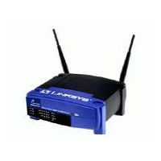
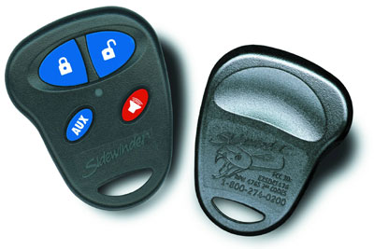



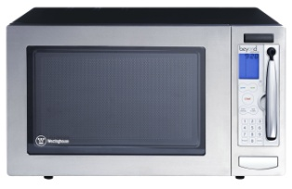
Growing Interference in Unlicensed Bands
Anecdotal evidence of problems, but how severe?
Characterize how 802.11 operates under interference in practice
Other 802.11
Notes:
The main problem we’re concerned with today is the impact of growing RF interference in unlicensed spectrum such as the 2.4GHz band used by 802.11. There has recently been a spate of anecdotal reports about the increasing severity of RF interference problems on the operation of wireless networks such as 802.11, but we don’t yet clearly know what the magnitude or the trend of the problem is. So, we would like to characterize how 802.11 performs under interference in reality.
Today, an 802.11 network has to contend with other 802.11 networks, as well as with other wireless devices that share the same spectrum, such as cordless phones, microwave ovens, car alarm systems, bluetooth, and a growing variety of other unlicensed band devices.

Slide 92
What do we expect?
Throughput to decrease linearly with interference
There to be lots of options for 802.11 devices to tolerate interference
  Bit-rate adaptation
  Power control
  FEC
  Packet size variation
  Spread-spectrum processing
  Transmission and reception diversity
Theory
Throughput (linear)
Interferer power
(log-scale)
Notes:
The standard SINR or (Signal to Interference and Noise Ratio) model predicts that throughput should decrease linearly with interferer power. The interferer power is on a log-scale. If this standard model holds in practice, then 802.11 devices have a variety of options at their disposal to tolerate interference gracefully. For example, they can change the bit rate at which they transmit, they can change the transmission power, they can use forward error correction, they can use smaller packets, and exploit various diversity techniques for transmission and reception, such as using multi-antenna systems.

Slide 93
Key Questions
How damaging can a low-power and/or narrow-band interferer be?
How can today’s hardware tolerate interference well?
  What 802.11 options work well, and why?
Notes:
The key questions before us are whether 802.11 copes well with different types of low-power and/or narrow-band interferers, and which of the 802.11 options work well in practice, and why.

Slide 94
What we see
Effects of interference more severe in practice
Caused by hardware limitations of commodity cards, which theory doesn’t model
Theory
Throughput (linear)
Practice
Interferer power
(log-scale)
Notes:
The most interesting result we see is that the effects of interference are more severe in practice than theory would predict. There is a large gap between theory and practice at both low-end and high-end of the interference range. In fact, we find that the link throughput can drop to zero at medium to high end of the interference range. Such a rapid and severe degradation in performance is caused by several hardware limitations of commodity cards, which are not adequately modeled by theory.

Slide 95
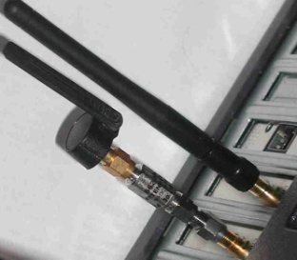
Experimental Setup
Access
Point
UDP flow
802.11 Interferer
802.11
Client
Notes:
Our setup is a controlled testbed within an office building consisting of 802.11 transmitter and receiver that use different commodity cards. They exchange UDP flows. Interferers are various types of wireless devices such as an 802.11 interferer that can output arbitrary modulated 802.11 bit patterns, ZigBee sensor nodes, cordless phones, and camera jammers. They represent both worst-case natural and adversarial interferers arising in practice. The interferer varies in power as its physical distance to the 802.11 link changes. In order to simulate the effects of such an interferer in a controlled manner, we use hardware attenuators to vary the output power. The picture here shows such an attenuated 802.11 interferer.

Slide 96
802.11 Receiver Path
PHY
MAC
To RF Amplifiers
AGC
Analog
signal
ADC
Timing
Recovery
Barker
Correlator
Data
(includes beacons)
Demodulator
Descrambler
6-bit
samples
Preamble Detector/
Header CRC-16 Checker
Receiver
SYNC
SFD
CRC
Payload
PHY header
Extend SINR model to capture these vulnerabilities
Interested in worst-case natural or adversarial interference
  Have developed range of “attacks” that trigger these vulnerabilities
Notes:
For example, when three consecutive beacons from the AP are lost by the MAC layer, the link is commonly assumed to be dead.

Slide 97
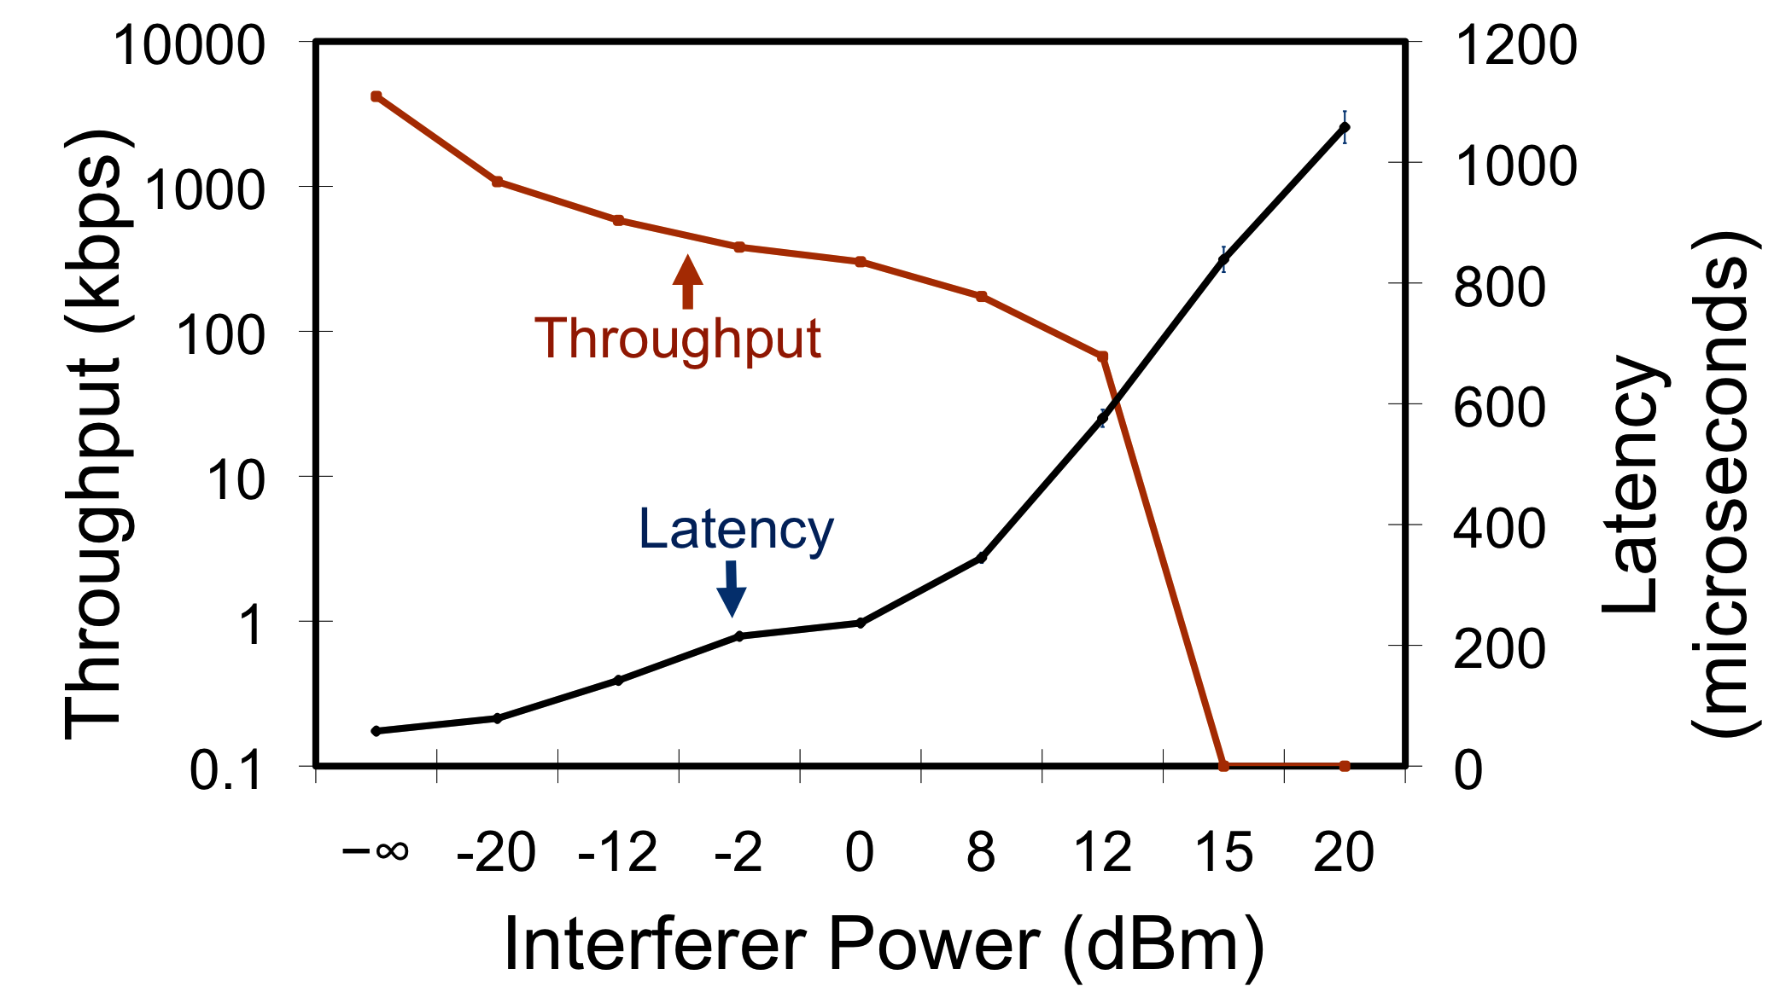
Timing Recovery Interference
Interferer sends continuous SYNC pattern
Interferes with packet acquisition (PHY reception errors)
Weak interferer
Moderate
interferer
Log-scale
Notes:
We found an interferer that sends a continuous sync pattern

Slide 98
Interference Management
Interference will get worse
  Density/device diversity is increasing
  Unlicensed spectrum is not keeping up
Spectrum management
  “Channel hopping” 802.11 effective at mitigating some performance problems [Sigcomm07]
  Coordinated spectrum use – based on RF sensor network
Transmission power control
  Enable spatial reuse of spectrum by controlling transmit power
  Must also adapt carrier sense behavior to take advantage

Slide 99
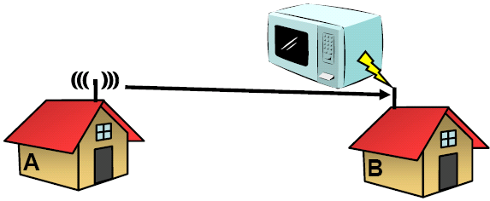
Is it Bursty Interference?
May interfere but not impact SNR measurement

Slide 100
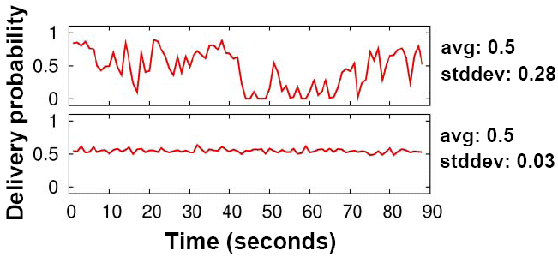
Two Different Roofnet Links
Top is typical of bursty interference, bottom is not
Most links are like the bottom

Slide 101
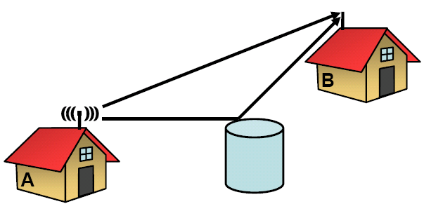
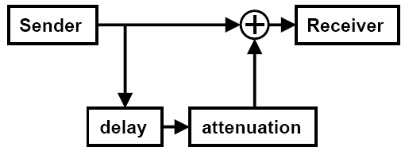
Is it Multipath Interference?
Simulate with channel emulator

Slide 102
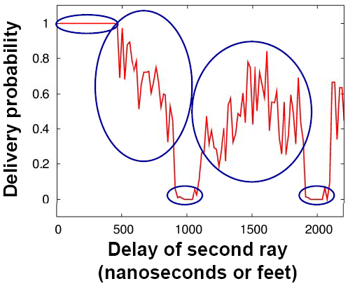
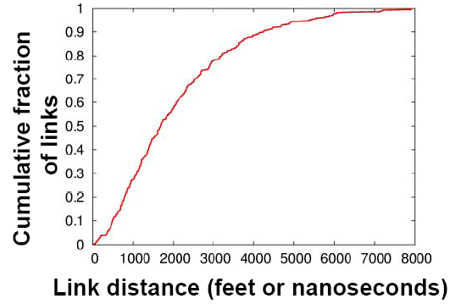
A Plausible Explanation
Multi-path can produce intermediate loss rates
Appropriate multi-path delay is possible due to long-links

