Slide 1
15-744: Computer Networking
L-18 Privacy

Slide 2
Overview
CCN

Slide 3
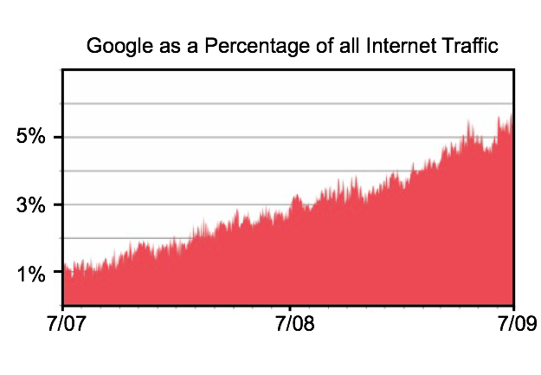
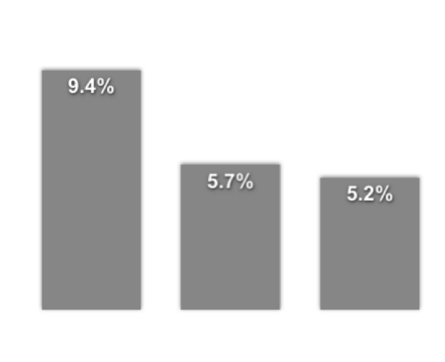
Google…
Biggest content source
Third largest ISP
Level(3)
Global
Crossing
Google
source: ‘ATLAS’ Internet Observatory 2009 Annual Report’, C. Labovitz et.al.

Slide 4
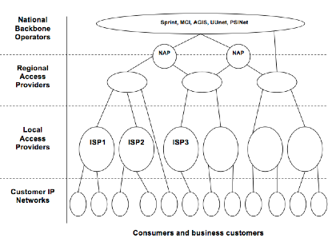
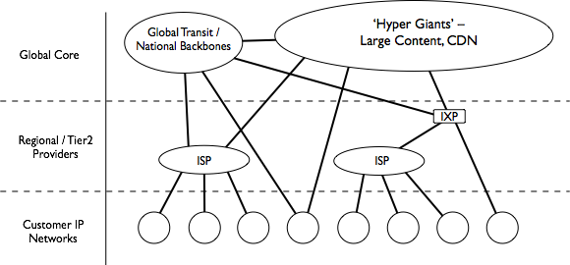
1995 - 2007:
Textbook Internet
2009:
Rise of the
Hyper Giants
source: ‘ATLAS’ Internet Observatory 2009 Annual Report’, C. Labovitz et.al.

Slide 5




What does the network look like…
ISP
ISP

Slide 6

What should the network look like…
ISP
ISP

Slide 7
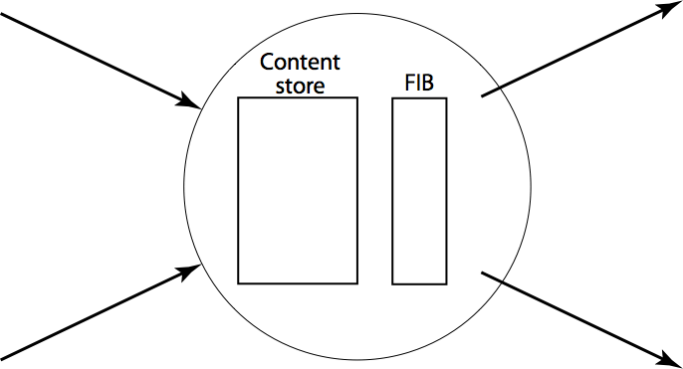


CCN Model
Data
Packets say ‘what’ not ‘who’ (no src or dst)
communication is to local peer(s)
upstream performance is measurable
memory makes loops impossible

Slide 8
Names
Like IP, CCN imposes no semantics on names.
‘Meaning’ comes from application, institution and global conventions:
/parc.com/people/van/presentations/CCN
/parc.com/people/van/calendar/freeTimeForMeeting
/thisRoom/projector
/thisMeeting/documents
/nearBy/available/parking
/thisHouse/demandReduction/2KW

Slide 9
CCN Names/Security
⎧
⎪
⎨
⎪
⎩
/nytimes.com/web/frontPage/v20100415/s0/0x3fdc96a4...
signature
0x1b048347
key
nytimes.com/web/george/desktop public key
⎧
⎪
⎨
⎪
⎩
Signed by nytimes.com/web/george
⎧
⎪
⎨
⎪
⎩
Signed by nytimes.com/web
Signed by nytimes.com
Per-packet signatures using public key
  Packet also contain link to public key

Slide 10
Names Route Interests
FIB lookups are longest match (like IP prefix lookups) which helps guarantee log(n) state scaling for globally accessible data.
Although CCN names are longer than IP identifiers, their explicit structure allows lookups as efficient as IP’s.
Since nothing can loop, state can be approximate (e.g., bloom filters).

Slide 11
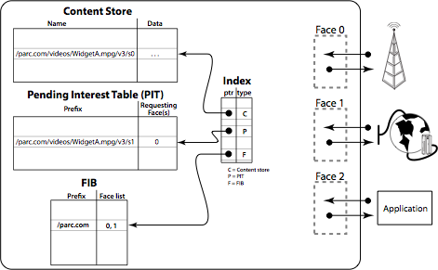
CCN node model

Slide 12
CCN node model
get /parc.com/videos/WidgetA.mpg/v3/s2
P
/parc.com/videos/WidgetA.mpg/v3/s2 0

Slide 13
Flow/Congestion Control
One Interest pkt → one data packet
All xfers are done hop-by-hop – so no need for congestion control
Sequence numbers are part of the name space

Slide 14
“But ...
“this doesn’t handle conversations or realtime.
  Yes it does - see ReArch VoCCN paper.
“this is just Google.
  This is IP-for-content. We don’t search for data, we route to it.
“this will never scale.
  Hierarchically structured names give same log(n) scaling as IP but CCN tables can be much smaller since multi-source model allows inexact state (e.g., Bloom filter).

Slide 15
What about connections/VoIP?
Key challenge - rendezvous
Need to support requesting ability to request content that has not yet been published
E.g., route request to potential publishers, and have them create the desired content in response

Slide 16
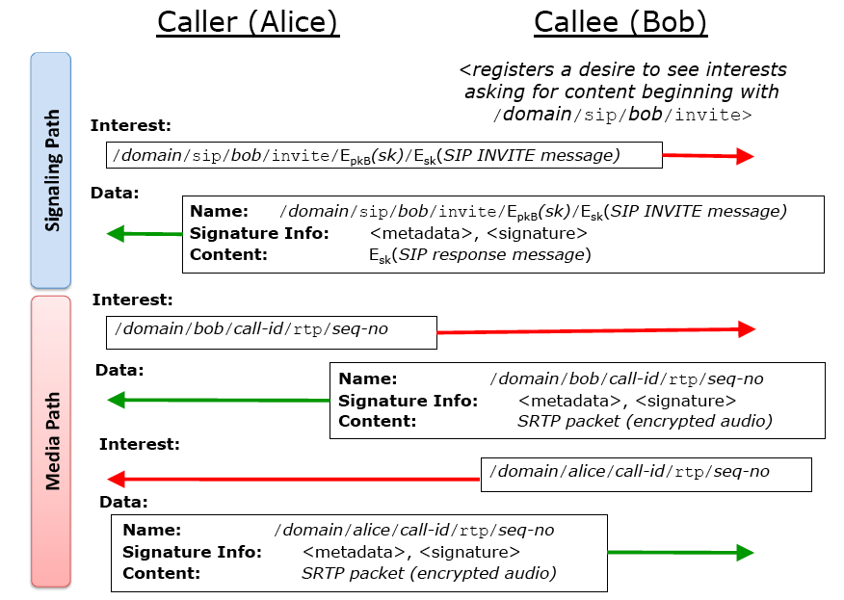

Slide 17
Summary
Applications
Limits Application Innovation
Applications
Innovation
Moving up the
UDP
TCP
Transport
(TCP/Other)
‘Thin Waist’
Network (IP/Other)
Increases Data Delivery Flexibility
Data Link
Data Link
Flexibility
Physical
Physical
The Hourglass Model
The Hourglass Model

Slide 18
Overview
Routing privacy
Privacy and Accountability
Wireless Privacy

Slide 19
Randomized Routing
Hide message source by routing it randomly
  Popular technique: Crowds, Freenet, Onion routing
Routers don’t know for sure if the apparent source of a message is the true sender or another router

Slide 20
Onion Routing
R
R
R₄
R
R₃
R
R₁
R
R₂
Alice
R
Bob
Sender chooses a random sequence of routers
  Some routers are honest, some controlled by attacker
  Sender controls the length of the path

Slide 21
Route Establishment
R₂
R₄
Alice
R₃
Bob
R₁
{M}_{pk(B)}
{B,k₄}_{pk(R4)},{ }_{k4}
{R₄,k₃}_{pk(R3)},{ }_{k3}
{R₃,k₂}_{pk(R2)},{ }_{k2}
{R₂,k₁}_{pk(R1)},{ }_{k1}
Routing info for each link encrypted with router’s public key
Each router learns only the identity of the next router

Slide 22
Tor
Second-generation onion routing network
  http://tor.eff.org
  Developed by Roger Dingledine, Nick Mathewson and Paul Syverson
  Specifically designed for low-latency anonymous Internet communications
Running since October 2003
100s nodes on four continents, thousands of users
“Easy-to-use” client proxy
  Freely available, can use it for anonymous browsing

Slide 23
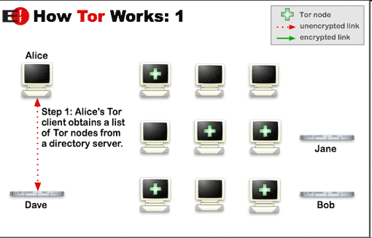
How does Tor work?

Slide 24
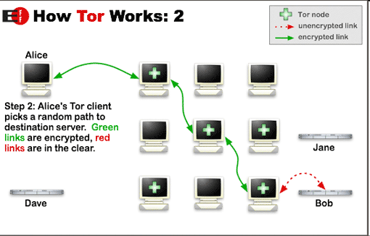
How does Tor work?

Slide 25
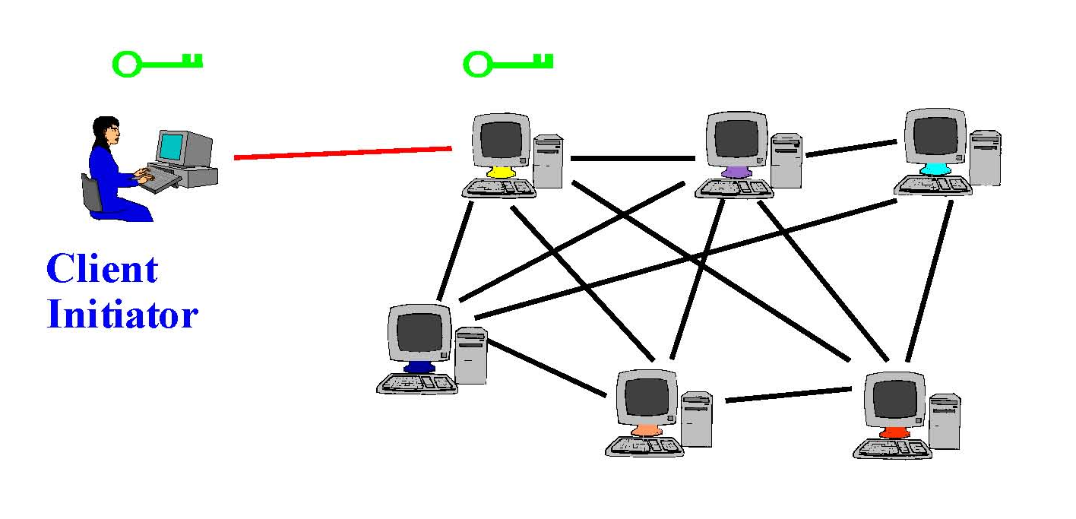
Tor Circuit Setup (1)
Client proxy establish a symmetric session key and circuit with Onion Router #1

Slide 26
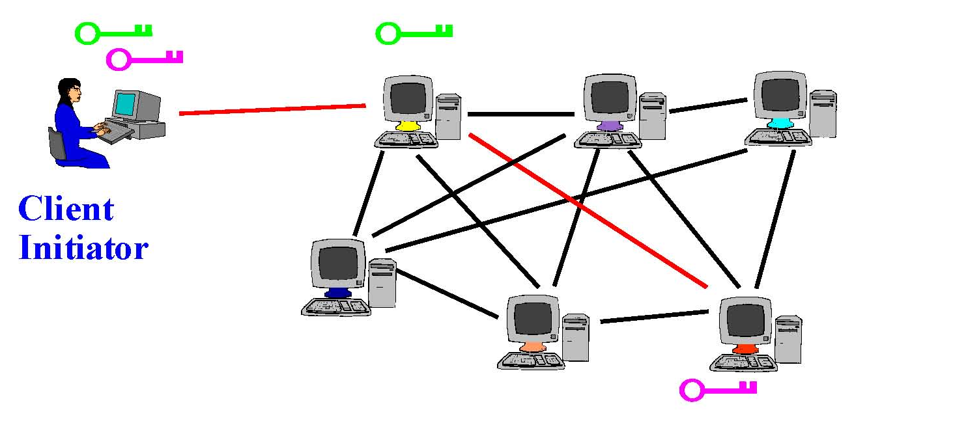
Tor Circuit Setup (2)
Client proxy extends the circuit by establishing a symmetric session key with Onion Router #2
  Tunnel through Onion Router #1

Slide 27

Tor Circuit Setup (3)
Client proxy extends the circuit by establishing a symmetric session key with Onion Router #3
  Tunnel through Onion Routers #1 and #2

Slide 28
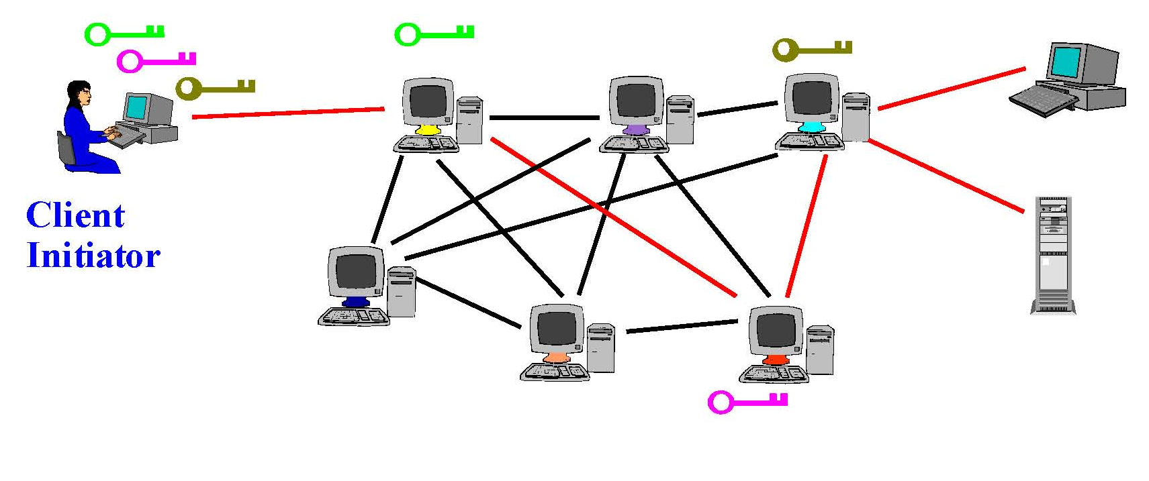
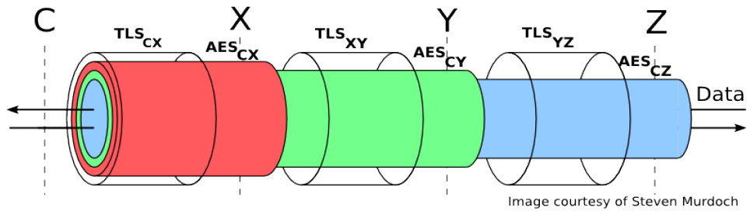
Using a Tor Circuit
Client applications connect and communicate over the established Tor circuit

Slide 29
Location Hidden Servers
Goal: deploy a server on the Internet that anyone can connect to without knowing where it is or who runs it
Accessible from anywhere
Resistant to censorship
Can survive full-blown DoS attack
Resistant to physical attack
  Can’t find the physical server!

Slide 30
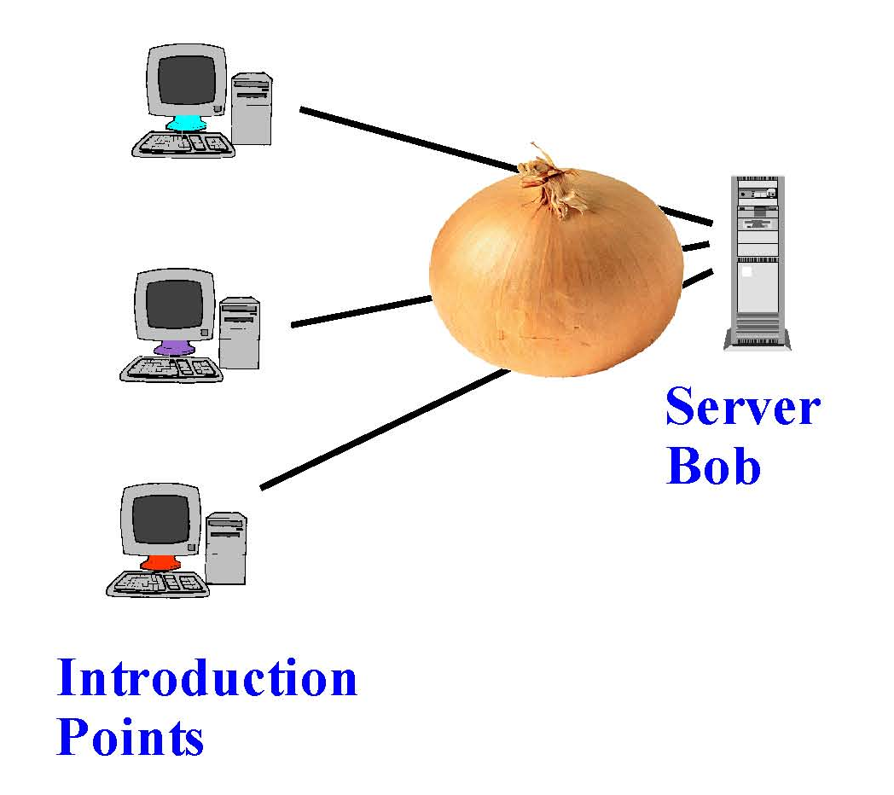
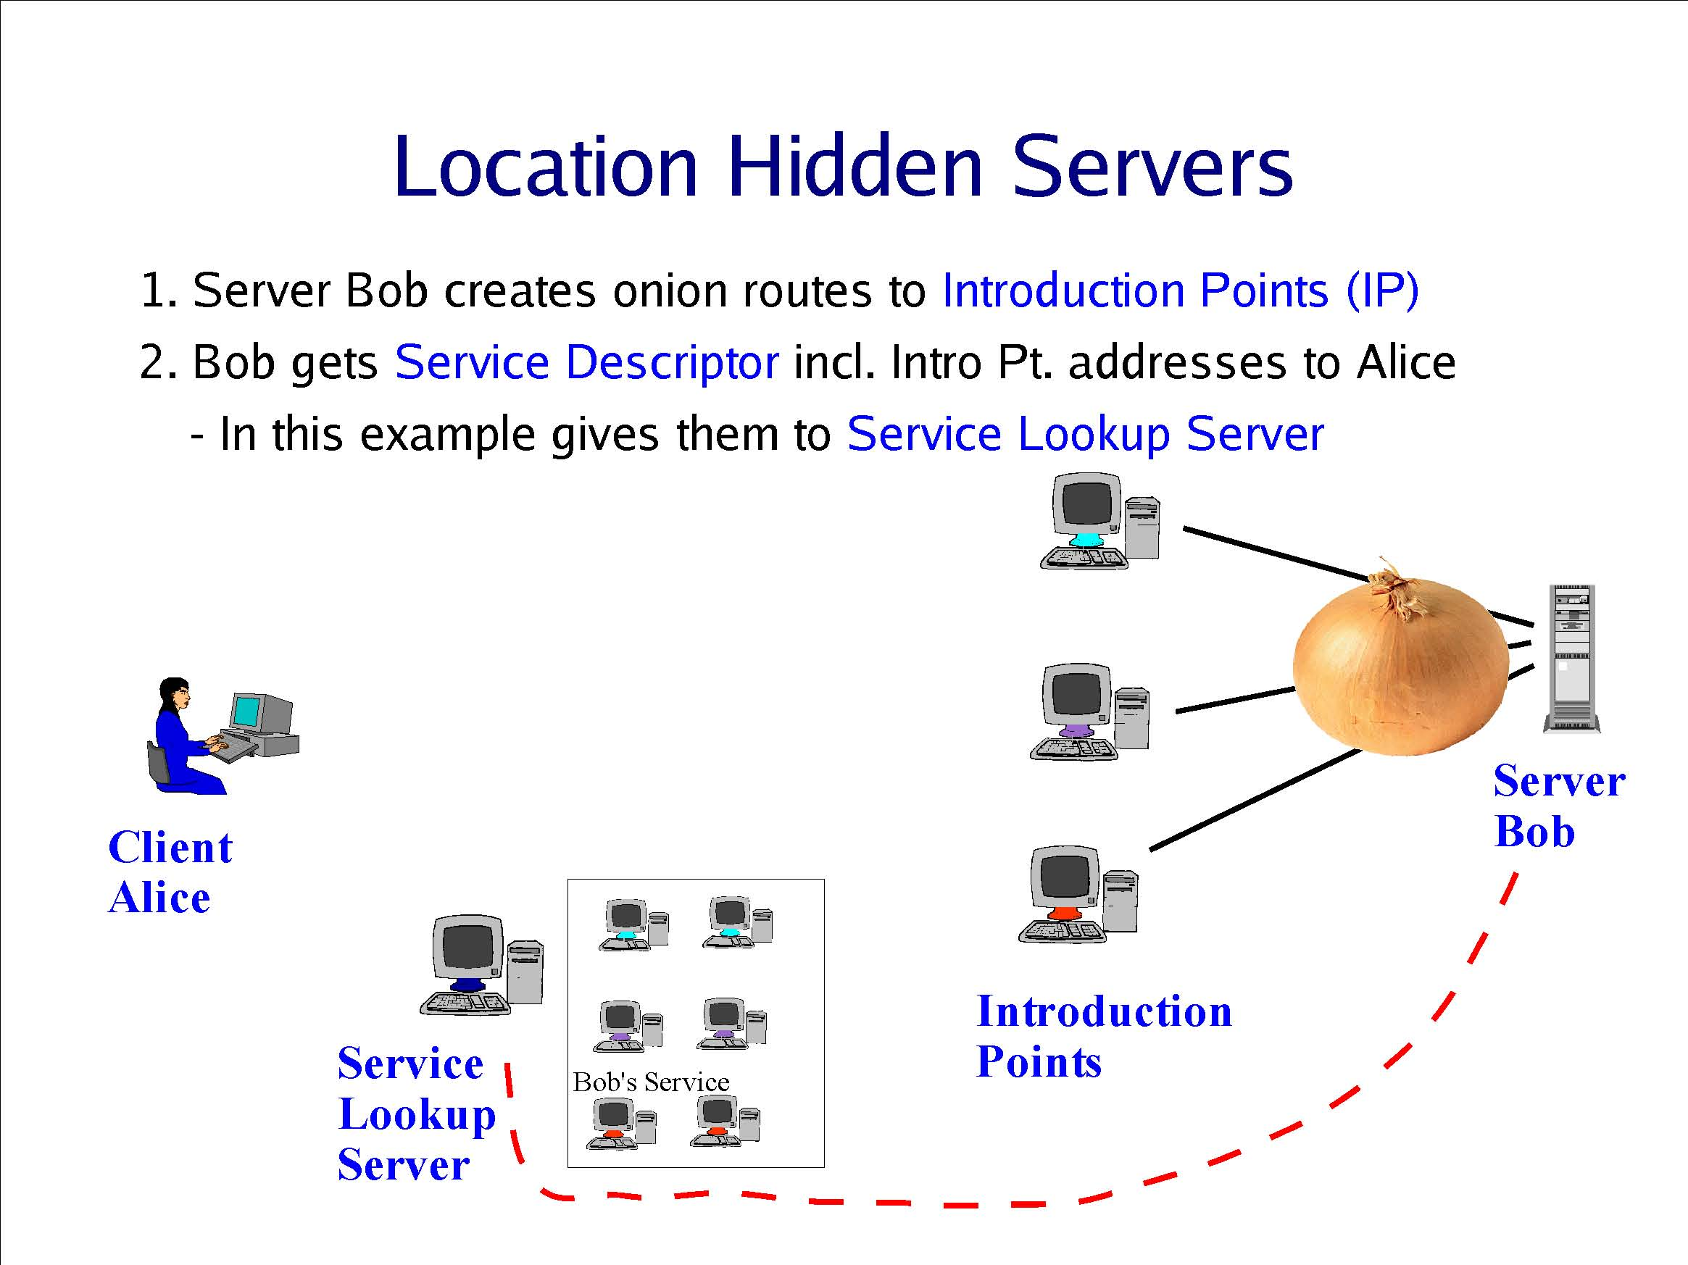
Creating a Location Hidden Server
Server creates onion routes
to “introduction points”
Client obtains service
descriptor and intro point
address from directory
Server gives intro points’
descriptors and addresses
to service lookup directory

Slide 31
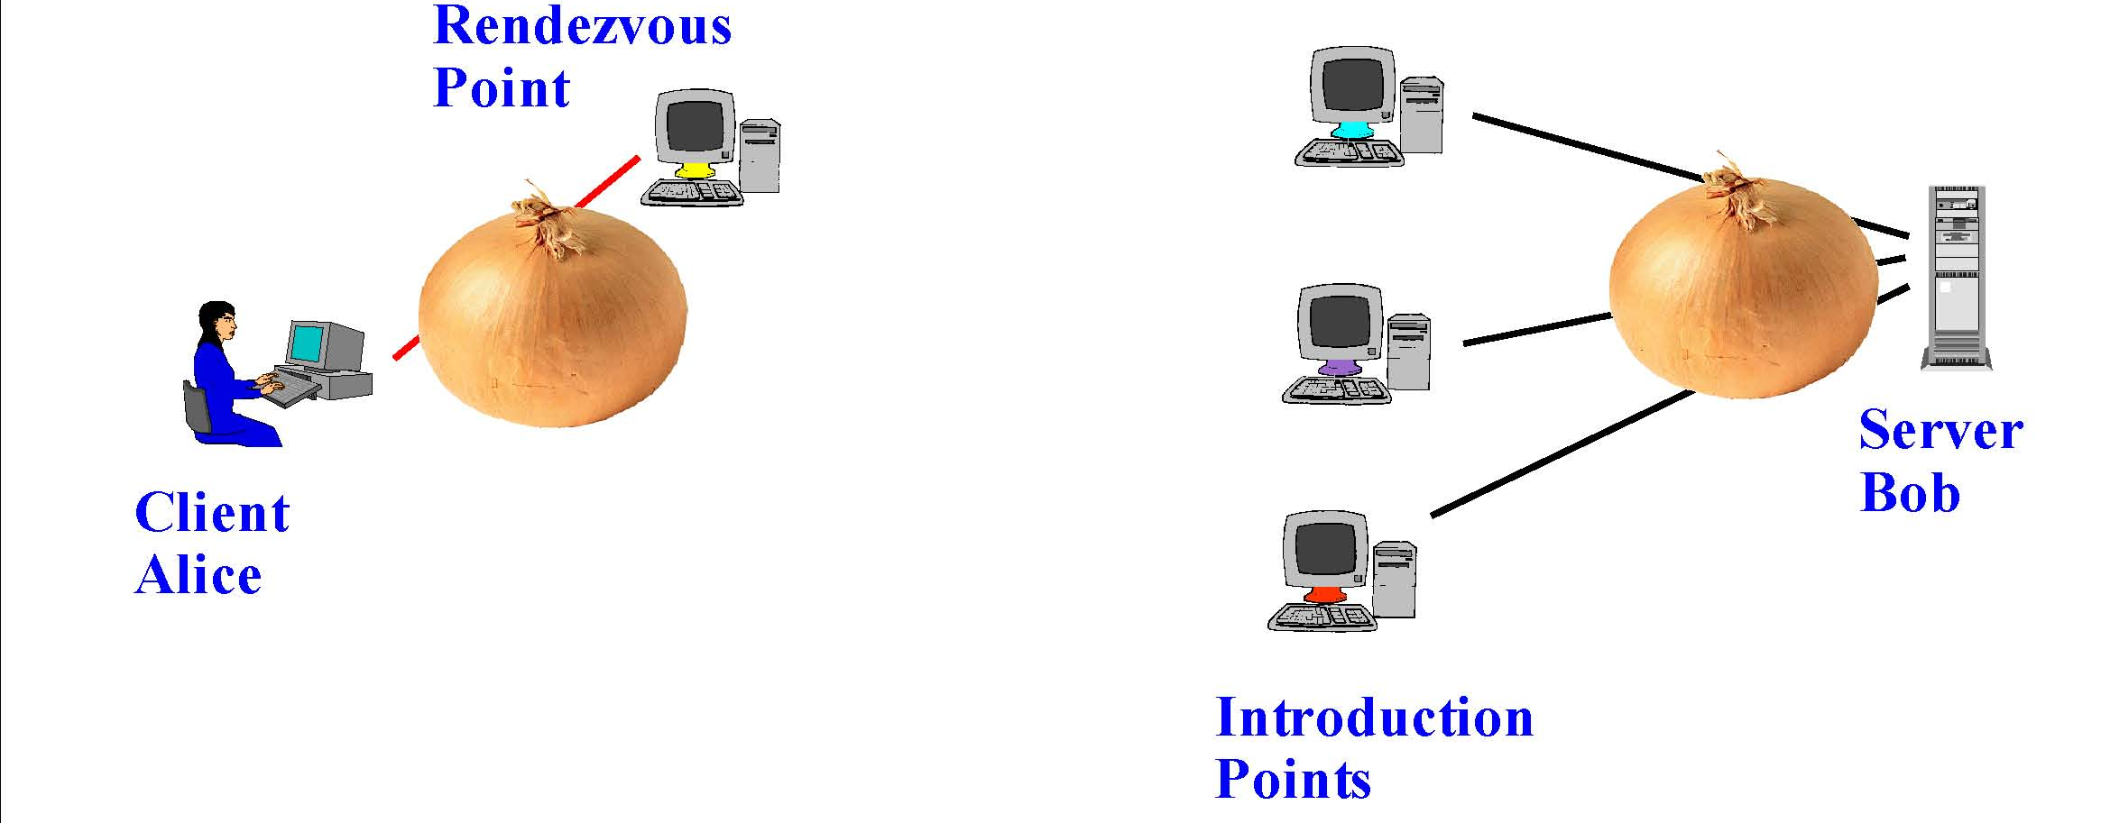
Using a Location Hidden Server
Client creates onion route
to a “rendezvous point”
Rendezvous point
mates the circuits
from client & server
If server chooses to talk to client,
connect to rendezvous point
Client sends address of the
rendezvous point and any
authorization, if needed, to
server through intro point

Slide 32
Overview
Routing privacy
Privacy and Accountability
Wireless Privacy

Slide 33
Accountability
Accountable Internet Protocol
operators want to know who sends each packet
so they can stop malicious senders
[Andersen et al., SIGCOMM 2008]
cryptographic addresses
No Privacy
unforgeable source addresses
Shutoff is Stop-Gap Fix
anti-spoofing mechanism
+ shutoff protocol
Requires “Smart NIC”
VS
Privacy
Tor Instead of IP
[Liu et al., HotNets 2011]
users want to hide who sends certain packets
so they can do stuff without the whole world knowing
No Accountability
hidden source addresses
routers act as onion nodes
Heavyweight

Slide 34
Destination Address
Source Address
…
return address
sender identity
flow ID
accountability
error reporting

Slide 35
Destination Address
Accountability Address
Return Address
…
Separate Accountability
and Return Addresses

Slide 36




APIP:
Accountable and Private Internet Protocol
Destination Address
Accountability Address
Return Address
+
+
Return Address
…
Separate Accountability
and Return Addresses
Hidden Return
Addresses
Delegated Accountability

Slide 37
Delegated Accountability
Accountability
Delegate
shutoff(P)
brief(P)
OK
verify(P)
P
P
Sender
Receiver

Slide 38
brief(P)
Fingerprint
Cache
04AF4DE779
Batch fingerprints in Bloom filter
Sender to Delegate:
B217C45091
F(P)
Delegate
cf24dba5f0
b0afd9c282
“I sent this packet.”
30e26e83b2
Delegate does not learn packet contents
P
Sender

Slide 39
Delegated Accountability
Accountability
Delegate
shutoff(P)
brief(P)
verify(P)
P
P
Sender
Receiver

Slide 40
verify(P)
TWO CHECKS:
PA➞B in fingerprint cache
Flow A➞B not shut off
A’s Delegate
Verifier to Delegate:
Most effective at first hop
“Do you vouch for this packet?”
Verified flow entries periodically expire
OK
verify(P)
verify(P)
Routers keep no state during verification
PA → B
Verified Flows
A → B
A

Slide 41
Delegated Accountability
Accountability
Delegate
shutoff(P)
brief(P)
verify(P)
P
P
Sender
Receiver

Slide 42
shutoff(P)
BLOCKED
Flows
A’s Delegate
A → B
shutoff(P)
Receiver to Delegate:
Signature proves receiver sent shutoff
“Stop this flow.”
verify(P)
DROP_FLOW
Filtering happens at router, not NIC
PA → B
PA → B
PA → B
Delegate also facilitates long-term fix
Verified Flows
B
A → B

Slide 43

Flow Granularity
One flow ID for all clients
Granularity: Delegate ⬌ Destination
Large Anonymity Set
One flow ID per connection
Granularity: TCP Flow
No Collateral Damage for Shutoff

Slide 44
Assigning Flow IDs
Delegate
Delegate’s Clients
Flow IDs
Shared
Variety of Classes
Unique
Large Anonymity Set
Flexible
No Collateral Damage

Slide 45
APIP:
Accountable and Private Internet Protocol
Destination Address
Accountability Address
Return Address
+
+
Return Address
…
Separate Accountability
and Return Addresses
Hidden Return
Addresses
Delegated Accountability
Real-World Deployment

Slide 46
Hiding Return Addresses
1
End-To-End Encryption
2
Address Translation
Destination
Destination
Destination
Accountability
Accountability
Accountability
Return
Return
Opaque ID
…
…
…
Protection From:
 | Source Domain
✓ | Local Observers
✓ | Transit Networks
 | Receiver
Protection From:
 | Source Domain
 | Local Observers
✓ | Transit Networks
✓ | Receiver

Slide 47

Example Deployments
Specialized Companies
as Delegates
Source Domains
as Delegates
EXTERNAL
Delegate
Fingerprint
Cache
DESTINATION
ACCOUNTABILITY
DESTINATION
DESTINATION
ACCOUNTABILITY
RETURN
RETURN
Border Router
+ Delegate
Source Domain
No burden on source domains
No briefing overhead
Larger anonymity set
Lower verification latency

Slide 48
Accountability
every packet carries an accountability address
for reporting misbehavior
unforgeable source addresses
Delegated Accountability
VS
&
Privacy
Return Address
return address can be hidden
since network just needs accountability address
hidden source addresses
Hidden Return
Addresses

Slide 49
Overview
Routing privacy
Privacy and Accountability
Wireless Privacy

Slide 50

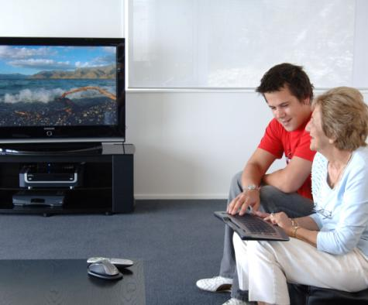




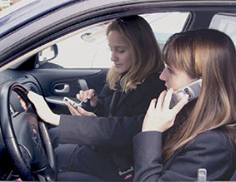











Our Wireless World
tcpdump
Link Layer Header
Blood pressure: high
Link Layer Header
PrivateVideo1.avi
Link Layer Header
PrivatePhoto1.jpg
Link Layer Header
Buddy list: Alice, Bob, …
Link Layer Header
Home location=(47.28,…
Notes:
More and more personal devices are being equipped with wireless capabilities like 802.11 and bluetooth. They include everything from media players and ipods to sensors on our clothing and our bodies.
Because of this trend, we now often carry wireless devices with us where ever we go, from our homes to our cars and even to places that we think should have more privacy.
Unfortunately, in this emerging wireless world, bad guys still exist. They can easily overhear any of our wireless transmissions, often with nothing more than a laptop computer. Thus, without protection, an eavesdropper can easily obtain private information.

Slide 51



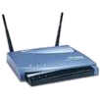




Best Security Practices
Bootstrap
Username: Alice
Key: 0x348190…
SSID: Bob’s Network
Key: 0x2384949…
Out-of-band (e.g., password, WiFi Protected Setup)
Discover
802.11 probe
Is Bob’s Network here?
802.11 beacon
Bob’s Network is here
Authenticate
and Bind
802.11 auth
Proof that I’m Alice
802.11 auth
Proof that I’m Bob
tcpdump
Send Data
802.11 header
Confidentiality
Authenticity
Integrity
802.11 header
Notes:
Protocols such as 802.11 try to protect against such threats with the following best practices.
Beforehand, Alice, a client such as a laptop, and Bob, a service such as an access point, exchange keys in a secure, out-of-band manner. For example, by passing a password on a post-it note.
Now, whenever Alice opens up her laptop, it tries to discover if Bob is present with probes or listening for Bob’s beacons.
If she discovers that Bob is present, then they use the bootstrapped key to exchange information that proves to each other they are who they think they are.
This process enables them to encrypt the data they send each other in a manner that is confidential, authentic, and maintains its data integrity.

Slide 52


Privacy Problems Remain
Bootstrap
Many exposed bits are (or can be used as) identifiers that are linked over time
SSID: Bob’s Network
Secret: 0x2384949…
Username: Alice
Secret: 0x348190…
Discover
802.11 probe
Is Bob’s Network here?
Is Bob’s Network here?
802.11 beacon
Bob’s Network is here
Bob’s Network is here
Authenticate
and Bind
802.11 auth
Proof that I’m Alice
802.11 auth
Proof that I’m Bob
tcpdump
Proof that I’m Bob
Send Data
802.11 header
Confidentiality
Authenticity
Integrity
MAC addr, seqno, …
MAC addr, seqno, …
Notes:
Unfortunately, in our pervasive wireless world, the information that remains exposed during this process poses additional privacy threats.
This is because many bits that remain exposed are, or can be used as, identifiers that are linked over time.

Slide 53



Problem: Long-Term Linking
802.11 beacon
Alice’s iPod is here
802.11 beacon
Alice’s iPod is here
MAC: 12:34:56:78:90:ab
MAC: 12:34:56:78:90:ab
tcpdump
Alice
Alice?
802.11 probe
Is Alice’s iPod here?
Alice’s friend?
Easy to identify and relate devices over time
Notes:
For example, this enables long-term linking. Identifiers such as MAC addresses and network names remain present in link layer headers and during the discovery process.
These identifiers are consistent over long periods of time, so it is relatively easy to track the movement of devices and infer their relationships.

Slide 54
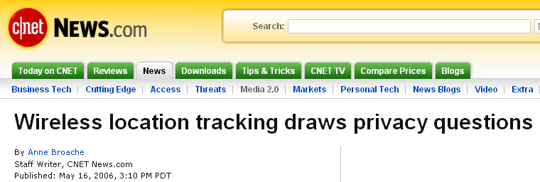

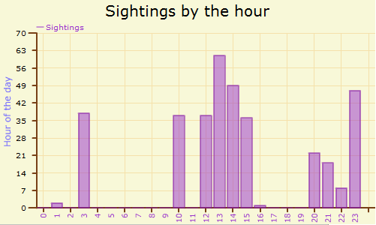
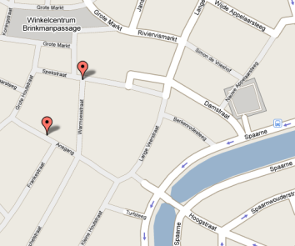




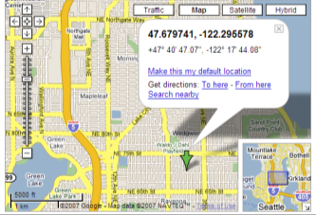
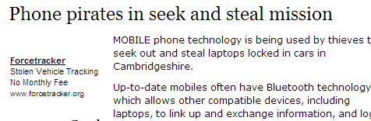

Problem: Long-Term Linking
Linking enables location tracking, user profiling, inventorying, relationship profiling, …
[Greenstein, HotOS ’07; Jiang, MobiSys ’07; Pang, MobiCom ’07, HotNets ’07]
www.bluetoothtracking.org
802.11 header
Is “djw” here?
“djw” is here
Home
www.wigle.net
Notes:
Long-term linking enables many attacks against our privacy such as location tracking, user profiling, and inventorying.
These attacks are just emerging but there are already real tracking networks, such as the bluetooth network in the netherlands listed on this slide. In addition, there are many concerns expressed in the popular media.

Slide 55


Problem: Short-Term Linking
12:34:56:78:90:ab, seqno: 1, …
3-9 data streams overlap
each 100 ms, on average
12:34:56:78:90:ab
12:34:56:78:90:ab, seqno: 2, …
12:34:56:78:90:ab
00:00:99:99:11:11, seqno: 102, …
Alice -> AP
00:00:99:99:11:11
12:34:56:78:90:ab, seqno: 3, …
12:34:56:78:90:ab
00:00:99:99:11:11, seqno: 103, …
Alice -> AP
00:00:99:99:11:11
12:34:56:78:90:ab, seqno: 4, …
12:34:56:78:90:ab
00:00:99:99:11:11, seqno: 104, …
Alice -> AP
00:00:99:99:11:11
tcpdump
Easy to isolate distinct packet streams
Notes:
A second problem is short-term linking. Most of the time, an eavesdropper will overhear data streams from many devices. But identifiers in link-layer headers make it easy for eavesdroppers to isolate individual data streams. The obvious identifier that he can use is a MAC address, but in many cases, other bits of information, such as sequence numbers will work as well.

Slide 56


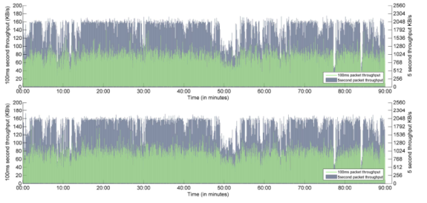
Problem: Short-Term Linking
Isolated data streams are more susceptible to side-channel analysis on packet sizes and timing
  Exposes keystrokes, VoIP calls, webpages, movies, …
[Liberatore, CCS ‘06; Pang, MobiCom ’07; Saponas, Usenix Security ’07;
Song, Usenix Security ‘01; Wright, IEEE S&P ‘08; Wright, Usenix Security ‘07]
Device
fingerprints
100
250
300
500
120
200
Video
compression signatures
transmission sizes
transmission sizes
DFT
Keystroke
timings
≈
Notes:
Short-term linking is problematic because isolated data streams are more susceptible to side-channel analysis. Recent research has shown that even when encrypted, the sequence of packet sizes and timings in a data stream can reveal its contents. This includes things like keys you type, words in your voice-over-IP calls, and webpages you visit.
Data packets have a wide interface so many more applications may inadvertently be vulnerable because they don’t add any additional protection before encapsulating data in them. Short-term linking helps enable them because they are less successful when multiple packet streams are mixed together.

Slide 57
Fundamental Problem
Bootstrap
Many exposed bits are (or can be used as) identifiers that are linked over time
SSID: Bob’s Network
Secret: 0x2384949…
Username: Alice
Secret: 0x348190…
Discover
802.11 probe
Is Bob’s Network here?
Is Bob’s Network here?
802.11 beacon
Bob’s Network is here
Bob’s Network is here
Authenticate
and Bind
802.11 auth
Proof that I’m Alice
802.11 auth
Proof that I’m Bob
tcpdump
Proof that I’m Bob
Send Data
MAC addr, seqno, …
MAC addr, seqno, …
Notes:
So fundamental problem in both long-term and short-term linking is that many exposed bits are, or can be used as identifiers that are linked over time.

Slide 58
Goal: Make All Bits Appear Random
Bootstrap
SSID: Bob’s Network
Key: 0x2384949…
Username: Alice
Key: 0x348190…
Discover
?
Authenticate
and Bind
tcpdump
Send Data
Notes:
Therefore, our goal in this talk is to develop a protocol that makes all bits appear random to third parties. This includes all the packets sent for discovery and authentication and all bits in link layer headers.

Slide 59
Challenge: Filtering without Identifiers
Which packets are mine?
Which packets are mine?
Notes:
Why is this hard to do? Since no longer have source or destination addresses in packets, filtering packets efficiently becomes much more challenging.

Slide 60
Design Requirements
When A generates Message to B, she sends:
PrivateMessage = F(A, B, Message)
where F has these properties:
  Confidentiality: Only A and B can determine Message.
  Authenticity: B can verify A created PrivateMessage.
  Integrity: B can verify Message not modified.
  Unlinkability: Only A and B can link PrivateMessages
  to same sender or receiver.
  Efficiency: B can process PrivateMessages as fast
  as he can receive them.
A→B Header…
Unencrypted payload
Notes:
More specifically, what I mean…

Slide 61


Solution Summary
Confidentiality
Authenticity
Unlinkability
Integrity
Efficiency
Only
Data
Payload
Only
Data
Payload
Only
Data
Payload
802.11 WPA
MAC Pseudonyms
Public Key
Symmetric Key
SlyFi: Discovery/Binding
SlyFi: Data packets
Notes:
For example, …

Slide 62
Straw man: MAC Pseudonyms
Idea: change MAC address periodically
  Per session or when idle [Gruteser ’05, Jiang ‘07]
Other fields remain (e.g., in discovery/binding)
  No mechanism for data authentication/encryption
  Doesn’t hide network names during discovery or
  credentials during authentication
Pseudonyms are linkable in the short-term
  Same MAC must be used for each association
  Data streams still vulnerable to side-channel leaks
Notes:
To try to get unlinkability, the first thing we might try is to remove the obviously identifying bits of information in packets, such as MAC addresses. For example, it has recently been proposed…

Slide 63
Solution Summary
Confidentiality
Authenticity
Unlinkability
Integrity
Efficiency
Only
Data
Payload
Only
Data
Payload
Only
Data
Payload
802.11 WPA
MAC Pseudonyms
Long Term
Public Key
Symmetric Key
SlyFi: Discovery/Binding
SlyFi: Data packets
Notes:
So MAC Pseudonyms by themselves do not give us…
It is also non-trivial to combine pseudonyms and WPA because WPA exposes identifiers in the discovery and binding process

Slide 64


Straw man: Encrypt Everything
Bootstrap
SSID: Bob’s Network
Key: 0x2384949…
Username: Alice
Key: 0x348190…
Idea: Use bootstrapped keys to encrypt everything
Discover
Authenticate
and Bind
Send Data
Notes:
To try to obtain the best of both worlds, we then may try to encrypt everything. After all, we already have…

Slide 65






Straw man: Public Key Protocol
Client
Service
Probe “Bob”
Check signature:
K_{Alice}
Sign:
K⁻¹_{Alice}
Slow! (>100ms)
K_{Bob}
K⁻¹_{Bob}
Key-private encryption
(e.g., ElGamal)
Try to decrypt
Based on [Abadi ’04]
Notes:
One way we can do this is …

Slide 66

Straw man: Symmetric Key Protocol
Client
Service
Slow! (scales w/ # keys)
Check MAC:
K_{AB}
Probe “Bob”
Can’t identify the
decryption key in the packet or else it is linkable
MAC:
K_{AB}
K_{Shared1}
K_{Shared2}
K_{Shared3}
…
K_{AB}
Try to
decrypt
with each
shared key
Symmetric encryption
(e.g., AES w/ random IV)
Different symmetric key per potential sender
Notes:
To address this problem, we might instead try to use symmetric key encryption, because it is much faster than public key encryption…

Slide 67
Solution Summary
Confidentiality
Authenticity
Unlinkability
Integrity
Efficiency
Only
Data
Payload
Only
Data
Payload
Only
Data
Payload
802.11 WPA
MAC Pseudonyms
Long
Term
Public Key Protocol
Symmetric Key Protocol
SlyFi: Discovery/Binding
SlyFi: Data packets
Notes:
So the encrypt everything approach

Slide 68
SlyFi
Symmetric key almost works, but tension between:
  Unlinkability: can’t expose the identity of the key
  Efficiency: need to identify the key to avoid trying all keys
Idea: Identify the key in an unlinkable way
Approach:
  Sender A and receiver B agree on tokens: T₁ , T₂ , T₃ , …
  A attaches T_{i} to encrypted packet for B
_{AB}
_{AB}
_{AB}
_{AB}
Notes:
To try to regain efficiency, we make the following observation: …
The key idea we leverage in our design of our solution slyfi is…

Slide 69
SlyFi
Required properties:
  Third parties can not link T_{i} and T_{j} if i ≠ j
  A doesn’t reuse T_{i}
  A and B can compute T_{i} independently
Client
Service
_{AB}
_{AB}
_{AB}
Check MAC:
K_{AB}
Probe “Bob”
_{AB}
MAC:
K_{AB}
Main challenge:
Sender and receiver must synchronize i
K_{AB}
K_{AB}
_{AB}
T_{i}
_{AB}
Lookup T_{i} in a
table to get K_{AB}
Symmetric encryption
(e.g., AES w/ random IV)
_{AB}
_{AB}
T_{i} = AES_{K} (i)
T_{i} = AES_{K} (i)
_{AB}
_{AB}
Notes:
That is, SlyFi is basically the same as the symmetric key approach, but …

Slide 70

SlyFi: Data Transport
Data messages:
  Only sent over established connections
  ⇒ Expect messages to be delivered
  ⇒ Use implicit transmission number to synchronize i
_{AB}
T_{i} = AES_{K} (i) where i = transmission #
_{AB}
_{AB}
T_{i}
_{AB}
T_{i+1}
_{AB}
T_{i +2}
_{AB}
T_{i +3}
Notes:
For data messages we make the observation …

Slide 71
SlyFi: Data Transport
Data messages:
  Only sent over established connections
  ⇒ Expect messages to be delivered
  ⇒ Use implicit transmission number to synchronize i
_{AB}
T_{i} = AES_{K} (i) where i = transmission #
_{AB}
_{AB}
_{AB}
On receipt of T_{i} , B computes next expected: T_{i+1}
Handling message loss:
  On receipt of T_{i} save T_{i+1}, … , T_{i+k} in table
  Tolerates k consecutive losses (k=50 is enough)
  No loss ⇒ compute one token per reception
_{AB}
_{AB}
_{AB}
Notes:
For data messages we make the observation …

Slide 72
SlyFi: Discovery/Binding
Discovery & binding messages:
  Often sent when other party is not present
  ⇒ Can’t expect most messages to be delivered
  ⇒ Can’t rely on transmission reception to synchronize i
_{AB}
Nope.
T_{i}
Is Bob’s Network here?
..
_{AB}
Nope.
T_{i +1}
Is Bob’s Network here?
..
_{AB}
Nope.
T_{i +2}
Is Bob’s Network here?
…...
i = ?
_{AB}
T_{i +3}
Is Bob’s Network here?
Notes:
We can not use the same approach for discovery and binding messages however, because discovery messages are often sent when the other party is not present. For example, Alice sends discovery probes whenever she opens up her laptop, even if bob is not present.

Slide 73
SlyFi: Discovery/Binding
Discovery & binding messages:
  Infrequent: only sent when trying to associate
  Narrow interface: single application, few side-channels
  ⇒ Linkability at short timescales is usually OK
  ⇒ Use loosely synchronized time to synchronize i
_{AB}
T_{i} = AES_{K} (i) where i = ⎣current time/5 min⎦
_{AB}
_{AB}
T_{i}
802.11 probe
_{BA}
T_{i}
802.11 beacon
_{AB}
T_{i}
802.11 auth
_{BA}
T_{i}
802.11 auth
Notes:
Instead, we make two observations…

Slide 74
SlyFi: Discovery/Binding
Discovery & binding messages:
  Infrequent: only sent when trying to associate
  Narrow interface: single application, few side-channels
  ⇒ Linkability at short timescales is usually OK
  ⇒ Use loosely synchronized time to synchronize i
_{AB}
T_{i} = AES_{K} (i) where i = ⎣current time/5 min⎦
_{AB}
_{AB}
At the start of time interval i compute T_{i}
Handling clock skew:
  Receiver B saves T_{i-s}, … , T_{i+s} in table
  Tolerates clock skew of 5⋅s minutes
_{AB}
_{AB}
Notes:
Instead, we make two observations…

Slide 75
Solution Summary
Confidentiality
Authenticity
Unlinkability
Integrity
Efficiency
Only
Data
Payload
Only
Data
Payload
Only
Data
Payload
802.11 WPA
MAC Pseudonyms
Long
Term
Public Key
Symmetric Key
SlyFi: Discovery/Binding
Long
Term
SlyFi: Data packets
Notes:
Thus, we conclude that slyfi is efficient. For discovery and binding, it also provides …

Slide 76
Next Lecture…
Read: BlindBox: Deep Packet Inspection over Encrypted Traffic
Attend Justine Sherry’s talk “Middleboxes as a cloud service”
  Monday, March 28th 10:00 AM GHC 6115
  Today's networks do much more than merely deliver packets. Through the deployment of middleboxes, enterprise networks today provide improved security -- e.g., filtering malicious content -- and performance capabilities -- e.g., caching frequently accessed content. Although middleboxes are deployed widely in enterprises, they bring with them many challenges: they are complicated to manage, expensive, prone to failures, and challenge privacy expectations.
  In this talk, we aim to bring the benefits of cloud computing to networking. We argue that middlebox services can be outsourced to cloud providers in a similar fashion to how mail, compute, and storage are today outsourced. We begin by presenting APLOMB, a system that allows enterprises to outsource middlebox processing to a third party cloud or ISP. For enterprise networks, APLOMB can reduce costs, ease management, and provide resources for scalability and failover. For service providers, APLOMB offers new customers and business opportunities, but also presents new challenges. Middleboxes have tighter performance demands than existing cloud services, and hence supporting APLOMB requires redesigning software at the cloud. We re-consider classical cloud challenges including fault-tolerance and privacy, showing how to implement middlebox software solutions with throughput and latency 2-4 orders of magnitude more efficient than general-purpose cloud approaches. Some of the technologies discussed in this talk are presently being adopted by industrial systems used by cloud providers and ISPs.

Slide 77
Overview
Routing privacy
Web Privacy
Wireless Privacy

Slide 78
An “Old” Problem
Many governments/companies trying to limit their citizens’ access to information
  Censorship (prevent access)
  Punishment (deter access)
  China, Saudi Arabia, HP
How can we defeat such attempts?
  Circumvent censorship
  Undetectably

Slide 79
Proxy-Based Web Censorship
Government manages national web firewall
  Not optional---catches ALL web traffic
Block certain requests
  Possibly based on content
  More commonly on IP address/publisher
  China: Western news sites, Taiwan material
Log requests to detect troublemakers
  Even without blocking, may just watch traffic
But they don’t turn off the whole net
  Creates a crack in their barrier

Slide 80
Goal
Circumvent censor via innocent web activity
  Normal web server and client cooperate to create covert channel
Without consequence for client
And without consequence for server
  Broad participation increases system robustness
  Ensure offering service doesn’t lead to trouble
  e.g., loss of business through being blocked
  Also, “law knows no boundaries”

Slide 81
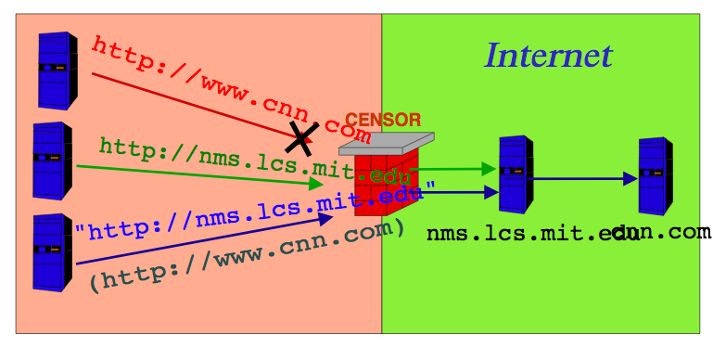
The Big Picture

Slide 82
Requirements
Client deniability
  Detection could be embarrassing or worse
Client statistical deniability
  Even suspicion could be a problem
Server covertness/statistical deniability
  If server detected, can be blocked
Communication robustness
  Even without detecting, censor could scramble covert channel
Performance (bandwidth, latency)

Slide 83
(Un)related Work
SSL
  Encrypted connection---can’t tell content
  Suspicious!
  Doesn’t help reach blocked servers
  Govt. can require revealing SSL keys
Anonymizing Proxies
  Prevent servers from knowing identity of client
  But proxy inside censor can’t reach content
  And proxy outside censor can be blocked
  And use of proxy is suspicious

Slide 84
Safeweb/Triangle boy
Operation
  Client contacts triangle-boy “reflector”
  Reflector forwards requests to blocked server
  Server returns content to client (IP spoof)
Circumvents censorship
But still easily detected
  “Local monitoring of the user only reveals an encrypted conversation between User and Triangle Boy machine.” (Safeweb manual)

Slide 85
Summary
Easy to hide what you are getting
  Just use SSL
And easy to circumvent censors
  Safeweb
But hard to hide that you are doing it

Slide 86
Circumventing Censors
Censors allow certain traffic
Use to construct a covert channel
  Talk to normal servers
  Embed requests for censored content in normal-seeming requests
  Receive censored content hidden in normal-seeming responses
Requester: client asking for hidden content
Responder: server covertly providing it

Slide 87
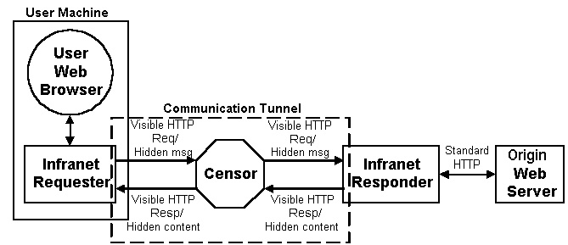
System Architecture

Slide 88
Receiving Content is Easier Half
Responder is a normal web server, serving images (among other things)
Encrypt data using requestor key
Embed in “unimportant, random” bits of images
  E.g., high order color bits
  Watermarking
Encrypted data looks random---only requestor can tell it isn’t (and decrypt)

Slide 89
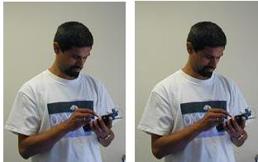
Example
One image has embedded content
You can’t tell which (shows it’s working)

Slide 90
Goals Analysis
Client looks innocent (receives images)
  Infranet users & nonusers indistinguishable
Server less so
  Any one image seems innocent
  But same image with different “random bits” in each copy is suspicious
  Evasion: never use same image-URL twice
    Justify: per-individual customized web site
    Human inspection might detect odd URL usage
  Evasion: use time-varying image (webcam)
Performance: 1/3 of image bits

Slide 91
Upstream (Requests) is Harder
No “random content bits” that can be fiddled to send messages to responder
Solution: let browsing pattern itself be the message
Suppose web page has k links.
  GET on i^{th} link signifies symbol “i” to requestor
  Result: log₂(k) message bits from link click
Can be automated
To prevent censor from seeing message, encrypt with responder key

Slide 92
Goals Analysis
Deniability: requestor generates standard http GETs to allowed web sites
  Fact of GETs isn’t itself proof of wrongdoing
  Known rule for translating GETs to message, but message is encrypted, so not evidence
Statistical deniability
  Encrypting message produces “random” string
  Sent via series of “random” GETs
  Problem: normal user browsing not random
    Some links rare
    Conditional dependence of browsing on past browsing

Slide 93
Performance vs. Deniability
Middling deniability, poor performance
  Request URL may be (say) 50 characters
  16 Links/Page (say) means 4 bits
  So need 100 GETs to request one URL!
  And still poor statistical deniability
Can we enhance deniability?
  Yes, by decreasing performance further
Can we enhance performance?
  Yes, and enhance deniability at same time

Slide 94
Paranoid Alternative
Settle for one message bit per GET
  Odd/even links on page
  Or generalize to “mod k” for some small k
User has many link choices for each bit
  Can choose one that is reasonable
  Incorporate error correcting code in case no reasonable next link sends correct bit
Drawback: user must be directly involved in sending each message bit
  Very low bandwidth vs time spent

Slide 95
Higher Performance
Idea: arithmetic coding of requests
  If request i has probability p_{i}, then entropy of request distribution is –Σ p_{i} log p_{i}
  Arithmetic coding encodes request i using log p_{i} bits
  Result: expected request size equals entropy
  Optimal
Problem: requestor doesn’t know probability distribution of requests
  Doesn’t have info needed for encoding

Slide 96
Solution: Range Mapping
Adler-Maggs
Exploit asymmetric bandwidth
Responder sends probability distribution to requester using easy, downstream path
Requestor uses this “dictionary” to build arithmetic code, send encoded result
Variation for non-binary
  Our messages aren’t bits, they are clicks
  And server knows different clicks should have different probabilities

Slide 97
Toy Example
Suppose possible requests fewer than links on page
Responder sends dictionary:
  “link 1 means http://mit.edu”
  “link 2 means http://stanford.edu”
  Assigns common requests to common GETs
Requestor GETs link matching intended request
One GET sends full (possibly huge) request
Problem: in general, ∞ possible requests
  Can’t send a dictionary for all

Slide 99
Overview
P2P Privacy

Slide 100
Freenet
Addition goals to file location:
  Provide publisher anonymity, security
  Resistant to attacks – a third party shouldn’t be able to deny the access to a particular file (data item, object), even if it compromises a large fraction of machines
Files are stored according to associated key
  Core idea: try to cluster information about similar keys
Messages
  Random 64bit ID used for loop detection
  TTL
    TTL 1 are forwarded with finite probablity
    Helps anonymity
  Depth counter
    Opposite of TTL – incremented with each hop
    Depth counter initialized to small random value

Slide 101
Data Structure
Each node maintains a common stack
  id – file identifier
  next_hop – another node that store the file id
  file – file identified by id being stored on the local node
Forwarding:
  Each message contains the file id it is referring to
  If file id stored locally, then stop
    Forwards data back to upstream requestor
    Requestor adds file to cache, adds entry in routing table
  If not, search for the “closest” id in the stack, and forward the message to the corresponding next_hop
id next_hop file
…
…

Slide 102
Query Example
query(10)
n1
n2
4 n1 f4
12 n2 f12
5 n3
1
9 n3 f9
4’
4
n4
n5
2
14 n5 f14
13 n2 f13
3 n6
5
4 n1 f4
10 n5 f10
8 n6
n3
3
3 n1 f3
14 n4 f14
5 n3
Note: doesn’t show file caching on the reverse path

Slide 103
Freenet Requests
Any node forwarding reply may change the source of the reply (to itself or any other node)
  Helps anonymity
Each query is associated a TTL that is decremented each time the query message is forwarded; to obscure distance to originator:
  TTL can be initiated to a random value within some bounds
  When TTL=1, the query is forwarded with a finite probability
Each node maintains the state for all outstanding queries that have traversed it → help to avoid cycles
If data is not found, failure is reported back
  Requestor then tries next closest match in routing table

Slide 104
Freenet Request
Data Request
Data Reply
C
Request Failed
2
3
1
A
B
12
D
6
11
10
4
7
9
5
E
F
8

Slide 105
Freenet Search Features
Nodes tend to specialize in searching for similar keys over time
  Gets queries from other nodes for similar keys
Nodes store similar keys over time
  Caching of files as a result of successful queries
Similarity of keys does not reflect similarity of files
Routing does not reflect network topology

Slide 106
Freenet File Creation
Key for file generated and searched → helps identify collision
  Not found (“All clear”) result indicates success
  Source of insert message can be change by any forwarding node
Creation mechanism adds files/info to locations with similar keys
New nodes are discovered through file creation
Erroneous/malicious inserts propagate original file further

Slide 107
Cache Management
LRU Cache of files
Files are not guaranteed to live forever
  Files “fade away” as fewer requests are made for them
File contents can be encrypted with original text names as key
  Cache owners do not know either original name or contents → cannot be held responsible

Slide 108
Freenet Naming
Freenet deals with keys
  But humans need names
  Keys are flat → would like structure as well
Could have files that store keys for other files
  File /text/philiosophy could store keys for files in that directory → how to update this file though?
Search engine → undesirable centralized solution

Slide 109
Freenet Naming - Indirect files
Normal files stored using content-hash key
  Prevents tampering, enables versioning, etc.
Indirect files stored using name-based key
  Indirect files store keys for normal files
  Inserted at same time as normal file
Has same update problems as directory files
  Updates handled by signing indirect file with public/private key
  Collisions for insert of new indirect file handled specially → check to ensure same key used for signing
Allows for files to be split into multiple smaller parts

Slide 111
How does Tor work?

Slide 112
How does Tor work?

Slide 113
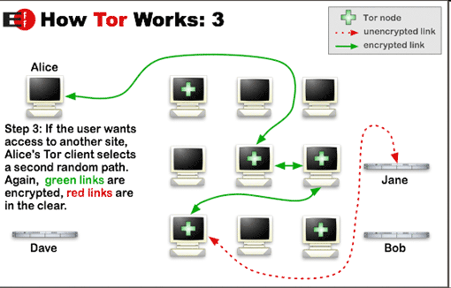
How does Tor work?

Slide 114
Building a circuit
Create c₂ E(g^{x2})
Created c₁, g^{y1}, H(K₁)
Created c₂, g^{y2}, H(K₂)
Relay c₁(Extended, g^{y2}, H(K₂)
Create c₁, E(g^{x1})
Relay c₁ (Extend, OR₂, E(g^{x1}))

Slide 115
Fetching a web page
Relay c₂ (Begin <Bob>)
Relay c₂ (Connected)
Relay c₁ (Connected)
TCP Handshake
Relay c₁ (Begin <Bob>)
Last onion router should get the IP address of Bob’s website to protect Alice’s anonymity.

Slide 116
Accountability
operators want to know who sends each packet
so they can stop malicious senders
VS
Privacy
users want to hide who sends certain packets
so they can do stuff without the whole world knowing

Slide 117
Accountability
Accountable Internet Protocol
[Andersen et al., SIGCOMM 2008]
cryptographic addresses
No Privacy
Shutoff is Stop-Gap Fix
anti-spoofing mechanism
+ shutoff protocol
Requires “Smart NIC”
VS
Privacy
Tor Instead of IP
[Liu et al., HotNets 2011]
No Accountability
routers act as onion nodes
Heavyweight

Slide 118
Accountability
Accountable Internet Protocol
unforgeable source addresses
VS
Privacy
Tor Instead of IP
hidden source addresses

Slide 119
Destination Address
Source Address
…
return address
accountability
sender identity
error reporting
flow ID

Slide 120
Destination Address
Source Address
Accountability Address
Source Address
Return Address
…

Slide 121
APIP:
Accountable and Private Internet Protocol
Destination Address
Accountability Address
Return Address
+
+
Return Address
…
Separate Accountability
and Return Addresses
Hidden Return
Addresses
Delegated Accountability
Real-World Deployment

Slide 122
APIP:
Accountable and Private Internet Protocol
Destination Address
Accountability Address
Return Address
+
+
Return Address
…
Separate Accountability
and Return Addresses
Hidden Return
Addresses
Delegated Accountability
How it Works
Flow
Granularity
Feasibility
Real-World Deployment

Slide 123
brief(P)
Sender to Delegate:
“I sent this packet.”

Slide 124
brief(P)
Fingerprint
Cache
04AF4DE779
B217C45091
F(P)
Delegate
cf24dba5f0
b0afd9c282
30e26e83b2
P
Sender

Slide 125
brief(P)
Batch fingerprints in Bloom filter
Delegate does not learn packet contents

Slide 126
verify(P)
Verifier to Delegate:
“Do you vouch for this packet?”

Slide 127
verify(P)
TWO CHECKS:
PA➞B in fingerprint cache
Flow A➞B not shut off
A’s Delegate
verify(P)
OK
verify(P)
PA → B
Verified Flows
DROPPED P
(PENDING VERIFICATION)
A → B
A

Slide 128
verify(P)
Most effective at first hop
Verified flow entries periodically expire
Routers keep no state during verification

Slide 129
shutoff(P)
Receiver to Delegate:
“Stop this flow.”

Slide 130
shutoff(P)
BLOCKED
Flows
A’s Delegate
A → B
shutoff(P)
verify(P)
DROP_FLOW
PA → B
PA → B
PA → B
Verified Flows
B
A → B

Slide 131
shutoff(P)
Signature proves receiver sent shutoff
Filtering happens at router, not NIC
Delegate also facilitates long-term fix

Slide 132
Delegated Accountability
Is This Technically Feasible?
Accountability
Delegate
shutoff(P)
brief(P)
verify(P)
P
P
Sender
Receiver

Slide 133
Is This Technically Feasible?
brief(P)
Storage Overhead
fingerprints at delegate
< 1GB
?
Network Overhead
sending fingerprints
0.5%
?

Slide 134
Is This Technically Feasible?
Accountability
Delegate
shutoff(P)
brief(P)
verify(P)
P
P
Sender
Receiver

Slide 135
Is This Technically Feasible?
verify(P)
Computational Overhead
at delegate
78K
verifies per sec
?
Storage Overhead
verified flow list at router
94MB
?
CuckooFilter: [Zhou et al., CoNEXT 2013]
ed25519: [Bernstein et al., 2012]

Slide 136
Is This Technically Feasible?
Accountability
Delegate
shutoff(P)
brief(P)
verify(P)
P
P
Sender
Receiver

Slide 137
Accountability
unforgeable source addresses
VS
Privacy
hidden source addresses

Slide 138
Accountability
every packet carries an accountability address
for reporting misbehavior
Delegated Accountability
VS
Privacy
Return Address
return address can be hidden
since network just needs accountability address
Hidden Return
Addresses

