Slide 1
15-744: Computer Networking
L-17 DNS

Slide 2
This lecture
Domain Name System (DNS)
Content Delivery Networks (CDN)
Extension mechanisms for DNS (EDNS)

Slide 3
Readings
The Akamai Network: A Platform for High-Performance Internet Applications
Exploring EDNS-Client-Subnet Adopters in your Free Time
Optional
  End-User Mapping: Next Generation Request Routing for Content Delivery
  Development of the Domain Name System
  Measuring and Evaluating Large-Scale CDNs

Slide 4
DNS

Slide 5
Host Names vs. IP Addresses
Name are human readable ➔ Easy to remember
  www.cs.cmu.edu vs. 128.2.217.13
Flexibility ➔ Decoupling name and location
  Same name to multiple IP addresses
    To reduce latency, etc
  Aliasing: multiple names for the same IP address
  IP addresses can change underneath
    Smooth server switch in failover
DNS: Translate host name ➔ IP address

Slide 6
Obvious Solutions (1)
Why not centralize DNS?
Single point of failure
Traffic volume
Distant centralized database
Single point of update
Doesn’t scale!

Slide 7
Obvious Solutions (2)
Why not use /etc/hosts?
Original Name to Address Mapping
  Flat namespace
  /etc/hosts
  SRI kept main copy
  Downloaded regularly
Count of hosts was increasing: machine per domain → machine per user
  Many more downloads
  Many more updates

Slide 8
Domain Name System Goals
Basically building a wide area distributed database
Scalability
Decentralized maintenance
Robustness
Global scope
  Names mean the same thing everywhere
Don’t need
  Atomicity
  Strong consistency
CAP theorem – hard to get consistency, availability and partition tolerance

Slide 9
DNS Records
RR format: (class, name, value, type, ttl)
DB contains tuples called resource records (RRs)
  Classes = Internet (IN), Chaosnet (CH), etc.
  Each class defines value associated with type
FOR IN class:
Type=A
  name is hostname
  value is IP address
Type=NS
  name is domain (e.g. foo.com)
  value is name of authoritative name server for this domain
Type=CNAME
  name is an alias name for some “canonical” (the real) name
  value is canonical name
Type=MX
  value is hostname of mailserver associated with name

Slide 10
DNS Design: Hierarchy Definitions
Each node in hierarchy stores a list of names that end with same suffix
  Suffix = path up tree
E.g., given this tree, where would following be stored:
  Fred.com
  Fred.edu
  Fred.cmu.edu
  Fred.cmcl.cs.cmu.edu
  Fred.cs.mit.edu
root
org
net
edu
com
uk
gwu
ucb
cmu
bu
mit
cs
ece
cmcl

Slide 11
DNS Design: Zone Definitions
Zone = contiguous section of name space
E.g., Complete tree, single node or subtree
A zone has an associated set of name servers
root
org
ca
net
edu
com
uk
gwu
ucb
cmu
bu
mit
Subtree
cs
ece
cmcl
Single node
Complete Tree

Slide 12
Root Zone
Generic Top Level Domains (gTLD) = .com, .net, .org, etc…
Country Code Top Level Domain (ccTLD) = .us, .ca, .fi, .uk, etc…
Root server ({a-m}.root-servers.net) also used to cover gTLD domains
  Load on root servers was growing quickly!
  Moving .com, .net, .org off root servers was clearly necessary to reduce load → done Aug 2000

Slide 13
New gTLDs
.info → general info
.biz → businesses
.aero → air-transport industry
.coop → business cooperatives
.name → individuals
.pro → accountants, lawyers, and physicians
.museum → museums
Only new one actives so far = .info, .biz, .name

Slide 14
DNS Design: Cont.
Zones are created by convincing owner node to create/delegate a subzone
  Records within zone stored multiple redundant name servers
  Primary/master name server updated manually
  Secondary/redundant servers updated by zone transfer of name space
    Zone transfer is a bulk transfer of the “configuration” of a DNS server – uses TCP to ensure reliability
Example:
  CS.CMU.EDU created by CMU.EDU administrators

Slide 15
Servers/Resolvers
Each host has a resolver
  Typically a library that applications can link to
  Local name servers hand-configured (e.g. /etc/resolv.conf)
Name servers
  Either responsible for some zone or…
  Local servers
    Do lookup of distant host names for local hosts
    Typically answer queries about local zone

Slide 16
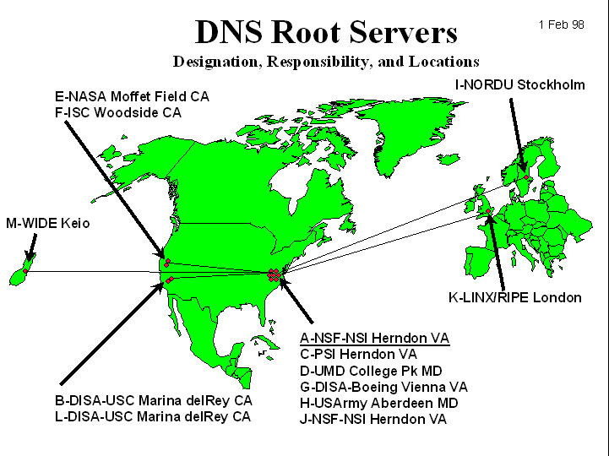
DNS: Root Name Servers
Responsible for “root” zone
Approx. dozen root name servers worldwide
  Currently {a-m}.root-servers.net
Local name servers contact root servers when they cannot resolve a name
  Configured with well-known root servers

Slide 17
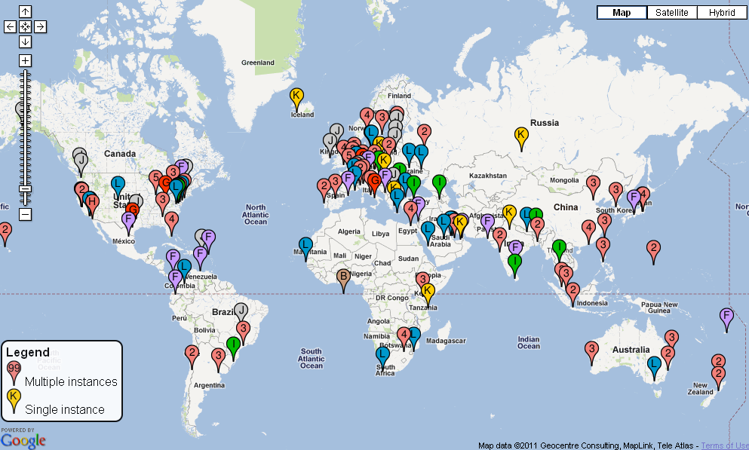
Physical Root Name Servers
  Several root servers have multiple physical servers
  Packets routed to “nearest” server by “Anycast” protocol
  346 servers total

Slide 18
Typical Resolution
root & edu
DNS server
www.cs.cmu.edu
www.cs.cmu.edu
NS ns1.cmu.edu
ns1.cmu.edu
DNS server
Local
DNS server
NS ns1.cs.cmu.edu
Client
ns1.cs.cmu.edu
DNS
server
A www=IPaddr

Slide 19
Lookup Methods
Recursive query:
Server goes out and searches for more info (recursive)
Only returns final answer or “not found”
Iterative query:
Server responds with as much as it knows (iterative)
“I don’t know this name, but ask this server”
Workload impact on choice?
Local server typically does recursive
Root/distant server does iterative
root name server
2
iterated query
3
4
7
local name server
dns.eurecom.fr
intermediate name server
dns.umass.edu
5
6
1
8
authoritative name server
dns.cs.umass.edu
requesting host
surf.eurecom.fr
gaia.cs.umass.edu

Slide 20
DNS Caching
DNS responses are cached
  Quick response for repeated translations
  Other queries may reuse some parts of lookup
    NS records for domains
DNS negative queries are cached
  Don’t have to repeat past mistakes
  E.g. misspellings, search strings in resolv.conf
Cached data periodically times out
  Lifetime (TTL) of data controlled by owner of data
  TTL passed with every record

Slide 21
Typical Resolution
root & edu
DNS server
www.cs.cmu.edu
www.cs.cmu.edu
NS ns1.cmu.edu
ns1.cmu.edu
DNS server
Local
DNS server
NS ns1.cs.cmu.edu
Client
ns1.cs.cmu.edu
DNS
server
A www=IPaddr

Slide 22
Subsequent Lookup Example
root & edu
DNS server
ftp.cs.cmu.edu
cmu.edu
DNS server
Local
DNS server
Client
ftp.cs.cmu.edu
cs.cmu.edu
DNS
server
ftp=IPaddr

Slide 23
Reliability
DNS servers are replicated
  Name service available if ≥ one replica is up
  Queries can be load balanced between replicas
UDP used for queries
  Need reliability → must implement this on top of UDP!
  Why not just use TCP?
Try alternate servers on timeout
  Exponential backoff when retrying same server

Slide 24
Discussion: Cost of Using Hierarchy
Why hierarchical name is a bad idea?
  http://www.cs.cmu.edu/index.html ➔ http://4e52/
  Stable reference (when object changes)
  Object replication
  Avoid fighting over names (typo squatting)
Potential solution: semantics-free reference
  Use DHT to map a reference to an IP
Adding another layer of “indirection”
  End-system multicast, etc

Slide 25
Next Lecture
Privacy

Slide 26
Workload and Caching
What workload do you expect for different servers/names?
  Why might this be a problem? How can we solve this problem?
DNS responses are cached
  Quick response for repeated translations
  Other queries may reuse some parts of lookup
    NS records for domains
DNS negative queries are cached
  Don’t have to repeat past mistakes
  E.g. misspellings, search strings in resolv.conf
Cached data periodically times out
  Lifetime (TTL) of data controlled by owner of data
  TTL passed with every record

Slide 27
Reverse Name Lookup
128.2.206.138?
  Lookup 138.206.2.128.in-addr.arpa
  Why is the address reversed?
  Happens to be www.intel-iris.net and mammoth.cmcl.cs.cmu.edu → what will reverse lookup return? Both?
    Should only return name that reflects address allocation mechanism

Slide 28
Prefetching
Name servers can add additional data to any response
Typically used for prefetching
  CNAME/MX/NS typically point to another host name
  Responses include address of host referred to in “additional section”

Slide 29
New Registrars
Network Solutions (NSI) used to handle all registrations, root servers, etc…
  Clearly not the democratic (Internet) way
  Large number of registrars that can create new domains → However, NSI still handle root servers

Slide 30
Do you trust the TLD operators?
Wildcard DNS record for all .com and .net domain names not yet registered by others
  September 15 – October 4, 2003
  February 2004: Verisign sues ICANN
Redirection for these domain names to Verisign web portal (SiteFinder)
What services might this break?

Slide 31
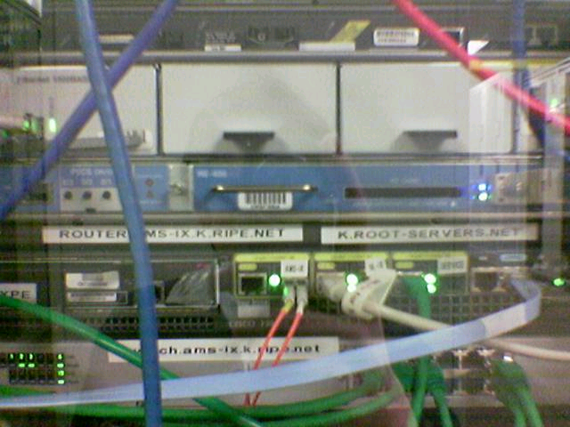
Protecting the Root Nameservers
Attack On Internet Called Largest Ever
David McGuire and Brian Krebs, Washington Post 2002-10-23
The heart of the Internet sustained its largest and most sophisticated attack ever, starting late Monday, according to officials at key online backbone organizations.
Around 5:00 p.m. EDT on Monday, a "distributed denial of service" (DDOS) attack struck the 13 "root servers" that provide the primary roadmap for almost all Internet communications. Despite the scale of the attack, which lasted about an hour, Internet users worldwide were largely unaffected, experts said.
Sophisticated?
Why did nobody notice?
seshan.org. 13759 NS www.seshan.org.
Defense Mechanisms
Redundancy: 13 root nameservers
IP Anycast for root DNS servers {c,f,i,j,k}.root-servers.net
  RFC 3258
  Most physical nameservers lie outside of the US

