Slide 1
15-744: Computer Networking
L-16 Data-Oriented Networking

Slide 2
Data-Oriented Networking Overview
In the beginning...
  First applications strictly focused on host-to-host interprocess communication:
    Remote login, file transfer, ...
  Internet was built around this host-to-host model.
  Architecture is well-suited for communication between pairs of stationary hosts.
... while today
  Vast majority of Internet usage is data retrieval and service access.
  Users care about the content and are oblivious to location. They are often oblivious as to delivery time:
    Fetching headlines from CNN, videos from YouTube, TV from Tivo
    Accessing a bank account at “www.bank.com”.

Slide 3
To the beginning...
What if you could re-architect the way “bulk” data transfer applications worked
  HTTP
  FTP
  Email
  etc.
... knowing what we know now?

Slide 4
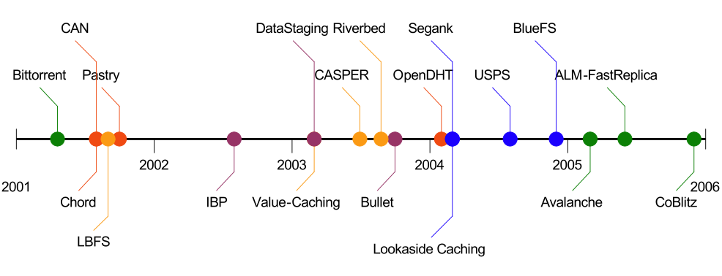
Innovation in Data Transfer is Hard
Imagine: You have a novel data transfer technique
How do you deploy?
  Update HTTP. Talk to IETF. Modify Apache, IIS, Firefox, Netscape, Opera, IE, Lynx, Wget, …
  Update SMTP. Talk to IETF. Modify Sendmail, Postfix, Outlook…
  Give up in frustration
Notes:
This is not because people don’t feel that data transfer is important. In fact, over the last few years, a number of projects have looked at the issue. To name just a few systems, you have protocols such as Bittorrent…
However, while a large body of work exists in the area, deploying these new techniques is hard. Most of the above systems have usually applied their new transfer technique within the context of particular system or application. Applying these techniques to a broad category of applications is harder.
Imagine you come up with a new way of efficiently transferring data. If you want to apply YOUR new technique to a a commonly used protocol such as HTTP. You would have to update the protocol to incorporate your changes, maybe talk to a standards body to incorporate those changes, and then go about modifying the host of systems that actually use the protocol so that they can benefit from your new ideas.
Now, if you wanted to apply your techniques to a completely different category of applications, say email, you would need to repeat the entire process.

Slide 5
Overview
Bittorrent
RE
CCN

Slide 6

Peer-to-Peer Networks: BitTorrent
BitTorrent history and motivation
  2002: B. Cohen debuted BitTorrent
  Key motivation: popular content
    Popularity exhibits temporal locality (Flash Crowds)
    E.g., Slashdot/Digg effect, CNN Web site on 9/11, release of a new movie or game
  Focused on efficient fetching, not searching
    Distribute same file to many peers
    Single publisher, many downloaders
  Preventing free-loading

Slide 7
BitTorrent: Simultaneous Downloading
Divide large file into many pieces
  Replicate different pieces on different peers
  A peer with a complete piece can trade with other peers
  Peer can (hopefully) assemble the entire file
Allows simultaneous downloading
  Retrieving different parts of the file from different peers at the same time
  And uploading parts of the file to peers
  Important for very large files

Slide 8
BitTorrent: Tracker
Infrastructure node
  Keeps track of peers participating in the torrent
Peers register with the tracker
  Peer registers when it arrives
  Peer periodically informs tracker it is still there
Tracker selects peers for downloading
  Returns a random set of peers
  Including their IP addresses
  So the new peer knows who to contact for data
Can have “trackerless” system using DHT

Slide 9
BitTorrent: Chunks
Large file divided into smaller pieces
  Fixed-sized chunks
  Typical chunk size of 256 Kbytes
Allows simultaneous transfers
  Downloading chunks from different neighbors
  Uploading chunks to other neighbors
Learning what chunks your neighbors have
  Periodically asking them for a list
File done when all chunks are downloaded

Slide 10
Self-certifying Names
A piece of data comes with a public key and a signature.
Client can verify the data did come from the principal by
  Checking the public key hashes into P, and
  Validating that the signature corresponds to the public key.
Challenge is to resolve the flat names into a location.

Slide 11
BitTorrent: Overall Architecture
Web Server
Tracker
Web page
with link
to .torrent
.torrent
C
A
Peer
[Seed]
Peer
[Leech]
Downloader
“US”
B
Peer
[Leech]

Slide 12
BitTorrent: Overall Architecture
Web Server
Tracker
Web page
with link
to .torrent
Get-announce
C
A
Peer
[Seed]
Peer
[Leech]
Downloader
“US”
B
Peer
[Leech]

Slide 13
BitTorrent: Overall Architecture
Web Server
Tracker
Web page
with link
to .torrent
Response-peer list
C
A
Peer
[Seed]
Peer
[Leech]
Downloader
“US”
B
Peer
[Leech]

Slide 14
BitTorrent: Overall Architecture
Web Server
Tracker
Web page
with link
to .torrent
Shake-hand
C
A
Peer
[Seed]
Peer
[Leech]
Downloader
“US”
Shake-hand
B
Peer
[Leech]

Slide 15
BitTorrent: Overall Architecture
Web Server
Tracker
Web page
with link
to .torrent
pieces
C
A
pieces
Peer
[Seed]
Peer
[Leech]
Downloader
“US”
B
Peer
[Leech]

Slide 16
BitTorrent: Overall Architecture
Web Server
Tracker
Web page
with link
to .torrent
pieces
C
A
pieces
Peer
[Seed]
Peer
[Leech]
Downloader
“US”
pieces
B
Peer
[Leech]

Slide 17
BitTorrent: Overall Architecture
Web Server
Tracker
Web page
with link
to .torrent
Get-announce
Response-peer list
pieces
C
A
pieces
Peer
[Seed]
Peer
[Leech]
Downloader
“US”
pieces
B
Peer
[Leech]

Slide 18
BitTorrent: Chunk Request Order
Which chunks to request?
  Could download in order
  Like an HTTP client does
Problem: many peers have the early chunks
  Peers have little to share with each other
  Limiting the scalability of the system
Problem: eventually nobody has rare chunks
  E.g., the chunks need the end of the file
  Limiting the ability to complete a download
Solutions: random selection and rarest first

Slide 19
BitTorrent: Rarest Chunk First
Which chunks to request first?
  The chunk with the fewest available copies
  I.e., the rarest chunk first
Benefits to the peer
  Avoid starvation when some peers depart
Benefits to the system
  Avoid starvation across all peers wanting a file
  Balance load by equalizing # of copies of chunks

Slide 20
Free-Riding Problem in P2P Networks
Vast majority of users are free-riders
  Most share no files and answer no queries
  Others limit # of connections or upload speed
A few “peers” essentially act as servers
  A few individuals contributing to the public good
  Making them hubs that basically act as a server
BitTorrent prevent free riding
  Allow the fastest peers to download from you
  Occasionally let some free loaders download

Slide 21
Bit-Torrent: Preventing Free-Riding
Peer has limited upload bandwidth
  And must share it among multiple peers
Prioritizing the upload bandwidth: tit for tat
  Favor neighbors that are uploading at highest rate
Rewarding the top few (e.g. four) peers
  Measure download bit rates from each neighbor
  Reciprocates by sending to the top few peers
  Recompute and reallocate every 10 seconds
Optimistic unchoking
  Randomly try a new neighbor every 30 seconds
  To find a better partner and help new nodes startup

Slide 22
BitTyrant: Gaming BitTorrent
Lots of altruistic contributors
High contributors take a long time to find good partners
Active sets are statically sized
  Peer uploads to top N peers at rate 1/N
  E.g., if N=4 and peers upload at 15, 12, 10, 9, 8, 3
  … then peer uploading at rate 9 gets treated quite well

Slide 23
BitTyrant: Gaming BitTorrent
Best to be the N^{th} peer in the list, rather than 1st
  Distribution of BW suggests 14KB/s is enough
  Dynamically probe for this value
Use saved bandwidth to expand peer set
  Choose clients that maximize download/upload ratio
Discussion
  Is “progressive tax” so bad?
  What if everyone does this?

Slide 24
BitTorrent and DHTs
Since 2005, BitTorrent supports the use of a Kademlia-based DHT (Mainline) for finding peers
Key = sha1(info section of torrent metafile)
get_peers(key) → gets a list of peers for a torrent
Each host also “puts” their own info into the DHT

Slide 25

Aside: Chunk boundaries and Rabin Fingerprinting
Hash 1
Hash 2
File Data
Rabin Fingerprints
4
7
8
2
8
Natural Boundary
Natural Boundary
Given Value - 8

Slide 26
Overview
Bittorrent
RE
CCN

Slide 27


Redundant Traffic in the Internet
Lots of redundant traffic in the Internet
Redundancy due to…
  Identical objects
  Partial content match (e.g. page banners)
  Application-headers
  …
Same content traversing same set of links
Time T + 5
Time T

Slide 28
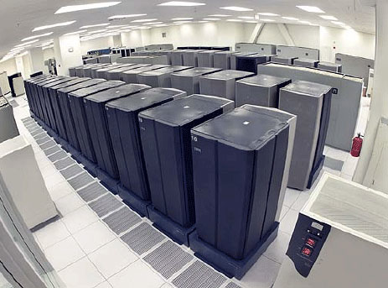
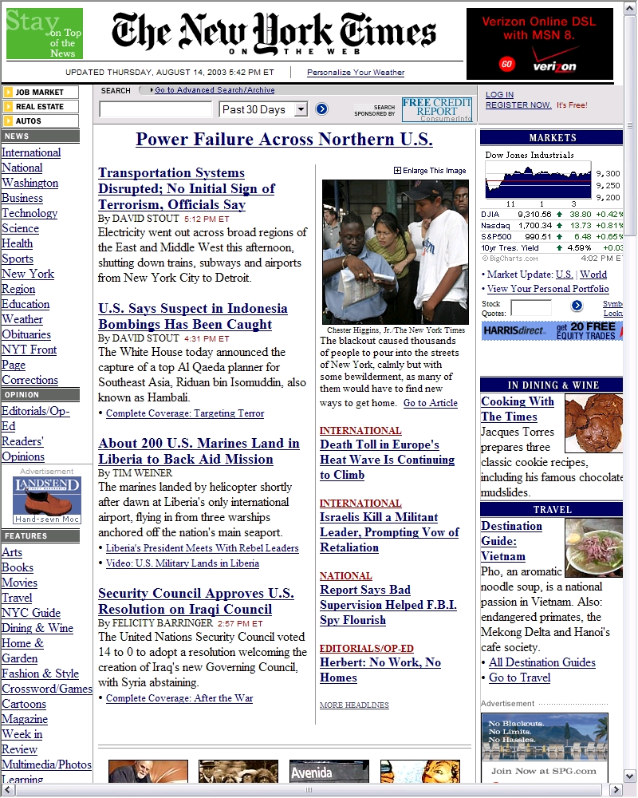









Scale link capacities by suppressing duplicates
A key idea: suppress duplicates
  Popular objects, partial content matches, backups, app headers
  Effective capacity improves ~ 2X
Many approaches
  Application-layer caches
  Protocol-independent schemes
    Below app-layer
    WAN accelerators, de-duplication
  Content distribution
    CDNs like Akamai, CORAL
    Bittorrent
Point solutions → apply to specific link, protocol, or app
Data
centers
Other svcs
(backup)
Web content
Video
Wan
Opt
Dedup/
archival
CDN
Wan
Opt
Dedup/
archival
ISP HTTP
cache
Enterprises
Mobile
users
Home users

Slide 29

Universal need to scale capacities
Point solutions inadequate
Architectural support to address universal need to scale capacities? Implications?
RE: A primitive operation supported inherently in
the network
Applies to all links, flows (long/short), apps, unicast/multicast
Transparent network service; optional end-point modifications
How? Implications?
Wan
Opt
Dedup/
archival
Bittorrent
Network Redundancy
Elimination Service
✗ Point solutions:
Other links must
re-implement specific
RE mechanisms
Point solutions:
Little or no benefit
in the core
✗ Point solutions:
Only benefit
system/app
attached
Wan
Opt
Dedup/
archival
ISP HTTP
cache

Slide 30
How? Ideas from WAN optimization
WAN link
Cache
Cache
Data center
Enterprise
Network must examine byte streams, remove duplicates, reinsert
Building blocks from WAN optimizers: RE agnostic to application, ports or flow semantics
Upstream cache = content table + fingerprint index
  Fingerprint index: content-based names for chunks of bytes in payload
  Fingerprints computed for content, looked up to identify redundant byte-strings
  Downstream cache: content table

Slide 31
Redundancy Elimination
Object-level caching
  Application layer approaches like Web proxy caches
  Store static objects in local cache
  [Summary Cache: SIGCOMM 98, Co-operative Caching: SOSP 99]
Packet-level caching
  [Spring et. al: SIGCOMM 00]
  WAN Optimization Products: Riverbed, Peribit, Packeteer, ..
Enterprise
Internet
Access link
Packet-Cache
Packet-Cache
Packet-level caching is better than object-level caching

Slide 32
Towards Universal RE
However, existing RE approaches apply only to point deployments
  E.g. at stub network access links, or between branch offices
They only benefit the system to which they are directly connected.
Why not make RE a native network service that everyone can use?

Slide 33
Universal Redundancy Elimination
At All Routers
Wisconsin
Packet cache
at every router
Total packets with universal RE= 12
(ignoring tiny packets)
Upstream router removes redundant bytes.
Downstream router reconstructs full packet
Internet2
Total packets
w/o RE = 18
33%
CMU
Berkeley

Slide 34
Benefits of Universal Redundancy Elimination
Subsumes benefits of point deployments
Also benefits Internet Service Providers
  Reduces total traffic carried ➔ better traffic engineering
  Better responsiveness to sudden overload (e.g. flash crowds)
Re-design network protocols with redundancy elimination in mind ➔ Further enhance the benefits of universal RE

Slide 35
Redundancy-Aware Routing
Wisconsin
ISP needs information of traffic similarity between CMU and Berkeley
ISP needs to compute redundancy-aware routes
Total packets with RE = 12
Total packets with RE + routing= 10
(Further 20% benefit )
45%
CMU
Berkeley

Slide 36
Overview
Bittorrent
RE
CCN

Slide 37
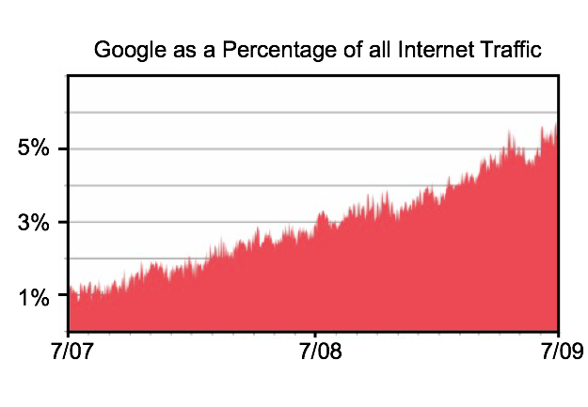
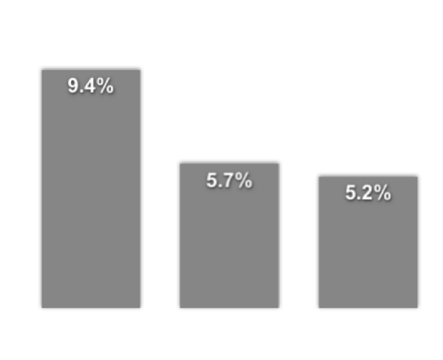
Google…
Biggest content source
Third largest ISP
Level(3)
Global
Crossing
Google
source: ‘ATLAS’ Internet Observatory 2009 Annual Report’, C. Labovitz et.al.

Slide 38
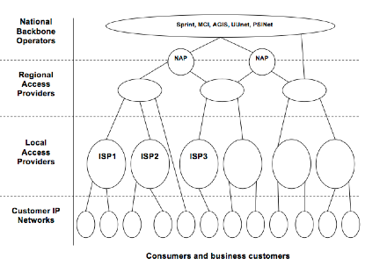
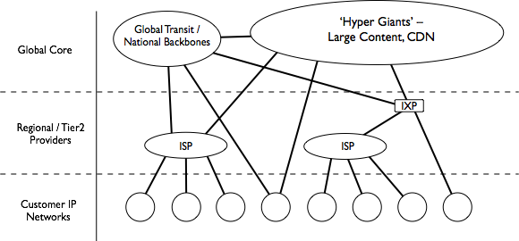
1995 - 2007:
Textbook Internet
2009:
Rise of the
Hyper Giants
source: ‘ATLAS’ Internet Observatory 2009 Annual Report’, C. Labovitz et.al.

Slide 39




What does the network look like…
ISP
ISP

Slide 40

What should the network look like…
ISP
ISP

Slide 41
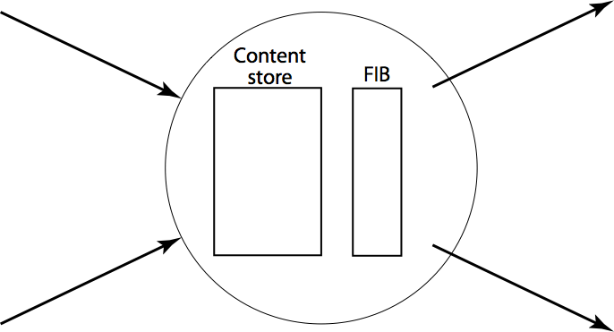


CCN Model
Data
Packets say ‘what’ not ‘who’ (no src or dst)
communication is to local peer(s)
upstream performance is measurable
memory makes loops impossible

Slide 42
Names
Like IP, CCN imposes no semantics on names.
‘Meaning’ comes from application, institution and global conventions:
/parc.com/people/van/presentations/CCN
/parc.com/people/van/calendar/freeTimeForMeeting
/thisRoom/projector
/thisMeeting/documents
/nearBy/available/parking
/thisHouse/demandReduction/2KW

Slide 43
CCN Names/Security
⎧
⎪
⎨
⎪
⎩
/nytimes.com/web/frontPage/v20100415/s0/0x3fdc96a4...
signature
0x1b048347
key
nytimes.com/web/george/desktop public key
⎧
⎪
⎨
⎪
⎩
Signed by nytimes.com/web/george
⎧
⎪
⎨
⎪
⎩
Signed by nytimes.com/web
Signed by nytimes.com
Per-packet signatures using public key
  Packet also contain link to public key

Slide 44
Names Route Interests
FIB lookups are longest match (like IP prefix lookups) which helps guarantee log(n) state scaling for globally accessible data.
Although CCN names are longer than IP identifiers, their explicit structure allows lookups as efficient as IP’s.
Since nothing can loop, state can be approximate (e.g., bloom filters).

Slide 45
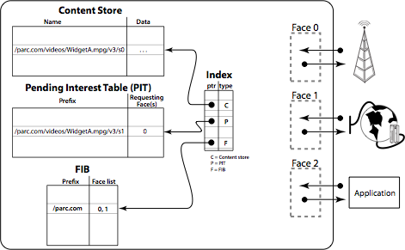
CCN node model

Slide 46
CCN node model
get /parc.com/videos/WidgetA.mpg/v3/s2
P
/parc.com/videos/WidgetA.mpg/v3/s2 0

Slide 47
Flow/Congestion Control
One Interest pkt → one data packet
All xfers are done hop-by-hop – so no need for congestion control
Sequence numbers are part of the name space

Slide 48
“But ...
“this doesn’t handle conversations or realtime.
  Yes it does - see ReArch VoCCN paper.
“this is just Google.
  This is IP-for-content. We don’t search for data, we route to it.
“this will never scale.
  Hierarchically structured names give same log(n) scaling as IP but CCN tables can be much smaller since multi-source model allows inexact state (e.g., Bloom filter).

Slide 49
What about connections/VoIP?
Key challenge - rendezvous
Need to support requesting ability to request content that has not yet been published
E.g., route request to potential publishers, and have them create the desired content in response

Slide 50
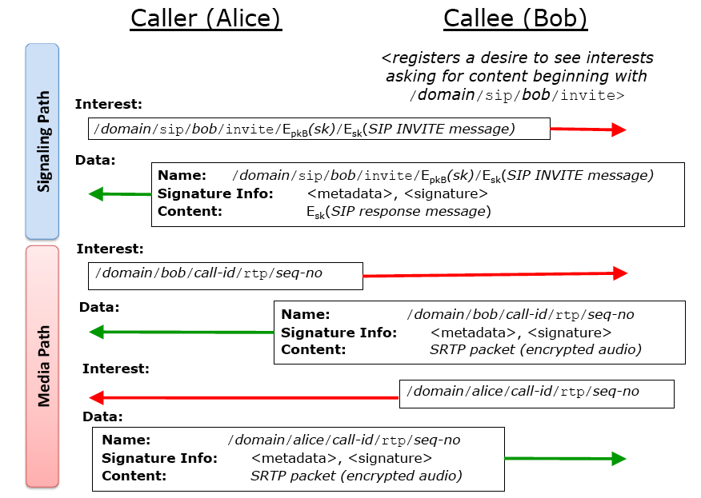

Slide 51
Summary
Applications
Limits Application Innovation
Applications
Innovation
Moving up the
UDP
TCP
Transport
(TCP/Other)
‘Thin Waist’
Network (IP/Other)
Increases Data Delivery Flexibility
Data Link
Data Link
Flexibility
Physical
Physical
The Hourglass Model
The Hourglass Model

Slide 52
Next Lecture
DNS, Web and CDNs
Reading:
  TBD – will be updated soon

Slide 54
Outline
DTNs

Slide 55
Unstated Internet Assumptions
Some path exists between endpoints
  Routing finds (single) “best” existing route
E2E RTT is not very large
  Max of few seconds
  Window-based flow/cong ctl. work well
E2E reliability works well
  Requires low loss rates
Packets are the right abstraction
  Routers don’t modify packets much
  Basic IP processing

Slide 56
New Challenges
Very large E2E delay
  Propagation delay = seconds to minutes
  Disconnected situations can make delay worse
Intermittent and scheduled links
  Disconnection may not be due to failure (e.g. LEO satellite)
  Retransmission may be expensive
Many specialized networks won’t/can’t run IP

Slide 57
IP Not Always a Good Fit
Networks with very small frames, that are connection-oriented, or have very poor reliability do not match IP very well
  Sensor nets, ATM, ISDN, wireless, etc
IP Basic header – 20 bytes
  Bigger with IPv6
Fragmentation function:
  Round to nearest 8 byte boundary
  Whole datagram lost if any fragment lost
  Fragments time-out if not delivered (sort of) quickly

Slide 58
IP Routing May Not Work
End-to-end path may not exist
  Lack of many redundant links [there are exceptions]
  Path may not be discoverable [e.g. fast oscillations]
  Traditional routing assumes at least one path exists, fails otherwise
Insufficient resources
  Routing table size in sensor networks
  Topology discovery dominates capacity
Routing algorithm solves wrong problem
  Wireless broadcast media is not an edge in a graph
  Objective function does not match requirements
    Different traffic types wish to optimize different criteria
    Physical properties may be relevant (e.g. power)

Slide 59
What about TCP?
Reliable in-order delivery streams
Delay sensitive [6 timers]:
  connection establishment, retransmit, persist, delayed-ACK, FIN-WAIT, (keep-alive)
Three control loops:
  Flow and congestion control, loss recovery
Requires duplex-capable environment
  Connection establishment and tear-down

Slide 60
Performance Enhancing Proxies
Perhaps the bad links can be ‘patched up’
  If so, then TCP/IP might run ok
  Use a specialized middle-box (PEP)
Types of PEPs [RFC3135]
  Layers: mostly transport or application
  Distribution
  Symmetry
  Transparency

Slide 61
TCP PEPs
Modify the ACK stream
  Smooth/pace ACKS → avoids TCP bursts
  Drop ACKs → avoids congesting return channel
  Local ACKs → go faster, goodbye e2e reliability
  Local retransmission (snoop)
  Fabricate zero-window during short-term disruption
Manipulate the data stream
  Compression, tunneling, prioritization

Slide 62
Architecture Implications of PEPs
End-to-end “ness”
  Many PEPs move the ‘final decision’ to the PEP rather than the endpoint
  May break e2e argument [may be ok]
Security
  Tunneling may render PEP useless
  Can give PEP your key, but do you really want to?
Fate Sharing
  Now the PEP is a critical component
Failure diagnostics are difficult to interpret

Slide 63
Architecture Implications of PEPs [2]
Routing asymmetry
  Stateful PEPs generally require symmetry
  Spacers and ACK killers don’t
Mobility
  Correctness depends on type of state
  (similar to routing asymmetry issue)

Slide 64
Delay-Tolerant Networking Architecture
Goals
  Support interoperability across ‘radically heterogeneous’ networks
  Tolerate delay and disruption
    Acceptable performance in high loss/delay/error/disconnected environments
    Decent performance for low loss/delay/errors
Components
  Flexible naming scheme
  Message abstraction and API
  Extensible Store-and-Forward Overlay Routing
  Per-(overlay)-hop reliability and authentication

Slide 65
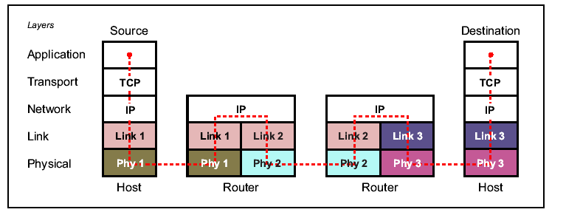
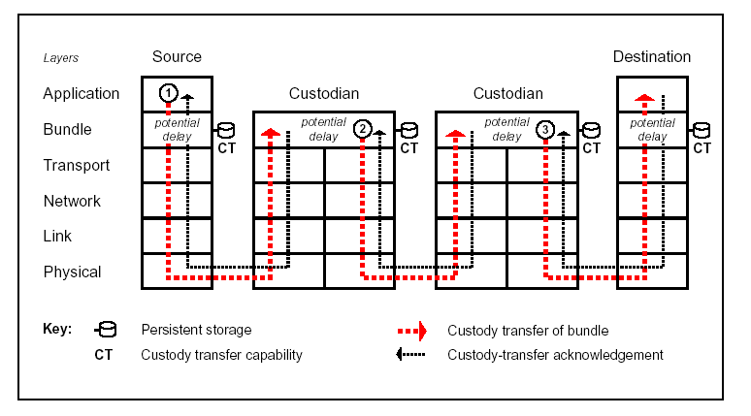
Disruption Tolerant Networks

Slide 66
Disruption Tolerant Networks

Slide 67
Naming Data (DTN)
Endpoint IDs are processed as names
  refer to one or more DTN nodes
  expressed as Internet URI, matched as strings
URIs
  Internet standard naming scheme [RFC3986]
  Format: <scheme> : <SSP>
SSP can be arbitrary, based on (various) schemes
More flexible than DOT/DONA design but less secure/scalable

Slide 68
Naming
Support ‘radical heterogeneity’ using URI’s:
  {scheme ID (allocated), scheme-specific-part}
  associative or location-based names/addresses optional
  Variable-length, can accommodate “any” net’s names/addresses
Endpoint IDs:
  multicast, anycast, unicast
Late binding of EID permits naming flexibility:
  EID “looked up” only when necessary during delivery
  contrast with Internet lookup-before-use DNS/IP

Slide 69
Message Abstraction
Network protocol data unit: bundles
  “postal-like” message delivery
  coarse-grained CoS [4 classes]
  origination and useful life time [assumes sync’d clocks]
  source, destination, and respond-to EIDs
  Options: return receipt, “traceroute”-like function, alternative reply-to field, custody transfer
  fragmentation capability
  overlay atop TCP/IP or other (link) layers [layer ‘agnostic’]
Applications send/receive messages
  “Application data units” (ADUs) of possibly-large size
  Adaptation to underlying protocols via ‘convergence layer’
  API includes persistent registrations

Slide 70
DTN Routing
DTN Routers form an overlay network
  only selected/configured nodes participate
  nodes have persistent storage
DTN routing topology is a time-varying multigraph
  Links come and go, sometimes predictably
  Use any/all links that can possibly help (multi)
  Scheduled, Predicted, or Unscheduled Links
    May be direction specific [e.g. ISP dialup]
    May learn from history to predict schedule
Messages fragmented based on dynamics
  Proactive fragmentation: optimize contact volume
  Reactive fragmentation: resume where you failed

Slide 71



Example Routing Problem
2
Internet
City
bike
3
1
Village

Slide 72
Example Graph Abstraction
Village 2
City
Village 1
bike (data mule)
intermittent high capacity
time (days)
Geo satellite
medium/low capacity
bike
bandwidth
satellite
dial-up link
low capacity
phone
Connectivity: Village 1 – City

Slide 73
So, is this just e-mail?
Many similarities to (abstract) e-mail service
Primary difference involves routing, reliability and security
E-mail depends on an underlying layer’s routing:
  Cannot generally move messages ‘closer’ to their destinations in a partitioned network
  In the Internet (SMTP) case, not disconnection-tolerant or efficient for long RTTs due to “chattiness”
E-mail security authenticates only user-to-user

Slide 74
Interoperability: Datagrams vs. Data Blocks
 | Datagrams | Data Blocks
What must be standardized? | IP Addresses Name→Address translation (DNS) | Data Labels Name → Label translation (Google?)
Application Support | Exposes much of underlying network’s capability | Practice has shown that this is what applications need
Lower Layer Support | Supports arbitrary links Requires end-to-end connectivity | Supports arbitrary links Supports arbitrary transport Support storage (both in-network and for transport)

Slide 76

Performance: Opportunistically Aggregate Upstream Bandwidth
Neighbors decide whether to ship the
pieces upstream
Sender broadcasts
to available neighbors
Challenges:
  Multi-hop: decide whether to send upstream or forward one extra hop
  Requires both data-oriented design and opportunistic forwarding

Slide 77
The DTN Routing Problem
Inputs: topology (multi)graph, vertex buffer limits, contact set, message demand matrix (w/priorities)
An edge is a possible opportunity to communicate:
  One-way: (S, D, c(t), d(t))
  (S, D): source/destination ordered pair of contact
  c(t): capacity (rate); d(t): delay
  A Contact is when c(t) > 0 for some period [i_{k},i_{k+1}]
Vertices have buffer limits; edges in graph if ever in any contact, multigraph for multiple physical connections
Problem: optimize some metric of delivery on this structure
  Sub-questions: what metric to optimize?, efficiency?

Slide 78
Knowledge-Performance Tradeoff
Algorithm
Oracle
LP
Higher performance, higher complexity
Contacts
+
Queuing
+
Traffic
EDAQ
EDLQ
Contacts
+
Queuing
(global)
Performance
Contacts
+
Queuing
(local)
ED
MED
Contacts
FC
Contacts
Summary
None
Use of Knowledge Oracles
Notes:
MED == Minimized expected delay E[everything over time]
ED, EDLQ, EDAQ: Dijkstra w/ different weight fn
If ED -> EDLQ immediate
Weakness: all require pretty good contact knowledge
NOTE: FC missing from slides

Slide 79
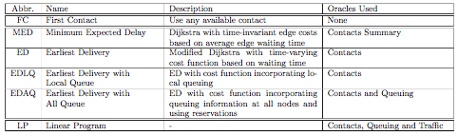
Knowledge-Performance Tradeoff

Slide 80
Routing Solutions - Replication
“Intelligently” distribute identical data copies to contacts to increase chances of delivery
  Flooding (unlimited contacts)
  Heuristics: random forwarding, history-based forwarding, predication-based forwarding, etc. (limited contacts)
Given “replication budget”, this is difficult
  Using simple replication, only finite number of copies in the network [Juang02, Grossglauser02, Jain04, Chaintreau05]
  Routing performance (delivery rate, latency, etc.) heavily dependent on “deliverability” of these contacts (or predictability of heuristics)
  No single heuristic works for all scenarios!
Notes:
Long delays could be incurred if the contacts selected don’t see the destination in the near future.

Slide 81
Using Erasure Codes
Rather than seeking particular “good” contacts, “split” messages and distribute to more contacts to increase chance of delivery
  Same number of bytes flowing in the network, now in the form of coded blocks
  Partial data arrival can be used to reconstruct the original message
    Given a replication factor of r, (in theory) any 1/r code blocks received can be used to reconstruct original data
  Potentially leverage more contacts opportunity that result in lowest worse-case latency
Intuition:
  Reduces “risk” due to outlier bad contacts
Notes:
High-level overview. However, in reality, we need to take those factors into consideration. We plan to look at these issues in future work.

Slide 82
Erasure Codes
Message n blocks
Encoding
Opportunistic Forwarding
Decoding
Message n blocks

Slide 83
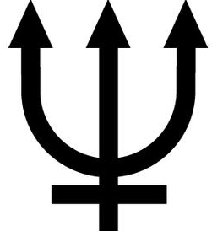
DTN Security
Bundle Agent

Bundle Application


Source
Destination
Receiver/
Sender



BAH
BAH
BAH
BAH
Sender
Receiver/
Sender
Receiver/
Sender
Security Policy Router
(may check PSH value)
PSH
Payload Security Header (PSH) end-to-end security header
Bundle Authentication Header (BAH) hop-by-hop security header
credit: MITRE

Slide 85
Naming Data (DONA)
Names organized around principals.
Names are of the form P : L.
  P is cryptographic hash of principal’s public key, and
  L is a unique label chosen by the principal.
Granularity of naming left up to principals.
Names are “flat”.

Slide 86
Name Resolution (DONA)
Resolution infrastructure consists of Resolution Handlers.
  Each domain will have one logical RH.
Two primitives FIND(P:L) and REGISTER(P:L).
  FIND(P:L) locates the object named P:L.
  REGISTER messages set up the state necessary for the RHs to route FINDs effectively.

Slide 87
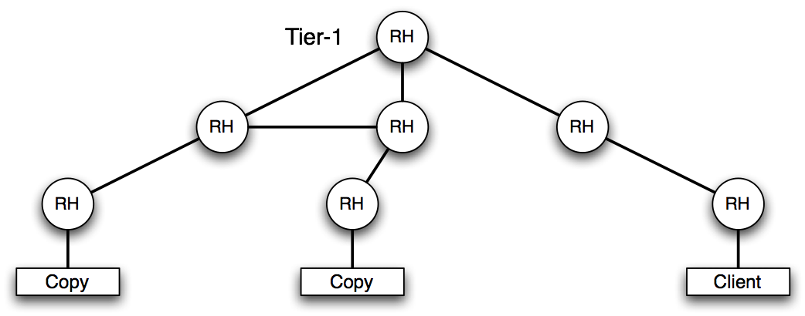
Locating Data (DONA)
REGISTER state
FIND being routed

Slide 88
Establishing REGISTER state
Any machine authorized to serve a datum or service with name P:L sends a REGISTER(P:L) to its first-hop RH
RHs maintain a registration table that maps a name to both next-hop RH and distance (in some metric)
REGISTERs are forwarded according to interdomain policies.
  REGISTERs from customers to both peers and providers.
  REGISTERs from peers optionally to providers/peers.

Slide 89
Forwarding FIND(P:L)
When FIND(P:L) arrives to a RH:
  If there’s an entry in the registration table, the FIND is sent to the next-hop RH.
  If there’s no entry, the RH forwards the FIND towards to its provider.
In case of multiple equal choices, the RH uses its local policy to choose among them.

Slide 90
Redundancy Elimination
Object-level caching
  Application layer approaches like Web proxy caches
  Store static objects in local cache
  [Summary Cache: SIGCOMM 98, Co-operative Caching: SOSP 99]
Packet-level caching
  [Spring et. al: SIGCOMM 00]
  WAN Optimization Products: Riverbed, Peribit, Packeteer, ..
Enterprise
Internet
Access link
Packet-Cache
Packet-Cache
Packet-level caching is better than object-level caching

Slide 91
Towards Universal RE
However, existing RE approaches apply only to point deployments
  E.g. at stub network access links, or between branch offices
They only benefit the system to which they are directly connected.
Why not make RE a native network service that everyone can use?

Slide 92
From WAN acceleration to router packet caches
Wisconsin
Packet cache
at every router
Router upstream removes redundant bytes
Router downstream reconstructs full packet
Network RE service: apply protocol-indep RE at the packet-level on network links
→ IP-layer RE service
Internet2
(Hop-by-hop works for
slow links
Alternate approaches to scale to faster links…)
CMU
Berkeley

Slide 93
Outline
RE
DOT
CCN
DTNs

Slide 94

Data-Oriented Network Design
USB
USB
Xfer
NET
wireless
Xfer
NET
Multi-path
Internet
NET
( DSL )
SENDER
RECEIVER
Features
NET
Xfer
Multipath and Mirror support
CACHE
Store-carry-forward

Slide 95
New Approach: Adding to the Protocol Stack
ALG
Application
Middleware
Object Exchange
Data Transfer
Transport
Network
Router
Data Link
Bridge
Physical
Software-defined radio
Internet Protocol Layers
Notes:
Application layer gateways (ALGs) are one way. The tend to be specific to the protocols being interconnected.

Slide 96
Data Transfer Service
Sender
Application Protocol
Receiver
and Data
Xfer Service
Xfer Service
Data
Transfer Service responsible for finding/transferring data
  Transfer Service is shared by applications
How are users, hosts, services, and data named?
How is data secured and delivered reliably?
How are legacy systems incorporated?
Notes:
We believe that a possible solution to this problem is the creation of a transfer service.

Slide 97


Naming Data (DOT)
Application defined names are not portable
Use content-naming for globally unique names
Objects represented by an OID
Objects are further sub-divided into “chunks”
Secure and scalable!
Foo.txt
OID
Cryptographic Hash
Desc1
File
Desc2
Desc3

Slide 98
Naming Data (DOT)
All objects are named based only on their data
Objects are divided into chunks based only on their data
Object “A” is named the same
  Regardless of who sends it
  Regardless of what application deals with it
Similar parts of different objects likely to be named the same
  e.g., PPT slides v1, PPT slides v1 + extra slides
  First chunks of these objects are same
98

Slide 99

Locating Data (DOT)
Request File X
OID, Hints
Sender
Receiver
put(X)
OID, Hints
read() data
get(OID, Hints)
Transfer
Plugins
Xfer Service
Xfer Service

