Slide 1
15-744: Computer Networking
L-14 Data Center Networking III

Slide 2
Overview
Data Center Electric/Hybrid Networks
Data Center Transport
Data Center Scheduling

Slide 3

Design requirements
Traffic demands
Control plane:
  Traffic demand estimation
  Optical circuit configuration
Data plane:
  Dynamic traffic de-multiplexing
  Optimizing circuit utilization (optional)
Notes:
How can we manage optical circuits over such a hybrid network? We identify a set of design requirements that are needed.
On the control plane, we need to collect dynamic traffic demand and config …
When optical paths are provisioned, there exist two paths among different server racks. So on the data plane, we need to de-multiplex traffic to different network dynamically based on the current configuration. When optical paths are provisioned, applications may not be able to send fast enough to leverage optical paths. So the improve system performance, we also need to optimize circuit utilization. But this requirement is optional, the system can still work with out this.

Slide 4
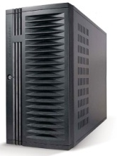
c-Through (a specific design)
No modification to applications and switches
Leverage end-hosts for traffic management
Centralized control for circuit configuration
Notes:
There is many design choice to accomplish these design requirements. We have a detailed discussion in the paper about the design choices and their trade-offs. Please refer to the paper for the discussion. Here I will go directly to a specific system, called c-Through, we have built to manage optical circuits in a hybrid network. The design strategy for c-Through system is:
C-Through use a centralized controller for …, c-Through does not need any modification on …, it leverage end-hosts in the traffic management.

Slide 5
c-Through - traffic demand estimation and traffic batching
Applications
Per-rack traffic demand vector
1. Transparent to applications.
Socket buffers
2. Packets are buffered per-flow
to avoid HOL blocking.
Accomplish two requirements:
  Traffic demand estimation
  Pre-batch data to improve optical circuit utilization
Notes:
c-Through estimate traffic demands by simply enlarge output buffer limits of sockets. When an application is trying to send a large amount of data and network bandwidth is not enough, the data will be queued up in socket output buffers. But look at the occupancy of socket output buffer, we can infer which flow has high traffic demands. Then we can aggregate the socket buffer occupancy based on the destination rack to get a per-rack traffic demand vector. For example, in this vector, darker color means high traffic demands for a particular destination rack.
This technique is transparent to …, packets are buffered … But with this simple technique, we can accomplish two-requirements: (1) traffic demand estimation (2) Socket buffers can be used to pre-batch data when optical path is not available. When optical path is provisioned, we can release the data quickly to optical path to improve circuit utilization.

Slide 6
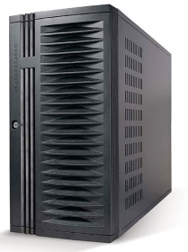
c-Through - optical circuit configuration
configuration
Traffic demand
Controller
configuration
Use Edmonds’ algorithm to compute optimal configuration
Many ways to reduce the control traffic overhead
Notes:
>2min too long !!!
C-Through use a centralize controller to collect traffic demands and configure optical circuits. The controller collect per-rack traffic demand vector from all the servers and aggregate them into a cross-rack traffic matrix. Then it compute a optimal configuration that can maximize the traffic volume that can be offload to optical network using a polynomial Edmonds’ alg. Everytime when the optical circuits are reconfigured, it will notified servers to tear down the path and configure it and then notify them about the new configuration. In a large data center, there could a significant overhead for the control traffic. But many ways can be used to reduce the overhead of control traffic.
For example, for traffic demand collection, servers only need to send to the controller when the demands change dramatically, traffic demand vectors can be aggregated within rack first, then send to the control. The configuration notification can be done using multicast.

Slide 7
c-Through - traffic de-multiplexing
VLAN-based network isolation:
  No need to modify switches
  Avoid the instability caused by circuit reconfiguration
VLAN #1
VLAN #2
traffic
circuit configuration
Traffic control on hosts:
  Controller informs hosts about the circuit configuration
  End-hosts tag packets accordingly
Traffic
de-multiplexer
VLAN #1
VLAN #2
Notes:
When optical path are configured, c-Through uses two techniques to realize traffic de-multiplexing.
First, we configure VLAN on all the ToR switches to isolate the electrical network and optical network into different VLANs.
As we mentioned before, it is a dynamic network. When optical circuits are reconfigured, the network topology is changing. If optical network and electrical network is organized into a unified network, this topology changes can cause instability in the control protocols in electrical network, such as spanning tree..
We isolate network to avoid the potential network instability caused by circuit reconfiguration.
C-Through leverage end-hosts to perform traffic de-multiplexing. Each server is configured with two virtual interface with VLAN1 and VLAN2 that mapping to electrical network and optical network. Everytime optical path is configured, controller will inform hosts about the current configuration. So a traffic de-multiplexer will tag packets accordingly to send them into appropriate network.

Slide 8
Overview
Data Center Electric/Hybrid Networks
Data Center Transport
Data Center Scheduling

Slide 9

Data Center Packet Transport
Large purpose-built DCs
  Huge investment: R&D, business
Transport inside the DC
  TCP rules (99.9% of traffic)
How’s TCP doing?

Slide 10
TCP in the Data Center
We’ll see TCP does not meet demands of apps.
  Suffers from bursty packet drops, Incast [SIGCOMM ‘09], ...
  Builds up large queues:
    Adds significant latency.
    Wastes precious buffers, esp. bad with shallow-buffered switches.
Operators work around TCP problems.
  Ad-hoc, inefficient, often expensive solutions
  No solid understanding of consequences, tradeoffs

Slide 11







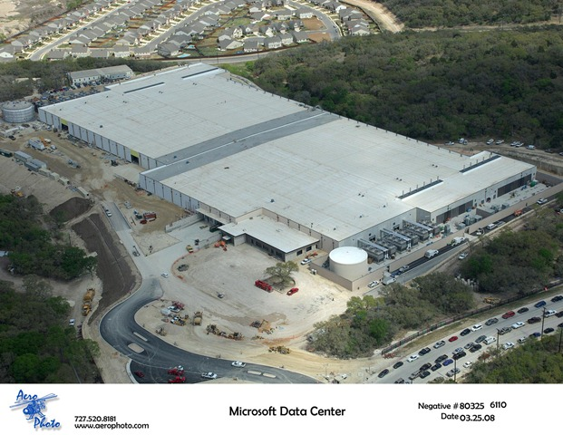










Partition/Aggregate Application Structure
1.
Picasso
Art is…
TLA
Deadline = 250ms
2. Art is a lie…
3.
…..
Picasso
Time is money
  Strict deadlines (SLAs)
Missed deadline
  Lower quality result
MLA
………
MLA
1. Art is a lie…
1.
Deadline = 50ms
2.
2. The chief…
…..
3.
…..
3.
“Bad artists copy.
Good artists steal.”
“The chief enemy of creativity is good sense.“
“I'd like to live as a poor man
with lots of money.“
“Computers are useless.
They can only give you answers.”
“Everything you can imagine is real.”
“It is your work in life that is the ultimate seduction.“
“Inspiration does exist,
but it must find you working.”
“Art is a lie that makes us
realize the truth.
Deadline = 10ms
Worker Nodes

Slide 12
Generality of Partition/Aggregate
The foundation for many large-scale web applications.
  Web search, Social network composition, Ad selection, etc.
Example: Facebook
  Partition/Aggregate ~ Multiget
  Aggregators: Web Servers
  Workers: Memcached Servers
Internet
Web
Servers
Memcached Protocol
Memcached Servers

Slide 13



Workloads
Partition/Aggregate
(Query)
Short messages [50KB-1MB]
(Coordination, Control state)
Large flows [1MB-50MB]
(Data update)
Delay-sensitive
Delay-sensitive
Throughput-sensitive
Notes:
Replace PDF

Slide 14


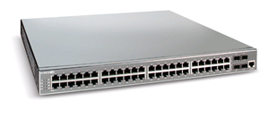
Incast: Cluster-based Storage Systems
Synchronized Read
1
R
R
R
R
2
Client
Switch
3
1
2
3
4
Server
Request Unit
(SRU)
Client now sends
next batch of requests
4
Storage
Servers
Data Block
Notes:
Data is striped across multiple servers for reliability (coding/replication) and performance. Also aids in incremental scalability.
To read this data a client performs a “Synchronized Read” operation.
The client reads data one data-block at a time. The portion of a data block stored by each server is called a SRU (in our terminology)
- mention that this setting is simplistic
- could have multiple clients, multiple outstanding blocks,
- describe sending of requests, responses
- the client sends out the next batch of requests only after it has received the entire data block (barrier synchronized)
To test how this read operation performs in the real world as we increase the number of servers on which we stripe data … (next slide)

Slide 15

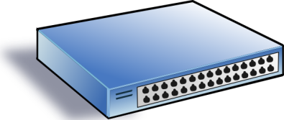
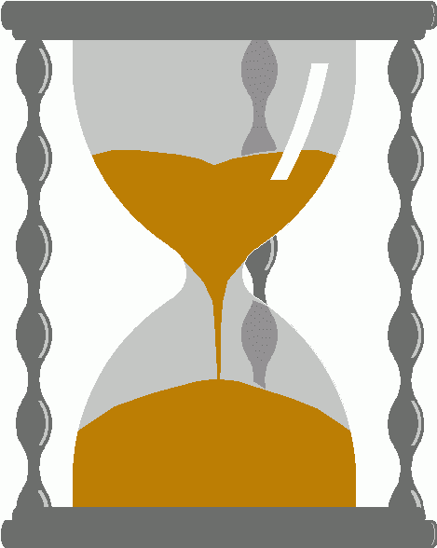
Incast
Worker 1
Synchronized mice collide.
  Caused by Partition/Aggregate.
Aggregator
Worker 2
Worker 3
RTO_{min} = 300 ms
Worker 4
TCP timeout

Slide 16
Queue Buildup
Sender 1
Big flows buildup queues.
  Increased latency for short flows.
Receiver
Sender 2
Measurements in Bing cluster
  For 90% packets: RTT < 1ms
  For 10% packets: 1ms < RTT < 15ms

Slide 17
Data Center Transport Requirements
High Burst Tolerance
  Incast due to Partition/Aggregate is common.
Low Latency
  Short flows, queries
3. High Throughput
  Continuous data updates, large file transfers
The challenge is to achieve these three together.

Slide 18
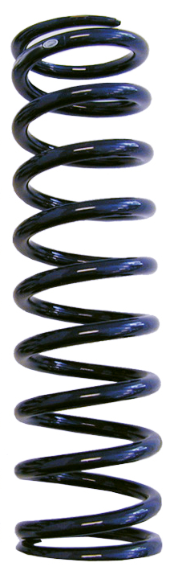
Tension Between Requirements
High Throughput
High Burst Tolerance
Low Latency
Deep Buffers:
Queuing Delays
Increase Latency
Shallow Buffers:
Bad for Bursts &
Throughput
Objective:
Low Queue Occupancy & High Throughput
Reduced RTO_{min} (SIGCOMM ‘09)
Doesn’t Help Latency
AQM – RED:
Avg Queue Not Fast
Enough for Incast
Notes:
Deep Buffers – bad for latency
Shallow Buffers – bad for bursts & throughput
Reduce RTO_{min} – no good for latency
AQM – Difficult to tune, not fast enough for incast-style micro-bursts, lose throughput in low stat-mux

Slide 19
Review: The TCP/ECN Control Loop
Sender 1
ECN = Explicit Congestion Notification
ECN Mark (1 bit)
Receiver
Sender 2
Notes:
DCTCP is based on the existing Explicit Congestion Notification framework in TCP.

Slide 20
Two Key Ideas
React in proportion to the extent of congestion, not its presence.
  Reduces variance in sending rates, lowering queuing requirements.
Mark based on instantaneous queue length.
  Fast feedback to better deal with bursts.
ECN Marks | TCP | DCTCP
1 0 1 1 1 1 0 1 1 1 | Cut window by 50% | Cut window by 40%
0 0 0 0 0 0 0 0 0 1 | Cut window by 50% | Cut window by 5%

Slide 21
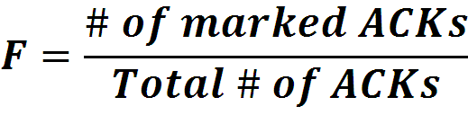

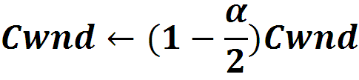
Data Center TCP Algorithm
B
K
Don’t
Mark
Switch side:
  Mark packets when Queue Length > K.
Mark
  Sender side:
  Maintain running average of fraction of packets marked (α).
  In each RTT:
Adaptive window decreases:
  Note: decrease factor between 1 and 2.
Notes:
very simple marking mechanism
not all the tunings other aqms have
on the source side, the source is tryign to estimate the fraction of packets getting marked
using the obs that there is a stream of ecn marks coming back – more info in the stream than in any single bit
trying to maintain smooth rate variations to operate well even when using shallow buffers, and only a few flows (no stat mux)
F over the last RTT. In TCP there is always a way to get the next RTT from the window size. Comes from the self-clocking of TCP.
Only changing the decrease. Simplest version – makes a lot of sense. So generic could apply it to any algorithm – CTCP, CUBIC – how to cut its window leaving increase part to what it already does. Have to be careful here.

Slide 22
DCTCP in Action
(Kbytes)
Setup: Win 7, Broadcom 1Gbps Switch
Scenario: 2 long-lived flows, K = 30KB
Notes:
Not ns2.

Slide 23
Why it Works
High Burst Tolerance
  Large buffer headroom → bursts fit.
  Aggressive marking → sources react before packets are dropped.
Low Latency
  Small buffer occupancies → low queuing delay.
3. High Throughput
  ECN averaging → smooth rate adjustments, low variance.

Slide 24
Conclusions
DCTCP satisfies all our requirements for Data Center packet transport.
  Handles bursts well
  Keeps queuing delays low
  Achieves high throughput
Features:
  Very simple change to TCP and a single switch parameter.
  Based on mechanisms already available in Silicon.

Slide 25
Overview
Data Center Electric/Hybrid Networks
Data Center Transport
Data Center Scheduling

Slide 26



Datacenters and OLDIs
OLDI = OnLine Data Intensive applications
  e.g., Web search, retail, advertisements
An important class of datacenter applications
Vital to many Internet companies
OLDIs are critical datacenter applications

Slide 27
OLDIs
Partition-aggregate
  Tree-like structure
  Root node sends query
  Leaf nodes respond with data
Deadline budget split among nodes and network
  E.g., total = 300 ms, parents-leaf RPC = 50 ms
Missed deadlines
  incomplete responses
  affect user experience & revenue

Slide 28
Challenges Posed by OLDIs
  Two important properties:
  Deadline bound (e.g., 300 ms)
    Missed deadlines affect revenue
  Fan-in bursts
  Large data, 1000s of servers
    Tree-like structure (high fan-in)
    Fan-in bursts → long “tail latency”
Network shared with many apps (OLDI and non-OLDI)
Network must meet deadlines & handle fan-in bursts

Slide 29
Current Approaches
TCP: deadline agnostic, long tail latency
  Congestion → timeouts (slow), ECN (coarse)
Datacenter TCP (DCTCP) [SIGCOMM '10]
first to comprehensively address tail latency
Finely vary sending rate based on extent of congestion
shortens tail latency, but is not deadline aware
  ~25% missed deadlines at high fan-in & tight deadlines
DCTCP handles fan-in bursts, but is not deadline-aware

Slide 30
D²TCP
Deadline-aware and handles fan-in bursts
Key Idea: Vary sending rate based on both deadline and extent of congestion
  Built on top of DCTCP
  Distributed: uses per-flow state at end hosts
  Reactive: senders react to congestion
    no knowledge of other flows

Slide 31
D²TCP’s Contributions
Deadline-aware and handles fan-in bursts
  Elegant gamma-correction for congestion avoidance
    far-deadline → back off more
    near-deadline → back off less
  Reactive, decentralized, state (end hosts)
Does not hinder long-lived (non-deadline) flows
Coexists with TCP → incrementally deployable
No change to switch hardware → deployable today
D²TCP achieves 75% and 50% fewer missed
deadlines than DCTCP and D³

Slide 32
Coflow Definition

Slide 41
Data Center Summary
Topology
  Easy deployment/costs
  High bi-section bandwidth makes placement less critical
  Augment on-demand to deal with hot-spots
Scheduling
  Delays are critical in the data center
  Can try to handle this in congestion control
  Can try to prioritize traffic in switches
  May need to consider dependencies across flows to improve scheduling

Slide 42
Review
Networking background
  OSPF, RIP, TCP, etc.
Design principles and architecture
  E2E and Clark
Routing/Topology
  BGP

Slide 43
Review
Resource allocation
  Congestion control and TCP performance
  FQ/CSFQ/XCP
Network evolution
  Overlays and architectures
  Openflow and click
  SDN concepts
  NFV and middleboxes
Data centers
  Routing
  Topology
  TCP
  Scheduling

Slide 44
Analysis
How low can DCTCP maintain queues without loss of throughput?
How do we set the DCTCP parameters?
Need to quantify queue size oscillations (Stability).
Window Size
W*+1
W*
(W*+1)(1-α/2)
Time

Slide 45
Analysis
How low can DCTCP maintain queues without loss of throughput?
How do we set the DCTCP parameters?
Need to quantify queue size oscillations (Stability).
Packets sent in this
RTT are marked.
Window Size
W*+1
W*
(W*+1)(1-α/2)
Time

Slide 46
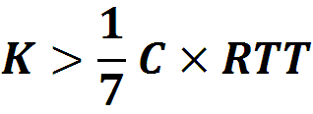
Analysis
How low can DCTCP maintain queues without loss of throughput?
How do we set the DCTCP parameters?
Need to quantify queue size oscillations (Stability).
85% Less Buffer than TCP

Slide 47
Evaluation
Implemented in Windows stack.
Real hardware, 1Gbps and 10Gbps experiments
  90 server testbed
  Broadcom Triumph 48 1G ports – 4MB shared memory
  Cisco Cat4948 48 1G ports – 16MB shared memory
  Broadcom Scorpion 24 10G ports – 4MB shared memory
Numerous micro-benchmarks
  – Throughput and Queue Length
  – Multi-hop
  – Queue Buildup
  – Buffer Pressure
Cluster traffic benchmark
– Fairness and Convergence
– Incast
– Static vs Dynamic Buffer Mgmt

Slide 48
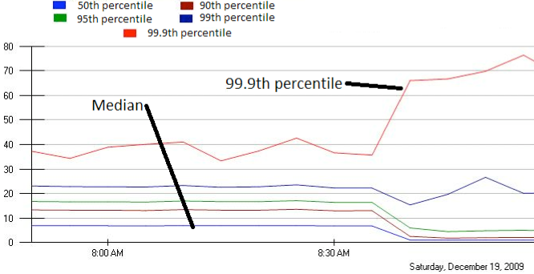
Incast Really Happens
MLA Query Completion Time (ms)
Requests are jittered over 10ms window.
Jittering switched off around 8:30 am.
99.9th percentile is being tracked.
Jittering trades off median against high percentiles.
Notes:
1. Incast really happens – see this actual screenshot from production tool
2. People care, they’ve solved it at application by jittering.
3. They care about the 99.9th percentile, 1-1000 customers

Slide 54
Overview
Data Center Overview
Routing in the DC
Transport in the DC

Slide 55
Cluster-based Storage Systems
Synchronized Read
1
R
R
R
R
2
Client
Switch
3
1
2
3
4
Server
Request Unit
(SRU)
Client now sends
next batch of requests
4
Storage
Servers
Data Block
Notes:
Data is striped across multiple servers for reliability (coding/replication) and performance. Also aids in incremental scalability.
To read this data a client performs a “Synchronized Read” operation.
The client reads data one data-block at a time. The portion of a data block stored by each server is called a SRU (in our terminology)
- mention that this setting is simplistic
- could have multiple clients, multiple outstanding blocks,
- describe sending of requests, responses
- the client sends out the next batch of requests only after it has received the entire data block (barrier synchronized)
To test how this read operation performs in the real world as we increase the number of servers on which we stripe data … (next slide)

Slide 56
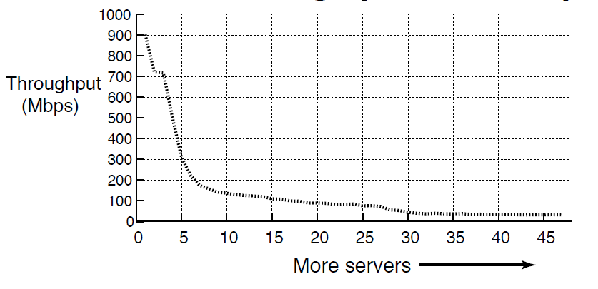
TCP Throughput Collapse
Cluster Setup
1Gbps Ethernet
Unmodified TCP
S50 Switch
1MB Block Size
Collapse!
TCP Incast
  Cause of throughput collapse:
  coarse-grained TCP timeouts
Notes:
And, here are the results of the experiment. On the Y axis we have Throughput (Goodput), and on the X axis we have the number of servers involved in the transfer. Initially the throughput is 900Mbps, close to the maximum achievable in the network. As we scale the number of servers, by around 7 servers we notice a drastic collapse in throughput down to 100Mbps (an order of magnitude lower than the max). This TCP throughput collapse is called TCP Incast, and the cause for this is coarse-grained TCP timeouts.

Slide 57
TCP: Loss recovery comparison
Timeout driven recovery is
slow (ms)
Data-driven recovery is
super fast (µs) in datacenters
Seq #
Seq #
1
1
Ack 1
2
2
3
Ack 1
4
3
5
Ack 1
Ack 1
4
5
Retransmit
2
Ack 5
Retransmission
Timeout
(RTO)
Sender
Receiver
Ack 1
1
Sender
Receiver
Notes:
So we have seen the 2 loss recovery mechanisms in TCP. The point to note is that timeouts are expensive, in ms, where as data-driven recovery is quick (us in datacenters)
But why are timeouts in milliseconds?

Slide 58
Link Idle Time Due To Timeouts
Synchronized Read
1
R
R
R
R
2
4
Client
Switch
3
1
2
3
4
Server
Request Unit
(SRU)
4
Req.
sent
Rsp.
sent
4 dropped
Response
resent
1 – 3 done
time
Link Idle!
Notes:
Let us revisit the synchronized reads scenario (in parallel filesystems) to understand why timeouts cause link idle time (and hence throughput collapse).
Setting: SRU contains only one packet worth of information for simplicity.
If 4 is dropped, when server 4 is timing out, the link is idle – no one is utilizing the available bandwidth.

Slide 59
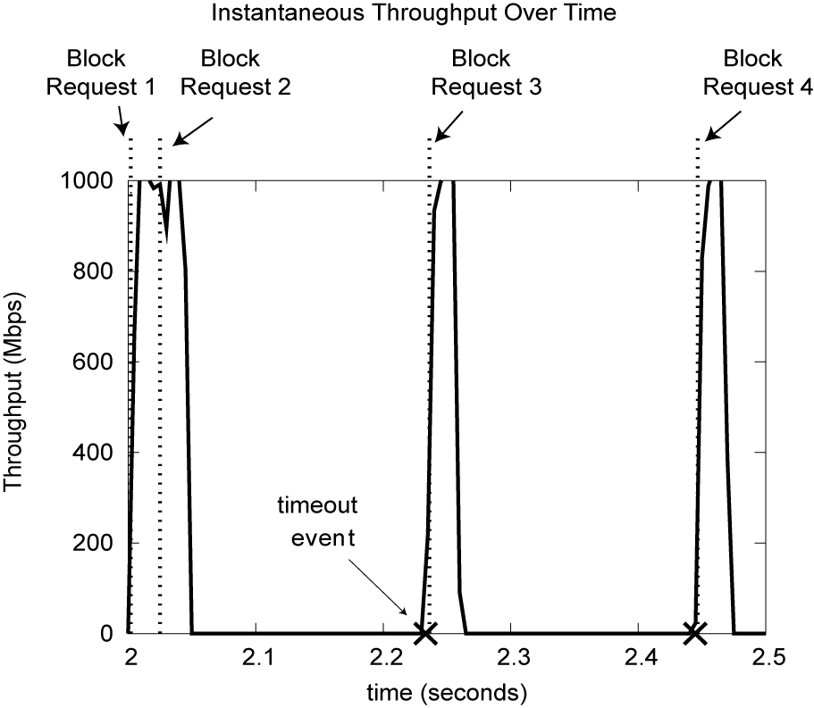
Client Link Utilization
Link Idle!
200ms
Notes:
Another way to visualize this is to look at the client link utilization when the transfer was taking place.
Y axis = Throughput
X axis = time
Let us consider only 1 block transfer (Block 2). When servers send their responses, the client link utilization reaches a peak (all links are 1Gbps). But one of the servers experiences losses and has to fallback on timeout driven loss recovery. When the remaining servers involved in the read finish their transfers, the link is idle (for 200ms in this example), just before the timeout event occurs and the final server completes the transfer. Once the entire data block is received, the request for the next data block can be sent out.
{ This is a visualization of a simulation run }

Slide 60
Default minRTO: Throughput Collapse
Unmodified TCP
(200ms minRTO)
Notes:
Same graph as before – synchronized reads, unmodified TCP on servers.

Slide 61
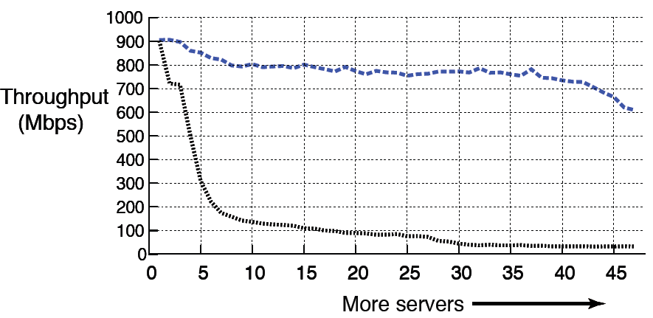
Lowering minRTO to 1ms helps
1ms minRTO
Unmodified TCP
(200ms minRTO)
Millisecond retransmissions are not enough
Notes:
The blue line represents the 1ms minRTO TCP implementation.
A single line change helps! Gets rid of collapse.
But not good enough at scale. There is a drop-off close to 40-47 servers.
Based on this one might be tempted to suggest, can we just eliminate minRTO. Only eliminating minRTO will not help. And the reason for this is that RTT is still measured in milliseconds, and hence the RTO values are still in miliseconds.
This is the case for microsecond retransmissions.

Slide 62
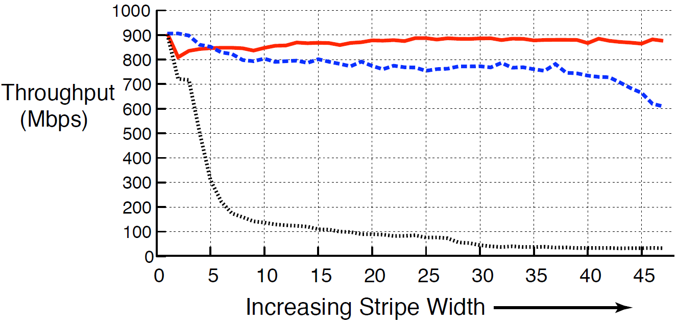
Solution: µsecond TCP + no minRTO
microsecond TCP
+ no minRTO
1ms minRTO
Unmodified TCP
(200ms minRTO)
more servers
High throughput for up to 47 servers

Slide 63
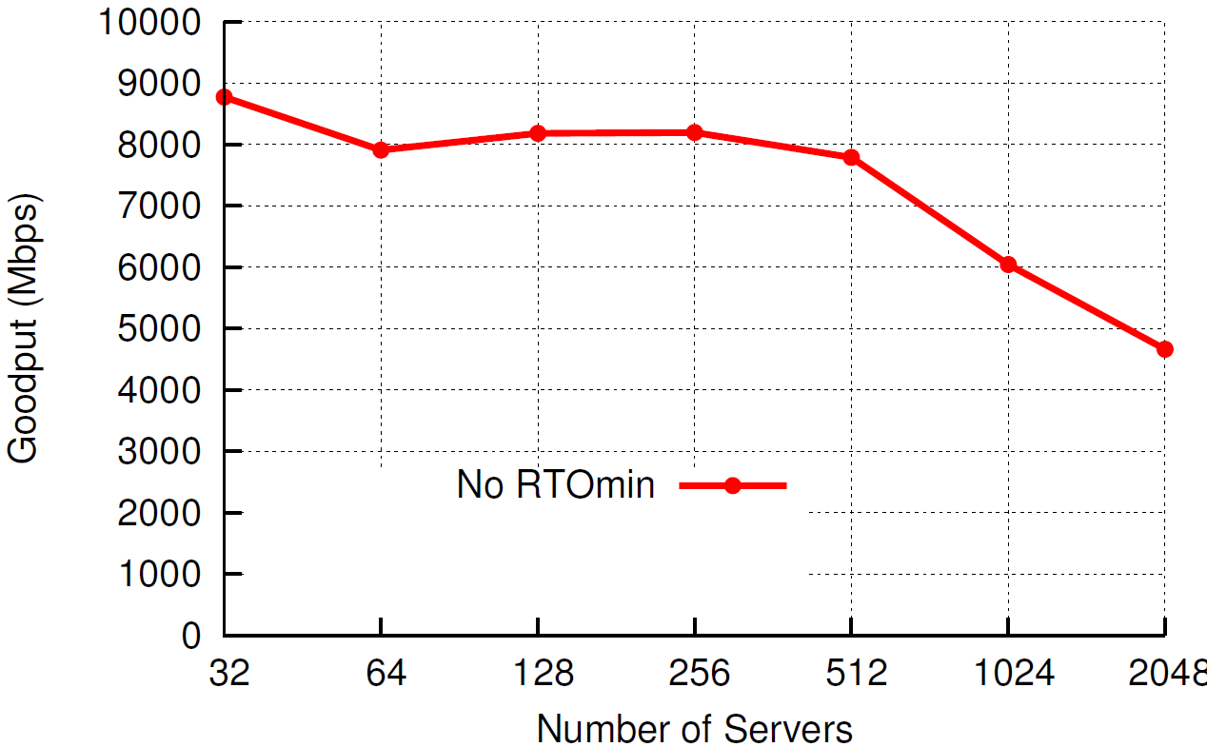
Simulation: Scaling to thousands
Block Size = 80MB, Buffer = 32KB, RTT = 20us
Notes:
Block size = 80MB, buffer = 32KB, RTT = 20us (next generation datacenters)

Slide 64
Delayed-ACK (for RTO > 40ms)
Seq #
Seq #
Seq #
1
1
1
2
2
Ack 2
Ack 0
40ms
Ack 1
Sender
Receiver
Sender
Receiver
Sender
Receiver
Delayed-Ack: Optimization to reduce #ACKs sent
Notes:
Explanation of Delayed ACK specification.

Slide 65
µsecond RTO and Delayed-ACK
RTO > 40ms
RTO < 40ms
Seq #
Seq #
1
1
Timeout
Retransmit packet
1
40ms
Ack 1
Ack 1
Sender
Receiver
Sender
Receiver
Premature Timeout
  RTO on sender triggers before Delayed-ACK on receiver
Notes:
Premature timeouts slow the rate of transfer (timeouts still result in {slow start + congestion avoidance}).

Slide 66
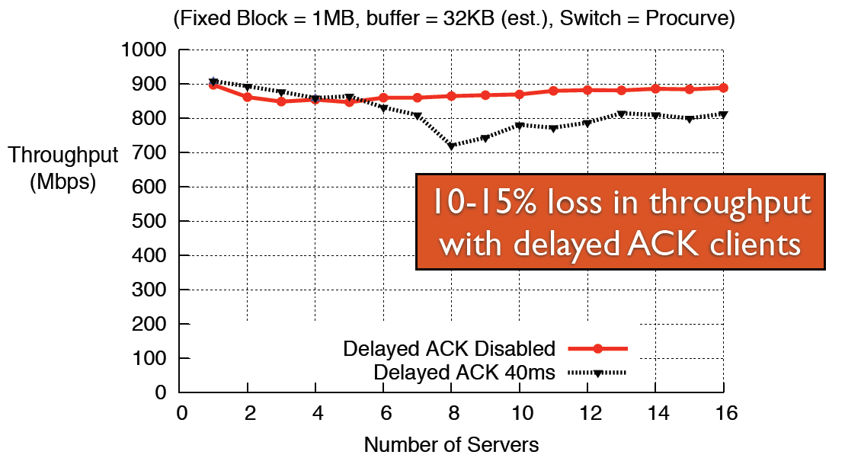
Impact of Delayed-ACK

Slide 67
Is it safe for the wide-area?
Stability: Could we cause congestion collapse?
  No: Wide-area RTOs are in 10s, 100s of ms
  No: Timeouts result in rediscovering link capacity (slow down the rate of transfer)
Performance: Do we timeout unnecessarily?
  [Allman99] Reducing minRTO increases the chance of premature timeouts
    Premature timeouts slow transfer rate
  Today: detect and recover from premature timeouts
  Wide-area experiments to determine performance impact
Notes:
Allman et. al said that reducing minRTO results in an increase in premature timeouts.
The reason why a premature timeout would occur in such a setting would be because of a sudden jump/increase in RTT, from it steady state value. Such a jump would most probably be caused by a significant path change in the wide area. We have reason to believe that such changes are not a common occurrence in the wide area today.
Also, premature timeouts just slow the rate of transfer (timeouts still result in {slow start + congestion avoidance}).
Premature timeouts are less harmful today
Can detect them using the tcp timestamp option - if we get an ack for a seq number that we retransmitted due to a timeout, but it has a timestamp of the first packet with this seq number that we transmitted, then we know we experienced a premature timeout.
Can recover from them (F-RTO) – If we detect a premature timeout, exit slow start and enter congestion avoidance (with cwnd = cwnd_before_timeout / 2)
Both implemented widely!

Slide 68

Wide-area Experiment
BitTorrent
Seeds
BitTorrent
Clients
Microsecond TCP
+
No minRTO
Standard TCP
Do microsecond timeouts harm wide-area throughput?

Slide 69
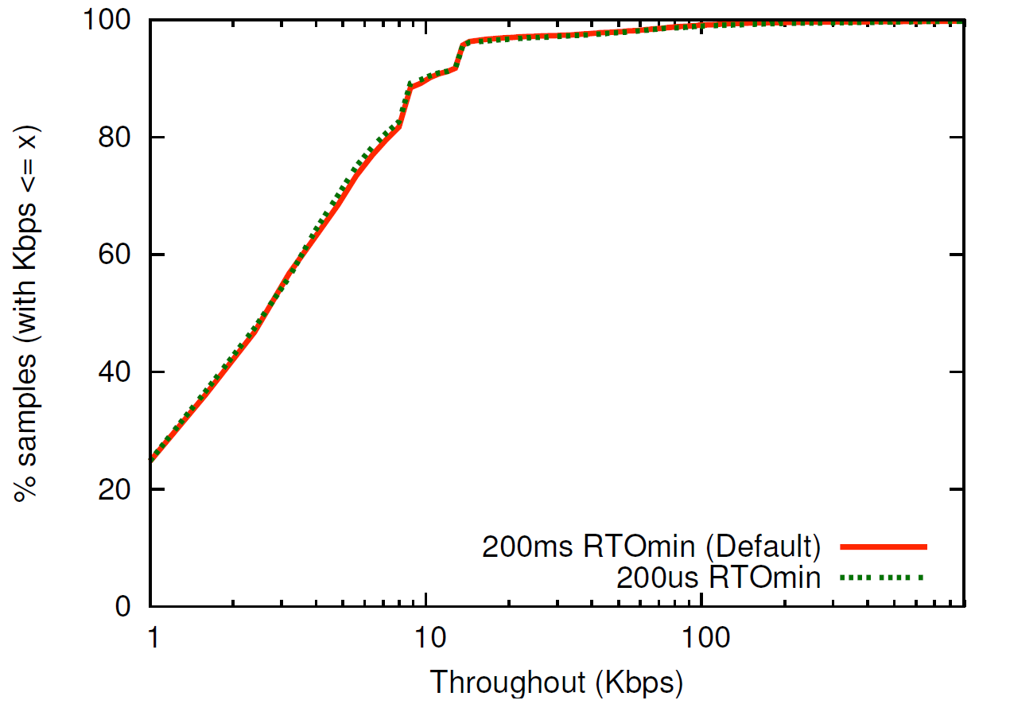
Wide-area Experiment: Results
No noticeable difference in throughput

Slide 70
Other Efforts
Topology
  Using extra links to meet traffic matrix
    60Ghz links → MSR paper in HotNets09
    Reconfigurable optical interconnects → CMU and UCSD in Sigcomm2010
Transport
  Data Center TCP → data-center only protocol that uses RED-like techniques in routers

Slide 71
Aside: Disk Power
IBM Microdrive (1inch)
writing 300mA (3.3V)
1W
standby 65mA (3.3V)
.2W
IBM TravelStar (2.5inch)
read/write 2W
spinning 1.8W
low power idle .65W
standby .25W
sleep .1W
startup 4.7 W
seek 2.3W

Slide 72
Spin-down Disk Model
4.7W
2.3W
2W
Spinning
& Seek
Spinning
up
Request
Spinning
& Access
Trigger:
request or
predict
Predictive
Not
Spinning
Spinning
& Ready
.2W
Spinning
down
.65-1.8W
Inactivity Timeout
threshold*

Slide 73
Disk Spindown
Disk Power Management – Oracle (off-line)
Disk Power Management – Practical scheme (on-line)
IdleTime > BreakEvenTime
access1
access2
Idle for
BreakEvenTime
Wait time
Source: from the presentation slides of the authors
Notes:
73
There are two disk power management schemes, one is called oracle scheme, the other is practical scheme. The oracle scheme is an offline scheme, which know ahead of time the length of upcoming idle period. If the idle time is larger than the breakeven time, the disk will spindown and spinup right in time before the next request. The practical scheme has no such future knowledge. If the disk is idle for a threshold of time, then the disk will spin down and spin up upon the arrival of next request. The previous work show if we set the threshold to be the breakeven time, the practical scheme is 2-compitative compared to the oracle scheme.

Slide 74
Spin-Down Policies
Fixed Thresholds
  T_{out} = spin-down cost s.t. 2*E_{transition} = P_{spin}*T_{out}
Adaptive Thresholds: T_{out} = f (recent accesses)
  Exploit burstiness in T_{idle}
Minimizing Bumps (user annoyance/latency)
  Predictive spin-ups
Changing access patterns (making burstiness)
  Caching
  Prefetching

Slide 75
Google
Since 2005, its data centers have been composed of standard shipping containers--each with 1,160 servers and a power consumption that can reach 250 kilowatts
Google server was 3.5 inches thick--2U, or 2 rack units, in data center parlance. It had two processors, two hard drives, and eight memory slots mounted on a motherboard built by Gigabyte

Slide 76
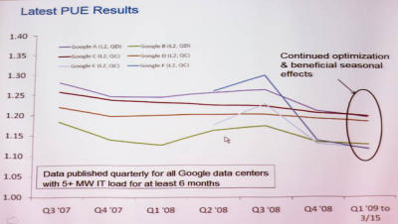
Google's PUE
In the third quarter of 2008, Google's PUE was 1.21, but it dropped to 1.20 for the fourth quarter and to 1.19 for the first quarter of 2009 through March 15
Newest facilities have 1.12

