Slide 1
15-744: Computer Networking
L-13 Data Center Networking II

Slide 2
Overview
Data Center Topologies
Data Center Scheduling

Slide 3



Current solutions for increasing data center network bandwidth
FatTree
BCube
1. Hard to construct
2. Hard to expand
Notes:
Data intensive application operating on large volumes of data have motivated a lot of research work on data center networking. The basic problem is traditional tree-structure Ethernet are heavily over-subscribed when a large amount of data are shuffled across different server racks. Recent solutions propose to construct full bisection bandwidth network using commodity packet switches. Full bisection bandwidth network means each server can talk to another server at full NIC rate. Full bisection bandwidth is a nice property, but as you can see , these full bisection bandwidth network is quite complicated. They requires a lot of wires and we have to follow restricted rules to construct such networks. When the network is constructed, it is hard to expand because they requires major rewiring to expand.

Slide 4

An alternative: hybrid packet/circuit switched data center network
Goal of this work:
  Feasibility: software design that enables efficient use of optical circuits
  Applicability: application performance over a hybrid network
Notes:
In this work, we explore an alternate design that using optical circuit switching technology to construct a simple network
yet still achieve good performance. In particular, we propose a hybrid data center network which augment the existing
Electrical network with circuit switched optical paths. Optical paths can be provisioned dynamically to provide high bandwidth
For applications. The goal of our work is trying to answer the fundamental feasibility and applicability question of hybrid
data center network. We study the software design that can enable optical circuits in data center networks, and understand how application would perform over such a network.

Slide 5
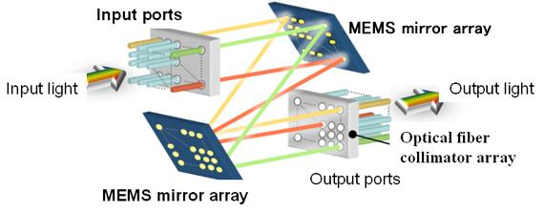
Optical circuit switching v.s.
Electrical packet switching
 | Electrical packet switching | Optical circuit switching
Switching technology | Store and forward | Circuit switching
Switching capacity
Switching time
16x40Gbps at high end
e.g. Cisco CRS-1
320x100Gbps on market, e.g. Calient FiberConnect
Packet granularity
Less than 10ms
e.g. MEMS optical switch
Notes:
Shorten for time 2:05, too long !!!
To understand our solution, let’s first take a look at the fundamental difference between electrical packet switching and optical circuit switching technologies. As you know, packet switches are based on the store-and-forward architecture.
Optical switches are circuit switched. There exist different technologies to realize optical circuit switching. For example, MEMS optical switches use MEMS mirror array to set up optical path by reflecting light beams between input and output ports.
These optical switches can switch at whatever rate modulated at input and output ports. Which can achieve very high switching capacity. For example, there already exist optical MEMS switches that can switch 320 optical links with 100Gbps rate.
On the contrast, today’s high end packet switched cisco routers can only switch 16 ports with 40gbps rate.
But the problem is that, the switching time of optical circuits are relatively long. Of course, packet switches can switch at packet granularity. But it takes a few ms to reconfigure optical paths. So, optical switches cannot provide full bisection bandwidth for all-to-all communication at packet granularity.

Slide 6
Optical Circuit Switch
Output 1
Output 2
Fixed
Mirror
Lenses
Input 1
Glass Fiber
Bundle
Does not decode packets
Needs take time to reconfigure
Rotate Mirror
Mirrors on Motors
2010-09-02 SIGCOMM
Nathan Farrington
6
Notes:
6

Slide 7
Optical circuit switching v.s.
Electrical packet switching
 | Electrical packet switching | Optical circuit switching
Switching technology | Store and forward | Circuit switching
Switching capacity
Switching time
Switching traffic
16x40Gbps at high end
e.g. Cisco CRS-1
320x100Gbps on market, e.g. Calient FiberConnect
Packet granularity
Less than 10ms
For bursty, uniform traffic
For stable, pair-wise traffic
7
Notes:
7

Slide 8
Optical circuit switching is promising despite slow switching time
[IMC09][HotNets09]: “Only a few ToRs are hot and most their traffic goes to a few other ToRs. …”
[WREN09]: “…we find that traffic at the five edge switches exhibit an ON/OFF pattern… ”
Full bisection bandwidth at packet granularity
may not be necessary
Notes:
But why do we still believe that optical circuit still worth considering in data centers?
The reason is because many measurement studies have observed evidence of traffic concentration in data centers. For example, in IMC09, microsoft researcher measured the traffic of their production data centers and observe that ….,
In another paper, WREN09 , researcher observe ON/OFF traffic pattern on data center switches. All this suggestion that, applications
are not sending to all destinations at full speed anyway. Full bisection….. may not be necessary. So there is a potential that we can ….

Slide 9
Hybrid packet/circuit switched network architecture
Electrical packet-switched network for low latency delivery
Optical circuit-switched network for high capacity transfer
Optical paths are provisioned rack-to-rack
  A simple and cost-effective choice
  Aggregate traffic on per-rack basis to better utilize optical circuits
Notes:
So, our idea is, we augment the traffic tree-structure Ethernet with a simple, rack-to-rack optical circuit-switched network. The electrical packet-switched network is always available there for low latency delivery and high speed optical circuits are provisioned dynamic for high capacity transfer based on traffic demands.
Optical circuits are provisioned rack-to-rack so that we only need to one optical transcer and one optical fiber for one rack, to keep the network simple and reduce the cost. Given one optical circuits can send more than 40gbps, we can aggregate traffic on per-rack basis to ….

Slide 10
Design requirements
Traffic demands
Control plane:
  Traffic demand estimation
  Optical circuit configuration
Data plane:
  Dynamic traffic de-multiplexing
  Optimizing circuit utilization (optional)
Notes:
How can we manage optical circuits over such a hybrid network? We identify a set of design requirements that are needed.
On the control plane, we need to collect dynamic traffic demand and config …
When optical paths are provisioned, there exist two paths among different server racks. So on the data plane, we need to de-multiplex traffic to different network dynamically based on the current configuration. When optical paths are provisioned, applications may not be able to send fast enough to leverage optical paths. So the improve system performance, we also need to optimize circuit utilization. But this requirement is optional, the system can still work with out this.

Slide 11
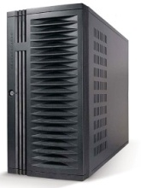
c-Through (a specific design)
No modification to applications and switches
Leverage end-hosts for traffic management
Centralized control for circuit configuration
Notes:
There is many design choice to accomplish these design requirements. We have a detailed discussion in the paper about the design choices and their trade-offs. Please refer to the paper for the discussion. Here I will go directly to a specific system, called c-Through, we have built to manage optical circuits in a hybrid network. The design strategy for c-Through system is:
C-Through use a centralized controller for …, c-Through does not need any modification on …, it leverage end-hosts in the traffic management.

Slide 12
c-Through - traffic demand estimation and traffic batching
Applications
Per-rack traffic demand vector
1. Transparent to applications.
Socket buffers
2. Packets are buffered per-flow
to avoid HOL blocking.
Accomplish two requirements:
  Traffic demand estimation
  Pre-batch data to improve optical circuit utilization
Notes:
c-Through estimate traffic demands by simply enlarge output buffer limits of sockets. When an application is trying to send a large amount of data and network bandwidth is not enough, the data will be queued up in socket output buffers. But look at the occupancy of socket output buffer, we can infer which flow has high traffic demands. Then we can aggregate the socket buffer occupancy based on the destination rack to get a per-rack traffic demand vector. For example, in this vector, darker color means high traffic demands for a particular destination rack.
This technique is transparent to …, packets are buffered … But with this simple technique, we can accomplish two-requirements: (1) traffic demand estimation (2) Socket buffers can be used to pre-batch data when optical path is not available. When optical path is provisioned, we can release the data quickly to optical path to improve circuit utilization.

Slide 13
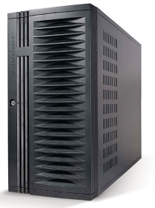
c-Through - optical circuit configuration
configuration
Traffic demand
Controller
configuration
Use Edmonds’ algorithm to compute optimal configuration
Many ways to reduce the control traffic overhead
Notes:
>2min too long !!!
C-Through use a centralize controller to collect traffic demands and configure optical circuits. The controller collect per-rack traffic demand vector from all the servers and aggregate them into a cross-rack traffic matrix. Then it compute a optimal configuration that can maximize the traffic volume that can be offload to optical network using a polynomial Edmonds’ alg. Everytime when the optical circuits are reconfigured, it will notified servers to tear down the path and configure it and then notify them about the new configuration. In a large data center, there could a significant overhead for the control traffic. But many ways can be used to reduce the overhead of control traffic.
For example, for traffic demand collection, servers only need to send to the controller when the demands change dramatically, traffic demand vectors can be aggregated within rack first, then send to the control. The configuration notification can be done using multicast.

Slide 14
c-Through - traffic de-multiplexing
VLAN-based network isolation:
  No need to modify switches
  Avoid the instability caused by circuit reconfiguration
VLAN #1
VLAN #2
traffic
circuit configuration
Traffic control on hosts:
  Controller informs hosts about the circuit configuration
  End-hosts tag packets accordingly
Traffic
de-multiplexer
VLAN #1
VLAN #2
Notes:
When optical path are configured, c-Through uses two techniques to realize traffic de-multiplexing.
First, we configure VLAN on all the ToR switches to isolate the electrical network and optical network into different VLANs.
As we mentioned before, it is a dynamic network. When optical circuits are reconfigured, the network topology is changing. If optical network and electrical network is organized into a unified network, this topology changes can cause instability in the control protocols in electrical network, such as spanning tree..
We isolate network to avoid the potential network instability caused by circuit reconfiguration.
C-Through leverage end-hosts to perform traffic de-multiplexing. Each server is configured with two virtual interface with VLAN1 and VLAN2 that mapping to electrical network and optical network. Everytime optical path is configured, controller will inform hosts about the current configuration. So a traffic de-multiplexer will tag packets accordingly to send them into appropriate network.

Slide 20
Overview
Data Center Topologies
Data Center Scheduling

Slide 21



Datacenters and OLDIs
OLDI = OnLine Data Intensive applications
  e.g., Web search, retail, advertisements
An important class of datacenter applications
Vital to many Internet companies
OLDIs are critical datacenter applications

Slide 22
OLDIs
Partition-aggregate
  Tree-like structure
  Root node sends query
  Leaf nodes respond with data
Deadline budget split among nodes and network
  E.g., total = 300 ms, parents-leaf RPC = 50 ms
Missed deadlines
  incomplete responses
  affect user experience & revenue

Slide 23
Challenges Posed by OLDIs
  Two important properties:
  Deadline bound (e.g., 300 ms)
    Missed deadlines affect revenue
  Fan-in bursts
  Large data, 1000s of servers
    Tree-like structure (high fan-in)
    Fan-in bursts → long “tail latency”
Network shared with many apps (OLDI and non-OLDI)
Network must meet deadlines & handle fan-in bursts

Slide 24
Current Approaches
TCP: deadline agnostic, long tail latency
  Congestion → timeouts (slow), ECN (coarse)
Datacenter TCP (DCTCP) [SIGCOMM '10]
first to comprehensively address tail latency
Finely vary sending rate based on extent of congestion
shortens tail latency, but is not deadline aware
  ~25% missed deadlines at high fan-in & tight deadlines
DCTCP handles fan-in bursts, but is not deadline-aware

Slide 25
D²TCP
Deadline-aware and handles fan-in bursts
Key Idea: Vary sending rate based on both deadline and extent of congestion
  Built on top of DCTCP
  Distributed: uses per-flow state at end hosts
  Reactive: senders react to congestion
    no knowledge of other flows

Slide 26
D²TCP’s Contributions
Deadline-aware and handles fan-in bursts
  Elegant gamma-correction for congestion avoidance
    far-deadline → back off more
    near-deadline → back off less
  Reactive, decentralized, state (end hosts)
Does not hinder long-lived (non-deadline) flows
Coexists with TCP → incrementally deployable
No change to switch hardware → deployable today
D²TCP achieves 75% and 50% fewer missed
deadlines than DCTCP and D³

Slide 27
Coflow Definition

Slide 36
Data Center Summary
Topology
  Easy deployment/costs
  High bi-section bandwidth makes placement less critical
  Augment on-demand to deal with hot-spots
Scheduling
  Delays are critical in the data center
  Can try to handle this in congestion control
  Can try to prioritize traffic in switches
  May need to consider dependencies across flows to improve scheduling

Slide 37
Review
Networking background
  OSPF, RIP, TCP, etc.
Design principles and architecture
  E2E and Clark
Routing/Topology
  BGP, powerlaws, HOT topology

Slide 38
Review
Resource allocation
  Congestion control and TCP performance
  FQ/CSFQ/XCP
Network evolution
  Overlays and architectures
  Openflow and click
  SDN concepts
  NFV and middleboxes
Data centers
  Routing
  Topology
  TCP
  Scheduling

Slide 39
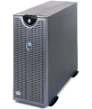
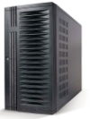
Testbed setup
16 servers with 1Gbps NICs
Emulate a hybrid network on 48-port Ethernet switch
Ethernet switch
100Mbps links
4Gbps links
Optical circuit emulation
  Optical paths are available only when hosts are notified
  During reconfiguration, no host can use optical paths
  10 ms reconfiguration delay
Emulated optical circuit switch
39
Notes:
39

Slide 40
Evaluation
Basic system performance:
  Can TCP exploit dynamic bandwidth quickly?
  Does traffic control on servers bring significant overhead?
  Does buffering unfairly increase delay of small flows?
Yes
No
No
Application performance:
  Bulk transfer (VM migration)?
  Loosely synchronized all-to-all communication (MapReduce)?
  Tightly synchronized all-to-all communication (MPI-FFT) ?
Yes
Yes
Yes
40
Notes:
40

Slide 41
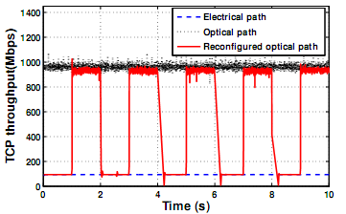
TCP can exploit dynamic bandwidth quickly
Throughput reach peak
within 10 ms
41
Notes:
41

Slide 42
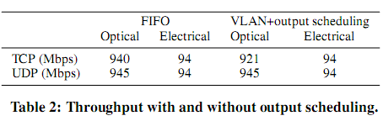
Traffic control on servers bring few overhead
Although optical management system adds an output scheduler in the server kernel, it does not significantly affect TCP or UDP throughput.

Slide 43
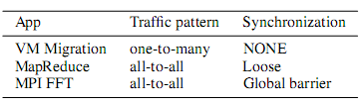
Application performance
Three different Benchmark applications

Slide 44
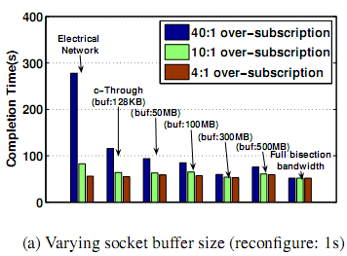
VM migration Application(1)

Slide 45
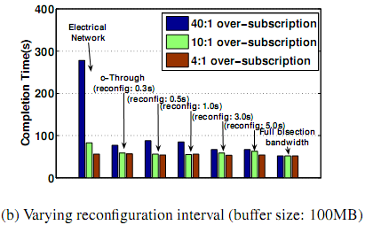
VM migration Application(2)

Slide 46
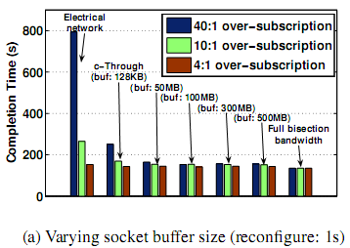
MapReduce(1)

Slide 47
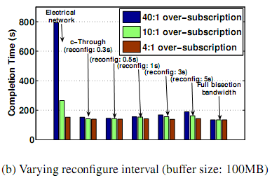
MapReduce(2)

Slide 48
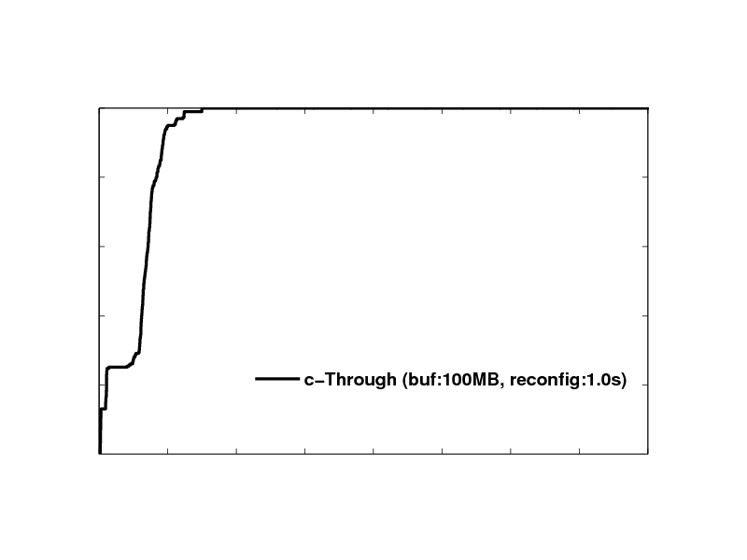
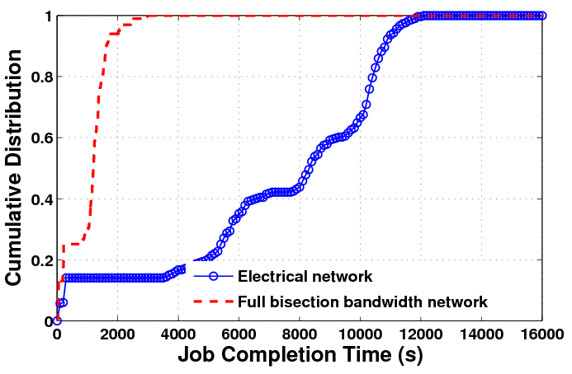
Yahoo Gridmix benchmark
3 runs of 100 mixed jobs such as web query, web scan and sorting
200GB of uncompressed data, 50 GB of compressed data
48
Notes:
48

Slide 49
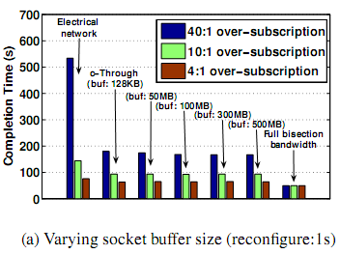
MPI FFT(1)

Slide 50
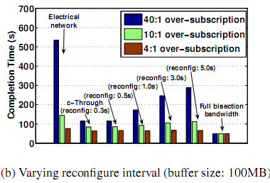
MPI FFT(2)

Slide 51
D²TCP: Congestion Avoidance
A D²TCP sender varies sending window (W) based on both extent of congestion and deadline
Note: Larger p ⇒ smaller window. p = 1 ⇒ W/2. p = 0 ⇒ W/2
W := W * ( 1 – p / 2 )
P is our gamma correction function

Slide 52
D²TCP: Gamma Correction Function
Gamma Correction (p) is a function of congestion & deadlines
α: extent of congestion, same as DCTCP’s α (0 ≤ α ≤ 1)
d: deadline imminence factor
  “completion time with window (W)” ÷ “deadline remaining”
  d < 1 for far-deadline flows, d > 1 for near-deadline flows
p = α^{d}

Slide 53
Gamma Correction Function (cont.)
Key insight: Near-deadline flows back off less
while far-deadline flows back off more
d < 1 for far-deadline flows
→ p large → shrink window
d > 1 for near-deadline flows
→ p small → retain window
Long lived flows → d = 1
  → DCTCP behavior
d = 1
d < 1 (far deadline)
d > 1 (near deadline)
W := W * ( 1 – p / 2 )
p = α^{d}
1.0
far
p
d = 1
near
α
1.0
Gamma correction elegantly combines congestion and deadlines

Slide 54
Gamma Correction Function (cont.)
α is calculated by aggregating ECN (like DCTCP)
  Switches mark packets if queue_length > threshold
    ECN enabled switches common
  Sender computes the fraction of marked packets averaged over time
Threshold

Slide 55
Gamma Correction Function (cont.)
The deadline imminence factor (d):
“completion time with window (W)” ÷ “deadline remaining” (d = T_{c} / D)
B → Data remaining, W → Current Window Size
Avg. window size ~= 3⁄4 * W ⇒ T_{c} ~= B ⁄ (3⁄4 * W)
A more precise analysis in the paper!

Slide 56
D²TCP: Stability and Convergence
D²TCP’s control loop is stable
  Poor estimate of d corrected in subsequent RTTs
When flows have tight deadlines (d >> 1)
  d is capped at 2.0 → flows not over aggressive
  As α (and hence p) approach 1, D²TCP defaults to TCP
  → D²TCP avoids congestive collapse
W := W * ( 1 – p / 2 )
p = α^{d}

Slide 57
D²TCP: Practicality
  Does not hinder background, long-lived flows
  Coexists with TCP
    Incrementally deployable
  Needs no hardware changes
    ECN support is commonly available
D²TCP is deadline-aware, handles fan-in bursts, and is deployable today

