Slide 1
15-744: Computer Networking
L-12 Data Center Networking I

Slide 2
Overview
Data Center Overview
Routing in the DC
Transport in the DC

Slide 3
Datacenter Arms Race
Amazon, Google, Microsoft, Yahoo!, … race to build next-gen mega-datacenters
Industrial-scale Information Technology
100,000+ servers
Located where land, water, fiber-optic connectivity, and cheap power are available

Slide 4
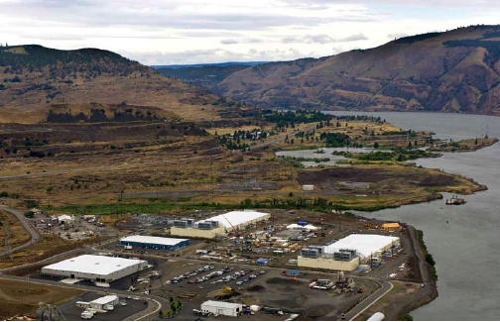
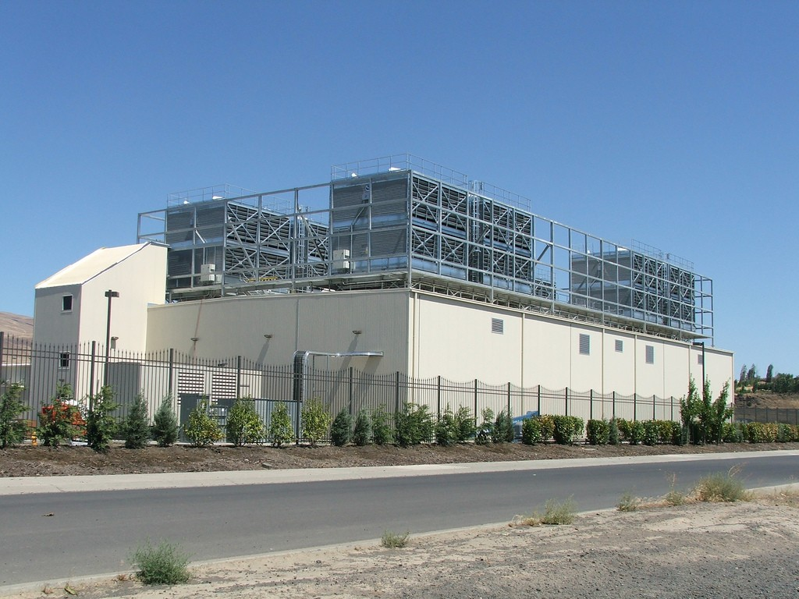
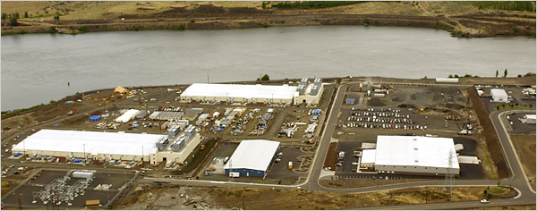
Google Oregon Datacenter

Slide 5
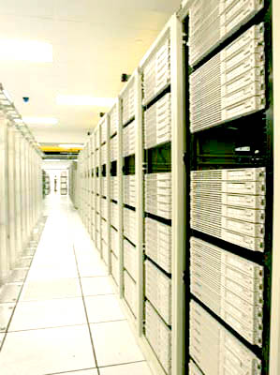
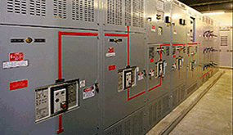
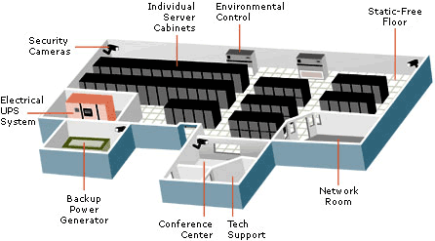
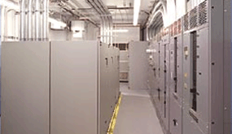
Computers + Net + Storage + Power + Cooling

Slide 6
Overview
Data Center Overview
Routing in the DC
Transport in the DC

Slide 7
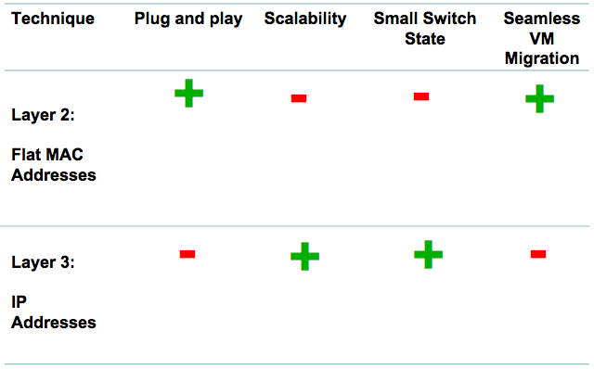
Layer 2 vs. Layer 3 for Data Centers

Slide 8
Flat vs. Location Based Addresses
Commodity switches today have ~640 KB of low latency, power hungry, expensive on chip memory
  Stores 32 – 64 K flow entries
Assume 10 million virtual endpoints in 500,000 servers in datacenter
Flat addresses ➔ 10 million address mappings ➔ ~100 MB on chip memory ➔ ~150 times the memory size that can be put on chip today
Location based addresses ➔ 100 – 1000 address mappings ➔ ~10 KB of memory ➔ easily accommodated in switches today

Slide 9
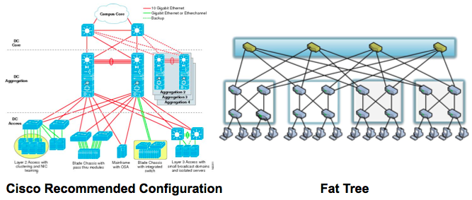
PortLand: Main Assumption
Hierarchical structure of data center networks:
  They are multi-level, multi-rooted trees

Slide 10
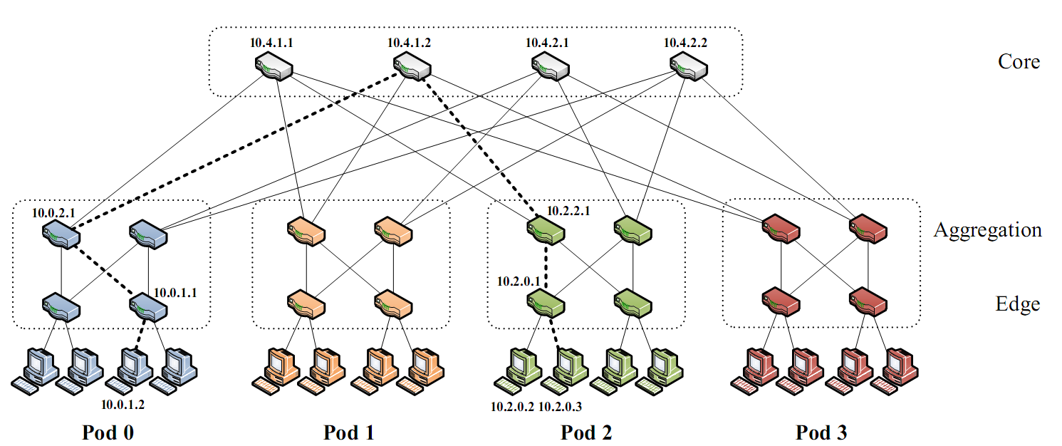
Background: Fat-Tree
Inter-connect racks (of servers) using a fat-tree topology
Fat-Tree: a special type of Clos Networks (after C. Clos)
K-ary fat tree: three-layer topology (edge, aggregation and core)
  each pod consists of (k/2)² servers & 2 layers of k/2 k-port switches
  each edge switch connects to k/2 servers & k/2 aggr. switches
  each aggr. switch connects to k/2 edge & k/2 core switches
  (k/2)² core switches: each connects to k pods
Fat-tree
with K=4

Slide 11
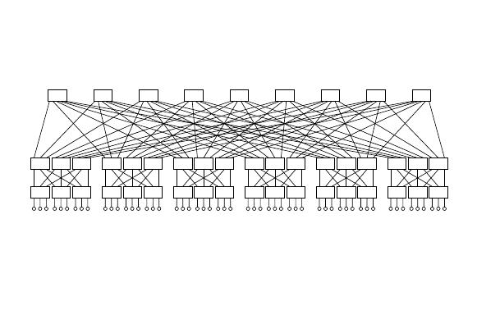
Why Fat-Tree?
Fat tree has identical bandwidth at any bisections
Each layer has the same aggregated bandwidth
Can be built using cheap devices with uniform capacity
  Each port supports same speed as end host
  All devices can transmit at line speed if packets are distributed uniform along available paths
Great scalability: k-port switch supports k³/4 servers
Fat tree network with K = 3 supporting 54 hosts

Slide 12
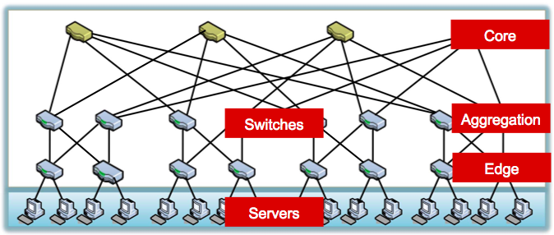
Data Center Network

Slide 13
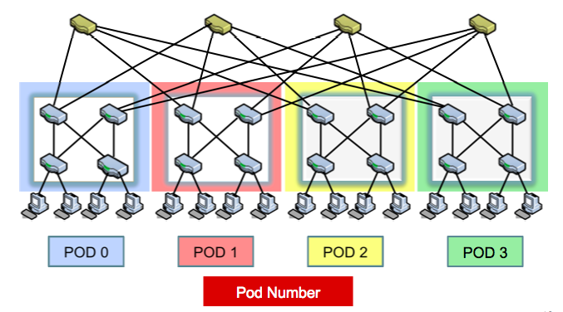
Hierarchical Addresses

Slide 14
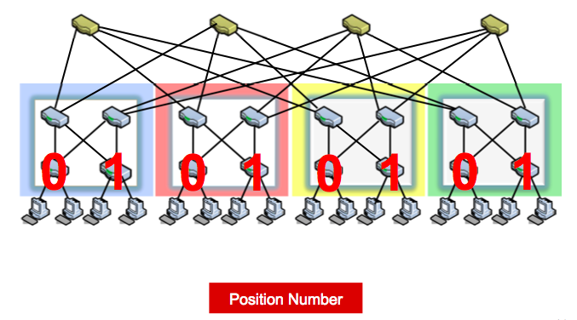
Hierarchical Addresses

Slide 15
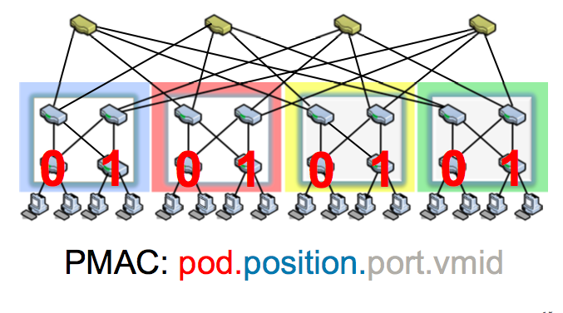
Hierarchical Addresses

Slide 16
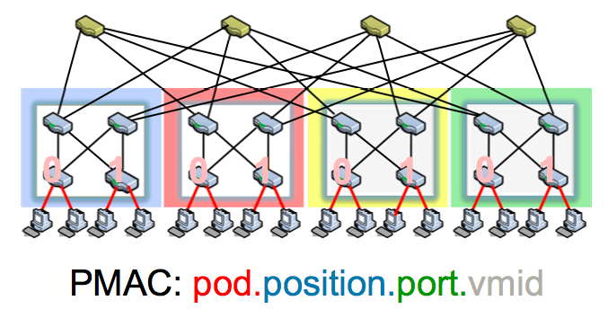
Hierarchical Addresses

Slide 17
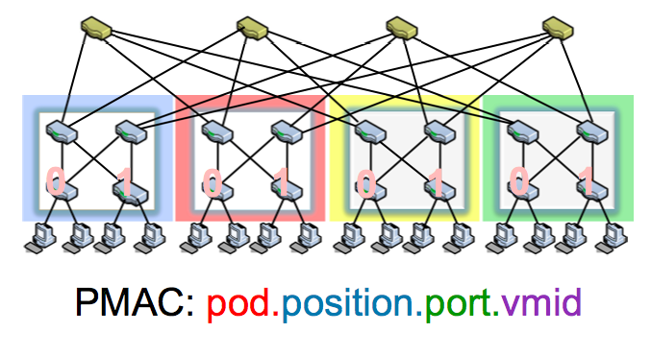
Hierarchical Addresses

Slide 18
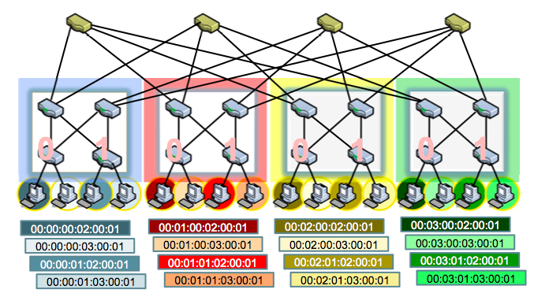
Hierarchical Addresses

Slide 19
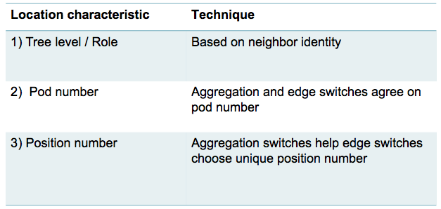
PortLand: Location Discovery Protocol
Location Discovery Messages (LDMs) exchanged between neighboring switches
Switches self-discover location on boot up

Slide 20
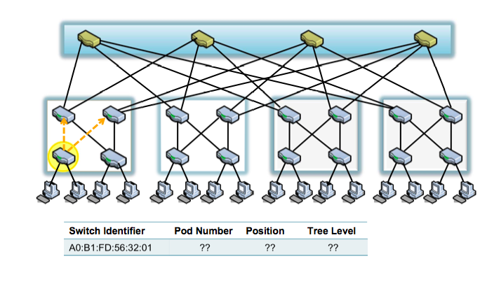
Location Discovery Protocol

Slide 21

Location Discovery Protocol

Slide 22
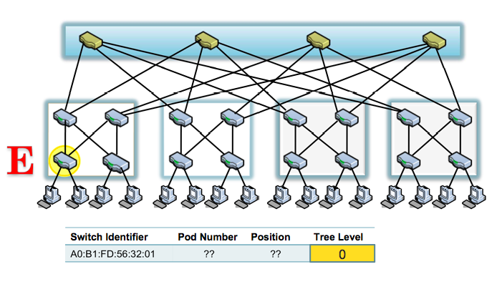
Location Discovery Protocol

Slide 23
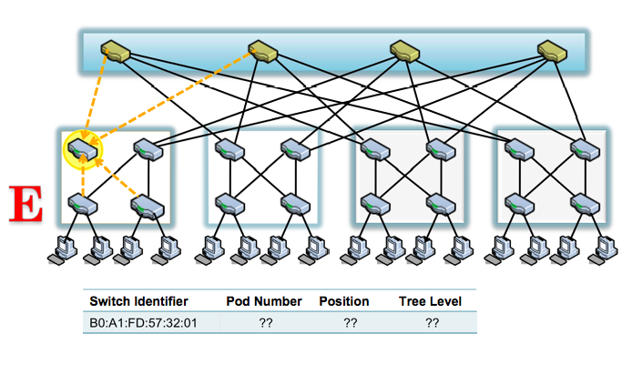
Location Discovery Protocol

Slide 24
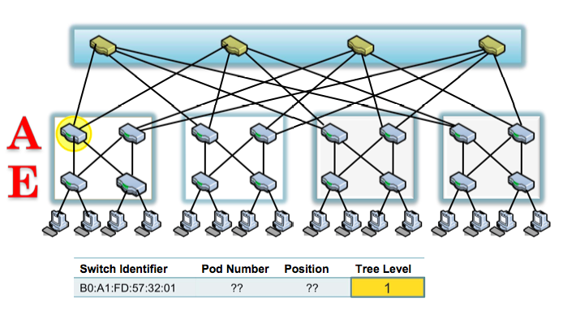
Location Discovery Protocol

Slide 25
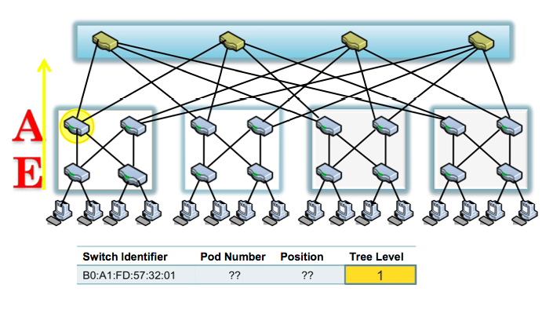
Location Discovery Protocol

Slide 26
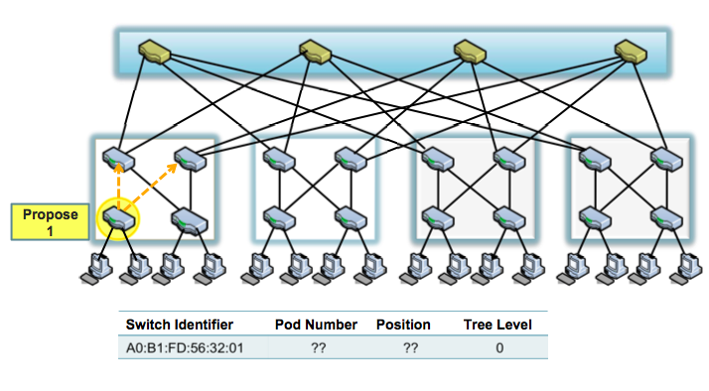
Location Discovery Protocol

Slide 27
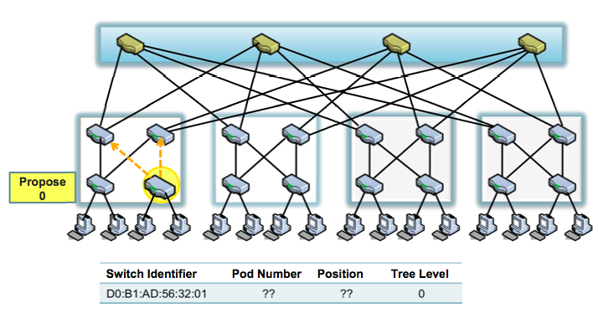
Location Discovery Protocol

Slide 28
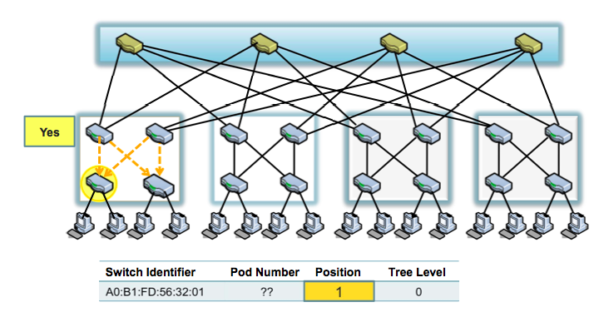
Location Discovery Protocol

Slide 29
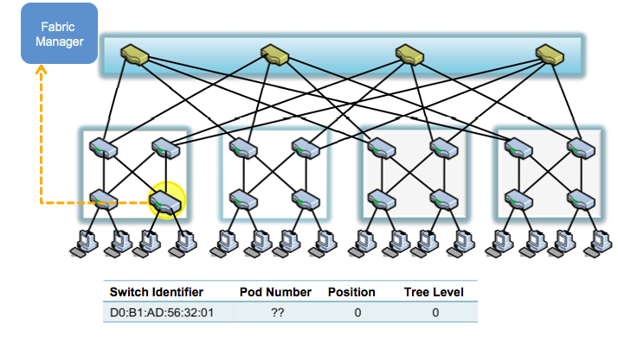
Location Discovery Protocol

Slide 30
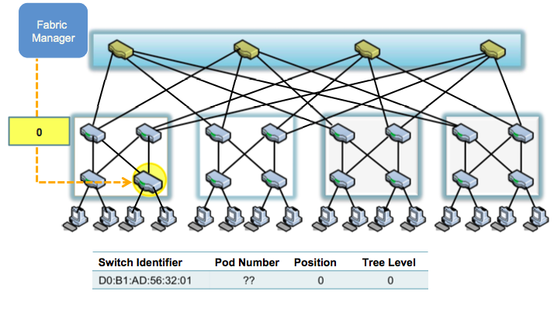
Location Discovery Protocol

Slide 31
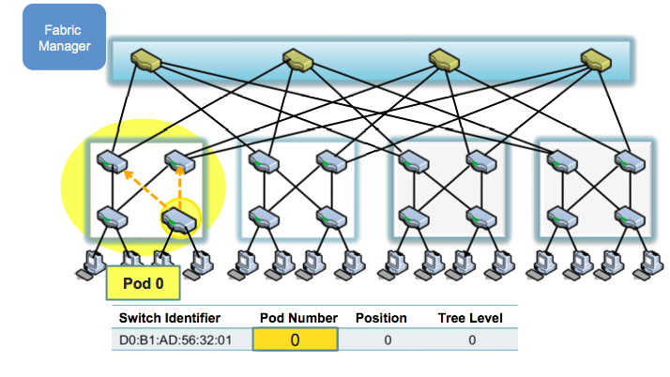
Location Discovery Protocol

Slide 32
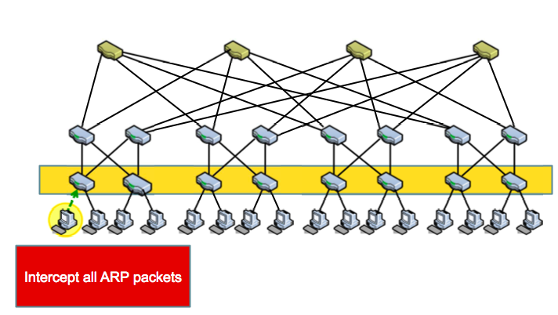
Name Resolution

Slide 33
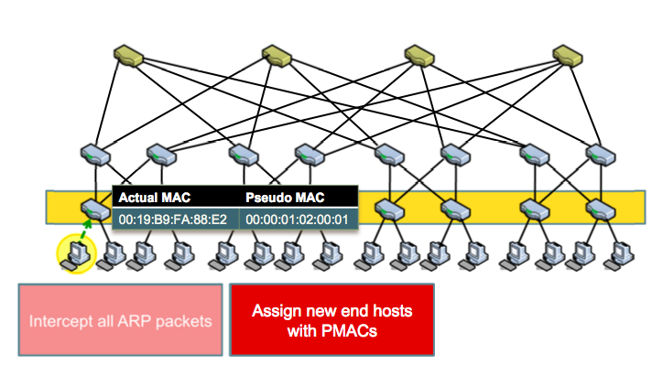
Name Resolution

Slide 34
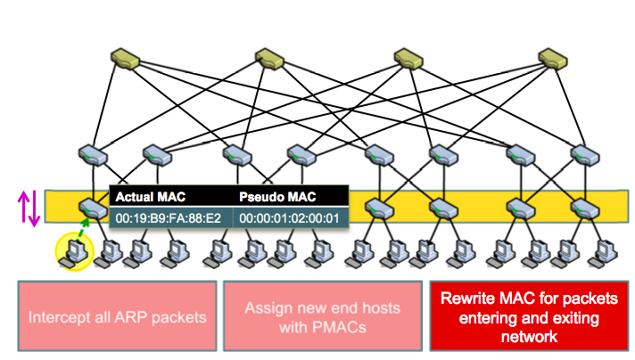
Name Resolution

Slide 35
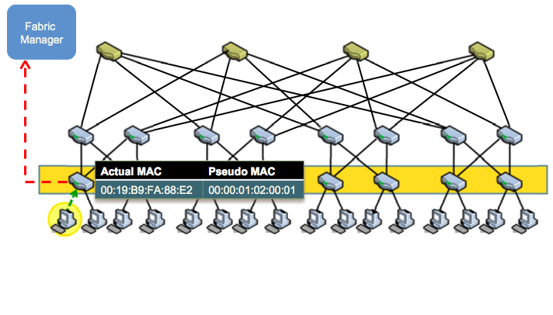
Name Resolution

Slide 36
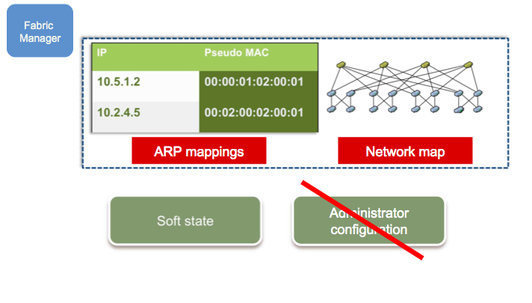
Fabric Manager

Slide 37
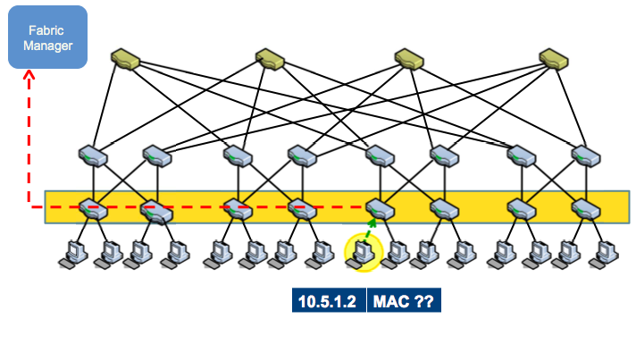
Name Resolution

Slide 38
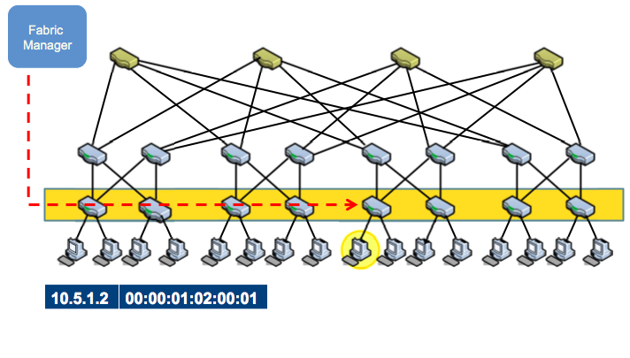
Name Resolution

Slide 39
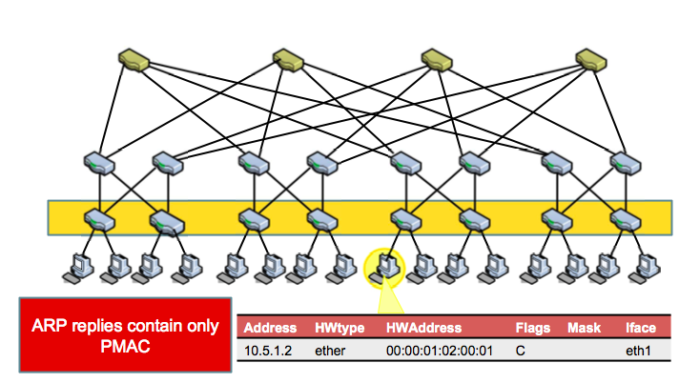
Name Resolution

Slide 40
Other Schemes
SEATTLE [SIGCOMM ‘08]:
  Layer 2 network fabric that works at enterprise scale
  Eliminates ARP broadcast, proposes one-hop DHT
  Eliminates flooding, uses broadcast based LSR
  Scalability limited by
    Broadcast based routing protocol
    Large switch state
VL2 [SIGCOMM ‘09]
  Network architecture that scales to support huge data centers
  Layer 3 routing fabric used to implement a virtual layer 2
  Scale Layer 2 via end host modifications
    Unmodified switch hardware and software
    End hosts modified to perform enhanced resolution to assist routing and forwarding

Slide 41
VL2: Name-Location Separation
Cope with host churns with very little overhead
VL2
Switches run link-state routing and
maintain only switch-level topology
Directory
Service
Allows to use low-cost switches
Protects network and hosts from host-state churn
Obviates host and switch reconfiguration
…
x → ToR₂
y → ToR₃
z → ToR₄
…
…
x → ToR₂
y → ToR₃
z → ToR₃
…
ToR₁
. . .
ToR₂
. . .
ToR₃
. . .
ToR₄
ToR₃
y
payload
Lookup &
Response
y, z
ToR₄
x
y
z
ToR₃
z
z
payload
payload
Servers use flat names

Slide 42
VL2: Random Indirection
Cope with arbitrary TMs with very little overhead
I_{ANY}
I_{ANY}
I_{ANY}
Links used
for up paths
Links used
for down paths
[ ECMP + IP Anycast ]
Harness huge bisection bandwidth
Obviate esoteric traffic engineering or optimization
Ensure robustness to failures
Work with switch mechanisms available today
T₁
T₂
T₃
T₄
T₅
T₆
I_{ANY}
T₃
T₅
y
z
payload
payload
x
y
z

Slide 43
Next Lecture
Data center topology
Data center scheduling
Required reading
  Efficient Coflow Scheduling with Varys
  c-Through: Part-time Optics in Data Centers

Slide 44
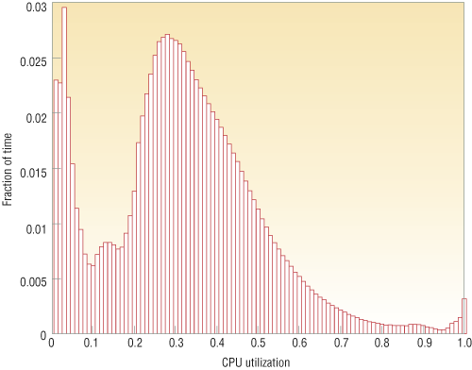
Energy Proportional Computing
It is surprisingly hard
to achieve high levels
of utilization of typical
servers (and your home
PC or laptop is even
worse)
“The Case for
Energy-Proportional
Computing,”
Luiz André Barroso,
Urs Hölzle,
IEEE Computer
December 2007
Figure 1. Average CPU utilization of more than 5,000 servers during a six-month period. Servers
are rarely completely idle and seldom operate near their maximum utilization, instead operating
most of the time at between 10 and 50 percent of their maximum

Slide 45
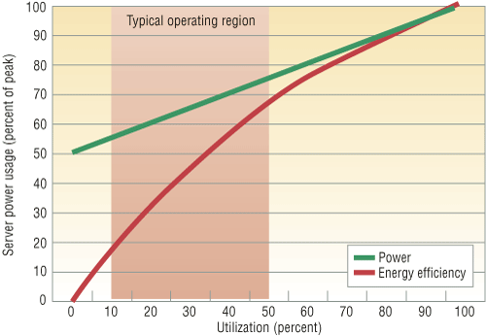
Energy Proportional Computing
“The Case for
Energy-Proportional
Computing,”
Luiz André Barroso,
Urs Hölzle,
IEEE Computer
December 2007
Doing nothing well …
NOT!
Figure 2. Server power usage and energy efficiency at varying utilization levels, from idle to
peak performance. Even an energy-efficient server still consumes about half its full power
when doing virtually no work.

Slide 46
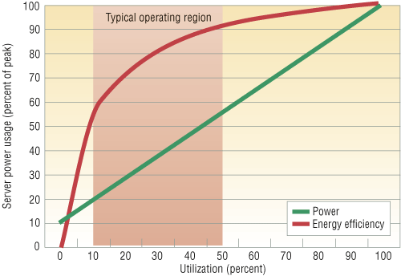
Energy Proportional Computing
“The Case for
Energy-Proportional
Computing,”
Luiz André Barroso,
Urs Hölzle,
IEEE Computer
December 2007
Doing nothing
VERY well
Design for
wide dynamic
power range and
active low power
modes
Figure 4. Power usage and energy efficiency in a more energy-proportional server. This
server has a power efficiency of more than 80 percent of its peak value for utilizations of
30 percent and above, with efficiency remaining above 50 percent for utilization levels as
low as 10 percent.

Slide 47
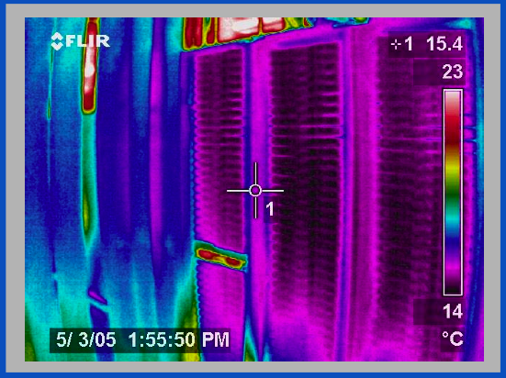
Thermal Image of Typical Cluster
Rack
Switch
M. K. Patterson, A. Pratt, P. Kumar,
“From UPS to Silicon: an end-to-end evaluation of datacenter efficiency”, Intel Corporation

Slide 48
DC Networking and Power
Within DC racks, network equipment often the “hottest” components in the hot spot
Network opportunities for power reduction
  Transition to higher speed interconnects (10 Gbs) at DC scales and densities
  High function/high power assists embedded in network element (e.g., TCAMs)

Slide 49
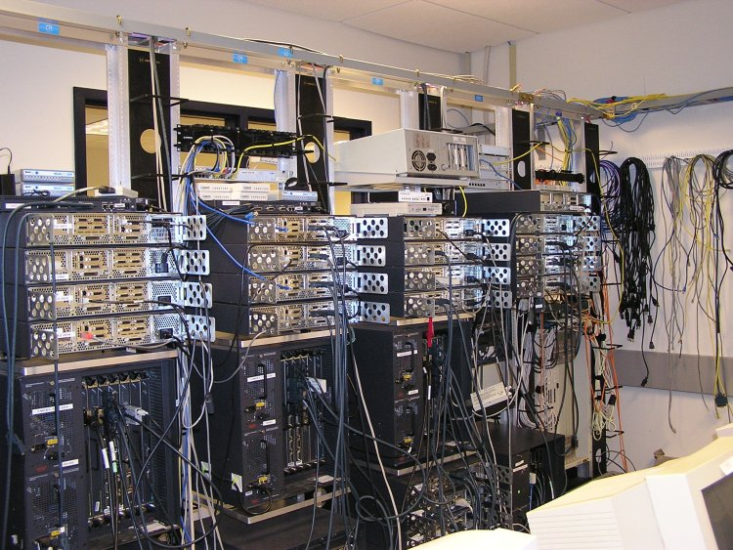
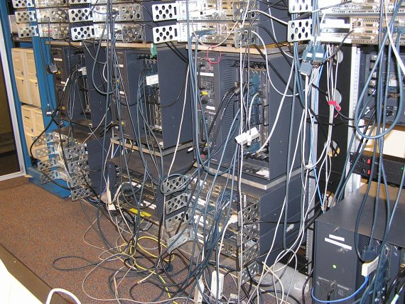
DC Networking and Power
96 x 1 Gbit port Cisco datacenter switch consumes around 15 kW -- approximately 100x a typical server @ 150 W
High port density drives network element design, but such high power density makes it difficult to tightly pack them with servers
Alternative distributed processing/communications topology under investigation by various research groups

Slide 50
Summary
Energy Consumption in IT Equipment
  Energy Proportional Computing
  Inherent inefficiencies in electrical energy distribution
Energy Consumption in Internet Datacenters
  Backend to billions of network capable devices
  Enormous processing, storage, and bandwidth supporting applications for huge user communities
  Resource Management: Processor, Memory, I/O, Network to maximize performance subject to power constraints: “Do Nothing Well”
  New packaging opportunities for better optimization of computing + communicating + power + mechanical

Slide 51
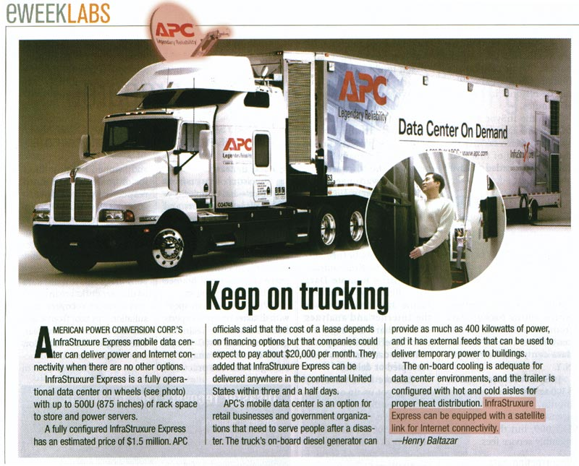

Slide 52
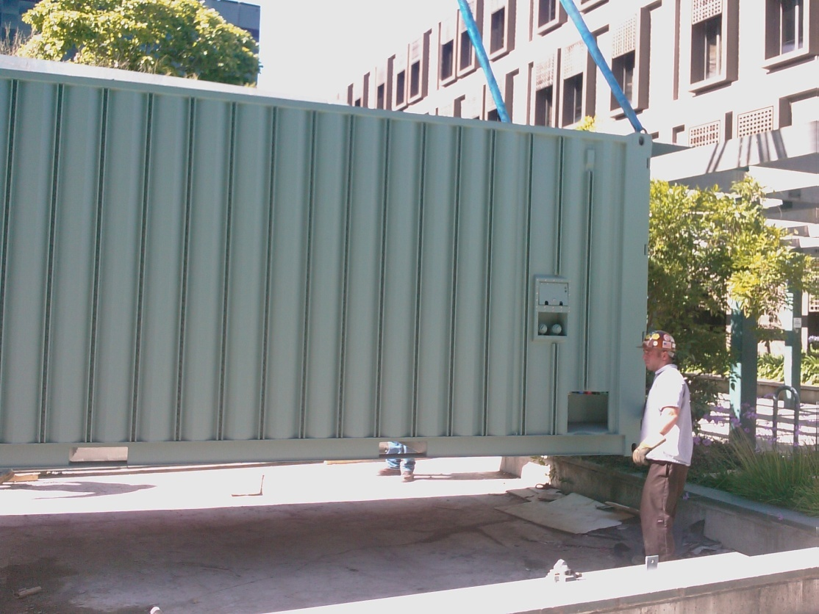
Containerized Datacenters
Sun Modular Data Center
  Power/cooling for 200 KW
  of racked HW
  External taps for electricity,
  network, water
  7.5 racks: ~250 Servers,
  7 TB DRAM, 1.5 PB disk
Notes:
52
2 slides imply many more devices to manage

Slide 53
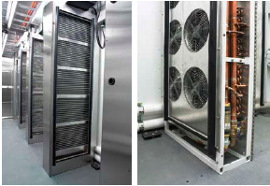
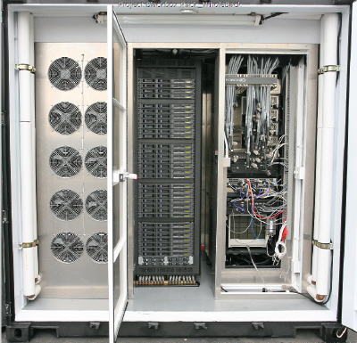
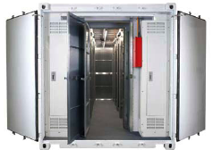
Containerized Datacenters

Slide 54
Aside: Disk Power
IBM Microdrive (1inch)
writing 300mA (3.3V)
1W
standby 65mA (3.3V)
.2W
IBM TravelStar (2.5inch)
read/write 2W
spinning 1.8W
low power idle .65W
standby .25W
sleep .1W
startup 4.7 W
seek 2.3W

Slide 55
Spin-down Disk Model
4.7W
2.3W
2W
Spinning
& Seek
Spinning
up
Request
Spinning
& Access
Trigger:
request or
predict
Predictive
Not
Spinning
Spinning
& Ready
.2W
Spinning
down
.65-1.8W
Inactivity Timeout
threshold*

Slide 56
Disk Spindown
Disk Power Management – Oracle (off-line)
Disk Power Management – Practical scheme (on-line)
IdleTime > BreakEvenTime
access1
access2
Idle for
BreakEvenTime
Wait time
Source: from the presentation slides of the authors
Notes:
56
There are two disk power management schemes, one is called oracle scheme, the other is practical scheme. The oracle scheme is an offline scheme, which know ahead of time the length of upcoming idle period. If the idle time is larger than the breakeven time, the disk will spindown and spinup right in time before the next request. The practical scheme has no such future knowledge. If the disk is idle for a threshold of time, then the disk will spin down and spin up upon the arrival of next request. The previous work show if we set the threshold to be the breakeven time, the practical scheme is 2-compitative compared to the oracle scheme.

Slide 57
Spin-Down Policies
Fixed Thresholds
  T_{out} = spin-down cost s.t. 2*E_{transition} = P_{spin}*T_{out}
Adaptive Thresholds: T_{out} = f (recent accesses)
  Exploit burstiness in T_{idle}
Minimizing Bumps (user annoyance/latency)
  Predictive spin-ups
Changing access patterns (making burstiness)
  Caching
  Prefetching

Slide 58
Google
Since 2005, its data centers have been composed of standard shipping containers--each with 1,160 servers and a power consumption that can reach 250 kilowatts
Google server was 3.5 inches thick--2U, or 2 rack units, in data center parlance. It had two processors, two hard drives, and eight memory slots mounted on a motherboard built by Gigabyte

Slide 59
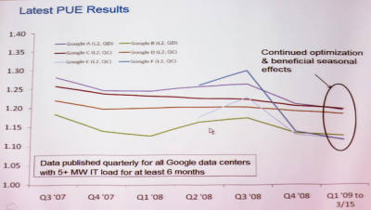
Google's PUE
In the third quarter of 2008, Google's PUE was 1.21, but it dropped to 1.20 for the fourth quarter and to 1.19 for the first quarter of 2009 through March 15
Newest facilities have 1.12

