Slide 1
Sybil Attack
Hyeontaek Lim
15-744
November 12, 2010

Slide 2
Sybil Attack
Generates multiple false identities to attack systems relying on identity
Example - Product rating
  a_honest_user: 2 stars. “Not worth the money.”
  another_honest_user: 1 star. “DOA.”
  john: 5 stars. “Highly recommended.”
  bob: 4 stars. “Well done.”
  sam: 5 stars. “Excellent!”
  Average: 3.4 stars (should be 1.5 stars)

Slide 3
Sybil Attack Domains and Solutions
Domains
  Mobile networks
  Auditing
  Cash economics
  Reputation systems
No solution applies to every case
SybilGuard
CAPTCHA
Brian Neil Levine, Clay Shields, N. Boris Margolin. A Survey of Solutions to the Sybil Attack. 2006.

Slide 4
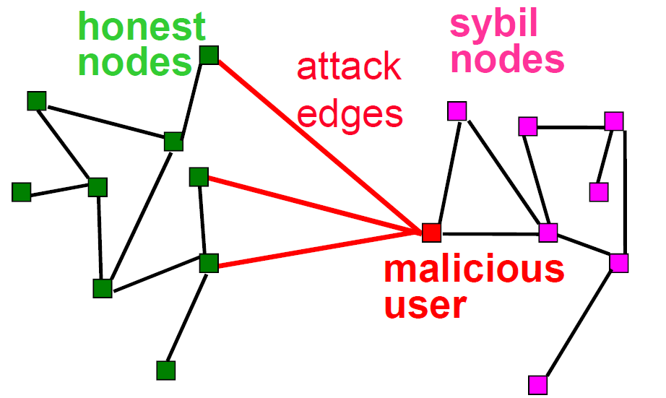
SybilGuard
Use social network to defend against Sybil attack
No extra links btw honest nodes and sybil nodes
Diagrams from authors’ slides

Slide 5
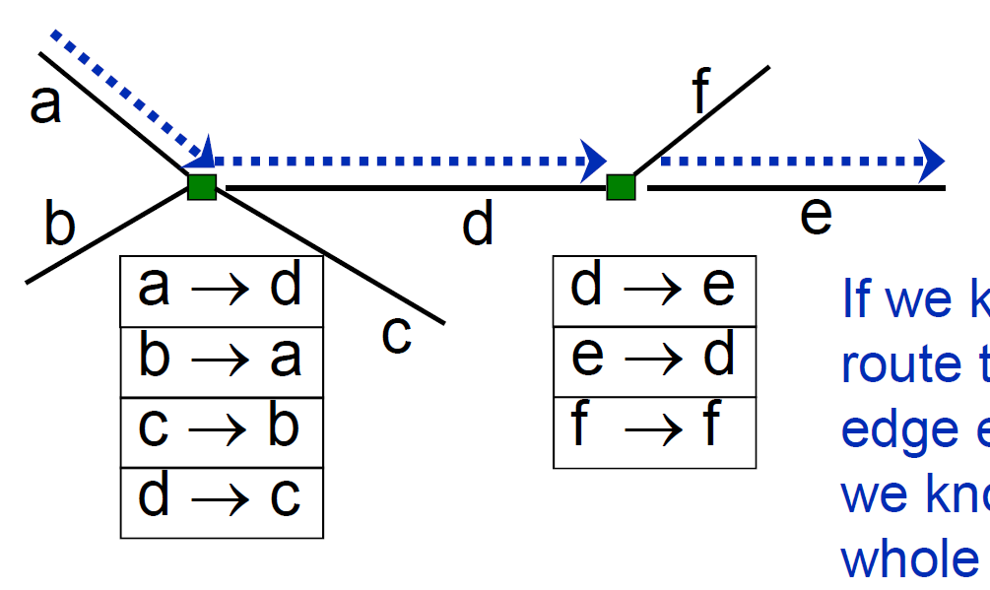
Random Route
1:1 mapping from incoming edge to outgoing edge
  Convergent & back-traceable

Slide 6
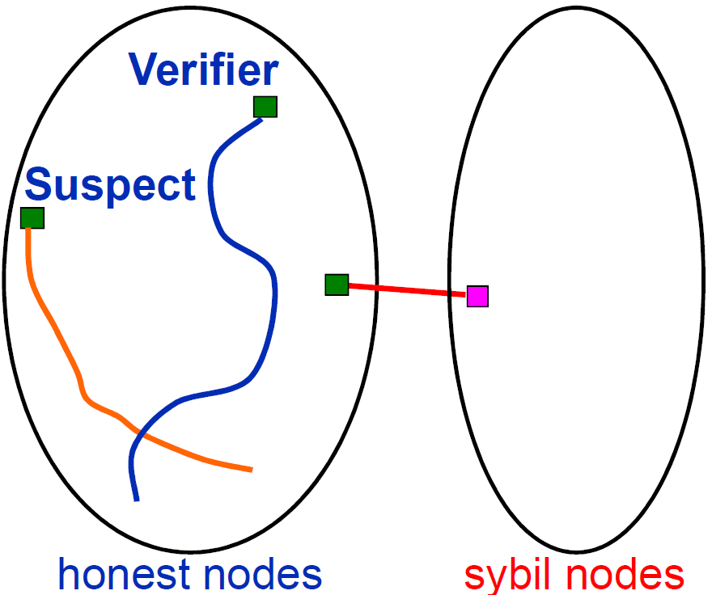
Random Route Intersection
Verifier and suspect use fixed-length random route
Random routes from honest verifier & honest suspect are highly likely to intersect at some point

Slide 7
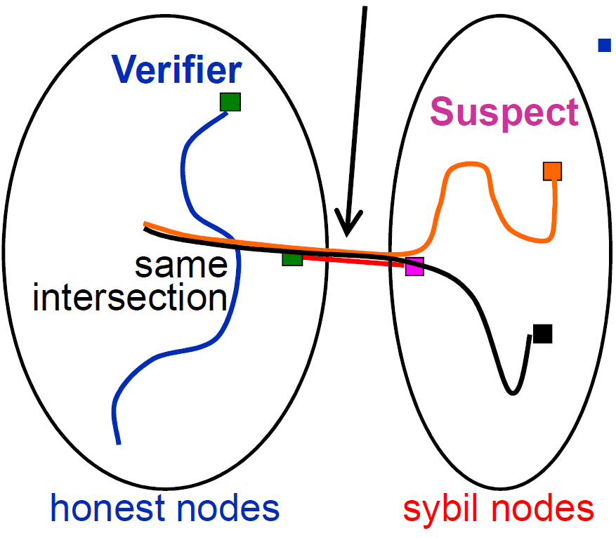
Bounding Number of Sybil Groups
Routes traversing
same edge traverse same intersection point
# of sybil groups <= # of attack edges

Slide 8
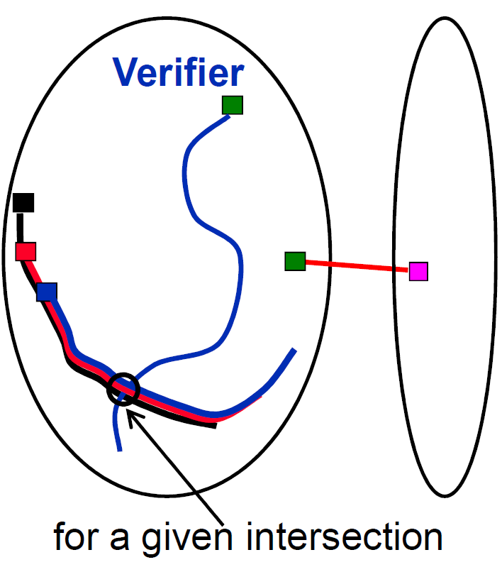
Bounding Size of Sybil Groups
Accept ~[route length] nodes per intersection point
Size of sybil group <= [route length]

Slide 9
Discussion
Validity
  Side effects of using random routes
  No real world evaluation
Limitations from using social network
  Privacy concerns
  Ambiguous notion of trust
  Compromised nodes
Performance
  High-degree nodes

