Slide 1
A Delay-Tolerant Network Architecture for Challenged Internets
Kevin Falls
A Data-Oriented (and beyond) Network Architecture
T. Koponen, M. Chawla, B.G. Chun, A. Ermolinskiy, K.H. Kim, S. Shenker, I. Stoica
Or Sheffet
Nov. 5th, 2010

Slide 2

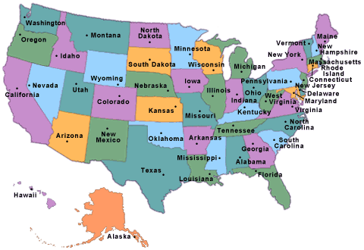

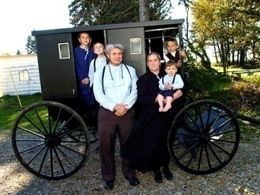

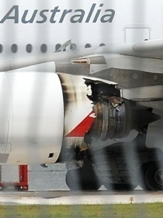


Appreciate Your Mailman!

Slide 3
Challenged Internets
Mobile
Exotic Media
Military
Sensor
…
Approach 1:
“Fool internet protocols into believing they are operating on a well-performing physical infrastructure”.
Approach 2:
Attach Challenged internets “at the edge of the internet”.

Slide 4
Challenging Internets
High latency
  Transmission rates are small.
Disconnection
  No end-to-end connection necessarily
Substantial queuing times
  Storing a message for a long time.
Interoperability
  Local scope, simple design
Security
  Authentication / access control on limited sources, particularly when we have multiple CoS
Limited Longevity
  End nodes may be damaged
  Life cycle < one-way delivery time!
Low Duty Cycle Operation
  A-priori scheduling communication patterns
Low performance
  Limited memory / processors
TCP/IP cannot work!
Best-effort routing isn’t suitable for these scenarios

Slide 5

Approach 1: Fooling IP
“Middle boxes”
Performance Enhancing Proxies
  Fragile
  Violate fate-sharing
  Confound end-to-end diagnostics
Protocol-boosters
  Specialized “internet to challenged-network” protocol translation.
Too specific:
  Can’t reuse for several applications
  Doesn’t use the “special resources the proxy node may have to offer”.

Slide 6

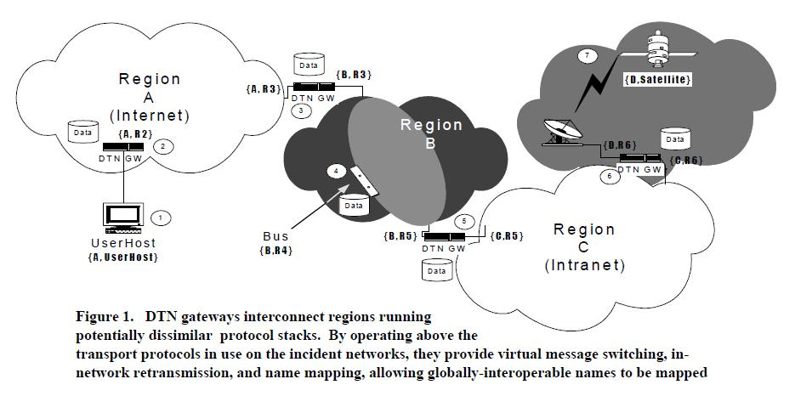
Delay Tolerant Networking
Gateways.
  Translation from one net to another.
  “A point to enforce policy and control”.
  Name mapping.
  Custody transfer.
  Store messages.

Slide 7
Delay Tolerant Networking
Name Mapping
  Name:={Region, Entity}
  Region: Global. Connecting one DTN gateway to another.
  Entity: Local, hierarchical.
  Late binding for name resolution. (NOT prior to destiny resolution!)
Custody Transfer
  Persistent / Non-Persistent nodes.
  Persistent nodes store messages, participate in custody transfer:
  Deliver responsibility for message arriving to destination!
  Hop-by-hop reliability (NOT end-2-end!)
  Violates fate-sharing!
  Might send “acknowledgements” to confirm delivery.

Slide 8
Delay Tolerant Networking
Path Selection
  Cascading time-dependant ad-hoc contacts.
Convergence Layers and Retransmission
  Forwards bundles, using convergence layer (augmenting different transport-protocols if needed, to get “underlying reliable delivery capability”+message boundaries).
Time Synchronization
  Requires synchronization, on a coarse level granularity
  May help congestion control
Security
  Verifiable access to the challenged net. (Routers check credentials.)
  Sender -> DTN -> DTN -> … -> DTN -> destination.
  Discard traffic a.s.a.p
  Cache keys for local senders + DTNs only.
Congestion/Flow Control
  Flow: To next hop. Congestion: Message storage in a node.
  Flow: Proactive (admission control) vs. reactive (direct flow control).
  Control: Rejecting message upon full buffer; custody transfers; discarding non-custody
  Approach: priority queue for custody storage.
    Priority inversion
    Head of line blocking

Slide 9
Discussion
Agreement as to the general approach.
  Even if it does violate fate sharing.
Implementation?
  Is it applicable?
Architecture?
  What’s the underlying mechanism?
Evaluation? Overhead issues.
  What are the good evaluations?
Need we talk to all these networks?
  Most communication is internal…
Analogy to mail incomplete: No supervising authority!
Objections to the other approach:
  Does he push the specification “under the rug”?
  Does DTN uses the specialized resources?

Slide 10
A Delay-Tolerant Network Architecture for Challenged Internets
Kevin Falls
A Data-Oriented (and beyond) Network Architecture
T. Koponen, M. Chawla, B.G. Chun, A. Ermolinskiy, K.H. Kim, S. Shenker, I. Stoica

Slide 11
DONA
“We take a clean-slate look at naming”.
“The user cares about content and is oblivious to location”.
Goal – same issues as in CCN:
  Persistence: Name should remain valid as long as data is available.
  Availability: Seek (and get) nearby copies of data.
  Authenticity (NOT trust-worthiness): No spoofing!
Major redesign of internet naming.
  Naming for Persistence and Authenticity,
  Name resolution for availability

Slide 12
DONA’s Basic Functionality
Naming
  Flat
  Organized by principals. Each principal in charge of its own data naming.
  Composed of “P:L”
    P: hash of principal; L: label chosen by principal
  Convert human-readable names to DONA names.
Name Resolution
  FIND(P:L) – Locate the data by name. Using a tree hierarchy of RHs.
  REGISTER(P:L) – Add a name to RHs w.r.t proximity to data.
“On top of Basic” / Extensions:
  Improved content delivery: via caching, adding TTLs to FIND, avoiding overloaded servers.
  DTNs: RH can be custody agents.
  Access rules + middleboxes: append FIND with authentication, imposing firewall’s required authentication.

Slide 13
Discussion
Preceding the CCN paper.
Do discuss implementation, feasibility and experimental results.
  HTTP
  Session Initiation Protocol
  Large-files (P2P)
  RSS
“Every aspect of the design is (proudly) stolen from elsewhere”.
Is the “naming revolution” feasible?

