Slide 1
Network Topology
Julian Shun

Slide 2
On Power-Law Relationships of the Internet Topology (Faloutsos 1999)
Observes that Internet graphs can be described by “power laws” (P[X > x] = kª x^{-a} L(x) )
Introduces power-law exponents to characterize Internet graphs
Comments
  Limited data
    Especially linear fit to measure hop-plot exponents (Fig. 7 and 8)
  How well have power laws held up since 1999?
  Explanatory power of power-law exponents?
  Other metrics?

Slide 3
Data
Power Laws and the AS-Level Internet Topology (Siganos, Faloutsos, 2003)
  Use much more data, obtained from Route Views
  Shows that power laws continue to hold for AS topology over 5 year interval
  Variation of power-law exponents less than 10%

Slide 4
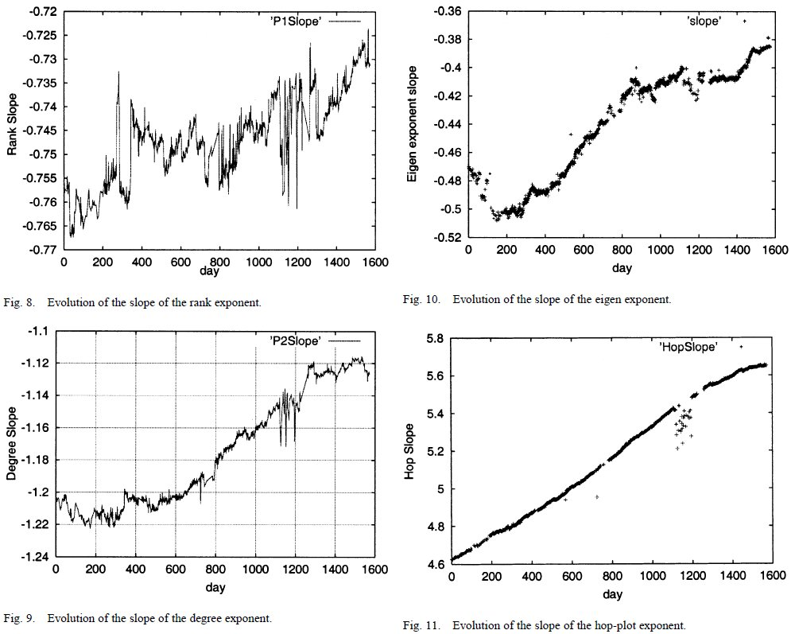
5-year intervals of exponents

Slide 5
Data
Measuring ISP Topologies with Rocketfuel (Spring, Mahajan and Wetherall, 2002)
  Obtains much more router-level data, and show that the topologies mostly obey a power law
Faloutsos’ 1999 paper won "Test of Time" award at SIGCOMM 2010

Slide 6
A First-Principles Approach to Understanding the Internet’s Router-level Topology (Li et.al. 2004)
Argues that previous metrics do not accurately model real Internet graphs
Introduces metrics based on first principles, such as throughput, router utilization, end user bandwidth distribution, likelihood metric
Comments
  Does not use real Internet data in evaluation
  Does not incorporate robustness into model
  Applicable to AS-level topology?
  Other metrics?

Slide 7
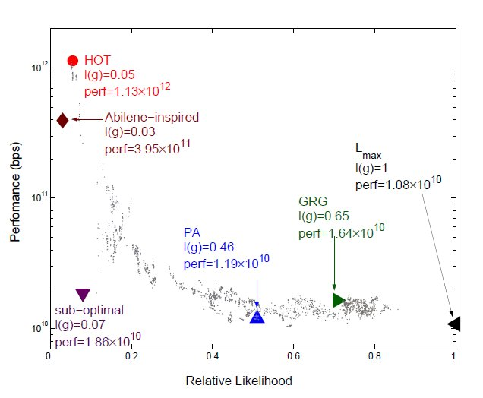
Data

Slide 8
Applicability to AS-level topology
Too many factors, such as political and economical ones, to consider
AS graph, Web graph, P2P networks left for future work

Slide 9
Other metrics
Distance distribution d(x) – the number of pairs of nodes distance x, divided by the total number of pairs (Shenker et.al. 2002)
Betweenness – weighted sum of # of shortest paths passing through a node or link (related to router utilization) (HOT paper and Shenker et.al. 2002)
Clustering C(k) – how close neighbors of the average k-degree node are to forming a clique (Bu and Towsley 2002)
dK-distribution – describes the correlation of degrees of d connected nodes (Vahdat et. Al. 2006)

Slide 10
Why is this important?
Gain more insight into structure of Internet
Create graph generators that produce “Internet-like” graphs for testing
Open question: How can we model the time evolution of Internet graphs?

