Slide 1
In Defense of Wireless
Carrier Sense
Ramya Mudduluri
Notes:
Figures are taken from the paper :
In Defense of Wireless Carrier Sense
Micah Z. Brodsky
MIT CSAIL
micahbro@csail.mit.edu
Robert T. Morris
MIT CSAIL
rtm@csail.mit.edu

Slide 2
Introduction
Carrier Sense uses the feedback from a receiver to decide if the sender should transmit
For large networks considering to reuse the network, carrier sense fails due to
- Exposed terminal problem
- Hidden terminal problem

Slide 3
Contributions
Analysis showing Carrier Sense provides nearly optimal throughput in general case
Identification of several distinct behavioral regimes for Carrier Sense, which perform well except one which typically encounters bad behavior
A model for high-level properties of adaptive bit-rate radio throughput

Slide 4
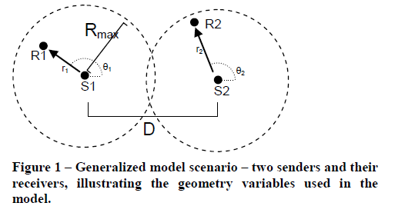
Formal Model

Slide 5
Carrier Sense Behavior Limiting Cases
Long Range Networks
When the pairs are far apart (D>>Rmax)
- Concurrency is optimal for receivers within Rmax (pairs interfere insignificantly)
When the pairs are very close (D<<Rmax)
- Multiplexing is optimal (since SNR would approach 0dB)
Short Range Networks
An interferer who is close enough to cause trouble effects all the receivers. Carrier sense performs well in this case.

Slide 6
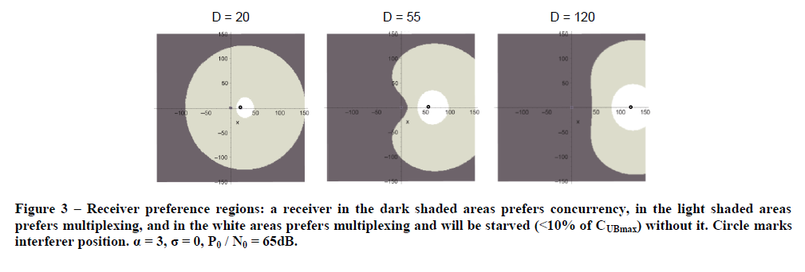
Preference Regions

Slide 7
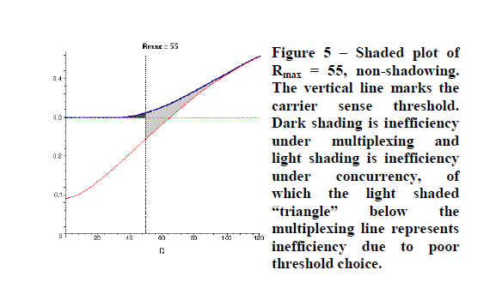

Choosing a Threshold

Slide 8
A Comparison of Mechanisms for Improving TCP Performance over
Wireless Links

Slide 9
Introduction
TCP invokes congestion control and avoidance algorithms to provide a reliable transfer
Problem
Networks with wireless and lossy links suffer from losses due to bit errors and handoffs significantly
Even in these scenarios TCP invokes congestion control and avoidance mechanisms which degrades end-to-end performance

Slide 10
Approaches
Hide non-congestion-related losses from the sender, so that the problem is solved locally
- reliable link-layer protocols (AIRMAIL), split connection (Indirect-TCP), TCP aware link-layer (Snoop protocol)
Make the sender realize that the packet losses are not due to congestion.

Slide 11
Basic Groups (Solutions)
End-to-end proposal
- SACKs, ELN,
Split Connection Protocols
- Uses NACKs, SACKs between Base Station and Destination
Link-layer proposals
- Forward Error Corrections (FEC)

Slide 12
Evaluation
Goodput = Actual transfer size/Total number of bytes transmitted over the path
Shielding TCP sender from duplicate ACKs caused by wireless losses improves throughput by 10-30%
SACKs, ELN result in significant performance improvements

