Slide 1
Networking with Wi-Fi like Connectivity
White Space
Victor Bahl, Ranveer Chandra, Thomas Moscibroda,
Microsoft Research
Rohan Murty*, Matt Welsh
Harvard University

Slide 2
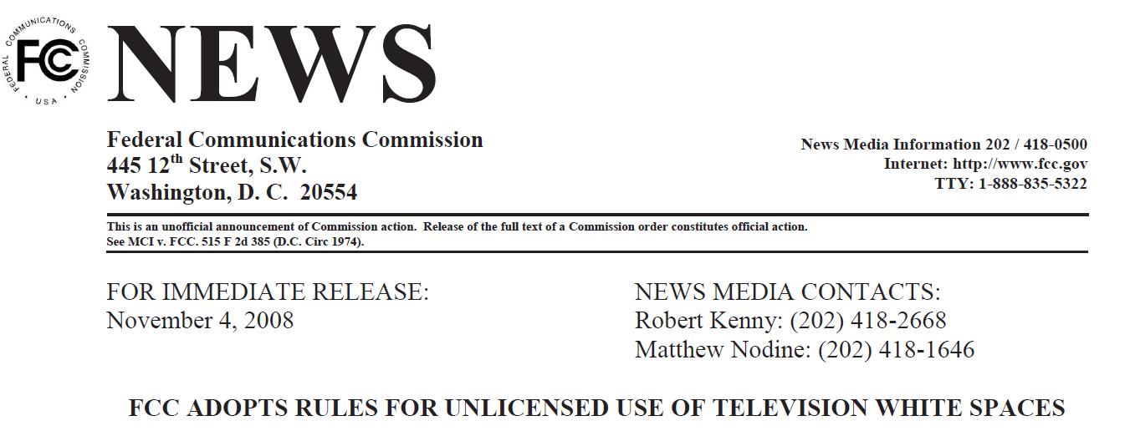
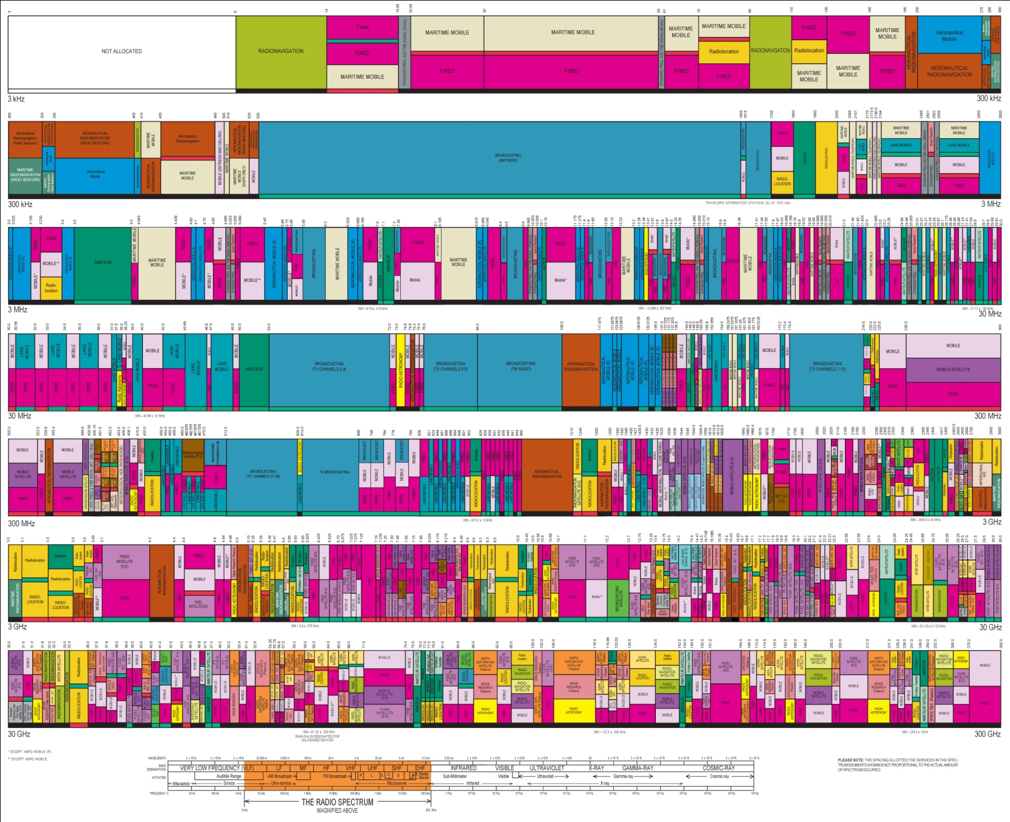



Analog TV → Digital TV
USA (2009)
Spain (2010)
Japan (2011)
Canada (2011)
UK (2012)
China (2015)
….
….
…..
Higher Frequency
Broadcast TV
Wi-Fi (ISM)

Slide 3


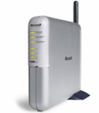
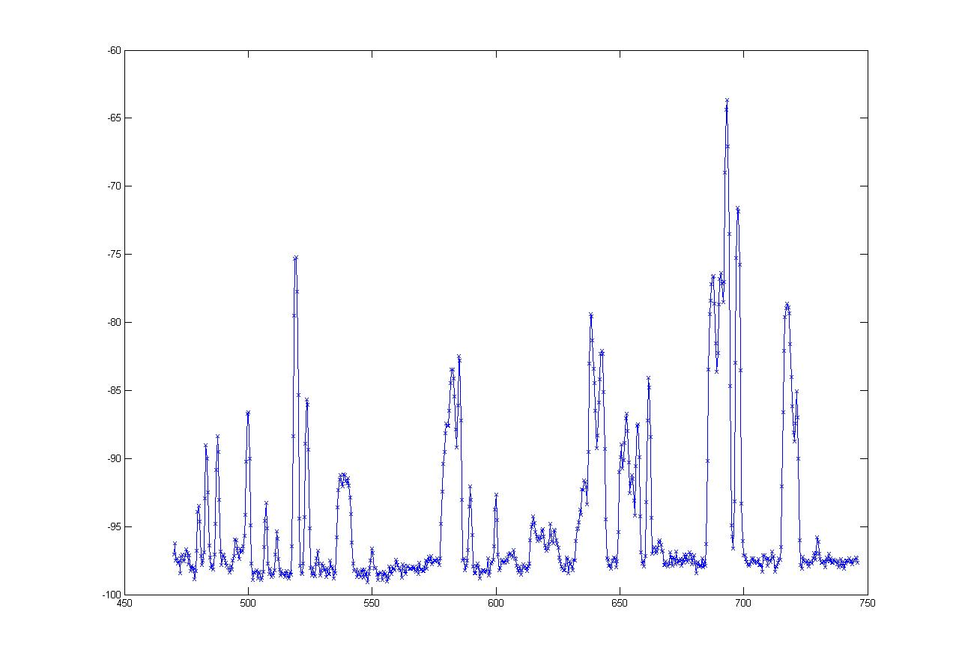
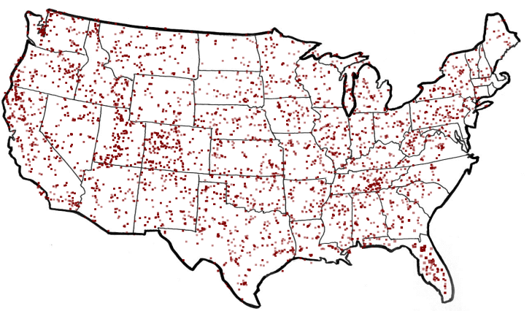
What are White Spaces?
TV
Wireless Mic
ISM (Wi-Fi)
0
MHz
54-90
170-216
470
700
2400
2500
5180
5300
7000
MHz
  50 TV Channels
  Each channel is 6 MHz wide
-60
“White spaces”
dbm
FCC Regulations*
    Sense TV stations and Mics
    Portable devices on channels 21 - 51
TV Stations in America
-100
470 MHz
Frequency
700 MHz
are Unoccupied TV Channels
White Spaces

Slide 4
Why should we care about White Spaces?

Slide 5
The Promise of White Spaces
TV
Wireless Mic
ISM (Wi-Fi)
0
MHz
470
700
2400
2500
5180
5300
54-90
174-216
7000
MHz
}
More Spectrum
Up to 3x of 802.11g
Potential Applications
Rural wireless broadband
City-wide mesh
……..
Longer Range
……..
at least 3 - 4x of Wi-Fi

Slide 6




Goal: Deploy Infrastructure Wireless
Base Station
(BS)
Good throughput for all nodes
Avoid interfering with incumbents

Slide 7
Why not reuse Wi-Fi based solutions, as is?

Slide 8
White Spaces Spectrum Availability
Differences from ISM(Wi-Fi)
Fragmentation
Variable channel widths
1
2
3
4
5
1
2
3
4
5
Each TV Channel is 6 MHz wide
Spectrum is Fragmented
⇒ Use multiple channels for more bandwidth

Slide 9
White Spaces Spectrum Availability
Differences from ISM(Wi-Fi)
Fragmentation
Variable channel widths
Spatial Variation
Cannot assume same
channel free everywhere
1
2
3
4
5
1
2
3
4
5
TV
Tower
Location impacts spectrum availability
⇒ Spectrum exhibits spatial variation

Slide 10


White Spaces Spectrum Availability
Differences from ISM(Wi-Fi)
Fragmentation
Variable channel widths
Spatial Variation
Cannot assume same
channel free everywhere
1
2
3
4
5
Temporal Variation
1
2
3
4
5
Same Channel will
not always be free
Any connection can be
disrupted any time
Incumbents appear/disappear over time
⇒ Must reconfigure after disconnection

Slide 11
WhiteFi System
Prototype Hardware Platform
Base Stations and Clients
Algorithms
Discovery
Spectrum Assignment
and Implementation
Handling Disconnections
Evaluation
Deployment of prototype nodes
Simulations

Slide 12
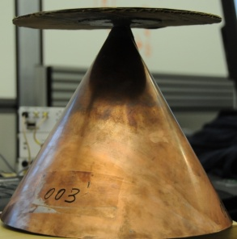
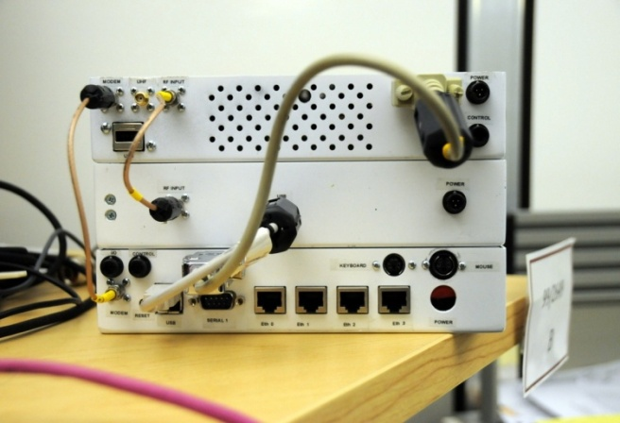
KNOWS White Spaces Platform
Windows PC
Scanner (SDR)
Net
Stack
TV/MIC detection
FFT
FPGA
UHF RX Daughterboard
Whitespace Radio
Connection Manager
Atheros Device Driver
Wi-Fi Card
UHF
Translator
Variable Channel Width Support*
*Case for Adapting Channel Widths, SIGCOMM 2008

Slide 13

WhiteFi System Challenges
Fragmentation | Spatial Variation | Temporal Variation | Impact
Discovery
Spectrum
Assignment
Disconnection

Slide 14
Discovering a Base Station
1
2
3
4
5
1
2
3
4
5
Discovery Time = Ο(B x W)
How does the new client discover channels used by the BS?
Can we optimize this discovery time?
BS and Clients must use same channels
Fragmentation
⇒ Try different center channel and widths

Slide 15
Whitespaces Platform: Adding SIFT
PC
Scanner (SDR)
Net
Stack
TV/MIC detection
FFT
FPGA
UHF RX Daughterboard
Temporal Analysis
(SIFT)
Whitespace Radios
Connection Manager
Atheros Device Driver
Wi-Fi Card
UHF
Translator
SIFT: Signal Interpretation before Fourier Transform

Slide 16
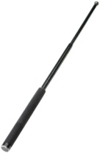
SIFT, by example
10 MHz
5 MHz
ADC
SIFT
SIFT
Data
ACK
Does not decode packets
Amplitude
SIFS
Pattern match in time domain
Time

Slide 17
BS Discovery: Optimizing with SIFT
1
2
3
4
5
1
2
3
4
5
18 MHz
Matched against 18 MHz packet signature
Amplitude
Time
SIFT enables faster discovery algorithms

Slide 18
BS Discovery: Optimizing with SIFT
Linear SIFT (L-SIFT)
1
2
3
4
5
Jump SIFT (J-SIFT)
1
2
3
4
5
6
7
8

Slide 19
Discovery: Comparison to Baseline
Baseline =Ο(B x W)
L-SIFT = Ο(B/W)
J-SIFT = Ο(B/W)
2X reduction

Slide 20
WhiteFi System Challenges
Fragmentation | Spatial Variation | Temporal Variation | Impact
Discovery
Spectrum
Assignment
Disconnection

Slide 21
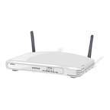
Channel Assignment in Wi-Fi
1
6
11
1
6
11
Fixed Width Channels
⇒ Optimize which channel to use

Slide 22
Spectrum Assignment in WhiteFi
Spectrum Assignment Problem
Goal
Maximize Throughput
Include
Spectrum at clients
1
2
3
4
5
1
2
3
4
5
Center Channel
Assign
&
Width
Fragmentation
⇒ Optimize for both, center channel and width
Spatial Variation
⇒ BS must use channel iff free at client

Slide 23
Accounting for Spatial Variation
1
2
3
4
5
1
2
3
4
5
1
2
3
4
5
∪
∪
=
1
2
3
4
5
1
2
3
4
5
1
2
3
4
5
1
2
3
4
5

Slide 24
Intuition
Intuition
Use widest possible channel
BS
But
Limited by most busy channel
1
2
3
4
5
Carrier Sense Across All Channels
All channels must be free
  ρ_{BS}(2 and 3 are free) = ρ_{BS}(2 is free) x ρ_{BS}(3 is free)
Tradeoff between wider channel widths
and opportunity to transmit on each channel

Slide 25

Multi Channel Airtime Metric (MCham)
BS
MCham_{n} (F, W) =
1
2
3
4
5
Pick (F, W) that maximizes
(N * MCham_{BS} + Σ_{n}MCham_{n})
ρ_{n}(c) = Approx. opportunity node n will
get to transmit on channel c
ρ_{BS}(2) ∝
ρ_{BS}(2) ∝ Free Air Time on Channel 2
ρ_{BS}(2) = Max (Free Air Time on channel 2, 1/Contention)

Slide 26
WhiteFi Prototype Performance
25
26
27
28
29
30
31
32
33
34
35
36
37
38
39
40

Slide 27
Conclusions and Future Work
WhiteFi: White Spaces based wireless network
  Go beyond considerations of a single link
  Change in spectrum access paradigm
    SIFT for quick BS discovery
    MCham to assign spectrum
    Handling Disconnections
On-going work: Campus wide deployment
Notes:
-deployment on 4KM radius

Slide 28


Questions?
rohan@eecs.harvard.edu

