Slide 1
Advanced Android Programming
George Nychis
Srinivasan Seshan

Slide 2
A Recap of Last Lecture
Use these lectures as a reference, in addition to documentation
Last Lecture: A higher level overview and the basics
Application and interface basics
Application and hardware permissions (“Android Manifest”)
How to multi-thread on Android (“AsyncTask”)
How info is passed between threads, interface, HW (“Intents”)

Slide 3
Advanced Android Topics
The first mile on Android: relatively straight forward
Should already know Java
GUI is roughly drag and drop
Lots of documentation and examples online…
Let’s get a little more advanced…
Debugging on an Android device
Persistent application storage (Preferences, Database)
Writing and linking non-Java code (e.g., C and C++)
Cross-compiling useful libraries to Android
Modifying the kernel (e.g., to add support, remove permissions)
NFC support

Slide 4
Some More Advanced Layouts
As mentioned, we have a research project on Android which uses a lot of advanced features and different layouts
Good examples of how to embed layouts within each other…
These layouts are available in our project:
https://github.com/gnychis/android-wmon/tree/master/application/res/layout

Slide 5
Root: What do you need it for?
Like “jailbreaking” -- a term most are familiar with
Think of it as: it literally just gives you Linux root access
What don’t you need it for?
Writing a standard application that uses standard APIs and HW
Writing native code that does not touch some aspects of F.S.
What do you need it for?
Modifying and replacing the kernel
E.g., to remove permission checks, modify TCP, modify WiFi stack…
Loading and/or removing new kernel modules
Modifying anything in /system or snooping around /data
Modifying the Android OS or APIs
Changing the ROM on the device (new OS + kernel)

Slide 6
Debugging
As usual, two ways to have debug information:
Android has a logging utility to print information to
Full debugger through ADB and Eclipse
Logging utility: good for printing periodic status of application and/or certain variables
Debugger: great for stepping through code, able to:
Set breakpoints and conditions
Check the values of any variable
Tag
Message

Slide 7
Debugging Example
Live demo…

Slide 8
Persistent Storage
You are likely going to want to persistently store data
In Android, there are 5 main ways to store data:
Shared Preferences – private key-value pair storage
Internal Storage – private storage per-application
External Storage – local shared storage (e.g., on SD card)
SQLite Database – private structured data
Network Storage – store data on your own server
You should be able to make a decision on which solution is best for various data in your application
Use multiple storage options!

Slide 9
Shared Preferences Overview
Good for basic data storage, simple examples:
Has the user completed the application settings? (boolean)
What is the user’s username? (string)
Shared Preferences accessed by string key, value can be:
boolean, float, int, long, string
Arbitrary objects cannot be stored in Shared Preferences, best two options for arbitrary objects:
Marshal to/from a private database (best)
Marshal to/from binary files in private storage

Slide 10
Shared Preferences Example
Name preference file (does not need to be globally unique)
Get a handle to your preferences:
Can read in values by key, specify value if does not exist
Writing needs specific handle, and need to commit all changes
Do not forget

Slide 11
SQLite Database
Should hopefully know the basics of databases
Best to store your main data/objects
Marshal your classes to and from a row in a database
Android provides some useful helper classes
SQLiteDatabase, Cursor, ContentValues….
Ultimately, I want to push you in the right direction, but you should be able to find the details…
Good example: http://www.androidhive.info/2011/11/android-sqlite-database-tutorial/

Slide 12
Writing Native Code (JNI)
JNI: framework that allows Java code to call, or be called by, native applications/libraries in other languages
E.g., Java code can call a function written in C++, and visa-versa
Easiest way to integrate pre-existing code and libraries in other languages (e.g., a pre-existing C encryption library)
Good to implement certain functionality which can be written more optimally in C, for example
Native code still runs within the application’s VM
Follows AndroidManifest (e.g., need “INTERNET” for sockets)
Android NDK: Toolset integrate/compile JNI in to Android app

Slide 13
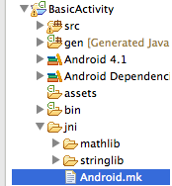
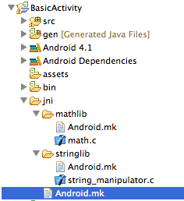
The Structure of Native Code
Directory structure: native code fits in “jni” directory
ndk-build uses Android.mk in each native directory

Slide 14
Top-Level Android.mk
Best way to make top-level Android.mk:
You can cross-reference in-between libraries
E.g., stringlib can use a function found in mathlib, the stringlib Android.mk file just needs to specify it links mathlib
List each subdirectory for ndk-build to enter and build individually.

Slide 15
Individual Library Android.mk
Each library needs its own Android.mk, with:
Local source files, linker/compiler flags, output (e.g., shared lib)
Something a little more advanced, for example:
Creates lib_____.so (i.e., libawmon.so)

Slide 16
Simple Native C Code Example
Need to include JNI environment header, logging also useful
Native function is passed …
Java environment: often used to allocate new Java objects
Java class object:
Your Parameters: any C/C++ primitives
__android_log_print(ANDROID_LOG_INFO, “NativeMath”, ”Error: %d”, eval);
Must match the class accessing and calling the native code (case sensitive)
Must match your package name
(case sensitive)

Slide 17
Building NDK Code
Make sure ndk-build is in your PATH env. Variable
Standard Android documentation should get you this far…
From the base of your application directory (outside jni dir):
All of your built libraries are copied to libs/armeabi/

Slide 18
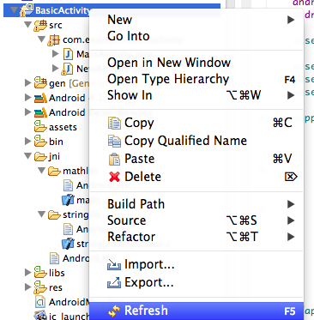
The Eclipse Gotcha
YOU MUST REFRESH YOUR DIRECTORY IN ECLIPSE!!
Eclipse does not look for changes, even if you were to rebuild app
You must refresh every time you run ndk-build otherwise your changes will not be included
Maybe something built in to Eclipse now?

Slide 19
Accessing Native Code in Java
Must load each native library: e.g.,
Can be done in any class or thread
It is a blocking call, to keep in mind if loading large libraries…
Must create native function prototypes in respective classes:
Once done, you can access these functions directly:

Slide 20
Using External Libraries
“I need a library to help me with _____, but it is a standard C or Linux implementation” (e.g., crypto library)
Proceed in this order:
Google “____ Android” – many libraries already cross-compiled
Write custom Android.mk to cross-compile it
You will be surprised how many libraries you find cross-compiled, and even if an older version: use their Android.mk

Slide 21
Cross-Compiling Libraries
For many libraries, look at the Makefile and see which source files it uses to build the library
Add these sources to Android.mk “LOCAL_SRC_FILES”
Use similar CFLAGS, LDFLAGS
Common for libraries to link to pthread, remove –lpthread but keep most pthread code. Custom pthread force linked
Look at the many examples online, including our own:
libpcap, libnl, libgcrpyt, libglib, libgpg, libusb ….
https://github.com/gnychis/android-wmon/tree/master/application/jni

Slide 22
Modifying the Kernel
Several key steps to modifying the kernel…
Obtaining the proper source code for HW + OS version
If you get the wrong kernel: phone will not boot (I’ll help you…)
Modifying the kernel (we’ll give you some pointers…)
Cross-compiling the kernel using the NDK
Installing the kernel (BE CAREFUL: CAN BRICK PHONE)
Best to use something called “AnyKernel” package
This needs to be done in Linux (e.g., in a Virtual Machine)

Slide 23
Obtaining Kernel Source Code
The two possible phones you are using for this class:
Galaxy Nexus: code name “maguro” (“tuna” for kernel)
Galaxy S: code name “crespo”
Best to start at this link: https://android.googlesource.com/
Kernel source code depends on the HW, for you:
Galaxy Nexus: https://android.googlesource.com/kernel/omap.git
Nexus S: https://android.googlesource.com/kernel/samsung.git
In “About Phone” you can find your git kernel commit:
3.0.31-g<hash> (i.e., d5a18e0)
… make sure to drop the g that is prepended to the hash

Slide 24
Building the Kernel
Build using cross-compiler provided by Google:
Setup your environment:
Checkout your kernel version: git checkout <hash>
Setup with the proper configuration
Galaxy Nexus: make tuna_defconfig
Nexus S: make crespo_defconfig
Finally, you can build with: make

Slide 25
Packaging the Kernel – Pt1
Need to create a ramdisk with the the proper init scripts
Can be extracted from the device, but we will provide you with it
See example…
Modifications to ramdisk are needed if you want to:
Load kernel modules on boot
Set permissions to certain devices/files on boot
Change the order services are initialized

Slide 26
Packaging the Kernel – Pt2
This is very tricky, and must be done properly or you will “brick” the phone, i.e., it will not boot and must be repaired
Install without building the entire OS by creating “update” ZIP
Runs a script to mount FS and extract kernel & modules
Usually includes system directory which is extracted
What the updater script looks like for Galaxy Nexus:

Slide 27
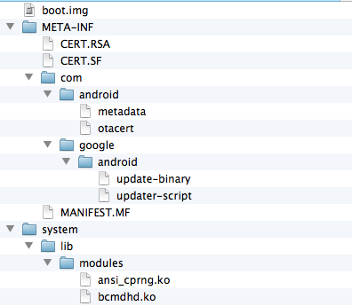
Packaging the Kernel – Pt3
Example hierarchy of the update ZIP
Boot image with kernel at root
These are standard
Specific to device,
updater script
MUST put all kernel modules in here that were rebuilt with kernel

Slide 28
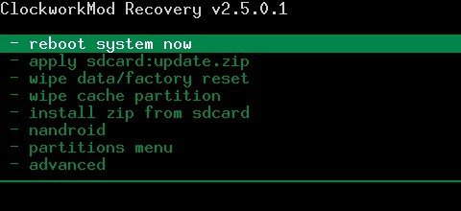
Installing the Kernel
Need to use “recovery” mode on the phone to install
Dedicated, bootable partition with recovery console
Put your updater zip on your SD card, then:
Use recovery to install the ZIP

Slide 29
Kernel Pointers
Based on the project page, some kernel locations you might be interested in….
WiFi Driver: drivers/net/wireless/bcmdhd
TCP Protocol / Sockets:
net/ipv4
include/net
Permissions (e.g., sockets): kernel/capability.c

Slide 30
Near Field Communication
Low rate short distance wireless communication
Approx. 10 centimeters supported
424 kbit/s across 13.56MHz
Current applications: payments, smart posters, check-ins…
Two major NFC modes:
Reader / Writer mode
Peer-to-Peer mode (emulate tags on Android)
Nexus S was first phone to really “mainstream” NFC

Slide 31
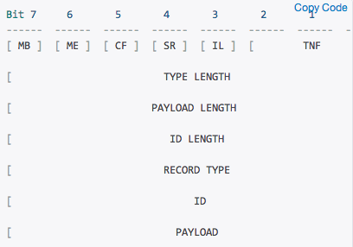
NDEF (NFC Data Exchange Format)
Standard data format created by NFC Forum
NDEF Messages: basic transportation mechanism
Can contain one or more NDEF Records
NDEF Record: contain specific structure with payload
TNF contains the record type (e.g., URI)

Slide 32
Tag Read / Write Example
Start with basic tag read and write example
Includes P2P mode ability
This was an example posted by Google that we modified to make a little more intuitive
Sample code was posted for you:
https://github.com/gnychis/stickynotes

Slide 33
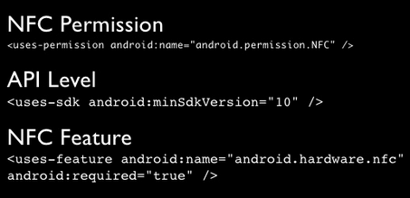
The Basic NFC Permissions
As usual, you need to have Android permissions
Important to specify minimum SDK
Ensure that the phone has NFC support

Slide 34
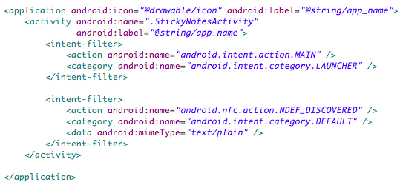
Receiving NFC Tag Information
Remember, all information in Android is broadcast
For NFC, you register to receive TAG read broadcasts:

Slide 35
Registering for NFC Data
Specify that the Activity should receive NFC Intents:
Can specify which data types the application should receive:
Need a handle to the “NFC Adapter” (i.e., hardware)
Apply and enable the filter in onResume()

Slide 36
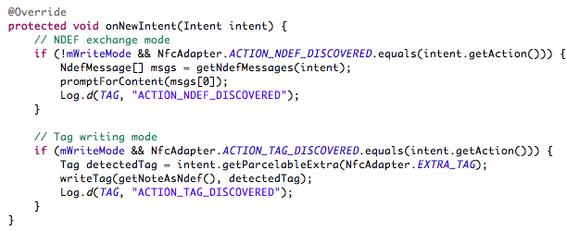
Receiving the NFC Data – Pt1
Receive callbacks in “onNewIntent()” you override:

Slide 37
Receiving the NFC Data – Pt2
NDEF Messages come in as an array
Then, you can go through the msgs array and get the payload:

Slide 38
Detecting Nearby Tag to Write
Just like you registered to receive NFC tag data, you register to know when a tag is simply detected and then use it to trigger a write to it:
When the user specifies to write, you enable this filter and use a software flag to know that you should write when the tag is detected nearby:

Slide 39
Writing to a Nearby Tag
Once you detect a tag is nearby, you should ensure:
The tag is not read-only
The tag’s capacity is sufficient
See the following code to perform those checks and actually write the message:

Slide 40
Wrap-up
Over time, I will fill in this wiki:
Expect to find there (in the next 2 weeks):
Links to your kernel sources
Links to your ramdisks for each of the phones
Scripts to help you build and package the kernels
If you want to root your phone…
Ask for permission (it voids the warranty), and come to us
We will root it for you
http://moo.cmcl.cs.cmu.edu/wiki/index.php/Main_Page#Android

