Slide 1
Intro to Android Programming
George Nychis
Srinivasan Seshan

Slide 2
Over the next two lectures…
Use these lectures as a reference, in addition to documentation
Today: A higher level overview and the basics
  Application and interface basics
  Application and hardware permissions (“Android Manifest”)
  How to multi-thread on Android (“AsyncTask”)
  How info is passed between threads, interface, HW (“Intents”)
Next Week: Advanced topics on Android
  Persistent application storage (Preferences, Database)
  Writing and linking non-Java code (e.g., C and C++)
  Cross-compiling useful libraries to Android
  Modifying the kernel (e.g., to add support, remove permissions)
  USB host support (to access external peripherals)

Slide 3
Quick Overview
Quick Overview
  Architecture: ARM
  OS: stripped down version of Linux
    E.g., Full linux kernel, but custom libraries (libc, libpthread…)
  Programming Language: Java with some customization
Applications are run in Dalvik VM for isolation, optimization
Android SDK vs. NDK
  SDK: build main application code and interface
  NDK: toolset to build/port “native” code and libraries in C/C++

Slide 4
ADB: Android Debug Bridge
ADB command line tool and program that:
  Has a client on your development machine (“adb”)
  Runs a server on your development machine
  Runs a daemon on your development device (i.e., phone/tablet)
ADB is what gets your code from machine to device, and sets up a bridge for true debugging (step by step) on device
Some useful “adb” commands:
  adb devices – shows your currently connected devices
  adb connect xxx.xxx.xxx.xxx – connect to device wirelessly
  adb shell – opens up a terminal/shell on your device
  adb push <file> <dest> -- send <file> to <dest> folder on device
  adb pull <dest_file> <local> -- get <dest_file> from dev, save to…

Slide 5
Application Basics
Activities: single focused user interaction, mainly for UI
  Typically used to create a full screen windows, dialogues
Activities run on their own thread
  Any code that runs on the UI thread will lock up the UI!
  Main “work” should be done in threads (we will get to this…)
Activities go through a basic “life cycle” that is important…

Slide 6
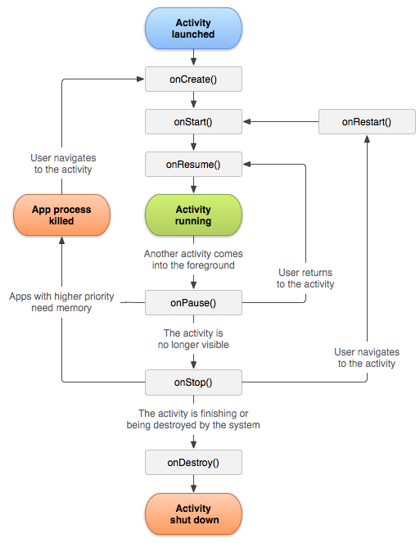
Activity
“Life Cycle”

Slide 7
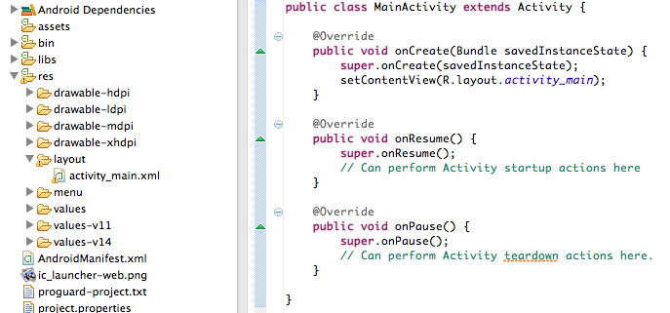
Creating an Activity
For each activity, you need….
  1) A Java declaration of the activity:

Slide 8
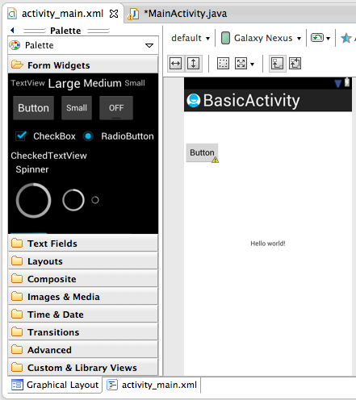
Activity Layouts
Can grab and drag these
Easiest to modify items
(and some of layout)
in the XML file

Slide 9
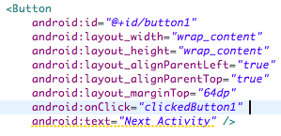

Activity Layout XML
Can add actions
and change properties
Create corresponding code
to run on the click action

Slide 10

Close Activity, Open Another
Create a new “Intent”
Start the new Activity
Call “finish()” to destroy the current activity
Instance of current Activity
Class of new Activity

Slide 11


Going “Back” in Activities
Two ways to go “backwards” in activities:
  Dictate exactly what Activity should show up
  Don’t call “finish()” when opening new Activity, then on back button click just closes new Activity, old should be back in focus
Method 1: Dictate the Activity that should be started
Method 2: Just “pop” the current Activity off stack

Slide 12
Android Manifest
Critical part of your entire application, it defines:
  Hardware application has permission to access
  Information the application can access/modify
  Defines all activities in the application
A single AndroidManifest.xml per application
  Skeleton generated when creating new application
Ordering of items and embedding of declarations is important
  Order: Permissions, <Application>, Activities, </Application>
Useful link for permissions: http://developer.android.com/reference/android/Manifest.permission.html

Slide 13
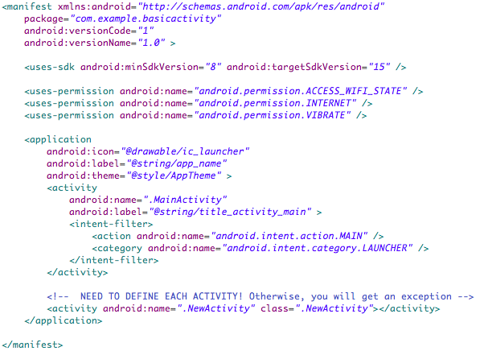
Example Manifest

Slide 14
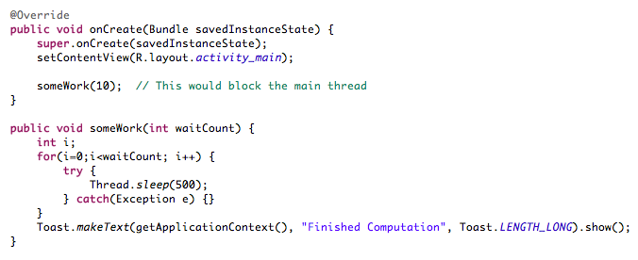
The Importance of Threading
This will stall execution of the main UI thread, locking interface:
Do not run “tasks” on your main UI thread!

Slide 15
Multithreading
2 main ways to achieve “code” that doesn’t run on UI thread
  AsyncTask (custom pthread wrapper)
  Background service (which you send requests to)
Critical: you can only modify the UI on the UI thread!
  If you try to modify it from another thread, you will get an exception and application will crash
AsyncTask: most commonly/easily used
  Provides callback on UI thread when complete, allowing you to update UI thread afterwards

Slide 16
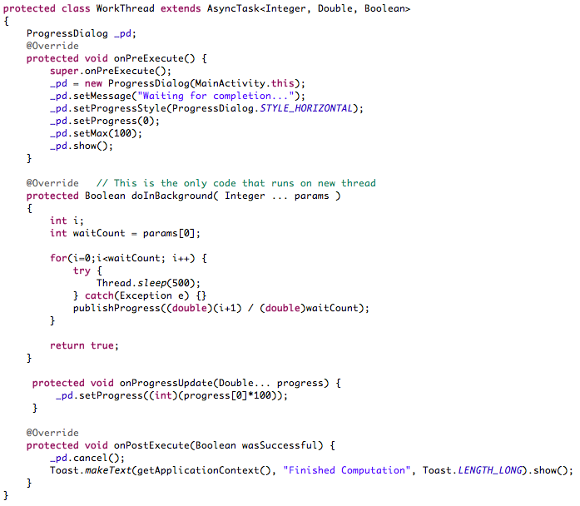
Runs before thread executes
(UI Thread)
Runs after onPreExecute()
(New Thread)
On every publishProgress()
(UI Thread)
After doInBackground() completes
(UI Thread)

Slide 18
Broadcast Intents
Android “broadcasts” information between services/threads
  Used to receive information from services, hardware, sensors…
  Used to pass information between threads
For example, you do not “query” accelerometer or GPS sensors
  You register a broadcast receiver to “catch” their broadcast info
Android is smart: if nothing registered to receive the information, the sensor is disabled
You’ll better understand this with some examples…

Slide 19

Accelerometer Example
Accelerometer is always “alive” but is not pollable and does not send out information unless it knows something wants it
A thread registers for the information, Android is smart and only when something is registered, it “broadcasts it”
This means, if some other application is requesting accelerometer data you can read it simply by listening for the broadcasts, but not guaranteed to get it unless you register.

Slide 20
Other Examples
GPS: You either tell system to give you updates every X milliseconds, or you can request a single reading
  Response is still broadcast throughout entire system… think: other applications can opportunistically use the data
Wifi: You can request an AP scan, result is broadcast (again) throughout entire system, you listen for the result.
Threads: You can create your own broadcast intents and listeners, and your threads can “broadcast” results to other threads in your application.

Slide 21


Broadcast Intent Example - Pt1
Broadcasts are labeled by “actions” which are Strings:
You register a receiver for a specific action which must be tied to an Activity, so it is commonly done in onResume()
Must unregister when Activity is paused/destroyed, otherwise it is “leaked” and you will get an exception:

Slide 22
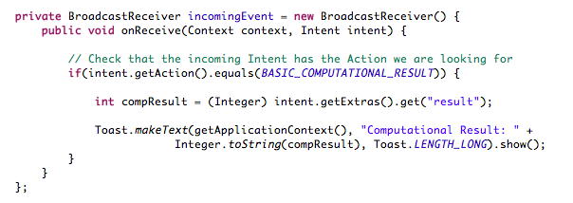
Broadcast Intent Example - Pt2
You then must create the receiver that you just registered
  Check that the incoming action equals what you’re looking for
Data passed with the action (e.g., sensor data) will always be with the Intent

Slide 23
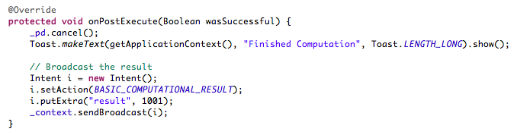
Broadcast Intent Example - Pt3
Next, you create a Broadcast which is sent, which in our example we broadcast after our Thread completes:
Extras can be put in the “Intent” but it cannot be arbitrary objects. You can extend arbitrary objects to be marshaled in out of intents with “Parcelable”

Slide 24
Wrap-up
Code is available on github for you to run in the Emulator or directly on your phone:
Feel free to ask me questions: gnychis@cmu.edu
Next week we will touch on the more advanced topics
  Anything you want to hear about, e-mail me and I’ll try to cover it
https://github.com/gnychis/basicactivity

