Slide 1
15-446 Distributed Systems
Spring 2009
Midterm Review

Slide 2
Topics Covered
Networking (Lecture 1~3)
Naming
RPC
Time
Replication
Security

Slide 3
Internet Design
Packet-switched datagram network
IP is the “compatibility layer”
  Hourglass architecture
  All hosts and routers run IP
Stateless architecture
  No per flow state inside network
TCP
UDP
IP
Satellite
Ethernet
ATM

Slide 4
Layering
Each layer relies on services from layer below and exports services to layer above
Interface defines interaction
Hides implementation
User B
User A
Application
Transport
Network
Link
Host
Host
Layering: technique to simplify complex systems

Slide 5
End-to-End Argument
Deals with where to place functionality
  Inside the network (in switching elements)
  At the edges
Argument:
  There are functions that can only be correctly implemented by the endpoints – do not try to completely implement these elsewhere
  File transfer example
Host A
Host B
Appl.
Appl.
OS
OS
OK

Slide 6
E2E Example: File Transfer
If network guaranteed reliable delivery
  The receiver has to do the check anyway!
    E.g., network card may malfunction
Full functionality can only be entirely implemented at application layer; no need for reliability from lower layers
Is there any need to implement reliability at lower layers?
  Yes, but only to improve performance
  If network is highly unreliable
  Adding some level of reliability helps performance, not correctness

Slide 7
Transport Layer
UDP
Single socket to receive messages
No guarantee of delivery
Not necessarily in-order delivery
Datagram – independent packets
TCP
Reliable – guarantee delivery
Byte stream – in-order delivery
Connection-oriented – single socket per connection
Setup connection followed by data transfer

Slide 8
Link Layer
Ethernet MAC (CSMA/CD)
Carrier Sense Multiple Access/Collision Detection
Packet?
No
Sense Carrier
Send
Detect Collision
Yes
Discard Packet
Jam channel b=CalcBackoff(); wait(b);
attempts++;
attempts < 16
attempts == 16

Slide 9
Routing
Distance Vector
  Have cost/next hop of best known path to each destination
  Advertise cost/next hop of best known path to each destination
Link State
  Every node gets complete copy of graph
  Every node “floods” network with data about its outgoing links
Message complexity
LS: with n nodes, E links, O(nE) messages
DV: exchange between neighbors only O(E)

Slide 10
TCP
Establishment – 3-way handshake
Tear down – 4-way handshake
Sliding window protocol
  AIMD
  Reaches steady state quickly
  ACK clocking
  TCP timeout based on RTT estimation

Slide 11
Wireless Network
Breaking assumptions
CSMA/CD does not work
  Relevant contention at the receiver, not sender
  Hard to build a radio that can transmit and receive at same time
  802.11-CSMA/CA
  Bluetooth-TDMA, Frequency hopping
Wireless devices are mobile
  Support for mobile addressing/routing
  Layer of indirection (Home agent, foreign agent)
Higher bit error rate
  TCP performance degrades when link loss rate is high
  TCP assumes packet loss is due to congestion

Slide 12
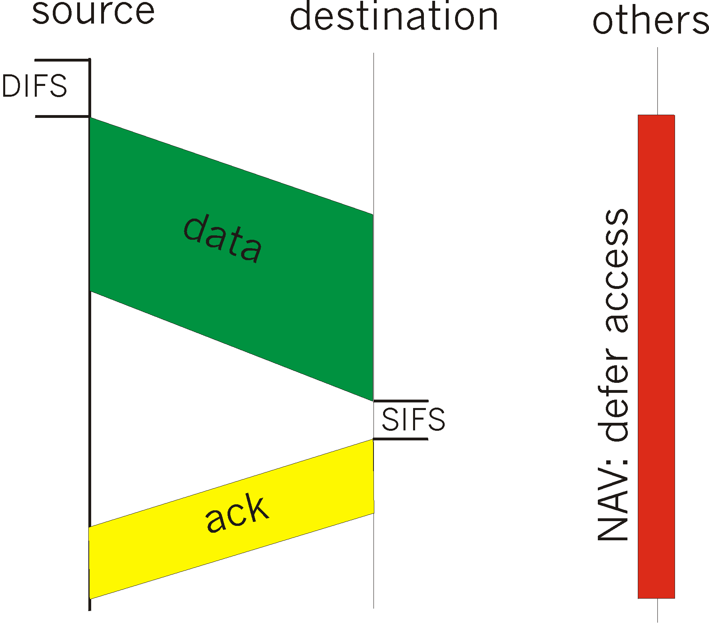
IEEE 802.11 MAC Protocol:
CSMA/CA
802.11 CSMA: sender
- If sense channel idle for DISF
(Distributed Inter Frame Space)
then transmit entire frame
(no collision detection)
- If sense channel busy
then binary backoff
802.11 CSMA receiver:
- If received OK
return ACK after SIFS
(Short IFS)
(ACK is needed due to
lack of collision detection)

Slide 13
Hidden and Exposed terminals
Hidden
Exposed
A
A
B
B
C
C
D
CSMA/CA is used

Slide 14
Naming
Names are mapped to values within some context → binding
Naming is a powerful tool in system design
  A layer of indirection can solve many problems (e.g., server selection)
How to determine context?
  Implicit → from environment
  Explicit → e.g., recursive names
  Search paths
How DNS works

Slide 15
DNS Resolution
Recursive query
Non-recursive query
Cache the result (TTL)
root & edu
DNS server
www.cs.cmu.edu
www.cs.cmu.edu
NS ns1.cmu.edu
www.cs.cmu.edu
ns1.cmu.edu
DNS server
A www=IPaddr
NS ns1.cs.cmu.edu
Local
DNS server
Client
www.cs.cmu.edu
ns1.cs.cmu.edu
DNS
server
A www=IPaddr

Slide 16
Subsequent Lookup Example
root & edu
DNS server
ftp.cs.cmu.edu
cmu.edu
DNS server
Local
DNS server
Client
ftp.cs.cmu.edu
cs.cmu.edu
DNS
server
ftp=IPaddr

Slide 17
RPC
A remote procedure call makes a call to a remote service look like a local call
  RPC makes transparent whether server is local or remote
  RPC allows applications to become distributed transparently
  RPC makes architecture of remote machine transparent
Except. Hard to provide true transparency
  Failures
  Latency
  Memory access
How to deal with hard problem → give up and let programmer deal with it
  “Worse is better”

Slide 18
RPC's difference from LPC
Failure semantics
  Possible semantics for RPC:
  Exactly-once
    Impossible in practice
  At least once:
    Only for idempotent operations
  At most once
    Zero, don’t know, or once
  Zero or once
    Transactional semantics
  At-most-once most practical But different from LPC
Parameter passing
  Passing reference (copy and restore)
  Solves the problem only partially

Slide 19
Physical Time
Clocks on different systems will always behave differently
  Skew and drift between clocks
Time Synchronization
  Cristian’s algorithm
  NTP
  Berkeley algorithm (Synchronizes a group of servers)

Slide 20
Logical Clock
Lamport Clock
  Capture’s happens before relationship
  Totally ordered multicast
Vector Clock
  Capture’s casual relationship
  Casually ordered multicast

Slide 21
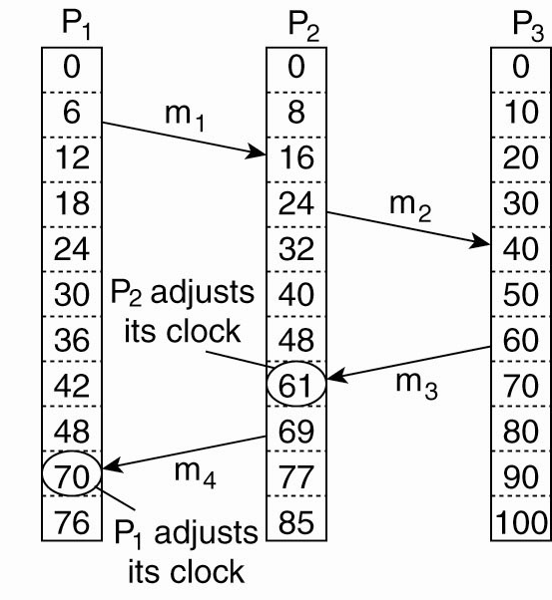
Lamport’s Logical Clocks
The "happens-before" relation → can be observed directly in two situations: locally, by message
Lamport’s algorithm corrects the clocks.

Slide 22
Lamport’s Logical Clocks
e →e’ implies L(e)<L(e’)
The converse is not true, that is L(e)<L(e') does not imply e →e’

Slide 23
Totally Ordered Multicast
Use Lamport timestamps
Algorithm
  Message is timestamped with sender’s logical time
  Message is multicast (including sender itself)
  When message is received
    It is put into local queue
    Ordered according to timestamp
    Multicast acknowledgement
  Message is delievered to applications only when
    It is at head of queue
    It has been acknowledged by all involved processes
  Lamport algorithm (extended) ensures total ordering of events

Slide 24
Vector Clocks
Vector clocks overcome the shortcoming of Lamport logical clocks
  L(e) < L(e’) does not imply e happened before e’
Vector timestamps are used to timestamp local events
They are applied in schemes for replication of data

Slide 25
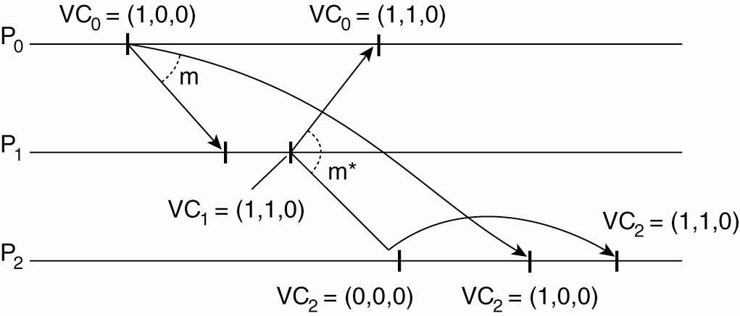
Causually Ordered Multicast
Enforcing causal communication

Slide 26
Replication
Replication → good for performance/reliability
  Key challenge → keeping replicas up-to-date
Consistency
  Consistency Model is a contract between processes and a data store

Slide 27
Data Centric Consistency Models
Consistency | Description
Strict | Absolute time ordering of all shared accesses matters.
Linearizability | All processes must see all shared accesses in the same order. Accesses are furthermore ordered according to a (nonunique) global timestamp
Sequential | All processes see all shared accesses in the same order. Accesses are not ordered in time
Causal | All processes see causally-related shared accesses in the same order.
FIFO | All processes see writes from each other in the order they were used. Writes from different processes may not always be seen in that order
 | (a)
Consistency | Description
Weak | Shared data can be counted on to be consistent only after a synchronization is done
Release | Shared data are made consistent when a critical region is exited
Entry | Shared data pertaining to a critical region are made consistent when a critical region is entered.
 | (b)
Consistency models not using synchronization operations.
Models with synchronization operations.

Slide 28
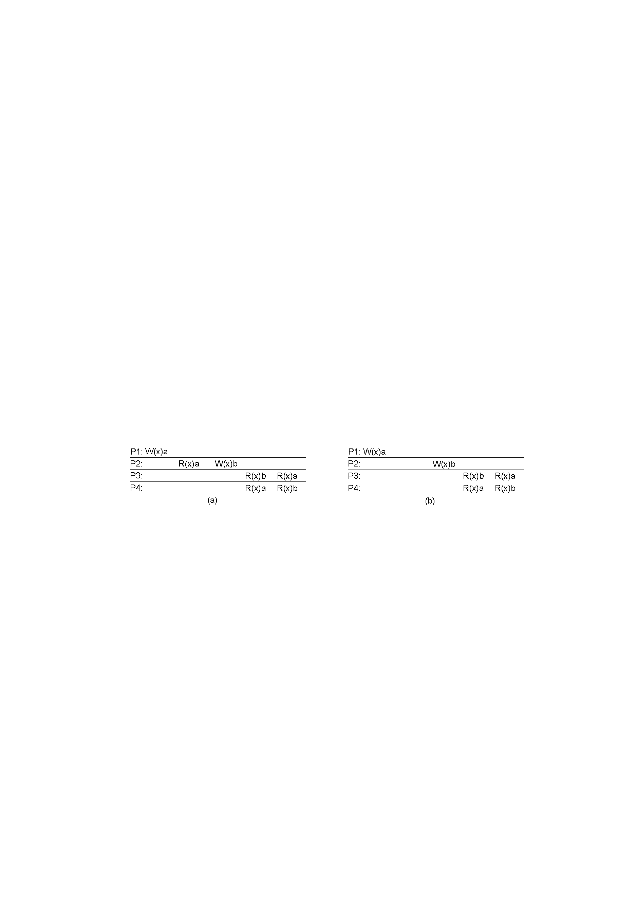
Causal Consistency
A violation of a causally-consistent store. The two writes are NOT concurrent because of the R₂(x)a.
A correct sequence of events in a causally-consistent store (W₁(x)a and W₂(x)b are concurrent).

Slide 29
Implementing Sequential Consistency
  Primary-based
  Each data item has associated primary responsible for coordination
  Remote-write protocols (primary writes to replicas)
  Local-write protocols (primary migrates)
  Replica-based
  Active replication using multicast communication
  Quorum-based protocols
    ROWA: R=1, W=N
      Fast reads, slow writes (and easily blocked)
    RAWO: R=N, W=1
      Fast writes, slow reads (andeasily blocked)
    Majority: R=W=N/2+1

Slide 30
Client-centric consistency models
Consistency models for accessing databases by mobile users
  Clients access any (typically a nearby) copy of the data
Only provide consistency guarantees of data accesses made for individual clients (not concerned with ensuring consistency across multiple clients
Four different client-central consistency models
  Monotonic reads
  Monotonic writes
  Read your writes
  Writes follow reads

Slide 31
ACID vs BASE
Modern Internet systems: focused on BASE
  Basically Available
  Soft-state (or scalable)
  Eventually consistent
What goals might you want from a system?
  C, A, P (You can only have two out of these three properties)
Strong Consistency: all clients see the same view, even in the presence of updates
High Availability: all clients can find some replica of the data, even in the presence of failures
Partition-tolerance: the system properties hold even when the system is partitioned

Slide 32
Eventual consistency
There are replica situations where updates (writes) are rare and where a fair amount of inconsistency can be tolerated.
If no updates occur for a while, all replicas should gradually become consistent.

Slide 33
Content Distribution Networks (CDNs)
The content providers are the CDN customers.
Content replication
CDN company installs hundreds of CDN servers throughout Internet
  Close to users
CDN replicates its customers’ content in CDN servers. When provider updates content, CDN updates servers
origin server
in North America
CDN distribution node
CDN server
in S. America
CDN server
in Asia
CDN server
in Europe

Slide 34
Server Selection
Service is replicated in many places in network
How do direct clients to a particular server?
  As part of routing → anycast, cluster load balancing
  As part of application → HTTP redirect
  As part of naming → DNS
Which server?
  Lowest load → to balance load on servers
  Best performance → to improve client performance
    Based on Geography? RTT? Throughput? Load?
  Any alive node → to provide fault tolerance

Slide 35
How Akamai Works
Root server gives NS record for akamai.net
Akamai.net name server returns NS record for g.akamaitech.net
  Name server chosen to be in region of client’s name server
  TTL is large
G.akamaitech.net nameserver chooses server in region
  Uses consistent hashing from aXYZ
    Load balancing
    Performance
    Fault tolerance
  TTL is small → why?

Slide 36
Security
Symmetric (pre-shared key, fast) and asymmetric (key pairs, slow) primitives provide:
    Confidentiality
    Integrity
    Authentication
  (You should know how to use them)
“Hybrid Encryption” leverages strengths of both. (TLS)
Great complexity exists in securely acquiring keys. (Key distribution)
  Kerberos
  PKI

Slide 37
BACKUPs

Slide 38
NTP Protocol
All modes use UDP
Each message bears timestamps of recent events:
  Local times of Send and Receive of previous message
  Local times of Send of current message
Recipient notes the time of receipt T_{i} (we have T_{i-3}, T_{i-2}, T_{i-1}, T_{i})
In symmetric mode there can be a non-negligible delay between messages
Server B
T
i
-2
T
i-1
Time
m
m'
Time
Server A
T
i
-
3
T
i
Notes:
Local times of Send and Receive of previous message
Local times of Send of current message
Recipient notes the time of receipt ( we have T_{i-3}, T_{i-2}, T_{i-1}, T_{i})
In symmetric mode there can be a non-negligible delay between messages

Slide 40
Establishing Connection:
Three-Way handshake
Each side notifies other of starting sequence number it will use for sending
  Why not simply chose 0?
    Must avoid overlap with earlier incarnation
    Security issues
Each side acknowledges other’s sequence number
  SYN-ACK: Acknowledge sequence number + 1
Can combine second SYN with first ACK
SYN: SeqC
ACK: SeqC+1
SYN: SeqS
ACK: SeqS+1
Client
Server

Slide 41
Tearing Down Connection
Either side can initiate tear down
  Send FIN signal
  “I’m not going to send any more data”
Other side can continue sending data
  Half open connection
  Must continue to acknowledge
Acknowledging FIN
  Acknowledge last sequence number + 1
A
B
FIN, SeqA
ACK, SeqA+1
Data
ACK
FIN, SeqB
ACK, SeqB+1

Slide 42
Distance-Vector Method
Initial Table for A
Dest | Cost | Next Hop
A | 0 | A
B | 4 | B
C | ∞ | –
D | ∞ | –
E | 2 | E
F | 6 | F
E
C
3
1
F
1
2
6
1
3
D
A
4
B
Idea
  At any time, have cost/next hop of best known path to destination
  Use cost ∞ when no path known
Initially
  Only have entries for directly connected nodes

Slide 43
NTP Protocol
All modes use UDP
Each message bears timestamps of recent events:
  Local times of Send and Receive of previous message
  Local times of Send of current message
Recipient notes the time of receipt T_{i} (we have T_{i-3}, T_{i-2}, T_{i-1}, T_{i})
In symmetric mode there can be a non-negligible delay between messages
Server B
T
i
-2
T
i-1
Time
m
m'
Time
Server A
T
i
-
3
T
i
Notes:
Local times of Send and Receive of previous message
Local times of Send of current message
Recipient notes the time of receipt ( we have T_{i-3}, T_{i-2}, T_{i-1}, T_{i})
In symmetric mode there can be a non-negligible delay between messages

