Slide 1
15-446 Distributed Systems
Spring 2009
Final Review

Slide 3
15-446 Distributed Systems
Spring 2009
L-14 Security

Slide 4
Important Lessons - Security
Internet design and growth → security challenges
Symmetric (pre-shared key, fast) and asymmetric (key pairs, slow) primitives provide:
    Confidentiality
    Integrity
    Authentication
“Hybrid Encryption” leverages strengths of both.
Great complexity exists in securely acquiring keys.
Crypto is hard to get right, so use tools from others, don’t design your own (e.g. TLS).

Slide 5
Two ways to cut a table (ACM)
Order by columns (ACL) or rows (Capability Lists)?
 | File1 | File2 | File3
Ann | rx | r | rwx
Bob | rwxo | r | --
Charlie | rx | rwo | w
ACLs
Capability

Slide 6
ACL:Default Permission and Abbreviation
Example: UNIX ➔
Three classes of users: owner, group, all others
6

Slide 7
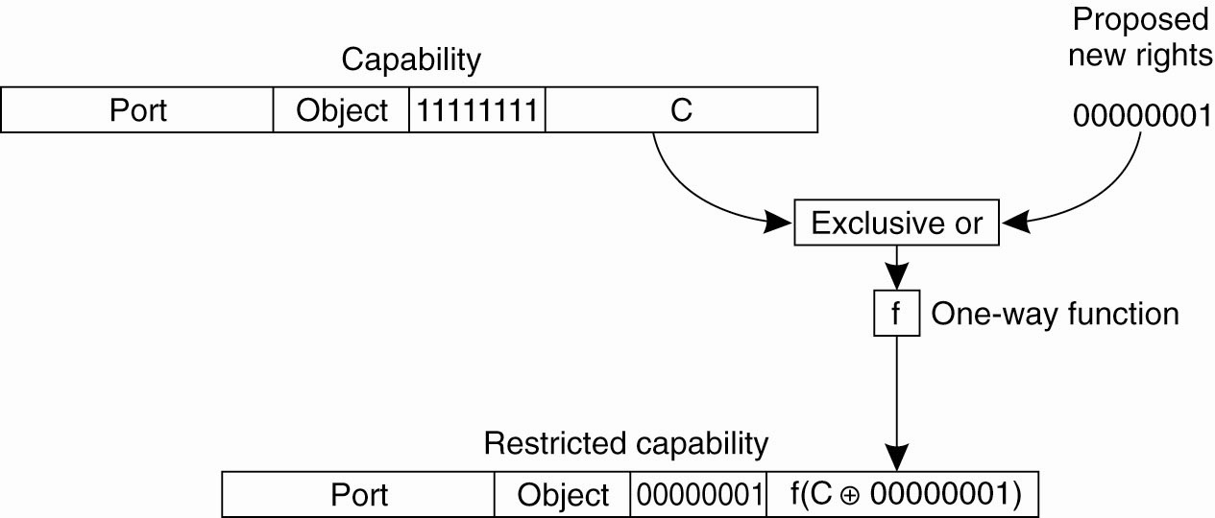
Capabilities and Attribute Certificates (2)
Generation of a restricted capability
from an owner capability.

Slide 8
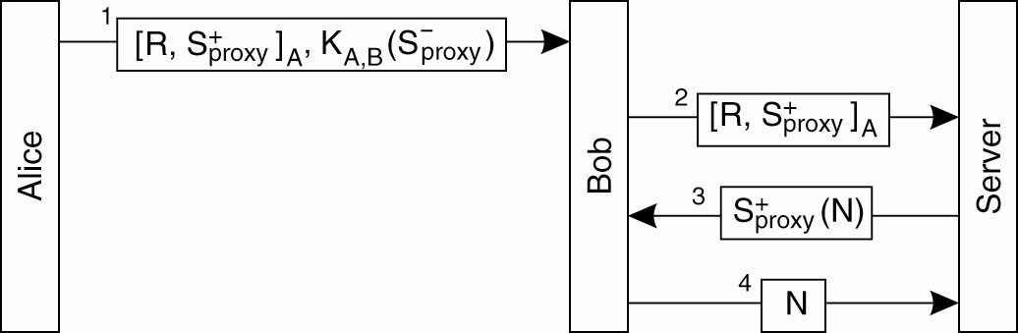
Delegation (2)
Using a proxy to delegate and prove ownership of access rights.

Slide 9
Sybil Attack undermines assumed mapping between identity to entity and hence number of faulty entities
A Sybil attack is the forging of multiple identities for malicious intent -- having a set of faulty entities represented through a larger set of identities.
The purpose of such an attack is to compromise a disproportionate share of a system.
Result is overthrowing of any assumption of designed reliably based on a limited proportion of faulty entities.
Notes:
Attack may result for example, in a disproportionate share of resources allocated to the attacker(s) or privacy violations.

Slide 11
15-446 Distributed Systems
Spring 2009
L-15 Fault Tolerance

Slide 12
Important Lessons
Terminology & Background
  Failure models
Byzantine Fault Tolerance
  Protocol design → with and without crypto
  How many servers do we need to tolerate
Issues in client/server
  Where do all those RPC failure semantics come from?
Reliable group communication
  How do we manage group membership changes as part of reliable multicast

Slide 13
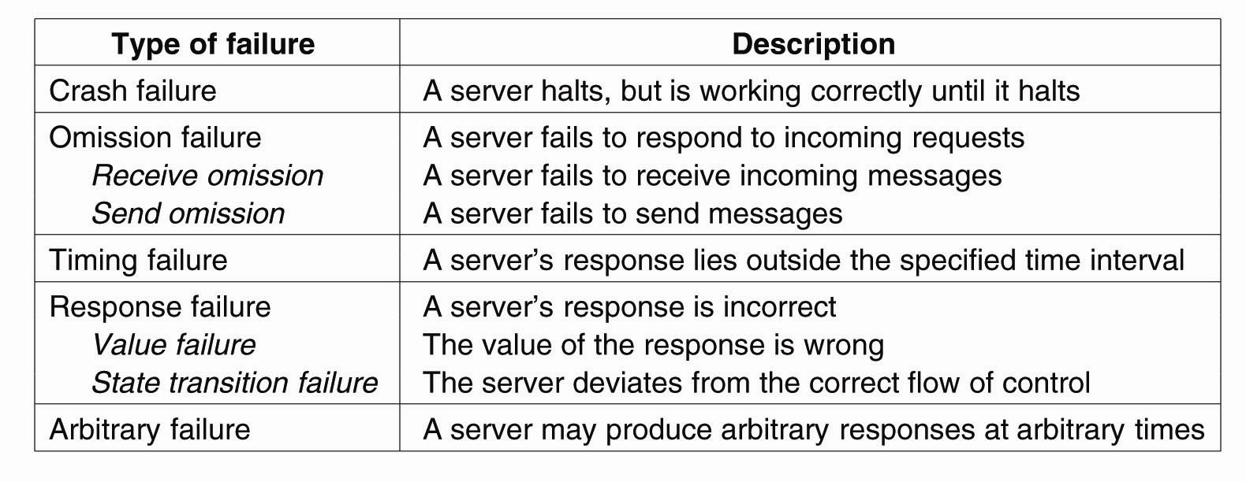
Failure Models
A system is said to fail if it cannot meet its promises. An error on the part of a system’s state may lead to a failure. The cause of an error is called a fault.

Slide 14
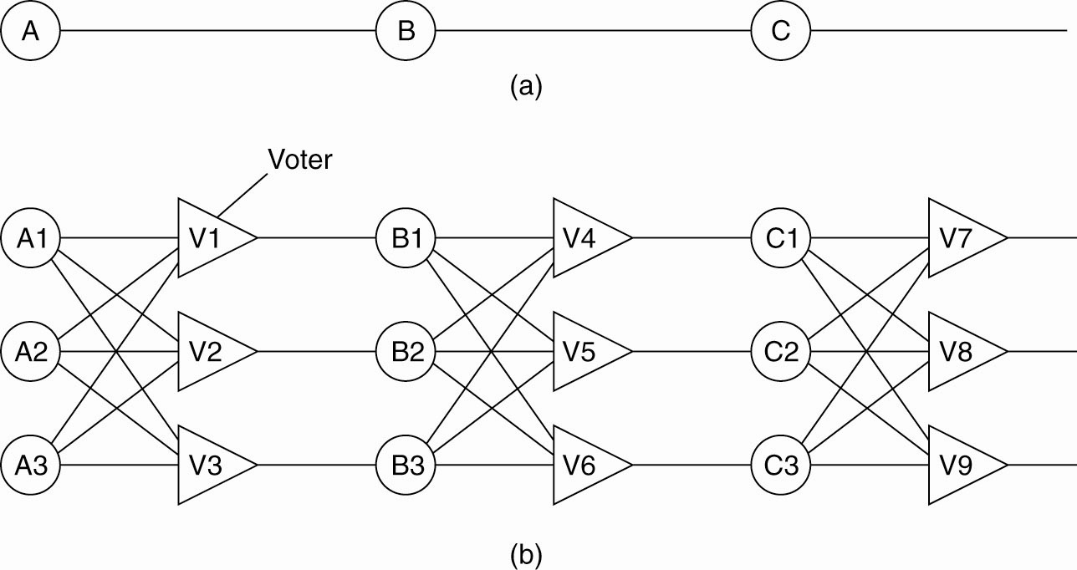
Failure Masking by Redundancy
Triple modular redundancy. For each voter, if two or three of the inputs are the same, the output is equal to the input. If all three inputs are different, the output is undefined.

Slide 15
Impossibility Results
General 1
General 1
attack
attack
attack
retreat
General 2
General 3
General 2
General 3
retreat
retreat
No solution for three processes can handle a single traitor.
In a system with m faulty processes agreement can be achieved only if there are 2m+1 (more than 2/3) functioning correctly.
Lamport, Shostak, Pease. The Byzantine General’s Problem. ACM TOPLAS, 4,3, July 1982, 382-401.

Slide 16
Byzantine General Problem
Example - 1
Phase 1: Generals announce their troop strengths to each other
1
P1
P2
1
1
P3
P4

Slide 17
Byzantine General Problem
Example - 2
Phase 1: Generals announce their troop strengths to each other
2
P1
P2
2
2
P3
P4

Slide 18
Byzantine General Problem
Example - 3
Phase 1: Generals announce their troop strengths to each other
P1
P2
4
4
4
P3
P4

Slide 19
Byzantine General Problem
Example - 4
Phase 2: Each general construct a vector with all troops
P1 | P2 | P3 | P4
1 | 2 | y | 4
P1 | P2 | P3 | P4
1 | 2 | x | 4
P1
P2
x
y
z
P1 | P2 | P3 | P4
1 | 2 | z | 4
P3
P4

Slide 20
Byzantine General Problem
Example - 5
Phase 3,4: Generals send their vectors to each other and compute majority voting
P1 | P2 | P3 | P4
1 | 2 | x | 4
e | f | g | h
1 | 2 | z | 4
P1 | P2 | P3 | P4
1 | 2 | y | 4
a | b | c | d
1 | 2 | z | 4
P1
P2
P1
P2
P3
P3
P4
P4
(a, b, c, d)
(1, 2, ?, 4)
(1, 2, ?, 4)
(e, f, g, h)
P1 | P2 | P3 | P4
1 | 2 | x | 4
1 | 2 | y | 4
h | i | j | k
(h, i, j, k)
P3
P4
P1
P2
P3
(1, 2, ?, 4)

Slide 21
Signed messages
General
General
attack:0
attack:0
attack:0
retreat:0
???
retreat:0:2
Lieutenant 1
Lieutenant 2
Lieutenant 1
Lieutenant 2
attack:0:1
attack:0:1
SM(1) with one traitor
Lamport, Shostak, Pease. The Byzantine General’s Problem. ACM TOPLAS, 4,3, July 1982, 382-401.

Slide 22
Server Crashes (3)
Consider scenario where a client sends text to a print server.
There are three events that can happen at the server:
  Send the completion message (M),
  Print the text (P),
  Crash (C) – at recovery, send ‘recovery’ message to clients.
Server strategies:
  send completion message before printing
  send completion message after printing

Slide 23
Server Crashes (4)
These events can occur in six different orderings:
M →P →C: A crash occurs after sending the completion message and printing the text.
M →C (→P): A crash happens after sending the completion message, but before the text could be printed.
P →M →C: A crash occurs after sending the completion message and printing the text.
P→C(→M): The text printed, after which a crash occurs before the completion message could be sent.
C (→P →M): A crash happens before the server could do anything.
C (→M →P): A crash happens before the server could do anything.

Slide 24
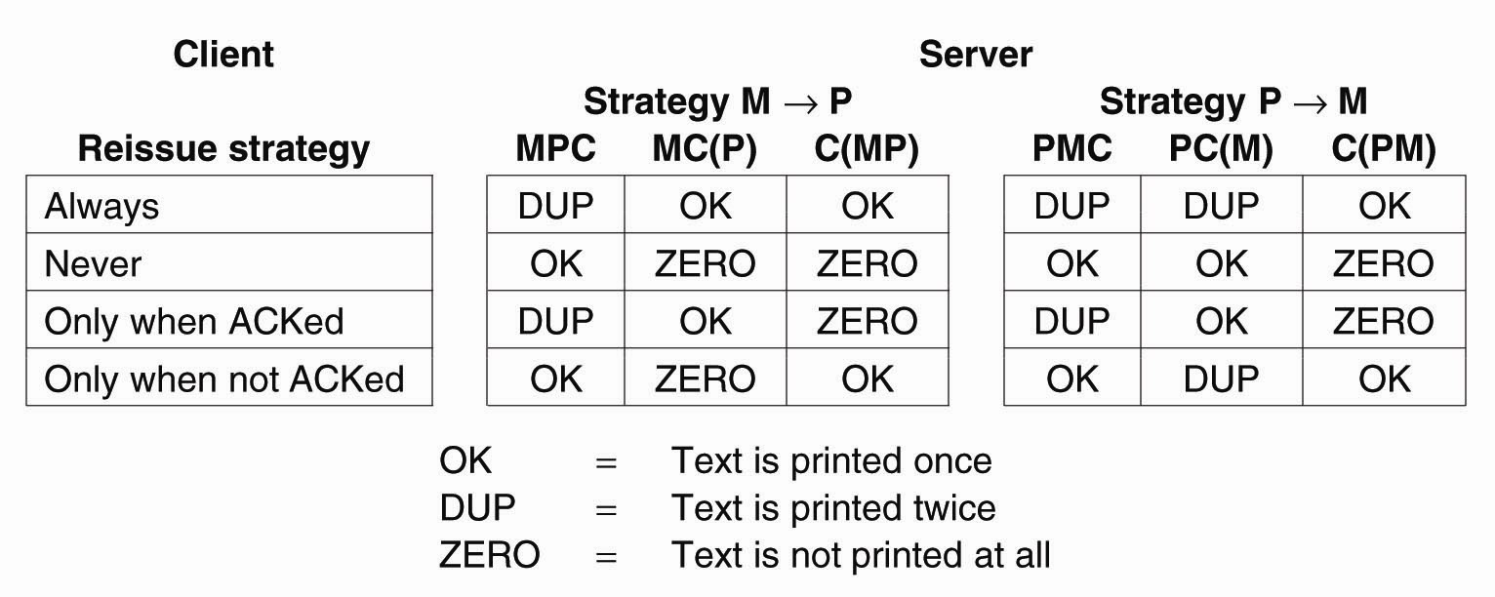
Server Crashes (6)
Different combinations of client and server
strategies in the presence of server crashes.

Slide 25
Client Crashes
Can create orphans (unwanted computations) that waste CPU, potentially lock up resources and create confusion when client re-boots.
Nelson solutions:
  Orphan Extermination – keep a log of RPCs at client that is checked at re-boot time to remove orphans.
  Reincarnation – divide time into epochs. After a client re-boot, increment its epoch and kill off any of its requests belonging to an earlier epoch.
  Gentle Reincarnation – at reboot time, an epoch announcement causes all machines to locate the owners of any remote computations.
  Expiration – each RPC is given time T to complete (but a live client can ask for more time)
Nelson. Remote Procedure Call. Ph.D. Thesis, CMU, 1981.

Slide 26
View-synchronous group communication
a (allowed).
b (allowed).
p crashes
p crashes
p
p
q
q
r
r
view (p, q, r)
view (q, r)
view (p, q, r)
view (q, r)
c (disallowed).
d (disallowed).
p crashes
p crashes
p
p
q
q
r
r
view (p, q, r)
view (q, r)
view (p, q, r)
view (q, r)

Slide 27
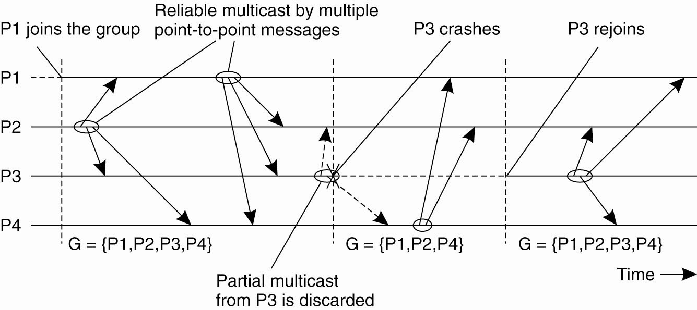
Virtual Synchrony (2)

Slide 28
Virtual Synchrony Implementation: Example
G_{i} = {P1, P2, P3, P4, P5}
P5 fails
P1 detects that P5 has failed
P1 send a “view change” message to every process in G_{i+1} = {P1, P2, P3, P4}
P2
P3
P1
change view
P4
P5

Slide 29
Virtual Synchrony Implementation: Example
Every process
  Send each unstable message m from Gi to members in G_{i+1}
  Marks m as being stable
  Send a flush message to mark that all unstable messages have been sent
unstable message
P2
P3
P1
flush
message
P4
P5

Slide 30
Virtual Synchrony Implementation: Example
Every process
  After receiving a flush message from any process in G_{i+1} installs G_{i+1}
P2
P3
P1
P4
P5

Slide 32
15-446 Distributed Systems
Spring 2009
L-16 Transactions

Slide 33
Transactions –
The ACID Properties
Are the four desirable properties for reliable handling of concurrent transactions.
Atomicity
  The “All or Nothing” behavior.
C: stands for either
  Concurrency: Transactions can be executed concurrently
  … or Consistency: Each transaction, if executed by itself, maintains the correctness of the database.
Isolation (Serializability)
  Concurrent transaction execution should be equivalent (in effect) to a serialized execution.
Durability
  Once a transaction is done, it stays done.

Slide 34
Transaction life histories
Successful
Aborted by client
Aborted by server
openTransaction
openTransaction
openTransaction
operation
operation
operation
operation
operation
operation
server aborts
transaction
operation
operation
operation ERROR
reported to client
closeTransaction
abortTransaction
openTransaction() → trans;
  starts a new transaction and delivers a unique TID trans. This identifier will be used in the other operations in the transaction.
closeTransaction(trans) → (commit, abort);
  ends a transaction: a commit return value indicates that the transaction has committed; an abort return value indicates that it has aborted.
abortTransaction(trans);
  aborts the transaction.

Slide 35
Need for serializable execution
T₁: R₁(X) R₁(Y) W₁(X) commit₁
T₂: R₂(X) W₂(X) W₂(Y) commit₂
DB: R₁(X) R₂(X) W₂(X) R₁(Y) W₁(X) W₂(Y) commit₁ commit₂
Data manager interleaves operations to improve concurrency

Slide 36
Non serializable execution
T₁: R₁(X) R₁(Y) W₁(X) commit₁
T₂: R₂(X) W₂(X) W₂(Y) commit₂
DB: R₁(X) R₂(X) W₂(X) R₁(Y) W₁(X) W₂(Y) commit₂ commit₁
Unsafe! Not serializable
Problem: transactions may “interfere”. Here, T₂ changes x, hence T₁ should have either run first (read and write) or after (reading the changed value).

Slide 37
Serializable execution
T₁: R₁(X) R₁(Y) W₁(X) commit₁
T₂: R₂(X) W₂(X) W₂(Y) commit₂
DB: R₂(X) W₂(X) R₁(X) W₁(X) W₂(Y) R₁(Y) commit₂ commit₁
Data manager interleaves operations to improve concurrency but schedules them so that it looks as if one transaction ran at a time. This schedule “looks” like T₂ ran first.

Slide 38
What about the locks?
Unlike other kinds of distributed systems, transactional systems typically lock the data they access
They obtain these locks as they run:
  Before accessing “x” get a lock on “x”
  Usually we assume that the application knows enough to get the right kind of lock. It is not good to get a read lock if you’ll later need to update the object
In clever applications, one lock will often cover many objects

Slide 39
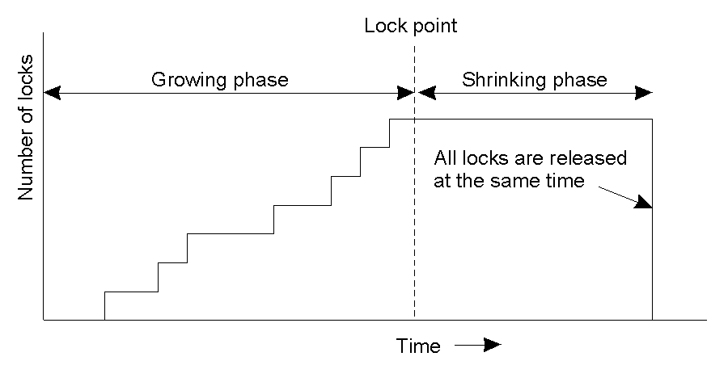
Strict Two-Phase Locking (2)
Strict two-phase locking.

Slide 40
Lock compatibility
For one object
Lock requested
read
write
Lock already set
none
OK
OK
read
OK
wait
write
wait
wait
Operation Conflict rules:
1. If a transaction T has already performed a read operation on a
  particular object, then a concurrent transaction U must not write
  that object until T commits or aborts
2. If a transaction T has already performed a read operation on a
  particular object, then a concurrent transaction U must not read
  or write that object until T commits or aborts

Slide 41
The wait-for graph
Held by
Waits for
A
T
U
T
U
Waits for
B
Held by

Slide 42
Dealing with Deadlock in two-phase locking
Deadlock prevention
  Acquire all needed locks in a single atomic operation
  Acquire locks in a particular order
Deadlock detection
  Keep graph of locks held. Check for cycles periodically or each time an edge is added
  Cycles can be eliminated by aborting transactions
Timeouts
  Aborting transactions when time expires

Slide 43
Contrast: Timestamped approach
Using a fine-grained clock, assign a “time” to each transaction, uniquely. E.g. T1 is at time 1, T2 is at time 2
Now data manager tracks temporal history of each data item, responds to requests as if they had occured at time given by timestamp
At commit stage, make sure that commit is consistent with serializability and, if not, abort

Slide 44
Contrast: Timestamped approach
Using a fine-grained clock, assign a “time” to each transaction, uniquely. E.g. T1 is at time 1, T2 is at time 2
Now data manager tracks temporal history of each data item, responds to requests as if they had occured at time given by timestamp
At commit stage, make sure that commit is consistent with serializability and, if not, abort

Slide 45
Two Phase Commit Protocol - 6
Recovery
‘Wait’ in Coordinator – use a time-out mechanism to detect participant crashes. Send GLOBAL_ABORT
‘Init’ in Participant – Can also use a time-out and send VOTE_ABORT
‘Ready’ in Participant P – abort is not an option (since already voted to COMMIT and so coordinator might eventually send GLOBAL_COMMIT). Can contact another participant Q and choose an action based on its state.
State of Q | Action by P
COMMIT | Transition to COMMIT
ABORT | Transition to ABORT
INIT | Both P and Q transition to ABORT (Q sends VOTE_ABORT)
READY | Contact more participants. If all participants are ‘READY’, must wait for coordinator to recover

Slide 46
Three Phase Commit protocol - 1
Problem with 2PC
  If coordinator crashes, participants cannot reach a decision, stay blocked until coordinator recovers
Three Phase Commit3PC
  There is no single state from which it is possible to make a transition directly to either COMMIT or ABORT states
  There is no state in which it is not possible to make a final decision, and from which a transition to COMMIT can be made

Slide 47
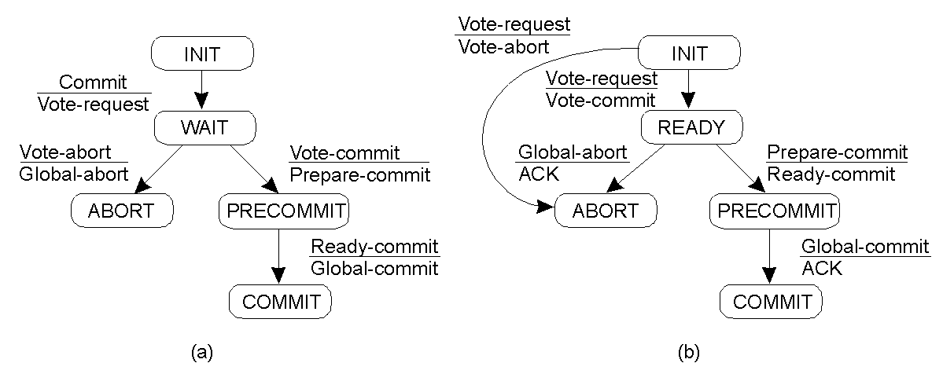
Three-Phase Commit protocol - 2
Finite state machine for the coordinator in 3PC
Finite state machine for a participant

Slide 48
Three Phase Commit Protocol - 3
Recovery
‘Wait’ in Coordinator – same
‘Init’ in Participant – same
‘PreCommit’ in Coordinator – Some participant has crashed but we know it wanted to commit. GLOBAL_COMMIT the application knowing that once the participant recovers, it will commit.
‘Ready’ or ‘PreCommit’ in Participant P – (i.e. P has voted to COMMIT)
State of Q | Action by P
PRECOMMIT | Transition to PRECOMMIT. If all participants in PRECOMMIT, if majority in PRECOMMIT can COMMIT the transaction
ABORT | Transition to ABORT
INIT | Both P (in READY) and Q transition to ABORT (Q sends VOTE_ABORT)
READY | Contact more participants. If can contact a majority and they are in ‘Ready’, then ABORT the transaction. If the participants contacted in ‘PreCommit’ it is safe to COMMIT the transaction
Note: if any participant
is in state PRECOMMIT,
it is impossible for any
other participant to be in
any state other than READY
or PRECOMMIT.

Slide 50
15-446 Distributed Systems
Spring 2009
L-17 Distributed File Systems

Slide 51
Wrap up: Design Issues
Name space
Authentication
Caching
Consistency
Locking

Slide 52
NFS V2 Design
“Dumb”, “Stateless” servers
Smart clients
Portable across different OSs
Immediate commitment and idempotency of operations
Low implementation cost
Small number of clients
Single administrative domain

Slide 53
Stateless File Server?
Statelessness
  Files are state, but...
  Server exports files without creating extra state
    No list of “who has this file open” (permission check on each operation on open file!)
    No “pending transactions” across crash
Results
  Crash recovery is “fast”
    Reboot, let clients figure out what happened
  Protocol is “simple”
State stashed elsewhere
  Separate MOUNT protocol
  Separate NLM locking protocol

Slide 54
NFS V2 Operations
V2:
  NULL, GETATTR, SETATTR
  LOOKUP, READLINK, READ
  CREATE, WRITE, REMOVE, RENAME
  LINK, SYMLINK
  READIR, MKDIR, RMDIR
  STATFS (get file system attributes)
Notes:
STATFS: attributes like block size, total # blocks, #free blocks, optimal transfer size

Slide 55
AFS Assumptions
Client machines are un-trusted
  Must prove they act for a specific user
    Secure RPC layer
  Anonymous “system:anyuser”
Client machines have disks(!!)
  Can cache whole files over long periods
Write/write and write/read sharing are rare
  Most files updated by one user, on one machine

Slide 56
Topic 1: Name-Space Construction and Organization
NFS: per-client linkage
  Server: export /root/fs1/
  Client: mount server:/root/fs1 /fs1 → fhandle
AFS: global name space
  Name space is organized into Volumes
    Global directory /afs;
    /afs/cs.wisc.edu/vol1/…; /afs/cs.stanford.edu/vol1/…
  Each file is identified as fid = <vol_id, vnode #, uniquifier>
  All AFS servers keep a copy of “volume location database”, which is a table of vol_id→ server_ip mappings
Notes:
Vol_id identifies a vol of files stored on a single server
Vnode # provides and index into an array on the server; the array entry contains information about how to access the files
Uniquifier ensures that no fid-triplet is ever used more than once in the history of the file system; this allows vnode #’s to be reused

Slide 57
Topic 2: User Authentication and Access Control
User X logs onto workstation A, wants to access files on server B
  How does A tell B who X is?
  Should B believe A?
Choices made in NFS V2
  All servers and all client workstations share the same <uid, gid> name space → B send X’s <uid,gid> to A
    Problem: root access on any client workstation can lead to creation of users of arbitrary <uid, gid>
  Server believes client workstation unconditionally
    Problem: if any client workstation is broken into, the protection of data on the server is lost;
    <uid, gid> sent in clear-text over wire → request packets can be faked easily

Slide 58
A Better AAA System: Kerberos
Basic idea: shared secrets
  User proves to KDC who he is; KDC generates shared secret between client and file server
KDC
ticket server
generates S
“Need to access fs”
K_{client}[S]
file server
K_{fs}[S]
encrypt S with
client’s key
client
S: specific to {client,fs} pair;
“short-term session-key”; expiration time (e.g. 8 hours)
Notes:
K_{client}[S] means encrypt S using client’s private key

Slide 59
AFS ACLs
Apply to directory, not to file
Format:
  sseshan rlidwka
  srini@cs.cmu.edu rl
  sseshan:friends rl
Default realm is typically the cell name (here andrew.cmu.edu)
Negative rights
  Disallow “joe rl” even though joe is in sseshan:friends
Notes:
ACLs apply to directories
“Makes sense” if files will inherit from directories
Not always true
Confuses users
Directories inherit ACLs
Easy to expose a whole tree accidentally
What else to do?
No good solution known
DFS horror

Slide 60
Topic 3: Client-Side Caching
Why is client-side caching necessary?
What is cached
  Read-only file data and directory data → easy
  Data written by the client machine → when is data written to the server? What happens if the client machine goes down?
  Data that is written by other machines → how to know that the data has changed? How to ensure data consistency?
  Is there any pre-fetching?

Slide 61
Client Caching in NFS v2
Cache both clean and dirty file data and file attributes
File attributes in the client cache expire after 60 seconds (file data doesn’t expire)
File data is checked against the modified-time in file attributes (which could be a cached copy)
  Changes made on one machine can take up to 60 seconds to be reflected on another machine
Dirty data are buffered on the client machine until file close or up to 30 seconds
  If the machine crashes before then, the changes are lost
  Similar to UNIX FFS local file system behavior

Slide 62
Implication of NFS v2 Client Caching
Data consistency guarantee is very poor
  Simply unacceptable for some distributed applications
  Productivity apps tend to tolerate such loose consistency
Different client implementations implement the “prefetching” part differently
Generally clients do not cache data on local disks

Slide 63
Client Caching in AFS v2
Client caches both clean and dirty file data and attributes
  The client machine uses local disks to cache data
  When a file is opened for read, the whole file is fetched and cached on disk
    Why? What’s the disadvantage of doing so?
However, when a client caches file data, it obtains a “callback” on the file
In case another client writes to the file, the server “breaks” the callback
  Similar to invalidations in distributed shared memory implementations
Implication: file server must keep state!

Slide 64
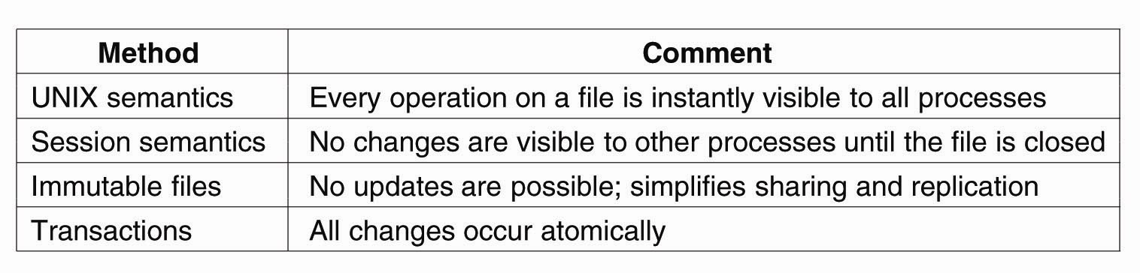
Semantics of File Sharing
Four ways of dealing with the shared files in a distributed system.

Slide 65
Session Semantics in AFS v2
What it means:
  A file write is visible to processes on the same box immediately, but not visible to processes on other machines until the file is closed
  When a file is closed, changes are visible to new opens, but are not visible to “old” opens
  All other file operations are visible everywhere immediately
Implementation
  Dirty data are buffered at the client machine until file close, then flushed back to server, which leads the server to send “break callback” to other clients
Notes:
Chunk-based I/O
No real consistency guarantees
close() failures surprising to many Unix programs
...and to early Linux kernels!

Slide 66
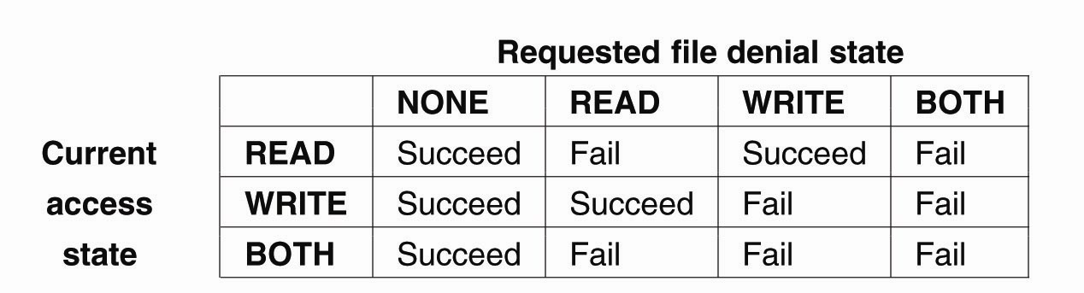
File Locking (3)
The result of an open operation with share reservations in NFS → When the client requests a denial state given the current file access state.

Slide 67
Failure recovery
What if server fails?
  Lock holders are expected to re-establish the locks during the “grace period”, during which no other locks are granted
What if a client holding the lock fails?
What if network partition occurs?
NFS relies on “network status monitor” for server monitoring

Slide 69
15-446 Distributed Systems
Spring 2009
L-18 More DFS

Slide 70
Hardware Model
CODA and AFS assume that client workstations are personal computers controlled by their user/owner
  Fully autonomous
  Cannot be trusted
CODA allows owners of laptops to operate them in disconnected mode
  Opposite of ubiquitous connectivity

Slide 71
Pessimistic Replica Control
Would require client to acquire exclusive (RW) or shared (R) control of cached objects before accessing them in disconnected mode:
  Acceptable solution for voluntary disconnections
  Does not work for involuntary disconnections
What if the laptop remains disconnected for a long time?

Slide 72
Leases
We could grant exclusive/shared control of the cached objects for a limited amount of time
Works very well in connected mode
  Reduces server workload
  Server can keep leases in volatile storage as long as their duration is shorter than boot time
Would only work for very short disconnection periods

Slide 73
Optimistic Replica Control (I)
Optimistic replica control allows access in every disconnected mode
  Tolerates temporary inconsistencies
  Promises to detect them later
  Provides much higher data availability

Slide 74
Coda (Venus) States
Hoarding
Emulating
Recovering
Hoarding:
Normal operation mode
Emulating:
Disconnected operation mode
Reintegrating:
Propagates changes and detects inconsistencies

Slide 75
Reintegration
When workstation gets reconnected, Coda initiates a reintegration process
  Performed one volume at a time
  Venus ships replay log to all volumes
  Each volume performs a log replay algorithm
Only care write/write confliction
  Succeed?
    Yes. Free logs, reset priority
    No. Save logs to a tar. Ask for help

Slide 76
Performance
Duration of Reintegration
  A few hours disconnection → 1 min
  But sometimes much longer
Cache size
  100MB at client is enough for a “typical” workday
Conflicts
  No Conflict at all! Why?
  Over 99% modification by the same person
  Two users modify the same obj within a day: <0.75%

Slide 77
Working on slow networks
Make local copies
  Must worry about update conflicts
Use remote login
  Only for text-based applications
Use instead a LBFS
  Better than remote login
  Must deal with issues like auto-saves blocking the editor for the duration of transfer

Slide 78
LBFS design
Provides close-to-open consistency
Uses a large, persistent file cache at client
  Stores clients working set of files
LBFS server divides file it stores into chunks and indexes the chunks by hash value
Client similarly indexes its file cache
Exploits similarities between files
  LBFS never transfers chunks that the recipient already has

Slide 79
Indexing
Uses the SHA-1 algorithm for hashing
  It is collision resistant
Central challenge in indexing file chunks is keeping the index at a reasonable size while dealing with shifting offsets
  Indexing the hashes of fixed size data blocks
  Indexing the hashes of all overlapping blocks at all offsets

Slide 80
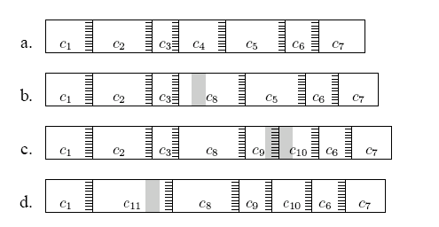
Effects of edits on file chunks
Chunks of file before/after edits
  Grey shading show edits
Stripes show 48byte regions with magic hash values creating chunk boundaries

Slide 82
15-446 Distributed Systems
Spring 2009
L-19 P2P

Slide 83
What’s out there?
 | Central | Flood | Super-node flood | Route
Whole File | Napster | Gnutella |  | Freenet
Chunk Based | BitTorrent |  | KaZaA (bytes, not chunks) | DHTs

Slide 84


Napster: Publish
insert(X,
123.2.21.23)
...
Publish
I have X, Y, and Z!
123.2.21.23

Slide 85
Napster: Search
123.2.0.18
search(A)
-->
123.2.0.18
Fetch
Query
Reply
Where is file A?

Slide 86
Gnutella: Search
I have file A.
I have file A.
Reply
Query
Where is file A?

Slide 87
KaZaA: File Insert
insert(X,
123.2.21.23)
...
Publish
I have X!
123.2.21.23

Slide 88
KaZaA: File Search
search(A)
-->
123.2.22.50
search(A)
-->
123.2.0.18
123.2.22.50
Query
Replies
Where is file A?
123.2.0.18

Slide 89
BitTorrent: Publish/Join
Tracker

Slide 90
BitTorrent: Fetch

Slide 91
DHT: Consistent Hashing
Key 5
K5
Node 105
N105
K20
Circular ID space
N32
N90
K80
A key is stored at its successor: node with next higher ID

Slide 92
DHT: Chord “Finger Table”
1/4
1/2
1/8
1/16
1/32
1/64
1/128
N80
Entry i in the finger table of node n is the first node that succeeds or equals n + 2^{i}
In other words, the ith finger points 1/2^{n-i} way around the ring
Notes:
Small tables, but multi-hop lookup. Table entries: IP address and Chord ID.
Navigate in ID space, route queries closer to successor. Log(n) tables, log(n) hops.
Route to a document between ¼ and ½ …

Slide 93
DHT: Chord Join
Succ. Table
i id+2^{i} succ
0 1 1
1 2 2
2 4 0
Nodes n0, n6 join
Succ. Table
0
i id+2^{i} succ
0 2 2
1 3 6
2 5 6
7
1
Succ. Table
i id+2^{i} succ
0 7 0
1 0 0
2 2 2
6
2
Succ. Table
5
3
i id+2^{i} succ
0 3 6
1 4 6
2 6 6
4

Slide 94
DHT: Chord Join
Succ. Table
Items
i id+2^{i} succ
0 1 1
1 2 2
2 4 0
7
Nodes:
n1, n2, n0, n6
Items:
f7, f2
0
Succ. Table
Items
7
1
i id+2^{i} succ
0 2 2
1 3 6
2 5 6
1
Succ. Table
6
2
i id+2^{i} succ
0 7 0
1 0 0
2 2 2
Succ. Table
5
3
i id+2^{i} succ
0 3 6
1 4 6
2 6 6
4

Slide 95
DHT: Chord Routing
Upon receiving a query for item id, a node:
Checks whether stores the item locally
If not, forwards the query to the largest node in its successor table that does not exceed id
Succ. Table
Items
i id+2^{i} succ
0 1 1
1 2 2
2 4 0
7
0
Succ. Table
Items
7
1
i id+2^{i} succ
0 2 2
1 3 6
2 5 6
1
query(7)
Succ. Table
6
2
i id+2^{i} succ
0 7 0
1 0 0
2 2 2
Succ. Table
5
3
i id+2^{i} succ
0 3 6
1 4 6
2 6 6
4

Slide 96
Flat Names Example
SID abstracts all object reachability information
Objects: any granularity (files, directories)
Benefit: Links (referrers) don’t break
Domain H
HTTP GET: /docs/pub.pdf
10.1.2.3
<A HREF=
http://f012012/pub.pdf
>here is a paper</A>
/docs/
HTTP GET: /~user/pubs/pub.pdf
Domain Y
(10.1.2.3,80,
/docs/)
20.2.4.6
(20.2.4.6,80,
/~user/pubs/)
/~user/pubs/
Resolution
Service

Slide 97
P2P-enabled Applications:
Self-Certifying Names
Name = Hash(pubkey, salt)
Value = <pubkey, salt, data, signature>
  can verify name related to pubkey and pubkey signed data
Can receive data from caches or other 3rd parties without worry
  much more opportunistic data transfer

Slide 98
CFS
D
H(D)
H(F)
public key
File Block
F
Directory
Block
signature
Root Block
H(B1)
H(B2)
B1
B2
Data Block
Data Block

Slide 100
15-446 Distributed Systems
Spring 2009
L-20 Multicast

Slide 101
IP Multicast Architecture
Service model
Hosts
Host-to-router protocol
(IGMP)
Routers
Multicast routing protocols
(various)

Slide 102
Multicast – Efficient Data Distribution
Src
Src

Slide 103
Multicast Scope Control – Small TTLs
TTL expanding-ring search to reach or find a nearby subset of a group
s
1
2
3

Slide 104
Prune
G
G
Prune (s,g)
S
Prune (s,g)
G

Slide 105
Implosion
Packet 1 is lost
All 4 receivers request a resend
S
Resend request
S
1
2
R1
R1
R2
R2
R3
R4
R3
R4

Slide 106
Exposure
Packet 1 does not reach R1;
Receiver 1 requests a resend
Packet 1 resent to all 4 receivers
Resend request
S
Resent packet
S
1
2
1
R1
1
R1
R2
R2
R3
R4
R3
R4

Slide 107
SRM Request Suppression
Packet 1 is lost; R1 requests resend to Source and Receivers
Packet 1 is resent; R2 and R3 no longer have to request a resend
Resend request
S
Resent packet
S
X
1
2
1
R1
R1
X
R2
R2
Delay varies by distance
X
R3
R3

Slide 108
Deterministic Suppression
3d
Time
d
data
2d
d
d
d
nack
repair
= Sender
3d
d
= Repairer
4d
= Requestor
d
Delay = C₁×d_{S,R}

Slide 109
SRM: Stochastic Suppression
0
Time
d
data
1
d
session msg
repair
d
2
NACK
d
3
2d
= Sender
Delay = U[0,D₂] ×d_{S,R}
= Repairer
= Requestor

Slide 110
Multicast Congestion Control
What if receivers have very different bandwidths?
Send at max?
Send at min?
Send at avg?
100Mb/s
100Mb/s
R
S
R
1Mb/s
???Mb/s
1Mb/s
R
56Kb/s
R

Slide 111
Layered Media Streams
R1 joins layer 1,
joins layer 2
joins layer 3
R2
R1
10Mbps
10Mbps
R2 join layer 1,
join layer 2
fails at layer 3
S
R
512Kbps
10Mbps
R
128Kbps
R3
R3 joins layer 1,
fails at layer 2

Slide 112
Join Experiments
Layer
4
3
2
1
Time

Slide 113
Supporting Multicast on the Internet
Application
?
At which layer should multicast be implemented?
IP
?
Network
Internet architecture
Notes:
In the hourglass Internet architecture,
IP is the compatibility layer in the Internet architecture.
All hosts must implement IP
Two choices
multicast at IP
or application: only a subset, customizability
One important architecture question is, at which layer should multicast be implemented.
The convention wisdom has been to support multicast in the IP layer for efficiency and performance reasons. However, more than 10 years since this is proposed, it still has not been widely deployed.
This paper revisits this question with emphasis on Internet evaluation. In particular, we show that multicast at the application layer can be efficient compared to IP Multicast.

Slide 114
IP Multicast
MIT
Berkeley
UCSD
CMU
routers
end systems
multicast flow
Highly efficient
Good delay
Notes:
In the IP Multicast architecture,
- routers replicate multicast pkts inside the network to all receivers
- motivation: highly efficiency
- highly efficient: single pkt that traverse each physical link
- delay is good from source to all receivers

Slide 115
End System Multicast
MIT1
MIT
Berkeley
MIT2
UCSD
CMU1
CMU
CMU2
Berkeley
MIT1
Overlay Tree
MIT2
UCSD
CMU1
CMU2
Notes:
Recently, we and others have advocated for an alternative architecture, where all multicast functionality, including pkt replication and group management are pushed to end systems.
- We call this architecture End System Multicast
- In this architecture, end system organize themselves into an overlay tree root at the source
- data is sent along the overlay tree.
- It is an overlay in the sense that each link in the overlay tree corresponds to a physical path in the underlying network

Slide 116
Publish/Subscribe
Want champions league football news
REAL MADRID 4-2 MARSEILLE
Subscribe
Publish
Publication
Want weather news for Lancaster
Publish/Subscribe
Service
Weather Lancaster : sunny intervals
min 11°C max 20°C
Subscription
Want Traffic update for junction A6
Subscriber
Publisher

Slide 117
Key attributes of P/S communication model
The publishing entities and subscribing entities are anonymous
The publishing entities and subscribing entities are highly de-coupled
Asynchronous communication model
The number of publishing and subscribing entities can dynamically change without affecting the entire system

Slide 118
Subject based vs.
Content based
Subject based:
  Generally also known as topic based, group based or channel based event filtering.
  Here each event is published to one of these channels by its publisher
  A subscriber subscribes to a particular channel and will receive all events published to the subscribed channel.
  Simple process for matching an event to subscriptions

Slide 119
Subject based vs.
Content based
Content based:
  More flexibility and power to subscribers, by allowing to express as an arbitrary query over the contents of the event.
  E.g. Notify me of all stock quotes of IBM from New York stock exchange if the price is greater than 150
  Added complexity in matching an event to subscriptions

Slide 120
Event routing
C1,C2,C3 are subscriptions of S1,S2,S3 respectively
P
C1
S1
Event broker
system
P
S2
C2
P
C3
S3
P
OR
Single broker
P- Event publisher
S – Event subscriber
Cluster of cooperating brokers

Slide 121
Basic elements of P/S model
Event data model
  Structure
  Types
Subscription model
  Filter language
  Scope (subject, content, context)
General challenge
  Expressiveness vs. Scalability

Slide 123
15-446 Distributed Systems
Spring 2009
L-22 Sensor Networks

Slide 124
Metric: Communication
Lifetime from one pair of AA batteries
  2-3 days at full power
  6 months at 2% duty cycle
Communication dominates cost
  < few mS to compute
  30mS to send message
Notes:
In sensor nets, power is the primary metric, rather than tradtional measures such as throughput or latency
Must schedule computation to enable sleeping
Primary component of power consumption is communication, because it takes about 30ms to transmit
A single message, and the computations were considering are generally simple (<< 30 ms).
Therefore, to a first approximation, a good metric of power consumption is the amount of communication,
Which is what I use throughout this talk

Slide 125
Communication In Sensor Nets
Radio communication has high link-level losses
  typically about 20% @ 5m
Ad-hoc neighbor discovery
Tree-based routing
A
B
C
D
F
E

Slide 126
Illustrating Directed Diffusion
Setting up gradients
Sending data
Source
Source
Sink
Sink
Reinforcing
stable path
Source
Source
Sink
Sink
Recovering
from node failure

Slide 127
Summary
Data Centric
  Sensors net is queried for specific data
  Source of data is irrelevant
  No sensor-specific query
Application Specific
  In-sensor processing to reduce data transmitted
  In-sensor caching
Localized Algorithms
  Maintain minimum local connectivity – save energy
  Achieve global objective through local coordination
Its gains due to aggregation and duplicate suppression may make it more viable than ad-hoc routing in sensor networks

Slide 128
Basic Aggregation
In each epoch:
  Each node samples local sensors once
  Generates partial state record (PSR)
    local readings
    readings from children
  Outputs PSR during its comm. slot.
At end of epoch, PSR for whole network output at root
(In paper: pipelining, grouping)
1
2
3
4
5

Slide 129
Illustration: Aggregation
SELECT COUNT(*) FROM sensors
Slot 3
Sensor #
1
 | 1 | 2 | 3 | 4 | 5
1 |  |  |  |  | 1
2 |  |  |  | 2
3 |  | 1 | 3
4
1
1
3
2
3
Slot #
4
5

Slide 130
Taxonomy of Aggregates
TAG insight: classify aggregates according to various functional properties
  Yields a general set of optimizations that can automatically be applied
Property | Examples | Affects
Partial State | MEDIAN : unbounded, MAX : 1 record | Effectiveness of TAG
Duplicate Sensitivity | MIN : dup. insensitive, AVG : dup. sensitive | Routing Redundancy
Exemplary vs. Summary | MAX : exemplary COUNT: summary | Applicability of Sampling, Effect of Loss
Monotonic | COUNT : monotonic AVG : non-monotonic | Hypothesis Testing, Snooping

Slide 131

A Naïve ODI Algorithm
Goal: count the live sensors in the network
0
0
1
0
0
0
0
0
0
0
0
1
id
Bit vector
0
1
0
0
0
0
0
0
0
0
1
0

Slide 132

Synopsis Diffusion (SenSys’04)
Goal: count the live sensors in the network
4
Challenge
Count 1 bits
0
1
1
0
1
1
0
Synopsis should be small
0
0
0
1
1
1
1
1
0
0
0
0
0
1
0
0
0
0
0
0
1
0
0
0
0
0
1
1
1
id
Bit vector
0
Boolean
OR
0
0
1
1
1
0
0
0
0
0
0
0
0
0
0
0
0
0
0
0
0
0
1
1
1
0
0
0
0
0
0
0
0
1
1
1
1
0
0
0
0
Approximate COUNT algorithm: logarithmic size bit vector

Slide 133
Synopsis Diffusion over Rings
A node is in ring i if it is i hops away from the base-station
Broadcasts by nodes in ring i are received by neighbors in ring i-1
Each node transmits once = optimal energy cost (same as Tree)
Ring 2

Slide 135
15-446 Distributed Systems
Spring 2009
Localization

Slide 136
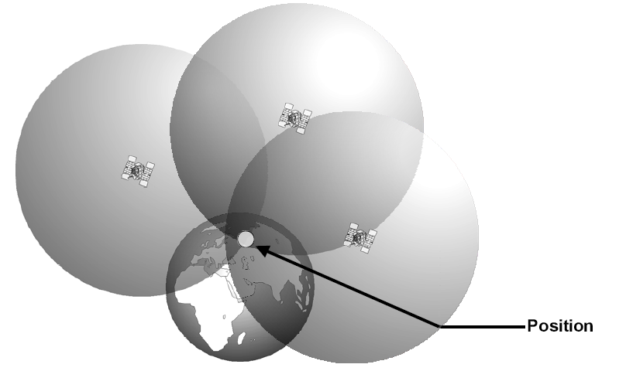
Positioning with synchronized clock
distance = travel time x The speed of light
Trilateration

Slide 137
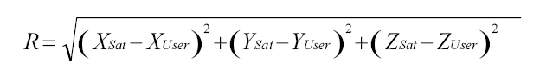
Accounting for the clock offset
Satellites’ clocks are well synchronized
Receiver clock is not synchronized.
Need to estimate 4 unknowns
  (x, y, z, Δt)
  Δt is the clock offset of the receiver
  R: real distance, PSR : estimated distance
  R = PSR - Δt ·c
Need 4 satellites

Slide 138
Wide Area Augmentation System
Error correction system that uses reference ground stations
25 reference stations in US
Monitor GPS and send correction values to two geo-stationary satellites
The two geo-stationary satellites broadcast back to Earth on GPS L1 frequency (1575.42MHz)
Only available in North America, WASS enabled GPS receiver needed

Slide 139
How good is WAAS?
With Selective Availability set to zero, and under ideal conditions, a GPS receiver without WAAS can achieve fifteen meter accuracy most of the time.*
+-15 meters
+ -
3 meters
Under ideal conditions a WAAS equipped GPS receiver can achieve three meter accuracy 95% of the time.*
* Precision depends on good satellite geometry, open sky view, and no user induced errors.

Slide 140
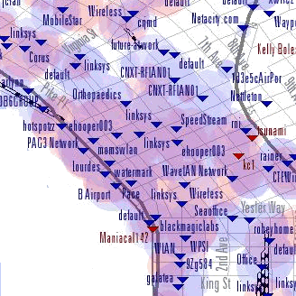



WiFi Positioning System
Exploit wide-scale WiFi deployment
  WiFi density increasing to point of overlap
WiFi base stations broadcast unique IDs
Position WiFi devices using a map of AP’s MAC to location

Slide 141
Indoor localization system
Usually more fine grained localization needed
  Often 3D (2.5D) : x,y and floor
  Often want to locate users in an office
RADAR
  Trilateration based on signal strength from APs
  Hard to predict distance based on signal strength because signal is blocked by walls and structures
  Use site-surveying
Lots of research has been done
  MIT Cricket (RF + ultrasound)
  AeroScout (WiFi), Ekahau (WiFi)

Slide 142
IP-Geography Mapping
Goal: Infer the geographic location of an Internet host given its IP address.
Why is this interesting?
  enables location-aware applications
  example applications:
    Territorial Rights Management
    Targeted Advertising
    Network Diagnostics
Why is this hard?
  IP address does not inherently indicate location
  proxies hide client identity, limit visibility into ISPs
Desirable features of a solution
  easily deployable, accuracy, confidence indicator

Slide 143
IP2Geo
Infer geo-location of IP based on various “properties”
  DNS names of routers often indicate location
  Network delay correlates with geographic distance
  Subnets are clustered
Three techniques
  GeoTrack
  GeoPing
  GeoClusters

Slide 144
IP2Geo Conclusions
IP2Geo encompasses a diverse set of techniques
  GeoTrack: DNS names
  GeoPing: network delay
  GeoCluster: geographic clusters
Median error 20-400 km
  GeoCluster also provides confidence indicator
Each technique best suited for a different purpose
  GeoTrack: locating routers, tracing geographic path
  GeoPing: location determination for proximity-based routing (e.g., CoopNet)
  GeoCluster: best suited for location-based services
Publications at SIGCOMM 2001 & USENIX 2002

Slide 145
GeoTrack
Location info often embedded in router DNS names
  ngcore1-serial8-0-0-0.Seattle.cw.net, 184.atm6-0.xr2.ewr1.alter.net
GeoTrack operation
  do a traceroute to the target IP address
  determine location of last recognizable router along the path
Key ideas in GeoTrack
  partitioned city code database to minimize chance of false match
  ISP-specific parsing rules
  delay-based correction
Limitations
  routers may not respond to traceroute
  DNS name may not contain location information or lookup may fail
  target host may be behind a proxy or a firewall

Slide 146
GeoPing
Nearest Neighbor in Delay Space(NNDS)
  delay vector: delay measurements from a host to a fixed set of landmarks
  delay map: database of delay vectors and locations for a set of known hosts
    (50,45,20,35) ↔ Indianapolis, IN
    (10,20,40,60) ↔ Seattle, WA
    •••
  target location corresponds to best match in delay map
  optimal dimensionality of delay vector is 7-9

Slide 147
GeoCluster
Basic Idea: identify geographic clusters
  partial IP-location database
    construct a database of the form (IPaddr, likely location)
    partial in coverage and potentially inaccurate
    sources: HotMail registration/login logs, TVGuide query logs
  cluster identification
    use prefix info. from BGP tables to identify topological clusters
    assign each cluster a location based on IP-location database
    do sub-clustering when no consensus on a cluster’s location
  location of target IP address is that of best matching cluster

Slide 149
15-446 Distributed Systems
Spring 2009
L-24 Adaptive Applications

Slide 150
Revisit: Why is Automated Adaptation Hard?
Must infer Internet performance
  Scalability
  Accuracy
  Tradeoff with timeliness
Support for a variety of applications
  Different performance metrics
  API requirements
Layered implementations hide information
Notes:
it would be good to have strong words to say about why measurement is fundamental to the internet -- why not just have a better network hand you the measurements you need? sounds silly to network folk, but is a natural question to people in other areas.
Layer hides info – layering is good for implementation, preserve layers but communicate info across layers

Slide 151
State of the Art: IDMaps [Francis et al ‘99]
A network distance prediction service
A/B
50ms
HOPS Server
Tracer
A
Tracer
Tracer
B

Slide 152
iPlane: Build a Structural Atlas of the Internet
Use PlanetLab + public traceroute servers
  Over 700 geographically distributed vantage points
Build an atlas of Internet routes
  Perform traceroutes to a random sample of BGP prefixes
  Cluster interfaces into PoPs
  Repeat daily from vantage points

Slide 153
Model for Path Prediction
V3 (Chicago)
V1 (Seattle)
I
Choose candidate path that models Internet routing
Identify candidate paths by intersecting observed routes
D
S
(Paris)
(Portland)
I2
Actual path unknown
V4 (Atlanta)
V2 (Rio)
Notes:
End with “Refer to paper for details on choosing among candidate paths.
I will demonstrate in a couple of slides that our approach works”

Slide 154
Multi-resolution Ring structure
For the i^{th} ring:
Inner Radius r_{i} = αs^{i-1}
Outer Radius R_{i} = αs^{i}
α is a constant
s is multiplicative increase factor
r₀ = 0, R₀ = α
Each node keeps track of finite rings

Slide 155
New Fundamental Concept:
“Internet Position”
Using GNP, every host can have an “Internet position”
  O(N) positions, as opposed to O(N²) distances
Accurate network distance estimates can be rapidly computed from “Internet positions”
“Internet position” is a local
property that can be
determined before
applications need it
Can be an interface
for independent systems
to interact
(x₂,y₂,z₂)
y
(x₁,y₁,z₁)
x
z
(x₃,y₃,z₃)
(x₄,y₄,z₄)

Slide 156
Landmark Operations
(Basic Design)
y
(x₂,y₂)
L₂
(x₁,y₁)
L₁
L₁
L₃
x
L₂
Internet
L₃
(x₃,y₃)
Measure inter-Landmark distances
  Use minimum of several round-trip time (RTT) samples
Compute coordinates by minimizing the discrepancy between measured distances and geometric distances
  Cast as a generic multi-dimensional minimization problem, solved by a central node

Slide 157
Ordinary Host Operations
(Basic Design)
y
(x₂,y₂)
L₂
(x₁,y₁)
L₁
L₁
L₃
x
L₂
Internet
L₃
(x₃,y₃)
(x₄,y₄)
Each host measures its distances to all the Landmarks
Compute coordinates by minimizing the discrepancy between measured distances and geometric distances
  Cast as a generic multi-dimensional minimization problem, solved by each host

Slide 158
Why the Difference?
IDMaps
GNP (1-dimensional model)
IDMaps overpredicts

Slide 159
Multi-resolution Ring structure
For the i^{th} ring:
Inner Radius r_{i} = αs^{i-1}
Outer Radius R_{i} = αs^{i}
α is a constant
s is multiplicative increase factor
r₀ = 0, R₀ = α
Each node keeps track of finite rings

Slide 161
15-446 Distributed Systems
Spring 2009
L-25 Cluster Computing

Slide 162
GFS: Architecture
One master server (state replicated on backups)
Many chunk servers (100s – 1000s)
  Spread across racks; intra-rack b/w greater than inter-rack
  Chunk: 64 MB portion of file, identified by 64-bit, globally unique ID
Many clients accessing same and different files stored on same cluster

Slide 163
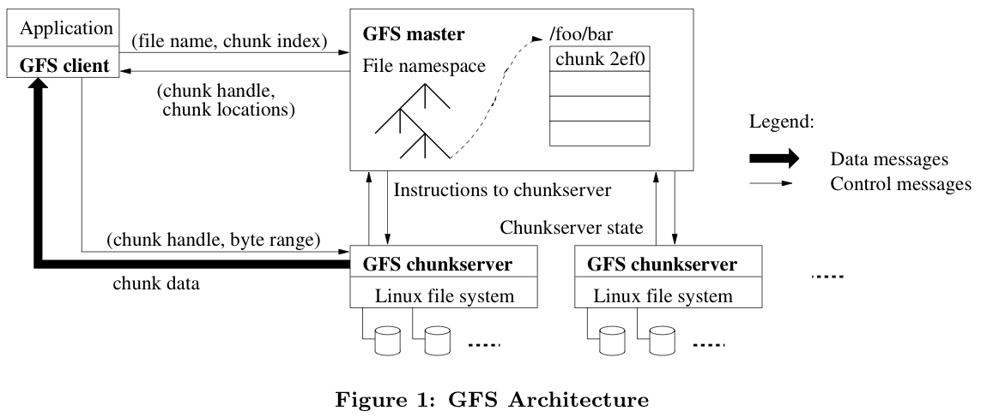
GFS: Architecture (2)

Slide 164
Master Server
Holds all metadata:
  Namespace (directory hierarchy)
  Access control information (per-file)
  Mapping from files to chunks
  Current locations of chunks (chunkservers)
Delegates consistency management
Garbage collects orphaned chunks
Migrates chunks between chunkservers
Holds all metadata in RAM; very fast operations on file system metadata

Slide 165
Client Read
Client sends master:
  read(file name, chunk index)
Master’s reply:
  chunk ID, chunk version number, locations of replicas
Client sends “closest” chunkserver w/replica:
  read(chunk ID, byte range)
  “Closest” determined by IP address on simple rack-based network topology
Chunkserver replies with data

Slide 166
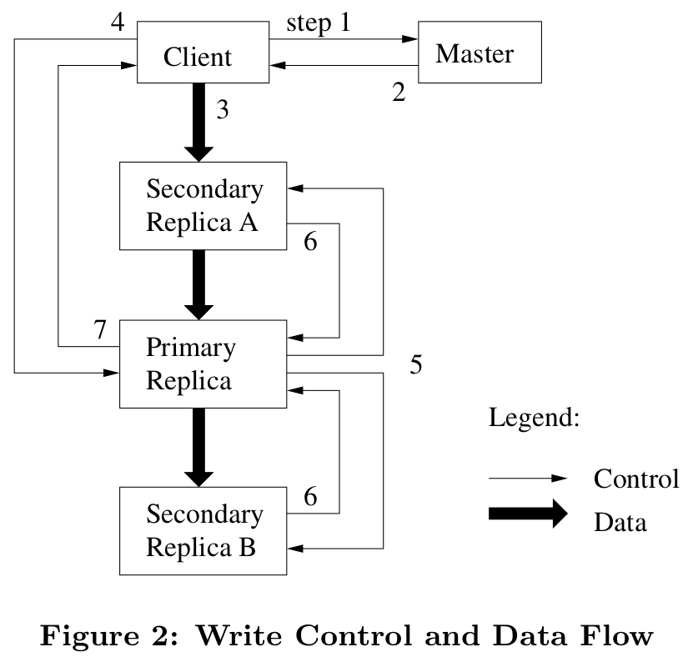
Client Write (2)

Slide 167
Client Record Append
Google uses large files as queues between multiple producers and consumers
Same control flow as for writes, except…
Client pushes data to replicas of last chunk of file
Client sends request to primary
Common case: request fits in current last chunk:
  Primary appends data to own replica
  Primary tells secondaries to do same at same byte offset in theirs
  Primary replies with success to client

Slide 168
GFS: Consistency Model (2)
Changes to data are ordered as chosen by a primary
  All replicas will be consistent
  But multiple writes from the same client may be interleaved or overwritten by concurrent operations from other clients
Record append completes at least once, at offset of GFS’s choosing
  Applications must cope with possible duplicates

Slide 169
What If the Master Reboots?
Replays log from disk
  Recovers namespace (directory) information
  Recovers file-to-chunk-ID mapping
Asks chunkservers which chunks they hold
  Recovers chunk-ID-to-chunkserver mapping
If chunk server has older chunk, it’s stale
  Chunk server down at lease renewal
If chunk server has newer chunk, adopt its version number
  Master may have failed while granting lease

Slide 170
What if Chunkserver Fails?
Master notices missing heartbeats
Master decrements count of replicas for all chunks on dead chunkserver
Master re-replicates chunks missing replicas in background
  Highest priority for chunks missing greatest number of replicas

Slide 171
GFS: Summary
Success: used actively by Google to support search service and other applications
  Availability and recoverability on cheap hardware
  High throughput by decoupling control and data
  Supports massive data sets and concurrent appends
Semantics not transparent to apps
  Must verify file contents to avoid inconsistent regions, repeated appends (at-least-once semantics)
Performance not good for all apps
  Assumes read-once, write-once workload (no client caching!)

Slide 172
MapReduce Programming Model
Input & Output: sets of <key, value> pairs
Programmer writes 2 functions:
  map (in_key, in_value) → list(out_key, intermediate_value)
    Processes <k,v> pairs
    Produces intermediate pairs
reduce (out_key, list(interm_val)) → list(out_value)
    Combines intermediate values for a key
    Produces a merged set of outputs (may be also <k,v> pairs)

Slide 173
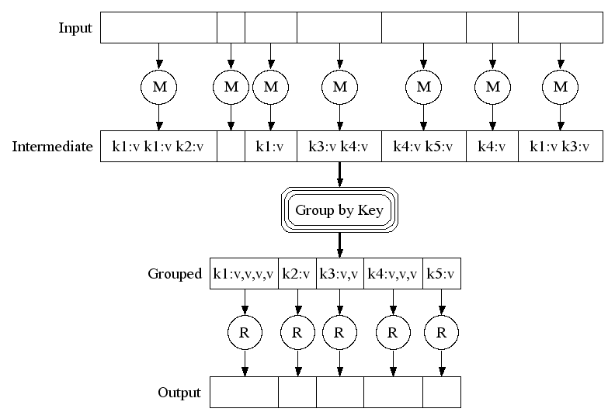
MapReduce: Example

Slide 174
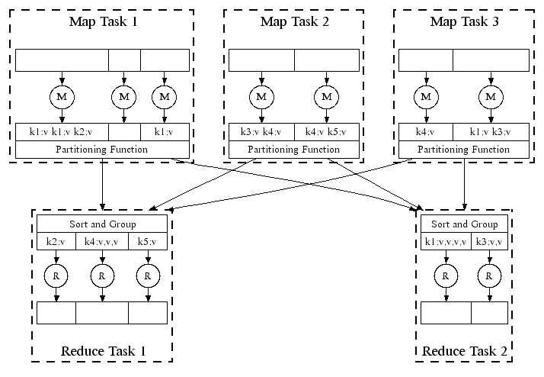
MapReduce in Parallel: Example

Slide 175
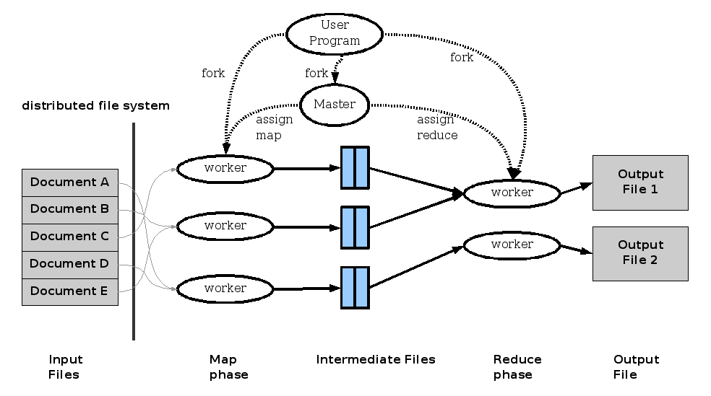
MapReduce: Execution overview

Slide 176
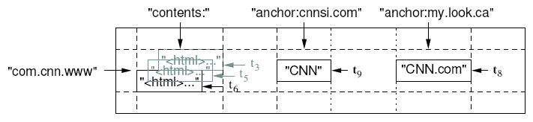
BigTable: Basic Data Model
A BigTable is a sparse, distributed persistent multi-dimensional sorted map
(row, column, timestamp) → cell contents
Good match for most Google applications

Slide 177
Table
Multiple tablets make up the table
SSTables can be shared
Tablets do not overlap, SSTables can overlap
Tablet
Tablet
aardvark
apple
apple_two_E
boat
SSTable
SSTable
SSTable
SSTable

Slide 178
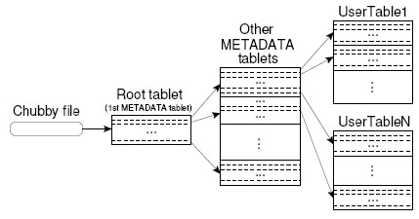
Tablet Location
Since tablets move around from server to server, given a row, how do clients find the right machine?
  Need to find tablet whose row range covers the target row

Slide 179
Chubby
{lock/file/name} service
Coarse-grained locks, can store small amount of data in a lock
5 replicas, need a majority vote to be active
Also an OSDI ’06 Paper

Slide 180
Master’s Tasks
Use Chubby to monitor health of tablet servers, restart failed servers
  Tablet server registers itself by getting a lock in a specific directory chubby
    Chubby gives “lease” on lock, must be renewed periodically
    Server loses lock if it gets disconnected
  Master monitors this directory to find which servers exist/are alive
    If server not contactable/has lost lock, master grabs lock and reassigns tablets
    GFS replicates data. Prefer to start tablet server on same machine that the data is already at

Slide 181
Master’s Tasks (Cont)
When (new) master starts
  grabs master lock on chubby
    Ensures only one master at a time
  Finds live servers (scan chubby directory)
  Communicates with servers to find assigned tablets
  Scans metadata table to find all tablets
    Keeps track of unassigned tablets, assigns them
    Metadata root from chubby, other metadata tablets assigned before scanning.

Slide 183
15-446 Distributed Systems
Spring 2009
L-26 Cluster Computer
(borrowed from Randy Katz, UCB)

Slide 184
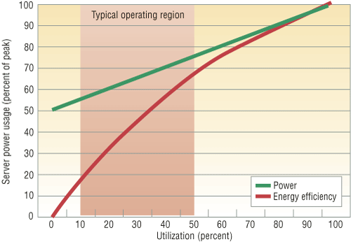
Energy Proportional Computing
“The Case for
Energy-Proportional
Computing,”
Luiz André Barroso,
Urs Hölzle,
IEEE Computer
December 2007
Doing nothing well …
NOT!
Figure 2. Server power usage and energy efficiency at varying utilization levels, from idle to
peak performance. Even an energy-efficient server still consumes about half its full power
when doing virtually no work.

Slide 185
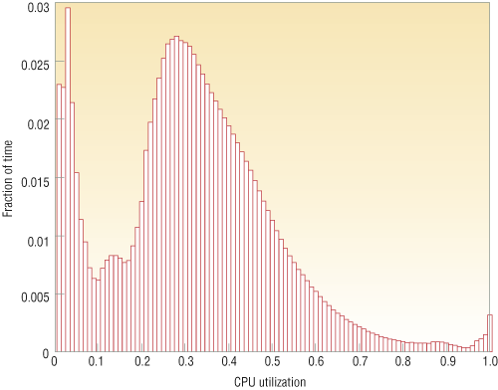
Energy Proportional Computing
“The Case for
Energy-Proportional
Computing,”
Luiz André Barroso,
Urs Hölzle,
IEEE Computer
December 2007
It is surprisingly hard
to achieve high levels
of utilization of typical
servers (and your home
PC or laptop is even
worse)
Figure 1. Average CPU utilization of more than 5,000 servers during a six-month period. Servers
are rarely completely idle and seldom operate near their maximum utilization, instead operating
most of the time at between 10 and 50 percent of their maximum

Slide 186
Spin-down Disk Model
4.7W
2.3W
2W
Spinning
& Seek
Spinning
up
Request
Spinning
& Access
Trigger:
request or
predict
Predictive
Not
Spinning
Spinning
& Ready
.2W
Spinning
down
.65-1.8W
Inactivity Timeout
threshold*

Slide 187
Disk Spindown
Disk Power Management – Oracle (off-line)
Disk Power Management – Practical scheme (on-line)
IdleTime > BreakEvenTime
access1
access2
Idle for
BreakEvenTime
Wait time
Source: from the presentation slides of the authors
Notes:
187
There are two disk power management schemes, one is called oracle scheme, the other is practical scheme. The oracle scheme is an offline scheme, which know ahead of time the length of upcoming idle period. If the idle time is larger than the breakeven time, the disk will spindown and spinup right in time before the next request. The practical scheme has no such future knowledge. If the disk is idle for a threshold of time, then the disk will spin down and spin up upon the arrival of next request. The previous work show if we set the threshold to be the breakeven time, the practical scheme is 2-compitative compared to the oracle scheme.

Slide 188
Spin-Down Policies
Fixed Thresholds
  T_{out} = spin-down cost s.t. 2*E_{transition} = P_{spin}*T_{out}
Adaptive Thresholds: T_{out} = f (recent accesses)
  Exploit burstiness in T_{idle}
Minimizing Bumps (user annoyance/latency)
  Predictive spin-ups
Changing access patterns (making burstiness)
  Caching
  Prefetching

Slide 189
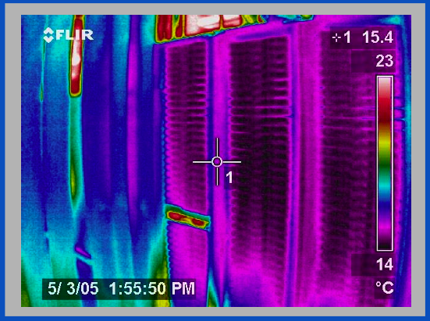
Thermal Image of Typical Cluster
Rack
Switch
M. K. Patterson, A. Pratt, P. Kumar,
“From UPS to Silicon: an end-to-end evaluation of datacenter efficiency”, Intel Corporation

Slide 190
Datacenter Power Efficiencies
Power conversions in server
  Power supply (<80% efficiency)
  Voltage regulation modules (80% common)
  Better available (95%) and inexpensive
Simple rules to minimize power distribution losses in priority order
  Avoid conversions (indirect UPS or no UPS)
  Increase efficiency of conversions
  High voltage as close to load as possible
  Size board voltage regulators to load and use high quality
  Direct Current small potential win (but regulatory issues)
Two interesting approaches:
  480VAC to rack and 48VDC (or 12VDC) within rack
  480VAC to PDU and 277VAC (1 leg of 480VAC 3-phase distribution) to each server
James Hamilton, Amazon

Slide 191
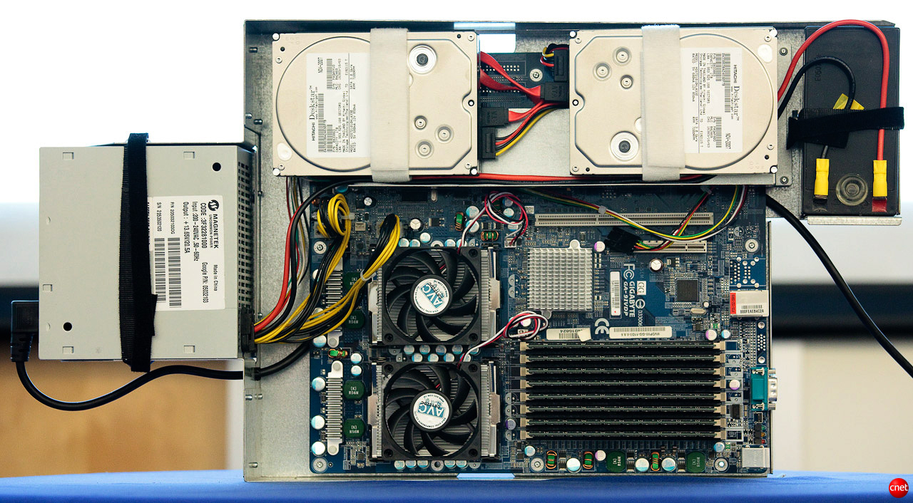
Google 1U + UPS

Slide 192
Why built-in batteries?
Building the power supply into the server is cheaper and means costs are matched directly to the number of servers
Large UPSs can reach 92 to 95 percent efficiency vs. 99.9 percent efficiency for server mounted batteries

Slide 194
15-446 Distributed Systems
Spring 2009
L-27 Social Networks and Other Stuff

Slide 195
Background: Sybil Attack
Sybil attack: Single user pretends many fake/sybil identities
  Creating multiple accounts from different IP addresses
Sybil identities can become a large fraction of all identities
  Out-vote honest users in collaborative tasks
honest
malicious
launch
sybil
attack

Slide 196
SybilGuard Basic Insight
Dis-proportionally small cut disconnecting a large number of identities
honest
nodes
sybil
nodes
But cannot search for such cut brute-force…

Slide 197
Random Route: Convergence
a
f
b
d
e
a → d
d → e
c
randomized
routing table
b → a
e → d
c → b
f → f
d → c
Random 1 to 1 mapping between
incoming edge and outgoing edge
Using routing table gives Convergence Property
  Routes merge if crossing the same edge

Slide 198
Random Route: Back-traceable
a
f
b
d
e
a → d
d → e
If we know the route traverses edge e, then we know the whole route
c
b → a
e → d
c → b
f → f
d → c
Using 1-1 mapping gives Back-traceable Property
  Routes may be back-traced

Slide 199
Random Route Intersection:
Honest Nodes
Verifier accepts a suspect if the two routes intersect
  Route length w:
  W.h.p., verifier’s route stays within honest region
  W.h.p., routes from two honest nodes intersect
Verifier
Suspect
honest nodes
sybil nodes

