Slide 1
15-446 Distributed Systems
Spring 2009
L-27 Social Networks and Other Stuff

Slide 2
Overview
Social Networks
Multiplayer Games
Class Feedback Discussion

Slide 3
Background: Sybil Attack
Sybil attack: Single user pretends many fake/sybil identities
  Creating multiple accounts from different IP addresses
Sybil identities can become a large fraction of all identities
  Out-vote honest users in collaborative tasks
honest
malicious
launch
sybil
attack

Slide 4
Background: Defending Against Sybil Attack
Using a trusted central authority
  Tie identities to actual human beings
Not always desirable
  Can be hard to find such authority
  Sensitive info may scare away users
  Potential bottleneck and target of attack
Without a trusted central authority
  Impossible unless using special assumptions [Douceur’02]
  Resource challenges not sufficient -- adversary can have much more resources than typical user

Slide 5
SybilGuard Basic Insight:
Leveraging Social Networks
Our Social Network Definition
Undirected graph
Nodes = identities
Edges = strong trust
  E.g., colleagues, relatives

Slide 6
SybilGuard Basic Insight
n honest users: One identity/node each
Malicious users: Multiple identities each (sybil nodes)
honest
nodes
sybil
nodes
attack edges
Sybil nodes may collude – the adversary
malicious
user
Observation: Adversary cannot create extra edges between honest nodes and sybil nodes

Slide 7
SybilGuard Basic Insight
Dis-proportionally small cut disconnecting a large number of identities
honest
nodes
sybil
nodes
But cannot search for such cut brute-force…

Slide 8
Goal of Sybil Defense
Goal: Enable a verifier node to decide whether to accept another suspect node
  Accept: Provide service to / receive service from
  Idealized guarantee: An honest node accepts and only accepts other honest nodes
SybilGuard:
  Bounds the number of sybil nodes accepted
  Guarantees are with high probability
  Approach: Acceptance based on random route intersection between verifier and suspect

Slide 9
Random Walk Review
a
f
b
d
e
c
pick random edge d
pick random edge e
pick random edge c

Slide 10
Random Route: Convergence
a
f
b
d
e
a → d
d → e
c
randomized
routing table
b → a
e → d
c → b
f → f
d → c
Random 1 to 1 mapping between
incoming edge and outgoing edge
Using routing table gives Convergence Property
  Routes merge if crossing the same edge

Slide 11
Random Route: Back-traceable
a
f
b
d
e
a → d
d → e
If we know the route traverses edge e, then we know the whole route
c
b → a
e → d
c → b
f → f
d → c
Using 1-1 mapping gives Back-traceable Property
  Routes may be back-traced

Slide 12
Random Route Intersection:
Honest Nodes
Verifier accepts a suspect if the two routes intersect
  Route length w:
  W.h.p., verifier’s route stays within honest region
  W.h.p., routes from two honest nodes intersect
Verifier
Suspect
honest nodes
sybil nodes

Slide 13
Random Route Intersection:
Sybil Nodes
SybilGuard bounds the number of accepted sybil nodes within g*w
  g: Number of attack edges
  w: Length of random routes
Next …
  Convergence property to bound the number of intersections within g
  Back-traceable property to bound the number of accepted sybil nodes per intersection within w

Slide 14
Bound # Intersections Within g
must cross attack edge to intersect even if sybil nodes do not follow the protocol
Convergence: Each attack edge gives one intersection
⇒ at most g intersections with g attack edges
Verifier
Suspect
same
intersection
Intersection =
(node, incoming edge
honest nodes
sybil nodes

Slide 15
Bound # Sybil Nodes Accepted per Intersection within w
Back-traceable: Each intersection should correspond to routes from at most w honest nodes
Verifier accepts at most w nodes per intersection
  Will not hurt honest nodes
Verifier
for a given intersection

Slide 16
Summary of SybilGuard Guarantees
Power of the adversary:
  Unlimited number of colluding sybil nodes
  Sybil nodes may not follow SybilGuard protocol
W.h.p., honest node accepts ≤ g*w sybil nodes
  g: # of attack edges
  w: Length of random route
If SybilGuard bounds # accepted sybil nodes within | Then apps can do
n/2 | byzantine consensus
n | majority voting
not much larger than n | effective replication

Slide 17
Overview
Social Networks
Multiplayer Games
Class Feedback Discussion

Slide 18
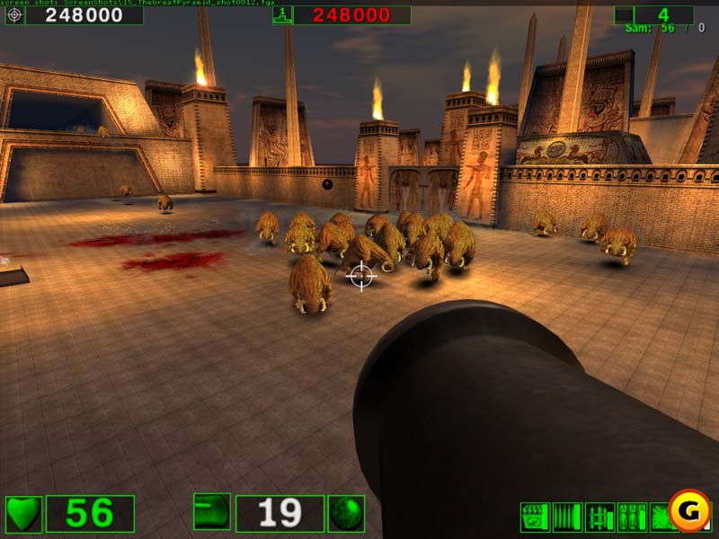
Individual Player’s View
Interactive environment (e.g. door, rooms)
Live ammo
Monsters
Players
Game state

Slide 19






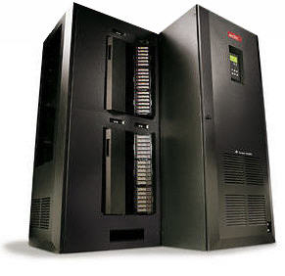


High-Speed, Large-Scale, P2P: Pick 2
Many console games are peer hosted to save costs
Limits high-speed games to 32 players
1000+ player games need dedicated servers
P2P
High-speed
Question: Can we achieve all 3?
Large-scale
Notes:
Multiplayer console games, like many xbox live games, are often hosted on the machines participating in the game rather than on dedicated servers in order to save costs and administrative overheads. However, this limits the scale of popular high-speed games, such as first person shooters, to a small number of players. Large-scale games, such as massively multiplayer games, support 1000 or 10s of thousands of players and are also very popular but they currently require dedicated servers.
So far, no game architecture has been able to support games that are high-speed, large-scale, and peer hosted. The question we ask in this talk is whether we can support all three.

Slide 20






P2P
Local View
Replica objects
Internet
Primary object
Notes:
To understand why this is hard, lets consider an example. In peer-to-peer games, the objects in the game such as player avatars are hosted on the peers themselves. Sometimes one peer acts as a server and hosts all the objects but we’re going to look at the case when each peer hosts its own player to leverage all peers’ bandwidth resources.
Each peer sends updates about its object to all others so that everyone can create a replica and render the current view.

Slide 21

High-Speed
Local View
Replica objects
Internet
Primary object
Inter-object writes
must be reflected
very quickly
Notes:
In high-speed games, interactions between objects, such as when one player shoots another, must be reflected very quickly, otherwise the game is no longer fun.

Slide 22
High-Speed
Local View
Replica objects
Internet
Primary object
20 updates/sec
≈ 16 kbps per player
Delay must be < 150ms
[Beigbeder ‘04]
Notes:
This implies that each peer must send updates very frequently so that when interactions occur, they appear consistently for the players involved. In practice, updates for FPS games are sent each game frame or 20 times per second and must be delivered within 150 milliseconds or else their staleness degrades the game play experience.

Slide 23

Large-Scale
Bandwidth per Player (Mbps)
Internet
Notes:
Finally, to achieve large-scale, a copy of each update must be delivered to each new player that enters the game. Thus, the aggregate upload capacity needed scales quadratically with the number of players. Because of the high-update rate, the constant factor is also very large.

Slide 24
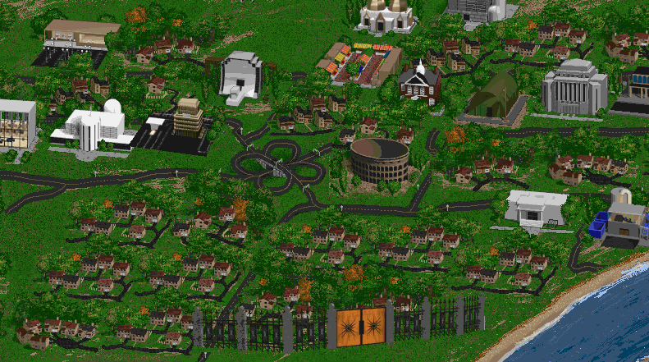
Area-of-Interest (AOI) Filtering
Large shared world
  Composed of map information, textures, etc
  Populated by active entities: user avatars, computer AI’s, etc
Only parts of world relevant to particular user/player
Game World
Player 1
Player 2

Slide 25
Object Model
Game world treated as collection of objects
Single primary copy for each object
  Maintained at a single owner node
  Serialization point for updates
  Determines actions/behavior of object
Secondary replicas
  Primary object may need to examine other objects to determine action
  Need low latency access to object → must replicate object in advance
How to find set of objects to replicate? → hardest part

Slide 26
Object Discovery –Solution
Use publish-subscribe to “register” long-lived distributed lookups
Publications created each time object is updated (or periodically when no update is done)
  Publication contents = state of object
Events
(50,250)
x 100
y 200
(100,200)
Player
x ≥ 50
x ≤ 150
y ≥ 150
y ≤ 250
Arena
(150,150)
Interests
Virtual World

Slide 27
Publish-Subscribe (PubSub) Overview
Publishers produce events
Subscribers register their interests
Publications
Subscription
Key feature → subscription language
  Subject/channel-based subscriptions (e.g. all publications on the IBM stock channel)
  Rich database-like subscription languages (e.g. all publications with name=IBM and volume > 1000)
State-of-the-art
  Scalable distributed designs with channel-based subscriptions
  Unscalable distributed designs with rich subscriptions
  Goal → scalable distributed design with “richer” subscriptions
    Example: x ≤ 200 & y < 100→ Support for multi-dimensional range predicates
Notes:
First some general background about publish subscribe (or pubsub). Publish subscribe is a common communication primitive used in many applications. In this primitive, publishers produce events with descriptions – for example a stock trade event could be described by the company, number of shares exchanged, price, etc.. Subscribers specify their interests and receive only events that match those interests. An important way in which pubsub systems differ is in the type of subscriptions they support. Many simply act like TV channels → subscribers tune into the something like the IBM stock channel and receive all IBM stock events. Others are much more flexible and allow subscribers to specify interests much like a database query – for example all trades on IBM that are above a 1000 shares.
If we look at the current state of the art in pubsub designs… We have scalable distributed designs supporting channel based subscriptions. However no such scalable designs with rich subscription support. Our goal is to fill this void by supporting subscriptions with both exact matches and range queries over multiple attributes

Slide 28
Using DHTs for Range Queries
No cryptographic hashing for key → identifier
Query: 6 ≤ x ≤ 13
key = 6 ➔ 0xab
key = 7 ➔ 0xd3
…
key = 13 ➔ 0x12
0xf0
0xe0
0x00
0xd0
0x10
0xc0
Query: 6 ≤ x ≤ 13
0x20
0xb0
0x30
0xa0
0x40
0x90
0x50
0x80
0x60
0x70
Notes:
So, let us consider using a standard DHT for performing range queries; the first problem one encounters is that hashing destroys data contiguity and so answering range queries becomes very expensive. Explain the example. So a critical design choice we make is to eliminate cryptographic hashing. Now, keys are stored contiguously and range queries can be answered by reaching the first data-item in the query and following the circle. Explain a little bit. So, we see that routing can be efficiently accomplished just like in a standard DHT.. By the way, whenever I reference the term naïve DHT here on, what I mean is a DHT without the ‘H’ and which does load balancing.
So, it appears that the system just works! But this system has a serious flaw. Let’s look at what happens when we insert a few data-items into this overlay.

Slide 29
Using DHTs for Range Queries
Nodes in popular regions can be overloaded
Load imbalance!

Slide 30
DHTs with Load Balancing
Mercury load balancing strategy
  Re-adjust responsibilities
Range ownerships are skewed!
Notes:
A natural load balancing strategy which Mercury here is to repartition the ranges in the system. Pick some of the slackers and move them to the heavily loaded region of the space. Now, how these nodes figure out where and whether to move is an important question, by itself and I will discuss it later. For now, even assuming that such a load balancing algorithm works, there’s a second problem that has arisen namely, range ownerships are now no longer uniform! Some nodes may hold a large portion of the unpopular space while a node in the popular region will hold a very small range of values.

Slide 31
DHTs with Load Balancing
0xf0
0xe0
0x00
0xd0
Popular
Region
0xb0
Finger pointers
get skewed!
0x30
0xa0
Each routing hop may not reduce node-space by half!
➔ no log(n) hop guarantee
0x90
0x80
Notes:
So, the range ownerships were skewed; as you see in this figure now, this results in the finger pointers of a node getting skewed! Ok, so what is the problem here? Remember that a DHT lookup, at a high level, performs a binary search of the node-space reducing the search space in reaching the destination by half at each hop. This is what guarantees the DHT a log(n) hop guarantee.
Animate at this point…
But in our case, the finger pointers are no longer exponentially spaced over the “space of nodes”… instead they are just exponentially spaced over the “space of identifiers or values”. This implies that every hop may not decrease the routing distance by a factor of 2, and so the log(n) hops guarantee vanishes.

Slide 32
Ideal Link Structure
0xf0
0xe0
0x00
0xd0
Popular
Region
0xb0
0x30
0xa0
0x90
0x80
Notes:
Thus, you would like to connect to nodes which are 1,2, 4, 8 hops away from you along the circle. The challenge is actually finding these nodes.

Slide 33
Mercury
Need to establish links based on node-distance
Values
v₄
v₈
4
8
Nodes
If we had the above information…
For finger i
  Estimate value v for which 2^{i} th node is responsible
Notes:
But suppose that we knew where every node in the system was located; that is the range that it is responsible for. Given this information, it would be easy to establish the correct set of links. For example, if you wanted to establish a link to the 8th node after you along the circle, you could find out the range that it is responsible for and route a join-message towards this node. Thus, you could create appropriately spaced finger pointers.

Slide 34
Mercury
Need to establish links based on node-distance
v₄
Values
Node-density
v₈
4
8
Nodes
Values
Piece-wise linear approximation
Histogram
Notes:
Since maintaining such fine-grained information is not scalable, each node in Mercury just keeps a piece-wise linear approximation to this data. This can also be viewed as maintaining a histogram of node-counts. i.e., how many nodes are present in a particular part of the entire value-space.

Slide 35
Histogram Maintenance
0xf0
Measure node-density locally
Gossip about it!
0xe0
0x00
0xd0
(Range, density)
(Range, density)
(Range, density)
0xb0
Request sample
0x30
0xa0
0x90
Node-density
0x80
0x70
Values
Notes:
After finishing the slide:
So every node obtains a sampled histogram and constructs proper links based on the mapping algorithm described in the last few slides. Ok, so we have solved the skewed finger pointers problem now – but I haven’t told you how to solve the second problem, namely load balancing.

Slide 36
Load Balancing
Heavy
Load histogram
Load
Average
Light
0
10
15
20
25
35
45
60
65
70
72.5
75
85
Basic idea: leave-rejoin
Steps
  Find average, check if heavy or light
  Light nodes perform a leave and rejoin
Notes:
Heavy if load ≥ α * Average

Slide 37
MERCURY Routing [Sigcomm 2004]
Send subscription to any one attribute hub
Send publications to all attribute hubs
Tunable number of long links → can range from full-mesh to DHT-like
Subscription
[240, 320)
50 ≤ price ≤ 150
150 ≤ volume ≤ 250
[0, 105)
[160, 240)
H_{price}
[0, 80)
H_{volume}
Publication
[105, 210)
price 100
volume 200
[210, 320)
Rendezvous point
[80, 160)
Notes:
Here we have two hubs organized as just described – one for stock price and one for stock volume.
When a subscription - shown in yellow – arrives we pick one of the attributes at random – in this case price and route the subscription to that hub. We start out at a random location on that hub – here the 240-320 node. This node realizes that it is not responsible for the subscription and forwards it clockwise. The 0-80 node realizes that it responsible for part of the subscription and stores it for future use. It then forwards it on. Similarly the 80-160 node also stores it but realizes that no-one else is responsible for the subscription and terminates the process.
When a publication arrives – shown in orange – it gets routed to all hubs. In this case we first send it to the volume hub where it gets routed much like a subscription. It eventually arrives at the matching node for volume = 200. This node tries to match it against any stored subscriptions. Since none are stored the publication is discarded. The publication is also sent to the price hub. Here it reaches the 80-160 and is successfully matched against the stored subscription. This rendezvous point for the publication and subscription then transmits the publication to the interested user.

Slide 38
Object Discovery – Basic Design
Use publish-subscribe to “register” long-lived distributed lookups
Publications created each time object is updated (or periodically when no update is done)
  Publication contents = state of object
Events
(50,250)
x 100
y 200
(100,200)
Player
x ≥ 50
x ≤ 150
y ≥ 150
y ≤ 250
Arena
(150,150)
Interests
Virtual World

Slide 39
Prefetching and Persistence
Basic design has problems
  Collecting/updating existing state is too slow
  High subscription update rate
1st fix → use Mercury only for object discovery and not state update
2nd fix → persistent publications/subscriptions
  Publication lifetimes → subsequent subscriptions would immediately trigger transmission
  Subscription lifetimes → enabled soft-state approach to subscriptions
3rd fix → predict future subscriptions
Creates a new hybrid of persistent storage and pubsub

Slide 40
Colyseus Architecture Overview
server s1
Object Store
R5
P1
P2
R3
R4
5. Infer Interests: R3, R4, P2
Object Location
Replica Management
Object Placement
1. Specify Predicted Interests:
(5 < X < 60 & 10 < y < 200) TTL 30sec
2. Locate Remote Objects: P3 on s2, P4 on s2
3. Register Replicas: R3 (to s2), R4 (to s2)
4. Synch Replicas: R3, R4
5. Optimize Placement: migrate P1 to server s2
Mercury
P3
P4
P1
server s2

Slide 41
Demo
Synthetic game used
for evaluation

Slide 42
View Inconsistency
no delay
100 ms delay
400 ms delay
Observations:
1. View inconsistency is small and gets repaired quickly
2. Missing objects on the periphery

Slide 43
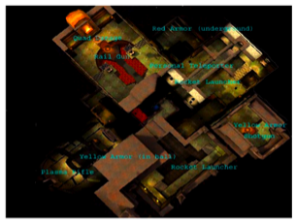
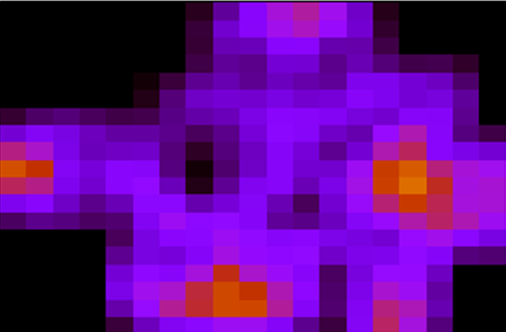

Area-of-Interest (AOI) Filtering
Only receive updates from players in your AOI
  Colyseus [Bharambe ‘06]
  VON [Hu ‘06]
  SimMUD [Knutsson ’04]
Problems:
  Open-area maps, large battles
  Region populations naturally follow a power-law
  [Bharambe ‘06, Pittman ‘07]
Quake 3 region popularity
Low population
High population
Requirement: ~1000 players in same AOI
Notes:
Previous work has tried to address this problem by using area-of-interest filtering. Some game worlds can be partitioned into different regions and players only need to receive updates from others in the same region, such as those that are currently visible. However, area-of-interest filtering can not help when the map can not be partitioned or when game developers want to engineer a large scale game event such as a large battle.
Furthermore, it has been shown that even in maps that are partitioned, the population in different regions follows a power-law. Thus, if there are 1000s or 10s of thousands of players in the game, it is still likely that there are about 1000 players in a single region.

Slide 44


Smoothing Infrequent Updates
Send guidance (predictions) instead of state updates
Guidable AI extrapolates transitions between points
  E.g., game path-finding code
Problem: Predictions are not always accurate
  Interactions appear inconsistent
  Jarring if player is paying attention
Actual path
Replica object
?
guidance
guidance
Notes:
Since we don’t have enough bandwidth to send updates at the ideal rate, we employ a novel technique to smooth infrequent updates. Players send guidance or predictions instead of state updates and we use guidable AI to smoothly extrapolate the transition between each guidance.
For example, we use existing path-finding code to make replicas move between each predicted position. Of course, if this was sufficient, we would never have needed to send frequent updates to begin with.
The problem is that predictions can still be wrong.
This means interactions between players will appear inconsistent. This is even more jarring than choppy movement when players are paying attention.

Slide 45


Donnybrook: Interest Sets
Intuition: A human can only focus on a constant number of objects at once
[Cowan ‘01, Robson ‘81]
  Only need a constant number of high-accuracy replicas
Interest Set: The 5 players that I am most interested in
  Subscribe to these players to receive 20 updates/sec
  Only get 1 update/sec from everyone else
My Interest Set
Me
Notes:
The intuition behind interest sets is that even when many players are visible, a human can only focus on a constant number of them at once. Thus, we should only need to have high-accuracy replicas of these objects.
We define my interest set as the five other players that I am most interested in. I subscribe to these players to receive frequent updates from them, while they receive only 1 update per second from everyone else. Other players replicas use guidable AI.

Slide 46

Donnybrook: Interest Sets
How to estimate human attention?
  Attention(i) = how much I am focused on player i
Attention(i) =
f_{proximity}(d_{i})
+
f_{aim}(θ_{i})
+
f_{interaction-recency}(t_{i})
θ₁
θ₂
d₁
d₂
Player 1
Player 2
Notes:
How does the game estimate what I am paying attention to?
We leverage the fact that several measurable metrics are often heavily correlated with attention in first person shooter games and compute attention as a weighted sum of these metrics:
-Proximity, because I am more likely to focus on players closer to me
Aim, because I am more likely to focus on players I am aiming at
And interaction-recentcy, because I am more likely to focus on a player I interacted with recently, such as if I shot them recently
We found that these simple metrics were a fairly good indicator of player focus in Quake III

Slide 47
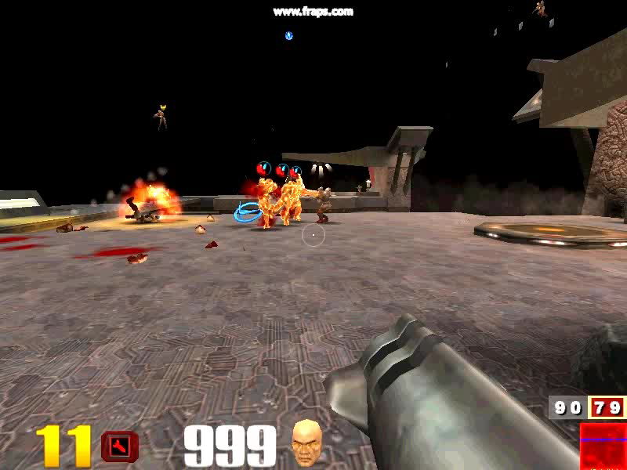

Not in Interest Set
= Interest Set
Notes:
To illustrate, lets look at a Quake III game. Here, the players in my interest set are glowing and have a marker over their head. Of course, we wouldn’t actually show which players these are in a real game. These players are in my interest set because they are closer to me and close to my center of aim, shown as a circle and a dot at the center of the screen.
As I move around and follow the player I am trying to shoot, my interest set changes, but intuitively, those in my interest set are probably those that I am paying most attention to.

Slide 48
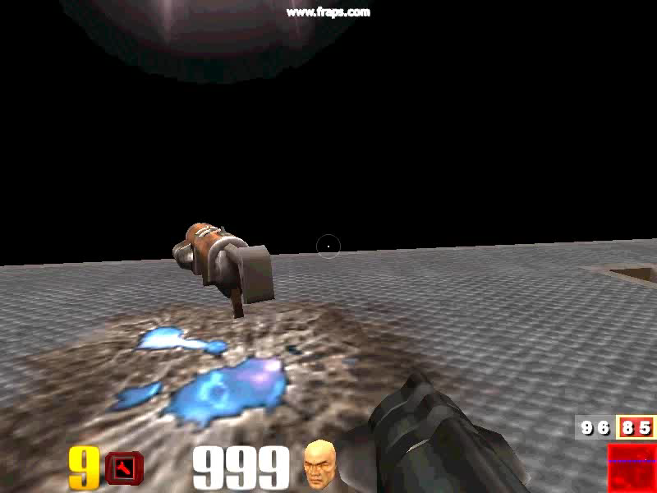
Notes:
Of course, sometimes I will pick up a sniper weapon and then aim will be more important than proximity.

Slide 49
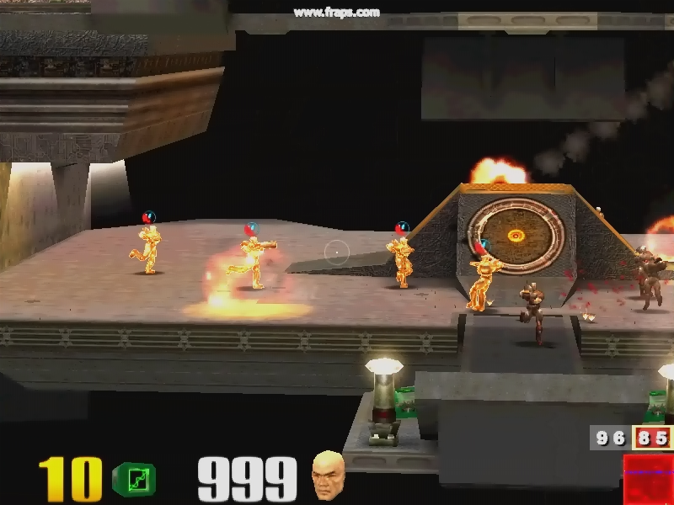
Notes:
Here we see that while some players are closer to me, the ones closer to the center of my screen are in my interest set because I am more likely to be aiming to shoot one of them.

Slide 50
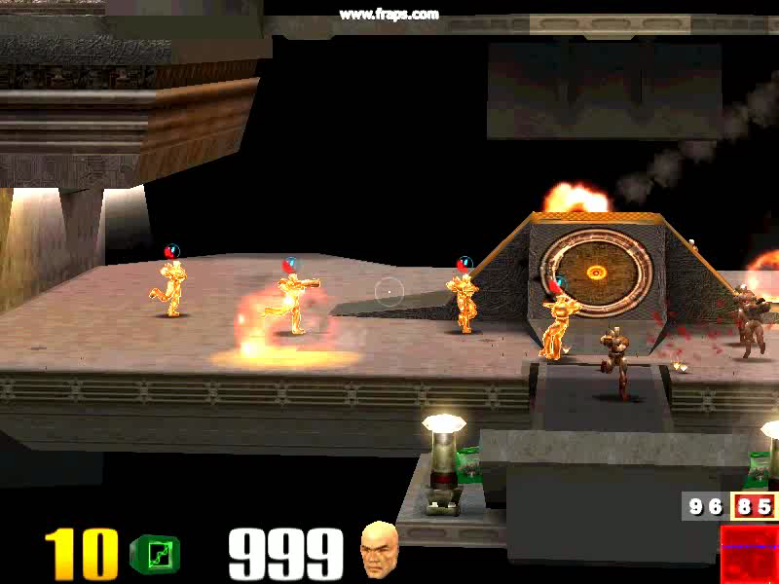
Notes:
Thus, interest sets allow the game to replay players I am paying attention to with higher accuracy, which makes interactions more likely to appear consistent.

Slide 51
Existing Distributed File Systems
Each server responsible for pseudo-random range of ID space
Object are given pseudo-random IDs
324
987
110
150-210
211-400
401-513

Slide 52
Preserving File Locality
Use Mercury to store data
6
Bill
userid
path encode
blockid
1
Docs
6
1
0
…
bid
1
6
1
1
…
bid
6
1
2
…
bid
2
7
Bob
570-600
601-660
661-700

Slide 53
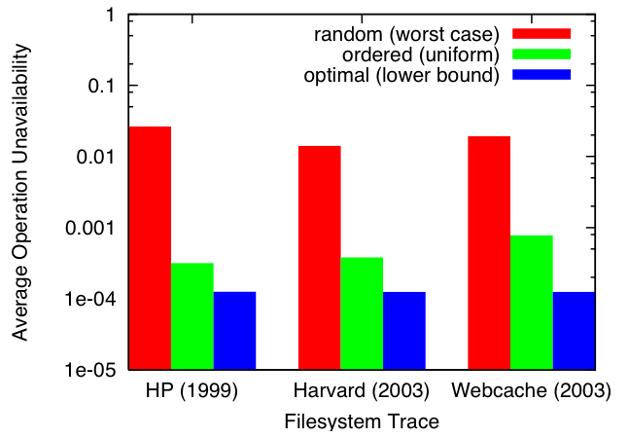
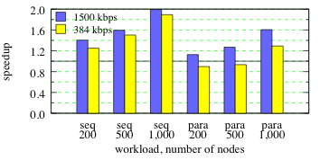
Benefits
Availability Improvement
Order preserving placement achieves availability within one ‘9’ of the optimal placement.
Order preserving placement can speedup task latency by 60-100%.
  Larger networks see greater speedup.
Request Speedup
Notes:
Simulated unavailability (failure rate) for file system operations in several real file system workloads. An operation is a sequence of temporally close accesses by a client.
Simulated DHT lookups for file system operations. An access requires a lookup if the ID’s owner is not in a client’s LRU-cache of recently contacted servers.

Slide 54
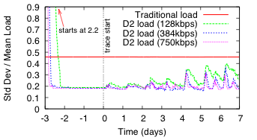
Continuous Load Balancing
Mercury can balance file system load better than existing systems even under very skewed write patterns

Slide 55
Overview
Social Networks
Multiplayer Games
Class Feedback Discussion

Slide 56
Discussion
Lecture topics?
  Balance of networking/dist sys/ubiq?
  Research/adv topics/practical engineering?
Text book vs. papers vs. lectures
Projects
  Free form vs. proposed
Android vs. no Android?

