Slide 1
15-446 Distributed Systems
Spring 2009
L-26 Cluster Computer
(borrowed from Randy Katz, UCB)

Slide 2
Overview
Data Center Overview
Per-node Energy
Power Distribution
Cooling and Mechanical Design

Slide 3

“The Big Switch,” Redux
“A hundred years ago, companies stopped generating their own power with steam engines and dynamos and plugged into the newly built electric grid. The cheap power pumped out by electric utilities didn’t just change how businesses operate. It set off a chain reaction of economic and social transformations that brought the modern world into existence. Today, a similar revolution is under way. Hooked up to the Internet’s global computing grid, massive information-processing plants have begun pumping data and software code into our homes and businesses. This time, it’s computing that’s turning into a utility.”

Slide 4
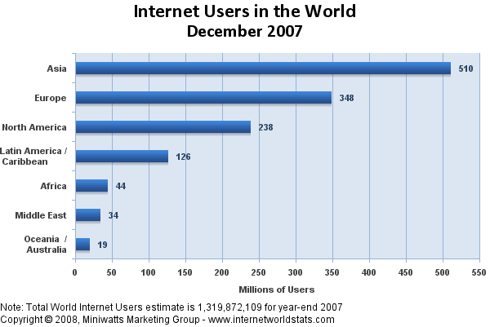
Growth of the Internet Continues …
1.32 billion in 4Q07
20% of world population
266% growth 2000-2007

Slide 5
Datacenter Arms Race
Amazon, Google, Microsoft, Yahoo!, … race to build next-gen mega-datacenters
  Industrial-scale Information Technology
  100,000+ servers
  Located where land, water, fiber-optic connectivity, and cheap power are available
E.g., Microsoft Quincy
  43600 sq. ft. (10 football fields), sized for 48 MW
  Also Chicago, San Antonio, Dublin @$500M each
E.g., Google:
  The Dalles OR, Pryor OK, Council Bluffs, IW, Lenoir NC, Goose Creek , SC

Slide 6
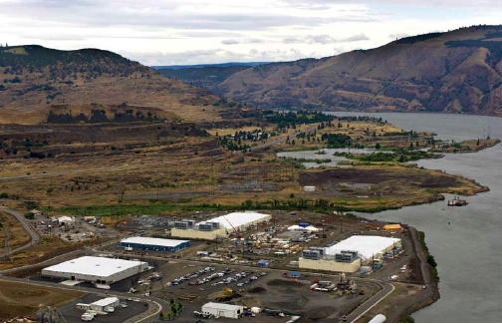
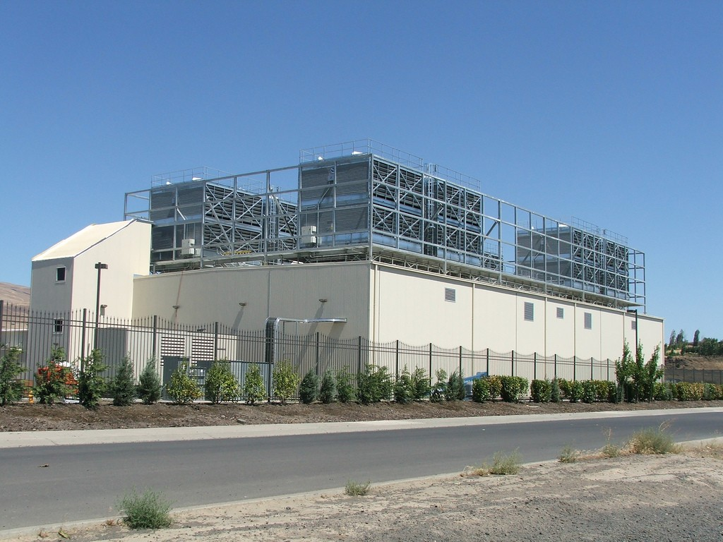
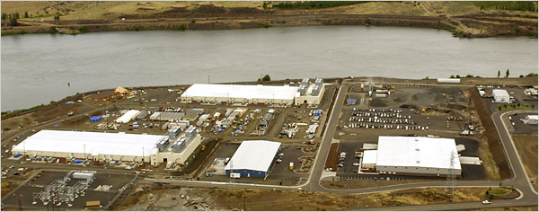
Google Oregon Datacenter

Slide 7
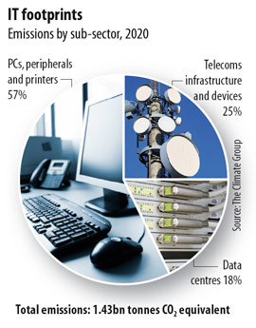
2020 IT Carbon Footprint
820m tons CO₂
360m tons CO₂
2007 Worldwide IT
carbon footprint:
2% = 830 m tons CO₂
Comparable to the
global aviation
industry
Expected to grow
to 4% by 2020
260m tons CO₂

Slide 8
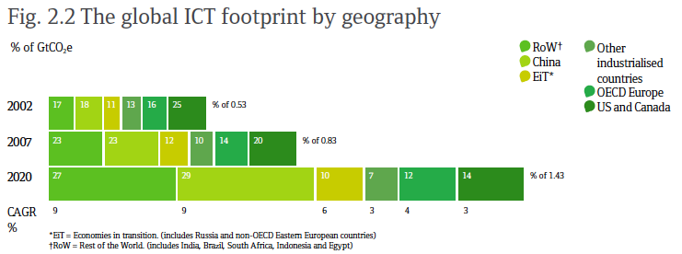
2020 IT Carbon Footprint
“SMART 2020: Enabling the Low Carbon Economy
in the Information Age”, The Climate Group

Slide 9
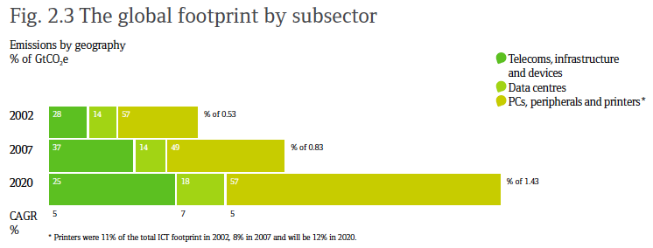
2020 IT Carbon Footprint
“SMART 2020: Enabling the Low Carbon Economy
in the Information Age”, The Climate Group

Slide 10
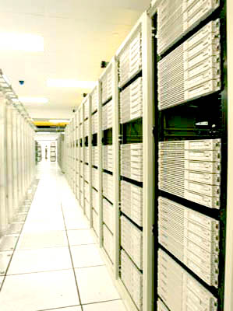
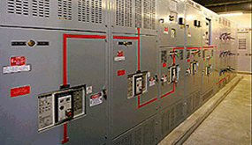
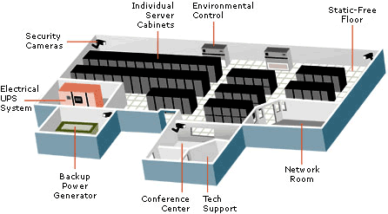
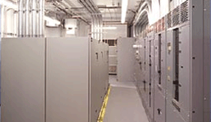
Computers + Net + Storage + Power + Cooling

Slide 11
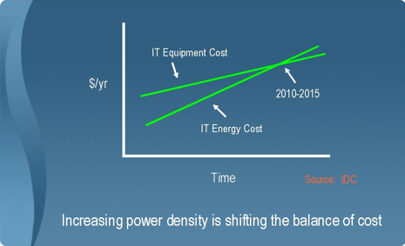
Energy Expense Dominates

Slide 12
Energy Use In Datacenters
LBNL

Slide 13
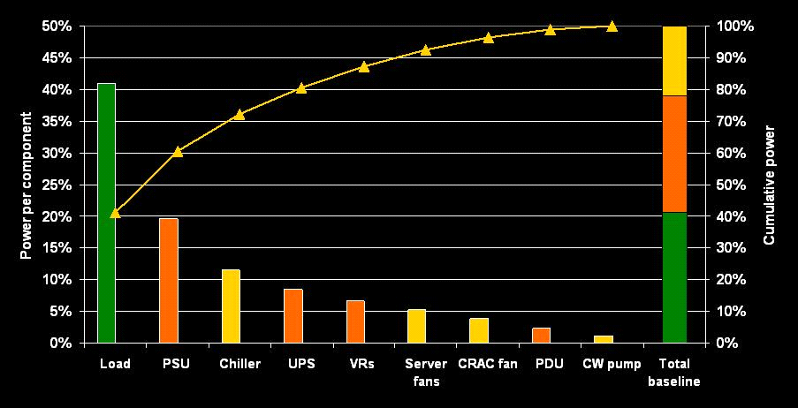
Energy Use In Datacenters
Michael Patterson, Intel

Slide 14
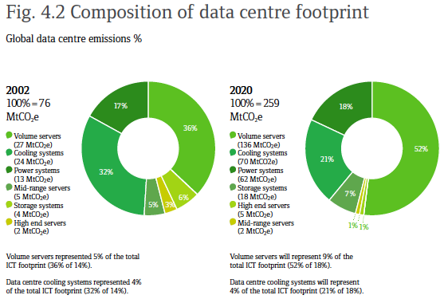
2020 IT Carbon Footprint

Slide 15
Utilization and Efficiency
PUE: Power Utilization Efficiency
  Total facility power / Critical load
  Good conventional data centers ~1.7 (a few are better)
  Poorly designed enterprise data centers as bad as 3.0
Assume a PUE of 1.7 and see where it goes:
  0.3 (18%): Power distribution
  0.4 (24%): Mechanical (cooling)
  1.0 (58%): Critical Load (server efficiency & utilization)
Low efficiency DCs spend proportionally more on cooling
  2 to 3x efficiency improvements possible by applying modern techniques
  Getting to 4x and above requires server design and workload management techniques
James Hamilton, Amazon

Slide 16
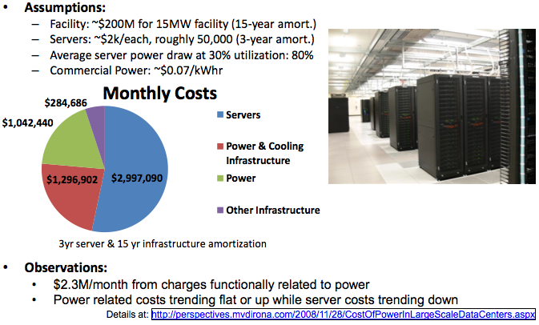
Where do the $$$'s go?

Slide 17
Overview
Data Center Overview
Per-node Energy
Power Distribution
Cooling and Mechanical Design

Slide 18
Nameplate vs. Actual Peak
Component | Peak Power (Watts) | Count | Total (Watts)
CPU | 40 | 2 | 80
Memory | 9 | 4 | 36
Disk | 12 | 1 | 12
PCI Slots | 25 | 2 | 50
Motherboard | 25 | 1 | 25
Fan | 10 | 1 | 10
System Total |  |  | 213
Nameplate peak
Measured Peak
(Power-intensive workload)
145 W
In Google’s world, for given DC power budget, deploy
as many machines as possible
X. Fan, W-D Weber, L. Barroso, “Power Provisioning for a
Warehouse-sized Computer,” ISCA’07, San Diego, (June 2007).

Slide 19
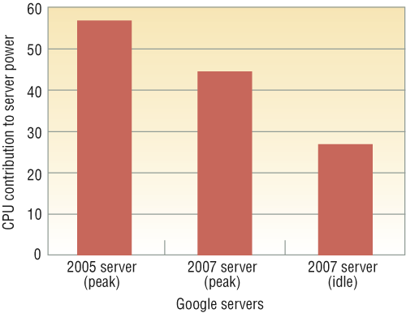
Energy Proportional Computing
“The Case for
Energy-Proportional
Computing,”
Luiz André Barroso,
Urs Hölzle,
IEEE Computer
December 2007
CPU energy improves,
but what about the rest of
the server architecture?
Figure 3. CPU contribution to total server power for two generations of Google servers
at peak performance (the first two bars) and for the later generation at idle (the rightmost bar).

Slide 20
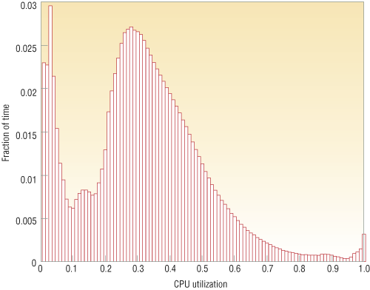
Energy Proportional Computing
“The Case for
Energy-Proportional
Computing,”
Luiz André Barroso,
Urs Hölzle,
IEEE Computer
December 2007
It is surprisingly hard
to achieve high levels
of utilization of typical
servers (and your home
PC or laptop is even
worse)
Figure 1. Average CPU utilization of more than 5,000 servers during a six-month period. Servers
are rarely completely idle and seldom operate near their maximum utilization, instead operating
most of the time at between 10 and 50 percent of their maximum

Slide 21
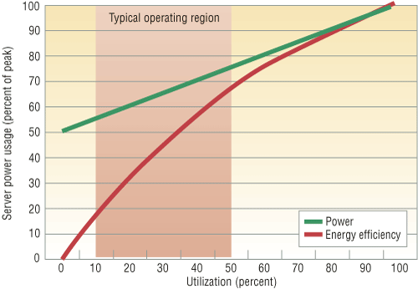
Energy Proportional Computing
“The Case for
Energy-Proportional
Computing,”
Luiz André Barroso,
Urs Hölzle,
IEEE Computer
December 2007
Doing nothing well …
NOT!
Figure 2. Server power usage and energy efficiency at varying utilization levels, from idle to
peak performance. Even an energy-efficient server still consumes about half its full power
when doing virtually no work.

Slide 22
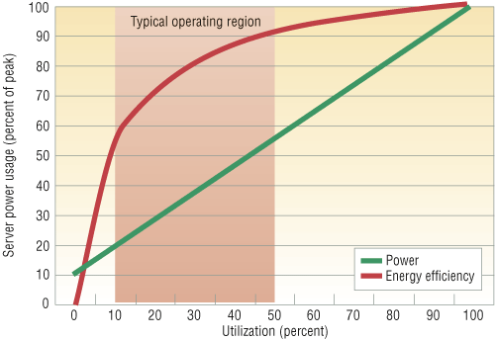
Energy Proportional Computing
“The Case for
Energy-Proportional
Computing,”
Luiz André Barroso,
Urs Hölzle,
IEEE Computer
December 2007
Doing nothing
VERY well
Design for
wide dynamic
power range and
active low power
modes
Figure 4. Power usage and energy efficiency in a more energy-proportional server. This
server has a power efficiency of more than 80 percent of its peak value for utilizations of
30 percent and above, with efficiency remaining above 50 percent for utilization levels as
low as 10 percent.

Slide 23
“Power” of Cloud Computing
SPECpower: two best systems
  Two 3.0-GHz Xeons,
  16 GB DRAM, 1 Disk
  One 2.4-GHz Xeon,
  8 GB DRAM, 1 Disk
50% utilization ➔
85% Peak Power
10%➔65% Peak Power
Save 75% power if
consolidate & turn off
  1 computer @ 50% = 225 W
  5 computers @ 10% = 870 W
Better to have one computer at 50% utilization than five computers at 10% utilization: Save $ via Consolidation (& Save Power)
Notes:
23

Slide 24
Bringing Resources
On-/Off-line
Save power by taking DC “slices” off-line
  Resource footprint of applications hard to model
  Dynamic environment, complex cost functions require measurement-driven decisions -- opportunity for statistical machine learning
  Must maintain Service Level Agreements, no negative impacts on hardware reliability
  Pervasive use of virtualization (VMs, VLANs, VStor) makes feasible rapid shutdown/migration/restart
Recent results suggest that conserving energy may actually improve reliability
  MTTF: stress of on/off cycle vs. benefits of off-hours

Slide 25
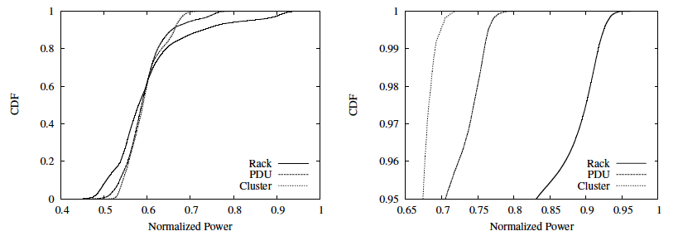
Typical Datacenter Power
Power-aware allocation of resources can achieve higher
levels of utilization – harder to drive a cluster to high levels
of utilization than an individual rack
X. Fan, W-D Weber, L. Barroso, “Power Provisioning for a
Warehouse-sized Computer,” ISCA’07, San Diego, (June 2007).

Slide 26
Aside: Disk Power
IBM Microdrive (1inch)
writing 300mA (3.3V)
1W
standby 65mA (3.3V)
.2W
IBM TravelStar (2.5inch)
read/write 2W
spinning 1.8W
low power idle .65W
standby .25W
sleep .1W
startup 4.7 W
seek 2.3W

Slide 27
Spin-down Disk Model
4.7W
2.3W
2W
Spinning
& Seek
Spinning
up
Request
Spinning
& Access
Trigger:
request or
predict
Predictive
Not
Spinning
Spinning
& Ready
.2W
Spinning
down
.65-1.8W
Inactivity Timeout
threshold*

Slide 28
Disk Spindown
Disk Power Management – Oracle (off-line)
Disk Power Management – Practical scheme (on-line)
IdleTime > BreakEvenTime
access1
access2
Idle for
BreakEvenTime
Wait time
Source: from the presentation slides of the authors
Notes:
28
There are two disk power management schemes, one is called oracle scheme, the other is practical scheme. The oracle scheme is an offline scheme, which know ahead of time the length of upcoming idle period. If the idle time is larger than the breakeven time, the disk will spindown and spinup right in time before the next request. The practical scheme has no such future knowledge. If the disk is idle for a threshold of time, then the disk will spin down and spin up upon the arrival of next request. The previous work show if we set the threshold to be the breakeven time, the practical scheme is 2-compitative compared to the oracle scheme.

Slide 29
Spin-Down Policies
Fixed Thresholds
  T_{out} = spin-down cost s.t. 2*E_{transition} = P_{spin}*T_{out}
Adaptive Thresholds: T_{out} = f (recent accesses)
  Exploit burstiness in T_{idle}
Minimizing Bumps (user annoyance/latency)
  Predictive spin-ups
Changing access patterns (making burstiness)
  Caching
  Prefetching

Slide 30
Dynamic Spindown
Helmbold, Long, Sherrod (MOBICOM96)
Dynamically choose a timeout value as function of recent disk activity
Based on machine learning techniques (for all you AI students!)
Exploits bursty nature of disk activity
Compares to (related previous work)
  best fixed timeout with knowledge of entire sequence of accesses
  optimal - per access best decision of what to do
  competitive algorithms - fixed timeout based on disk characteristics
  commonly used fixed timeouts

Slide 31
Spindown and Servers
The idle periods in server workloads are too short to justify high spinup/down cost of server disks [ISCA’03][ISPASS’03] [ICS’03]
  IBM Ultrastar 36Z15 -- 135J/10.9s
Multi-speed disk model [ISCA’03]
  RPMs: multiple intermediate power modes
  Smaller spinup/down costs
  Be able to save energy for server workloads
BUT… many energy/load optimizations have similar tradeoffs/algorithms
Notes:
31
The current research shows the idle period in server workloads are too short and cannot justify the high spinup/spindown cost of server disks. For example, one of the modern IBM Ultrastar server disks spend 135 joules and almost 11 seconds to spin up, which means accessing a disk when it is active is cheap and when the disk is in low power model, we should avoid accessing it., in other words, to make the idle period longer. To address this problem, a ISCA paper last year propose a multi-speed disk model. The disk has multiple rotation speeds, which serves as multiple intermediate power modes. Spinup from those intermediate speeds is much cheaper than spinup from the standby mode. We also use this disk model in our studies because it can save energy even for the server workload. The ISCA paper provide us two options, one is the disk can only service requests in active mode; the other is the disk can even serve requests in different rotation speed. We use the first options because it is a simple extension to the traditional power model. However, more previous work assume that all requests go to physical disks directly. Is it true?

Slide 32
Critical Load Optimization
Power proportionality is great, but “off” still wins by large margin
  Today: Idle server ~60% power of full load
  Off required changing workload location
  Industry secret: “good” data center server utilization around ~30% (many much lower)
What limits 100% dynamic workload distribution?
  Networking constraints (e.g. VIPs can’t span L2 nets, manual config, etc.)
  Data Locality
    Hard to move several TB and workload needs to be close to data
  Workload management:
    Scheduling work over resources optimizing power with SLA constraint
Server power management still interesting
  Most workloads don’t fully utilize all server resources
  Very low power states likely better than off (faster)
James Hamilton, Amazon

Slide 33
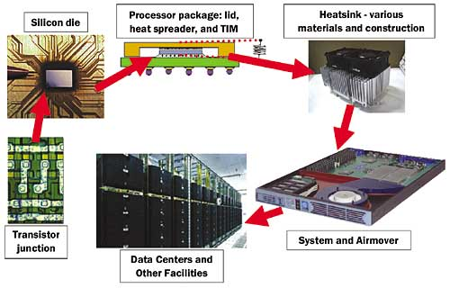
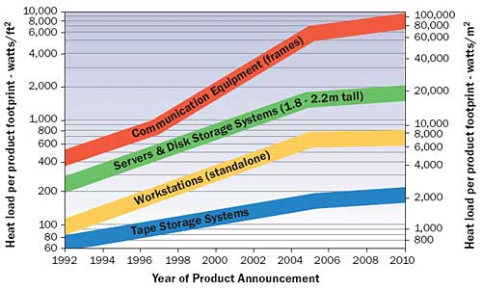
CPU Nodes vs. Other Stuff

Slide 34
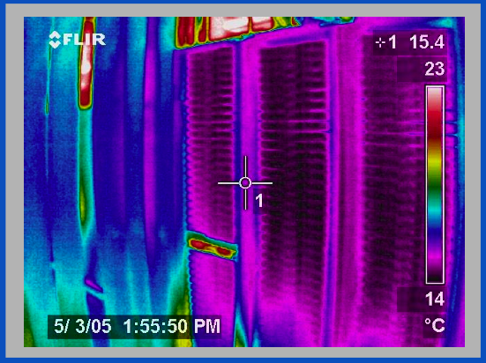
Thermal Image of Typical Cluster
Rack
Switch
M. K. Patterson, A. Pratt, P. Kumar,
“From UPS to Silicon: an end-to-end evaluation of datacenter efficiency”, Intel Corporation

Slide 35
DC Networking and Power
Within DC racks, network equipment often the “hottest” components in the hot spot
Network opportunities for power reduction
  Transition to higher speed interconnects (10 Gbs) at DC scales and densities
  High function/high power assists embedded in network element (e.g., TCAMs)

Slide 36
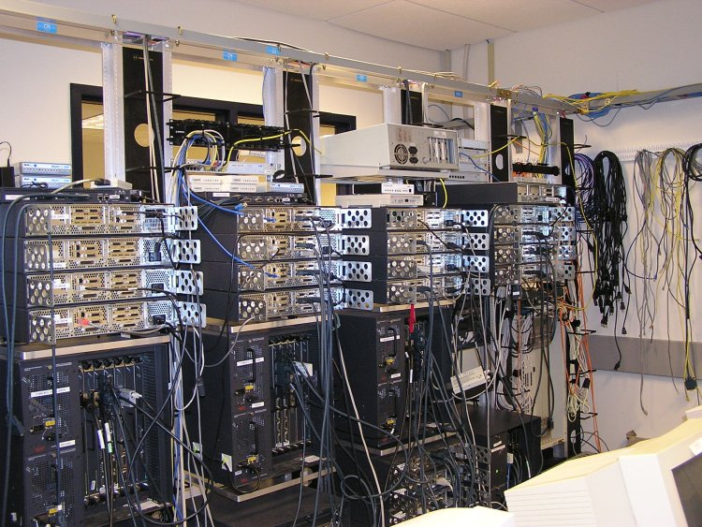
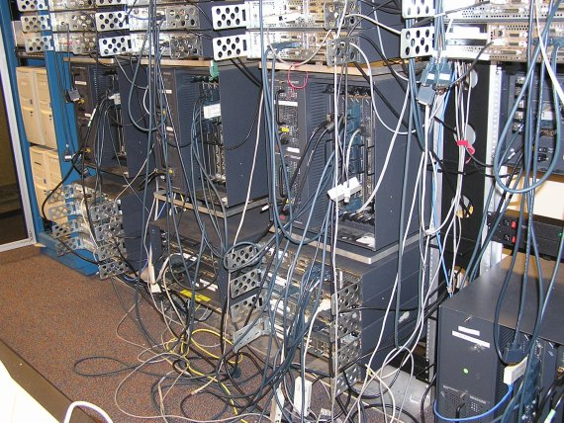
DC Networking and Power
96 x 1 Gbit port Cisco datacenter switch consumes around 15 kW -- approximately 100x a typical dual processor Google server @ 145 W
High port density drives network element design, but such high power density makes it difficult to tightly pack them with servers
Alternative distributed processing/communications topology under investigation by various research groups

Slide 37
Overview
Data Center Overview
Per-node Energy
Power Distribution
Cooling and Mechanical Design

Slide 38
Datacenter Power
Main Supply
Typical structure 1MW Tier-2 datacenter
Reliable Power
  Mains + Generator
  Dual UPS
Units of Aggregation
  Rack (10-80 nodes)
  PDU (20-60 racks)
  Facility/Datacenter
Transformer
ATS
Generator
1000 kW
Switch
Board
UPS
UPS
STS
PDU
…
STS
200 kW
PDU
50 kW
Panel
Panel
Circuit
2.5 kW
Rack
X. Fan, W-D Weber, L. Barroso, “Power Provisioning for a
Warehouse-sized Computer,” ISCA’07, San Diego, (June 2007).

Slide 39
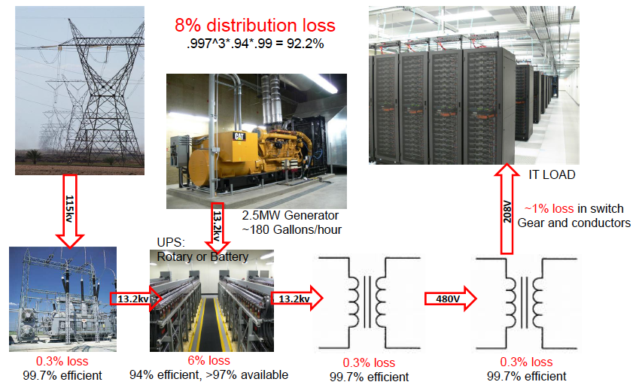
Datacenter Power Efficiencies
James Hamilton, Amazon

Slide 40
Datacenter Power Efficiencies
Power conversions in server
  Power supply (<80% efficiency)
  Voltage regulation modules (80% common)
  Better available (95%) and inexpensive
Simple rules to minimize power distribution losses in priority order
  Avoid conversions (indirect UPS or no UPS)
  Increase efficiency of conversions
  High voltage as close to load as possible
  Size board voltage regulators to load and use high quality
  Direct Current small potential win (but regulatory issues)
Two interesting approaches:
  480VAC to rack and 48VDC (or 12VDC) within rack
  480VAC to PDU and 277VAC (1 leg of 480VAC 3-phase distribution) to each server
James Hamilton, Amazon

Slide 41
Typical AC
Distribution Today
380 V DC after first stage conversion
480 Volt AC
LBNL

Slide 42
Facility-level DC Distribution
380V.DC
480 Volt AC
380V DC delivered directly to the server at the same point as in AC powered server
Eliminates DC-AC conversion at the UPS and the AC-DC conversion in the server
Less equipment needed

Slide 43
Rack-level DC Distribution
480 Volt AC
LBNL

Slide 44
AC System Loss Compared to DC
7-7.3% measured improvement
2-5% measured improvement
Rotary UPS
LBNL

Slide 45
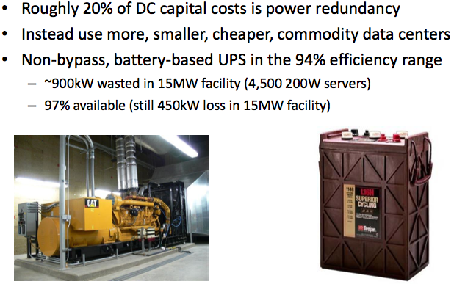
Power Redundancy

Slide 46
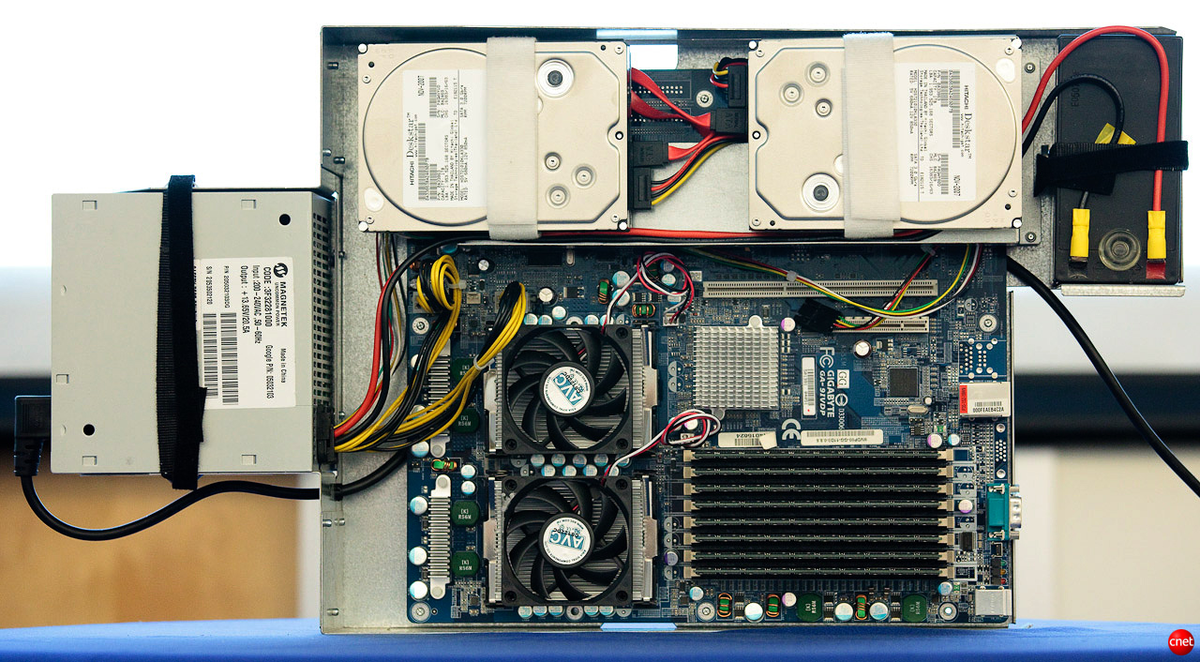
Google 1U + UPS

Slide 47
Why built-in batteries?
Building the power supply into the server is cheaper and means costs are matched directly to the number of servers
Large UPSs can reach 92 to 95 percent efficiency vs. 99.9 percent efficiency for server mounted batteries

Slide 48
Overview
Data Center Overview
Per-node Energy
Power Distribution
Cooling and Mechanical Design

Slide 49
Mechanical Optimization
Simple rules to minimize cooling costs:
  Raise data center temperatures
  Tight control of airflow with short paths
    ~1.4 to perhaps 1.3 PUE with the first two alone
  Air side economization (essentially, open the window)
  Water side economization (don’t run A/C)
  Low grade, waste heat energy reclamation
Best current designs have water cooling close to the load but don’t use direct water cooling
  Lower heat densities could be 100% air cooled but density trends suggest this won’t happen
James Hamilton, Amazon

Slide 50
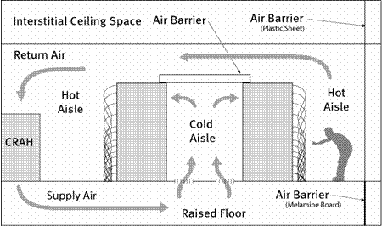
Ideal Machine Room Cooling
Hot and Cold Aisles
95-100ºF
70-75ºF
LBNL

Slide 51
Real Machine Rooms
More Complicated
Hewlett-Packard

Slide 52
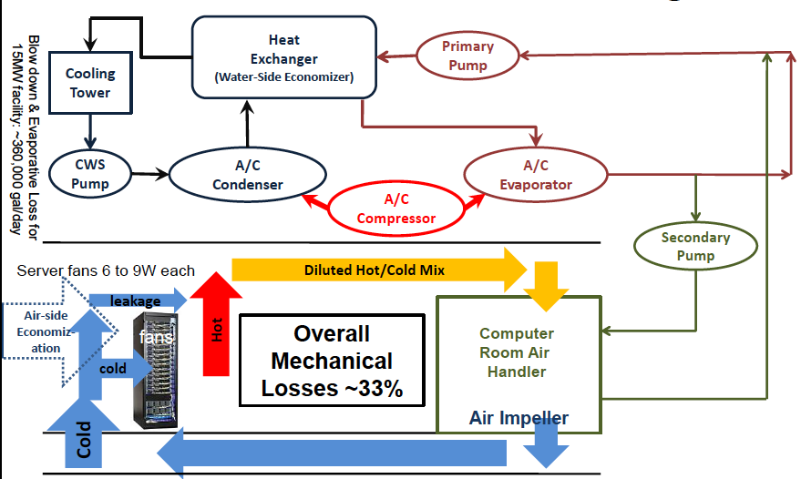
Conventional Datacenter Mechanical Design
James Hamilton, Amazon

Slide 53
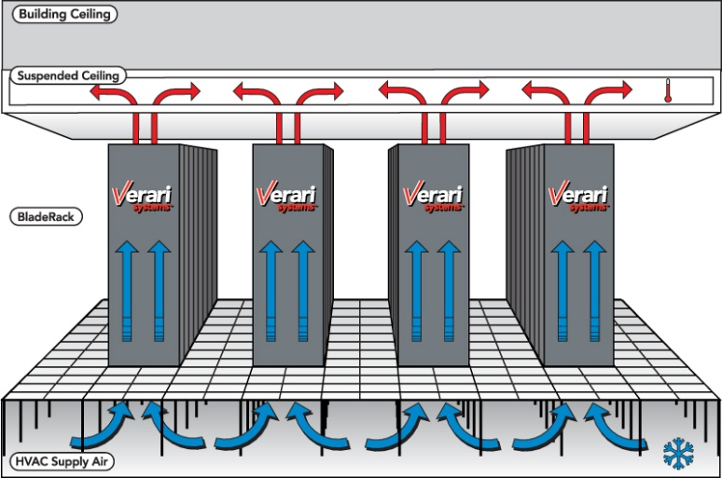
More Efficient Air Flow

Slide 54
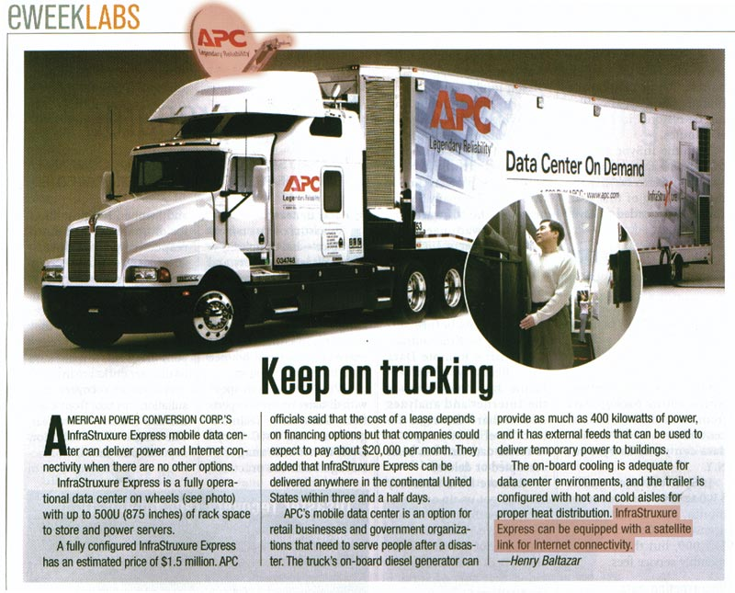

Slide 55
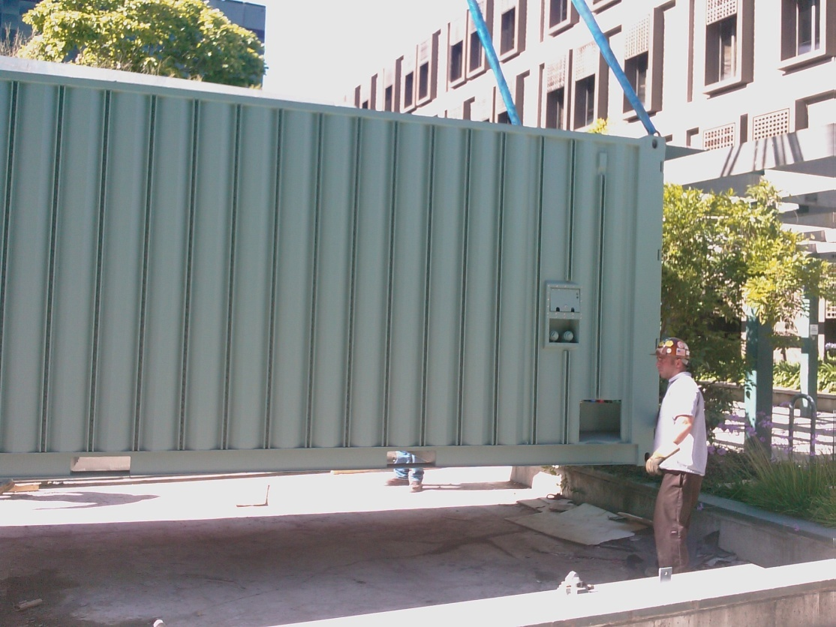
Containerized Datacenters
Sun Modular Data Center
  Power/cooling for 200 KW
  of racked HW
  External taps for electricity,
  network, water
  7.5 racks: ~250 Servers,
  7 TB DRAM, 1.5 PB disk
Notes:
55
2 slides imply many more devices to manage

Slide 56
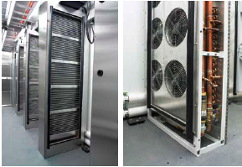
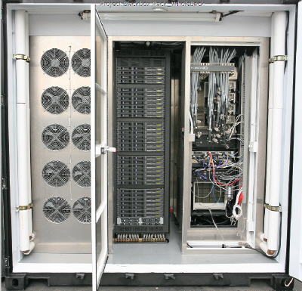
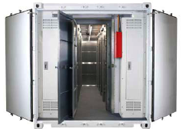
Containerized Datacenters

Slide 57
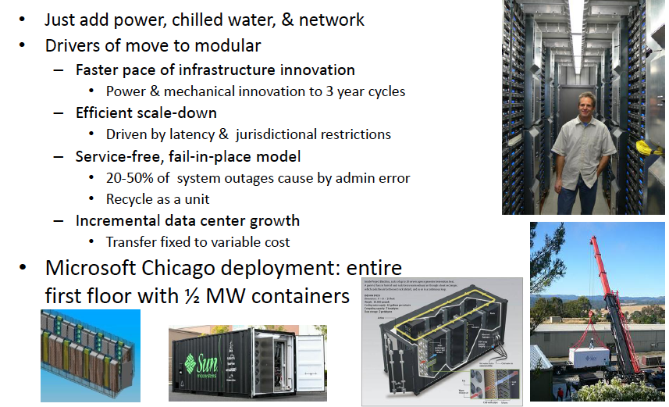
Modular Datacenters
James Hamilton, Amazon

Slide 58
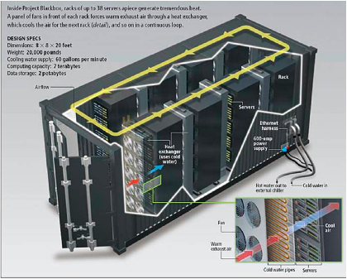
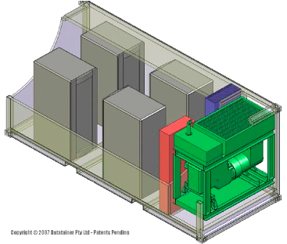
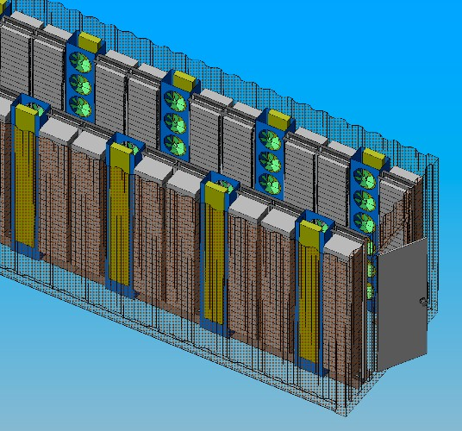
Containerized Datacenter
Mechanical-Electrical Design

Slide 59
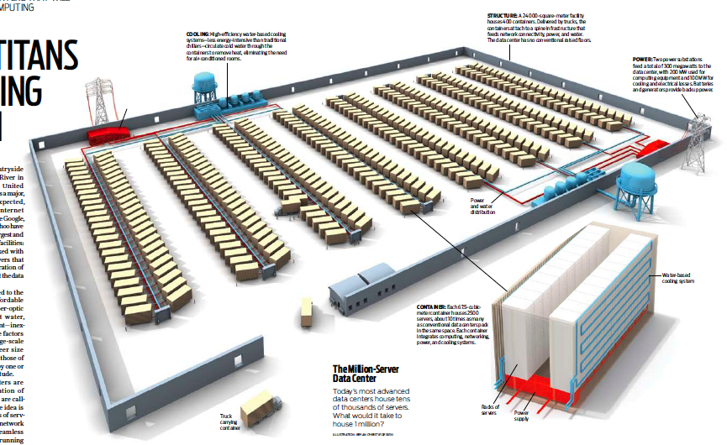
Microsoft’s Chicago
Modular Datacenter

Slide 60
The Million Server Datacenter
24000 sq. m housing 400 containers
  Each container contains 2500 servers
  Integrated computing, networking, power, cooling systems
300 MW supplied from two power substations situated on opposite sides of the datacenter
Dual water-based cooling systems circulate cold water to containers, eliminating need for air conditioned rooms

Slide 61
Google
Since 2005, its data centers have been composed of standard shipping containers--each with 1,160 servers and a power consumption that can reach 250 kilowatts
Google server was 3.5 inches thick--2U, or 2 rack units, in data center parlance. It had two processors, two hard drives, and eight memory slots mounted on a motherboard built by Gigabyte

Slide 62
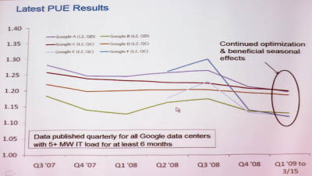
Google's PUE
In the third quarter of 2008, Google's PUE was 1.21, but it dropped to 1.20 for the fourth quarter and to 1.19 for the first quarter of 2009 through March 15
Newest facilities have 1.12

Slide 64
Summary and Conclusions
Energy Consumption in IT Equipment
  Energy Proportional Computing
  Inherent inefficiencies in electrical energy distribution
Energy Consumption in Internet Datacenters
  Backend to billions of network capable devices
  Enormous processing, storage, and bandwidth supporting applications for huge user communities
  Resource Management: Processor, Memory, I/O, Network to maximize performance subject to power constraints: “Do Nothing Well”
  New packaging opportunities for better optimization of computing + communicating + power + mechanical

Slide 65
Datacenter Optimization Summary
Some low-scale DCs as poor as 3.0 PUE
Workload management has great potential:
  Over-subscribe servers and use scheduler to manage
  Optimize workload placement and shut servers off
    Network, storage, & mgmt system issues need work
4x efficiency improvement from current generation high-scale DCs (PUE ~1.7) is within reach without technology breakthrough
The Uptime Institute reports that the average data center Power Usage Effectiveness is 2.0 (smaller is better). What this number means is that for every 1W of power that goes to a server in an enterprise data center, a matching watt is lost to power distribution and cooling overhead. Microsoft reports that its newer designs are achieving a PUE of 1.22 (Out of the box paradox…). All high scale services are well under 1.7 and most, including Amazon, are under 1.5.
James Hamilton, Amazon

