Slide 1
15-446 Distributed Systems
Spring 2009
L-25 Cluster Computing

Slide 2
Overview
Google File System
MapReduce
BigTable

Slide 3
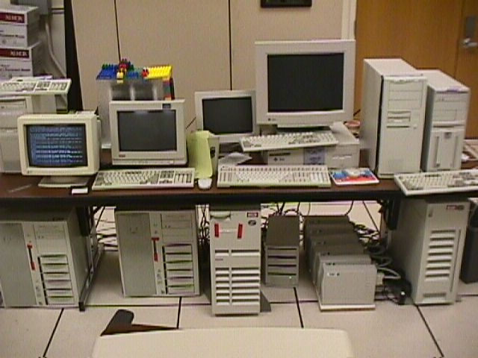
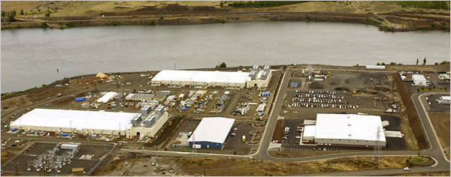
Google Disk Farm
Early days…
…today

Slide 4
Google Platform Characteristics
Lots of cheap PCs, each with disk and CPU
  High aggregate storage capacity
  Spread search processing across many CPUs
How to share data among PCs?

Slide 5
Google Platform Characteristics
100s to 1000s of PCs in cluster
Many modes of failure for each PC:
  App bugs, OS bugs
  Human error
  Disk failure, memory failure, net failure, power supply failure
  Connector failure
Monitoring, fault tolerance, auto-recovery essential

Slide 6
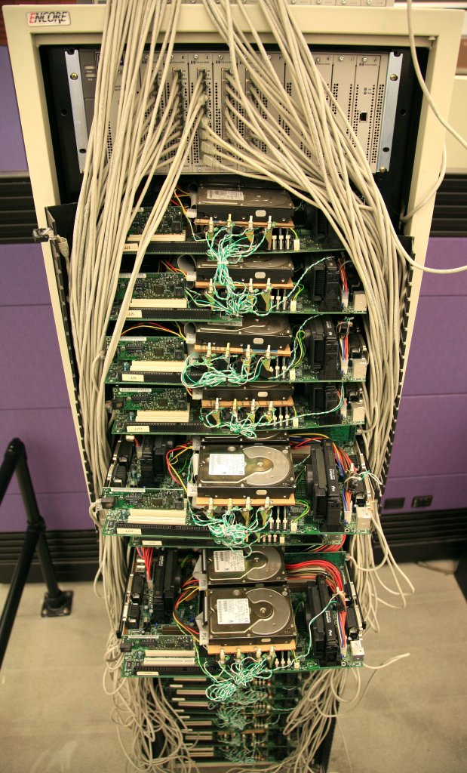
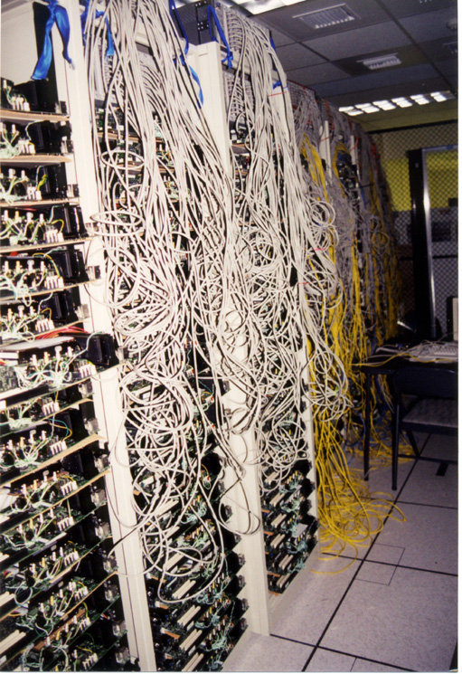

Slide 7
Google File System: Design Criteria
Detect, tolerate, recover from failures automatically
Large files, >= 100 MB in size
Large, streaming reads (>= 1 MB in size)
  Read once
Large, sequential writes that append
  Write once
Concurrent appends by multiple clients (e.g., producer-consumer queues)
  Want atomicity for appends without synchronization overhead among clients

Slide 8
GFS: Architecture
One master server (state replicated on backups)
Many chunk servers (100s – 1000s)
  Spread across racks; intra-rack b/w greater than inter-rack
  Chunk: 64 MB portion of file, identified by 64-bit, globally unique ID
Many clients accessing same and different files stored on same cluster

Slide 9
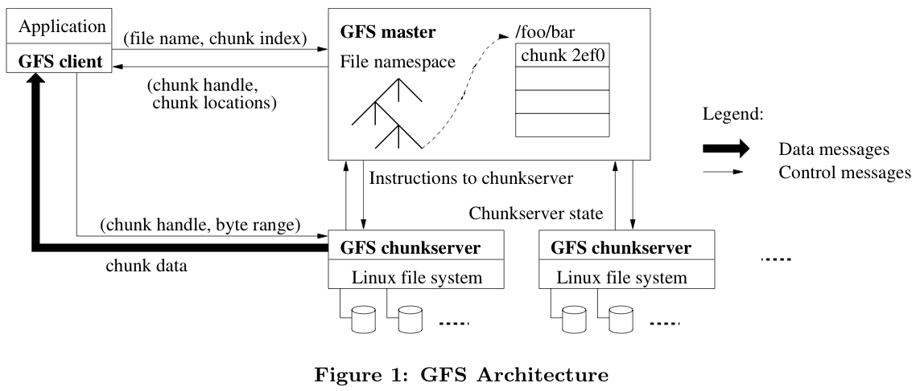
GFS: Architecture (2)

Slide 10
Master Server
Holds all metadata:
  Namespace (directory hierarchy)
  Access control information (per-file)
  Mapping from files to chunks
  Current locations of chunks (chunkservers)
Delegates consistency management
Garbage collects orphaned chunks
Migrates chunks between chunkservers
Holds all metadata in RAM; very fast operations on file system metadata

Slide 11
Chunkserver
Stores 64 MB file chunks on local disk using standard Linux filesystem, each with version number and checksum
Read/write requests specify chunk handle and byte range
Chunks replicated on configurable number of chunkservers (default: 3)
No caching of file data (beyond standard Linux buffer cache)

Slide 12
Client
Issues control (metadata) requests to master server
Issues data requests directly to chunkservers
Caches metadata
Does no caching of data
  No consistency difficulties among clients
  Streaming reads (read once) and append writes (write once) don’t benefit much from caching at client

Slide 13
Client Read
Client sends master:
  read(file name, chunk index)
Master’s reply:
  chunk ID, chunk version number, locations of replicas
Client sends “closest” chunkserver w/replica:
  read(chunk ID, byte range)
  “Closest” determined by IP address on simple rack-based network topology
Chunkserver replies with data

Slide 14
Client Write
Some chunkserver is primary for each chunk
  Master grants lease to primary (typically for 60 sec.)
  Leases renewed using periodic heartbeat messages between master and chunkservers
Client asks master for primary and secondary replicas for each chunk
Client sends data to replicas in daisy chain
  Pipelined: each replica forwards as it receives
  Takes advantage of full-duplex Ethernet links

Slide 15
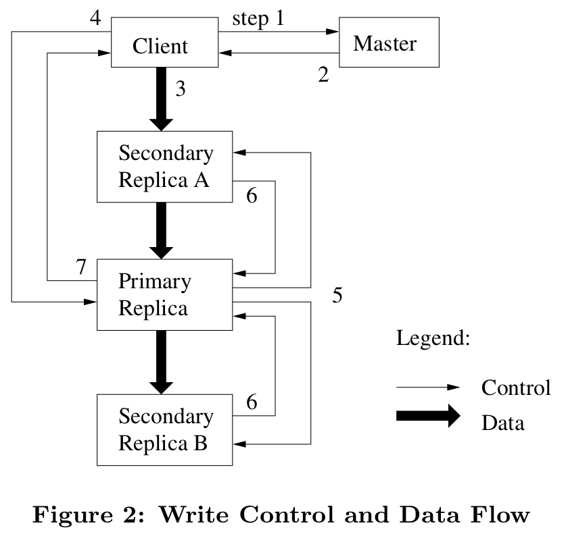
Client Write (2)

Slide 16
Client Write (3)
All replicas acknowledge data write to client
Client sends write request to primary
Primary assigns serial number to write request, providing ordering
Primary forwards write request with same serial number to secondaries
Secondaries all reply to primary after completing write
Primary replies to client

Slide 17
Client Record Append
Google uses large files as queues between multiple producers and consumers
Same control flow as for writes, except…
Client pushes data to replicas of last chunk of file
Client sends request to primary
Common case: request fits in current last chunk:
  Primary appends data to own replica
  Primary tells secondaries to do same at same byte offset in theirs
  Primary replies with success to client

Slide 18
Client Record Append (2)
When data won’t fit in last chunk:
  Primary fills current chunk with padding
  Primary instructs other replicas to do same
  Primary replies to client, “retry on next chunk”
If record append fails at any replica, client retries operation
  So replicas of same chunk may contain different data—even duplicates of all or part of record data
What guarantee does GFS provide on success?
  Data written at least once in atomic unit

Slide 19
GFS: Consistency Model
Changes to namespace (i.e., metadata) are atomic
  Done by single master server!
  Master uses log to define global total order of namespace-changing operations

Slide 20
GFS: Consistency Model (2)
Changes to data are ordered as chosen by a primary
  All replicas will be consistent
  But multiple writes from the same client may be interleaved or overwritten by concurrent operations from other clients
Record append completes at least once, at offset of GFS’s choosing
  Applications must cope with possible duplicates

Slide 21
Logging at Master
Master has all metadata information
  Lose it, and you’ve lost the filesystem!
Master logs all client requests to disk sequentially
Replicates log entries to remote backup servers
Only replies to client after log entries safe on disk on self and backups!

Slide 22
Chunk Leases and Version Numbers
If no outstanding lease when client requests write, master grants new one
Chunks have version numbers
  Stored on disk at master and chunkservers
  Each time master grants new lease, increments version, informs all replicas
Master can revoke leases
  e.g., when client requests rename or snapshot of file

Slide 23
What If the Master Reboots?
Replays log from disk
  Recovers namespace (directory) information
  Recovers file-to-chunk-ID mapping
Asks chunkservers which chunks they hold
  Recovers chunk-ID-to-chunkserver mapping
If chunk server has older chunk, it’s stale
  Chunk server down at lease renewal
If chunk server has newer chunk, adopt its version number
  Master may have failed while granting lease

Slide 24
What if Chunkserver Fails?
Master notices missing heartbeats
Master decrements count of replicas for all chunks on dead chunkserver
Master re-replicates chunks missing replicas in background
  Highest priority for chunks missing greatest number of replicas

Slide 25
File Deletion
When client deletes file:
  Master records deletion in its log
  File renamed to hidden name including deletion timestamp
Master scans file namespace in background:
  Removes files with such names if deleted for longer than 3 days (configurable)
  In-memory metadata erased
Master scans chunk namespace in background:
  Removes unreferenced chunks from chunkservers

Slide 26
Limitations
Security?
  Trusted environment, trusted users
  But that doesn’t stop users from interfering with each other…
Does not mask all forms of data corruption
  Requires application-level checksum

Slide 27
GFS: Summary
Success: used actively by Google to support search service and other applications
  Availability and recoverability on cheap hardware
  High throughput by decoupling control and data
  Supports massive data sets and concurrent appends
Semantics not transparent to apps
  Must verify file contents to avoid inconsistent regions, repeated appends (at-least-once semantics)
Performance not good for all apps
  Assumes read-once, write-once workload (no client caching!)

Slide 28
Overview
Google File System
MapReduce
BigTable

Slide 29

You are an engineer at:
Hare-brained-scheme.com
Your boss, comes to your office and says:
“We’re going to be hog-nasty rich! We just need a program to search for strings in text files...”
Input: <search_term>, <files>
Output: list of files containing <search_term>

Slide 30
One solution
public class StringFinder {
int main(…) {
foreach(File f in getInputFiles()) {
if(f.contains(searchTerm))
results.add(f.getFileName());
}
}
System.out.println(“Files:” + results.toString()); }
“But, uh, marketing says we have to search a lot of files.
More than will fit on one disk…”

Slide 31


Another solution
Throw hardware at the problem!
Use your StringFinder class on one machine…
but attach lots of disks!
“But, uh, well, marketing says it’s too slow…and besides, we need it
to work on the web…”

Slide 32
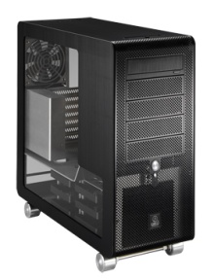
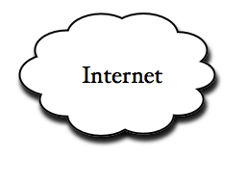
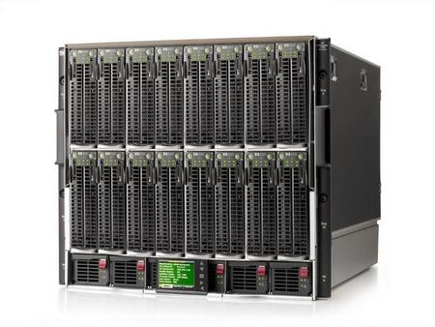
Third Time’s a charm
PCs
StringFinder
Indexed data
Web Server
Search
query
StringFinder
Indexed data
StringFinder
Indexed data
How do we distribute the searchable files on our machines?
2. What if our webserver goes down?
3. What if a StringFinder machine dies? How would you know it was dead?
4. What if marketing comes and says, “well, we also want to show pictures of the earth from space too! Ooh..and the moon too!”

Slide 33
StringFinder was the easy part!
You really need general infrastructure.
Likely to have many different tasks
Want to use hundreds or thousands of PC’s
Continue to function if something breaks
Must be easy to program…
MapReduce addresses this problem!

Slide 34
MapReduce
Programming model + infrastructure
Write programs that run on lots of machines
Automatic parallelization and distribution
Fault-tolerance
Scheduling, status and monitoring
Cool. What’s the catch?

Slide 35
MapReduce Programming Model
Input & Output: sets of <key, value> pairs
Programmer writes 2 functions:
  map (in_key, in_value) → list(out_key, intermediate_value)
    Processes <k,v> pairs
    Produces intermediate pairs
reduce (out_key, list(interm_val)) → list(out_value)
    Combines intermediate values for a key
    Produces a merged set of outputs (may be also <k,v> pairs)

Slide 36
Example: Counting Words…
map(String input_key, String input_value):
// input_key: document name
// input_value: document contents
  for each word w in input_value:
  EmitIntermediate(w, "1");
reduce(String output_key, Iterator intermediate_values):
// output_key: a word
// output_values: a list of counts
  int result = 0;
  for each v in intermediate_values:
  result += ParseInt(v);
  Emit(AsString(result));
MapReduce handles all the other details!

Slide 37
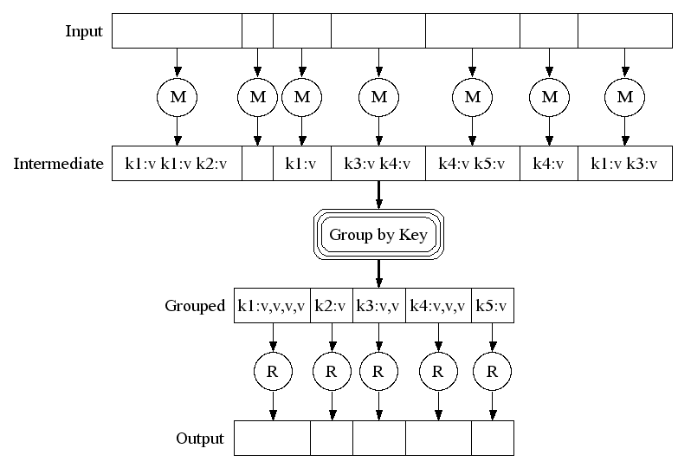
MapReduce: Example

Slide 38
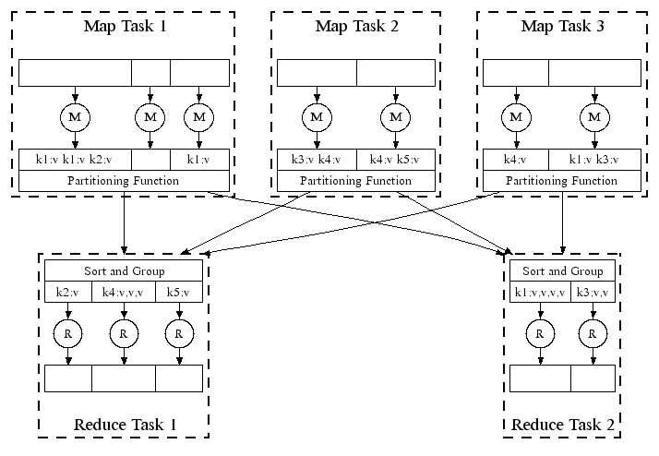
MapReduce in Parallel: Example

Slide 39
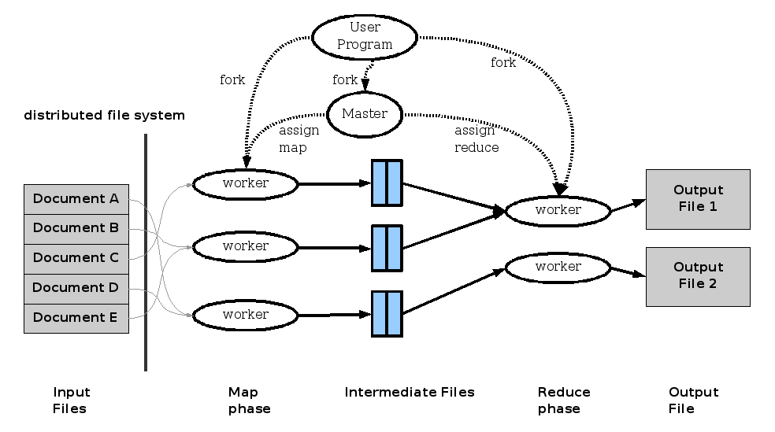
MapReduce: Execution overview

Slide 40
MapReduce: Refinements
Locality Optimization
Leverage GFS to schedule a map task on a machine that contains a replica of the corresponding input data.
Thousands of machines read input at local disk speed
Without this, rack switches limit read rate

Slide 41
MapReduce: Refinements Redundant Execution
Slow workers are source of bottleneck, may delay completion time.
Near end of phase, spawn backup tasks, one to finish first wins.
Effectively utilizes computing power, reducing job completion time by a factor.

Slide 42
MapReduce: Refinements
Skipping Bad Records
Map/Reduce functions sometimes fail for particular inputs.
Fixing the bug might not be possible : Third Party Libraries.
On Error
  Worker sends signal to Master
  If multiple error on same record, skip record

Slide 43
Take Home Messages
Although restrictive, provides good fit for many problems encountered in the practice of processing large data sets.
Functional Programming Paradigm can be applied to large scale computation.
Easy to use, hides messy details of parallelization, fault-tolerance, data distribution and load balancing from the programmers.
And finally, if it works for Google, it should be handy !!

Slide 44
Overview
Google File System
MapReduce
BigTable

Slide 45
BigTable
Distributed storage system for managing structured data.
Designed to scale to a very large size
  Petabytes of data across thousands of servers
Used for many Google projects
  Web indexing, Personalized Search, Google Earth, Google Analytics, Google Finance, …
Flexible, high-performance solution for all of Google’s products

Slide 46
Motivation
Lots of (semi-)structured data at Google
  URLs:
    Contents, crawl metadata, links, anchors, pagerank, …
  Per-user data:
    User preference settings, recent queries/search results, …
  Geographic locations:
    Physical entities (shops, restaurants, etc.), roads, satellite image data, user annotations, …
Scale is large
  Billions of URLs, many versions/page (~20K/version)
  Hundreds of millions of users, thousands or q/sec
  100TB+ of satellite image data

Slide 47
Why not just use commercial DB?
Scale is too large for most commercial databases
Even if it weren’t, cost would be very high
  Building internally means system can be applied across many projects for low incremental cost
Low-level storage optimizations help performance significantly
  Much harder to do when running on top of a database layer

Slide 48
Goals
Want asynchronous processes to be continuously updating different pieces of data
  Want access to most current data at any time
Need to support:
  Very high read/write rates (millions of ops per second)
  Efficient scans over all or interesting subsets of data
  Efficient joins of large one-to-one and one-to-many datasets
Often want to examine data changes over time
  E.g. Contents of a web page over multiple crawls

Slide 49
BigTable
Distributed multi-level map
Fault-tolerant, persistent
Scalable
  Thousands of servers
  Terabytes of in-memory data
  Petabyte of disk-based data
  Millions of reads/writes per second, efficient scans
Self-managing
  Servers can be added/removed dynamically
  Servers adjust to load imbalance

Slide 50
Building Blocks
Building blocks:
  Google File System (GFS): Raw storage
  Scheduler: schedules jobs onto machines
  Lock service: distributed lock manager
  MapReduce: simplified large-scale data processing
BigTable uses of building blocks:
  GFS: stores persistent data (SSTable file format for storage of data)
  Scheduler: schedules jobs involved in BigTable serving
  Lock service: master election, location bootstrapping
  Map Reduce: often used to read/write BigTable data

Slide 51
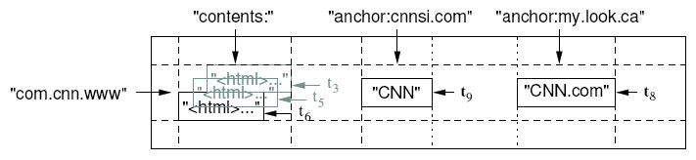
Basic Data Model
A BigTable is a sparse, distributed persistent multi-dimensional sorted map
(row, column, timestamp) -> cell contents
Good match for most Google applications

Slide 52
WebTable Example
Want to keep copy of a large collection of web pages and related information
Use URLs as row keys
Various aspects of web page as column names
Store contents of web pages in the contents: column under the timestamps when they were fetched.

Slide 53
Rows
Name is an arbitrary string
  Access to data in a row is atomic
  Row creation is implicit upon storing data
Rows ordered lexicographically
  Rows close together lexicographically usually on one or a small number of machines

Slide 54
Rows (cont.)
Reads of short row ranges are efficient and typically require communication with a small number of machines.
Can exploit this property by selecting row keys so they get good locality for data access.
Example:
  math.gatech.edu, math.uga.edu, phys.gatech.edu, phys.uga.edu
  VS
  edu.gatech.math, edu.gatech.phys, edu.uga.math, edu.uga.phys

Slide 55
Columns
Columns have two-level name structure:
    family:optional_qualifier
Column family
  Unit of access control
  Has associated type information
Qualifier gives unbounded columns
  Additional levels of indexing, if desired

Slide 56
Timestamps
Used to store different versions of data in a cell
  New writes default to current time, but timestamps for writes can also be set explicitly by clients
Lookup options:
  “Return most recent K values”
  “Return all values in timestamp range (or all values)”
Column families can be marked w/ attributes:
  “Only retain most recent K values in a cell”
  “Keep values until they are older than K seconds”

Slide 57
Implementation – Three Major Components
Library linked into every client
One master server
  Responsible for:
    Assigning tablets to tablet servers
    Detecting addition and expiration of tablet servers
    Balancing tablet-server load
    Garbage collection
Many tablet servers
  Tablet servers handle read and write requests to its table
  Splits tablets that have grown too large

Slide 58
Implementation (cont.)
Client data doesn’t move through master server. Clients communicate directly with tablet servers for reads and writes.
Most clients never communicate with the master server, leaving it lightly loaded in practice.

Slide 59
Tablets
Large tables broken into tablets at row boundaries
  Tablet holds contiguous range of rows
    Clients can often choose row keys to achieve locality
  Aim for ~100MB to 200MB of data per tablet
Serving machine responsible for ~100 tablets
  Fast recovery:
    100 machines each pick up 1 tablet for failed machine
  Fine-grained load balancing:
    Migrate tablets away from overloaded machine
    Master makes load-balancing decisions

Slide 60
SSTable
Immutable, sorted file of key-value pairs
Chunks of data plus an index
  Index is of block ranges, not values
64K block
64K block
64K block
SSTable
Index

Slide 61
Tablet
Contains some range of rows of the table
Built out of multiple SSTables
Tablet
Start:aardvark
End:apple
64K block
64K block
64K block
SSTable
64K block
64K block
64K block
SSTable
Index
Index

Slide 62
Table
Multiple tablets make up the table
SSTables can be shared
Tablets do not overlap, SSTables can overlap
Tablet
Tablet
aardvark
apple
apple_two_E
boat
SSTable
SSTable
SSTable
SSTable

Slide 63
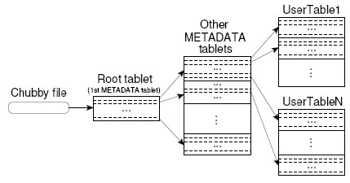
Tablet Location
Since tablets move around from server to server, given a row, how do clients find the right machine?
  Need to find tablet whose row range covers the target row

Slide 64
Chubby
{lock/file/name} service
Coarse-grained locks, can store small amount of data in a lock
5 replicas, need a majority vote to be active
Also an OSDI ’06 Paper

Slide 65
Servers
Tablet servers manage tablets, multiple tablets per server. Each tablet is 100-200 MB
  Each tablet lives at only one server
  Tablet server splits tablets that get too big
Master responsible for load balancing and fault tolerance

Slide 66
Editing a table
Mutations are logged, then applied to an in-memory memtable
  May contain “deletion” entries to handle updates
  Group commit on log: collect multiple updates before log flush
Tablet
Memtable
Insert
Insert
Memory
apple_two_E
boat
Delete
tablet log
Insert
Delete
SSTable
SSTable
GFS
Insert

Slide 67
Compactions
Minor compaction – convert the memtable into an SSTable
  Reduce memory usage
  Reduce log traffic on restart
Merging compaction
  Reduce number of SSTables
  Good place to apply policy “keep only N versions”
Major compaction
  Merging compaction that results in only one SSTable
  No deletion records, only live data

Slide 68
Master’s Tasks
Use Chubby to monitor health of tablet servers, restart failed servers
  Tablet server registers itself by getting a lock in a specific directory chubby
    Chubby gives “lease” on lock, must be renewed periodically
    Server loses lock if it gets disconnected
  Master monitors this directory to find which servers exist/are alive
    If server not contactable/has lost lock, master grabs lock and reassigns tablets
    GFS replicates data. Prefer to start tablet server on same machine that the data is already at

Slide 69
Master’s Tasks (Cont)
When (new) master starts
  grabs master lock on chubby
    Ensures only one master at a time
  Finds live servers (scan chubby directory)
  Communicates with servers to find assigned tablets
  Scans metadata table to find all tablets
    Keeps track of unassigned tablets, assigns them
    Metadata root from chubby, other metadata tablets assigned before scanning.

Slide 70
Tablet Assignment
Each tablet is assigned to one tablet server at a time.
Master server keeps track of the set of live tablet servers and current assignments of tablets to servers. Also keeps track of unassigned tablets.
When a tablet is unassigned, master assigns the tablet to an tablet server with sufficient room.

Slide 71
API
Metadata operations
  Create/delete tables, column families, change metadata
Writes (atomic)
  Set(): write cells in a row
  DeleteCells(): delete cells in a row
  DeleteRow(): delete all cells in a row
Reads
  Scanner: read arbitrary cells in a bigtable
    Each row read is atomic
    Can restrict returned rows to a particular range
    Can ask for just data from 1 row, all rows, etc.
    Can ask for all columns, just certain column families, or specific columns

Slide 72
Refinements: Locality Groups
Can group multiple column families into a locality group
  Separate SSTable is created for each locality group in each tablet.
Segregating columns families that are not typically accessed together enables more efficient reads.
  In WebTable, page metadata can be in one group and contents of the page in another group.

Slide 73
Refinements: Compression
Many opportunities for compression
  Similar values in the same row/column at different timestamps
  Similar values in different columns
  Similar values across adjacent rows
Two-pass custom compressions scheme
  First pass: compress long common strings across a large window
  Second pass: look for repetitions in small window
Speed emphasized, but good space reduction (10-to-1)

Slide 74
Refinements: Bloom Filters
Read operation has to read from disk when desired SSTable isn’t in memory
Reduce number of accesses by specifying a Bloom filter.
  Allows us ask if an SSTable might contain data for a specified row/column pair.
  Small amount of memory for Bloom filters drastically reduces the number of disk seeks for read operations
  Use implies that most lookups for non-existent rows or columns do not need to touch disk

Slide 76
MapReduce: Fault Tolerance
Handled via re-execution of tasks.
  Task completion committed through master
What happens if Mapper fails ?
  Re-execute completed + in-progress map tasks
What happens if Reducer fails ?
  Re-execute in progress reduce tasks
What happens if Master fails ?
  Potential trouble !!

Slide 77
MapReduce:
Walk through of One more Application

Slide 78
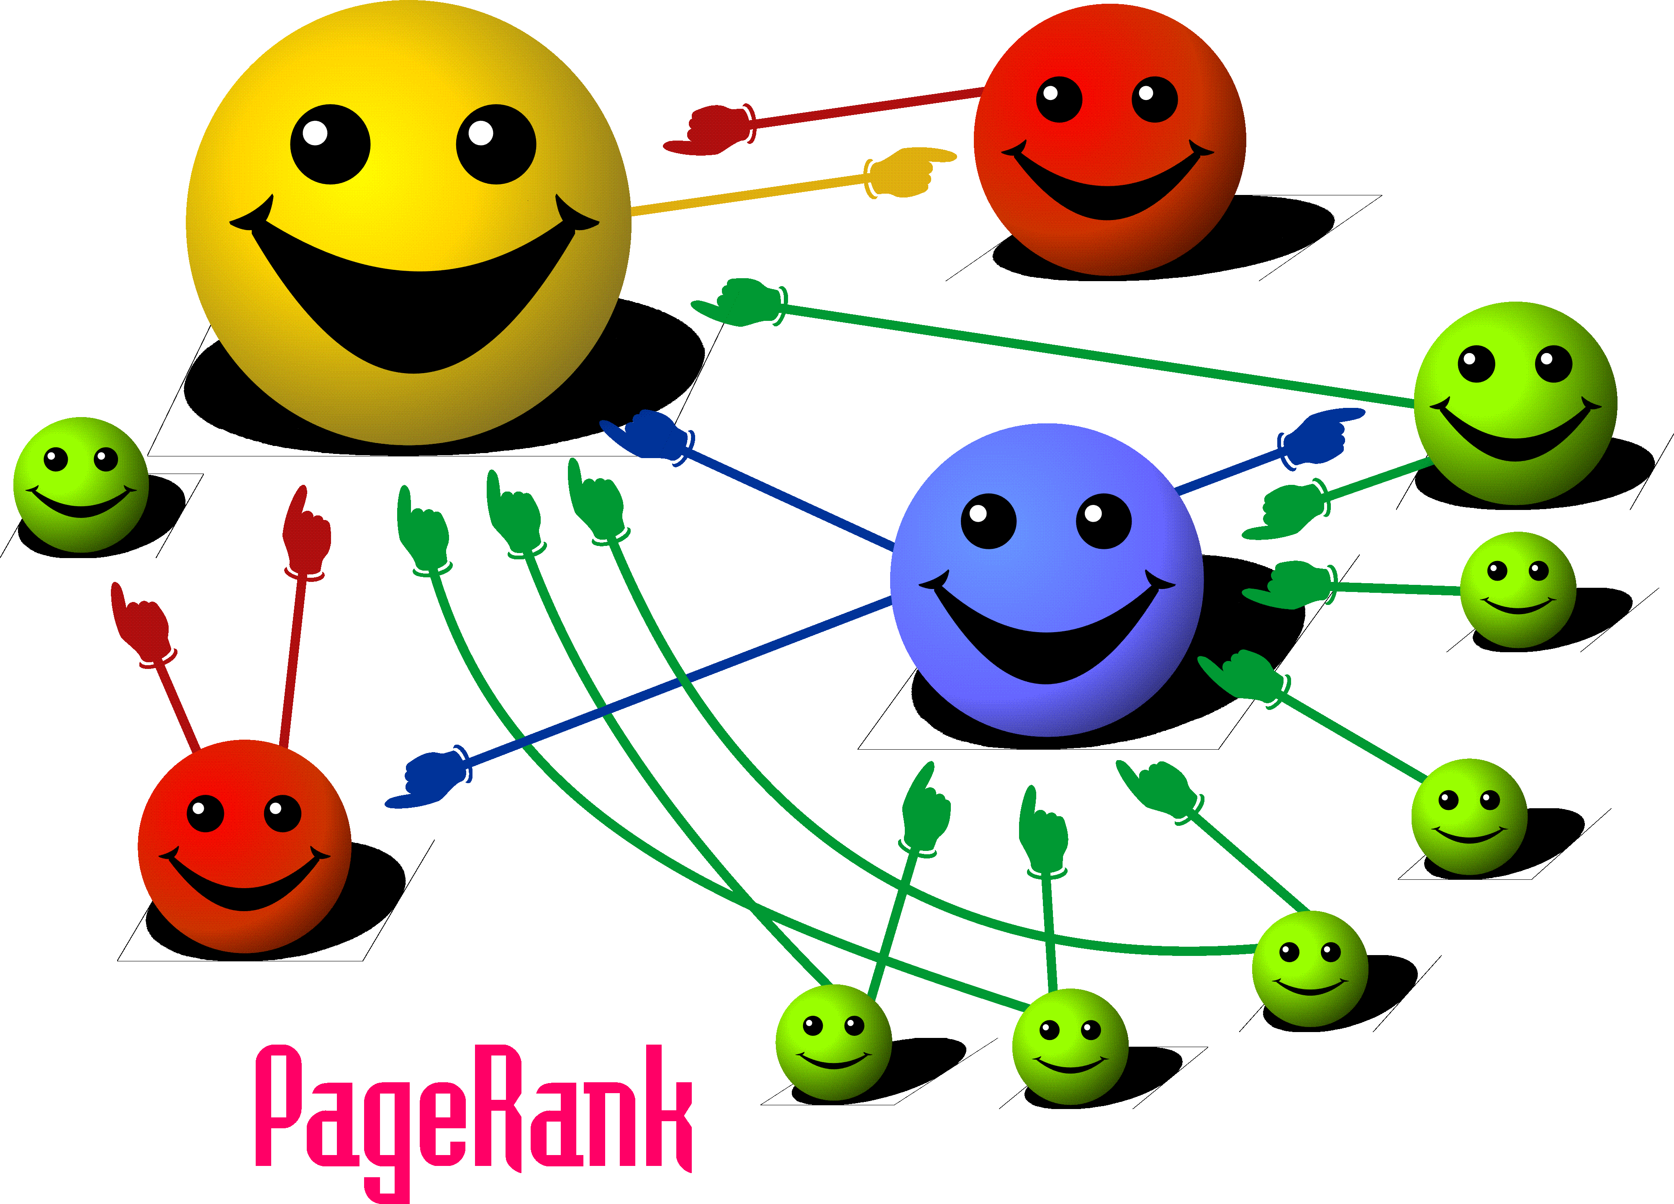

Slide 79
MapReduce : PageRank
PageRank models the behavior of a “random surfer”.
C(t) is the out-degree of t, and (1-d) is a damping factor (random jump)
The “random surfer” keeps clicking on successive links at random not taking content into consideration.
Distributes its pages rank equally among all pages it links to.
The dampening factor takes the surfer “getting bored” and typing arbitrary URL.

Slide 80
Computing PageRank

Slide 81
PageRank : Key Insights
  Effects at each iteration is local. i+1th iteration depends only on i^{th} iteration
  At iteration i, PageRank for individual nodes can be computed independently

Slide 82
PageRank using MapReduce
Use Sparse matrix representation (M)
Map each row of M to a list of PageRank “credit” to assign to out link neighbours.
These prestige scores are reduced to a single PageRank value for a page by aggregating over them.

Slide 83
PageRank using MapReduce
Map: distribute PageRank “credit” to link targets
Reduce: gather up PageRank “credit” from multiple sources to compute new PageRank value
Iterate until
convergence
Source of Image: Lin 2008

Slide 84
Phase 1: Process HTML
Map task takes (URL, page-content) pairs and maps them to (URL, (PR_{init}, list-of-urls))
  PR_{init} is the “seed” PageRank for URL
  list-of-urls contains all pages pointed to by URL
Reduce task is just the identity function

Slide 85
Phase 2: PageRank Distribution
Reduce task gets (URL, url_list) and many (URL, val) values
  Sum vals and fix up with d to get new PR
  Emit (URL, (new_rank, url_list))
Check for convergence using non parallel component

Slide 86
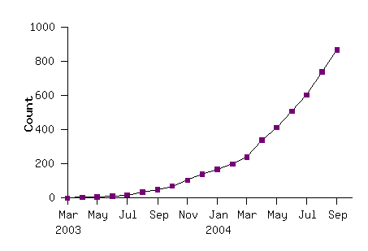
MapReduce: Some More Apps
Distributed Grep.
Count of URL Access Frequency.
Clustering (K-means)
Graph Algorithms.
Indexing Systems
MapReduce Programs In Google Source Tree

Slide 87
MapReduce: Extensions and similar apps
PIG (Yahoo)
Hadoop (Apache)
DryadLinq (Microsoft)

Slide 89
Immutability
SSTables are immutable
  simplifies caching, sharing across GFS etc
  no need for concurrency control
  SSTables of a tablet recorded in METADATA table
  Garbage collection of SSTables done by master
  On tablet split, split tables can start off quickly on shared SSTables, splitting them lazily
Only memtable has reads and updates concurrent
  copy on write rows, allow concurrent read/write

Slide 91
GFS: Data Mutation Consistency
 | Write | Record Append
serial success | defined | defined interspersed with inconsistent
concurrent success | consistent but undefined
failure | inconsistent

Slide 92
Applications and
Record Append Semantics
Applications should use self-describing records and checksums when using Record Append
  Reader can identify padding / record fragments
If application cannot tolerate duplicated records, should include unique ID in record
  Reader can use unique IDs to filter duplicates

Slide 93
System Interactions:
Leases and Mutation Order
Leases maintain a mutation order across all chunk replicas
Master grants a lease to a replica, called the primary
The primary choses the serial mutation order, and all replicas follow this order
Minimizes management overhead for the Master
Notes:
Mutation is an Op to change the contents/metadata of a chunk. Performed on all replicas
FOR CONCURRENT WRITES: writes may be interleaved with and overwritten by concurrent OPS from other clients. The shared region may end up containing fragments from diff clients, HOWEVER replicas will be identical because the indiv ops are done in the same order.

Slide 94
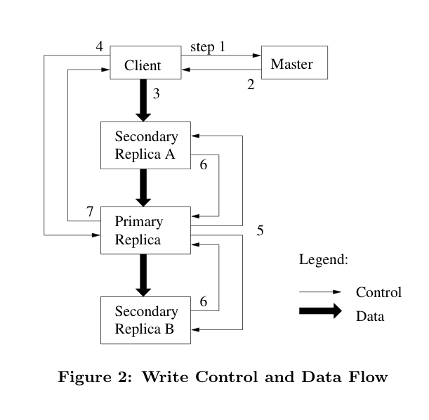
System Interactions:
Leases and Mutation Order
Notes:
1&2. client gets chunk location. 3. Client pushes data to replicas. (replicas forward data once they receive over TCP it like a pipeline to achieve max BW. push to next closest replica) 4. client sends write req. to primary. saying write to this offset 5. primary forwards request to replicas. 6. replicas reply to primary when done. 7. primary replies to client, gives errors if there were any

Slide 95




Atomic Record Append
Client specifies the data to write; GFS chooses and returns the offset it writes to and appends the data to each replica at least once
Heavily used by Google’s Distributed applications.
No need for a distributed lock manager
  GFS choses the offset, not the client
Notes:
Traditionally, the client specifies the offset to write to. Concurrent writes to the same region are not serializable: the section may contain data from different writers.

Slide 96
Atomic Record Append: How?
Follows similar control flow as mutations
Primary tells secondary replicas to append at the same offset as the primary
If a replica append fails at any replica, it is retried by the client.
  So replicas of the same chunk may contain different data, including duplicates, whole or in part, of the same record

Slide 97
Atomic Record Append: How?
GFS does not guarantee that all replicas are bitwise identical.
Only guarantees that data is written at least once in an atomic unit.
  Data must be written at the same offset for all chunk replicas for success to be reported.

Slide 98
Replica Placement
Placement policy maximizes data reliability and network bandwidth
Spread replicas not only across machines, but also across racks
  Guards against machine failures, and racks getting damaged or going offline
Reads for a chunk exploit aggregate bandwidth of multiple racks
Writes have to flow through multiple racks
  tradeoff made willingly
Notes:
NOTE: there are hundreds of chunkservers spread across many machine racks

Slide 99
Fault Tolerance:
High Availability
Fast recovery
  Master and chunkservers can restart in seconds
Chunk Replication
Master Replication
  “shadow” masters provide read-only access when primary master is down
  mutations not done until recorded on all master replicas

Slide 100
Fault Tolerance:
Data Integrity
Chunkservers use checksums to detect corrupt data
  Since replicas are not bitwise identical, chunkservers maintain their own checksums
For reads, chunkserver verifies checksum before sending chunk
Update checksums during writes
Notes:
FOR READ, returns an error if checksum doesn’t match
updating CS for WRITES... OPTIMIZED for append writes, since that’s what’s dominant

Slide 101
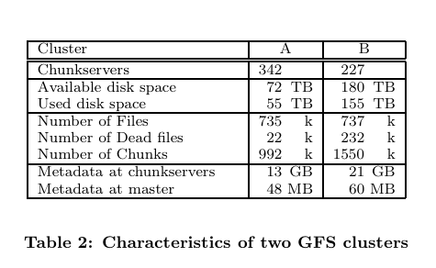
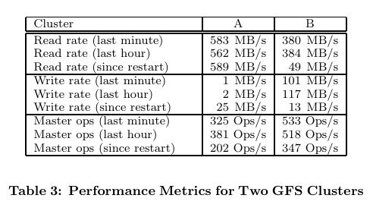
Performance!
Actual network load is 3x, since writes propagate to 3 replicas
Network configuration can support 750 MB/s
Notes:
A - used for research and development; B - used for production data processing
STORAGE: almost all replicas stored 3 times... so has about A ~ 18TB and B ~ 52TB
METADATA: chunkservers must store checksums and version #s for replicas it has; Master - stores filenames (prefix compressed), ownership/permissions, map of files -> chunks, current version, replica locations

