Slide 1
15-446 Distributed Systems
Spring 2009
L-24 Adaptive Applications

Slide 2





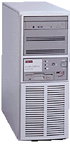
State of the Art – Manual Adaptation
California
New York
?
Objective: automating adaptation

Slide 3
Motivation
Large-scale distributed services and applications
  Napster, Gnutella, End System Multicast, etc
Large number of configuration choices
K participants ⇒ O(K²) e2e paths to consider
MIT
MIT
MIT
CMU
CMU
Stanford
CMU
Stanford
Stanford
MIT
MIT
MIT
Berkeley
Berkeley
Berkeley
CMU
CMU
Berkeley
CMU
Berkeley
Berkeley
Stanford
Stanford
Stanford

Slide 4
Why is Automated Adaptation Hard?
Must infer Internet performance
  Scalability
  Accuracy
  Tradeoff with timeliness
Support for a variety of applications
  Different performance metrics
  API requirements
Layered implementations hide information
Notes:
it would be good to have strong words to say about why measurement is fundamental to the internet -- why not just have a better network hand you the measurements you need? sounds silly to network folk, but is a natural question to people in other areas.
Layer hides info – layering is good for implementation, preserve layers but communicate info across layers

Slide 5
Tools to Automate Adaptation
Tools to facilitate the creation of adaptive networked applications
Adapting on longer time scale (minutes)
  Deciding what actions to perform
  Deciding where to perform actions
  Need to predict performance
Adapting on short time scale (round-trip time)
  Deciding how to perform action
  Need to determine correct rate of transmission

Slide 6
Adaptation on Different Time Scales
Long Time Scale
Short Time Scale
Content Negotiation
Server Selection
California
New York
Adaptive Media
?

Slide 7
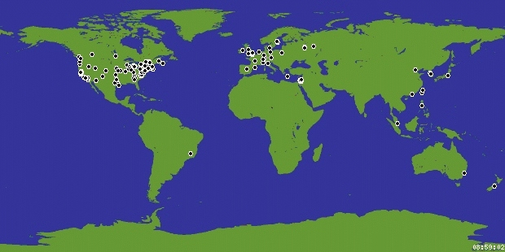
Motivation
What’s the closest server to a client in Brazil ?
Geographical distances
-------------------------------
server1 -> 4500 miles
server2 -> 6000 miles
…
…
Client
Server
Source: planet-lab.org

Slide 8
Motivation
Difficulties:
  Geographical distances ≠ network distances
    Routing policies/Connectivity
    GPS not available
  Client needs ‘N’ distances to select the closest server

Slide 9
Motivation
Network Latency (time)
Network Latency
-------------------------------
server1 -> 120 ms
server2 -> 130 ms
…
…
Source: planet-lab.org

Slide 10
Motivation
Network latency = network distance
  E.g. ping measurements
Still have the issue of ‘N’ distances…
  Need ‘N’ measurements (high overhead)
  Update list of network distances
  How do we solve this problem ?

Slide 11
Outline
Active Measurements
Passive Observation
Network Coordinates

Slide 12
Network Distance
Round-trip propagation and transmission delay
Reflects Internet topology and routing
A good first order performance optimization metric
  Helps achieve low communication delay
  A reasonable indicator of TCP throughput
    Can weed out most bad choices
But the O(N²) network distances are also hard to determine efficiently in Internet-scale systems

Slide 13
Active Measurements
Network distance can be measured with ping-pong messages
But active measurement does not scale

Slide 14
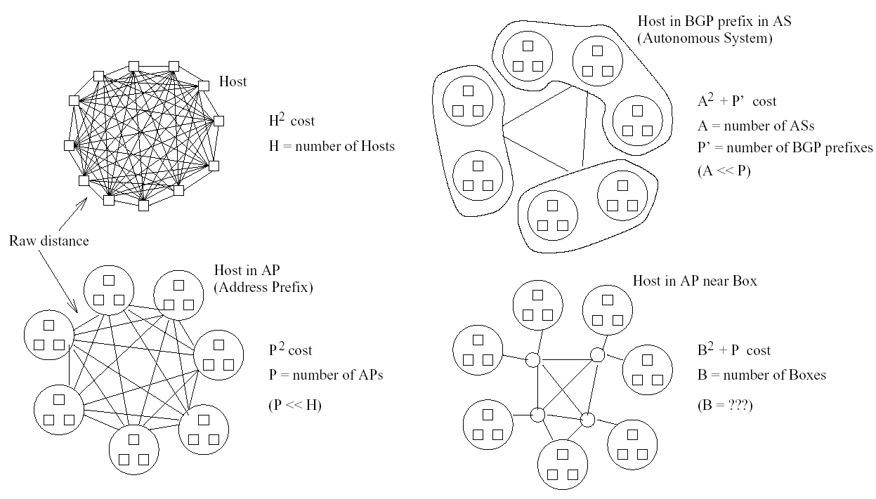
Scaling Alternatives

Slide 15
State of the Art: IDMaps [Francis et al ‘99]
A network distance prediction service
A/B
50ms
HOPS Server
Tracer
A
Tracer
Tracer
B

Slide 16
Assumptions
Probe nodes approximate direct path
  May require large number
  Careful placement may help
Requires that distance between end-points is approximated by sum
  Triangle inequality must hold (i.e., (a,c) > (a,b) + (b,c)

Slide 17
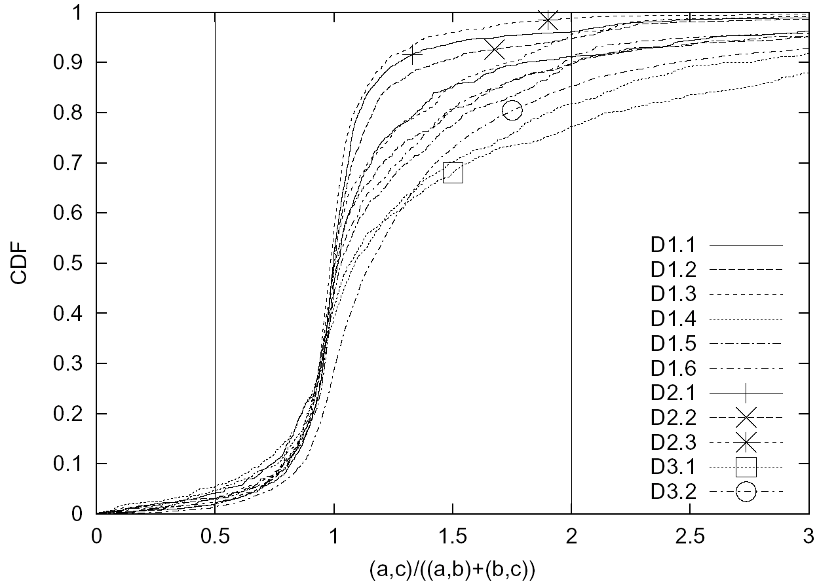
Triangle Inequality in the Internet

Slide 18
A More Detailed Internet Map
How do we …
  build a structured atlas of the Internet?
  predict routing between arbitrary end-hosts?
  measure properties of links in the core?
  measure links at the edge?

Slide 19
Build a Structural Atlas of the Internet
Use PlanetLab + public traceroute servers
  Over 700 geographically distributed vantage points
Build an atlas of Internet routes
  Perform traceroutes to a random sample of BGP prefixes
  Cluster interfaces into PoPs
  Repeat daily from vantage points

Slide 20
Model for Path Prediction
V3 (Chicago)
V1 (Seattle)
I
Choose candidate path that models Internet routing
Identify candidate paths by intersecting observed routes
D
S
(Paris)
(Portland)
I2
Actual path unknown
V4 (Atlanta)
V2 (Rio)
Notes:
End with “Refer to paper for details on choosing among candidate paths.
I will demonstrate in a couple of slides that our approach works”

Slide 21
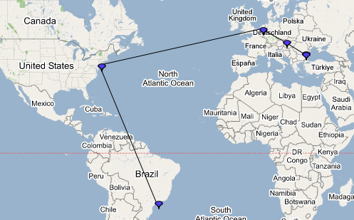
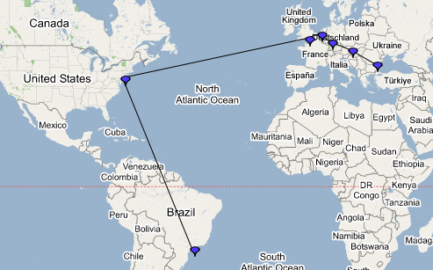
Example of Path Prediction
Actual path: RTT 298ms
Predicted path: RTT 310ms

Slide 22
Predicting Path Properties
To estimate end-to-end path properties between arbitrary S and D
  Use measured atlas to predict route
  Combine properties of
    Links in the core along predicted route
    Access links at either end
Latency | Sum of link latencies
Loss-rate | Product of link loss-rates
Bandwidth | Minimum of link bandwidths

Slide 23
Outline
Active Measurements
Passive Observation
Network Coordinates

Slide 24
SPAND Design Choices
Measurements are shared
  Hosts share performance information by placing it in a per-domain repository
Measurements are passive
  Application-to-application traffic is used to measure network performance
Measurements are application-specific
  When possible, measure application response time, not bandwidth, latency, hop count, etc.
Notes:
3 basic design choices that SPAND uses

Slide 25
SPAND Architecture
Internet
Client
Packet Capture Host
Data
Performance
Server
Perf. Reports
Perf Query/
Response
Client

Slide 26
SPAND Assumptions
Geographic Stability: Performance observed by nearby clients is similar → works within a domain
Amount of Sharing: Multiple clients within domain access same destinations within reasonable time period → strong locality exists
Temporal Stability: Recent measurements are indicative of future performance → true for 10’s of minutes

Slide 27
Prediction Accuracy
Cumulative Probability
Ratio of Predicted to Actual Throughput
Packet capture trace of IBM Watson traffic
Compare predictions to actual throughputs

Slide 28
Outline
Active Measurements
Passive Observation
Network Coordinates

Slide 29
First Key Insight
With millions of hosts, “What are the O(N²) network distances?” may be the wrong question
Instead, could we ask: “Where are the hosts in the Internet?”
  What does it mean to ask “Where are the hosts in the Internet?” Do we need a complete topology map?
  Can we build an extremely simple geometric model of the Internet?

Slide 30
New Fundamental Concept:
“Internet Position”
Using GNP, every host can have an “Internet position”
  O(N) positions, as opposed to O(N²) distances
Accurate network distance estimates can be rapidly computed from “Internet positions”
“Internet position” is a local
property that can be
determined before
applications need it
Can be an interface
for independent systems
to interact
(x₂,y₂,z₂)
y
(x₁,y₁,z₁)
x
z
(x₃,y₃,z₃)
(x₄,y₄,z₄)

Slide 31
Vision: Internet Positioning Service
(2,4)
33.99.31.1
(5,4)
65.4.3.87
128.2.254.36
12.5.222.1
(7,3)
(1,3)
(6,0)
(2,0)
126.93.2.34
123.4.22.54
Enable every host to independently determine its Internet position
Internet position should be as fundamental as IP address
  “Where” as well as “Who”

Slide 32
Global Network Positioning (GNP) Coordinates
Model the Internet as a geometric space (e.g. 3-D Euclidean)
Characterize the position of any end host with geometric coordinates
Use geometric distances to predict network distances
(x₂,y₂,z₂)
y
(x₁,y₁,z₁)
x
z
(x₃,y₃,z₃)
(x₄,y₄,z₄)

Slide 33
Landmark Operations
(Basic Design)
y
(x₂,y₂)
L₂
(x₁,y₁)
L₁
L₁
L₃
x
L₂
Internet
L₃
(x₃,y₃)
Measure inter-Landmark distances
  Use minimum of several round-trip time (RTT) samples
Compute coordinates by minimizing the discrepancy between measured distances and geometric distances
  Cast as a generic multi-dimensional minimization problem, solved by a central node

Slide 34
Ordinary Host Operations
(Basic Design)
y
(x₂,y₂)
L₂
(x₁,y₁)
L₁
L₁
L₃
x
L₂
Internet
L₃
(x₃,y₃)
(x₄,y₄)
Each host measures its distances to all the Landmarks
Compute coordinates by minimizing the discrepancy between measured distances and geometric distances
  Cast as a generic multi-dimensional minimization problem, solved by each host

Slide 35
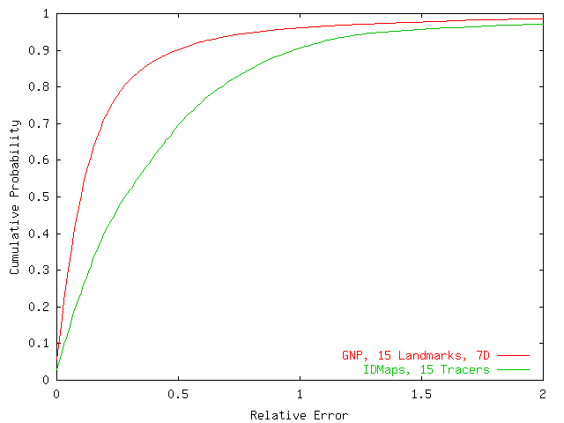
Overall Accuracy
0.1
0.28

Slide 36
Why the Difference?
IDMaps
GNP (1-dimensional model)
IDMaps overpredicts

Slide 37
Alternate Motivation
Select nodes based on a set of system properties
Real-world problems
  Locate closest game server
  Distribute web-crawling to nearby hosts
  Perform efficient application level multicast
  Satisfy a Service Level Agreement
  Provide inter-node latency bounds for clusters

Slide 38
Underlying Abstract Problems
Finding closest node to target
Finding the closest node to the center of a set of targets
Finding a node that is <r_{i} ms from target t_{i} for all targets

Slide 39
Meridian Approach
Solve node selection directly without computing coordinates
  Combine query routing with active measurements
3 Design Goals
  Accurate: Find satisfying nodes with high probability
  General: Users can express their network location requirements
  Scalable: O(log N) state per node
Design Tradeoffs
  Active measurements incur higher query latencies
  Overhead more dependent on query load

Slide 40
Multi-resolution Rings
Organize peers into small fixed number of concentric rings
Radii of rings grow outwards exponentially
Logarithmic number of peers per ring
Retains a sufficient number of pointers to remote regions

Slide 41
Multi-resolution Ring structure
For the i^{th} ring:
Inner Radius r_{i} = αs^{i-1}
Outer Radius R_{i} = αs^{i}
α is a constant
s is multiplicative increase factor
r₀ = 0, R₀ = α
Each node keeps track of finite rings

Slide 42
Ring Membership Management
Number of nodes per ring represents tradeoff between accuracy and overhead
Geographical diversity maintained within each ring
Ring membership management run in background

Slide 43
Gossip Based Node Discovery
Aimed to assist each node to maintain a few pointers to a diverse set of nodes
Protocol
  Each node A randomly picks a node B from each of its rings and sends a gossip packet to B containing a randomly chosen node from each of its rings
  On receiving the packet, node B determines through direct probes its latency to A and to each of the nodes contained in the gossip packet from A
  After sending a gossip packet to a node in each of its rings, node A waits until the start of its next gossip period and then begins again from step 1

Slide 44
Closest Node Discovery
Client sends closest node discovery request for target T to Meridian node A
Node A determines latency to T, say d
Node A probes its ring members within distance (1-β).d to (1+β).d, where β is the acceptance threshold between 0 and 1
The request is then forwarded to closest node discovered that is closer than β times the distance d to T
Process continues until no node that is β times closer can be found

Slide 45
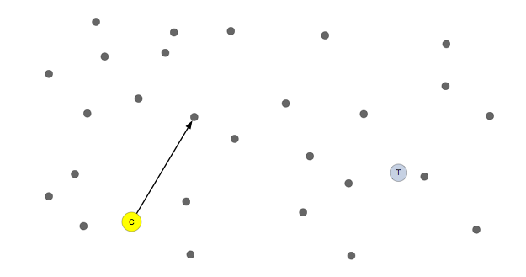

Slide 46
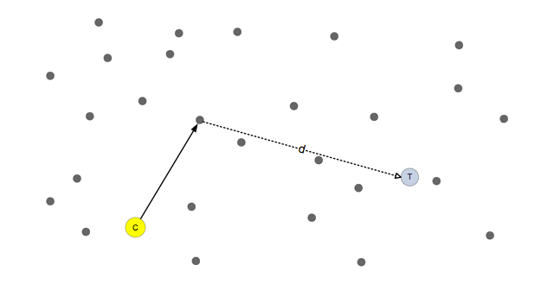

Slide 47
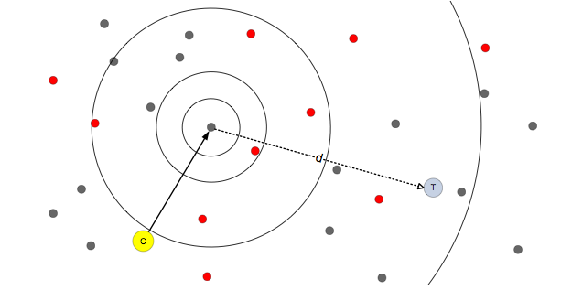

Slide 48
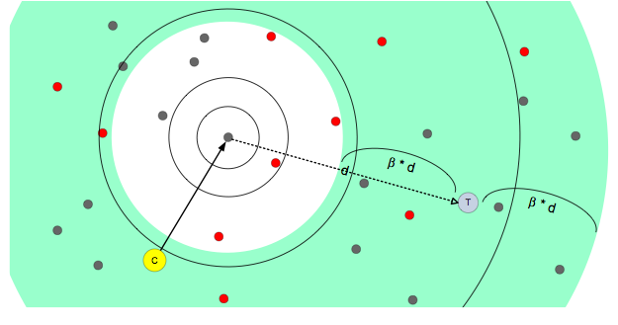

Slide 49
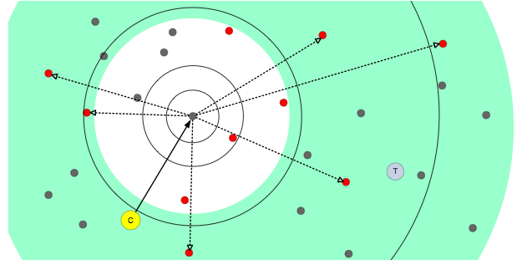

Slide 50
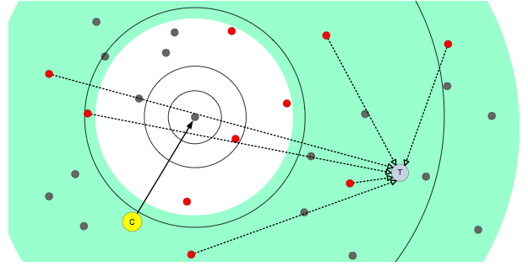

Slide 51
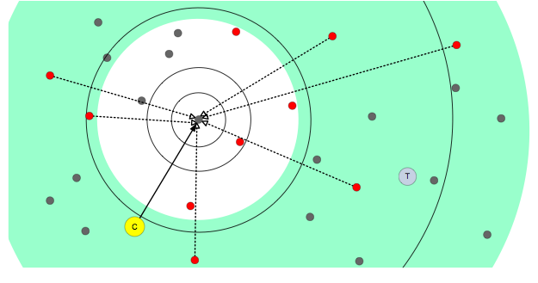

Slide 52
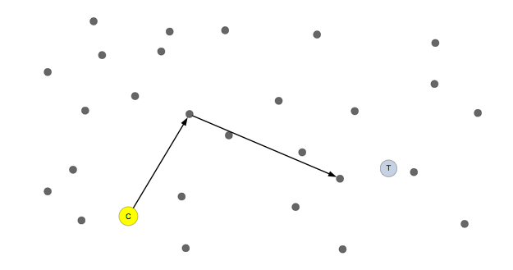

Slide 53
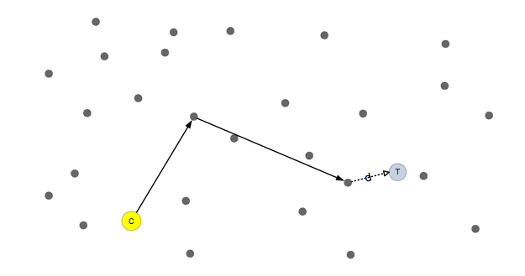

Slide 54
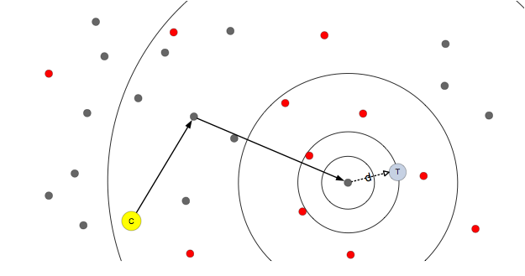

Slide 55
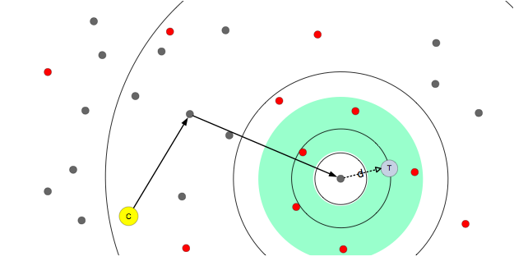

Slide 56
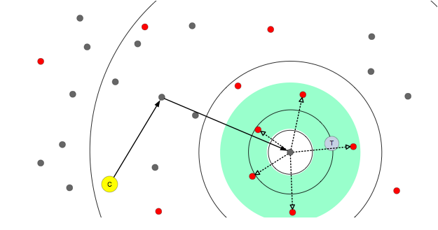

Slide 57


Slide 58


Slide 59
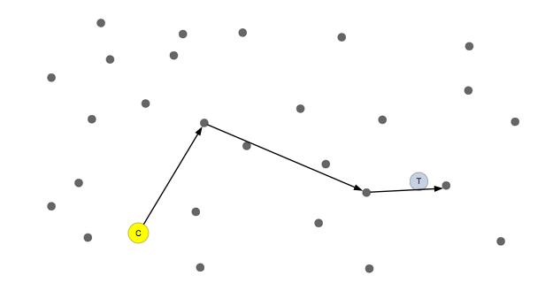

Slide 60


Slide 61
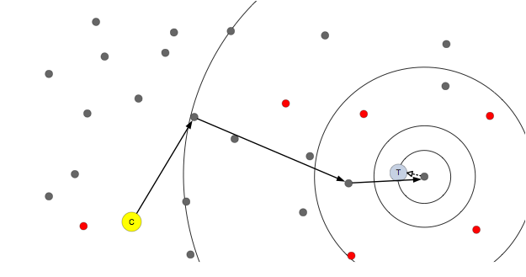

Slide 62
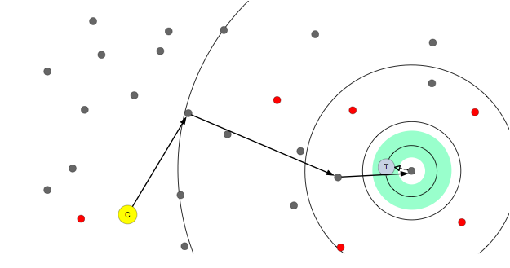

Slide 63
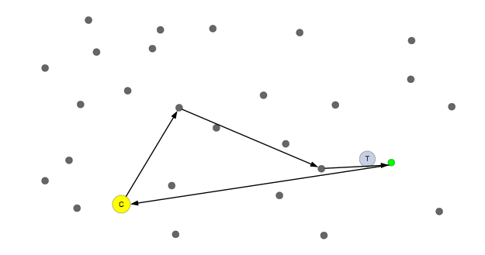

Slide 64
Revisit: Why is Automated Adaptation Hard?
Must infer Internet performance
  Scalability
  Accuracy
  Tradeoff with timeliness
Support for a variety of applications
  Different performance metrics
  API requirements
Layered implementations hide information
Notes:
it would be good to have strong words to say about why measurement is fundamental to the internet -- why not just have a better network hand you the measurements you need? sounds silly to network folk, but is a natural question to people in other areas.
Layer hides info – layering is good for implementation, preserve layers but communicate info across layers

Slide 66
Locality-aware P2P: P2P’s Attempt to Improve Network Efficiency
P2P has flexibility in shaping communication patterns
Locality-aware P2P tries to use this flexibility to improve network efficiency
  E.g., Karagiannis et al. 2005, Bindal et al. 2006, Choffnes et al. 2008 (Ono)

Slide 67
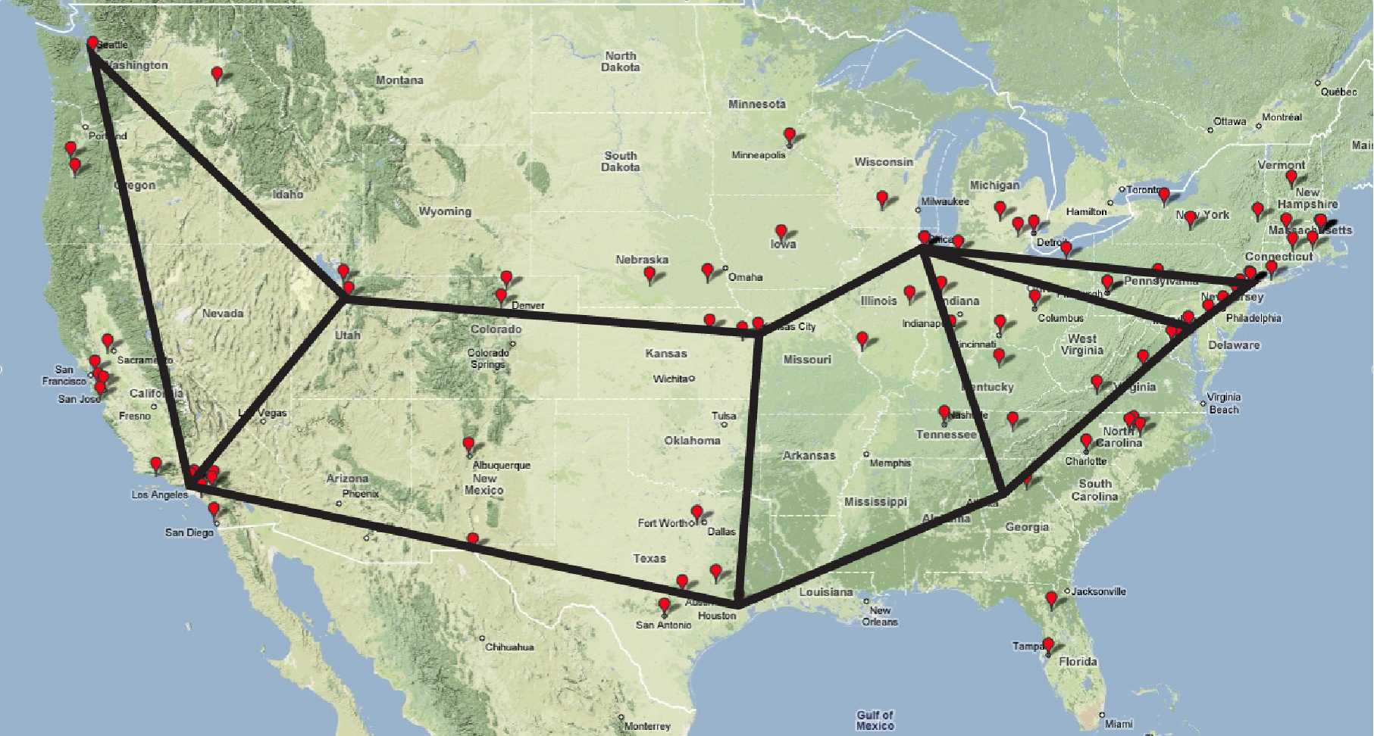
Problems of Locality-aware P2P
Locality-aware P2P needs to reverse engineer network topology, traffic load and network policy
Locality-aware P2P may not achieve network efficiency
Choose congested links Traverse costly interdomain links
ISP 1
ISP 0
ISP 2
ISP K

Slide 69
Can Miss Intersections
V3
V1
I
Cluster interfaces that have similar routing performance
S
D
Helps in reuse of measurements without loss of accuracy
Fewer links to be measured

Slide 70
Cluster Interfaces into PoPs
Interfaces on the same router use the same routing table
Routers at the same location within an AS will have similar routing tables
  Discover locations based on DNS names
    Invalidate inferred locations if incorrect
  Discover co-located interfaces
    Nearby interfaces have similar reverse paths back to each vantage point

Slide 71
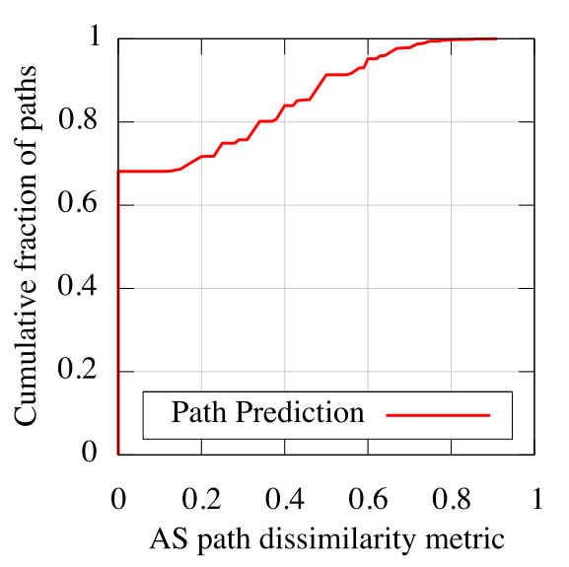
Does Path Prediction work?
Used atlas measured from PlanetLab to predict paths from public traceroute servers
68% of path predictions are perfect
|
Intersection of ASes
1
−
|
|
Union of ASes |
Notes:
Note that this is a conservative estimate since we use routes measured from public traceroute servers to predict paths from other nodes.

Slide 72
Challenges in building iPlane
How do we …
  build a structured atlas of the Internet?
  predict routing between arbitrary end-hosts?
  measure properties of links in the core?
  measure links at the edge?

Slide 73
Measuring Links in the Core
Only need to measure inter-cluster links
Objectives
  Probe each link mostly once
  Distribute probing load evenly across vantage points
  Probe each link from closest vantage point
Frontier Search algorithm selects paths that cover all links
  Parallelized BFS across PlanetLab nodes
To span atlas measured from 200 PlanetLab sites
  Each node has to measure around 700 links
Notes:
Say “measure links”, not “measure paths”

Slide 74
Challenges in building iPlane
How do we …
  build a structured atlas of the Internet?
  predict routing between arbitrary end-hosts?
  measure properties of links in the core?
  measure links at the edge?

Slide 75
Measuring the Edge
Participate in BitTorrent swarms
  Popular application: wide coverage of end-hosts
Passively monitor TCP connections to measure access link properties
  Will not raise alarms
Notes:
Remember to mention legal issues

Slide 76
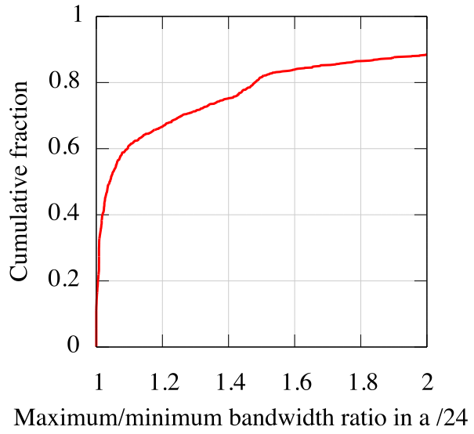
Reusability of Measurements
Measurements to multiple addresses in the same /24 within 20% of each other in 66% of cases
Reuse bandwidth measurements within a /24 prefix

