Slide 1
15-446 Distributed Systems
Spring 2009
Localization

Slide 2
Announcements
Assignment HW3 due 4/21
No lecture
  4/16 Carnival
Schedule change
  4/21 lecture moved to recitation slot on 4/22 (Wed)
  Location TBA

Slide 3

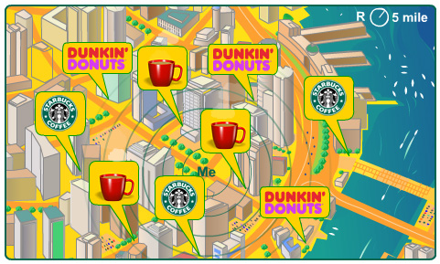
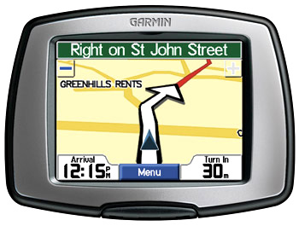
Localization
What is localization? ➔ Telling where you are
Why? ➔ Location Base Services
  E-911 Emergency assistance: Where are they?
  Advertising: You are here!
  Social networking: Where are my friends?
  Tracking: Where are you going?
  Virtual Tour: I am close to...
  Service discovery: What is here?
  Device recovery: Where’s my stolen laptop?

Slide 4
Overview
GPS
WiFi Positioning Systems
IP2Geo
Recent research on AP localization

Slide 5
Global Positioning System
NAVSTAR-GPS
  NAVigation System with Timing And Ranging Global Positioning System
  Satellite-based distributed system
First satellite launched in 1978 by DoD
Fully operational in April, 1995.
Civilian use(Standard Positioning Service) and military use (Precise Positioning Service)

Slide 6
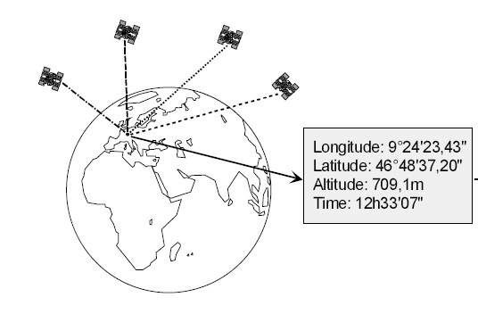
Basic function of GPS
1. Exact location (longitude, latitude,height) Accuracy ~15m
2. Precisetime (UTC)
Accuracy ~45ns

Slide 7
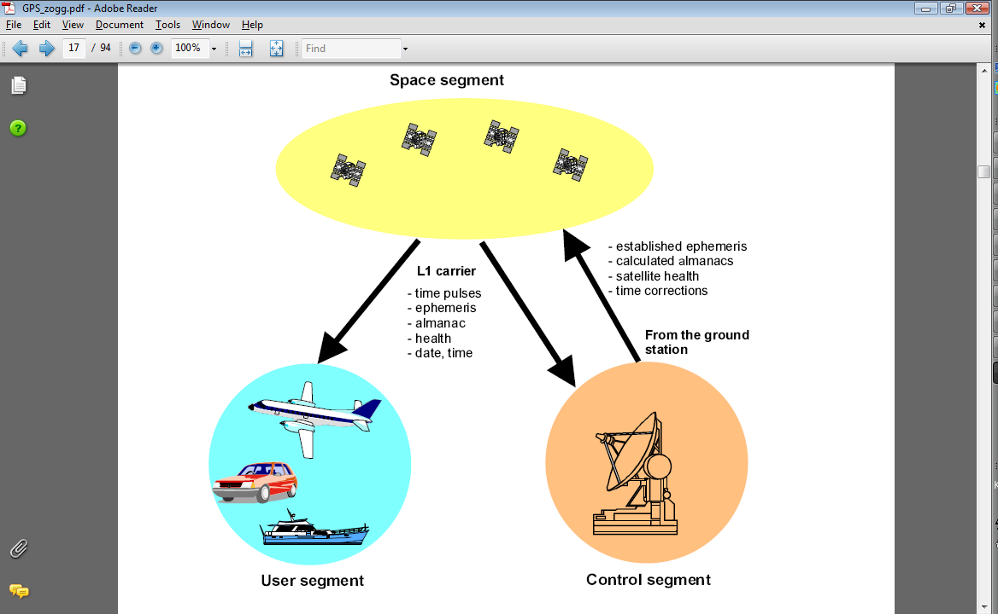
Three segments of GPS

Slide 8
Control Segment
US Space Command
Cape Canaveral
Hawaii
Kwajalein Atoll
Diego Garcia
Ascension Is.
Master Control Station
Monitor Station
Ground Antenna

Slide 9
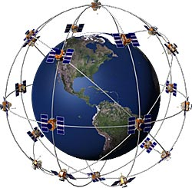
Space Segment
28 satellites in 6 orbits
Each satellite has 4 atomic clocks
Orbits the Earth at 20,180km
12 hours orbital time
Atleast4satellites can be seen in any part of the planet

Slide 10
Positioning is based on time
Satellite keeps an accurate time
  Atomic clock synchronize with each other
  Regularly adjusted from control segments on Earth
Each satellite broadcasts the exact location and time at 1575.42 MHz (L1).
Receiver can calculate the travel time if the clock is synchronized.

Slide 11
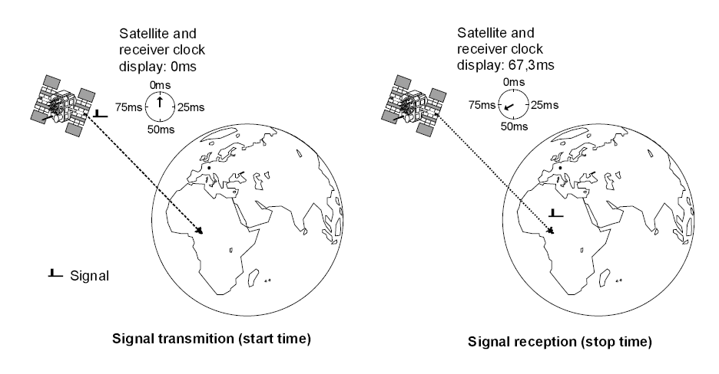
Positioning with synchronized clock
distance = travel time x The speed of light

Slide 12
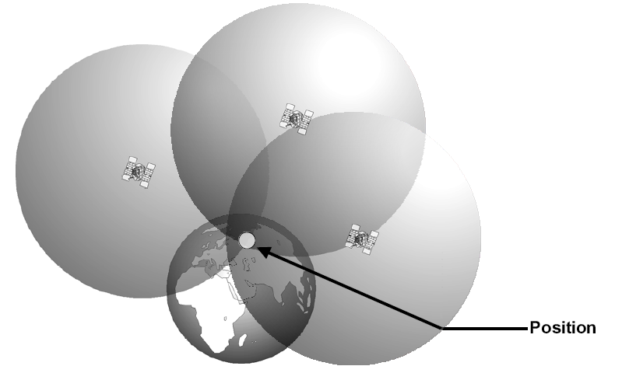
Positioning with synchronized clock
distance = travel time x The speed of light
Trilateration

Slide 13
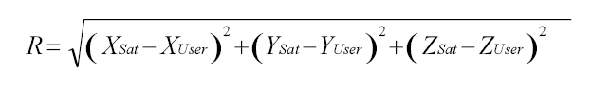
Accounting for the clock offset
Satellites’ clocks are well synchronized
Receiver clock is not synchronized.
Need to estimate 4 unknowns
  (x, y, z, Δt)
  Δt is the clock offset of the receiver
  R: real distance, PSR : estimated distance
  R = PSR - Δt ·c
Need 4 satellites

Slide 14
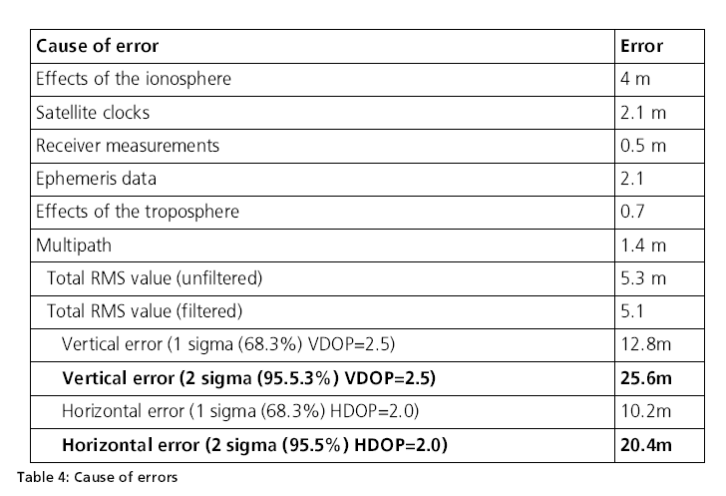
GPS accuracy
~15 meter (worsens in urban canyon)
Source of Error (speed of light changes)

Slide 15
Wide Area Augmentation System
Error correction system that uses reference ground stations
25 reference stations in US
Monitor GPS and send correction values to two geo-stationary satellites
The two geo-stationary satellites broadcast back to Earth on GPS L1 frequency (1575.42MHz)
Only available in North America, WASS enabled GPS receiver needed

Slide 16
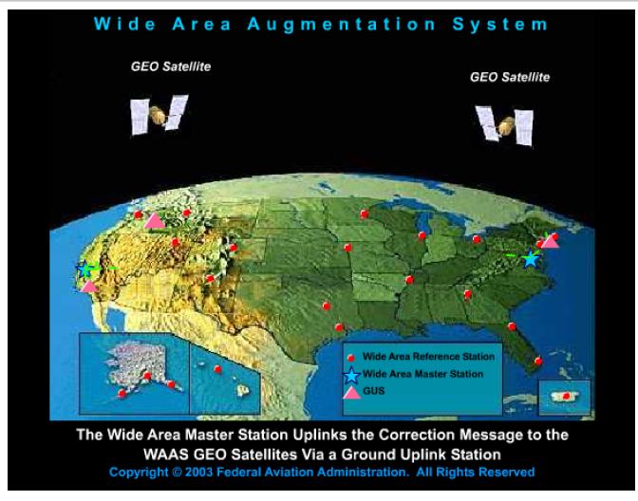
WAAS

Slide 17
How good is WAAS?
With Selective Availability set to zero, and under ideal conditions, a GPS receiver without WAAS can achieve fifteen meter accuracy most of the time.*
+-15 meters
+ -
3 meters
Under ideal conditions a WAAS equipped GPS receiver can achieve three meter accuracy 95% of the time.*
* Precision depends on good satellite geometry, open sky view, and no user induced errors.

Slide 18
Overview
Need for localization
  Location Based Service
GPS
WiFi Positioning Systems
IP2Geo

Slide 19
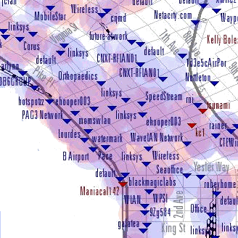



WiFi Positioning System
Exploit wide-scale WiFi deployment
  WiFi density increasing to point of overlap
WiFi base stations broadcast unique IDs
Position WiFi devices using a map of AP’s MAC to location

Slide 20
PlaceLab
Keeps a database of WiFi measurements
  Maps BSSID (MAC address) to locations
  Wigle.net, public war driving database
Mobile users download part of the DB
Match the current observation of APs to location using the DB
Accuracy around 20m

Slide 21
PlaceLab localization algorithms
Centroid/Weighted Centroid
  Locates the client at the average location of the Aps
Finger printing
  Requires signal map at each location
  Find the nearest neighbor in signal strength space
Particle filter
  Requires signal map at each location
  Takes account of the user movement

Slide 22
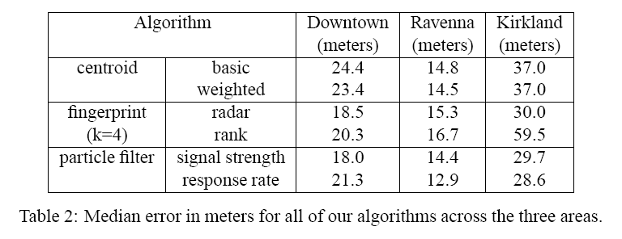
PlaceLab
Localization algorithms used to locate mobile users
  Centroid/Weighted Centroid
  Finger printing
  Particle filter
High density
low density

Slide 23
PlaceLab
Requires a database of WiFi hotspots
Cost
  Infrastructure (wireless APs) are already there
  Wireless device is cheap
Coverage
  Indoors as well as outdoors
  Most areas have dense deployment of APs

Slide 24
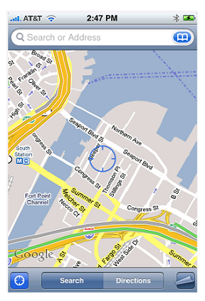
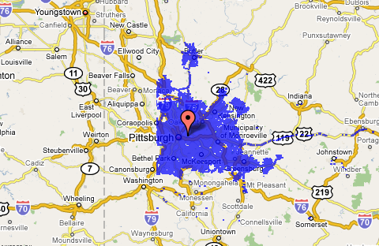
SkyHook
Commercial system extended from PlaceLab
Uses WiFi, GPS, Cell tower (hybrid approach)
Updates the database regularly
Default app in iPhone, iPods

Slide 25
Indoor localization system
Usually more fine grained localization needed
  Often 3D (2.5D) : x,y and floor
  Often want to locate users in an office
RADAR
  Trilateration based on signal strength from APs
  Hard to predict distance based on signal strength because signal is blocked by walls and structures
  Use site-surveying
Lots of research has been done
  MIT Cricket (RF + ultrasound)
  AeroScout (WiFi), Ekahau (WiFi)

Slide 26
Overview
Need for localization
  Location Based Service
GPS
WiFi Positioning Systems
IP2Geo

Slide 27
IP-Geography Mapping
Goal: Infer the geographic location of an Internet host given its IP address.
Why is this interesting?
  enables location-aware applications
  example applications:
    Territorial Rights Management
    Targeted Advertising
    Network Diagnostics
Why is this hard?
  IP address does not inherently indicate location
  proxies hide client identity, limit visibility into ISPs
Desirable features of a solution
  easily deployable, accuracy, confidence indicator

Slide 28
IP2Geo
Infer geo-location of IP based on various “properties”
  DNS names of routers often indicate location
  Network delay correlates with geographic distance
  Subnets are clustered
Three techniques
  GeoTrack
  GeoPing
  GeoClusters

Slide 29
GeoTrack
Location info often embedded in router DNS names
  ngcore1-serial8-0-0-0.Seattle.cw.net, 184.atm6-0.xr2.ewr1.alter.net
GeoTrack operation
  do a traceroute to the target IP address
  determine location of last recognizable router along the path
Key ideas in GeoTrack
  partitioned city code database to minimize chance of false match
  ISP-specific parsing rules
  delay-based correction
Limitations
  routers may not respond to traceroute
  DNS name may not contain location information or lookup may fail
  target host may be behind a proxy or a firewall

Slide 30
GeoPing
Nearest Neighbor in Delay Space(NNDS)
  delay vector: delay measurements from a host to a fixed set of landmarks
  delay map: database of delay vectors and locations for a set of known hosts
    (50,45,20,35) ↔ Indianapolis, IN
    (10,20,40,60) ↔ Seattle, WA
    •••
  target location corresponds to best match in delay map
  optimal dimensionality of delay vector is 7-9

Slide 31
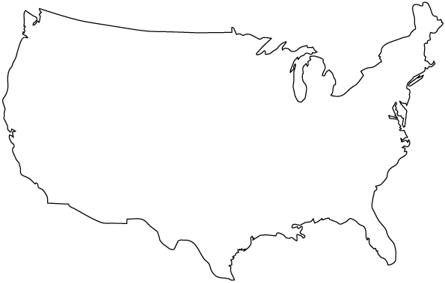
Delay Map Construction
Landmark #1
50 ms
Landmark #4
35 ms
45 ms
20 ms
Landmark #2
Landmark #3
Delay Vector = (50,45,20,35) ↔ Indianapolis, IN

Slide 32
GeoCluster
Basic Idea: identify geographic clusters
  partial IP-location database
    construct a database of the form (IPaddr, likely location)
    partial in coverage and potentially inaccurate
    sources: HotMail registration/login logs, TVGuide query logs
  cluster identification
    use prefix info. from BGP tables to identify topological clusters
    assign each cluster a location based on IP-location database
    do sub-clustering when no consensus on a cluster’s location
  location of target IP address is that of best matching cluster

Slide 33
Constructing IP-Location Database
Registration logs
Login logs
User A ↔ San Francisco, CA
User B ↔ Berkeley, CA
User C ↔ Little Rock, AK
User D ↔ San Francisco, CA
User E ↔ New York, NY
User F ↔ Clinton, AK
User A ↔ 128.11.20.35
User B ↔ 128.11.35.123
User C ↔ 128.11.132.40
User D ↔ 128.11.20.145
User E ↔ 128.11.100.23
User F ↔ 128.11.163.112
128.11.20.35 ↔ San Francisco, CA
128.11.35.123 ↔ Berkeley, CA
128.11.132.40 ↔ Little Rock, AK
128.11.20.145 ↔ San Francisco, CA
128.11.100.23 ↔ New York, NY
128.11.163.112 ↔ Clinton, AK
IP-location
database

Slide 34
Geographic sub-clusters in a cluster
128.11.0.0/16
No consensus in location estimate for entire cluster

Slide 35
Geographic sub-clusters in a cluster
128.11.0.0/17
128.11.128.0/17
Consensus in location within sub-clusters

Slide 36
Performance
Median Error: GeoTrack :102 km, GeoPing: 382 km, GeoCluster: 28 km

Slide 37
IP2Geo Conclusions
IP2Geo encompasses a diverse set of techniques
  GeoTrack: DNS names
  GeoPing: network delay
  GeoCluster: geographic clusters
Median error 20-400 km
  GeoCluster also provides confidence indicator
Each technique best suited for a different purpose
  GeoTrack: locating routers, tracing geographic path
  GeoPing: location determination for proximity-based routing (e.g., CoopNet)
  GeoCluster: best suited for location-based services
Publications at SIGCOMM 2001 & USENIX 2002

Slide 38
Summary
Location based services require the location of users
Different localization systems are built for different purposes
Each localization system has different performance and limitations
Localization and location based systems are interesting/active area of research

