Slide 1
15-446 Distributed Systems
Spring 2009
L-22 Sensor Networks

Slide 2
Overview
Ad hoc routing
Sensor Networks
Directed Diffusion
Aggregation
  TAG
  Synopsis Diffusion

Slide 3
Ad Hoc Routing
Goal: Communication between wireless nodes
  No external setup (self-configuring)
  Often need multiple hops to reach dst

Slide 4
Ad Hoc Routing
Create multi-hop connectivity among set of wireless, possibly moving, nodes
Mobile, wireless hosts act as forwarding nodes as well as end systems
Need routing protocol to find multi-hop paths
  Needs to be dynamic to adapt to new routes, movement
  Interesting challenges related to interference and power limitations
  Low consumption of memory, bandwidth, power
  Scalable with numbers of nodes
  Localized effects of link failure

Slide 5
Challenges and Variants
Poorly-defined “links”
  Probabilistic delivery, etc. Kind of n² links
Time-varying link characteristics
No oracle for configuration (no ground truth configuration file of connectivity)
Low bandwidth (relative to wired)
Possibly mobile
Possibly power-constrained

Slide 6
Problems Using DV or LS
DV protocols may form loops
  Very wasteful in wireless: bandwidth, power
  Loop avoidance sometimes complex
LS protocols: high storage and communication overhead
More links in wireless (e.g., clusters) - may be redundant → higher protocol overhead

Slide 7
Problems Using DV or LS
Periodic updates waste power
  Tx sends portion of battery power into air
  Reception requires less power, but periodic updates prevent mobile from “sleeping”
Convergence may be slower in conventional networks but must be fast in ad-hoc networks and be done without frequent updates

Slide 8
Proposed Protocols
Destination-Sequenced Distance Vector (DSDV)
  DV protocol, destinations advertise sequence number to avoid loops, not on demand
Temporally-Ordered Routing Algorithm (TORA)
  On demand creation of hbh routes based on link-reversal
Dynamic Source Routing (DSR)
  On demand source route discovery
Ad Hoc On-Demand Distance Vector (AODV)
  Combination of DSR and DSDV: on demand route discovery with hbh routing

Slide 9
DSR Concepts
Source routing
  No need to maintain up-to-date info at intermediate nodes
On-demand route discovery
  No need for periodic route advertisements

Slide 10
DSR Components
Route discovery
  The mechanism by which a sending node obtains a route to destination
Route maintenance
  The mechanism by which a sending node detects that the network topology has changed and its route to destination is no longer valid

Slide 11
DSR Route Discovery
Route discovery - basic idea
  Source broadcasts route-request to Destination
  Each node forwards request by adding own address and re-broadcasting
  Requests propagate outward until:
    Target is found, or
    A node that has a route to Destination is found

Slide 12
C Broadcasts Route Request to F
A
D
E
Route Request
B
Source
C
Destination
F
G
H

Slide 13
C Broadcasts Route Request to F
A
D
E
Route Request
B
Source
C
Destination
F
G
H

Slide 14
H Responds to Route Request
A
D
E
B
Source
C
Destination
F
G
H
G,H,F

Slide 15
C Transmits a Packet to F
A
D
E
B
Source
C
G,H,F
Destination
F
G
H,F
H
F

Slide 16
Forwarding Route Requests
A request is forwarded if:
  Node is not the destination
  Node not already listed in recorded source route
  Node has not seen request with same sequence number
  IP TTL field may be used to limit scope
Destination copies route into a Route-reply packet and sends it back to Source

Slide 17
Route Cache
All source routes learned by a node are kept in Route Cache
  Reduces cost of route discovery
If intermediate node receives RR for destination and has entry for destination in route cache, it responds to RR and does not propagate RR further
Nodes overhearing RR/RP may insert routes in cache

Slide 18
Sending Data
Check cache for route to destination
If route exists then
  If reachable in one hop
    Send packet
  Else insert routing header to destination and send
If route does not exist, buffer packet and initiate route discovery

Slide 19
Discussion
Source routing is good for on demand routes instead of a priori distribution
Route discovery protocol used to obtain routes on demand
  Caching used to minimize use of discovery
Periodic messages avoided

Slide 20
Overview
Ad Hoc Routing
Sensor Networks
Directed Diffusion
Aggregation
  TAG
  Synopsis Diffusion

Slide 21
Smart-Dust/Motes
First introduced in late 90’s by groups at UCB/UCLA/USC
  Published at Mobicom/SOSP conferences
Small, resource limited devices
  CPU, disk, power, bandwidth, etc.
Simple scalar sensors – temperature, motion
Single domain of deployment (e.g. farm, battlefield, etc.) for a targeted task (find the tanks)
Ad-hoc wireless network

Slide 22
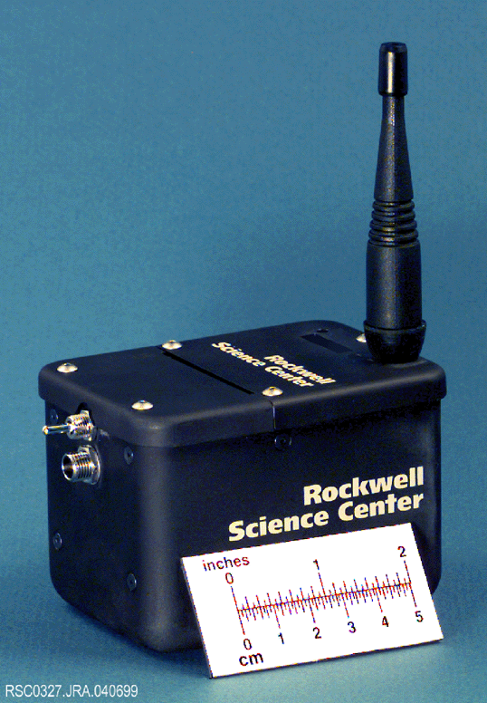
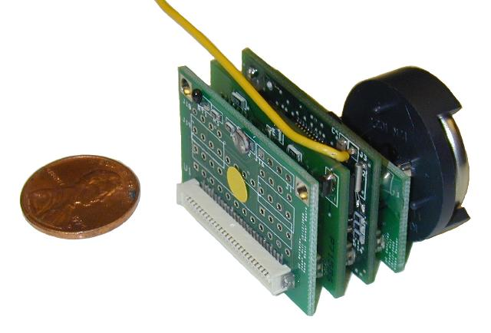
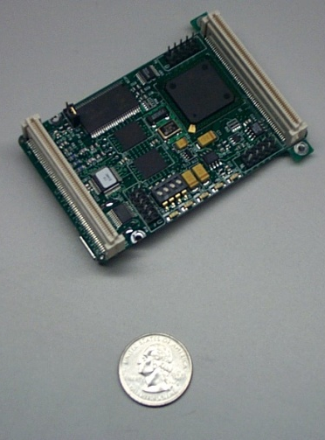
Smart-Dust/Motes
Hardware
  UCB motes
Programming
  TinyOS
Query processing
  TinyDB
  Directed diffusion
  Geographic hash tables
Power management
  MAC protocols
  Adaptive topologies

Slide 23
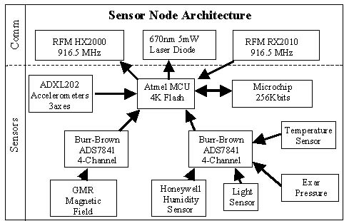
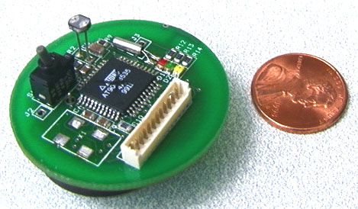
Berkeley Motes
Devices that incorporate communications, processing, sensors, and batteries into a small package
Atmel microcontroller with sensors and a communication unit
  RF transceiver, laser module, or a corner cube reflector
  Temperature, light, humidity, pressure, 3 axis magnetometers, 3 axis accelerometers

Slide 24
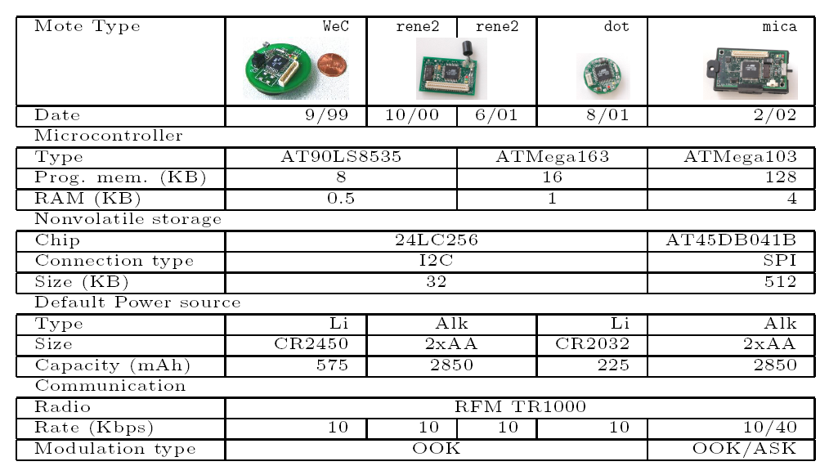
Berkeley Motes (Levis & Culler, ASPLOS 02)

Slide 25

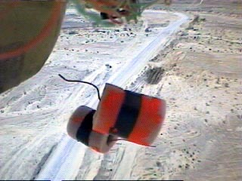
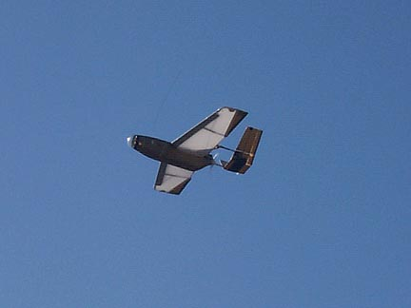
Sensor Net Sample Apps
Habitat Monitoring: Storm petrels on great duck island, microclimates on James Reserve.
Earthquake monitoring in shake-test sites.
Vehicle detection: sensors along a road, collect data about passing vehicles.
Traditional monitoring apparatus.

Slide 26
Metric: Communication
Lifetime from one pair of AA batteries
  2-3 days at full power
  6 months at 2% duty cycle
Communication dominates cost
  < few mS to compute
  30mS to send message
Notes:
In sensor nets, power is the primary metric, rather than tradtional measures such as throughput or latency
Must schedule computation to enable sleeping
Primary component of power consumption is communication, because it takes about 30ms to transmit
A single message, and the computations were considering are generally simple (<< 30 ms).
Therefore, to a first approximation, a good metric of power consumption is the amount of communication,
Which is what I use throughout this talk

Slide 27
Communication In Sensor Nets
Radio communication has high link-level losses
  typically about 20% @ 5m
Ad-hoc neighbor discovery
Tree-based routing
A
B
C
D
F
E

Slide 28
Overview
Ad Hoc Routing
Sensor Networks
Directed Diffusion
Aggregation
  TAG
  Synopsis Diffusion

Slide 29
The long term goal
Embed numerous distributed devices to monitor and interact with physical world: in work-spaces, hospitals, homes, vehicles, and “the environment” (water, soil, air…)
Circulatory Net
Disaster Response
Network these devices so that they can coordinate to perform higher-level tasks.
Requires robust distributed systems of tens of thousands of devices.

Slide 30
Motivation
Properties of Sensor Networks
  Data centric, but not node centric
  Have no notion of central authority
  Are often resource constrained
Nodes are tied to physical locations, but:
  They may not know the topology
  They may fail or move arbitrarily
Problem: How can we get data from the sensors?

Slide 31
Directed Diffusion
Data centric – nodes are unimportant
Request driven:
  Sinks place requests as interests
  Sources are eventually found and satisfy interests
  Intermediate nodes route data toward sinks
Localized repair and reinforcement
Multi-path delivery for multiple sources, sinks, and queries

Slide 32
Motivating Example
Sensor nodes are monitoring a flat space for animals
We are interested in receiving data for all 4-legged creatures seen in a rectangle
We want to specify the data rate

Slide 33
Interest and Event Naming
Query/interest:
  Type=four-legged animal
  Interval=20ms (event data rate)
  Duration=10 seconds (time to cache)
  Rect=[-100, 100, 200, 400]
Reply:
  Type=four-legged animal
  Instance = elephant
  Location = [125, 220]
  Intensity = 0.6
  Confidence = 0.85
  Timestamp = 01:20:40
Attribute-Value pairs, no advanced naming scheme

Slide 34
Diffusion (High Level)
Sinks broadcast interest to neighbors
Interests are cached by neighbors
Gradients are set up pointing back to where interests came from at low data rate
Once a sensor receives an interest, it routes measurements along gradients

Slide 35
Illustrating Directed Diffusion
Setting up gradients
Sending data
Source
Source
Sink
Sink
Reinforcing
stable path
Source
Source
Sink
Sink
Recovering
from node failure

Slide 36
Summary
Data Centric
  Sensors net is queried for specific data
  Source of data is irrelevant
  No sensor-specific query
Application Specific
  In-sensor processing to reduce data transmitted
  In-sensor caching
Localized Algorithms
  Maintain minimum local connectivity – save energy
  Achieve global objective through local coordination
Its gains due to aggregation and duplicate suppression may make it more viable than ad-hoc routing in sensor networks

Slide 37
Overview
Ad Hoc Routing
Sensor Networks
Directed Diffusion
Aggregation
  TAG
  Synopsis Diffusion

Slide 38
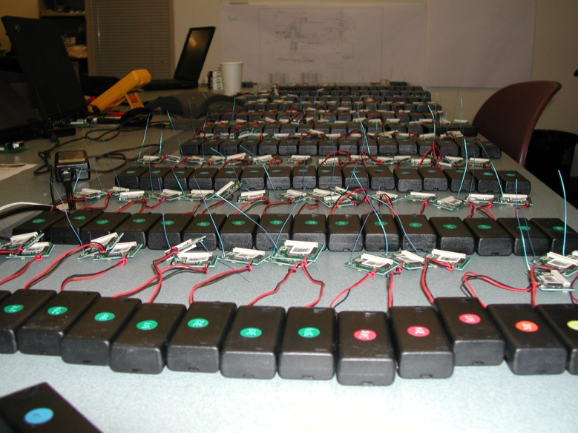
TAG Introduction
Programming sensor nets is hard!
Declarative queries are easy
  Tiny Aggregation (TAG): In-network processing via declarative queries
In-network processing of aggregates
  Common data analysis operation
  Communication reducing
    Operator dependent benefit
  Across nodes during same epoch
Exploit semantics improve efficiency!
Example:
    Vehicle tracking application: 2 weeks for 2 students
    Vehicle tracking query: took 2 minutes to write, worked just as well!
SELECT MAX(mag)
FROM sensors
WHERE mag > thresh
EPOCH DURATION 64ms
Notes:
A sensor network is a collection of battery powered computing devices, each of which is equipped with a radio and some sensing hardware. These networks are increasingly being deployed in 10s or 100s in remote locations that they are expected to monitor autonomously for months at a time
As you can imagine, programming for such environments is hard, because applications have to deal with power mgmt, routing, failed nodes, etc.
In contrast, a declarative interface allows users to express what they want from the network, and allows the query processing system to manage these difficulties.
The purpose of TAG is demonstrate that it is possible to efficiently disseminate and execute declarative queries within a sensor network
As an example of the possible benefit, consider a vehicle tracking application. It took two graduate students at UC berkeley about two weeks to build a simple application that used a magnetometer to track a vehicle moving through a field of sensors
Using our prototype query processor, we were able to achieve the same functionality in about two minutes, via the 4 line query you see here!

Slide 39
Basic Aggregation
In each epoch:
  Each node samples local sensors once
  Generates partial state record (PSR)
    local readings
    readings from children
  Outputs PSR during its comm. slot.
At end of epoch, PSR for whole network output at root
(In paper: pipelining, grouping)
1
2
3
4
5

Slide 40
Illustration: Aggregation
SELECT COUNT(*) FROM sensors
Slot 1
Sensor #
1
 | 1 | 2 | 3 | 4 | 5
1 |  |  |  |  | 1
2
3
4
1
2
3
Slot #
4
1
5

Slide 41
Illustration: Aggregation
SELECT COUNT(*) FROM sensors
Slot 2
Sensor #
1
 | 1 | 2 | 3 | 4 | 5
1 |  |  |  |  | 1
2 |  |  |  | 2
3
4
1
2
3
2
Slot #
4
5

Slide 42
Illustration: Aggregation
SELECT COUNT(*) FROM sensors
Slot 3
Sensor #
1
 | 1 | 2 | 3 | 4 | 5
1 |  |  |  |  | 1
2 |  |  |  | 2
3 |  | 1 | 3
4
1
1
3
2
3
Slot #
4
5

Slide 43
Illustration: Aggregation
SELECT COUNT(*) FROM sensors
5
Slot 4
Sensor #
1
 | 1 | 2 | 3 | 4 | 5
1 |  |  |  |  | 1
2 |  |  |  | 2
3 |  | 1 | 3
4 | 5
1
2
3
Slot #
4
5

Slide 44
Illustration: Aggregation
SELECT COUNT(*) FROM sensors
Slot 1
Sensor #
1
 | 1 | 2 | 3 | 4 | 5
1 |  |  |  |  | 1
2 |  |  |  | 2
3 |  | 1 | 3
4 | 5
1 |  |  |  |  | 1
2
3
Slot #
4
1
5

Slide 45
Types of Aggregates
SQL supports MIN, MAX, SUM, COUNT, AVERAGE
Any function can be computed via TAG
In network benefit for many operations
  E.g. Standard deviation, top/bottom N, spatial union/intersection, histograms, etc.
  Compactness of PSR

Slide 46
Taxonomy of Aggregates
TAG insight: classify aggregates according to various functional properties
  Yields a general set of optimizations that can automatically be applied
Property | Examples | Affects
Partial State | MEDIAN : unbounded, MAX : 1 record | Effectiveness of TAG
Duplicate Sensitivity | MIN : dup. insensitive, AVG : dup. sensitive | Routing Redundancy
Exemplary vs. Summary | MAX : exemplary COUNT: summary | Applicability of Sampling, Effect of Loss
Monotonic | COUNT : monotonic AVG : non-monotonic | Hypothesis Testing, Snooping

Slide 47
Benefit of In-Network Processing
Simulation Results
2500 Nodes
50x50 Grid
Depth = ~10
Neighbors = ~20
Some aggregates require dramatically more state!

Slide 48
Optimization: Channel Sharing (“Snooping”)
Insight: Shared channel enables optimizations
Suppress messages that won’t affect aggregate
  E.g., MAX
  Applies to all exemplary, monotonic aggregates

Slide 49
Optimization: Hypothesis Testing
Insight: Guess from root can be used for suppression
  E.g. ‘MIN < 50’
  Works for monotonic & exemplary aggregates
    Also summary, if imprecision allowed
How is hypothesis computed?
  Blind or statistically informed guess
  Observation over network subset

Slide 50
Optimization: Use Multiple Parents
For duplicate insensitive aggregates
Or aggregates that can be expressed as a linear combination of parts
  Send (part of) aggregate to all parents
    In just one message, via broadcast
  Decreases variance
B
B
B
B
C
C
C
B
C
C
1/2
1/2
1
A
A
A
A
A

Slide 51
Overview
Ad Hoc Routing
Sensor Networks
Directed Diffusion
Aggregation
  TAG
  Synopsis Diffusion

Slide 52

Aggregation in Wireless Sensors
Aggregate data is often more important
In-network aggregation
over tree with unreliable communication
10
10
Count =
3
Used by current systems,
TinyDB [Madden et al. OSDI’02]
Cougar [Bonnet et al. MDM’01]
2
1
7
1
3
3
1
Not robust against
node- or link-failures
1
1
1

Slide 53
Traditional Approach
Reliable communication
  E.g., RMST over Directed Diffusion [Stann’03]
High resource overhead
  3x more energy consumption
  3x more latency
  25% less channel capacity
Not suitable for resource constrained sensors

Slide 54

Exploiting Broadcast Medium
Robust multi-path
Energy-efficient
Count =
58
10
20
23
Challenge
Double-counting
Different ordering
15
2
7
3
4
1
2
1
Challenge: order and duplicate insensitivity
(ODI)

Slide 55
A Naïve ODI Algorithm
Goal: count the live sensors in the network
0
0
1
0
0
0
0
0
0
0
0
1
id
Bit vector
0
1
0
0
0
0
0
0
0
0
1
0

Slide 56
Synopsis Diffusion (SenSys’04)
Goal: count the live sensors in the network
4
Challenge
Count 1 bits
0
1
1
0
1
1
0
Synopsis should be small
0
0
0
1
1
1
1
1
0
0
0
0
0
1
0
0
0
0
0
0
1
0
0
0
0
0
1
1
1
id
Bit vector
0
Boolean
OR
0
0
1
1
1
0
0
0
0
0
0
0
0
0
0
0
0
0
0
0
0
0
1
1
1
0
0
0
0
0
0
0
0
1
1
1
1
0
0
0
0
Approximate COUNT algorithm: logarithmic size bit vector

Slide 57
Synopsis Diffusion over Rings
A node is in ring i if it is i hops away from the base-station
Broadcasts by nodes in ring i are received by neighbors in ring i-1
Each node transmits once = optimal energy cost (same as Tree)
Ring 2

Slide 58
Evaluation
Approximate COUNT with Synopsis Diffusion
Scheme | Energy
Tree | 41.8 mJ
Syn. Diff. | 42.1 mJ
Typical
loss rates
Per node energy
Almost as energy efficient as Tree
More robust than Tree

Slide 60
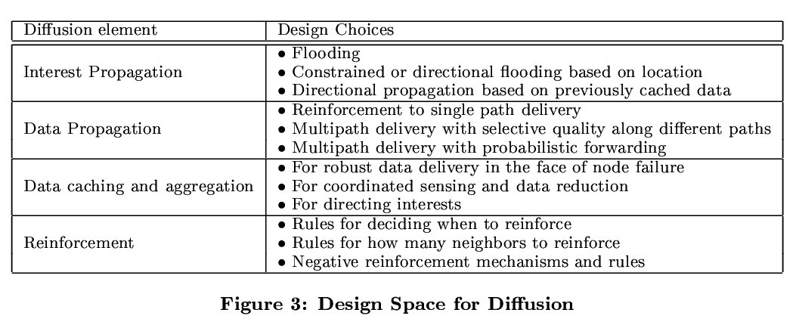
Design Considerations

Slide 61
Directed Diffusion (Data)
Sensors match signature waveforms from codebook against observations
Sensors match data against interest cache, compute highest event rate request from all gradients, and (re) sample events at this rate
Receiving node:
  Finds matching entry in interest cache, no match – silent drop
  Checks and updates data cache (loop prevention, aggregation)
  Retrieve all gradients, and resend message, doing frequency conversion if necessasry

Slide 62
Directed Diffusion (Reinforcement)
Reinforcement:
  Data-driven rules unseen msg. from neighbor → resend original with smaller interval
  This neighbor, in turn, reinforces upstream nodes
  Passive reinforcement handling (timeout) or active (weights)

Slide 63
Approach
Energy is the bottleneck resource
  And communication is a major consumer--avoid communication over long distances
Pre-configuration and global knowledge are not applicable
  Achieve desired global behavior through localized interactions
  Empirically adapt to observed environment
Leverage points
  Small-form-factor nodes, densely distributed to achieve Physical locality to sensed phenomena
  Application-specific, data-centric networks
  Data processing/aggregation inside the network

Slide 64
Directed Diffusion Concepts
Application-aware communication primitives
  expressed in terms of named data (not in terms of the nodes generating or requesting data)
Consumer of data initiates interest in data with certain attributes
Nodes diffuse the interest towards producers via a sequence of local interactions
This process sets up gradients in the network which channel the delivery of data
Reinforcement and negative reinforcement used to converge to efficient distribution
Intermediate nodes opportunistically fuse interests, aggregate, correlate or cache data

Slide 65
Query Propagation
SELECT COUNT(*)…
Comm. Slot
1
Epoch
2
3
4
5

Slide 66
Synopsis Diffusion (SenSys’04)
Synopsis Diffusion: a general framework
Count | Uniform Sample
Sum (Average) | Iceberg queries
Distinct count | Top-k items
Synopsis
Diffusion
algorithms

Slide 67
Aggregation Framework
As in extensible databases, we support any aggregation function conforming to:
Agg_{n}={f_{init}, f_{merge}, f_{evaluate}}
f_{init}{a₀} → <a₀>
F_{merge}{<a₁>,<a₂>} → <a₁₂>
F_{evaluate}{<a₁>} → aggregate value
(Merge associative, commutative!)
Partial State Record (PSR)
Example: Average
AVG_{init} {v} → <v,1>
AVG_{merge} {<S₁, C₁>, <S₂, C₂>} → < S₁ + S₂ , C₁ + C₂>
AVG_{evaluate}{<S, C>} → S/C

Slide 68
Multiple Parents Results
No Splitting
With Splitting
Better than previous analysis expected!
Losses aren’t independent!
Insight: spreads data over many links
Critical Link!

