Slide 1
15-446 Distributed Systems
Spring 2009
L-18 More DFS

Slide 2
Review of Last Lecture
Distributed file systems functionality
Implementation mechanisms example
  Client side: VFS interception in kernel
  Communications: RPC
  Server side: service daemons
Design choices
  Topic 1: name space construction
    Mount (NFS) vs. global name space (AFS)
  Topic 2: AAA in distributed file systems
    Kerberos
  Topic 3: client-side caching
    NFS and AFS

Slide 3
Today's Lecture
DFS design comparisons continued
  Topic 4: file access consistency
    NFS, AFS, Sprite, and DCE DFS
  Topic 5: Locking
Other types of DFS
  Coda – disconnected operation
  LBFS – weakly connected operation

Slide 4
Topic 4: File Access Consistency
In UNIX local file system, concurrent file reads and writes have “sequential” consistency semantics
  Each file read/write from user-level app is an atomic operation
    The kernel locks the file vnode
  Each file write is immediately visible to all file readers
Neither NFS nor AFS provides such concurrency control
  NFS: “sometime within 30 seconds”
  AFS: session semantics for consistency

Slide 5
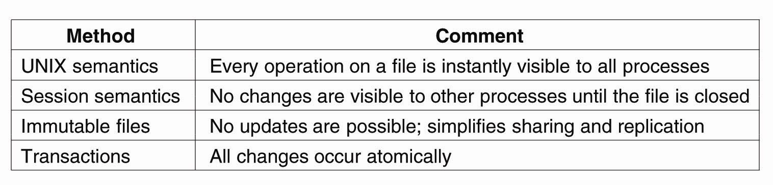
Semantics of File Sharing
Four ways of dealing with the shared files in a distributed system.

Slide 6
Session Semantics in AFS v2
What it means:
  A file write is visible to processes on the same box immediately, but not visible to processes on other machines until the file is closed
  When a file is closed, changes are visible to new opens, but are not visible to “old” opens
  All other file operations are visible everywhere immediately
Implementation
  Dirty data are buffered at the client machine until file close, then flushed back to server, which leads the server to send “break callback” to other clients
Notes:
Chunk-based I/O
No real consistency guarantees
close() failures surprising to many Unix programs
...and to early Linux kernels!

Slide 7
AFS Write Policy
Data transfer is by chunks
  Minimally 64 KB
  May be whole-file
Writeback cache
  Opposite of NFS “every write is sacred”
  Store chunk back to server
    When cache overflows
    On last user close()
  ...or don't (if client machine crashes)
Is writeback crazy?
  Write conflicts “assumed rare”
  Who wants to see a half-written file?

Slide 8
Access Consistency in the “Sprite” File System
Sprite: a research file system developed in UC Berkeley in late 80’s
Implements “sequential” consistency
  Caches only file data, not file metadata
  When server detects a file is open on multiple machines but is written by some client, client caching of the file is disabled; all reads and writes go through the server
  “Write-back” policy otherwise
    Why?

Slide 9
Implementing Sequential Consistency
How to identify out-of-date data blocks
  Use file version number
  No invalidation
  No issue with network partition
How to get the latest data when read-write sharing occurs
  Server keeps track of last writer

Slide 10
Implication of “Sprite” Caching
Server must keep state!
  Recovery from power failure
  Server failure doesn’t impact consistency
  Network failure doesn’t impact consistency
Price of sequential consistency: no client caching of file metadata; all file opens go through server
  Performance impact
  Suited for wide-area network?

Slide 11
“Tokens” in DCE DFS
How does one implement sequential consistency in a file system that spans multiple sites over WAN
Callbacks are evolved into 4 kinds of “Tokens”
  Open tokens: allow holder to open a file; submodes: read, write, execute, exclusive-write
  Data tokens: apply to a range of bytes
    “read” token: cached data are valid
    “write” token: can write to data and keep dirty data at client
  Status tokens: provide guarantee of file attributes
    “read” status token: cached attribute is valid
    “write” status token: can change the attribute and keep the change at the client
  Lock tokens: allow holder to lock byte ranges in the file

Slide 12
Compatibility Rules for Tokens
Open tokens:
  Open for exclusive writes are incompatible with any other open, and “open for execute” are incompatible with “open for write”
  But “open for write” can be compatible with “open for write”
Data tokens: R/W and W/W are incompatible if the byte range overlaps
Status tokens: R/W and W/W are incompatible

Slide 13
Token Manager
Resolve conflicts: block the new requester and send notification to other clients’ tokens
Handle operations that request multiple tokens
  Example: rename
  How to avoid deadlocks

Slide 14
Topic 5: File Locking for Concurrency Control
Issues
  Whole file locking or byte-range locking
  Mandatory or advisory
    UNIX: advisory
    Windows: if a lock is granted, it’s mandatory on all other accesses
NFS: network lock manager (NLM)
  NLM is not part of NFS v2, because NLM is stateful
  Provides both whole file and byte-range locking

Slide 15
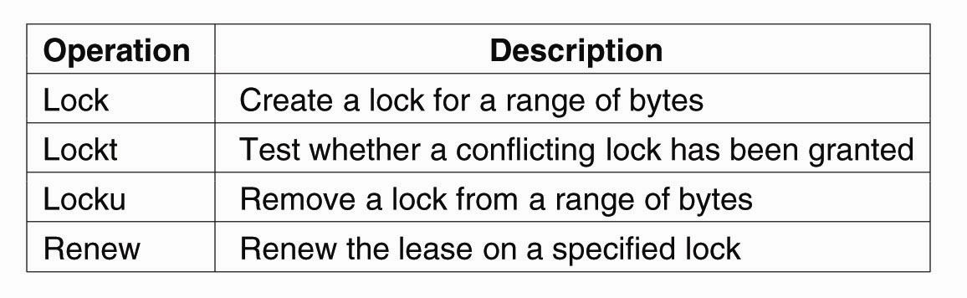
File Locking (1)
NFSv4 operations related to file locking
  Lease based

Slide 16
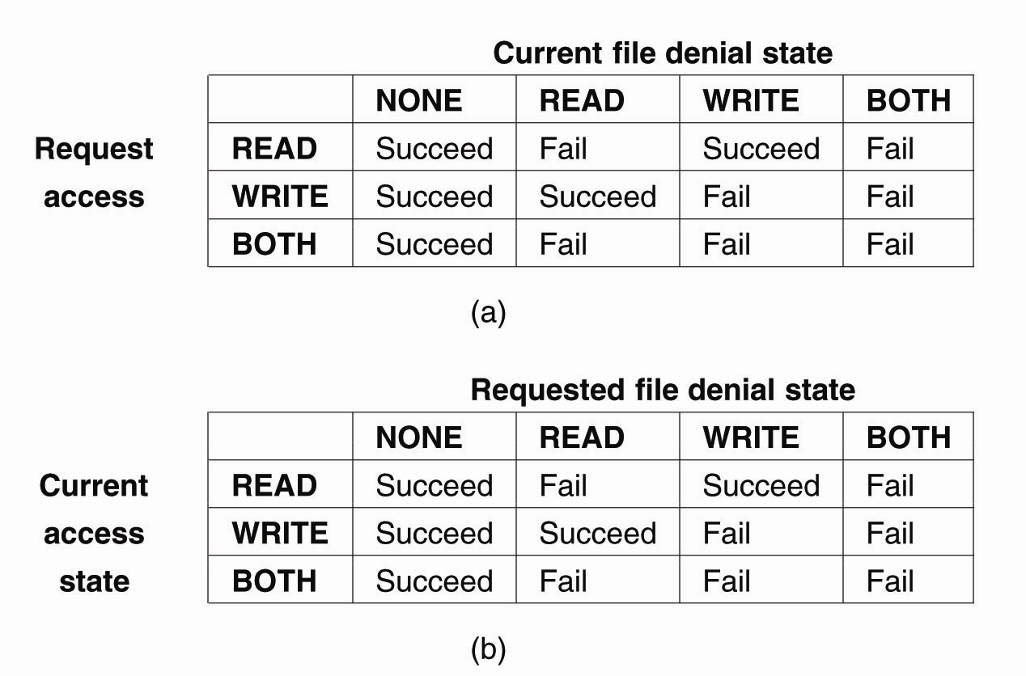
File Locking (2)
The result of an open operation with share reservations in NFS → When the client requests shared access given the current denial state.

Slide 17
File Locking (3)
The result of an open operation with share reservations in NFS → When the client requests a denial state given the current file access state.

Slide 18
Failure recovery
What if server fails?
  Lock holders are expected to re-establish the locks during the “grace period”, during which no other locks are granted
What if a client holding the lock fails?
What if network partition occurs?
NFS relies on “network status monitor” for server monitoring

Slide 19
Wrap up: Design Issues
Name space
Authentication
Caching
Consistency
Locking

Slide 20
AFS Retrospective
Small AFS installations are hard
  Step 1: Install Kerberos
    2-3 servers
    Inside locked boxes!
  Step 2: Install ~4 AFS servers (2 data, 2 pt/vldb)
  Step 3: Explain Kerberos to your users
    Ticket expiration!
  Step 4: Explain ACLs to your users

Slide 21
AFS Retrospective
Worldwide file system
Good security, scaling
Global namespace
“Professional” server infrastructure per cell
  Don't try this at home
  Only ~190 AFS cells (2002-03)
    8 are cmu.edu, 14 are in Pittsburgh
“No write conflict” model only partial success

Slide 22
Today's Lecture
DFS design comparisons continued
  Topic 4: file access consistency
    NFS, AFS, Sprite, and DCE DFS
  Topic 5: Locking
Other types of DFS
  Coda – disconnected operation
  LBFS – weakly connected operation

Slide 23
Background
We are back to 1990s.
Network is slow and not stable
Terminal → “powerful” client
  33MHz CPU, 16MB RAM, 100MB hard drive
Mobile Users appeared
  1st IBM Thinkpad in 1992
We can do work at client without network

Slide 24
CODA
Successor of the very successful Andrew File System (AFS)
AFS
  First DFS aimed at a campus-sized user community
  Key ideas include
    open-to-close consistency
    callbacks

Slide 25
Hardware Model
CODA and AFS assume that client workstations are personal computers controlled by their user/owner
  Fully autonomous
  Cannot be trusted
CODA allows owners of laptops to operate them in disconnected mode
  Opposite of ubiquitous connectivity

Slide 26
Accessibility
Must handle two types of failures
  Server failures:
    Data servers are replicated
  Communication failures and voluntary disconnections
    Coda uses optimistic replication and file hoarding

Slide 27
Design Rationale
Scalability
  Callback cache coherence (inherit from AFS)
  Whole file caching
  Fat clients. (security, integrity)
  Avoid system-wide rapid change
Portable workstations
  User’s assistance in cache management

Slide 28
Design Rationale –Replica Control
Pessimistic
  Disable all partitioned writes
  - Require a client to acquire control of a cached object prior to disconnection
Optimistic
  Assuming no others touching the file
  sophisticated: conflict detection
  + fact: low write-sharing in Unix
  + high availability: access anything in range

Slide 29
What about Consistency?
Pessimistic replication control protocols guarantee the consistency of replicated in the presence of any non-Byzantine failures
  Typically require a quorum of replicas to allow access to the replicated data
  Would not support disconnected mode

Slide 30
Pessimistic Replica Control
Would require client to acquire exclusive (RW) or shared (R) control of cached objects before accessing them in disconnected mode:
  Acceptable solution for voluntary disconnections
  Does not work for involuntary disconnections
What if the laptop remains disconnected for a long time?

Slide 31
Leases
We could grant exclusive/shared control of the cached objects for a limited amount of time
Works very well in connected mode
  Reduces server workload
  Server can keep leases in volatile storage as long as their duration is shorter than boot time
Would only work for very short disconnection periods

Slide 32
Optimistic Replica Control (I)
Optimistic replica control allows access in every disconnected mode
  Tolerates temporary inconsistencies
  Promises to detect them later
  Provides much higher data availability

Slide 33
Optimistic Replica Control (II)
Defines an accessible universe: set of replicas that the user can access
  Accessible universe varies over time
At any time, user
  Will read from the latest replica(s) in his accessible universe
  Will update all replicas in his accessible universe

Slide 34
Coda (Venus) States
Hoarding
Emulating
Recovering
Hoarding:
Normal operation mode
Emulating:
Disconnected operation mode
Reintegrating:
Propagates changes and detects inconsistencies

Slide 35
Hoarding
Hoard useful data for disconnection
Balance the needs of connected and disconnected operation.
  Cache size is restricted
  Unpredictable disconnections
Prioritized algorithm – cache manage
hoard walking – reevaluate objects

Slide 36
Prioritized algorithm
User defined hoard priority p: how interest it is?
Recent Usage q
Object priority = f(p,q)
Kick out the one with lowest priority
+ Fully tunable
  Everything can be customized
- Not tunable (?)
  No idea how to customize

Slide 37
Hoard Walking
Equilibrium – uncached obj < cached obj
  Why it may be broken? Cache size is limited.
Walking: restore equilibrium
  Reloading HDB (changed by others)
  Reevaluate priorities in HDB and cache
  Enhanced callback
Increase scalability, and availability
Decrease consistency

Slide 38
Emulation
In emulation mode:
  Attempts to access files that are not in the client caches appear as failures to application
  All changes are written in a persistent log,
  the client modification log (CML)
  Venus removes from log all obsolete entries like those pertaining to files that have been deleted

Slide 39
Persistence
Venus keeps its cache and related data structures in non-volatile storage
All Venus metadata are updated through
atomic transactions
  Using a lightweight recoverable virtual memory (RVM) developed for Coda
  Simplifies Venus design

Slide 40
Reintegration
When workstation gets reconnected, Coda initiates a reintegration process
  Performed one volume at a time
  Venus ships replay log to all volumes
  Each volume performs a log replay algorithm
Only care write/write confliction
  Succeed?
    Yes. Free logs, reset priority
    No. Save logs to a tar. Ask for help

Slide 41
Performance
Duration of Reintegration
  A few hours disconnection → 1 min
  But sometimes much longer
Cache size
  100MB at client is enough for a “typical” workday
Conflicts
  No Conflict at all! Why?
  Over 99% modification by the same person
  Two users modify the same obj within a day: <0.75%

Slide 42
Coda Summary
Puts scalability and availability before
data consistency
  Unlike NFS
Assumes that inconsistent updates are very infrequent
Introduced disconnected operation mode and file hoarding

Slide 43
Remember this slide?
We are back to 1990s.
Network is slow and not stable
Terminal → “powerful” client
  33MHz CPU, 16MB RAM, 100MB hard drive
Mobile Users appear
  1st IBM Thinkpad in 1992

Slide 44
What’s now?
We are in 2000s now.
Network is fast and reliable in LAN
“powerful” client → very powerful client
  2.4GHz CPU, 1GB RAM, 120GB hard drive
Mobile users everywhere
Do we still need disconnection?
  How many people are using coda?

Slide 45
Do we still need disconnection?
WAN and wireless is not very reliable, and is slow
PDA is not very powerful
  200MHz strongARM, 128M CF Card
  Electric power constrained
LBFS (MIT) on WAN, Coda and Odyssey (CMU) for mobile users
  Adaptation is also important

Slide 46
What is the future?
High bandwidth, reliable wireless everywhere
Even PDA is powerful
  2GHz, 1G RAM/Flash
What will be the research topic in FS?
  P2P?

Slide 47
Today's Lecture
DFS design comparisons continued
  Topic 4: file access consistency
    NFS, AFS, Sprite, and DCE DFS
  Topic 5: Locking
Other types of DFS
  Coda – disconnected operation
  LBFS – weakly connected operation

Slide 48
Low Bandwidth File System
Key Ideas
A network file systems for slow or wide-area networks
Exploits similarities between files or versions of the same file
  Avoids sending data that can be found in the server’s file system or the client’s cache
Also uses conventional compression and caching
Requires 90% less bandwidth than traditional network file systems

Slide 49
Working on slow networks
Make local copies
  Must worry about update conflicts
Use remote login
  Only for text-based applications
Use instead a LBFS
  Better than remote login
  Must deal with issues like auto-saves blocking the editor for the duration of transfer

Slide 50
LBFS design
Provides close-to-open consistency
Uses a large, persistent file cache at client
  Stores clients working set of files
LBFS server divides file it stores into chunks and indexes the chunks by hash value
Client similarly indexes its file cache
Exploits similarities between files
  LBFS never transfers chunks that the recipient already has

Slide 51
Indexing
Uses the SHA-1 algorithm for hashing
  It is collision resistant
Central challenge in indexing file chunks is keeping the index at a reasonable size while dealing with shifting offsets
  Indexing the hashes of fixed size data blocks
  Indexing the hashes of all overlapping blocks at all offsets

Slide 52
LBFS indexing solution
Considers only non-overlapping chunks
Sets chunk boundaries based on file contents rather than on position within a file
Examines every overlapping 48-byte region of file to select the boundary regions called breakpoints using Rabin fingerprints
  When low-order 13 bits of region’s fingerprint equals a chosen value, the region constitutes a breakpoint

Slide 53
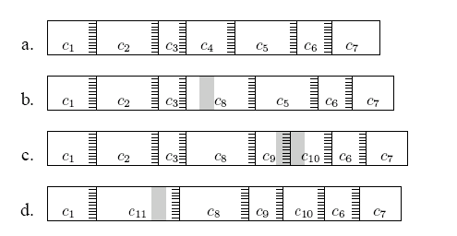
Effects of edits on file chunks
Chunks of file before/after edits
  Grey shading show edits
Stripes show 48byte regions with magic hash values creating chunk boundaries

Slide 54
More Indexing Issues
Pathological cases
  Very small chunks
    Sending hashes of chunks would consume as much bandwidth as just sending the file
  Very large chunks
    Cannot be sent in a single RPC
LBFS imposes minimum and maximum chuck sizes

Slide 55
The Chunk Database
Indexes each chunk by the first 64 bits of its SHA-1 hash
To avoid synchronization problems, LBFS always recomputes the SHA-1 hash of any data chunk before using it
  Simplifies crash recovery
Recomputed SHA-1 values are also used to detect hash collisions in the database

Slide 56
Conclusion
Under normal circumstances, LBFS consumes 90% less bandwidth than traditional file systems.
Makes transparent remote file access a viable and less frustrating alternative to running interactive programs on remote machines.

Slide 58
“File System Interfaces” vs.
“Block Level Interfaces”
Data are organized in files, which in turn are organized in directories
Compare these with disk-level access or “block” access interfaces: [Read/Write, LUN, block#]
Key differences:
  Implementation of the directory/file structure and semantics
  Synchronization (locking)

Slide 59
Digression:
“Network Attached Storage” vs. “Storage Area Networks”
 | NAS | SAN
Access Methods | File access | Disk block access
Access Medium | Ethernet | Fiber Channel and Ethernet
Transport Protocol | Layer over TCP/IP | SCSI/FC and SCSI/IP
Efficiency | Less | More
Sharing and Access Control | Good | Poor
Integrity demands | Strong | Very strong
Clients | Workstations | Database servers

Slide 60
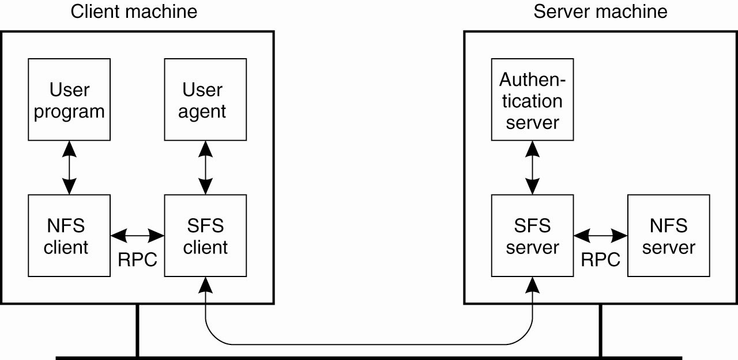
Decentralized Authentication (1)
Figure 11-31. The organization of SFS.

Slide 61
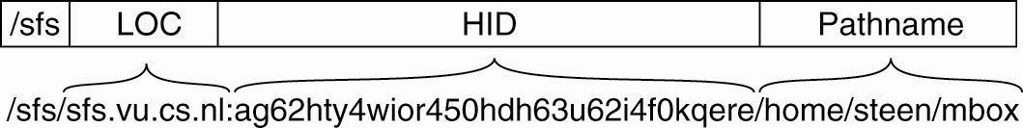
Decentralized Authentication (2)
Figure 11-32. A self-certifying pathname in SFS.

Slide 62
General Organization (II)
Clients view Coda as a single location-transparent shared Unix file system
  Complements local file system
Coda namespace is mapped to individual file servers at the granularity of subtrees called volumes
Each client has a cache manager (VICE)

Slide 63
General Organization (III)
High availability is achieved through
  Server replication:
    Set of replicas of a volume is VSG
    (Volume Storage Group)
    At any time, client can access AVSG (Available Volume Storage Group)
  Disconnected Operation:
    When AVSG is empty

Slide 65
Protocol
Based of NFS version 3
LBFS adds extensions
  Leases
  Compresses all RPC traffic using conventional gzip compression
  New NFS procedures
    GETHASH(fh, offset, count) – retrieve hashes of data chunks in a file
    MKTMPFILE(fd, fhandle) – create a temporary file for later use in atomic update
    TMPWRITE(fd,offset,count,data) – write to created temporary file
    CONDWRITE(fd,offset,count,sha_hash) – similar to TMPWRITE except SHA-1 hash of data
    COMMITTMP(fd,target_fhandle) – commits the contents of temporary file

Slide 66
File Consistency
LBFS client performs whole file caching
Uses a 3-tiered scheme to check file status
  Whenever a client makes any RPC on a file it gets back read lease on file
  When user opens file, if lease is valid and file version up to date then open succeeds with no message exchange with server
  When user opens file, if lease has expired, clients gets new lease & attributes from server.
  If modification time has not changed client uses version from cache else it gets new contents from the server
No need for write leases due to close-to-open consistency

Slide 67
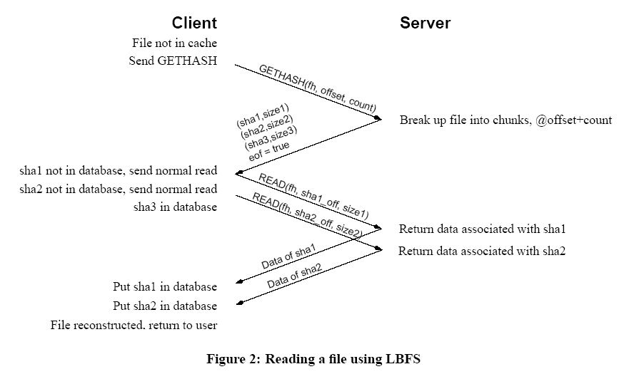
File read

Slide 68
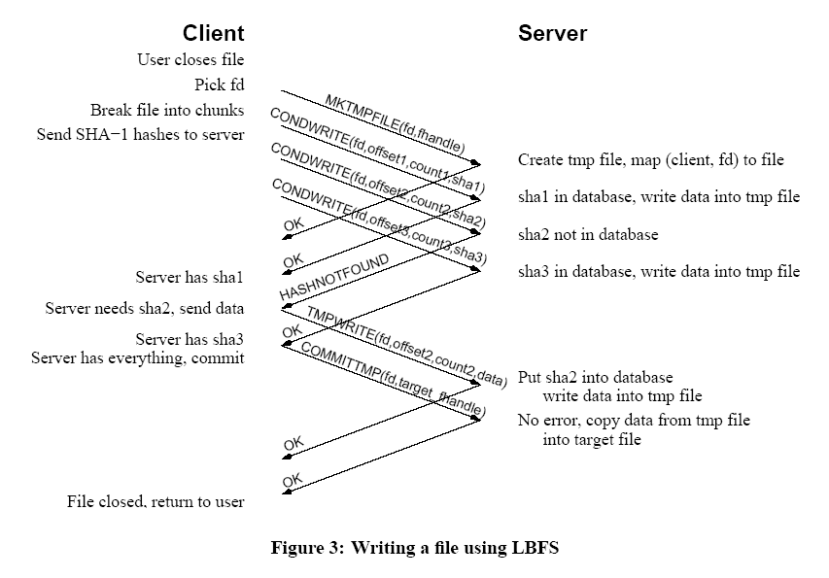
File write

Slide 69
Security Considerations
It uses the security infrastructure from SFS
Every server has public key and client specifies it on mounting the server.
Entire LBFS protocol is gzip compressed, tagged with a MAC and then encrypted
User can check whether the file system contains a particular hash of the chunk by observing server’s answer to CONDWRITE request at subtle timing differences

Slide 70
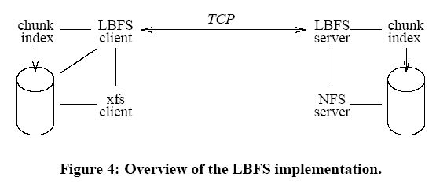
Implementation
Client and server run at user level
Client implements FS using xfs device driver
Server uses NFS to access files
Client-server communication done using RPC over TCP

Slide 71
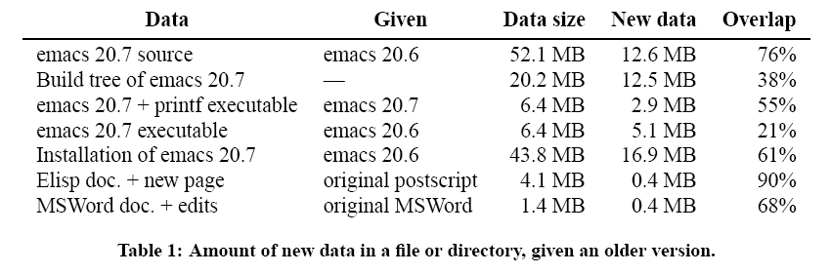
Evaluation: repeated data in files

Slide 72
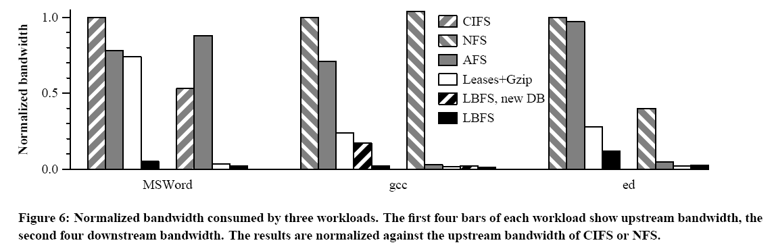
Evaluation (2) : bandwidth utilization

Slide 73
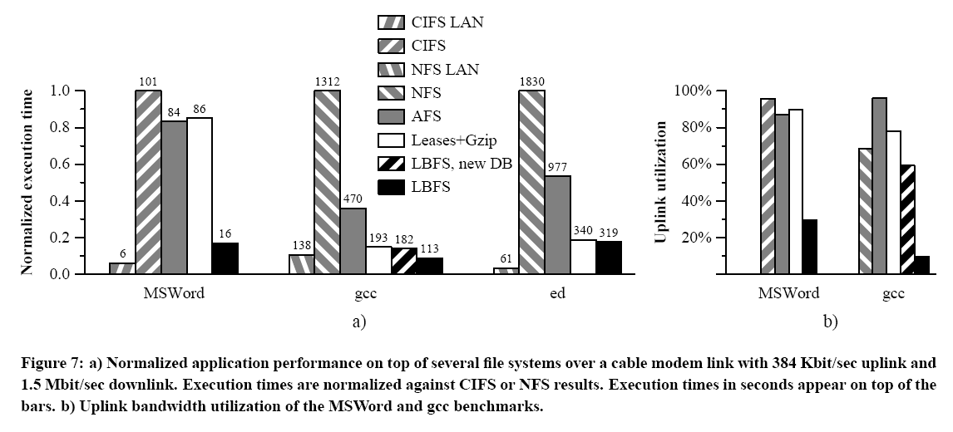
Evaluation (3) : application performance

Slide 74
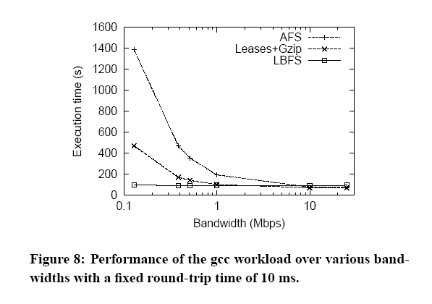
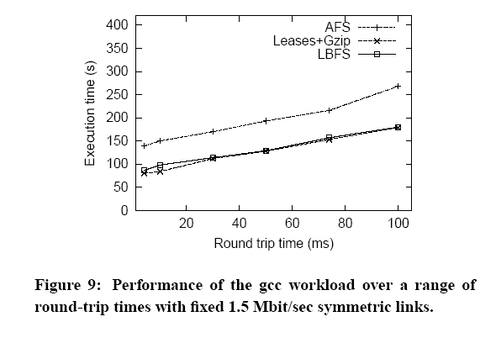
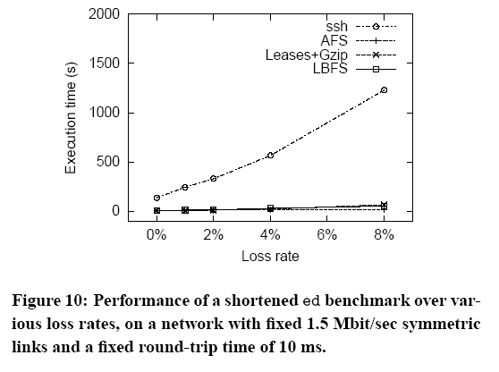
Evaluation (4)

Slide 75
Conclusion
LBFS is a network file system for low-bandwidth networks
Saves bandwidth by exploiting commonality between files
  Breaks files into variable sized chunks based on contents
  Indexes file chunks by their hash value
  Looks up chunks to reconstruct files that contain same data without sending that data over network
It consumes over an order of magnitude less bandwidth than traditional file systems
Can be used where other file systems cannot be used
makes remote file access a viable alternative to run interactive applications on remote machines

Slide 76
UNIX sharing semantics
Centralized UNIX file systems provide one-copy semantics
  Every modification to every byte of a file is immediately and permanently visible to all processes accessing the file
AFS uses a open-to-close semantics
Coda uses an even laxer model

Slide 77
Open-to-Close Semantics (I)
First version of AFS
  Revalidated cached file on each open
  Propagated modified files when they were closed
If two users on two different workstations modify the same file at the same time, the users closing the file last will overwrite the changes made by the other user

Slide 78
Open-to-Close Semantics (II)
Example:
First client
F’
F” overwrites F’
F
F’
F”
Time
F”
Second Client

Slide 79
Open to Close Semantics (III)
Whenever a client opens a file, it always gets the latest version of the file known to the server
Clients do not send any updates to the server until they close the file
As a result
  Server is not updated until file is closed
  Client is not updated until it reopens the file

Slide 80
Callbacks (I)
AFS-1 required each client to call the server every time it was opening an AFS file
  Most of these calls were unnecessary as user files are rarely shared
AFS-2 introduces the callback mechanism
  Do not call the server, it will call you!

Slide 81
Callbacks (II)
When a client opens an AFS file for the first time, server promises to notify it whenever it receives a new version of the file from any other client
  Promise is called a callback
Relieves the server from having to answer a call from the client every time the file is opened
  Significant reduction of server workload

Slide 82
Callbacks (III)
Callbacks can be lost!
  Client will call the server every tau minutes to check whether it received all callbacks it should have received
  Cached copy is only guaranteed to reflect the state of the server copy up to tau minutes before the time the client opened the file for the last time

Slide 83
Coda semantics
Client keeps track of subset s of servers it was able to connect the last time it tried
Updates s at least every tau seconds
At open time, client checks it has the most recent copy of file among all servers in s
  Guarantee weakened by use of callbacks
  Cached copy can be up to tau minutes behind the server copy

