Slide 1
15-446 Distributed Systems
Spring 2009
L-17 Distributed File Systems

Slide 2
Outline
Why Distributed File Systems?
Basic mechanisms for building DFSs
  Using NFS and AFS as examples
Design choices and their implications
  Naming
  Authentication and Access Control
  Caching
  Concurrency Control
  Locking

Slide 3
What Distributed File Systems Provide
Access to data stored at servers using file system interfaces
What are the file system interfaces?
  Open a file, check status of a file, close a file
  Read data from a file
  Write data to a file
  Lock a file or part of a file
  List files in a directory, create/delete a directory
  Delete a file, rename a file, add a symlink to a file
  etc

Slide 4
Why DFSs are Useful
Data sharing among multiple users
User mobility
Location transparency
Backups and centralized management

Slide 5
Outline
Why Distributed File Systems?
Basic mechanisms for building DFSs
  Using NFS and AFS as examples
Design choices and their implications
  Naming
  Authentication and Access Control
  Caching
  Concurrency Control
  Locking

Slide 6
Components in a DFS Implementation
Client side:
  What has to happen to enable applications to access a remote file the same way a local file is accessed?
  Accessing remote files in the same way as accessing local files → kernel support
Communication layer:
  Just TCP/IP or a protocol at a higher level of abstraction?
Server side:
  How are requests from clients serviced?

Slide 7
VFS interception
VFS provides “pluggable” file systems
Standard flow of remote access
  User process calls read()
  Kernel dispatches to VOP_READ() in some VFS
  nfs_read()
    check local cache
    send RPC to remote NFS server
    put process to sleep
  server interaction handled by kernel process
    retransmit if necessary
    convert RPC response to file system buffer
    store in local cache
    wake up user process
  nfs_read()
    copy bytes to user memory

Slide 8
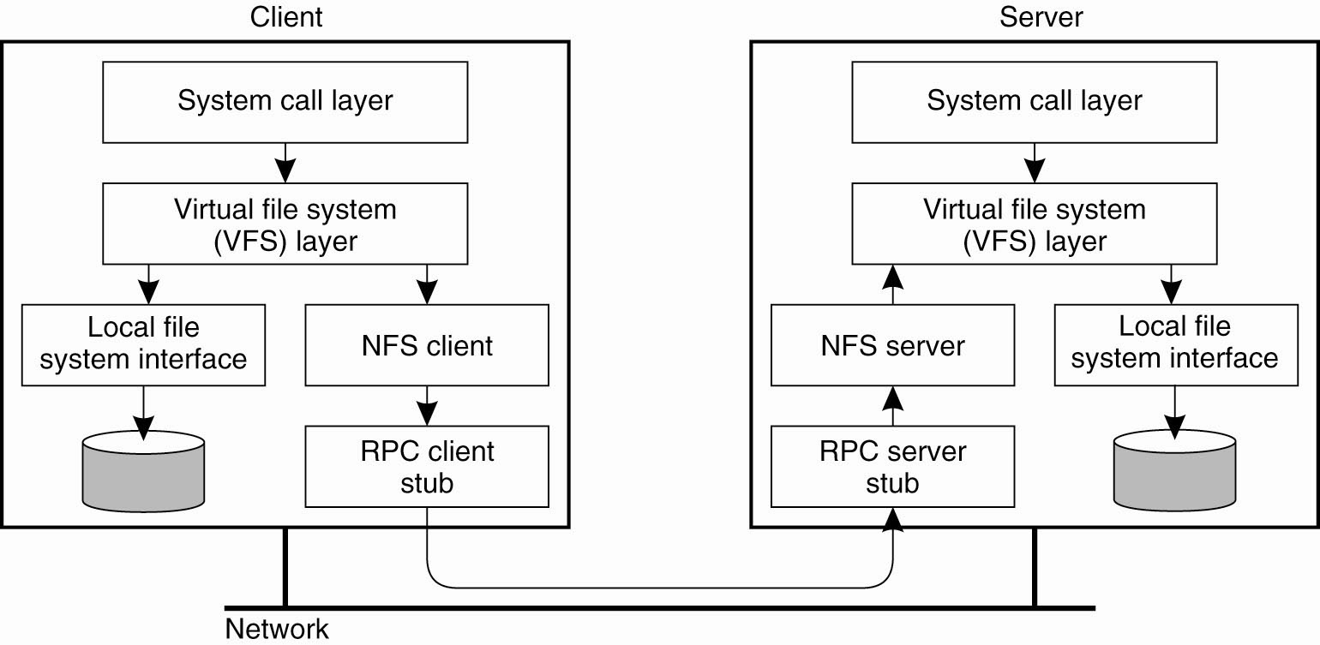
VFS Interception

Slide 9
Communication Layer Example:
Remote Procedure Calls (RPC)
RPC call
RPC reply
xid
“call”
service
version
procedure
auth-info
arguments
….
xid
“reply”
reply_stat
auth-info
results
…
Failure handling: timeout and re-issue

Slide 10
Extended Data Representation (XDR)
Argument data and response data in RPC are packaged in XDR format
  Integers are encoded in big-endian format
  Strings: len followed by ascii bytes with NULL padded to four-byte boundaries
  Arrays: 4-byte size followed by array entries
  Opaque: 4-byte len followed by binary data
Marshalling and un-marshalling data
Extra overhead in data conversion to/from XDR

Slide 11
Some NFS V2 RPC Calls
NFS RPCs using XDR over, e.g., TCP/IP
fhandle: 32-byte opaque data (64-byte in v3)
Proc. | Input args | Results
LOOKUP | dirfh, name | status, fhandle, fattr
READ | fhandle, offset, count | status, fattr, data
CREATE | dirfh, name, fattr | status, fhandle, fattr
WRITE | fhandle, offset, count, data | status, fattr

Slide 12
Server Side Example: mountd and nfsd
mountd: provides the initial file handle for the exported directory
  Client issues nfs_mount request to mountd
  mountd checks if the pathname is a directory and if the directory should be exported to the client
nfsd: answers the RPC calls, gets reply from local file system, and sends reply via RPC
  Usually listening at port 2049
Both mountd and nfsd use underlying RPC implementation

Slide 13
NFS V2 Design
“Dumb”, “Stateless” servers
Smart clients
Portable across different OSs
Immediate commitment and idempotency of operations
Low implementation cost
Small number of clients
Single administrative domain

Slide 14
Stateless File Server?
Statelessness
  Files are state, but...
  Server exports files without creating extra state
    No list of “who has this file open” (permission check on each operation on open file!)
    No “pending transactions” across crash
Results
  Crash recovery is “fast”
    Reboot, let clients figure out what happened
  Protocol is “simple”
State stashed elsewhere
  Separate MOUNT protocol
  Separate NLM locking protocol

Slide 15
NFS V2 Operations
V2:
  NULL, GETATTR, SETATTR
  LOOKUP, READLINK, READ
  CREATE, WRITE, REMOVE, RENAME
  LINK, SYMLINK
  READIR, MKDIR, RMDIR
  STATFS (get file system attributes)
Notes:
STATFS: attributes like block size, total # blocks, #free blocks, optimal transfer size

Slide 16
NFS V3 and V4 Operations
V3 added:
  READDIRPLUS, COMMIT (server cache!)
  FSSTAT, FSINFO, PATHCONF
V4 added:
  COMPOUND (bundle operations)
  LOCK (server becomes more stateful!)
  PUTROOTFH, PUTPUBFH (no separate MOUNT)
  Better security and authentication
  Very different than V2/V3 → stateful
Notes:
V2:
use separate NLM lock manager protocol and MOUNT protocol
Older MOUNT protocol: mapped path names to file handles; not part of NFS. Used to get first file handle
Technically, MOUNT table makes server stateful, but doesn’t really have to be maintained once file handle is given out. Just let’s server inform client when it goes down
PATHCONF: retrieve POSIX information; formerly sometimes could be done with MOUNT protocol; now part of NFS
FSTAT: retrieve volatile info about file system, e.g., # free bytes
FSINFO: retrieve non-volatile info about file system, e.g., preferred/maximum read/write transfer sizes
V3:
COMMIT: server can now cache data – COMMIT writes to disk
COMPOUND: bundling of several operations; attempt each in sequence, return failure as soon as one fails; not atomic
LOCK: byte-range locking now part of the protocol (server becomes stateful!)
PUTROOTFH, GETROOTFH: no longer need to use separate MOUNT protocol
PUTROOTFH sets current filehandle to root of server’s file tree

Slide 17
Operator Batching
Should each client/server interaction accomplish one file system operation or multiple operations?
  Advantage of batched operations?
  How to define batched operations
Examples of Batched Operators
  NFS v3:
    READDIRPLUS
  NFS v4:
    COMPOUND RPC calls

Slide 18
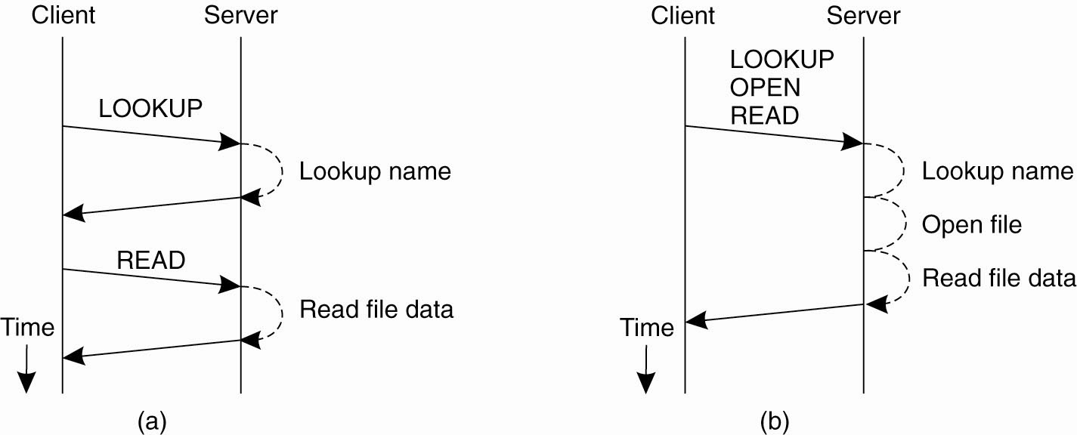
Remote Procedure Calls in NFS
(a) Reading data from a file in NFS version 3
(b) Reading data using a compound procedure in version 4.

Slide 19
AFS Goals
Global distributed file system
  “One AFS”, like “one Internet”
    Why would you want more than one?
LARGE numbers of clients, servers
  1000 machines could cache a single file,
  some local, some (very) remote
Goal: O(0) work per client operation
  O(1) may just be too expensive!

Slide 20
AFS Assumptions
Client machines are un-trusted
  Must prove they act for a specific user
    Secure RPC layer
  Anonymous “system:anyuser”
Client machines have disks(!!)
  Can cache whole files over long periods
Write/write and write/read sharing are rare
  Most files updated by one user, on one machine

Slide 21
AFS Cell/Volume Architecture
Cells correspond to administrative groups
  /afs/andrew.cmu.edu is a cell
Client machine has cell-server database
  protection server handles authentication
  volume location server maps volumes to servers
Cells are broken into volumes (miniature file systems)
  One user's files, project source tree, ...
  Typically stored on one server
  Unit of disk quota administration, backup

Slide 22
Outline
Why Distributed File Systems?
Basic mechanisms for building DFSs
  Using NFS and AFS as examples
Design choices and their implications
  Naming
  Authentication and Access Control
  Caching
  Concurrency Control
  Locking

Slide 23
Topic 1: Name-Space Construction and Organization
NFS: per-client linkage
  Server: export /root/fs1/
  Client: mount server:/root/fs1 /fs1 → fhandle
AFS: global name space
  Name space is organized into Volumes
    Global directory /afs;
    /afs/cs.wisc.edu/vol1/…; /afs/cs.stanford.edu/vol1/…
  Each file is identified as fid = <vol_id, vnode #, uniquifier>
  All AFS servers keep a copy of “volume location database”, which is a table of vol_id→ server_ip mappings
Notes:
Vol_id identifies a vol of files stored on a single server
Vnode # provides and index into an array on the server; the array entry contains information about how to access the files
Uniquifier ensures that no fid-triplet is ever used more than once in the history of the file system; this allows vnode #’s to be reused

Slide 24
Implications on Location Transparency
NFS: no transparency
  If a directory is moved from one server to another, client must remount
AFS: transparency
  If a volume is moved from one server to another, only the volume location database on the servers needs to be updated

Slide 25
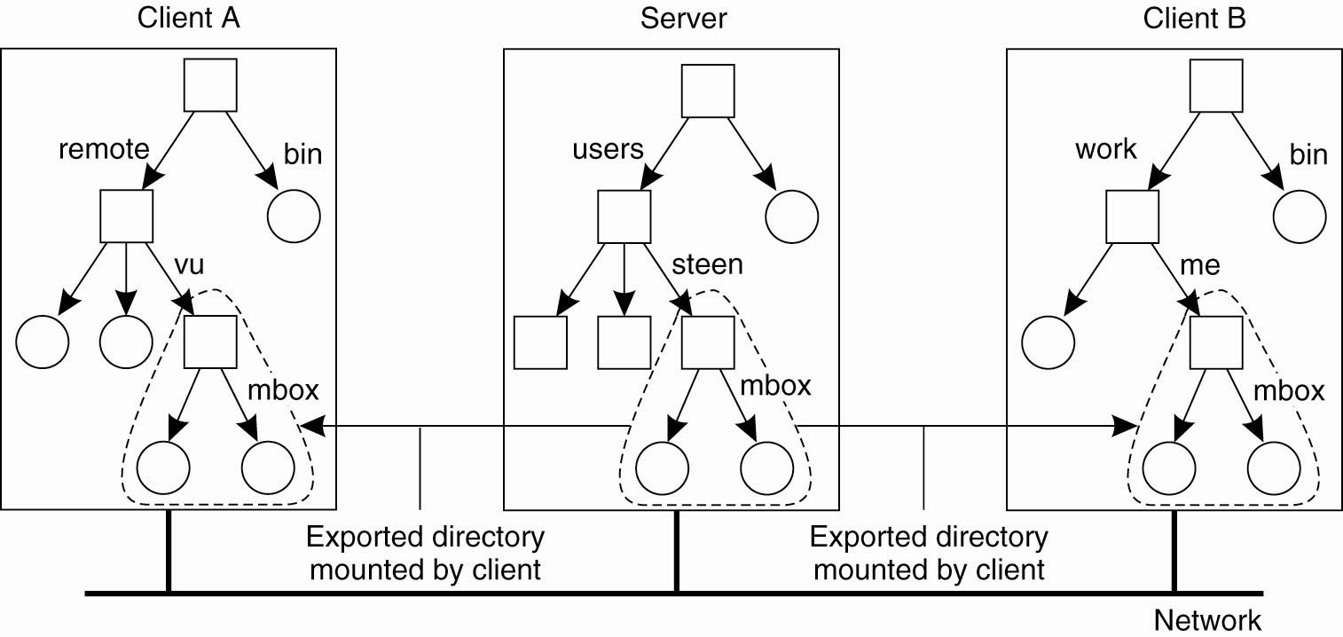
Naming in NFS (1)
Figure 11-11. Mounting (part of) a remote file system in NFS.

Slide 26
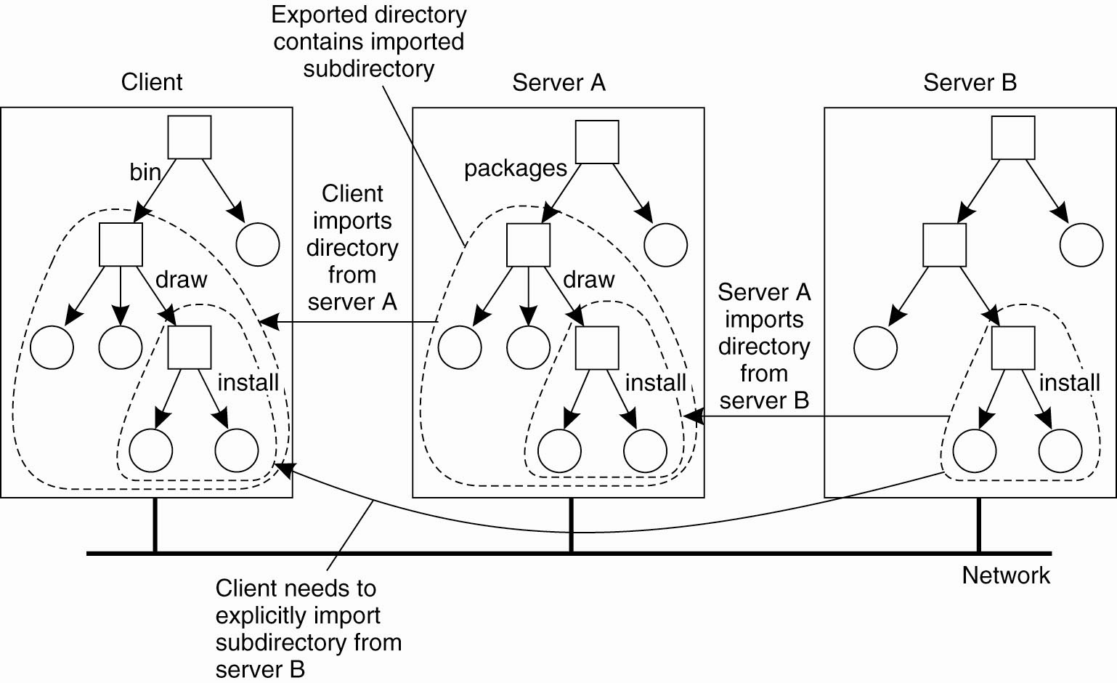
Naming in NFS (2)

Slide 27
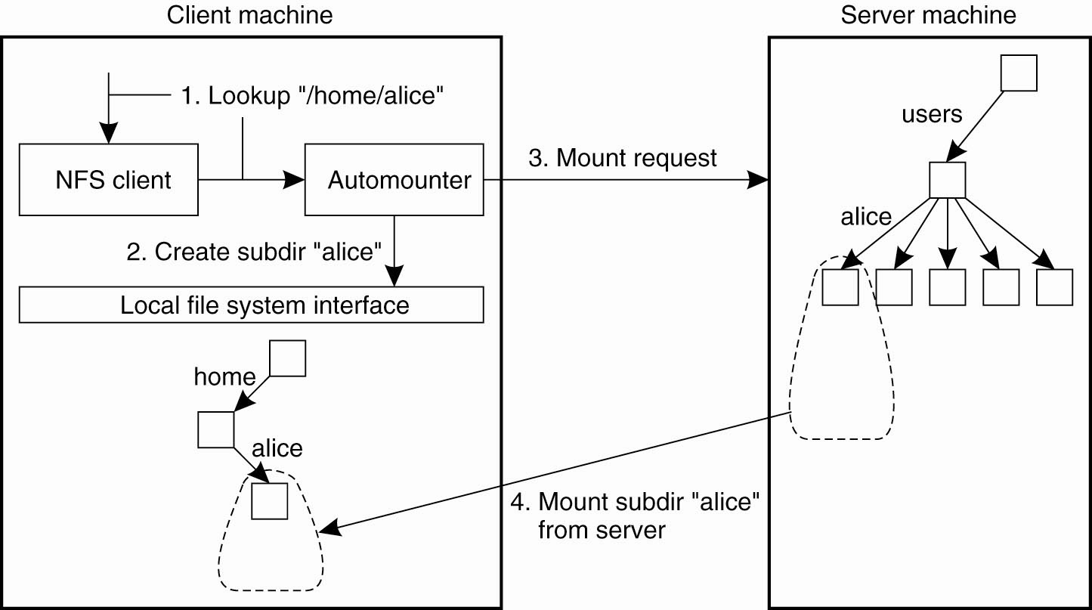
Automounting (1)
A simple automounter for NFS.

Slide 28
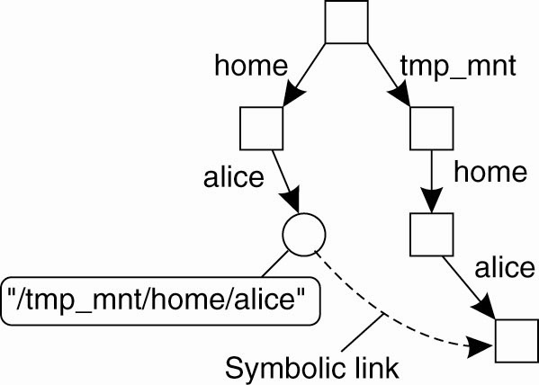
Automounting (2)
Using symbolic links with automounting.

Slide 29
Topic 2: User Authentication and Access Control
User X logs onto workstation A, wants to access files on server B
  How does A tell B who X is?
  Should B believe A?
Choices made in NFS V2
  All servers and all client workstations share the same <uid, gid> name space → B send X’s <uid,gid> to A
    Problem: root access on any client workstation can lead to creation of users of arbitrary <uid, gid>
  Server believes client workstation unconditionally
    Problem: if any client workstation is broken into, the protection of data on the server is lost;
    <uid, gid> sent in clear-text over wire → request packets can be faked easily

Slide 30
User Authentication (cont’d)
How do we fix the problems in NFS v2
  Hack 1: root remapping → strange behavior
  Hack 2: UID remapping → no user mobility
  Real Solution: use a centralized Authentication/Authorization/Access-control (AAA) system

Slide 31
A Better AAA System: Kerberos
Basic idea: shared secrets
  User proves to KDC who he is; KDC generates shared secret between client and file server
KDC
ticket server
generates S
“Need to access fs”
K_{client}[S]
file server
K_{fs}[S]
encrypt S with
client’s key
client
S: specific to {client,fs} pair;
“short-term session-key”; expiration time (e.g. 8 hours)
Notes:
K_{client}[S] means encrypt S using client’s private key

Slide 32
Kerberos Interactions
KDC
“Need to access fs”
ticket server
generates S
1.
K_{client}[S], ticket = K_{fs}[use S for client]
client
ticket=K_{fs}[use S for client], S{client, time}
2.
S{time}
client
file server
Why “time”?: guard against replay attack
mutual authentication
File server doesn’t store S, which is specific to {client, fs}
Client doesn’t contact “ticket server” every time it contacts fs

Slide 33
AFS Security (Kerberos)
Kerberos has multiple administrative domains (realms)
  principal@realm
  srini@cs.cmu.edu sseshan@andrew.cmu.edu
Client machine presents Kerberos ticket
  Arbitrary binding of (user,machine) to Kerberos (principal,realm)
    dongsuh on grad.pc.cs.cmu.edu machine can be srini@cs.cmu.edu
Server checks against access control list (ACL)
Notes:
Cell is an AFS (not Kerberos) administrative domain
Realm is a set of managed host nodes sharing the same kerberos database, e.g., cs.cmu.edu
Principal is a user or service known to Kerberos
Principal can be qualified by instance, e.g., bmm.mail

Slide 34
AFS ACLs
Apply to directory, not to file
Format:
  sseshan rlidwka
  srini@cs.cmu.edu rl
  sseshan:friends rl
Default realm is typically the cell name (here andrew.cmu.edu)
Negative rights
  Disallow “joe rl” even though joe is in sseshan:friends
Notes:
ACLs apply to directories
“Makes sense” if files will inherit from directories
Not always true
Confuses users
Directories inherit ACLs
Easy to expose a whole tree accidentally
What else to do?
No good solution known
DFS horror

Slide 35
Topic 3: Client-Side Caching
Why is client-side caching necessary?
What is cached
  Read-only file data and directory data → easy
  Data written by the client machine → when is data written to the server? What happens if the client machine goes down?
  Data that is written by other machines → how to know that the data has changed? How to ensure data consistency?
  Is there any pre-fetching?

Slide 36
Client Caching in NFS v2
Cache both clean and dirty file data and file attributes
File attributes in the client cache expire after 60 seconds (file data doesn’t expire)
File data is checked against the modified-time in file attributes (which could be a cached copy)
  Changes made on one machine can take up to 60 seconds to be reflected on another machine
Dirty data are buffered on the client machine until file close or up to 30 seconds
  If the machine crashes before then, the changes are lost
  Similar to UNIX FFS local file system behavior

Slide 37
Implication of NFS v2 Client Caching
Data consistency guarantee is very poor
  Simply unacceptable for some distributed applications
  Productivity apps tend to tolerate such loose consistency
Different client implementations implement the “prefetching” part differently
Generally clients do not cache data on local disks

Slide 38
Client Caching in AFS v2
Client caches both clean and dirty file data and attributes
  The client machine uses local disks to cache data
  When a file is opened for read, the whole file is fetched and cached on disk
    Why? What’s the disadvantage of doing so?
However, when a client caches file data, it obtains a “callback” on the file
In case another client writes to the file, the server “breaks” the callback
  Similar to invalidations in distributed shared memory implementations
Implication: file server must keep state!

Slide 39
AFS v2 RPC Procedures
Procedures that are not in NFS
  Fetch: return status and optionally data of a file or directory, and place a callback on it
  RemoveCallBack: specify a file that the client has flushed from the local machine
  BreakCallBack: from server to client, revoke the callback on a file or directory
    What should the client do if a callback is revoked?
  Store: store the status and optionally data of a file
Rest are similar to NFS calls

Slide 40
Failure Recovery in AFS v2
What if the file server fails?
What if the client fails?
What if both the server and the client fail?
Network partition
  How to detect it? How to recover from it?
  Is there anyway to ensure absolute consistency in the presence of network partition?
    Reads
    Writes
What if all three fail: network partition, server, client?

Slide 41
Key to Simple Failure Recovery
Try not to keep any state on the server
If you must keep some state on the server
  Understand why and what state the server is keeping
  Understand the worst case scenario of no state on the server and see if there are still ways to meet the correctness goals
  Revert to this worst case in each combination of failure cases

Slide 42
Topic 4: File Access Consistency
In UNIX local file system, concurrent file reads and writes have “sequential” consistency semantics
  Each file read/write from user-level app is an atomic operation
    The kernel locks the file vnode
  Each file write is immediately visible to all file readers
Neither NFS nor AFS provides such concurrency control
  NFS: “sometime within 30 seconds”
  AFS: session semantics for consistency

Slide 43
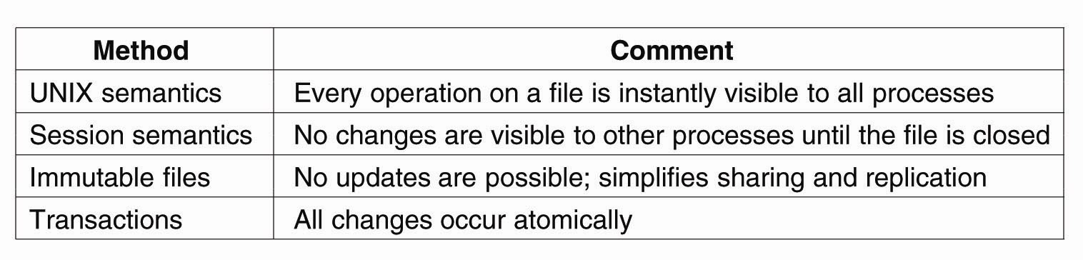
Semantics of File Sharing
Four ways of dealing with the shared files in a distributed system.

Slide 44
Session Semantics in AFS v2
What it means:
  A file write is visible to processes on the same box immediately, but not visible to processes on other machines until the file is closed
  When a file is closed, changes are visible to new opens, but are not visible to “old” opens
  All other file operations are visible everywhere immediately
Implementation
  Dirty data are buffered at the client machine until file close, then flushed back to server, which leads the server to send “break callback” to other clients
Notes:
Chunk-based I/O
No real consistency guarantees
close() failures surprising to many Unix programs
...and to early Linux kernels!

Slide 45
AFS Write Policy
Data transfer is by chunks
  Minimally 64 KB
  May be whole-file
Writeback cache
  Opposite of NFS “every write is sacred”
  Store chunk back to server
    When cache overflows
    On last user close()
  ...or don't (if client machine crashes)
Is writeback crazy?
  Write conflicts “assumed rare”
  Who wants to see a half-written file?

Slide 46
Access Consistency in the “Sprite” File System
Sprite: a research file system developed in UC Berkeley in late 80’s
Implements “sequential” consistency
  Caches only file data, not file metadata
  When server detects a file is open on multiple machines but is written by some client, client caching of the file is disabled; all reads and writes go through the server
  “Write-back” policy otherwise
    Why?

Slide 47
Implementing Sequential Consistency
How to identify out-of-date data blocks
  Use file version number
  No invalidation
  No issue with network partition
How to get the latest data when read-write sharing occurs
  Server keeps track of last writer

Slide 48
Implication of “Sprite” Caching
Server must keep states!
  Recovery from power failure
  Server failure doesn’t impact consistency
  Network failure doesn’t impact consistency
Price of sequential consistency: no client caching of file metadata; all file opens go through server
  Performance impact
  Suited for wide-area network?

Slide 49
“Tokens” in DCE DFS
How does one implement sequential consistency in a file system that spans multiple sites over WAN
Callbacks are evolved into 4 kinds of “Tokens”
  Open tokens: allow holder to open a file; submodes: read, write, execute, exclusive-write
  Data tokens: apply to a range of bytes
    “read” token: cached data are valid
    “write” token: can write to data and keep dirty data at client
  Status tokens: provide guarantee of file attributes
    “read” status token: cached attribute is valid
    “write” status token: can change the attribute and keep the change at the client
  Lock tokens: allow holder to lock byte ranges in the file

Slide 50
Compatibility Rules for Tokens
Open tokens:
  Open for exclusive writes are incompatible with any other open, and “open for execute” are incompatible with “open for write”
  But “open for write” can be compatible with “open for write” --- why?
Data tokens: R/W and W/W are incompatible if the byte range overlaps
Status tokens: R/W and W/W are incompatible
Data token and status token: compatible or incompatible?

Slide 51
Token Manager
Resolve conflicts: block the new requester and send notification to other clients’ tokens
Handle operations that request multiple tokens
  Example: rename
  How to avoid deadlocks

Slide 52
Topic 5: File Locking for Concurrency Control
Issues
  Whole file locking or byte-range locking
  Mandatory or advisory
    UNIX: advisory
    Windows: if a lock is granted, it’s mandatory on all other accesses
NFS: network lock manager (NLM)
  NLM is not part of NFS v2, because NLM is stateful
  Provides both whole file and byte-range locking
  Advisory
  Relies on “network status monitor” for server monitoring

Slide 53
Issues in Locking Implementations
Failure recovery
  What if server fails?
    Lock holders are expected to re-establish the locks during the “grace period”, during which no other locks are granted
  What if a client holding the lock fails?
  What if network partition occurs?

Slide 54
Wrap up: Design Issues
Name space
Authentication
Caching
Consistency
Locking

Slide 55
AFS Retrospective
Small AFS installations are hard
  Step 1: Install Kerberos
    2-3 servers
    Inside locked boxes!
  Step 2: Install ~4 AFS servers (2 data, 2 pt/vldb)
  Step 3: Explain Kerberos to your users
    Ticket expiration!
  Step 4: Explain ACLs to your users

Slide 56
AFS Retrospective
Worldwide file system
Good security, scaling
Global namespace
“Professional” server infrastructure per cell
  Don't try this at home
  Only ~190 AFS cells (2002-03)
    8 are cmu.edu, 14 are in Pittsburgh
“No write conflict” model only partial success

Slide 58
Failure Recovery in Token Manager
What if the server fails?
What if a client fails?
What if network partition happens?

Slide 59

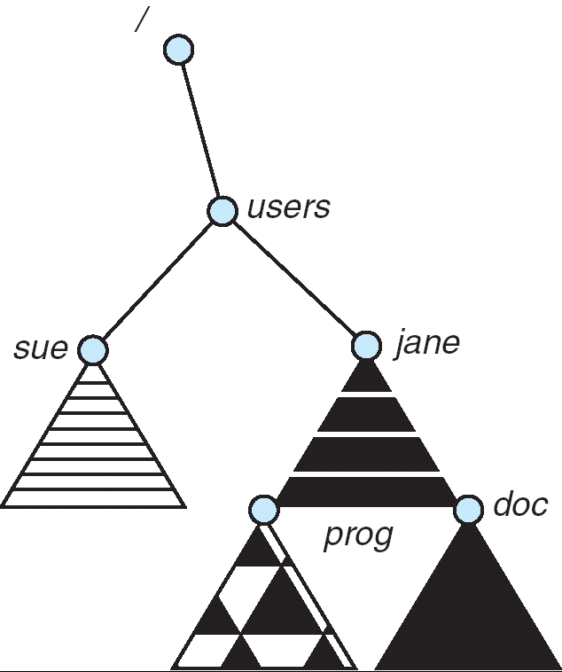
Distributed File Systems
Read File
Network
Data
Client
Server
Distributed File System:
  Transparent access to files stored on a remote disk
Naming choices (always an issue):
  Hostname:localname: Name files explicitly
    No location or migration transparency
  Mounting of remote file systems
    System manager mounts remote file system
    by giving name and local mount point
    Transparent to user: all reads and writes
    look like local reads and writes to user
    e.g. /users/sue/foo→/sue/foo on server
  A single, global name space: every file
  in the world has unique name
    Location Transparency: servers
    can change and files can move
    without involving user
mount
kubi:/jane
mount
coeus:/sue
mount
kubi:/prog

Slide 60
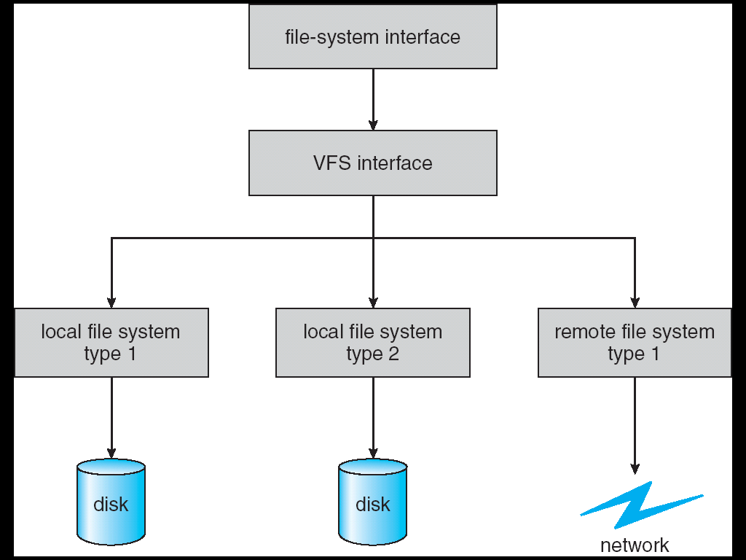
Virtual File System (VFS)
VFS: Virtual abstraction similar to local file system
  Instead of “inodes” has “vnodes”
  Compatible with a variety of local and remote file systems
    provides object-oriented way of implementing file systems
VFS allows the same system call interface (the API) to be used for different types of file systems
  The API is to the VFS interface, rather than any specific type of file system

Slide 61
Simple Distributed File System
Read (RPC)
Return (Data)
Client
Write (RPC)
Server
cache
ACK
Client
Remote Disk: Reads and writes forwarded to server
  Use RPC to translate file system calls
  No local caching/can be caching at server-side
Advantage: Server provides completely consistent view of file system to multiple clients
Problems? Performance!
  Going over network is slower than going to local memory
  Lots of network traffic/not well pipelined
  Server can be a bottleneck

Slide 62
Use of caching to reduce network load
Crash!
Crash!
read(f1)
→V1
cache
Read (RPC)
read(f1)→V1
read(f1)→V1
F1:V1
Return (Data)
read(f1)→V1
Client
Write (RPC)
Server
cache
F1:V1
F1:V2
ACK
cache
write(f1)
→OK
F1:V2
read(f1)→V2
Client
Idea: Use caching to reduce network load
  In practice: use buffer cache at source and destination
Advantage: if open/read/write/close can be done locally, don’t need to do any network traffic…fast!
Problems:
  Failure:
    Client caches have data not committed at server
  Cache consistency!
    Client caches not consistent with server/each other

Slide 63
Failures
Crash!
What if server crashes? Can client wait until server comes back up and continue as before?
  Any data in server memory but not on disk can be lost
  Shared state across RPC: What if server crashes after seek? Then, when client does “read”, it will fail
  Message retries: suppose server crashes after it does UNIX “rm foo”, but before acknowledgment?
    Message system will retry: send it again
    How does it know not to delete it again? (could solve with two-phase commit protocol, but NFS takes a more ad hoc approach)
Stateless protocol: A protocol in which all information required to process a request is passed with request
  Server keeps no state about client, except as hints to help improve performance (e.g. a cache)
  Thus, if server crashes and restarted, requests can continue where left off (in many cases)
What if client crashes?
  Might lose modified data in client cache

Slide 64
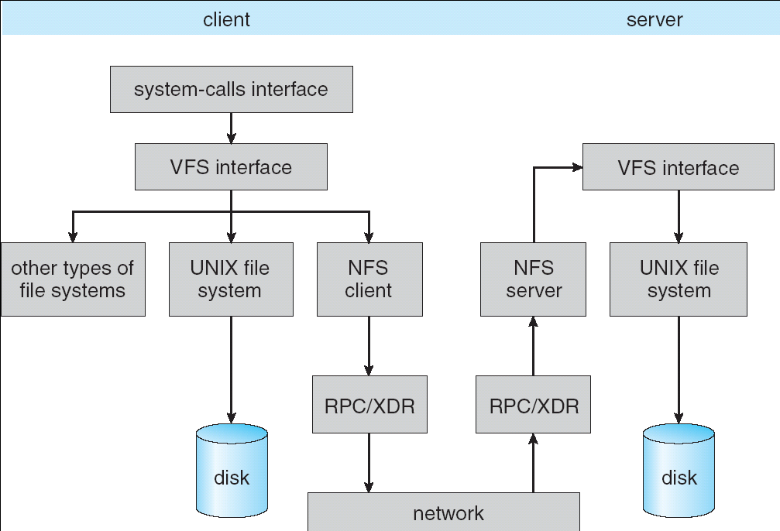
Schematic View of NFS Architecture

Slide 65
Network File System (NFS)
Three Layers for NFS system
  UNIX file-system interface: open, read, write, close calls + file descriptors
  VFS layer: distinguishes local from remote files
    Calls the NFS protocol procedures for remote requests
  NFS service layer: bottom layer of the architecture
    Implements the NFS protocol
NFS Protocol: RPC for file operations on server
  Reading/searching a directory
  manipulating links and directories
  accessing file attributes/reading and writing files
Write-through caching: Modified data committed to server’s disk before results are returned to the client
  lose some of the advantages of caching
  time to perform write() can be long
  Need some mechanism for readers to eventually notice changes! (more on this later)

Slide 66
NFS Continued
NFS servers are stateless; each request provides all arguments require for execution
  E.g. reads include information for entire operation, such as ReadAt(inumber,position), not Read(openfile)
  No need to perform network open() or close() on file – each operation stands on its own
Idempotent: Performing requests multiple times has same effect as performing it exactly once
  Example: Server crashes between disk I/O and message send, client resend read, server does operation again
  Example: Read and write file blocks: just re-read or re-write file block – no side effects
  Example: What about “remove”? NFS does operation twice and second time returns an advisory error
Failure Model: Transparent to client system
  Is this a good idea? What if you are in the middle of reading a file and server crashes?
  Options (NFS Provides both):
    Hang until server comes back up (next week?)
    Return an error. (Of course, most applications don’t know they are talking over network)

Slide 67
NFS Cache consistency
NFS protocol: weak consistency
  Client polls server periodically to check for changes
    Polls server if data hasn’t been checked in last 3-30 seconds (exact timeout it tunable parameter).
    Thus, when file is changed on one client, server is notified, but other clients use old version of file until timeout.
  What if multiple clients write to same file?
    In NFS, can get either version (or parts of both)
    Completely arbitrary!
cache
F1 still ok?
F1:V2
F1:V1
No: (F1:V2)
Client
Write (RPC)
Server
cache
F1:V2
ACK
cache
F1:V2
Client

Slide 68
Sequential Ordering Constraints
What sort of cache coherence might we expect?
  i.e. what if one CPU changes file, and before it’s done, another CPU reads file?
Example: Start with file contents = “A”
What would we actually want?
  Assume we want distributed system to behave exactly the same as if all processes are running on single system
    If read finishes before write starts, get old copy
    If read starts after write finishes, get new copy
    Otherwise, get either new or old copy
  For NFS:
    If read starts more than 30 seconds after write, get new copy; otherwise, could get partial update
Client 1:
Read: gets A
Write B
Read: parts of B or C
Client 2:
Read: gets A or B
Write C
Client 3:
Read: parts of B or C
Time

Slide 69
NFS Pros and Cons
NFS Pros:
  Simple, Highly portable
NFS Cons:
  Sometimes inconsistent!
  Doesn’t scale to large # clients
    Must keep checking to see if caches out of date
    Server becomes bottleneck due to polling traffic

Slide 70
Andrew File System
Andrew File System (AFS, late 80’s) → DCE DFS (commercial product)
Callbacks: Server records who has copy of file
  On changes, server immediately tells all with old copy
  No polling bandwidth (continuous checking) needed
Write through on close
  Changes not propagated to server until close()
  Session semantics: updates visible to other clients only after the file is closed
    As a result, do not get partial writes: all or nothing!
    Although, for processes on local machine, updates visible immediately to other programs who have file open
In AFS, everyone who has file open sees old version
  Don’t get newer versions until reopen file

Slide 71
Andrew File System (con’t)
Data cached on local disk of client as well as memory
  On open with a cache miss (file not on local disk):
    Get file from server, set up callback with server
  On write followed by close:
    Send copy to server; tells all clients with copies to fetch new version from server on next open (using callbacks)
What if server crashes? Lose all callback state!
  Reconstruct callback information from client: go ask everyone “who has which files cached?”
AFS Pro: Relative to NFS, less server load:
  Disk as cache ⇒ more files can be cached locally
  Callbacks ⇒ server not involved if file is read-only
For both AFS and NFS: central server is bottleneck!
  Performance: all writes→server, cache misses→server
  Availability: Server is single point of failure
  Cost: server machine’s high cost relative to workstation

Slide 72
Conclusion (2)
VFS: Virtual File System layer
  Provides mechanism which gives same system call interface for different types of file systems
Distributed File System:
  Transparent access to files stored on a remote disk
    NFS: Network File System
    AFS: Andrew File System
  Caching for performance
Cache Consistency: Keeping contents of client caches consistent with one another
  If multiple clients, some reading and some writing, how do stale cached copies get updated?
  NFS: check periodically for changes
  AFS: clients register callbacks so can be notified by server of changes

Slide 73
Example AAA System: NTLM
Microsoft Windows Domain Controller
  Centralized AAA server
  NTLM v2: per-connection authentication
Domain Controller
1
2
3
4
6
7
client
5
file server

