Slide 1
15-446 Distributed Systems
Spring 2009
L-14 Security

Slide 2
Important Lessons - Security
Internet design and growth → security challenges
Symmetric (pre-shared key, fast) and asymmetric (key pairs, slow) primitives provide:
    Confidentiality
    Integrity
    Authentication
“Hybrid Encryption” leverages strengths of both.
Great complexity exists in securely acquiring keys.
Crypto is hard to get right, so use tools from others, don’t design your own (e.g. TLS).

Slide 3
Today's Lecture
Access Control
Identity and Trust
Project 2

Slide 4
Security Threats, Policies, and Mechanisms
Security implies dependability, confidentiality, and integrity.
Types of security threats to consider:
  Interception – an unauthorized party gains access to data or service
  Interruption – situation where data or service becomes unavailable
  Modification – unauthorized changing of data or tampering with a service so that it no longer adheres to its spec.
  Fabrication – situation where data or activity generated that normally would not exist.

Slide 5
Denial of Service attacks
Bandwidth depletion
  Typically accomplished by sending many message to a single machine, making it difficult for the normal messages to be processed.
Resource depletion
  Attempting to tie up resources that are needed by normal processes.
One thing that makes the problem particularly difficult is that attackers use innocent users by secretly installing code on their machine.
Detecting/stopping DoS attacks typically involves monitoring of message traffic.

Slide 6
Security Threats, Policies, and Mechanisms
Security policy – describes which actions the entities in a system are allowed to take (and which are prohibited)
Security mechanism – way to enforce policy
  Encryption – data confidentiality, data integrity
  Authentication – verify the claims of a user, client, server or host
  Authorization – see if an authenticated client is allowed to perform the requested action
  Auditing – logging access

Slide 7
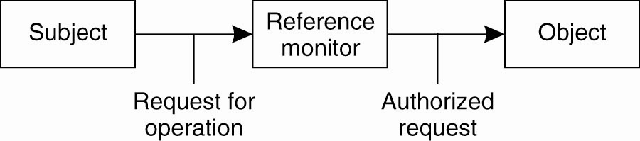
Access Control (1)
Once secure communication between a client and server has been established, we now have to worry about access control – when the client issues a request, how do we know that the client has authorization?

Slide 8
The Access Control Matrix (ACM)
A model of protection systems
Describes who (subject) can do what (rights) to what/whom (object/subject)
Example
  An instructor can assign and grade homework and exams
  A TA can grade homework
  A Student can evaluate the instructor and TA
8
Notes:
homework exam instructor TA students
Instructor {assign,grade} {assign,grade}
TA {grade}
Students {evaluate} {evaluate}

Slide 9
An Access Control Matrix
Allowed Operations (Rights): r,x,w,o
 | File1 | File2 | File3
Ann | rx | r | rwx
Bob | rwxo | r | --
Charlie | rx | rwo | w

Slide 10
ACMs and ACLs; Capabilities
Real systems have to be fast and not use excessive space

Slide 11
What’s Wrong with an ACM?
If we have 1k ‘users’ and 100k ‘files’ and a user should only read/write his or her own files
  The ACM will have 100k columns and 1k rows
  Most of the 100M elements are either empty or identical
Good for theoretical study but bad for implementation
  Remove the empty elements?
11

Slide 12
Two ways to cut a table (ACM)
Order by columns (ACL) or rows (Capability Lists)?
 | File1 | File2 | File3
Ann | rx | r | rwx
Bob | rwxo | r | --
Charlie | rx | rwo | w
ACLs
Capability

Slide 13
Access Control Lists
An ACL stores (non-empty elements of) each column with its object
Columns of access control matrix
ACLs:
file1: { (Andy, rx) (Betty, rwxo) (Charlie, rx) }
file2: { (Andy, r) (Betty, r) (Charlie, rwo) }
file3: { (Andy, rwo) (Charlie, w) }
 | File1 | File2 | File3
Andy | rx | r | rwx
Betty | rwxo | r | --
Charlie | rx | rwo | w
13

Slide 14
Capability Lists
Rows of access control matrix
C-Lists:
  Andy: { (file1, rx) (file2, r) (file3, rwo) }
  Betty: { (file1, rwxo) (file2, r) }
  Charlie: { (file1, rx) (file2, rwo) (file3, w) }
 | File1 | File2 | File3
Andy | rx | r | rwx
Betty | rwxo | r | --
Charlie | rx | rwo | w
14

Slide 15
ACL:Default Permission and Abbreviation
Example: UNIX ➔
Three classes of users: owner, group, all others
15

Slide 16
ACL Abbreviations
Augment abbreviated lists with ACLs
  Intent is to shorten ACL without losing the granularity
Example ➔ IBM AIX
  ACL overrides base permission
  Denial takes precedence
16

Slide 17
Permissions in IBM AIX
attributes:
base (traditional UNIX) permissions
owner(bishop): rw-
group(sys): r--
others: ---
extended permissions enabled
permit -w- u:heidi, g=sys [Add]
permit rw- u:matt
deny -w- u:holly, g=faculty [Remove right]
17

Slide 18
Semantics of Capability
Like a bus ticket
  Mere possession indicates rights that subject has over object
  Object identified by capability (as part of the token)
    Name may be a reference, location, or something else
  The key challenge is to prevent process/user from altering capabilities
    Otherwise a subject can augment its capabilities at will
18

Slide 19
Implementation of Capability
Tagged architecture
  Bits protect individual words
Paging/segmentation protections
  Like tags, but put capabilities in a read-only segment or page
Cryptography
  Associate with each capability a cryptographic checksum enciphered using a key known to OS
  When process presents capability, OS validates checksum

Slide 20
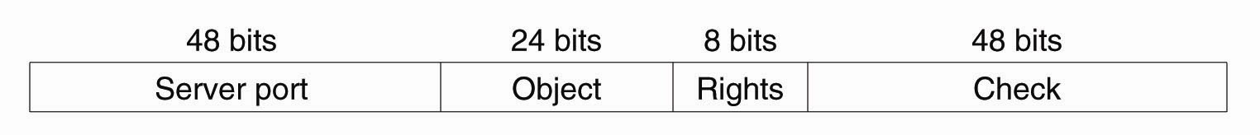
Capabilities and Attribute Certificates (1)
Owner capability in Amoeba.

Slide 21
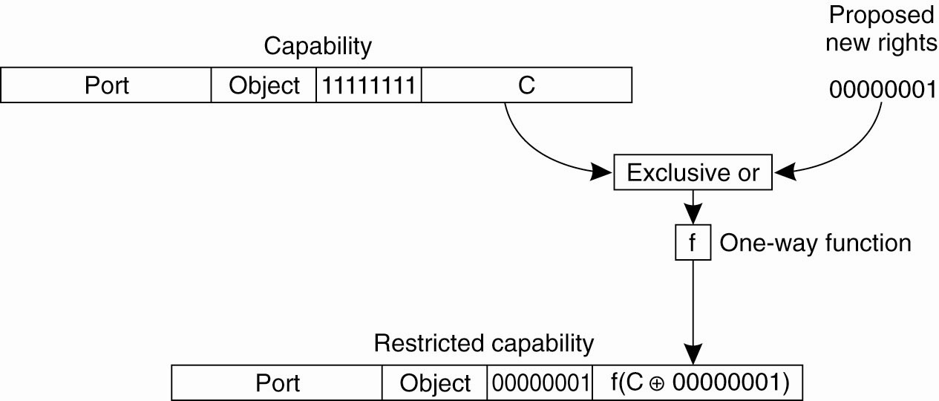
Capabilities and Attribute Certificates (2)
Generation of a restricted capability
from an owner capability.

Slide 22
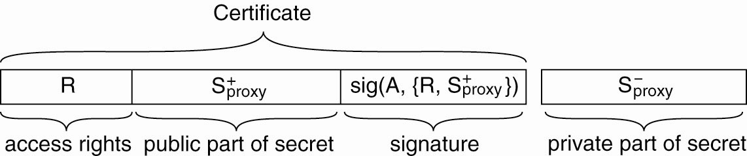
Delegation (1)
The general structure of a proxy as used for delegation.

Slide 23
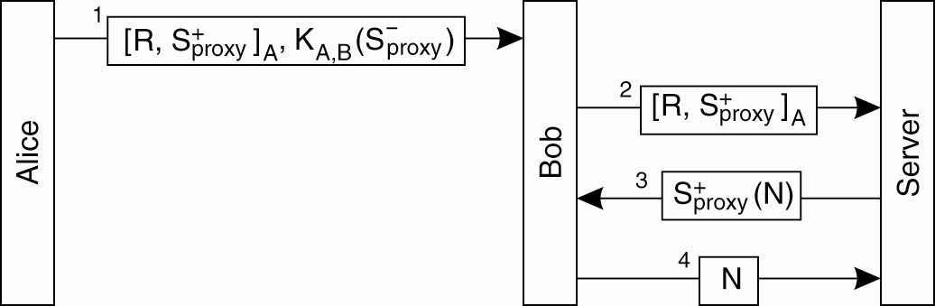
Delegation (2)
Using a proxy to delegate and prove ownership of access rights.

Slide 24
ACLs vs. Capabilities
They are equivalent:
  Given a subject, what objects can it access, and how?
  Given an object, what subjects can access it, and how?
  ACLs answer second easily; C-Lists, answer the first easily.
The second question in the past was most used; thus ACL-based systems are more common
But today some operations need to answer the first question

Slide 25
Today's Lecture
Access Control
Identity and Trust
Project 2

Slide 26
Fault Tolerance
Being fault tolerant is strongly related to what are called dependable systems. Dependability implies the following:
Availability: probability the system operates correctly at any given moment
Reliability: ability to run correctly for a long interval of time
Safety: failure to operate correctly does not lead to catastrophic failures
Maintainability: ability to “easily” repair a failed system

Slide 27
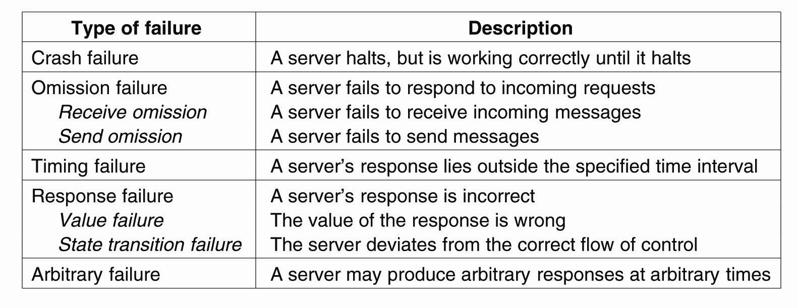
Failure Models
A system is said to fail if it cannot meet its promises. An error on the part of a system’s state may lead to a failure. The cause of an error is called a fault.

Slide 28
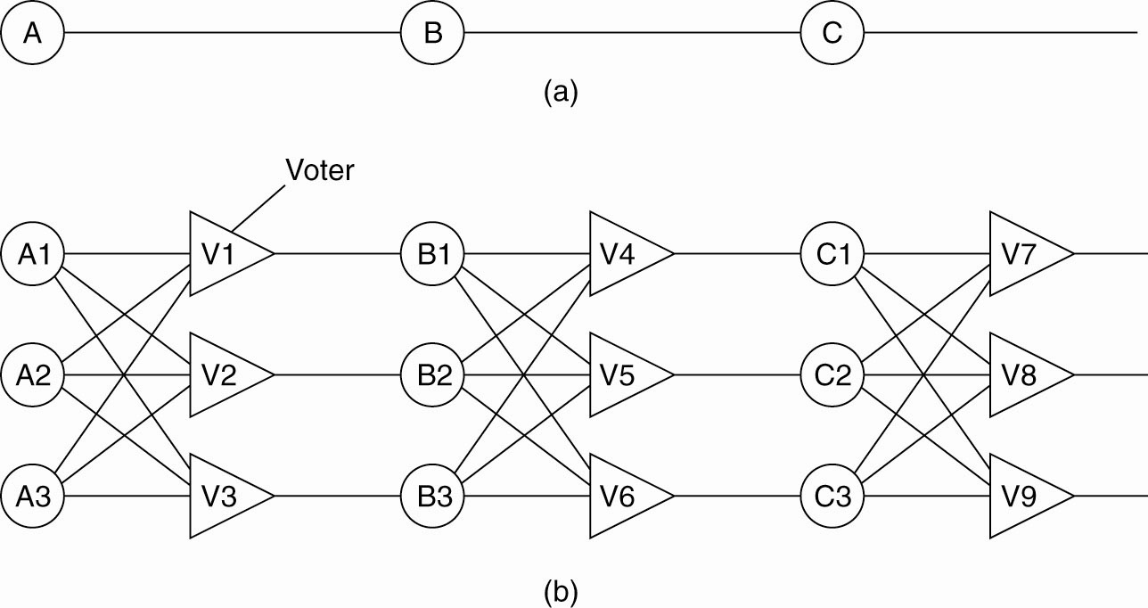
Failure Masking by Redundancy
Triple modular redundancy. For each voter, if two or three of the inputs are the same, the output is equal to the input. If all three inputs are different, the output is undefined.

Slide 29
Sybil Attack undermines assumed mapping between identity to entity and hence number of faulty entities
A Sybil attack is the forging of multiple identities for malicious intent -- having a set of faulty entities represented through a larger set of identities.
The purpose of such an attack is to compromise a disproportionate share of a system.
Result is overthrowing of any assumption of designed reliably based on a limited proportion of faulty entities.
Notes:
Attack may result for example, in a disproportionate share of resources allocated to the attacker(s) or privacy violations.

Slide 30
Model
Model in Douceur(2002):
Set E of entities e; two disjoint subsets C (c is correct) and F (f is faulty).
Broadcast communication cloud, pipe connecting each entity to the cloud.
Entities communicate by broadcast messages, all messages received within bounded time, not necessarily in order.
Assume local entity l is correct.
remote entities
communication
cloud
local entity

Slide 31
Goal: accept all legitimate identities, but no counterfeits
Model (continued)
Identity i is abstract representation of entity e which persists across multiple messages.
3 sources of info for which a local entity can accept identity i of remote e :
  Trusted agency
  Itself
  Other entities
Two ways to validate entities not received from trusted agency:
  Direct validation
  Indirect validation; accept identities vouched for by already accepted identities
Notes:
Each correct entity c presents one legitimate identity.
Each faulty entity f may attempt to present a legitimate identity and one or more counterfeit.

Slide 32
Sybil Attack
Result: for direct or indirect validation, a set of faulty entities can counterfeit an unbounded number of identities
Method: for direct and and indirect validation (not using trusted agency), utilize computational tasks to validate distinctness;
  basically, validate distinctness of two entities by getting them to perform some task (computational puzzle) that a single entity could not.
  can not assume homogeneous resources, only minimum; faulty entity could have more than minimum
  practical impossibility of having challenges issued simultaneously.
Notes:
This is the practical result: some theoretical ability to limit impact of faulty entities by performing simultaneous and concurrent identity validation

Slide 33
Sybil Attack
Douceur’s Conclusion: A centralized authority is required to realize a reliable distributed system
Validation which does not use a trust agency can’t provable meet the identity goal;
  Identification based on local-only information not practical (remember days when DNS was a file on your system?)
  PGP-style web of (certification) trust not adequate; is indirect-validation.

Slide 34
Today's Lecture
Access Control
Identity and Trust
Project 2

Slide 35
Midterm
79.3 Average
80 Median
7.2 Standard Deviation
91 Max
65 Min
Grade for exam (not other parts of class) a bit more lenient than usual…roughly….
  80+ → A
  70-80 → B
  60-70 → C

Slide 36
Project 2
3 person groups
Build a real, useable distributed application
  Should have some distributed systems component
    E.g. routing, replication, consistency, …
  Should make use of Android
Project proposals due 3/19
  1pg writeup
  Expected timeline for progress
Project meetings
  1st – 3/24 → refine/approve project idea
  2nd – 4/6 → progress update
  3rd – 4/23 → progress update
  4th – 4/30 → project demos
Final report due 5/3

Slide 37
Collaboration Applications
Shared event recording
  Class note taking
  Photos
  Audio
Classroom tools
  Polls, Q&A
Collaborative editing
  Whiteboard, documents
Distributed IM
Reviewing/reputation designs
  Photos, files, songs
  802.11 access points and other services

Slide 38
Games
Strategy games
  Slow-paced, move exchange on meetings
Position based
Standard FPS
  Managing BW more aggressively than wired games

Slide 39
Application Distribution
Get updates and find new applications from your friends
P2P filesharing
Running code in an distributed experiment
P2P routing of messages through phones

Slide 40
Social Networks
Locating friends via local multi-hop
  Finding friends of friends without revealing relationships
Sybil attack prevention
Shared “bulletin boards”
  Leaving notes for your friends
Trajectory reporting

Slide 41
Sensor Networks Applications
How many people are near you
  Can we measure density in different parts of campus?
  Privacy preserving
  Synopsis diffusion
Image or audio sensing
  Distributing sensing requests
User entered data
  Item prices
  Weather

Slide 42
Locks and Keys
Associate lock with object and key with subject
  Key controls what the subject can access and how
  Subject presents key; if it corresponds to any of the locks on the object, access is granted
This is flexible
  Can change either locks or keys
ACL
C-List
Locks/Keys
42

Slide 43
Cryptographic Implementation
Enciphering key is lock; deciphering key is key
  Encipher object o; store Ek (o)
  Use subject’s key k′ to compute Dk′ (Ek (o))
  Any of n can access o: store
  o′ = (E1 (o), …, En (o))
  Requires consent of all n to access o: store
  o′ = (E1(E2(…(En(o))…))
43

Slide 44
Revocation of Rights
Scan all C-lists, remove relevant capabilities
  Far too expensive! (return your tickets?)
Use indirection
  Each object has entry in a global object table
  Names in capabilities name the entry, not the object
    To revoke, zap the entry in the table
    Can have multiple entries for a single object to allow control of different sets of rights and/or groups of users for each object
  Example: Amoeba: owner requests server change random number in server table
    All capabilities for that object now invalid
  Re-issue tickets and invalidate old tickets

Slide 45
Mobile Code (1)
Securing mobile code involves protecting the local site from code created remotely.
  ‘Sandboxes’ allow downloaded programs to be run in such a way that each executed instruction is carefully controlled either by static analysis before executing the code or by inserting dynamic checks (or both).
  Java uses byte code verification, specialized loaders for remote classes, and a security manager
    byte code verifiers – check Java byte code for illegal instructions or for parts of the code that do not conform to some format standards.
    specialized loaders – prohibit certain types of instructions that may allow things like additional loading of (potentially unchecked) classes
    Security manager – runtime checks – acts as a reference manager.
    The text discusses various ways to implement security policy: capabilities, stack introspection, name space management.

Slide 46
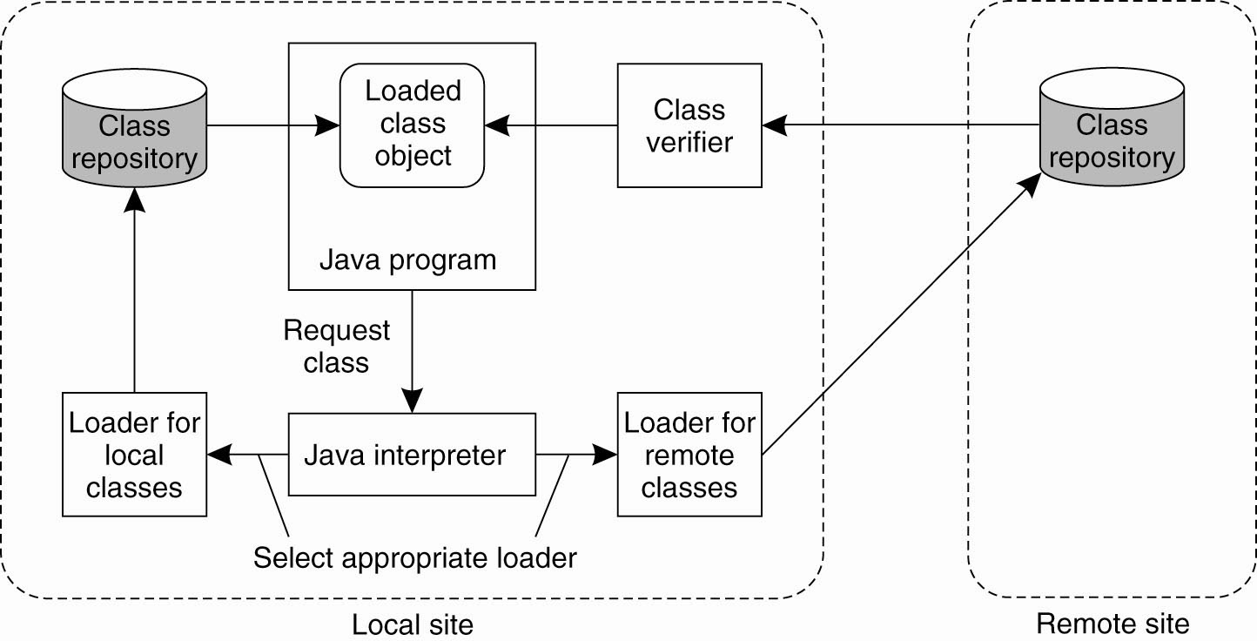
Protecting the Target (1)
Java Sandbox

Slide 47
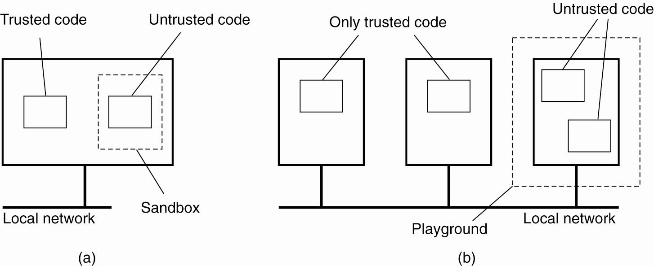
Protecting the Target (2)
A playground is a separate designated machine that can be used to run untrusted code.

Slide 48
Discussion
Do we believe any of this?
  Any flaws in the logic chain?
  Is there something about trust authorities that means they must (by nature) be centralized?
Is this really a problem?
  Existing systems seem to be working fine.
  What’s wrong with a dist sys using a centralized trust authority?
  Is a (centralized) CA part of the dist sys that uses it?
  Are existing practices good enough in practice
    Similar reasoning to why most systems don’t utilize BzG solutions.
    Use of implicit central authority.
    Toys (e.g. most p2p systems).

Slide 49
Securing Process Groups
It is often necessary to set up secure communication within a process group.
Using a single shared key for this implies that all members of the process group can be trusted.
  One solution is to use keys between each pair but scalability may be an issue.
  Can use public/private keys for each member – this scales better
In either case, if one member of the group proves trustworthy, it can be removed from the communication without compromising any other keys

Slide 50
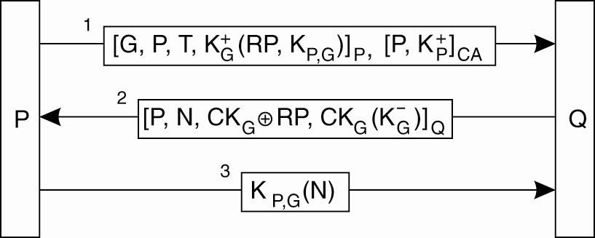
Secure Group Management
Figure 9-35. Securely admitting a new group member.

