Slide 1
15-446 Distributed Systems
Spring 2009
L-11 Consistency

Slide 2
Important Lessons
Replication → good for performance/reliability
  Key challenge → keeping replicas up-to-date
Wide range of consistency models
  Will see more next lecture
  Range of correctness properties
Most obvious choice (sequential consistency) can be expensive to implement
  Multicast, primary, quorum

Slide 3
Today's Lecture
ACID vs. BASE – philosophy
Client-centric consistency models
Eventual consistency
Bayou

Slide 4
Two Views of Distributed Systems
Optimist: A distributed system is a collection of independent computers that appears to its users as a single coherent system
Pessimist: “You know you have one when the crash of a computer you’ve never heard of stops you from getting any work done.” (Lamport)

Slide 5
Recurring Theme
Academics like:
  Clean abstractions
  Strong semantics
  Things that prove they are smart
Users like:
  Systems that work (most of the time)
  Systems that scale
  Consistency per se isn’t important
Eric Brewer had the following observations

Slide 6
A Clash of Cultures
Classic distributed systems: focused on ACID semantics (transaction semantics)
  Atomicity: either the operation (e.g., write) is performed on all replicas or is not performed on any of them
  Consistency: after each operation all replicas reach the same state
  Isolation: no operation (e.g., read) can see the data from another operation (e.g., write) in an intermediate state
  Durability: once a write has been successful, that write will persist indefinitely
Modern Internet systems: focused on BASE
  Basically Available
  Soft-state (or scalable)
  Eventually consistent

Slide 7
ACID vs BASE
ACID
Strong consistency for transactions highest priority
Availability less important
Pessimistic
Rigorous analysis
Complex mechanisms
BASE
Availability and scaling highest priorities
Weak consistency
Optimistic
Best effort
Simple and fast

Slide 8
Why Not ACID+BASE?
What goals might you want from a system?
  C, A, P
Strong Consistency: all clients see the same view, even in the presence of updates
High Availability: all clients can find some replica of the data, even in the presence of failures
Partition-tolerance: the system properties hold even when the system is partitioned

Slide 9
CAP Theorem [Brewer]
You can only have two out of these three properties
The choice of which feature to discard determines the nature of your system

Slide 10
Consistency and Availability
Comment:
  Providing transactional semantics requires all functioning nodes to be in contact with each other (no partition)
Examples:
  Single-site and clustered databases
  Other cluster-based designs
Typical Features:
  Two-phase commit
  Cache invalidation protocols
  Classic DS style

Slide 11
Partition-Tolerance and Availability
Comment:
  Once consistency is sacrificed, life is easy….
Examples:
  DNS
  Web caches
  Practical distributed systems for mobile environments: Coda, Bayou
Typical Features:
  Optimistic updating with conflict resolution
  This is the “Internet design style”
  TTLs and lease cache management

Slide 12
Voting with their Clicks
In terms of large-scale systems, the world has voted with their clicks:
  Consistency less important than availability and partition-tolerance

Slide 13
Today's Lecture
ACID vs. BASE – philosophy
Client-centric consistency models
Eventual consistency
Bayou

Slide 14
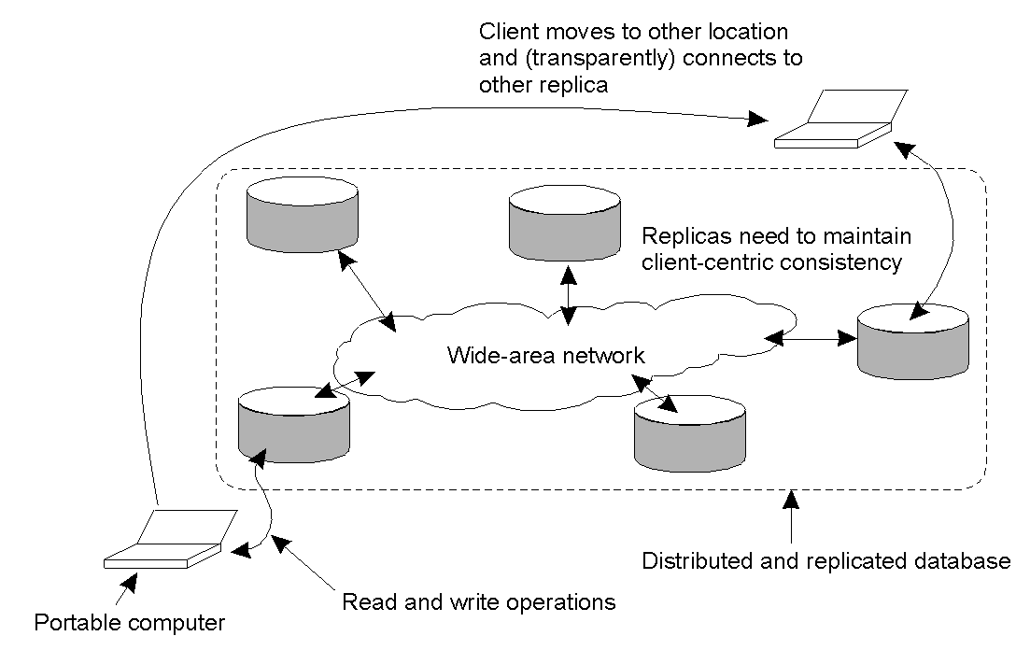
Client-centric Consistency Models
A mobile user may access different replicas of a distributed database at different times. This type of behavior implies the need for a view of consistency that provides guarantees for single client regarding accesses to the data store.

Slide 15
Session Guarantees
When client move around and connects to different replicas, strange things can happen
  Updates you just made are missing
  Database goes back in time
Responsibility of “session manager”, not servers
Two sets:
  Read-set: set of writes that are relevant to session reads
  Write-set: set of writes performed in session
Update dependencies captured in read sets and write sets
Four different client-central consistency models
  Monotonic reads
  Monotonic writes
  Read your writes
  Writes follow reads

Slide 16

Monotonic Reads
L1 and L2 are
two locations
process moves from L1 to L2
indicates propagation of the earlier write
process moves from L1 to L2
No propagation guarantees
A data store provides monotonic read consistency if when a process reads the value of a data item x, any successive read operations on x by that process will always return the same value or a more recent value.
Example error: successive access to email have ‘disappearing messages’
A monotonic-read consistent data store
A data store that does not provide monotonic reads.

Slide 17

Monotonic Writes
In both examples,
process performs a
write at L1, moves
and performs a write
at L2
A write operation by a process on a data item x is completed before any successive write operation on x by the same process. Implies a copy must be up to date before performing a write on it.
Example error: Library updated in wrong order.
A monotonic-write consistent data store.
A data store that does not provide monotonic-write consistency.

Slide 18

Read Your Writes
In both examples,
process performs a
write at L1, moves
and performs a read
at L2
The effect of a write operation by a process on data item x will always be seen by a successive read operation on x by the same process.
Example error: deleted email messages re-appear.
A data store that provides read-your-writes consistency.
A data store that does not.

Slide 19

Writes Follow Reads
In both examples,
process performs a
read at L1, moves
and performs a write
at L2
A write operation by a process on a data item x following a previous read operation on x by the same process is guaranteed to take place on the same or a more recent value of x that was read.
Example error: Newsgroup displays responses to articles before original article has propagated there
A writes-follow-reads consistent data store
A data store that does not provide writes-follow-reads consistency

Slide 20
Today's Lecture
ACID vs. BASE – philosophy
Client-centric consistency models
Eventual consistency
Bayou

Slide 21
Many Kinds of Consistency
Strict: updates happen instantly everywhere
  A read has to return the result of the latest write which occurred on that data item
  Assume instantaneous propagation; not realistic
Linearizable: updates appear to happen instantaneously at some point in time
  Like “Sequential” but operations are ordered using a global clock
  Primarly used for formal verification of concurrent programs
Sequential: all updates occur in the same order everywhere
  Every client sees the writes in the same order
    Order of writes from the same client is preserved
    Order of writes from different clients may not be preserved
  Equivalent to Atomicity + Consistency + Isolation
Eventual consistency: if all updating stops then eventually all replicas will converge to the identical values

Slide 22
Eventual Consistency
There are replica situations where updates (writes) are rare and where a fair amount of inconsistency can be tolerated.
  DNS – names rarely changed, removed, or added and changes/additions/removals done by single authority
  Web page update – pages typically have a single owner and are updated infrequently.
If no updates occur for a while, all replicas should gradually become consistent.
May be a problem with mobile user who access different replicas (which may be inconsistent with each other).

Slide 23
Why (not) eventual consistency?
Support disconnected operations
  Better to read a stale value than nothing
  Better to save writes somewhere than nothing
Potentially anomalous application behavior
  Stale reads and conflicting writes…

Slide 24
Implementing Eventual Consistency
Can be implemented with two steps:
All writes eventually propagate to all replicas
Writes, when they arrive, are written to a log and applied in the same order at all replicas
  Easily done with timestamps and “undo-ing” optimistic writes

Slide 25
Update Propagation
Rumor or epidemic stage:
  Attempt to spread an update quickly
  Willing to tolerate incompletely coverage in return for reduced traffic overhead
Correcting omissions:
  Making sure that replicas that weren’t updated during the rumor stage get the update

Slide 26
Anti-Entropy
Every so often, two servers compare complete datasets
Use various techniques to make this cheap
If any data item is discovered to not have been fully replicated, it is considered a new rumor and spread again

Slide 27
Today's Lecture
ACID vs. BASE – philosophy
Client-centric consistency models
Eventual consistency
Bayou

Slide 28
System Assumptions
Early days: nodes always on when not crashed
  Bandwidth always plentiful (often LANs)
  Never needed to work on a disconnected node
  Nodes never moved
  Protocols were “chatty”
Now: nodes detach then reconnect elsewhere
  Even when attached, bandwidth is variable
  Reconnection elsewhere means often talking to different replica
  Work done on detached nodes

Slide 29
Disconnected Operation
Challenge to old paradigm
  Standard techniques disallowed any operations while disconnected
  Or disallowed operations by others
But eventual consistency not enough
  Reconnecting to another replica could result in strange results
    E. g., not seeing your own recent writes
  Merely letting latest write prevail may not be appropriate
  No detection of read-dependencies
What do we do?

Slide 30
Bayou
System developed at PARC in the mid-90’s
First coherent attempt to fully address the problem of disconnected operation
Several different components

Slide 31
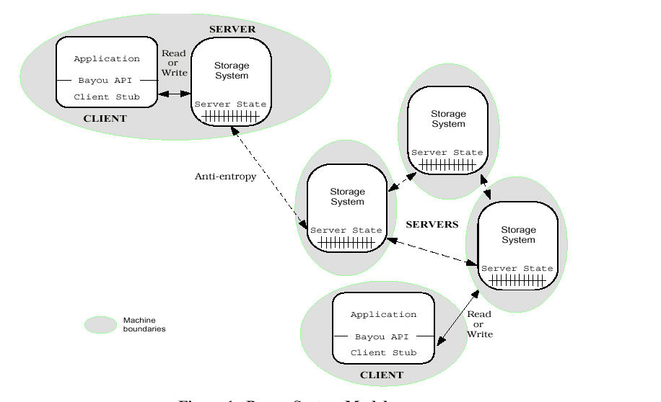
Bayou Architecture

Slide 32
Motivating Scenario: Shared Calendar
Calendar updates made by several people
  e.g., meeting room scheduling, or exec+admin
Want to allow updates offline
But conflicts can’t be prevented
Two possibilities:
  Disallow offline updates?
  Conflict resolution?

Slide 33
Conflict Resolution
Replication not transparent to application
  Only the application knows how to resolve conflicts
  Application can do record-level conflict detection, not just file-level conflict detection
  Calendar example: record-level, and easy resolution
Split of responsibility:
  Replication system: propagates updates
  Application: resolves conflict
Optimistic application of writes requires that writes be “undo-able”

Slide 34
Meeting room scheduler
Reserve same room at same time: conflict
Reserve different rooms at same time: no conflict
Reserve same room at different times: no conflict
Only the application would know this!
Rm1
time
Rm2
No conflict

Slide 35
Meeting Room Scheduler
Rm1
No conflict
time
Rm2

Slide 36
Meeting Room Scheduler
Conflict detection
Rm1
time
Rm2
conflict

Slide 37
Meeting Room Scheduler
Automated resolution
Rm1
No conflict
time
Rm2

Slide 38
Meeting Room Scheduler
Rm1
time
Rm2
No conflict

Slide 39
Other Resolution Strategies
Classes take priority over meetings
Faculty reservations are bumped by admin reservations
Move meetings to bigger room, if available
Point:
  Conflicts are detected at very fine granularity
  Resolution can be policy-driven

Slide 40
Updates
Client sends update to a server
Identified by a triple:
  <Commit-stamp, Time-stamp, Server-ID of accepting server>
Updates are either committed or tentative
  Commit-stamps increase monotonically
  Tentative updates have commit-stamp = inf

Slide 41
Anti-Entropy Exchange
Each server keeps a vector timestamp
When two servers connect, exchanging the version vectors allows them to identify the missing updates
These updates are exchanged in the order of the logs, so that if the connection is dropped the crucial monotonicity property still holds
  If a server X has an update accepted by server Y, server X has all previous updates accepted by that server

Slide 42
Example with Three Servers
P
[0,0,0]
A
[0,0,0]
B
[0,0,0]
Version Vectors

Slide 43
Vector Clocks
Vector clocks overcome the shortcoming of Lamport logical clocks
  L(e) < L(e’) does not imply e happened before e’
Vector timestamps are used to timestamp local events
They are applied in schemes for replication of data

Slide 44
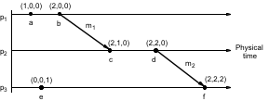
Vector Clocks
How to ensure causality?
Two rules for delaying message processing:
  VC must indicate that this is next message from source
  VC must indicate that you have all the other messages that “caused” this message

Slide 45
All Servers Write Independently
P
<inf,1,P>
<inf,4,P>
<inf,8,P>
[8,0,0]
A
<inf,2,A>
<inf,3,A>
<inf,10,A>
[0,10,0]
B
<inf,1,B>
<inf,5,B>
<inf,9,B>
[0,0,9]

Slide 46
Bayou Writes
Identifier (commit-stamp, time-stamp, server-ID)
Nominal value
Write dependencies
Merge procedure

Slide 47
Conflict Detection
Write specifies the data the write depends on:
  Set X=8 if Y=5 and Z=3
  Set Cal(11:00-12:00)=dentist if Cal(11:00-12:00) is null
These write dependencies are crucial in eliminating unnecessary conflicts
  If file-level detection was used, all updates would conflict with each other

Slide 48
Conflict Resolution
Specified by merge procedure (mergeproc)
When conflict is detected, mergeproc is called
  Move appointments to open spot on calendar
  Move meetings to open room

Slide 49
P and A Do Anti-Entropy Exchange
P
<inf,1,P>
<inf,2,A>
<inf,3,A>
<inf,4,P>
<inf,8,P>
<inf,10,A>
[8,10,0]
A
<inf,1,P>
<inf,2,A>
<inf,3,A>
<inf,4,P>
<inf,8,P>
<inf,10,A>
[8,10,0]
B
<inf,1,B>
<inf,5,B>
<inf,9,B>
[0,0,9]
<inf,1,P>
<inf,4,P>
<inf,8,P>
[8,0,0]
<inf,2,A>
<inf,3,A>
<inf,10,A>
[0,10,0]

Slide 50
Bayou uses a primary to commit a total order
Why is it important to make log stable?
  Stable writes can be committed
  Stable portion of the log can be truncated
Problem: If any node is offline, the stable portion of all logs stops growing
Bayou’s solution:
  A designated primary defines a total commit order
  Primary assigns CSNs (commit-seq-no)
  Any write with a known CSN is stable
  All stable writes are ordered before tentative writes

Slide 51
P Commits Some Early Writes
P
<1,1,P>
<2,2,A>
<3,3,A>
<inf,4,P>
<inf,8,P>
<inf,10,A>
[8,10,0]
A
<inf,1,P>
<inf,2,A>
<inf,3,A>
<inf,4,P>
<inf,8,P>
<inf,10,A>
[8,10,0]
B
<inf,1,B>
<inf,5,B>
<inf,9,B>
[0,0,9]
<inf,1,P>
<inf,2,A>
<inf,3,A>
<inf,4,P>
<inf,8,P>
<inf,10,A>
[8,10,0]

Slide 52
P and B Do Anti-Entropy Exchange
P
<1,1,P>
<2,2,A>
<3,3,A>
<inf,1,B>
<inf,4,P>
<inf,5,B>
<inf,8,P>
<inf,9,B>
<inf,10,A>
[8,10,9]
A
<inf,1,P>
<inf,2,A>
<inf,3,A>
<inf,4,P>
<inf,8,P>
<inf,10,A>
[8,10,0]
B
<1,1,P>
<2,2,A>
<3,3,A>
<inf,1,B>
<inf,4,P>
<inf,5,B>
<inf,8,P>
<inf,9,B>
<inf,10,A>
[8,10,9]
<1,1,P>
<2,2,A>
<3,3,A>
<inf,4,P>
<inf,8,P>
<inf,10,A>
[8,10,0]
<inf,1,B>
<inf,5,B>
<inf,9,B>
[0,0,9]

Slide 53
P Commits More Writes
P
<1,1,P>
<2,2,A>
<3,3,A>
<inf,1,B>
<inf,4,P>
<inf,5,B>
<inf,8,P>
<inf,9,B>
<inf,10,A>
[8,10,9]
P
<1,1,P>
<2,2,A>
<3,3,A>
<4,1,B>
<5,4,P>
<6,5,B>
<7,8,P>
<inf,9,B>
<inf,10,A>
[8,10,9]

Slide 54
Bayou Summary
Simple gossip based design
Key difference → exploits knowledge of application semantics
  To identify conflicts
  To handle merges
Greater complexity for the programmer
  Might be useful in ubicomp context

Slide 55
Important Lessons
ACID vs. BASE
  Understand the tradeoffs you are making
  ACID makes things better for programmer/system designed
  BASE often preferred by users
Client-centric consistency
  Different guarantees than data-centric
Eventual consistency
  BASE-like design → better performance/availability
  Must design system to tolerate
  Bayou a good example of making tolerance explicit

Slide 57
Vector Clocks
V_{i} [ i ] is the number of events that p_{i} has timestamped
V_{i} [ j ] ( j≠ i) is the number of events at p_{j} that p_{i} has been affected by
Vector clock V_{i} at process p_{i} is an array of N integers
initially V_{i}[j] = 0 for i, j = 1, 2, …N
before p_{i} timestamps an event it sets V_{i}[i] := V_{i}[i] +1
p_{i} piggybacks t = V_{i} on every message it sends
when p_{i} receives (m,t) it sets V_{i}[j] := max(V_{i}[j] , t[j]) j = 1, 2, …N ( then before next event adds 1 to own element using rule 2)
Notes:
Following points animated :
Vector clocks overcome the shortcoming of Lamport logical clocks (L(e) < L(e’) does not imply e happened before e’) e.g. events e and c
Vector timestamps are used to timestamp local events.
Applied in schemes for replication of data e.g. Gossip (p 572), Coda (p585) and causal multicast
The rules VC1-VC4 are for updating vector clocks
Work through figure 10.7. At p1 a(1,0,0) b (2,0,0) send (2,0,0) on m1
At p2 on receipt of m1 get max((0,0,0), (2,0,0) = (2,0,0) add 1 -> (2,1,0).
Meaning of =, <=, max etc for vector timestamps.
Note that e-> e’ implies V(e) < V(e’). The converse is also true.
But c || e parallel) because neither V(c) <= V(e) nor V(e) <= V(c).

Slide 58
Vector Clocks
At p₁
  a occurs at (1,0,0); b occurs at (2,0,0)
  piggyback (2,0,0) on m₁
At p₂ on receipt of m₁ use max ((0,0,0), (2,0,0)) = (2, 0, 0) and add 1 to own element = (2,1,0)
Meaning of =, <=, max etc for vector timestamps
  compare elements pairwise
Notes:
Following points animated :
Vector clocks overcome the shortcoming of Lamport logical clocks (L(e) < L(e’) does not imply e happened before e’) e.g. events e and c
Vector timestamps are used to timestamp local events.
Applied in schemes for replication of data e.g. Gossip (p 572), Coda (p585) and causal multicast
The rules VC1-VC4 are for updating vector clocks
Work through figure 10.7. At p1 a(1,0,0) b (2,0,0) send (2,0,0) on m1
At p2 on receipt of m1 get max((0,0,0), (2,0,0) = (2,0,0) add 1 -> (2,1,0).
Meaning of =, <=, max etc for vector timestamps.
Note that e-> e’ implies V(e) < V(e’). The converse is also true.
But c || e parallel) because neither V(c) <= V(e) nor V(e) <= V(c).

Slide 59
Vector Clocks
Note that e e’ implies L(e)<L(e’). The converse is also true
Can you see a pair of parallel events?
  c || e( parallel) because neither V(c) <= V(e) nor V(e) <= V(c)

Slide 60

Bayou
0:0
1:0
2:0
Write
log
Version
Vector
N1
0:0
1:0
2:0
N0
0:0
1:0
2:0
N2

Slide 61
Bayou propagation
1:1 W(x)
0:0
1:1
2:0
Write
log
Version
Vector
N1
1:0 W(x)
2:0 W(y)
3:0 W(z)
0:3
1:0
2:0
1:0 W(x)
2:0 W(y)
3:0 W(z)
0:3
1:0
2:0
N0
0:0
1:0
2:0
N2

Slide 62
Bayou propagation
1:0 W(x)
1:1 W(x)
2:0 W(y)
3:0 W(z)
0:3
1:4
2:0
Write
log
Version
Vector
N1
1:0 W(x)
2:0 W(y)
3:0 W(z)
0:3
1:0
2:0
0:3
1:4
2:0
1:1 W(x)
N0
0:0
1:0
2:0
N2

Slide 63
Bayou propagation
1:0 W(x)
1:1 W(x)
2:0 W(y)
3:0 W(z)
0:3
1:4
2:0
Write
log
Version
Vector
N1
1:0 W(x)
1:1 W(x)
2:0 W(y)
3:0 W(z)
0:4
1:4
2:0
N0
Which portion of
The log is stable?
0:0
1:0
2:0
N2

Slide 64
Bayou propagation
1:0 W(x)
1:1 W(x)
2:0 W(y)
3:0 W(z)
0:3
1:4
2:0
Write
log
Version
Vector
N1
1:0 W(x)
1:1 W(x)
2:0 W(y)
3:0 W(z)
0:4
1:4
2:0
N0
1:0 W(x)
1:1 W(x)
2:0 W(y)
3:0 W(z)
0:3
1:4
2:5
N2

Slide 65
Bayou propagation
1:0 W(x)
1:1 W(x)
2:0 W(y)
3:0 W(z)
0:3
1:6
2:5
Write
log
Version
Vector
N1
1:0 W(x)
1:1 W(x)
2:0 W(y)
3:0 W(z)
0:4
1:4
2:0
0:3
1:4
2:5
N0
1:0 W(x)
1:1 W(x)
2:0 W(y)
3:0 W(z)
0:4
1:4
2:5
N2

Slide 66
Bayou propagation
∞:1:1 W(x)
0:0
1:1
2:0
Write
log
Version
Vector
N1
1:1:0 W(x)
2:2:0 W(y)
3:3:0 W(z)
0:3
1:0
2:0
∞:1:1 W(x)
0:0
1:1
2:0
N0
0:0
1:0
2:0
N2

Slide 67
Bayou propagation
∞:1:1 W(x)
0:0
1:1
2:0
Write
log
Version
Vector
N1
1:1:0 W(x)
2:2:0 W(y)
3:3:0 W(z)
0:4
1:1
2:0
1:1:0 W(x)
2:2:0 W(y)
3:3:0 W(z)
4:1:1 W(x)
0:4
1:1
2:0
N0
4:1:1 W(x)
0:0
1:0
2:0
N2

