Slide 1
15-446 Distributed Systems
Spring 2009
L-9 Logical Time

Slide 2
Announcements
Project 1 update – Thursday
  Due 2/26
HW 1 – due Thursday

Slide 3
Last Lecture – Clock Sync Important Lessons
Clocks on different systems will always behave differently
  Skew and drift between clocks
Time disagreement between machines can result in undesirable behavior
Two paths to solution: synchronize clocks or ensure consistent clocks
Clock synchronization
  Rely on a time-stamped network messages
  Estimate delay for message transmission
  Can synchronize to UTC or to local source

Slide 4
Today's Lecture
Lamport Clocks
Vector Clocks
Mutual Exclusion
Election

Slide 5
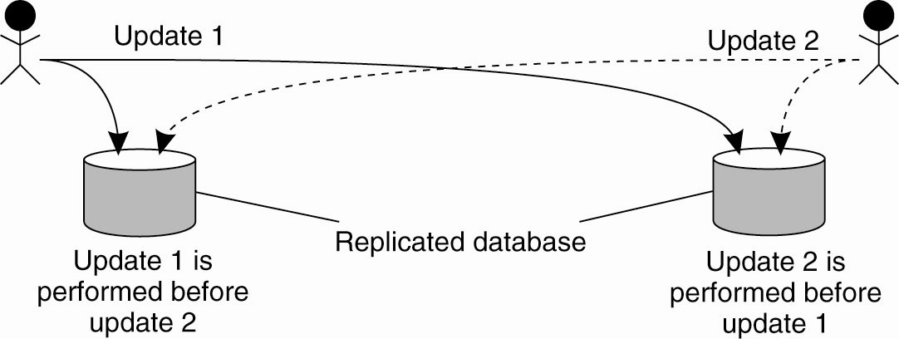
Example: Totally Ordered Multicasting
Updating a replicated database and leaving it in an inconsistent state

Slide 6
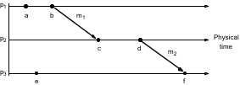
Logical time and logical clocks (Lamport 1978)
Events at three processes

Slide 7
Logical time and logical clocks (Lamport 1978)
Instead of synchronizing clocks, event ordering can be used
  If two events occurred at the same process pi (i = 1, 2, … N) then they occurred in the order observed by pi, that is   
  when a message, m is sent between two processes, send(m) happened before receive(m)
  The happened before relation is transitive
the happened before relation is the relation of causal ordering
Notes:
Animation explains the following:
In Figure 10.5 a -> b (at p1) c->d at p2 and b->c because of m1 also d-> f because of m2.
Not all events are related by -> (happened before) consider a and e. (different processes and no chain of messages to relate them)
Happened before relation - relation of causal ordering
HB1, HB2 and HB3 (page 397) are formal statements of the three points on the slide

Slide 8
Logical time and logical clocks (Lamport 1978)
a → b (at p1) c →d (at p2)
b → c because of m1
also d → f because of m2
Notes:
Animation explains the following:
In Figure 10.5 a -> b (at p1) c->d at p2 and b->c because of m1 also d-> f because of m2.
Not all events are related by -> (happened before) consider a and e. (different processes and no chain of messages to relate them)
Happened before relation - relation of causal ordering
HB1, HB2 and HB3 (page 397) are formal statements of the three points on the slide

Slide 9
Logical time and logical clocks (Lamport 1978)
Not all events are related by →
Consider a and e (different processes and no chain of messages to relate them)
  they are not related by → ; they are said to be concurrent
  written as a || e
Notes:
Animation explains the following:
In Figure 10.5 a -> b (at p1) c->d at p2 and b->c because of m1 also d-> f because of m2.
Not all events are related by -> (happened before) consider a and e. (different processes and no chain of messages to relate them)
Happened before relation - relation of causal ordering
HB1, HB2 and HB3 (page 397) are formal statements of the three points on the slide

Slide 10
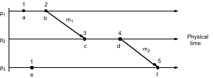
Lamport Clock (1)
A logical clock is a monotonically increasing software counter
  It need not relate to a physical clock.
Each process p_{i} has a logical clock, L_{i} which can be used to apply logical timestamps to events
  Rule 1: L_{i} is incremented by 1 before each event at process p_{i}
  Rule 2:
    (a) when process p_{i} sends message m, it piggybacks t = L_{i}
    (b) when p_{j} receives (m,t) it sets L_{j} := max(L_{j}, t) and applies rule 1 before timestamping the event receive (m)
Notes:
Discuss LC1 and LC2 for Figure 10.6 (same as 10.5).
Initially clocks all set to 0. (a -> 1) b->2 etc. For m1, 2 is piggybacked and c gets max(1,2) + 1. Same for m2.
Note e -> e’ implies L(e) < L(e’). Converse not true. E.g. events b and e.
(b || e) concurrent.

Slide 11
Lamport Clock (1)
each of p1, p2, p3 has its logical clock initialised to zero,
the clock values are those immediately after the event.
e.g. 1 for a, 2 for b.
for m1, 2 is piggybacked and c gets max(0,2)+1 = 3

Slide 12
Lamport Clock (1)
e →e’ implies L(e)<L(e’)
The converse is not true, that is L(e)<L(e') does not imply e →e’
  e.g. L(b) > L(e) but b || e

Slide 13
Today's Lecture
Lamport Clocks
Vector Clocks
Mutual Exclusion
Election

Slide 14
Vector Clocks
Vector clocks overcome the shortcoming of Lamport logical clocks
  L(e) < L(e’) does not imply e happened before e’
Vector timestamps are used to timestamp local events
They are applied in schemes for replication of data

Slide 15
Vector Clocks
V_{i} [ i ] is the number of events that p_{i} has timestamped
V_{i} [ j ] ( j≠ i) is the number of events at p_{j} that p_{i} has been affected by
Vector clock V_{i} at process p_{i} is an array of N integers
initially V_{i}[j] = 0 for i, j = 1, 2, …N
before p_{i} timestamps an event it sets V_{i}[i] := V_{i}[i] +1
p_{i} piggybacks t = V_{i} on every message it sends
when p_{i} receives (m,t) it sets V_{i}[j] := max(V_{i}[j] , t[j]) j = 1, 2, …N ( then before next event adds 1 to own element using rule 2)
Notes:
Following points animated :
Vector clocks overcome the shortcoming of Lamport logical clocks (L(e) < L(e’) does not imply e happened before e’) e.g. events e and c
Vector timestamps are used to timestamp local events.
Applied in schemes for replication of data e.g. Gossip (p 572), Coda (p585) and causal multicast
The rules VC1-VC4 are for updating vector clocks
Work through figure 10.7. At p1 a(1,0,0) b (2,0,0) send (2,0,0) on m1
At p2 on receipt of m1 get max((0,0,0), (2,0,0) = (2,0,0) add 1 -> (2,1,0).
Meaning of =, <=, max etc for vector timestamps.
Note that e-> e’ implies V(e) < V(e’). The converse is also true.
But c || e parallel) because neither V(c) <= V(e) nor V(e) <= V(c).

Slide 16
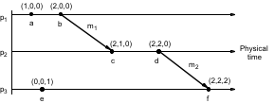
Vector Clocks
At p₁
  a occurs at (1,0,0); b occurs at (2,0,0)
  piggyback (2,0,0) on m₁
At p₂ on receipt of m₁ use max ((0,0,0), (2,0,0)) = (2, 0, 0) and add 1 to own element = (2,1,0)
Meaning of =, <=, max etc for vector timestamps
  compare elements pairwise
Notes:
Following points animated :
Vector clocks overcome the shortcoming of Lamport logical clocks (L(e) < L(e’) does not imply e happened before e’) e.g. events e and c
Vector timestamps are used to timestamp local events.
Applied in schemes for replication of data e.g. Gossip (p 572), Coda (p585) and causal multicast
The rules VC1-VC4 are for updating vector clocks
Work through figure 10.7. At p1 a(1,0,0) b (2,0,0) send (2,0,0) on m1
At p2 on receipt of m1 get max((0,0,0), (2,0,0) = (2,0,0) add 1 -> (2,1,0).
Meaning of =, <=, max etc for vector timestamps.
Note that e-> e’ implies V(e) < V(e’). The converse is also true.
But c || e parallel) because neither V(c) <= V(e) nor V(e) <= V(c).

Slide 17
Vector Clocks
Note that e e’ implies L(e)<L(e’). The converse is also true
Can you see a pair of parallel events?
  c || e( parallel) because neither V(c) <= V(e) nor V(e) <= V(c)

Slide 18
Vector Clocks
How to ensure causality?
Two rules for delaying message processing:
  VC must indicate that this is next message from source
  VC must indicate that you have all the other messages that “caused” this message

Slide 19
Today's Lecture
Lamport Clocks
Vector Clocks
Mutual Exclusion
Election

Slide 20
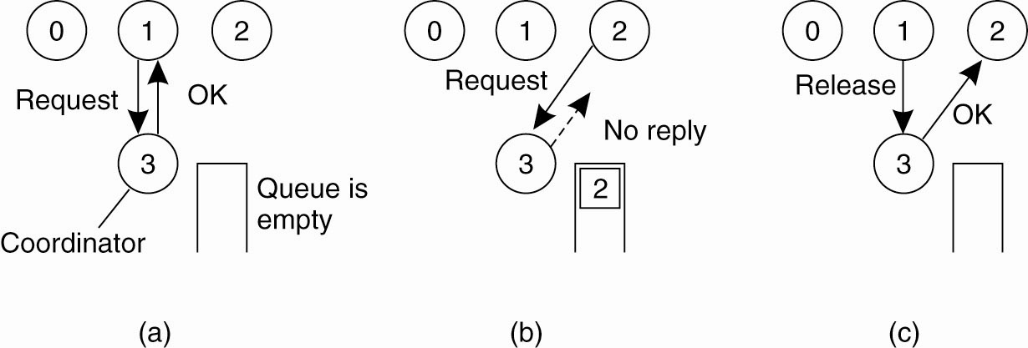
Mutual Exclusion
A Centralized Algorithm
Process 1 asks the coordinator for permission to access a shared resource → Permission is granted
Process 2 then asks permission to access the same resource → The coordinator does not reply
When process 1 releases the resource, it tells the coordinator, which then replies to 2

Slide 21
A Distributed Algorithm (1)
Three different cases:
If the receiver is not accessing the resource and does not want to access it, it sends back an OK message to the sender.
If the receiver already has access to the resource, it simply does not reply. Instead, it queues the request.
If the receiver wants to access the resource as well but has not yet done so, it compares the timestamp of the incoming message with the one contained in the message that it has sent everyone. The lowest one wins.

Slide 22
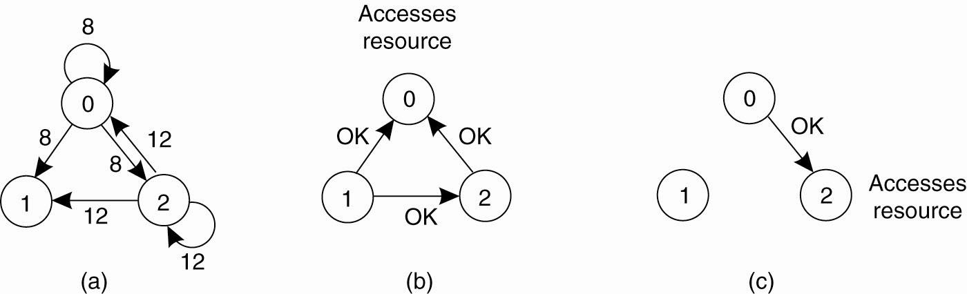
A Distributed Algorithm (2)
Accesses
Resource
Accesses
Resource
Two processes want to access a
shared resource at the same moment.
Process 0 has the lowest timestamp, so it wins
When process 0 is done, it sends an OK also, so 2 can now go ahead.

Slide 23
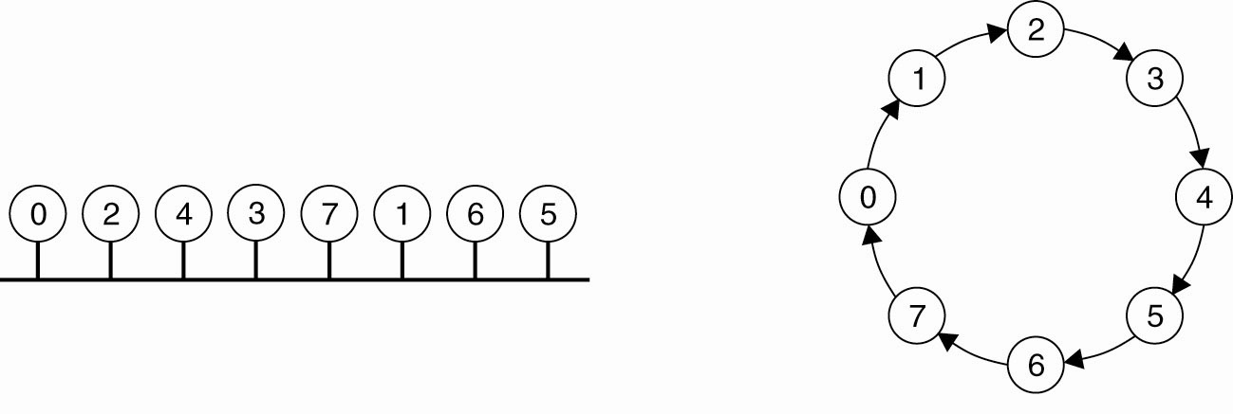
A Token Ring Algorithm
An unordered group of processes on a network → A logical ring constructed in software
  Use ring to pass right to access resource

Slide 24
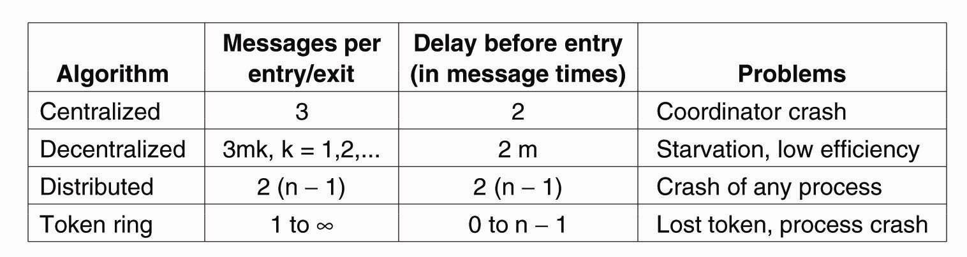
A Comparison of the Four Algorithms

Slide 25
Today's Lecture
Lamport Clocks
Vector Clocks
Mutual Exclusion
Election

Slide 26
Election Algorithms
The Bully Algorithm:
P sends an ELECTION message to all processes with higher numbers.
If no one responds, P wins the election and becomes coordinator.
If one of the higher-ups answers, it takes over. P’s job is done.

Slide 27
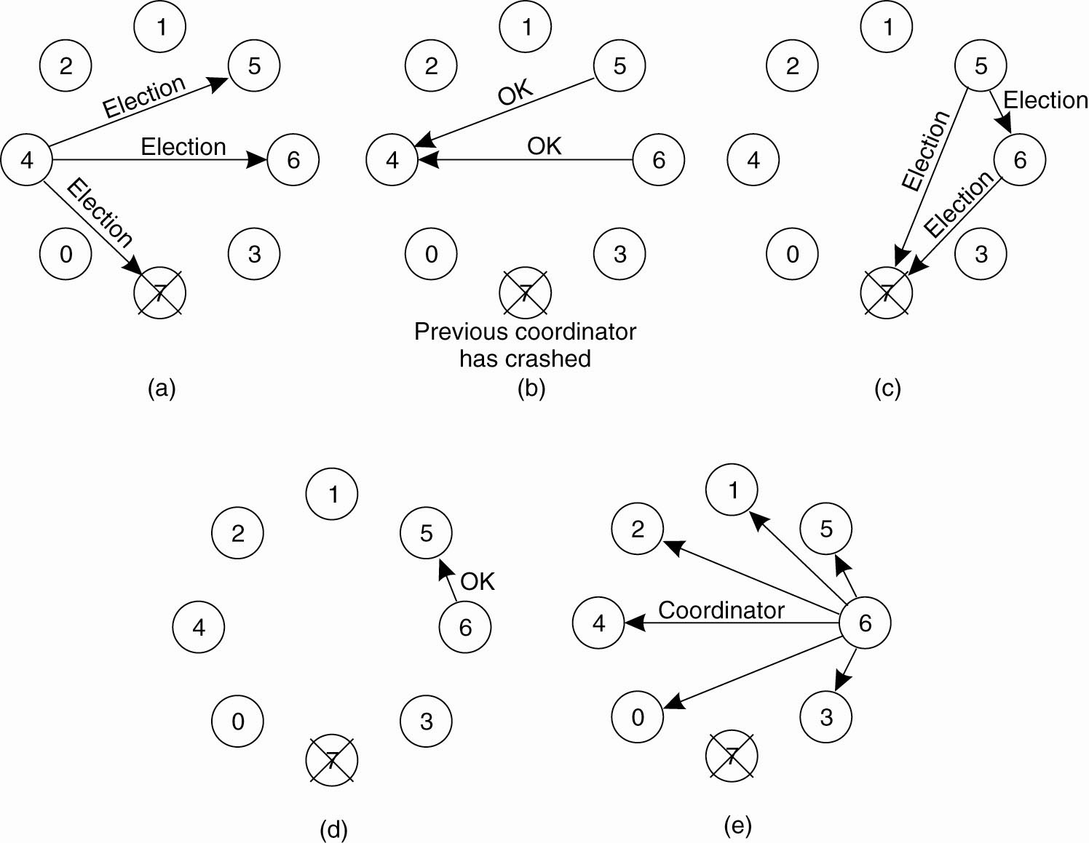
The Bully Algorithm (1)
(a) Process 4 holds an election
(b) Processes 5 and 6 respond, telling 4 to stop.
(c) Now 5 and 6 each hold an election.

Slide 28
The Bully Algorithm (2)
(d) Process 6 tells 5 to stop
(e) Process 6 wins and tells everyone.

Slide 29
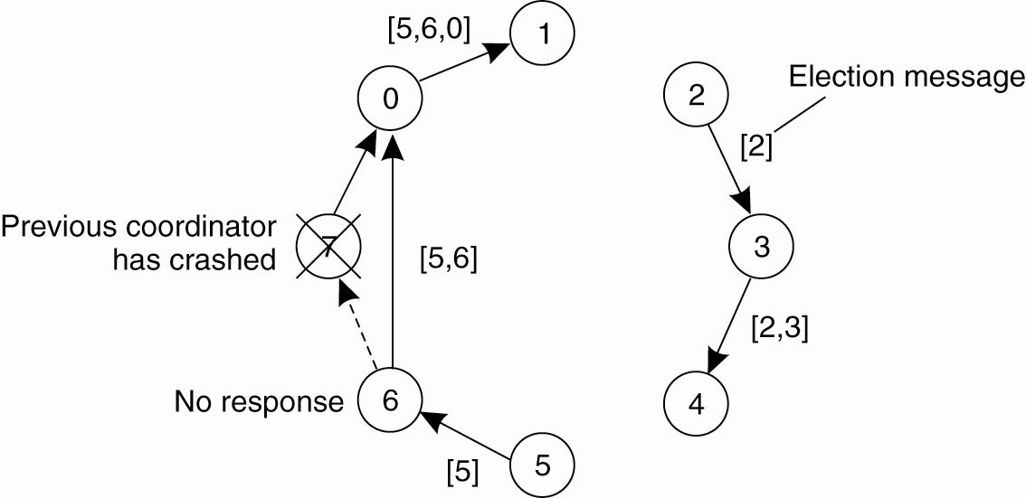
A Ring Algorithm

Slide 30
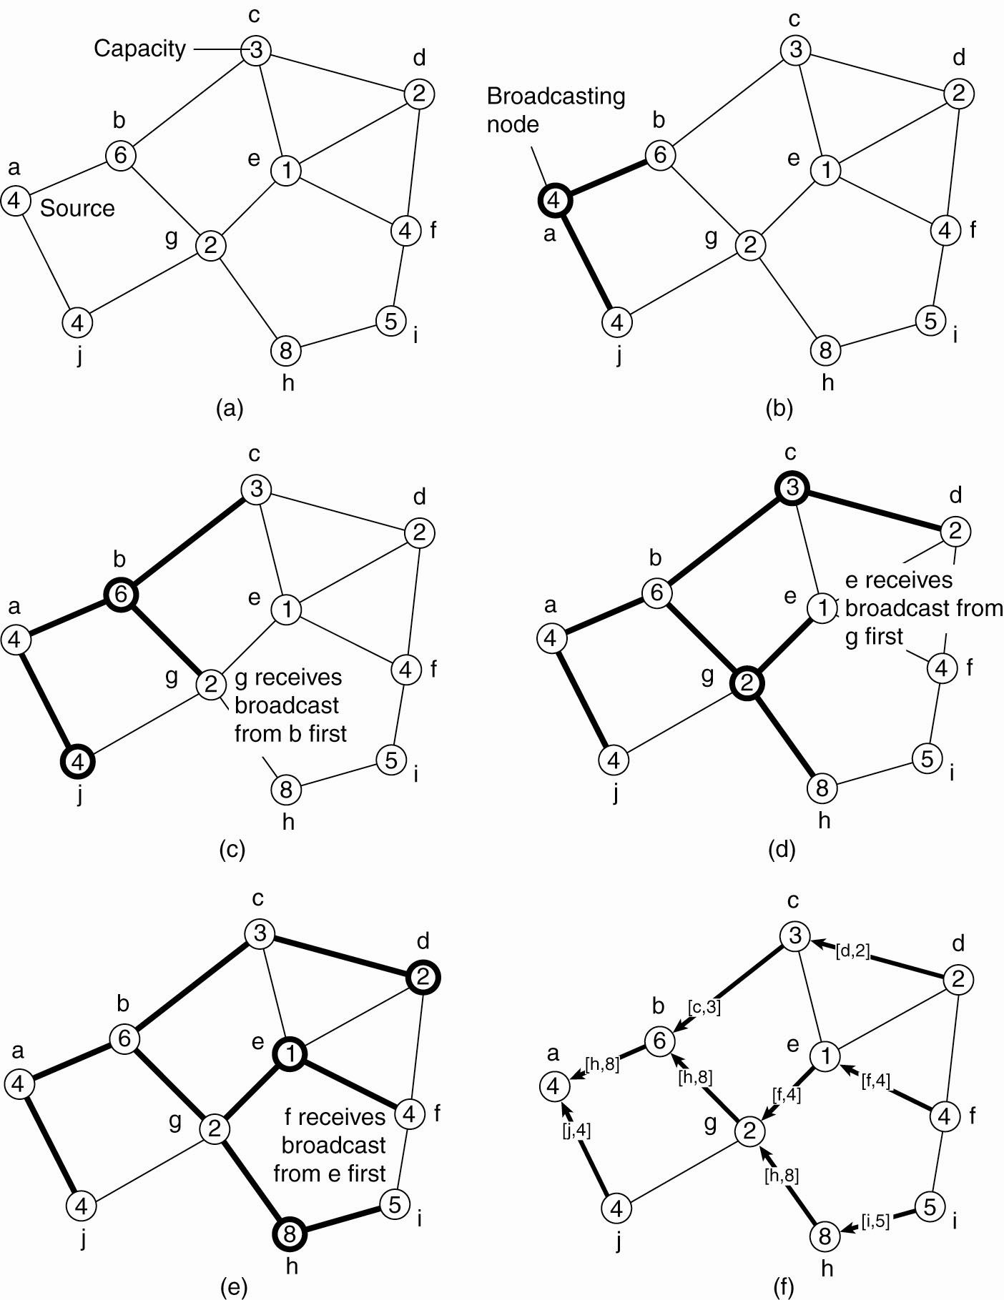
Elections in Wireless Environments (1)
node a as the source
The build-tree phase

Slide 31
Elections in Wireless Environments (2)
Figure 6-22. Election algorithm in a wireless network, with node a as the source. (a) Initial network. (b)–(e) The build-tree phase

Slide 32
Elections in Wireless Environments (3)
Reporting of best node to source.

Slide 33
Important Lessons
Lamport & vector clocks both give a logical timestamps
  Total ordering vs. causal ordering
Other issues in coordinating node activities
  Exclusive access to resources
  Choosing a single leader

Slide 34
Lamport’s Logical Clocks (1)
The "happens-before" relation → can be observed directly in two situations:
If a and b are events in the same process, and a occurs before b, then a → b is true.
If a is the event of a message being sent by one process, and b is the event of the message being received by another process, then a → b

Slide 35
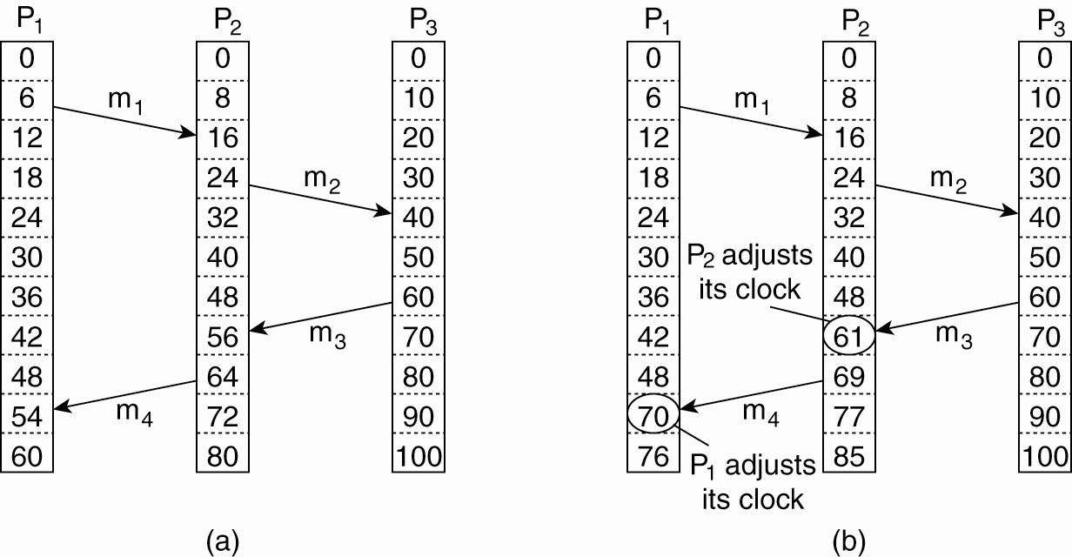
Lamport’s Logical Clocks (2)
Three processes, each with its own clock.
The clocks run at different rates.

Slide 36
Lamport’s Logical Clocks (3)
Lamport’s algorithm corrects the clocks.

Slide 37
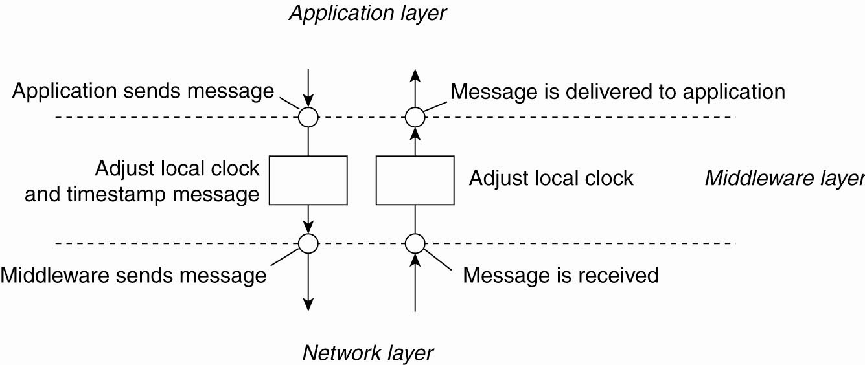
Lamport’s Logical Clocks (4)
The positioning of Lamport’s logical
clocks in distributed systems.

Slide 38
Lamport’s Logical Clocks (5)
Updating counter C_{i} for process P_{i}
Before executing an event P_{i} executes
C_{i} ← C_{i} + 1.
When process P_{i} sends a message m to P_{j}, it sets m’s timestamp ts (m) equal to C_{i} after having executed the previous step.
Upon the receipt of a message m, process P_{j} adjusts its own local counter as
C_{j} ← max{C_{j} , ts (m)}, after which it then executes the first step and delivers the message to the application.

Slide 39
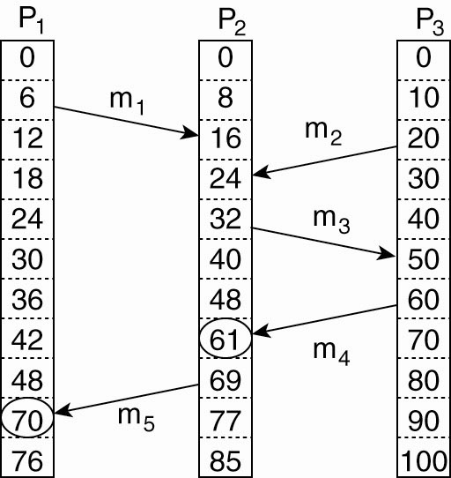
Vector Clocks (1)
Concurrent message transmission using logical clocks.

Slide 40
Vector Clocks (2)
Vector clocks are constructed by letting each process P_{i} maintain a vector VC_{i} with the following two properties:
VC_{i} [ i ] is the number of events that have occurred so far at P_{i}. In other words, VC_{i} [ i ] is the local logical clock at process P_{i} .
If VC_{i} [ j ] = k then P_{i} knows that k events have occurred at P_{j}. It is thus P_{i}’s knowledge of the local time at P_{j} .

Slide 41
Vector Clocks (3)
Steps carried out to accomplish property 2 of previous slide:
Before executing an event P_{i} executes
VC_{i} [ i ] ← VC_{i} [i ] + 1.
When process P_{i} sends a message m to P_{j}, it sets m’s (vector) timestamp ts (m) equal to VC_{i} after having executed the previous step.
Upon the receipt of a message m, process P_{j} adjusts its own vector by setting
VC_{j} [k ] ← max{VC_{j} [k ], ts (m)[k ]} for each k, after which it executes the first step and delivers the message to the application.

Slide 42
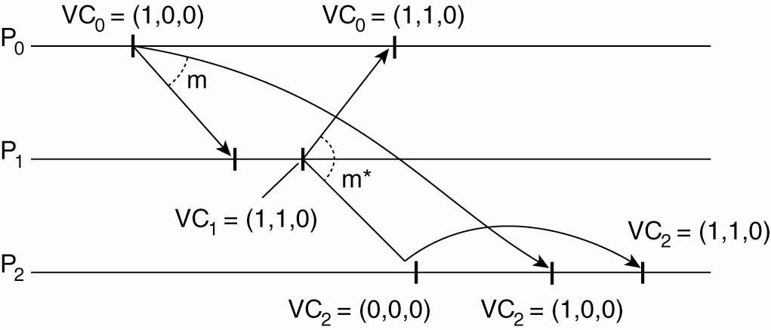
Enforcing Causal Communication
Enforcing causal communication

