Slide 1
15-446 Distributed Systems
Spring 2009
L-7 RPC

Slide 2
Last Lecture
Important Lessons - Naming
Naming is a powerful tool in system design
  A layer of indirection can solve many problems
Name+context to value translation → binding
How to determine context?
  Implicit → from environment
  Explicit → e.g., recursive names
  Search paths
Structure of names
  Implications on lookup, flexibility
Late binding
How DNS works

Slide 3
Today's Lecture
RPC overview
RPC transparency
RPC implementation issues

Slide 4
Client-server architecture
Client sends a request, server replies w. a response
  Interaction fits many applications
  Naturally extends to distributed computing
Why do people like client/server architecture?
  Provides fault isolation between modules
  Scalable performance (multiple servers)
  Central server:
    Easy to manage
    Easy to program

Slide 5
Remote procedure call
A remote procedure call makes a call to a remote service look like a local call
  RPC makes transparent whether server is local or remote
  RPC allows applications to become distributed transparently
  RPC makes architecture of remote machine transparent

Slide 6
Developing with RPC
Define APIs between modules
  Split application based on function, ease of development, and ease of maintenance
  Don’t worry whether modules run locally or remotely
Decide what runs locally and remotely
  Decision may even be at run-time
Make APIs bullet proof
  Deal with partial failures

Slide 7
Stubs: obtaining transparency
Compiler generates from API stubs for a procedure on the client and server
Client stub
  Marshals arguments into machine-independent format
  Sends request to server
  Waits for response
  Unmarshals result and returns to caller
Server stub
  Unmarshals arguments and builds stack frame
  Calls procedure
  Server stub marshalls results and sends reply

Slide 8
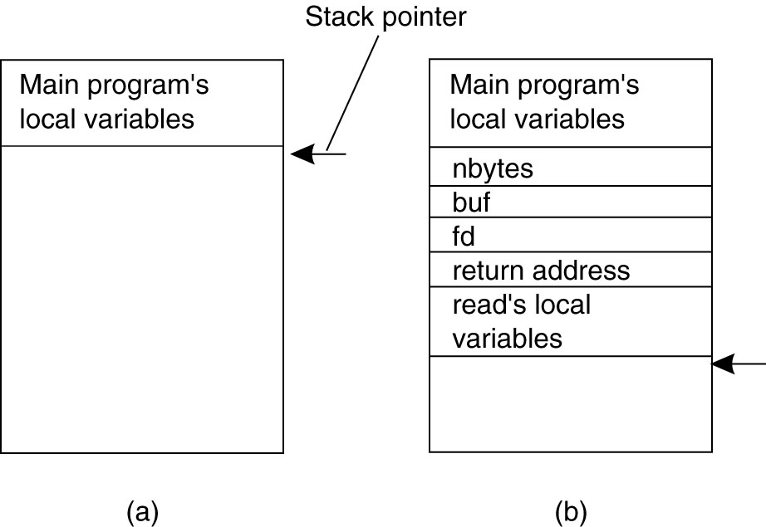
Conventional Procedure Call
(a) Parameter passing in a local procedure call: the stack before the call to read
(b) The stack while the called procedure – read(fd, buf, nbytes) - is active.

Slide 9
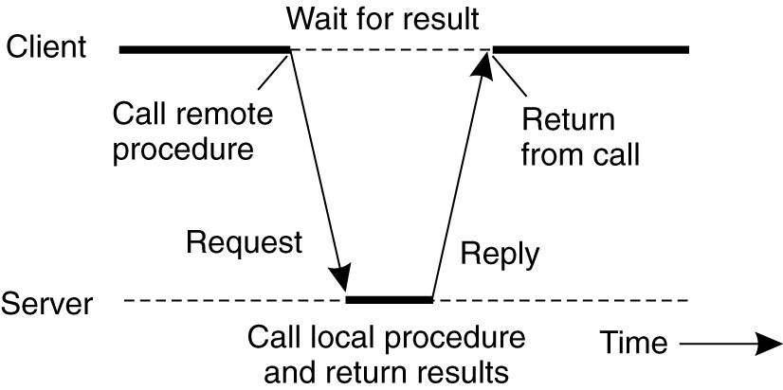
Client and Server Stubs
Principle of RPC between a client and server program.

Slide 10
Remote Procedure Calls (1)
A remote procedure call occurs in the following steps:
The client procedure calls the client stub in the normal way.
The client stub builds a message and calls the local operating system.
The client’s OS sends the message to the remote OS.
The remote OS gives the message to the server stub.
The server stub unpacks the parameters and calls the server.
Continued …

Slide 11
Remote Procedure Calls (2)
A remote procedure call occurs in the following steps (continued):
The server does the work and returns the result to the stub.
The server stub packs it in a message and calls its local OS.
The server’s OS sends the message to the client’s OS.
The client’s OS gives the message to the client stub.
The stub unpacks the result and returns to the client.

Slide 12
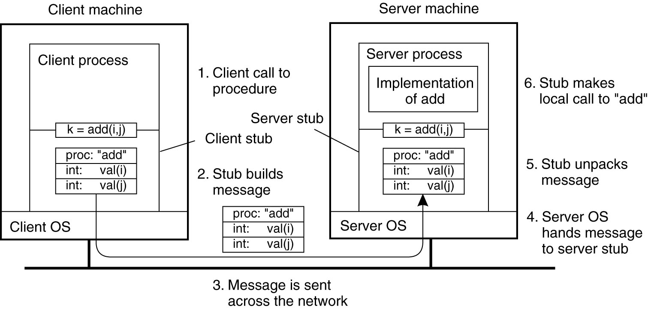
Passing Value Parameters (1)
The steps involved in a doing a
remote computation through RPC.

Slide 13

Passing Value Parameters (2)
Original message on the Pentium
The message after receipt on the SPARC
The message after being inverted. The little numbers in boxes indicate the address of each byte

Slide 14
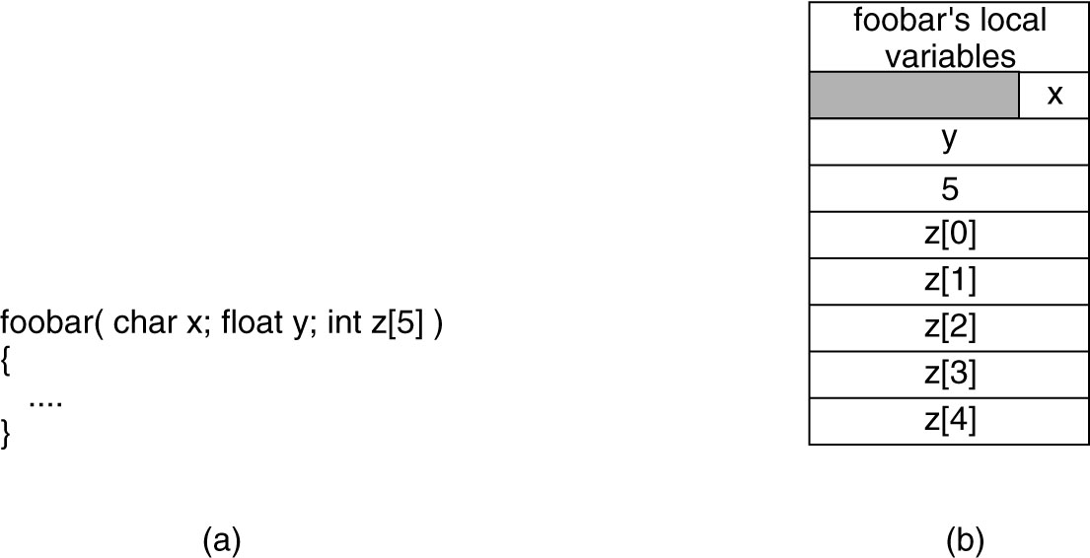
Parameter Specification and Stub Generation
(a) A procedure
(b) The corresponding
message.

Slide 15
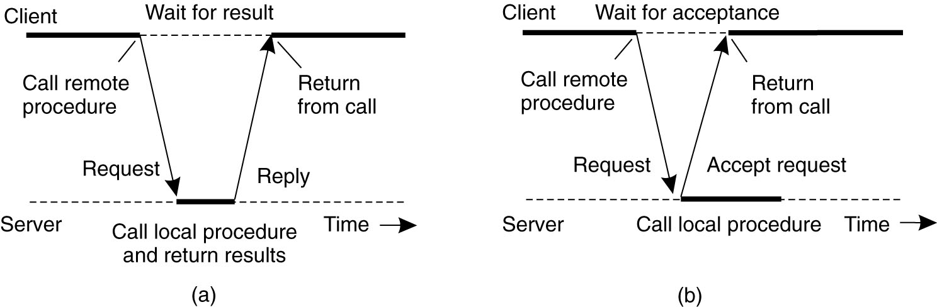
Asynchronous RPC (1)
The interaction between client and
server in a traditional RPC.

Slide 16
Asynchronous RPC (2)
The interaction using asynchronous RPC.

Slide 17
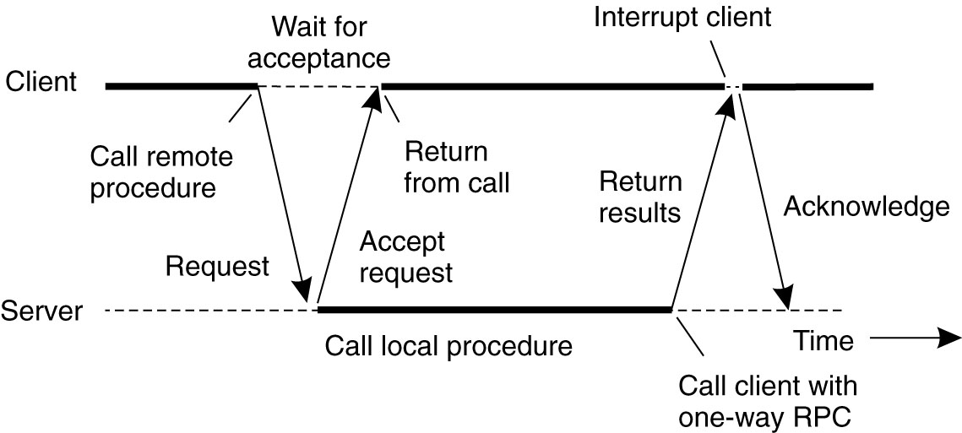
Asynchronous RPC (3)
A client and server interacting through
two asynchronous RPCs.

Slide 18
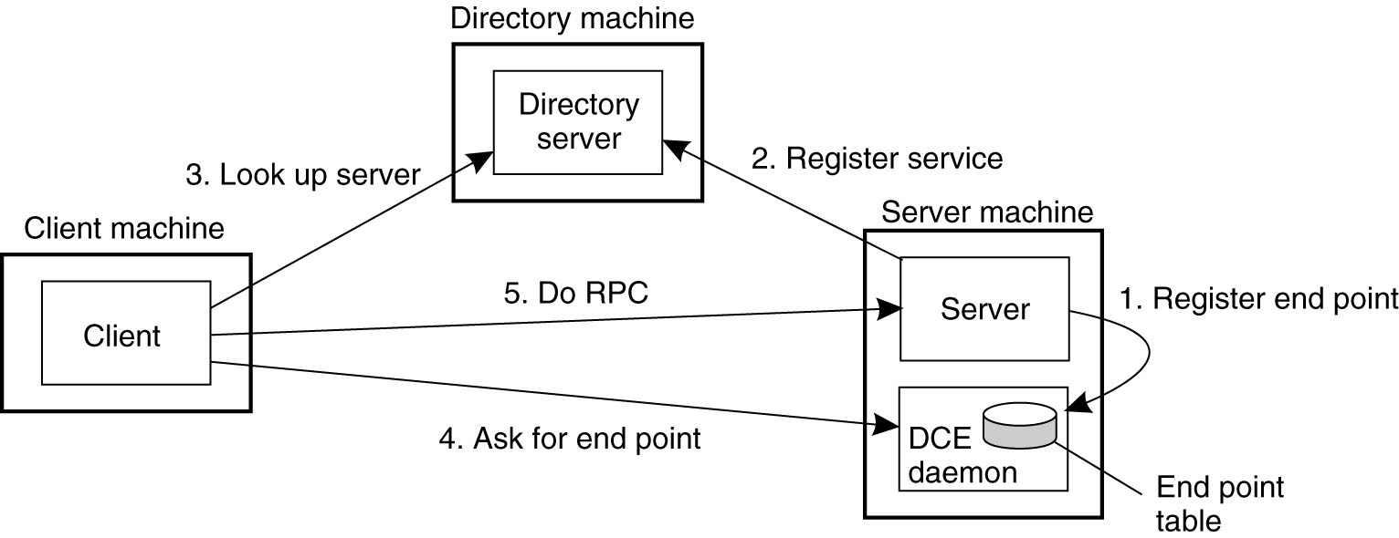
Binding a Client to a Server
Registration of a server makes it possible for a client to locate the server and bind to it
Server location is done in two steps:
  Locate the server’s machine.
  Locate the server on that machine.

Slide 19
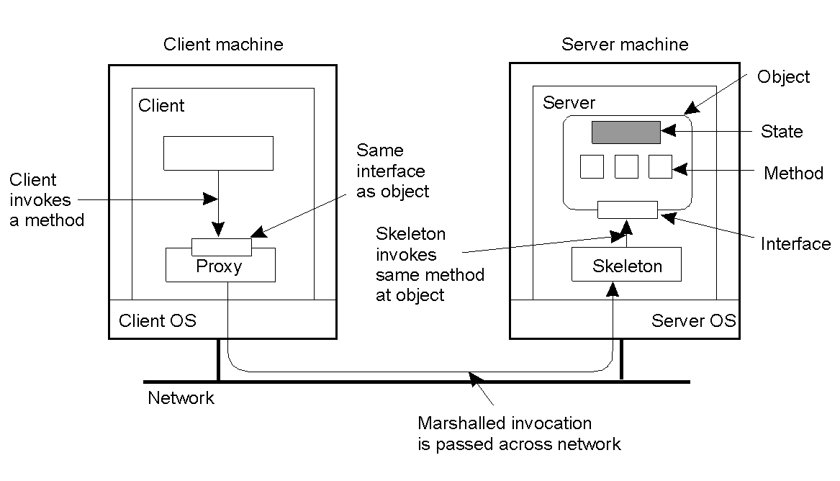
Distributed Objects
Common organization of a remote object with client-side proxy.

Slide 20
Today's Lecture
RPC overview
RPC transparency
RPC implementation issues

Slide 21
RPC vs. LPC
4 properties of distributed computing that make achieving transparency difficult:
  Partial failures
  Latency
  Memory access

Slide 22
Passing Reference Parameters
Replace with pass by copy/restore
Need to know size of data to copy
  Difficult in some programming languages
Solves the problem only partially
  What about data structures containing pointers?
  Access to memory in general?

Slide 23
Partial failures
In local computing:
  if machine fails, application fails
In distributed computing:
  if a machine fails, part of application fails
  one cannot tell the difference between a machine failure and network failure
How to make partial failures transparent to client?

Slide 24
Strawman solution
Make remote behavior identical to local behavior:
  Every partial failure results in complete failure
    You abort and reboot the whole system
  You wait patiently until system is repaired
Problems with this solution:
  Many catastrophic failures
  Clients block for long periods
    System might not be able to recover

Slide 25
Real solution: break transparency
Possible semantics for RPC:
  Exactly-once
    Impossible in practice
  At least once:
    Only for idempotent operations
  At most once
    Zero, don’t know, or once
  Zero or once
    Transactional semantics
At-most-once most practical
  But different from LPC

Slide 26
Summary: expose remoteness to client
Expose RPC properties to client, since you cannot hide them
Application writers have to decide how to deal with partial failures
  Consider: E-commerce application vs. game

Slide 27
Today's Lecture
RPC overview
RPC transparency
RPC implementation issues

Slide 28
RPC implementation
Stub compiler
  Generates stubs for client and server
  Language dependent
  Compile into machine-independent format
    E.g., XDR
  Format describes types and values
RPC protocol
RPC transport

Slide 29
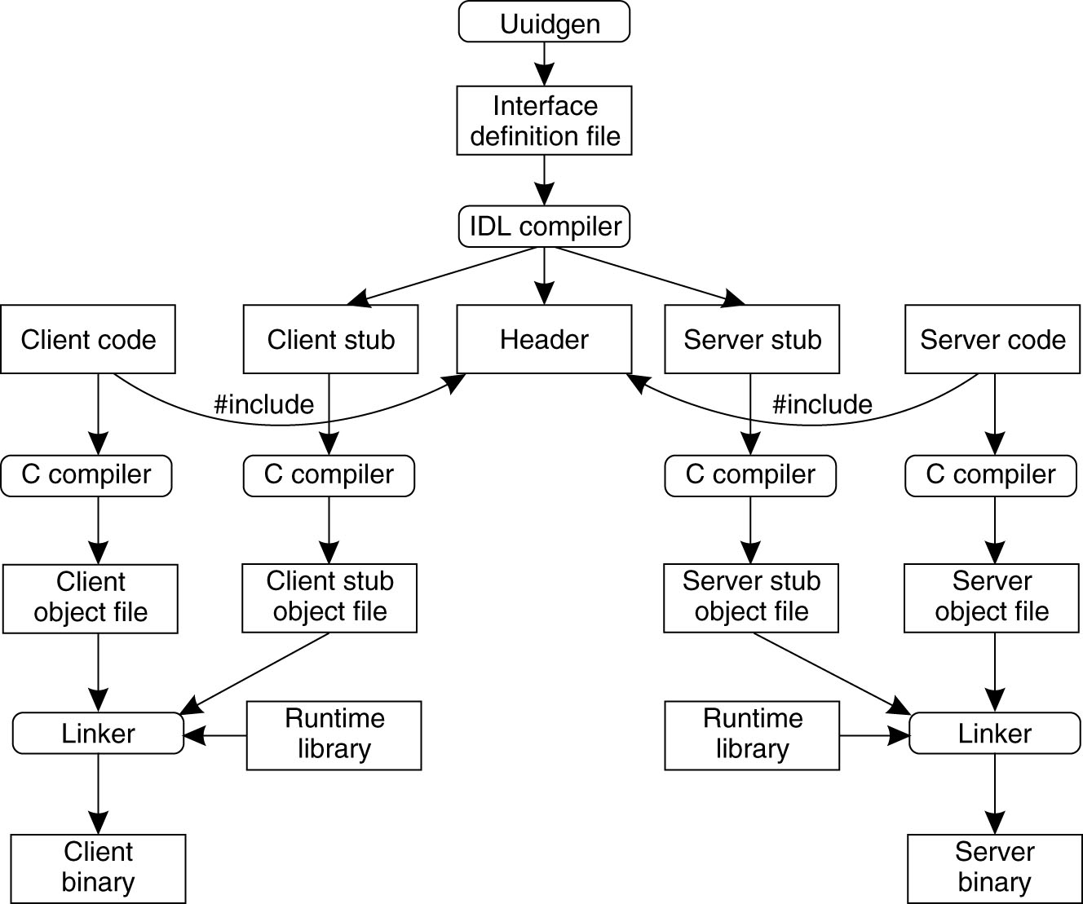
Writing a Client and a Server (1)
The steps in writing a
client and a server in
DCE RPC.

Slide 30
Writing a Client and a Server (2)
Three files output by the IDL compiler:
A header file (e.g., interface.h, in C terms).
The client stub.
The server stub.

Slide 31
RPC protocol
Guarantee at-most-once semantics by tagging requests and response with a nonce
RPC request header:
  Request nonce
  Service Identifier
  Call identifier
Protocol:
  Client resends after time out
  Server maintains table of nonces and replies

Slide 32
RPC transport
Use reliable transport layer
  Flow control
  Congestion control
  Reliable message transfer
Combine RPC and transport protocol
  Reduce number of messages
    RPC response can also function as acknowledgement for message transport protocol

Slide 33
Important Lessons
Procedure calls
  Simple way to pass control and data
  Elegant transparent way to distribute application
  Not only way…
Hard to provide true transparency
  Failures
  Performance
  Memory access
  Etc.
How to deal with hard problem → give up and let programmer deal with it
  “Worse is better”

Slide 34
Next Lecture
Time Synchronization
NTP

Slide 36
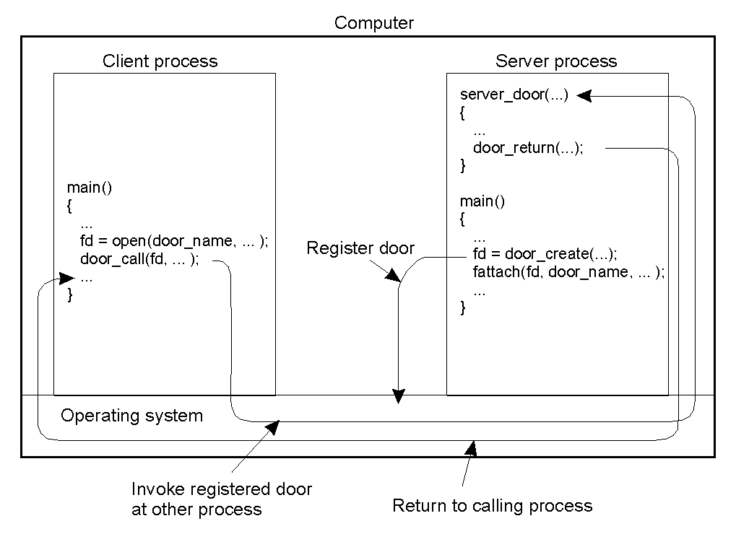
Doors
The principle of using doors as IPC mechanism.

Slide 37
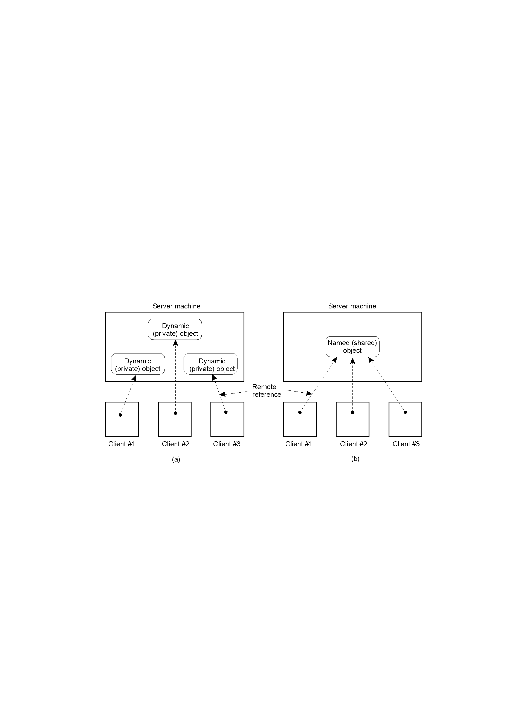
The DCE Distributed-Object Model
2-19
Distributed dynamic objects in DCE.
Distributed named objects

Slide 38
Binding a Client to an Object
Distr_object* obj_ref; //Declare a systemwide object reference
obj_ref = …; // Initialize the reference to a distributed object
obj_ref-> do_something(); // Implicitly bind and invoke a method
(a)
Distr_object objPref; //Declare a systemwide object reference
Local_object* obj_ptr; //Declare a pointer to local objects
obj_ref = …; //Initialize the reference to a distributed object
obj_ptr = bind(obj_ref); //Explicitly bind and obtain a pointer to the local proxy
obj_ptr -> do_something(); //Invoke a method on the local proxy
(b)
(a) Example with implicit binding using only global references
(b) Example with explicit binding using global and local references

Slide 39
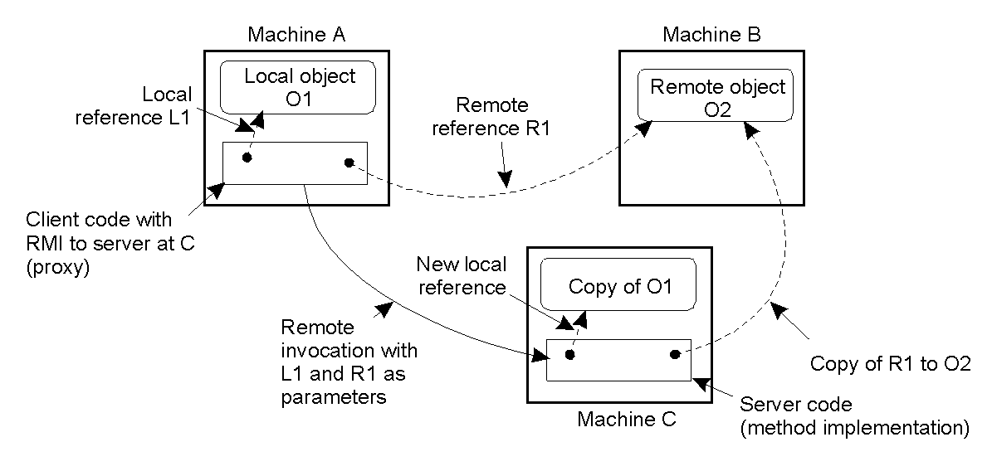
Parameter Passing
The situation when passing an object by reference or by value.
2-18

Slide 40
Example: NFSv2
Old file system API used in distributed computing
  No current directory
  No file descriptors
  No streams (unnamed pipes)
  No close
Inodes are named by file handles:
  Opaque to client
  Servers stores inode and device number
Open() RPC translates names to file handles

Slide 41
NFS implementation
Uses RPC
  Marshals data structures in XDR format
    Pointers for directories
  Generates stubs at client and server
State-less protocol
  Client maintains no state (No close() RPC!)
  Server has no crucial runtime state
    File handles contain info to recover from server reboots
NFS semantics:
  Soft mounting: zero or more
  Hard mounting: one or more

Slide 42
Implementation of write
Semantics of writes:
  Write-through (no close() RPC)
What are possible outcomes after server failure:
  Failed (stale file handle, I/O error)
  Succeeded (NFS OK)
  Don’t know (Client cannot tell!)
    Rename() example
  Might happen multiple times

Slide 43
NFS RPC summary
Remote service is not transparent
  API is different
  Failure semantics are different
    Not specified
    File systems semantics are unspecified!
  Concurrency semantics awkard

Slide 44
Where RPC transparency breaks
True concurrency
  Clients run truely concurrently
    client() {
    if (exists(file))
      if (!remove(file)) abort(“remove failed??”);
    }
RPC latency is high
  Orders of magnitude larger than LPC’s
Memory access
  Pointers are local to an address space

