Slide 1
15-446 Distributed Systems
Spring 2009
L-6 Naming

Slide 2
Today's Lecture
Naming overview
DNS
Service location
Server selection

Slide 3
Names
Names are associated with objects
  Enables passing of references to objects
  Indirection
  Deferring decision on meaning/binding
Examples
  Registers → R5
  Memory → 0xdeadbeef
  Host names → srini.com
  User names → sseshan
  Email → srini@cmu.edu
  File name → /usr/srini/foo.txt
  URLs → http://www.srini.com/index.html

Slide 4
Naming Model
3 key elements
Name space
  Alphabet of symbols + syntax that specify names
Name-mapping
  Associates each name to some value in…
Universe of values
  Typically an object or another name from original name space (or another name space)
Name-to-value mapping is called a “binding” i.e. name is bound to value

Slide 5
Names
Uniqueness
  One-to-one mapping
  One-to-many or many-to-one (name-to-value) mappings
  Context sensitive resolution
Stable binding
  Names that are never reused
  Values that can only have one name
  E.g. using MD5 of file contents, bank account numbers
Reverse lookup support

Slide 6
Name Mapping
Names are mapped to values within some context
  E.g., different lookup tables for names in different settings
Two sources for context
  Resolver can supply default context
  Name can specify an explicit context to use → qualified name
  E.g. working directory vs. absolute path name

Slide 7
Context
Common problem → what context to use for names without context
Consider email from CMU
  To: srini, dongsu@gmail.com
  What happens when dongsu replies to all?
    What context will he email srini
  Solutions:
    Sendmail converts all address to qualified names
      Not in body of message
    Provide context information in email header
      E.g. like base element in HTML

Slide 8
Name Lookup Styles
Table lookup
  Simple, table per context
Recursive
  Names consist of context + name
  E.g. path + filename, hostname + domain name
  Context name must also be resolved
    Need special context such as “root” built into resolver
Multiple lookup
  Try multiple contexts to resolve name → search paths

Slide 9
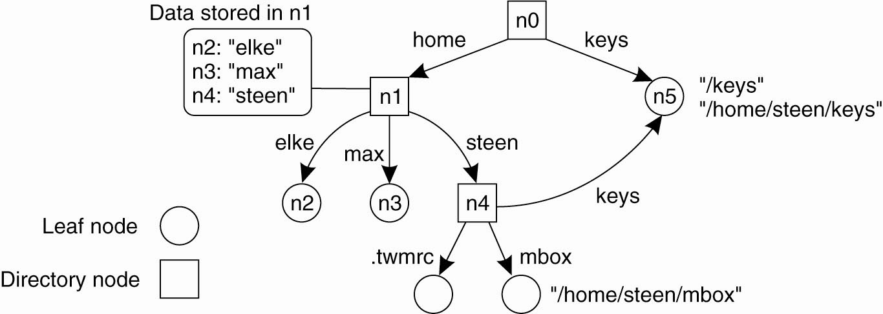
Recursive Name Spaces
A general naming graph with a single root node.

Slide 10
Name Discovery
Well-known name
  www.google.com, port 80…
Broadcast
  Advertise name → e.g. 802.11 Beacons
Query
  Use google
Broadcast query
  802.11 probes
Use another naming system
  DNS returns IP addresses
Introductions
  Web page hyperlinks
Physical rendezvous
  Exchange info in the real world

Slide 11
Today's Lecture
Naming overview
DNS
Service location
Server selection

Slide 12
Naming
How do we efficiently locate resources?
  DNS: name → IP address
Challenge
  How do we scale these to the wide area?

Slide 13
Obvious Solutions (1)
Why not centralize DNS?
Single point of failure
Traffic volume
Distant centralized database
Single point of update
Doesn’t scale!

Slide 14
Obvious Solutions (2)
Why not use /etc/hosts?
Original Name to Address Mapping
  Flat namespace
  /etc/hosts
  SRI kept main copy
  Downloaded regularly
Count of hosts was increasing: machine per domain → machine per user
  Many more downloads
  Many more updates

Slide 15
Domain Name System Goals
Basically a wide-area distributed database
Scalability
Decentralized maintenance
Robustness
Global scope
  Names mean the same thing everywhere
Don’t need
  Atomicity
  Strong consistency
Notes:
ACID
Atomic
Consistent
Isolated
Durable

Slide 16
Typical Resolution
Steps for resolving www.cmu.edu
  Application calls gethostbyname() (RESOLVER)
  Resolver contacts local name server (S₁)
  S₁ queries root server (S₂) for (www.cmu.edu)
  S₂ returns NS record for cmu.edu (S₃)
  What about A record for S₃?
    This is what the additional information section is for (PREFETCHING)
  S₁ queries S₃ for www.cmu.edu
  S₃ returns A record for www.cmu.edu
Can return multiple A records → what does this mean?

Slide 17
Lookup Methods
Recursive query:
Server goes out and searches for more info (recursive)
Only returns final answer or “not found”
Iterative query:
Server responds with as much as it knows (iterative)
“I don’t know this name, but ask this server”
Workload impact on choice?
Local server typically does recursive
Root/distant server does iterative
root name server
2
iterated query
3
4
7
local name server
dns.eurecom.fr
intermediate name server
dns.umass.edu
5
6
1
8
authoritative name server
dns.cs.umass.edu
requesting host
surf.eurecom.fr
gaia.cs.umass.edu

Slide 18
Workload and Caching
Are all servers/names likely to be equally popular?
  Why might this be a problem? How can we solve this problem?
DNS responses are cached
  Quick response for repeated translations
  Other queries may reuse some parts of lookup
    NS records for domains
DNS negative queries are cached
  Don’t have to repeat past mistakes
  E.g. misspellings, search strings in resolv.conf
Cached data periodically times out
  Lifetime (TTL) of data controlled by owner of data
  TTL passed with every record

Slide 19
Typical Resolution
root & edu
DNS server
www.cs.cmu.edu
www.cs.cmu.edu
NS ns1.cmu.edu
ns1.cmu.edu
DNS server
Local
DNS server
NS ns1.cs.cmu.edu
Client
ns1.cs.cmu.edu
DNS
server
A www=IPaddr

Slide 20
Subsequent Lookup Example
root & edu
DNS server
ftp.cs.cmu.edu
cmu.edu
DNS server
Local
DNS server
Client
ftp.cs.cmu.edu
cs.cmu.edu
DNS
server
ftp=IPaddr

Slide 21
Reverse DNS
unnamed root
Task
  Given IP address, find its name
Method
  Maintain separate hierarchy based on IP names
  Write 128.2.194.242 as 242.194.128.2.in-addr.arpa
    Why is the address reversed?
Managing
  Authority manages IP addresses assigned to it
  E.g., CMU manages name space 128.2.in-addr.arpa
arpa
edu
in-addr
cmu
128
cs
2
cmcl
194
kittyhawk
128.2.194.242
242

Slide 22
.arpa Name Server Hierarchy
in-addr.arpa
a.root-servers.net • • • m.root-servers.net
chia.arin.net
(dill, henna, indigo, epazote, figwort, ginseng)
128
cucumber.srv.cs.cmu.edu,
t-ns1.net.cmu.edu
t-ns2.net.cmu.edu
2
194
mango.srv.cs.cmu.edu
(peach, banana, blueberry)
At each level of hierarchy, have group of servers that are authorized to handle that region of hierarchy
kittyhawk
128.2.194.242

Slide 23
Prefetching
Name servers can add additional data to response
Typically used for prefetching
  CNAME/MX/NS typically point to another host name
  Responses include address of host referred to in “additional section”

Slide 24
Mail Addresses
MX records point to mail exchanger for a name
  E.g. mail.acm.org is MX for acm.org
Addition of MX record type proved to be a challenge
  How to get mail programs to lookup MX record for mail delivery?
  Needed critical mass of such mailers

Slide 25
DNS (Summary)
Motivations → large distributed database
  Scalability
  Independent update
  Robustness
Hierarchical database structure
  Zones
  How is a lookup done
Caching/prefetching and TTLs
Reverse name lookup
What are the steps to creating your own domain?

Slide 26
Today's Lecture
Naming overview
DNS
Service location
Server selection

Slide 27
Service Location
What if you want to lookup services with more expressive descriptions than DNS names
  E.g. please find me printers in cs.cmu.edu instead of laserjet1.cs.cmu.edu
What do descriptions look like?
How is the searching done?
How will it be used?
  Search for particular service?
  Browse available services?
  Composing multiple services into new service?

Slide 28
Service Descriptions
Typically done as hierarchical value-attribute pairs
  Type = printer → memory = 32MB, lang = PCL
  Location = CMU → building = WeH
Hierarchy based on attributes or attributes-values?
  E.g. Country → state or country=USA → state=PA and country=Canada → province=BC?
Can be done in something like XML

Slide 29
Service Discovery (Multicast)
Services listen on well known discovery group address
Client multicasts query to discovery group
Services unicast replies to client
Tradeoffs
  Not very scalable → effectively broadcast search
  Requires no dedicated infrastructure or bootstrap
  Easily adapts to availability/changes
  Can scope request by multicast scoping and by information in request

Slide 30
Service Discovery (Directory Based)
Services register with central directory agent
  Soft state → registrations must be refreshed or the expire
Clients send query to central directory → replies with list of matches
Tradeoffs
  How do you find the central directory service?
    Typically using multicast based discovery!
    SLP also allows directory to do periodic advertisements
  Need dedicated infrastructure
  How do directory agents interact with each other?
  Well suited for browsing and composition → knows full list of services

Slide 31
Other Issues
Dynamic attributes
  Many queries may be based on attributes such as load, queue length
  E.g., print to the printer with shortest queue
  Bind to value as late as possible
Security
  Don’t want others to serve/change queries
  Also, don’t want others to know about existance of services
    Srini’s home SLP server is advertising the $50,000 MP3 stereo system (come steal me!)

Slide 32
Today's Lecture
Naming overview
DNS
Service location
Server selection

Slide 33
Server Selection
Service is replicated in many places in network
How do direct clients to a particular server?
  As part of routing → anycast, cluster load balancing
  As part of application → HTTP redirect
  As part of naming → DNS
Which server?
  Lowest load → to balance load on servers
  Best performance → to improve client performance
    Based on Geography? RTT? Throughput? Load?
  Any alive node → to provide fault tolerance

Slide 34
Routing Based
Anycast
  Give service a single IP address
  Each node implementing service advertises route to address
  Packets get routed routed from client to “closest” service node
    Closest is defined by routing metrics
    May not mirror performance/application needs
  What about the stability of routes?

Slide 35
Routing Based
Cluster load balancing
  Router in front of cluster of nodes directs packets to server
  Must be done on connection by connection basis – why?
    Forces router to keep per connection state
  How to choose server
    Easiest to decide based on arrival of first packet in exchange
    Primarily based on local load
    Can be based on later packets (e.g. HTTP Get request) but makes system more complex

Slide 36
Application Based
HTTP support simple way to indicate that Web page has moved
Server gets Get request from client
  Decides which server is best suited for particular client and object
  Returns HTTP redirect to that server
Can make informed application specific decision
May introduce additional overhead → multiple connection setup, name lookups, etc.
While good solution in general HTTP Redirect has some design flaws – especially with current browsers

Slide 37
Naming Based
Client does name lookup for service
Name server chooses appropriate server address
What information can it base decision on?
  Server load/location → must be collected
  Name service client
    Typically the local name server for client
Round-robin
  Randomly choose replica
  Avoid hot-spots
[Semi-]static metrics
  Geography
  Route metrics
  How well would these work?

Slide 38
Naming Based
Predicted application performance
  How to predict?
  Only have limited info at name resolution
Multiple techniques
  Static metrics to get coarse grain answer
  Current performance among smaller group
How does this affect caching?
  Typically want low TTL to adapt to load changes
  What does the first and subsequent lookup do?

Slide 39
Summary
Naming is a powerful tool in system design
  A layer of indirection can solve many problems
Wide range of naming styles, resolution techniques
  Must choose the one appropriate to system needs/tradeoffs

Slide 40
Next Lecture
RPC
Read original Birrell & Nelson paper on RPC

Slide 41
Outline
DNS Design
DNS Today

Slide 42
Root Zone
Generic Top Level Domains (gTLD) = .com, .net, .org, etc…
Country Code Top Level Domain (ccTLD) = .us, .ca, .fi, .uk, etc…
Root server ({a-m}.root-servers.net) also used to cover gTLD domains
  Load on root servers was growing quickly!
  Moving .com, .net, .org off root servers was clearly necessary to reduce load → done Aug 2000

Slide 43
gTLDs
Unsponsored
  .com, .edu, .gov, .mil, .net, .org
  .biz → businesses
  .info → general info
  .name → individuals
Sponsored (controlled by a particular association)
  .aero → air-transport industry
  .cat → catalan related
  .coop → business cooperatives
  .jobs → job announcements
  .museum → museums
  .pro → accountants, lawyers, and physicians
  .travel → travel industry
Starting up
  .mobi → mobile phone targeted domains
  .post → postal
  .tel → telephone related
Proposed
  .asia, .cym, .geo, .kid, .mail, .sco, .web, .xxx

Slide 44
New Registrars
Network Solutions (NSI) used to handle all registrations, root servers, etc…
  Clearly not the democratic (Internet) way
  Large number of registrars that can create new domains → However NSI still handles A root server

Slide 45
Measurements of DNS
No centralized caching per site
  Each machine runs own caching local server
  Why is this a problem?
  How many hosts do we need to share cache? → recent studies suggest 10-20 hosts
“Hit rate for DNS = 80% → 1 - (#DNS/#connections)
  Is this good or bad?
  Most Internet traffic was Web with HTTP 1.0
    What does a typical page look like? → average of 4-5 imbedded objects → needs 4-5 transfers
    This alone accounts for 80% hit rate!
Lower TTLs for A records does not affect performance
DNS performance really relies more on NS-record caching

Slide 46
Tracing Hierarchy (1)
Dig Program
  Allows querying of DNS system
  Use flags to find name server (NS)
  Disable recursion so that operates one step at a time
  All .edu names handled by set of servers
unix> dig +norecurse @a.root-servers.net NS kittyhawk.cmcl.cs.cmu.edu
;; AUTHORITY SECTION:
edu. 172800 IN NS L3.NSTLD.COM.
edu. 172800 IN NS D3.NSTLD.COM.
edu. 172800 IN NS A3.NSTLD.COM.
edu. 172800 IN NS E3.NSTLD.COM.
edu. 172800 IN NS C3.NSTLD.COM.
edu. 172800 IN NS F3.NSTLD.COM.
edu. 172800 IN NS G3.NSTLD.COM.
edu. 172800 IN NS B3.NSTLD.COM.
edu. 172800 IN NS M3.NSTLD.COM.

Slide 47
Tracing Hierarchy (2)
3 servers handle CMU names
unix> dig +norecurse @e3.nstld.com NS kittyhawk.cmcl.cs.cmu.edu
;; AUTHORITY SECTION:
cmu.edu. 172800 IN NS CUCUMBER.SRV.cs.cmu.edu.
cmu.edu. 172800 IN NS T-NS1.NET.cmu.edu.
cmu.edu. 172800 IN NS T-NS2.NET.cmu.edu.

Slide 48
Tracing Hierarchy (3 & 4)
4 servers handle CMU CS names
Quasar is master NS for this zone
unix> dig +norecurse @t-ns1.net.cmu.edu NS kittyhawk.cmcl.cs.cmu.edu
;; AUTHORITY SECTION:
cs.cmu.edu. 86400 IN NS MANGO.SRV.cs.cmu.edu.
cs.cmu.edu. 86400 IN NS PEACH.SRV.cs.cmu.edu.
cs.cmu.edu. 86400 IN NS BANANA.SRV.cs.cmu.edu.
cs.cmu.edu. 86400 IN NS BLUEBERRY.SRV.cs.cmu.edu.
unix>dig +norecurse @blueberry.srv.cs.cmu.edu NS kittyhawk.cmcl.cs.cmu.edu
;; AUTHORITY SECTION:
cs.cmu.edu. 300 IN SOA QUASAR.FAC.cs.cmu.edu.
Notes:
Full SOA record…
cs.cmu.edu. 300 IN SOA QUASAR.FAC.cs.cmu.edu. GRIPE.cs.cmu.edu. 2004021352 3600 1800 604800 300

Slide 49
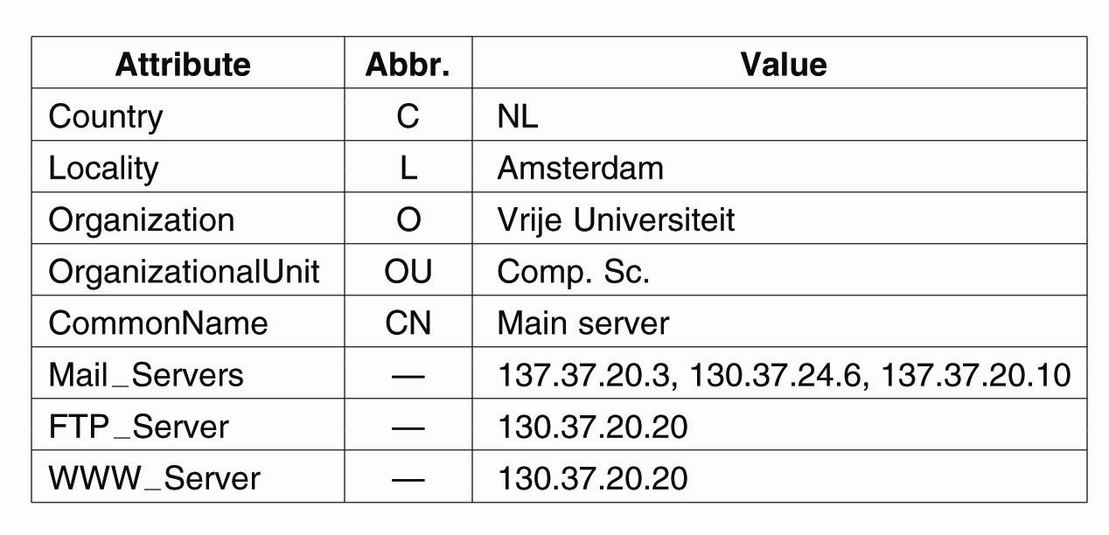
Hierarchical Implementations: LDAP (1)
A simple example of an LDAP directory entry using LDAP naming conventions.

Slide 50
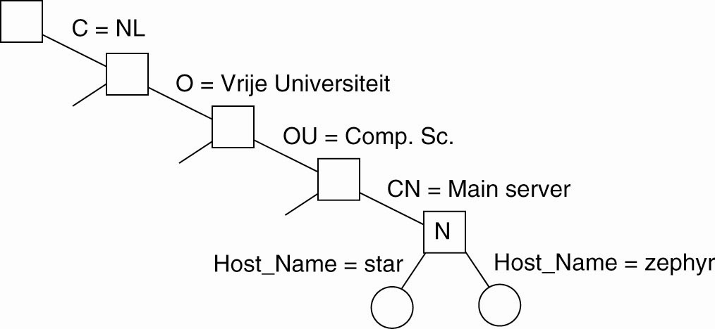
Hierarchical Implementations: LDAP (2)
Part of a directory information tree.

Slide 51
Hierarchical Implementations: LDAP (3)
Two directory entries having Host_Name as RDN.

Slide 52
Figure 9.10
X.500 service architecture
DUA
DSA
DSA
DUA
DSA
DSA
DSA
DUA
DSA

Slide 53
Figure 9.11
Part of the X.500 Directory Information Tree
X.500 Service (root)
...
France (country)
Great Britain (country)
Greece (country)
...
...
BT Plc (organization)
University of Gormenghast (organization)
...
...
Computing Service (organizationalUnit)
Department of Computer Science (organizationalUnit)
Engineering Department (organizationalUnit)
...
...
Departmental Staff (organizationalUnit)
ely (applicationProcess)
Research Students (organizationalUnit)
...
...
Alice Flintstone (person)
...
Pat King (person)
James Healey (person)
Janet Papworth (person)
...

Slide 54
Figure 9.12
An X.500 DIB Entry
info
Alice Flintstone, Departmental Staff, Department of Computer Science,
University of Gormenghast, GB
commonName
uid
Alice.L.Flintstone
alf
Alice.Flintstone
Alice Flintstone
mail
A. Flintstone
alf@dcs.gormenghast.ac.uk
surname
Alice.Flintstone@dcs.gormenghast.ac.uk
Flintstone
roomNumber
telephoneNumber
Z42
+44 986 33 4604
userClass
Research Fellow

Slide 55
Service discovery in Jini
Figure 9.6
admin
1. ‘finance’
Printing
Mobile client
service
lookup service?
admin
Lookup
Client
service
Network
2. Here I am: .....
4. Use printing
service
admin, finance
3. Request
Lookup
Corporate
Printing
printing &
receive
proxy
service
infoservice
service
finance
Jini services register their interfaces and descriptions with the Jini lookup services in their scope
Clients find the Jini lookup services in their scope by IP multicast
Jini lookup service searches by attribute or by interface type
  The designers of Jini argue convincingly that this the only reliable way to do discovery
*

Slide 56
Topics not covered
GNS case study (Section 9.4)
  an early research project (1985) that developed solutions for the problems of:
    large name spaces
    restructuring the name space
X.500 and LDAP (Section 9.5)
  a hierarchically-structured standard directory service designed for world-wide use
  accommodates resource descriptions in a standard form and their retrieval for any resource (online or offline)
  never fully deployed, but the standard forms the basis for LDAP, the Lightweight Directory Access Protocol, which is widely used
Trading services (see Section 17.3)
  Directories of services with retrieval by attribute searching
  Brokers negotiate the contract for the use of a service, including negotiation of attribute such as quality and quantity of service
*

Slide 57
Service Discovery (Routing Based)
Client issues query to overlay network
  Query can include both service description and actual request for service
Overlay network routes query to desired service[s]
If query only description, subsequent interactions can be outside overlay (early-binding)
If query includes request, client can send subsequent queries via overlay (late-binding)
  Subsequent requests may go to different services agents
  Enables easy fail-over/mobility of service
Tradeoffs
  Routing on complex parameters can be difficult/expensive
  Can work especially well in ad-hoc networks
  Can late-binding really be used in many applications?

Slide 58
Wide Area Scaling
How do we scale discovery to wide area?
  Hierarchy?
Hierarchy must be based on attribute of services
  All services must have this attribute
  All queries must include (implicitly or explicitly) this attribute
Tradeoffs
  What attribute? Administrative (like DNS)? Geographic? Network Topologic?
  Should we have multiple hierarchies?
  Do we really need hierarchy? Search engines seem to work fine!

Slide 59
Application Based
HTTP supports simple way to indicate that Web page has moved (30X responses)
Server receives Get request from client
  Decides which server is best suited for particular client and object
  Returns HTTP redirect to that server
Can make informed application specific decision
May introduce additional overhead → multiple connection setup, name lookups, etc.
While good solution in general, but…
  HTTP Redirect has some design flaws – especially with current browsers

Slide 60
Naming Based
Client does name lookup for service
Name server chooses appropriate server address
  A-record returned is “best” one for the client
What information can name server base decision on?
  Server load/location → must be collected
  Information in the name lookup request
    Name service client → typically the local name server for client

Slide 61
How Akamai Works
Clients fetch html document from primary server
  E.g. fetch index.html from cnn.com
URLs for replicated content are replaced in html
  E.g. <img src=“http://cnn.com/af/x.gif”> replaced with <img src=“http://a73.g.akamaitech.net/7/23/cnn.com/af/x.gif”>
Client is forced to resolve aXYZ.g.akamaitech.net hostname

Slide 62
How Akamai Works
How is content replicated?
Akamai only replicates static content (*)
Modified name contains original file name
Akamai server is asked for content
  First checks local cache
  If not in cache, requests file from primary server and caches file
* (At least, the version we’re talking about today. Akamai actually lets sites write code that can run on Akamai’s servers, but that’s a pretty different beast)

Slide 63
How Akamai Works
Root server gives NS record for akamai.net
Akamai.net name server returns NS record for g.akamaitech.net
  Name server chosen to be in region of client’s name server
  TTL is large
G.akamaitech.net nameserver chooses server in region
  Should try to chose server that has file in cache - How to choose?
  Uses aXYZ name and hash
  TTL is small → why?

Slide 64
Simple Hashing
Given document XYZ, we need to choose a server to use
Suppose we use modulo
Number servers from 1…n
  Place document XYZ on server (XYZ mod n)
  What happens when a servers fails? n → n-1
    Same if different people have different measures of n
  Why might this be bad?

Slide 65
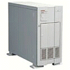

How Akamai Works
cnn.com (content provider)
DNS root server
Akamai server
Get foo.jpg
12
11
Get index.html
1
2
3
5
Akamai high-level DNS server
4
6
7
Akamai low-level DNS server
8
Nearby matching
Akamai server
9
End-user
10
Get /cnn.com/foo.jpg

Slide 66
Akamai – Subsequent Requests
cnn.com (content provider)
DNS root server
Akamai server
Get index.html
1
2
Akamai high-level DNS server
7
Akamai low-level DNS server
8
Nearby matching
Akamai server
9
10
End-user
Get /cnn.com/foo.jpg

