Slide 1
15-446 Distributed Systems
Spring 2009
L-5 Wireless

Slide 2
Wireless Challenges
Force us to rethink many assumptions
Need to share airwaves rather than wire
  Don’t know what hosts are involved
  Host may not be using same link technology
Mobility
Other characteristics of wireless
  Noisy → lots of losses
  Slow
  Interaction of multiple transmitters at receiver
    Collisions, capture, interference
  Multipath interference

Slide 3
Overview
Wireless Links
  802.11
  Bluetooth
Internet Mobility
Performance Issues

Slide 4
Cellular Reuse
Transmissions decay over distance
  Spectrum can be reused in different areas
  Different “LANs”
  Decay is 1/R² in free space, 1/R⁴ in some situations

Slide 5
IEEE 802.11 Wireless LAN
802.11b
  2.4-2.5 GHz unlicensed radio spectrum
  up to 11 Mbps
  direct sequence spread spectrum (DSSS) in physical layer
    all hosts use same chipping code
  widely deployed, using base stations
802.11a
  5-6 GHz range
  up to 54 Mbps
802.11g
  2.4-2.5 GHz range
  up to 54 Mbps
All use CSMA/CA for multiple access
All have base-station and ad-hoc network versions

Slide 6
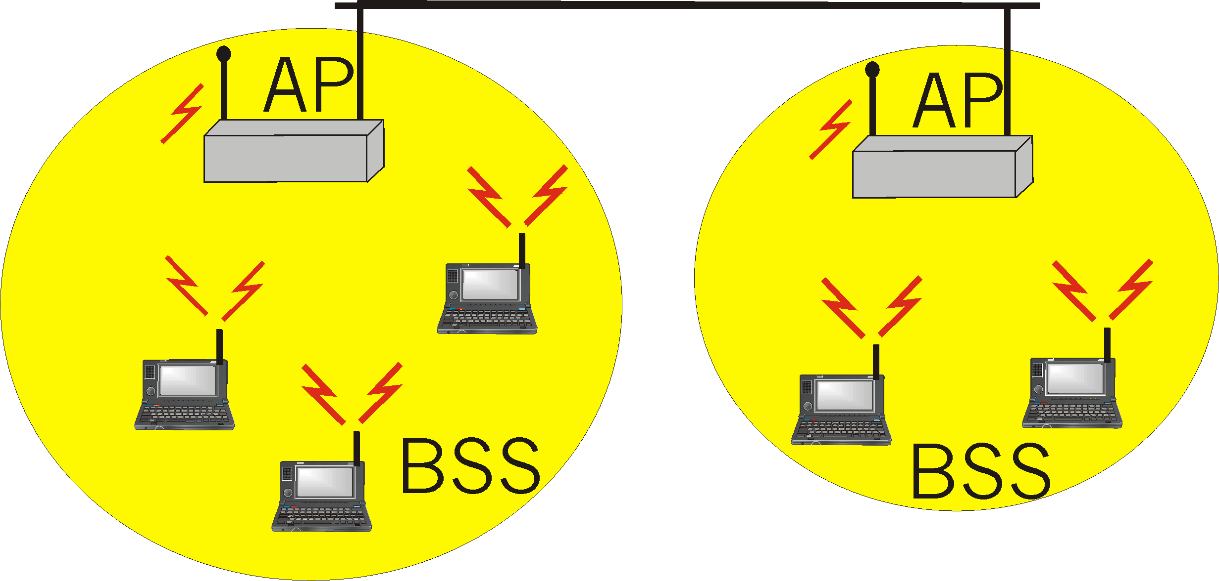
IEEE 802.11 Wireless LAN
Wireless host communicates with a base station
  Base station = access point (AP)
Basic Service Set (BSS) (a.k.a. “cell”) contains:
  Wireless hosts
  Access point (AP): base station
BSS’s combined to form distribution system (DS)

Slide 7
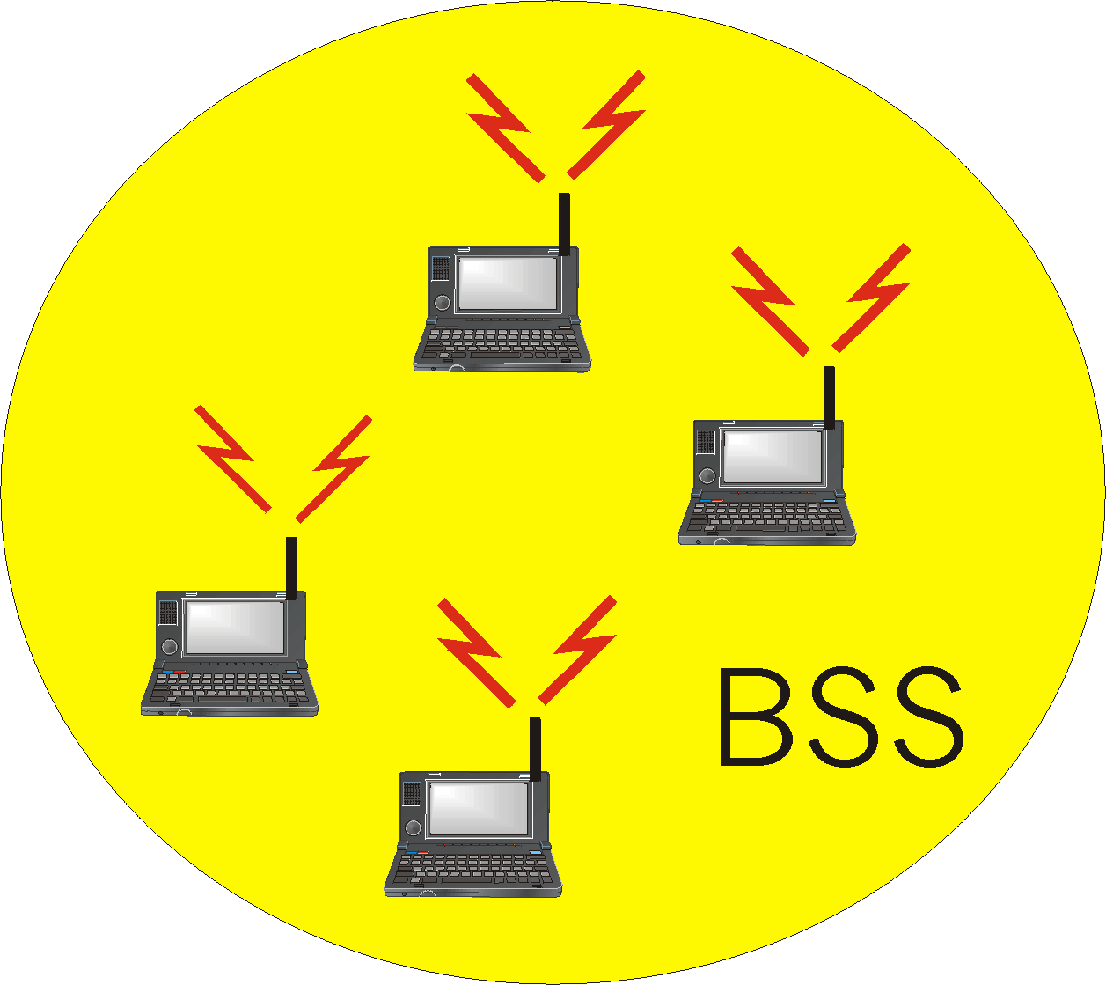
Ad Hoc Networks
Ad hoc network: IEEE 802.11 stations can dynamically form network without AP
Applications:
  Laptops meeting in conference room, car
  Interconnection of “personal” devices

Slide 8
CSMA/CD Does Not Work
Collision detection problems
  Relevant contention at the receiver, not sender
    Hidden terminal
    Exposed terminal
  Hard to build a radio that can transmit and receive at same time
Hidden
Exposed
A
A
B
B
C
C
D

Slide 9
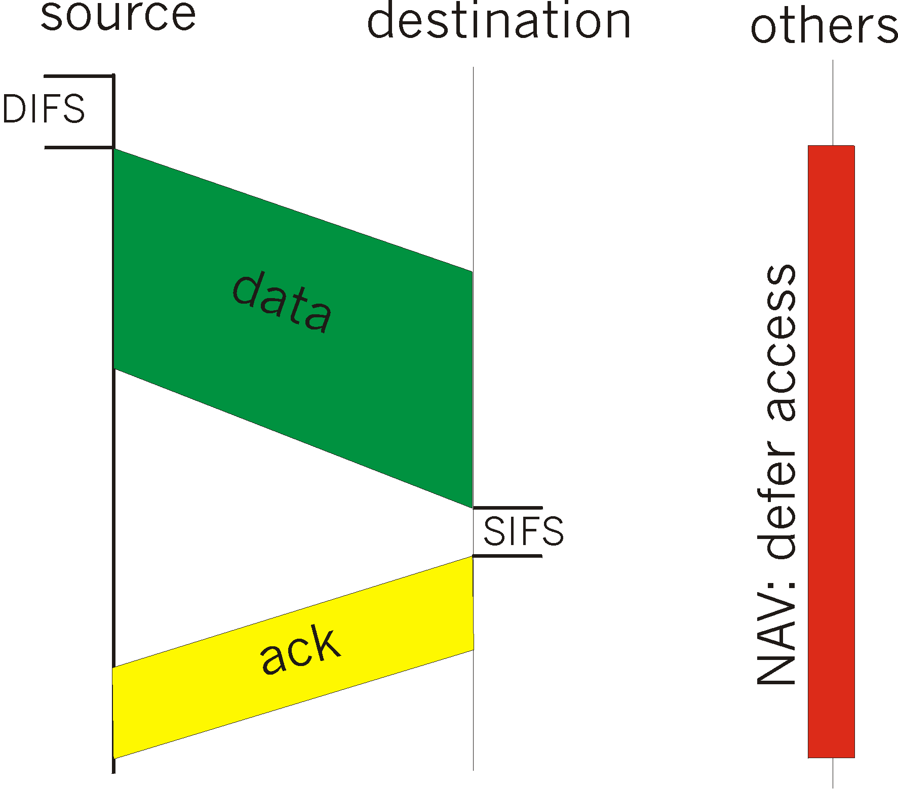
IEEE 802.11 MAC Protocol:
CSMA/CA
802.11 CSMA: sender
- If sense channel idle for DISF
(Distributed Inter Frame Space)
then transmit entire frame
(no collision detection)
- If sense channel busy
then binary backoff
802.11 CSMA receiver:
- If received OK
return ACK after SIFS
(Short IFS)
(ACK is needed due to
lack of collision detection)

Slide 10
802.11 Management Operations
Scanning
Association/Reassociation
Time synchronization
Power management

Slide 11
Scanning
Goal: find networks in the area
Passive scanning
  No require transmission → saves power
  Move to each channel, and listen for Beacon frames
Active scanning
  Requires transmission → saves time
  Move to each channel, and send Probe Request frames to solicit Probe Responses from a network

Slide 12
Association in 802.11
1: Association request
2: Association response
AP
3: Data traffic
Client

Slide 13
Reassociation in 802.11
1: Reassociation request
New AP
3: Reassociation response
5: Send buffered frames
Client
2: verify
previous
association
6: Data traffic
Old AP
4: send
buffered
frames

Slide 14
Time Synchronization in 802.11
Timing synchronization function (TSF)
  AP controls timing in infrastructure networks
  All stations maintain a local timer
  TSF keeps timer from all stations in sync
Periodic Beacons convey timing
  Beacons are sent at well known intervals
  Timestamp from Beacons used to calibrate local clocks
  Local TSF timer mitigates loss of Beacons

Slide 15
Power Management in 802.11
A station is in one of the three states
  Transmitter on
  Receiver on
  Both transmitter and receiver off (dozing)
AP buffers packets for dozing stations
AP announces which stations have frames buffered in its Beacon frames
Dozing stations wake up to listen to the beacons
If there is data buffered for it, it sends a poll frame to get the buffered data

Slide 16
Overview
Wireless Links
  802.11
  Bluetooth
Internet Mobility
Performance Issues

Slide 17
Bluetooth Basics
Short-range, high-data-rate wireless link for personal devices
  Originally intended to replace cables in a range of applications
  e.g., Phone headsets, PC/PDA synchronization, remote controls
Operates in 2.4 GHz ISM band
  Same as 802.11
  Frequency Hopping Spread Spectrum across ~ 80 channels

Slide 18
Usage Models
Wireless audio
  e.g., Wireless headset associated with a cell phone
  Requires guaranteed bandwidth between headset and base
  No need for packet retransmission in case of loss
Cable replacement
  Replace physical serial cables with Bluetooth links
  Requires mapping of RS232 control signals to Bluetooth messages
LAN access
  Allow wireless device to access a LAN through a Bluetooth connection
  Requires use of higher-level protocols on top of serial port (e.g., PPP)
File transfer
  Transfer calendar information to/from PDA or cell phone
  Requires understanding of object format, naming scheme, etc.
Lots of competing demands for one radio spec!

Slide 19
Protocol Architecture

Slide 20
Piconet Architecture
One master and up to 7 slave devices in each Piconet
Master controls transmission schedule of all devices in the Piconet
  Time Division Multiple Access (TDMA): Only one device transmits at a time
Frequency hopping used to avoid collisions with other Piconets
  79 physical channels of 1 MHz each, hop between channels 1600 times a sec

Slide 21
Bluetooth Physical Layer
Maximum data rate of up to 720 Kbps
  But, requires large packets (> 300 bytes)
Class 1: Up to 100mW (20 dBm) transmit power, ~100m range
  Class 1 requires that devices adjust transmit power dynamically to avoid interference with other devices
Class 2: Up to 2.4 mW (4 dBm) transmit power
Class 3: Up to 1 mW (0 dBm) transmit power

Slide 22
Bluetooth Physical Layer
79 1-MHz channels defined in the 2.4 GHz ISM band
  Gaussian FSK used as modulation, 115 kHz frequency deviation
Frequency Hopping Spread Spectrum
  Each Piconet has its own FH schedule, defined by the master
  1600 hops/sec, slot time 0.625 ms
Time Division Duplexing
  Master transmits to slave in one time slot, slave to master in the next
TDMA used to share channel across multiple slave devices
  Master determines which time slots each slave can occupy
  Allows slave devices to sleep during inactive slots

Slide 23
Time slots
Each time slot on a different frequency
  According to FH schedule
Packets may contain ACK bit to indicate successful reception in the previous time slot
  Depending on type of connection...
  e.g., Voice connections do not use ACK and retransmit
Packets may span multiple slots – stay on same frequency

Slide 24
Discussion
Nice points
  A number of interesting low power modes
  Device discovery
    Must synchronize FH schemes
    Burden on the searcher
Some odd decisions
  Addressing
  Somewhat bulky application interfaces
    Not just simple byte-stream data transmission
    Rather, complete protocol stack to support voice, data, video, file transfer, etc.
      Bluetooth operates at a higher level than 802.11 and 802.15.4

Slide 25
Overview
Wireless Links
  802.11
  Bluetooth
Internet Mobility
Performance Issues

Slide 26
Routing to Mobile Nodes
Obvious solution: have mobile nodes advertise route to mobile address/32
  Should work!!!
Why is this bad?
  Consider forwarding tables on backbone routers
    Would have an entry for each mobile host
    Not very scalable
What are some possible solutions?

Slide 27
How to Handle Mobile Nodes?
(Addressing)
Dynamic Host Configuration (DHCP)
  Host gets new IP address in new locations
  Problems
    Host does not have constant name/address → how do others contact host
    What happens to active transport connections?

Slide 28
How to Handle Mobile Nodes?
(Naming)
Naming
  Use DHCP and update name-address mapping whenever host changes address
  Fixes contact problem but not broken transport connections

Slide 29
How to Handle Mobile Nodes?
(Routing)
Allow mobile node to keep same address and name
How do we deliver IP packets when the endpoint moves?
  Can’t just have nodes advertise route to their address
What about packets from the mobile host?
  Routing not a problem
  What source address on packet? → this can cause problems
Key design considerations
  Scale
  Incremental deployment

Slide 30
Basic Solution to Mobile Routing
Same as other problems in computer science
  Add a level of indirection
Keep some part of the network informed about current location
  Need technique to route packets through this location (interception)
Need to forward packets from this location to mobile host (delivery)

Slide 31
Interception
Somewhere along normal forwarding path
  At source
  Any router along path
  Router to home network
  Machine on home network (masquerading as mobile host)
Clever tricks to force packet to particular destination
  “Mobile subnet” – assign mobiles a special address range and have special node advertise route

Slide 32
Delivery
Need to get packet to mobile’s current location
Tunnels
  Tunnel endpoint = current location
  Tunnel contents = original packets
Source routing
  Loose source route through mobile current location

Slide 33
Mobile IP (MH at Home)
Packet
Correspondent Host (CH)
Internet
Home
Visiting Location
Mobile Host (MH)

Slide 34
Mobile IP (MH Moving)
Packet
Correspondent Host (CH)
Internet
Home
Visiting Location
Home Agent (HA)
Mobile Host (MH)
I am here

Slide 35
Mobile IP (MH Away – FA)
Packet
Correspondent Host (CH)
Mobile Host (MH)
Internet
Home
Visiting Location
Encapsulated
Home Agent (HA)
Foreign Agent (FA)

Slide 36
Mobile IP (MH Away - Collocated)
Packet
Correspondent Host (CH)
Internet
Home
Visiting Location
Encapsulated
Home Agent (HA)
Mobile Host (MH)

Slide 37
Other Mobile IP Issues
Route optimality
  Resulting paths can be sub-optimal
  Can be improved with route optimization
    Unsolicited binding cache update to sender
Authentication
  Registration messages
  Binding cache updates
Must send updates across network
  Handoffs can be slow
Problems with basic solution
  Triangle routing
  Reverse path check for security

Slide 38
Overview
Wireless Links
  802.11
  Bluetooth
Internet Mobility
Performance Issues

Slide 39
Adapting Applications
Applications make key assumptions
  Hardware variation
    E.g. how big is screen?
  Software variation
    E.g. is there a postscript decoder?
  Network variation
    E.g. how fast is the network?
Basic idea – distillation
  Transcode object to meet needs of mobile host

Slide 40



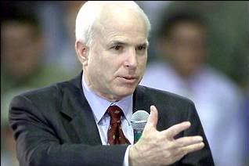
Transcoding Example
Generate reduced quality variant of Web page at proxy
  Must predict how much size reduction will result from transcoding
  How long to transcode?
Send appropriate reduced-size variant
  Target response time?
Notes:
Adapting content to available bandwidth
Identifying slow transfers
Requesting lower quality for slow transfers

Slide 41
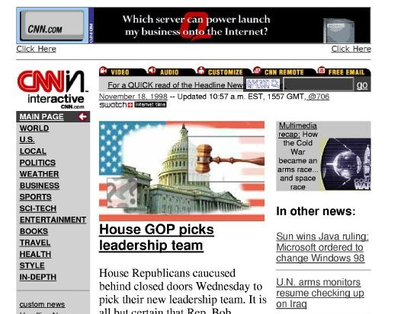


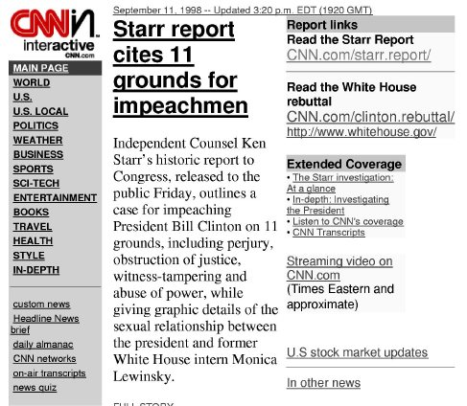
Source Adaptation
Can also just have source provide different versions
  Common solution today
  No waiting for transcoding
  Full version not sent across network
  Can’t handle fine grain adaptation

Slide 42

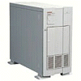
Wireless Bit-Errors
Router
Computer 1
Computer 2
Loss → Congestion
3
2
2
2
1
2
0
Loss → Congestion
Burst losses lead to coarse-grained timeouts
Wireless
Result: Low throughput

Slide 43
Performance Degradation
Best possible
TCP with no errors
(1.30 Mbps)
TCP Reno
(280 Kbps)
Sequence number (bytes)
Time (s)
2 MB wide-area TCP transfer over 2 Mbps Lucent WaveLAN

Slide 44
Important Lessons
Many assumptions built into Internet design
  Wireless forces reconsideration of issues
Link-layer
  Spatial reuse (cellular) vs wires
  Hidden/exposed terminal
  CSMA/CA (why CA?) and RTS/CTS
Network
  Mobile endpoints – how to route with fixed identifier?
  Link layer, naming, addressing and routing solutions
    What are the +/- of each?
Transport
  Losses can occur due to corruption as well as congestion
    Impact on TCP?
  How to fix this → hide it from TCP or change TCP

Slide 45
EXTRA SLIDES
The rest of the slides are FYI

Slide 46
Scatternets
Combine multiple Piconets into a larger Scatternet
  Device may act as master in one Piconet and slave in another
  Each Piconet using different FH schedule to avoid interference
Can extend the range of Bluetooth, can route across Piconets

Slide 47
How to Handle Mobile Nodes? (Transport)
TCP currently uses 4 tuple to describe connection
  <Src Addr, Src port, Dst addr, Dst port>
Modify TCP to allow peer’s address to be changed during connection
Security issues
  Can someone easily hijack connection?
Difficult deployment → both ends must support mobility

Slide 48
How to Handle Mobile Nodes?
(Link Layer)
Link layer mobility
  Learning bridges can handle mobility → this is how it is handled at CMU
  Encapsulated PPP (PPTP) → Have mobile host act like he is connected to original LAN
    Works for IP AND other network protocols

Slide 49
Mobile IP (RFC 2290)
Interception
  Typically home agent – a host on home network
Delivery
  Typically IP-in-IP tunneling
  Endpoint – either temporary mobile address or foreign agent
Terminology
  Mobile host (MH), correspondent host (CH), home agent (HA), foreign agent (FA)
  Care-of-address, home address

Slide 50
TCP Problems Over Noisy Links
Wireless links are inherently error-prone
  Fades, interference, attenuation
  Errors often happen in bursts
TCP cannot distinguish between corruption and congestion
  TCP unnecessarily reduces window, resulting in low throughput and high latency
Burst losses often result in timeouts
Sender retransmission is the only option
  Inefficient use of bandwidth

Slide 51
Proposed Solutions
Incremental deployment
  Solution should not require modifications to fixed hosts
  If possible, avoid modifying mobile hosts
End-to-end protocols
  Selective ACKs, Explicit loss notification
Split-connection protocols
  Separate connections for wired path and wireless hop
Reliable link-layer protocols
  Error-correcting codes
  Local retransmission

Slide 52
Approach Styles (End-to-End)
Improve TCP implementations
  Not incrementally deployable
  Improve loss recovery (SACK, NewReno)
  Help it identify congestion (ELN, ECN)
    ACKs include flag indicating wireless loss
  Trick TCP into doing right thing → E.g. send extra dupacks
Wired link
Wireless link

Slide 53
Approach Styles (Link Layer)
More aggressive local rexmit than TCP
  Bandwidth not wasted on wired links
Possible adverse interactions with transport layer
  Interactions with TCP retransmission
  Large end-to-end round-trip time variation
FEC does not work well with burst losses
Wired link
Wireless link
ARQ/FEC

